Slide 1
Collection

Slide 2
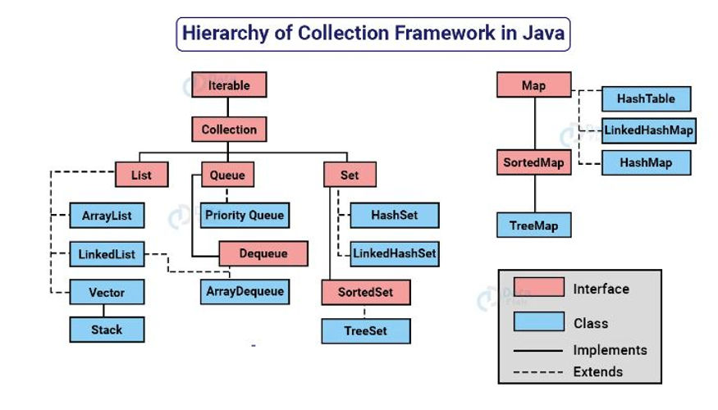
Collection Framework

Slide 3
Java 8 (released in 2014)
Feature | Java 8 | Prior to Java 8
Lambda expressions | (x, y) -> x + y | N/A
Method references | System.out::println | N/A
Default methods | default void foo() {…} | N/A
New Date and Time API | LocalDate date = LocalDate.of(2020, Month.JANUARY, 1); | Calendar cal = Calendar.getInstance(); cal.set(2020, 0, 1); Date date = cal.getTime();
Base64 Encoding | Base64.getEncoder(). encodeToString(str.getBytes()) | N/A
Stream API | list.stream().filter(s -> s.length() > 3).forEach(System.out::println); | N/A

Slide 4
Java 9 (released in 2017)
Feature | Java 9 | Prior to Java 9
Private methods in interfaces | private void foo() {} | N/A
Enhanced try-with-resources | try (resource) {} | try {} finally {}
Factory methods for ImmutableList, etc. | List.of(1, 2, 3) | Arrays.asList(1, 2, 3)
Collection.toArray(IntFunction) | list.toArray(String[]::new) | list.toArray(new String[list.size()])
jshell – The Java Shell | jshell | N/A
HTTP/2 Client | HttpClient client = HttpClient.newHttpClient(); | N/A
Modules (Project Jigsaw) | module com.example.app {} | N/A

Slide 5
Java 10 (released in 2018)
Feature | Java 10 | Prior to Java 10
Local-variable type inference | var num = 10; | int num = (int) 10;
var in lambda expressions | (var x, var y) -> x + y | (Integer x, Integer y) -> x + y
HTTP Client | var client = HttpClient.newHttpClient(); | HttpURLConnection connection = (HttpURLConnection) new URL(url).openConnection();

Slide 6
Java 11 (released in September 2018)
Feature | Java 11 | Prior to Java 11
Local variable type | var list = new ArrayList<String>(); | ArrayList<String> list = new ArrayList<String>();
HTTP Client | HttpClient client = HttpClient.newHttpClient(); | URL url = new URL(“http://example.com&#8221;); HttpURLConnection con = (HttpURLConnection) url.openConnection();
File handling | String content = Files.readString(Paths.get(“file.txt”)); | BufferedReader reader = new BufferedReader(new FileReader(“file.txt”)); String line; while ((line = reader.readLine()) != null) { … } reader.close();
Single-line if | if (bool) foo(); else bar(); | if (bool) { foo(); } else { bar(); }
Single-line for | for (int i : List.of(1, 2, 3)) foo(i); | for (int i : new int[] {1, 2, 3}) { foo(i); }

Slide 7
Java 12 (released in March 2019)
Feature | Java 12 | Prior to Java 12
Switch expressions | switch (day) { case MONDAY: return “Monday”; case TUESDAY: return “Tuesday”; default: return “Other day”; } | if (day == MONDAY) return “Monday”; else if (day == TUESDAY) return “Tuesday”; else return “Other day”;
Text blocks | String html = “”” <html> <body> <p>Hello, World</p> </body> </html> “””; | String html = “<html>\n” + ” <body>\n” + ” <p>Hello, World</p>\n” + ” </body>\n” + “</html>\n”;
Additional Unicode language support | System.out.println(“\uD83D\uDE02”); | System.out.println(“😂”);

Slide 8
Java 13 (released in September 2019)
Feature | Java 13 | Prior to Java 13
Dynamic CDS archives | java -XX:ArchiveClassesAtExit=myarchive.jsa | N/A
 | Creates a class data-sharing (CDS) archive at JVM exit for faster startup in future JVM runs
ZGC on macOS | java -XX:+UseZGC | N/A
 | Enables the Z Garbage Collector (ZGC) on macOS
Reimplementation of legacy DatagramSocket API | java.net.DatagramSocket | sun.net.DatagramSocketImpl
 | Replaces the legacy sun.net.DatagramSocketImpl implementation with a new implementation in the java.net package
Improved AARCH64 intrinsics | java -XX:+UseAARCH64Intrinsics | N/A
 | Enables intrinsic functions for the AARCH64 architecture to improve performance
Epsilon garbage collector | java -XX:+UseEpsilonGC | N/A
 | Enables the Epsilon garbage collector, which does not perform any actual memory reclamation and is intended for testing and benchmarking purposes

Slide 9
Java 14 (released in March 2020)
Feature | Java 14 | Prior to Java 14
Record classes | record Point(int x, int y) {} | N/A
Pattern matching for instanceof | if (obj instanceof Point p) {} | if (obj instanceof Point) { Point p = (Point) obj; }
Helpful NullPointerExceptions | NullPointerException.getMessage() | N/A

Slide 10
Java 15 (released in September 2020)
Feature | Java 15 | Prior to Java 15
Sealed classes | sealed class Shape permits Circle, Rectangle {} | N/A
Pattern matching for instanceof | if (obj instanceof Point p) {} | if (obj instanceof Point) { Point p = (Point) obj; }
Java 16 (released in March 2021)
Feature | Java 16 | Prior to Java 16
Records (Preview) | record Point(int x, int y) {} public record VehicleRecord(String code, String engineType) {} | N/A
Packaging tool | jpackage | N/A
Second Preview of Foreign-Memory Access API | java.lang.System.memory() | N/A

Slide 11
Java 17 (released in September 2021)
Feature | Java 17 | Prior to Java 17
Yield in switch statement | switch (day) { case MONDAY: yield TUESDAY; case FRIDAY: yield SUNDAY; } | N/A
Records (preview) | record Point(int x, int y) {} | N/A
Sealed classes (preview) | sealed interface Shape permits Circle, Rectangle {} | N/A
Enhanced enums | enum Color { RED(“#FF0000”), GREEN(“#00FF00”), BLUE(“#0000FF”) } | enum Color { RED(“#FF0000”), GREEN(“#00FF00”), BLUE(“#0000FF”); private String code; Color(String code) { this.code = code; } }

Slide 12
Java 18 (released in March 2022)
Feature | Java 18 | Prior to Java 18
Records | record Point(int x, int y) {} | N/A
 | Point p = new Point(1, 2); | N/A
Sealed Types | sealed interface Shape permits Circle, Square {} | N/A
 | final class Circle implements Shape {} | N/A
 | final class Square implements Shape {} | N/A
Pattern Matching for instanceof (Preview) | if (obj instanceof String s) { | N/A
 | // s has type String | N/A
 | } | N/A
Foreign-Memory Access (Incubating) | try (MemorySegment segment = MemorySegment.allocateNative(100)) { | N/A
 | // Use the memory segment | N/A
 | } | N/A

Slide 13
Java 19 (released in September 2022)
Records:
In Java 19, records have been further improved with the ability to specify custom “deep copy” methods, which are used to create a new instance of the record with copies of its components.
Copy coderecord
Point(double x, double y) {
public Point { if (x < 0 || y < 0) {
throw new IllegalArgumentException("Coordinates must be non-negative");
} }
// Custom deep copy method
public Point copy() {
return new Point(x, y);
} }
Enhanced Enums:
Java 19 introduces several new features for enums, including the ability to use the record keyword to define an enum with record components, and the ability to use the sealed keyword to restrict the inheritance of an enum.
interface Shape permits Circle,
Rectangle { }
record Circle(double radius)
implements Shape { } record Rectangle(double width, double height) implements Shape { }

