Slide 1
Javascript
Shruti Wali

Slide 2
Introduction
History
Tags
Forms
Order/UnOrder
Hyperlinks
Images
Text Formattings

Slide 3
Introduction
JavaScript is a lightweight, cross-platform, single-threaded, and interpreted compiled programming language. It is also known as the scripting language for webpages. It is well-known for the development of web pages, and many non-browser environments also use it.
Web Development:
Web Applications
Server Applications
Games
Mobile Applications

Slide 4
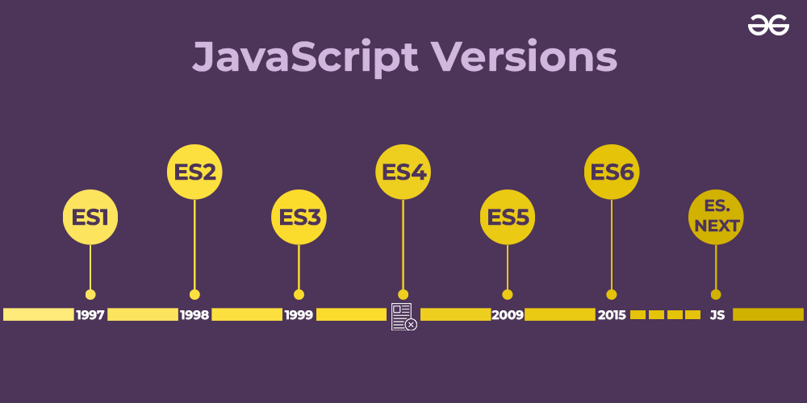
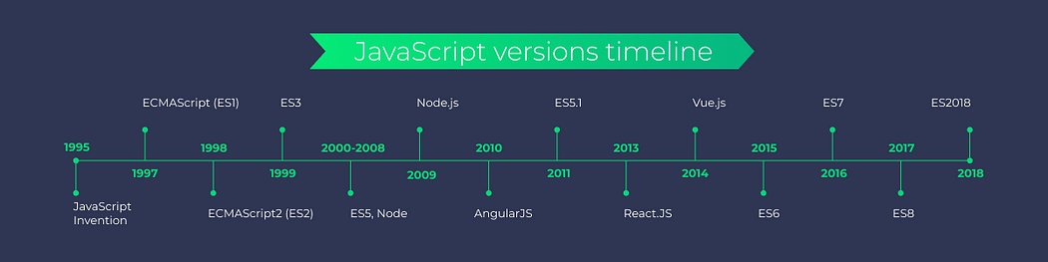
Java script versions

Slide 5
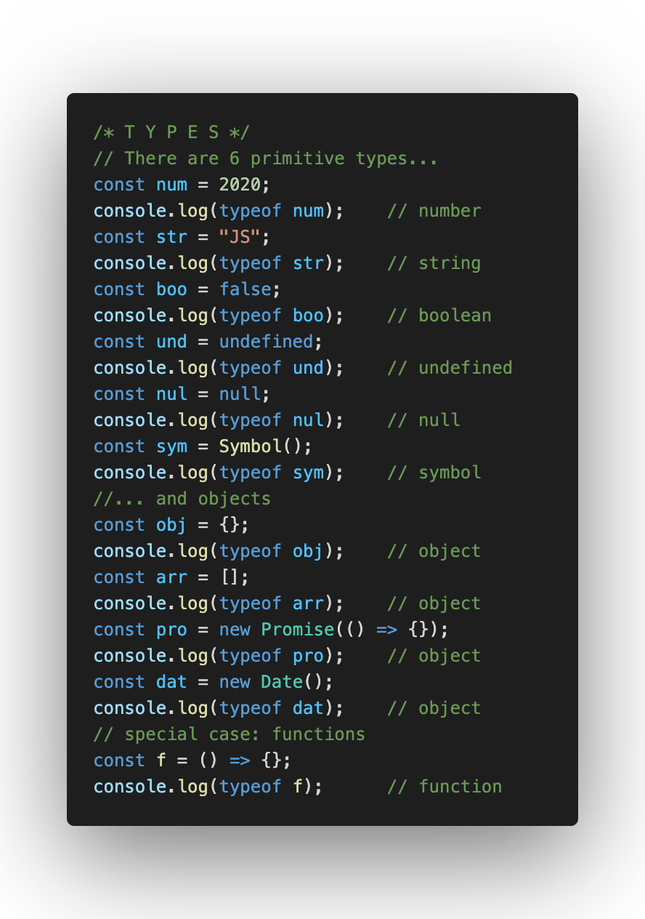
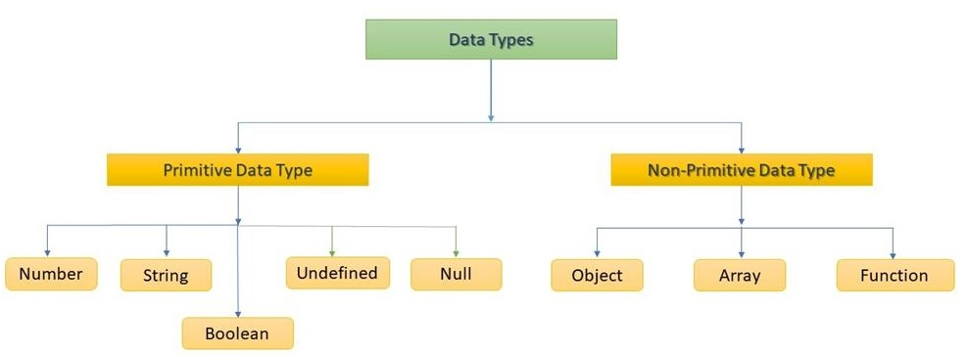
Data Types

Slide 6
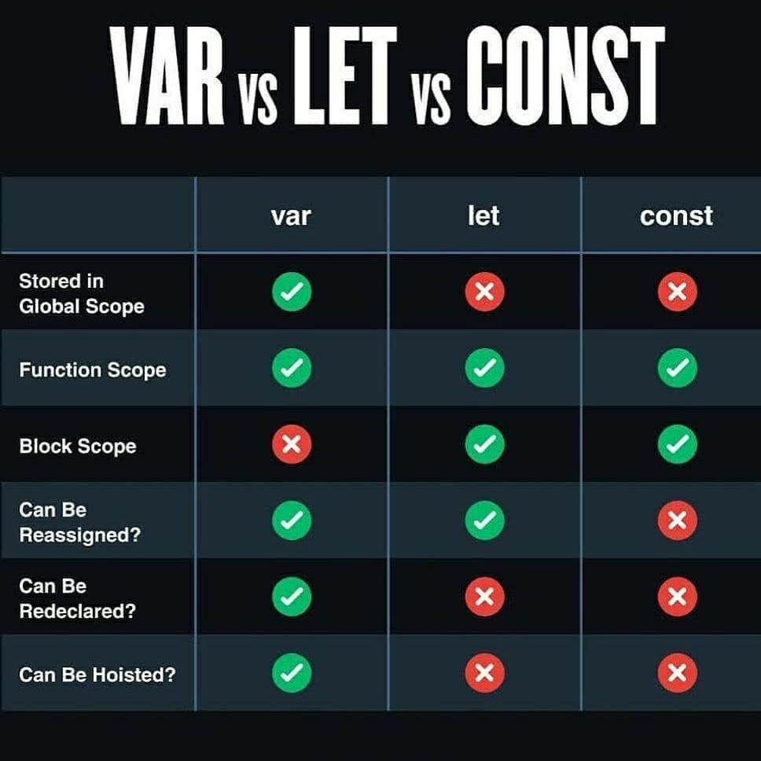
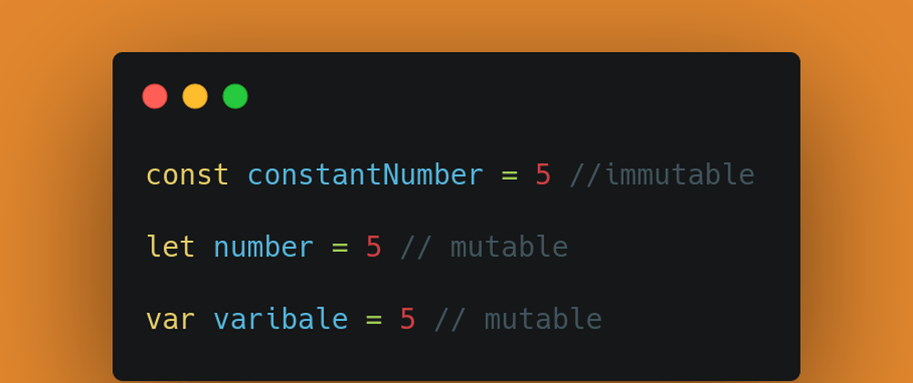
Var Let Const

Slide 7
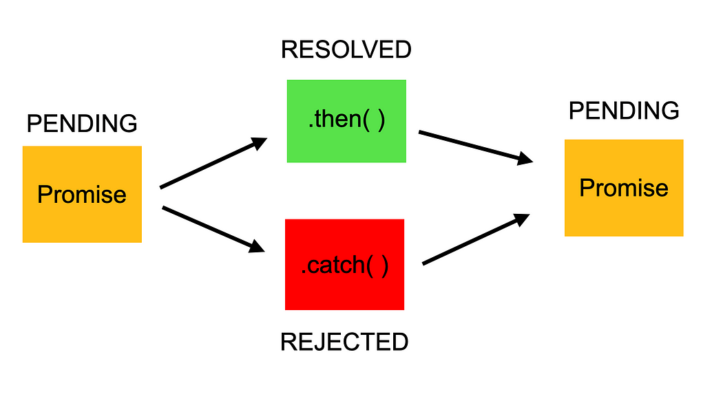
Promise
A promise is an object that may produce a single value sometime in the future.
A promise is a good way to handle asynchronous operations. It is used to find out if the asynchronous operation is successfully completed or not
In other words, Promise makes JavaScript behave asynchronously, which makes this language versatile.
Promise has three possible states:
Pending: You don’t know if you will gain 10kg by the next month.
Resolved/Fulfilled: You gained10kgs by the next month.
Rejected: You don’t gain weight at all.

Slide 8
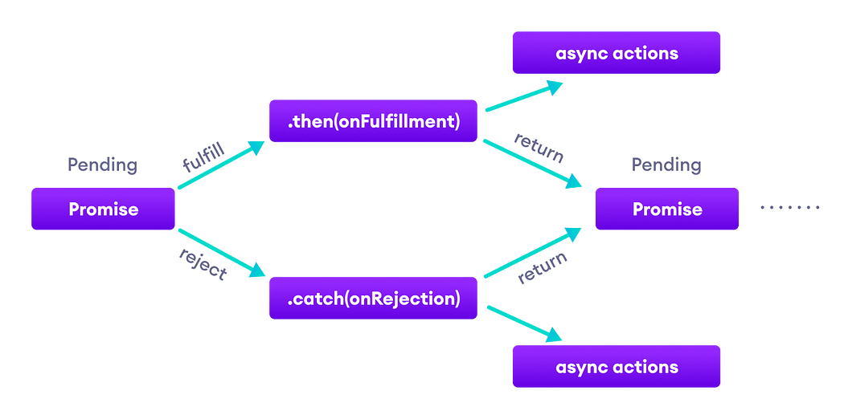
JavaScript Promise Chaining

Slide 9
Fetch API
Fetch is a native JavaScript API developed after XMLHttpRequest that utilizes AJAX programming. Below is the structure of a basic fetch request taken from API
fetch('http://example.com/movies.json') .then(response => response.json()) .then(data => console.log(data))
.catch(return => console.log(data))

Slide 10
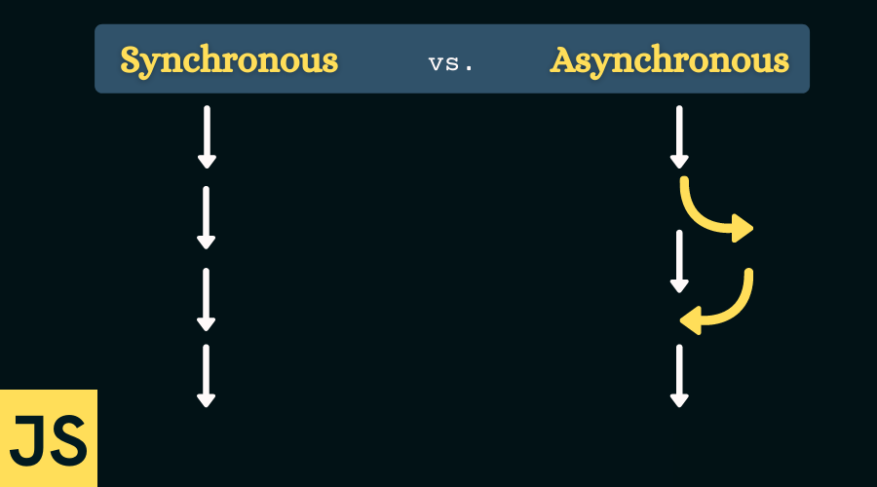
Asynchronous Programming in JavaScript with Async & Await
Callbacks :
In asynchronous JavaScript functions, callback functions will be called when an operation is completed, instead of waiting for the completion of that operation. When an operation is asynchronous, the program flow is not completely blocked, and the secondary function continues its execution while the operation is being completed. Once the operation is finished, the specified callback function is executed.
Promises
Async & Await

