Slide 1
Simulate Cloud in Mininet and Scale for Optimized Content Replication and Distribution Team members: Anumeha Shah Shruti Sharma Neha Rajkumar

Slide 2
WE WILL COVER
Geo distributed clouds
Advantages
Challenges in implementing Geo distributed clouds
Proposed solution
Simulators Used
Details about Simulators
Implementation Walkthrough
Comparison with existing simulator

Slide 3
Geo-distributed cloud
A geo-distributed cloud infrastructure is a combination of different cloud sites.
Dispersed in different geographical locations and owned by different providers.
Each cloud site resides in one data center and contains a collection of interconnected and virtualized servers.

Slide 4
Advantages
Low latency in streaming video contents.
Geo Distributed cloud can provide efficient services to the users in proximity.
Less management effort.
Low operational cost.

Slide 5
Challenges in Implementing the Geo distributed Clouds with Social Media Applications
How to migrate and store the contents efficiently in between different cloud sites to serve user’s demand cost effectively and with low latency.

Slide 6


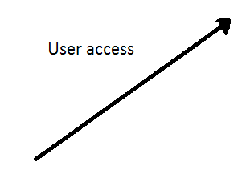


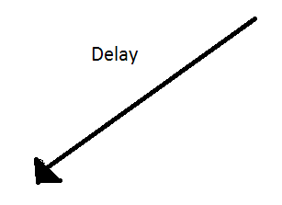
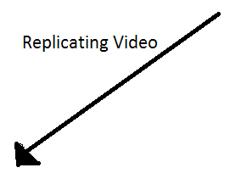

Proposed solution

Slide 7
Simulators used
Mininet : For simulating the network
Amazon AWS S3: Simulates Cloud
Amazon AWS CLI : Command line interface
Netcat : For transferring files between hosts
Mpg123 : For playing audio files in mininet

Slide 8
AMAZON S3(SIMPLE STORAGE SERVICE) for Cloud STORAGE
Simple web services interface that can be used to store and retrieve any amount of data, at any time, from anywhere on the web.
It gives any developer access to the same highly scalable, reliable, secure, inexpensive infrastructure that Amazon uses to run its own web sites.

Slide 9

WHAT IS AWS COMMAND LINE INTERFACE?
Unified tool to manage your AWS services
Can control multiple AWS services from the command line and automate them through scripts.
We have integrated Amazon CLI with Mininet to simulate the Social Cloud scenario.
CLI is configured using the command
$ aws configure

Slide 10
Netcat for file transfer
Netcat is a computer networking service for reading from and writing to network connections using TCP or UDP.
Netcat is designed to be a dependable backend that can be used directly or easily driven by other programs and scripts. This is the main reason we chose NETCAT.
Mpg123 for music streaming
Mpg123 is a free and open source audio player.
As the name suggests, it supports MPEG audio formats, including MP2, andMP3.
It is a console application, meaning that it has no graphical user interface.

Slide 11
ImageMagicK for displaying the graph plotted in mininet
ImageMagick is a software suite to create, edit, compose, or convert bitmap images.
The functionality of ImageMagick is typically utilized from the command line
Run this command in mininet and install ImageMagicK:sudo apt-get install imagemagick
Matplotlib for plotting graph at runtime in mininet
Matplotlib is a python 2D plotting library which can be used with Python scripts.
It provides an object-oriented API for embedding plots into applications. It is a procedural “pylab” interface designed to closely relate to that of MATLAB.

Slide 12
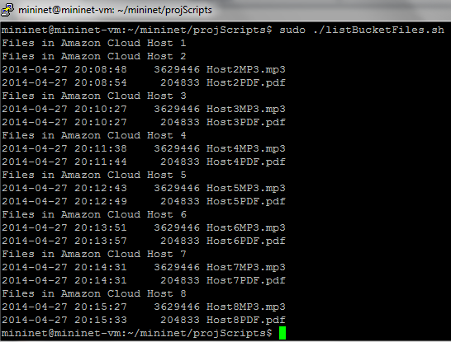
1: Listing All files currently present in amazon s3
First we will list the files that are present in all the buckets
Example CLI : aws s3 ls s3://shrutihost1 : Will list the number of files in Host1 on the Cloud.
We will execute the shell script : ./lishBucketFiles.sh to display the list of files in each of the hosts.

Slide 13
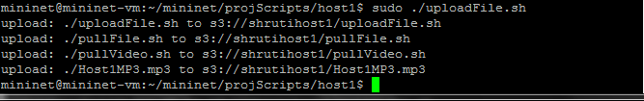
2: Uploading files to amazon s3
We can perform recursive uploads and downloads of multiple files in a single command.
Every host has a file uploadFile.sh which will recursively upload all the files present in the host to the cloud
$ aws s3 sync s3://shrutihost8 .

Slide 14

3: Downloading files recursively from amazon S3
A sync command makes it easy to synchronize the contents of a local folder with a copy in an S3 bucket.
Example : aws s3 sync . s3://shrutihost1;
This command will sync the current folder with all the files in the bucket named shrutihost1

Slide 15
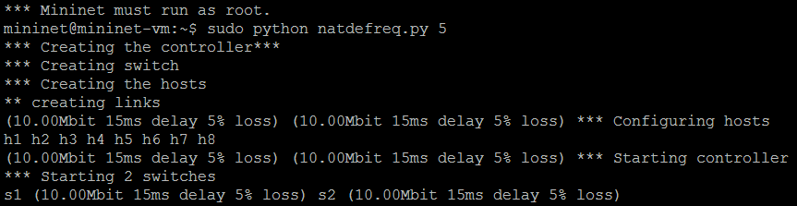
4: creating complex network in mininet and enabling hosts to connect to outside world
NAT (Network address translation) needs to be configured for each host in the network.
This will ensure that each of the hosts can communicate with the cloud and also with other hosts on the network.
How did we achieve this?
We have written a python script natdefreq.py : It creates a default gateway for all the hosts as root-eth0, and then uses iptables to allow natting to work.

Slide 16
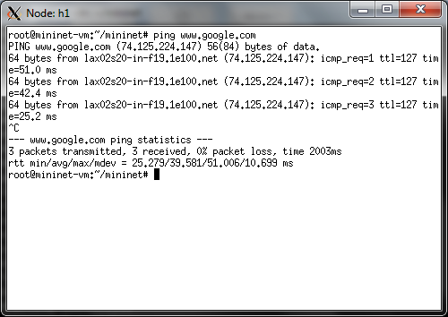
4: creating complex network in mininet and enabling hosts to connect to outside world
Example : Host1 can ping www.google.com

Slide 17
4: creating complex network in mininet and enabling hosts to connect to outside world
Network that we have created is in the below diagram.
C0
S1
S2
H1
H2
H3
H4
H5
H6
H7
H8

Slide 18
5: setting delay, bandwidth and packet loss
In order to simulate network conditions, we have set the Delay, bandwidth and packet loss while creating the network.
This has been done in the natdefreq.py file.
Delay is 15ms, Packet loss is 5%

Slide 19
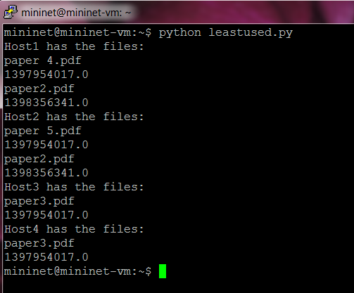
6: optimizing disk space : Find the files present in each host and access time
We have written an algorithm to find the files present in each host and the time when each of these files was accessed.
The leastused.py will list out all the files with .txt,.pdf,.mp3 formats.
We will be using this to determine which of the files have not been used/accessed and can be removed from the hosts.
The file with the largest time since accessed can be deleted.

Slide 20
7: Generating Traffic by implementing multiple pings to different hosts
We have created a multiple ping functionality to generate traffic and calculate the cost to reach each host.
Traffic is generated between host h1 and all the other hosts. We are also calculating the average ping time in between all the hosts and storing that value in a file for further analysis
Time is very important performance measuring factor and we are using time as one of the cost calculation factor to determine whether a file should be replicated from a server or not
Example h1 needs a file abc.pdf. It will ping all the hosts in the network h2, h3, h4 etc. to find the minimum cost to fetch the file.

Slide 21
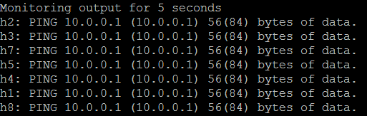
8: monitoring the output for certain duration
We will observe the ping across hosts for a certain duration of time.
We have also provided a functionality to set the number of times the host should ping other hosts.
In the above example 5 denotes the number of requests which is the input by the user

Slide 22
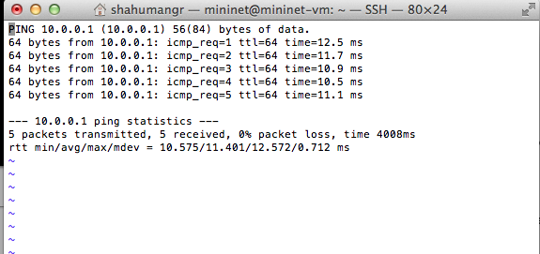
9: We are storing ping outputs for each host to hostname. Out file for analysis

Slide 23
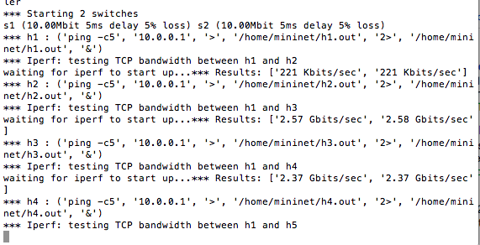
10: TESTING BANDWIDTH BETWEEN MULTIPLE HOSTS A PERFORMANCE MEASUREWMENT PARAMETER.

Slide 24
11: Calculating cost for streaming a file to one host from all the other host.
Cost calculation of streaming one file to one host from all the other hosts depends upon following factor:
No of requests
Time
Bandwidth
Delay
Packet loss
Storage cost
We are calculating cost as
No of requests * (time + bandwidth + delay+ packet loss+ storage)
We are also storing the ping time between hosts, bandwidth and total streaming cost to a file for further analysis and performance measurement

Slide 25
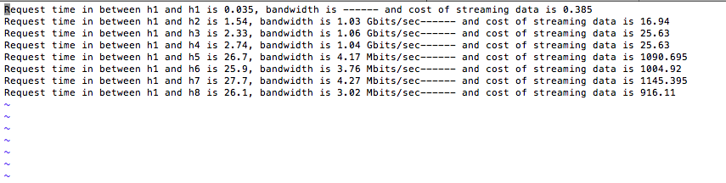
12: Calculating cost for streaming a file to one host from all the other hosts
Here From this output file we can deduce that the cost of streaming from far located servers/hosts h5, h6. h7, h8 are very high

Slide 26
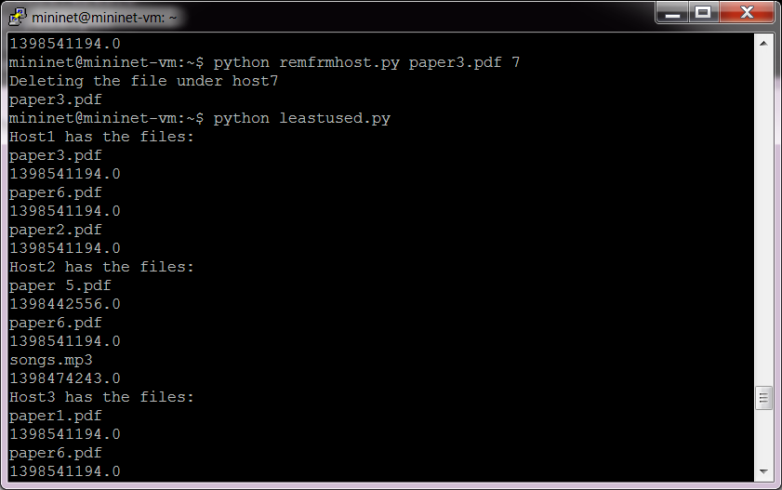
13: Removing the least used file
The least used file in a host was listed using the leastused.py file.
The file can be removed by running remfrmhost.py

Slide 27
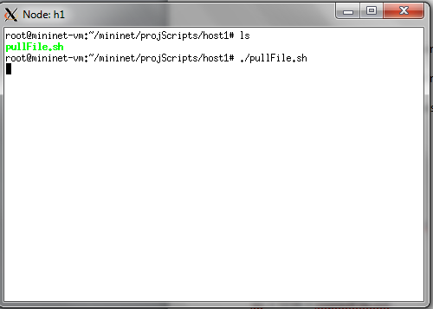
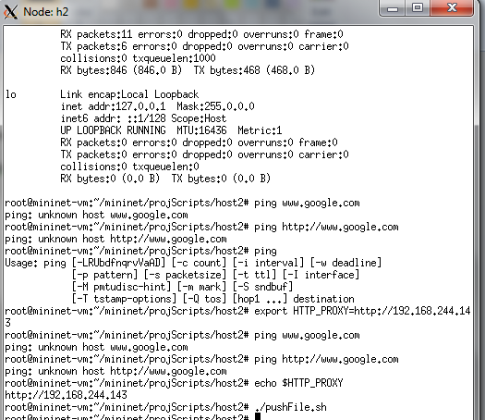
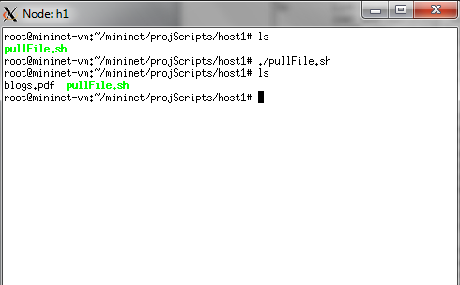
14: Transferring files between hosts

Slide 28
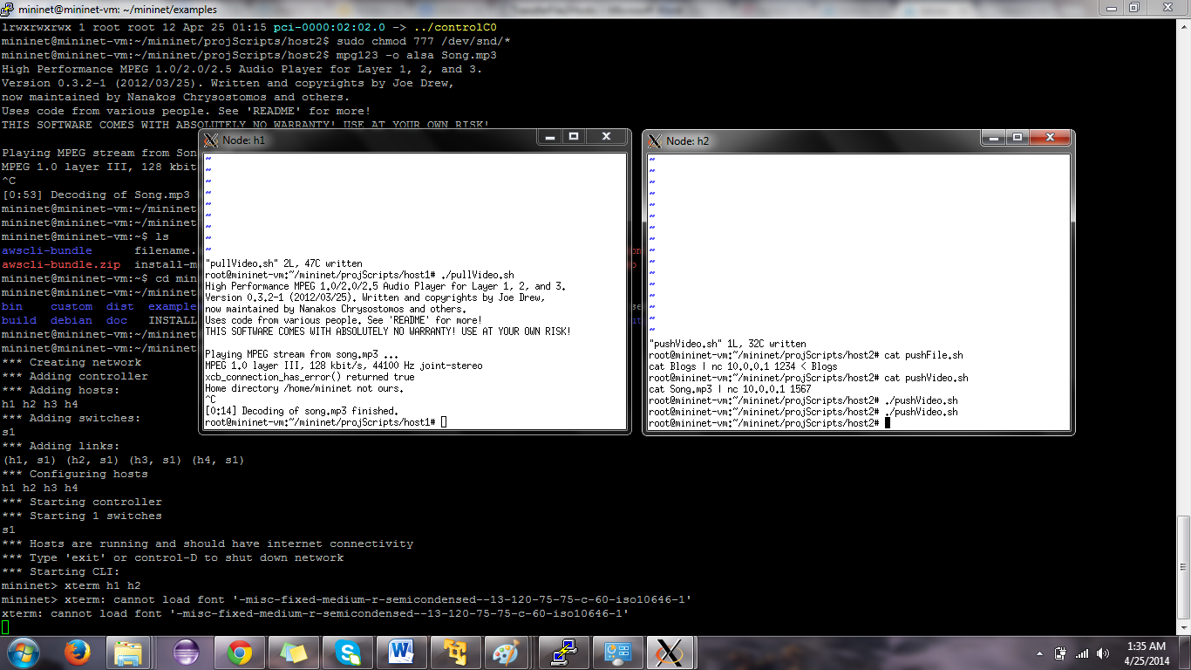
15: streaming audio files between hosts using Mpg123

Slide 29
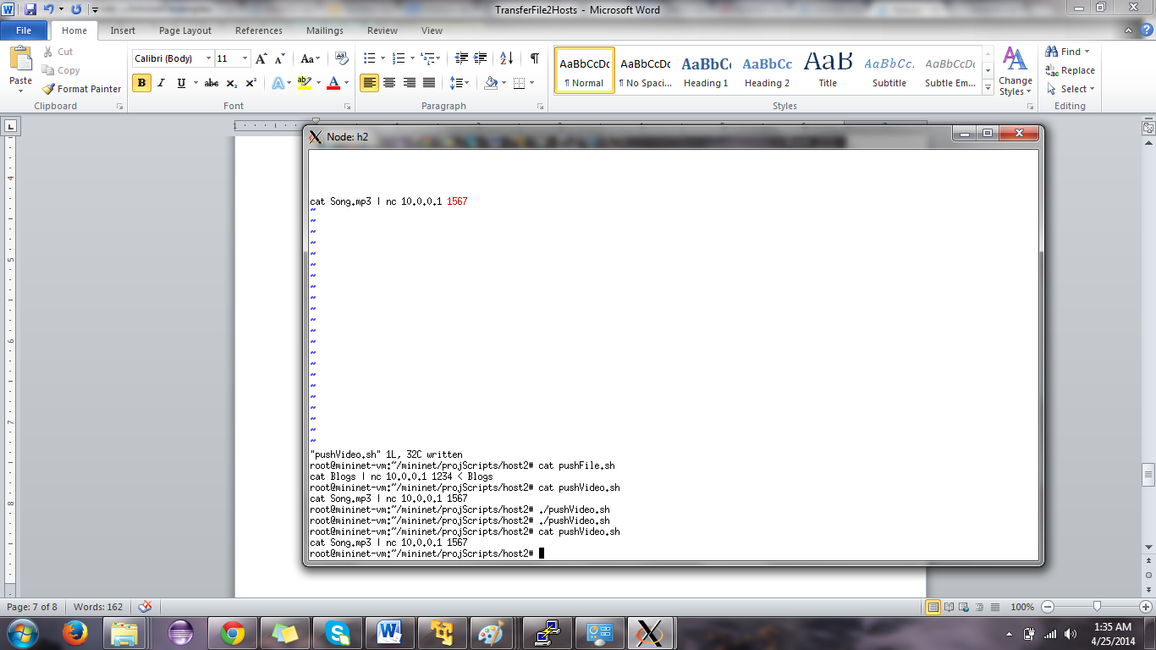
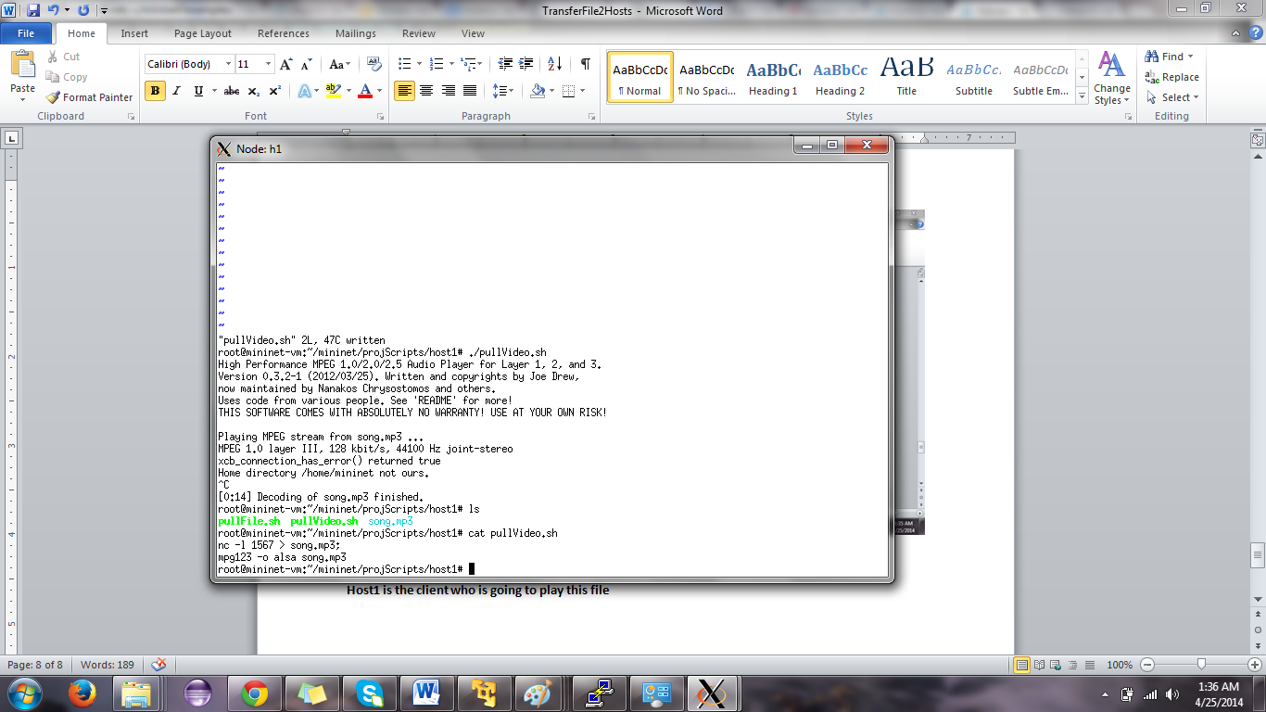
16: streaming audio files between hosts
Host 2 is the server sending the audio mp3 file. Song.mp3 should be present in this
Host1 is the client who is going to play this file

Slide 30
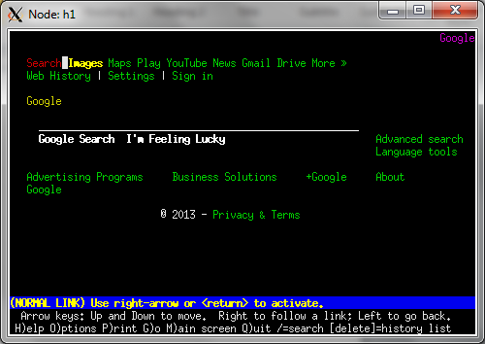
17: accessing browser from lynx
We have integrated browser to work with Mininet.
This allows each of the host to access files on cloud directly

Slide 31
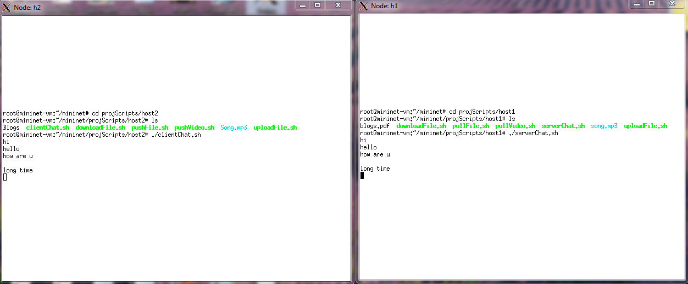
18. Live chat between hosts to request files
In order to make it easier for hosts to request files from other hosts we have integrated the chat functionality with each of these hosts.

Slide 32
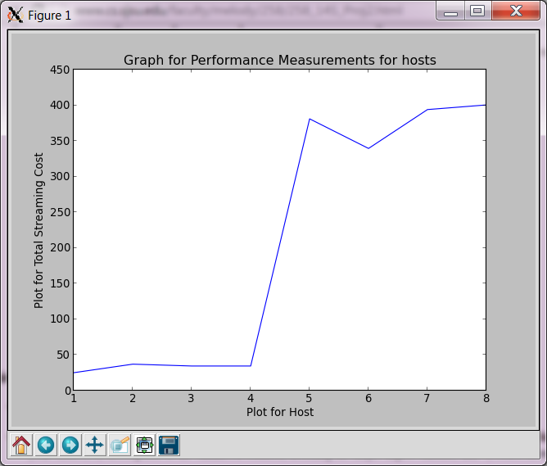
19: plotting graph for analyzing the system performance
The X- axis denotes the hosts: 1 to 8 , while the Y axis denotes the Total Streaming Cost.

Slide 33
19: plotting graph for analyzing the system performance
The total streaming cost is directly dependent upon no of requests, and performance measurement factors ping time and bandwidth between the hosts
If any of the above three factor changes the graph output also changes.
As seen in the graph above it is seen that the streaming cost from a nearby host is smaller compared to that of a farther host. So the experiment clearly proves that it is a feasible option to get a file from a nearby host rather than from a farther one

Slide 34
Comparison with the existing simulator system
Feature | IEEE Paper | Our Implementation
Collect statistics over a certain duration of time | Supported | Supported
Replicate data based on statistics collected | Supported | Supported
Data stored in multiple clouds across countries | Supported | Not supported
In case of decreased demands, remove data | Supported | Supported
Cost calculation | Supported | Supported
Plotting graph based on hosts and cost in real time | Not supported | Supported
Live chat between the hosts for requesting files | Not supported | Supported
Listening to audio files on another hosts system | Not supported | Supported
File transfer from Host to host on a network and deleting listing all files with a host | Not Supported | Supported

Slide 35
REFERENCES
[1] : Yu Wu, Chuan Wu, BoLi, Linquan Zhang, Zongpeng Li, and Francis C. M. Lau: Scaling Social Media applications into Geo Distributed Clouds, ‘IEEE/ACM TRANSACTIONS ON NETWORKING’.
[2] : http://www.mininet.org
[3]:http://comments.gmane.org/gmane.network.routing.openflow.general/2632
[4]: http://pages.cs.wisc.edu/~agember/cs640/s14/project3
[5]: https://mailman.stanford.edu/pipermail/mininet-discuss/2012-July/000979.html
[6]: http://groups.geni.net/geni/wiki/GeniTmix
[7]: http://www.brianlinkletter.com/mininet-test-drive/
[8]:http://nmap.org/book/inst-linux.html#inst-rpm
[9]:http://docs.aws.amazon.com/cli/latest/userguide/cli-chap-getting-set-up.html

Slide 36


