Slide 1



A Comparison between R and Octave
ctave
By,
Shruti Sharma
Suraj Natarajan

Slide 2
What’s R?
R is a Software environment for Statistical computing and graphical plotting
Mainly used for predictive analytics and data visualization
R is highly object-oriented
R is an interpreted language
Open source and easily extensible

Slide 3
What’s Octave?
Octave is a high-level language, primarily intended for numerical computations – solving Linear , Non linear problems
Highly interpreted
Provides graphical capabilities for data visualization
Its similar to Matlab but its FREE!!!!!!

Slide 4
Why did we choose to compare R and Octave?
Statistical Data Analysis : most sought after topics
Octave is similar to Matlab in functionality so we wanted to compare how the data visualization differs between these 2 front runners in statistical analysis.
How did we compare R and Octave?
Derived statistical analysis of Non-workers in India due to disability.

Slide 5
Major language differences
R
Statistical package
Plotting is much easier because of a package called ggplot2
Using R studio, all the commands can be executed
Has limited optimization packages
R supports lexical scoping and dynamic scoping
There is support for JIT but has to be done using Ra Extension to R
Octave
Computational package
Plotting is much tougher. Small tweaking requires big changes
Open source initiative to run m-code of Matlab
Has a command line interface for task execution which is interactive and persistent
Octave does not support closures – no nested functions with lexical scoping
Octave doesn't have a JIT so need to vectorize code

Slide 6

Main questions before choosing R and Octave
Software | R | Octave
Do not need hard core coding skills?
Easy to pick up?
Good with Big Data?
Good for Algorithm Development
Good Visualization

Slide 7
Data Types
R
Five basic data types:
Character
Numeric (Real)
Complex (Imaginary)
Integer
Logical (Boolean)
Octave
Matrices (real and complex)
Strings (matrices of characters)
Vectors: It's a matrix with one column/row
Integers: It's a double (you never have to worry)
Boolean: It's an integer (non-null=true, 0=false)
> char <- "Text is Character"
> num1 <- 1.23456 # numeric (real)
> num2 <- 1 # also numeric
> comp <- 2+3i # imaginary
> int <- 4L # integer,need L
> bool <- TRUE # TRUE(T), FALSE(F)

Slide 8
Matrices
Description | R | Octave
Row Vector = [1 2 3 4] | v = c(1, 2, 3, 4) | v = [1 2 3 4]
Column Vector = [1 2 3 4] | c(1,2,3,4) row and column vectors are same in R | [1; 2; 3; 4]
Matrix = [1 2 3] [4 5 6] | Row matrix(c(1,2,3,4,5,6), nrow=2, byrow=TRUE) Column matrix(c(1,4,2,5,3,6), nrow=2) | [1 2 3 ; 4 5 6]

Slide 9
Functions
Reference [1]
Description | R | Octave
Function Schema | myfunction <- function(arg1, arg2, ... ){ statements return(object) } | function [output args] = function_name(input args)
Implement a function | File name – add.r add = function(x,y) { return(x+y) } Execution : add(2,3) | File name - add.m function retval=add(x,y) retval = x+y; Execution : add(2,3) No explicit return statement is required
Lazy Evaluation | By default, R function arguments are lazy — they’re only evaluated if they’re actually used | Does not have extensive support for lazy evaluation

Slide 10
Scoping
Description | R | Octave
Lexical Scoping | R uses lexical scoping or static scoping. Lexical scoping in R means the values of free variables are searched for in the environment in which the function was defined. | Octave does not support Lexical Scoping.
Free Variables | Free variables are those which are not defined in function header or local to function Order of searching : Parent Environment -> Global Environment -> Empty Evironment -> Throws an error | There is no Free Variables concept in Octave. Variables generated in the function are local to the function, whereas for script files (.m files), variables are global

Slide 11
Plotting
Description | R | Octave
Plotting Libraties | R plotting functions use ggplot2 -> helps in producing multi-layered graphics | Octave plotting functions use gnuplot – > Open-source program
Bar Plots | barplot(variable, main=“Main Heading”, xlabel=“X Axis Label”, col=c("darkblue","red"),legend =rownames, beside=TRUE) | bar (types_data,w=0.9) set(h,"fontweight","bold"); set(h,"xtick",[1 2 3 4 5 6 7]); title (cstrcat("Activity of Non-Worker in", " ", area_name)); legend ('Rural', 'Urban');
Pie Charts | slices <- c(10, 12, 4, 16, 8) lbls <- c("US", "UK", "Australia") pct <- round(slices/sum(slices)*100) lbls <- paste(lbls, pct) # add percents to labels pie(slices,labels = lbls, col=rainbow(length(lbls)), main="Pie Chart of Countries") | pie ([value1, value2, value3]); title(‘Title');

Slide 12
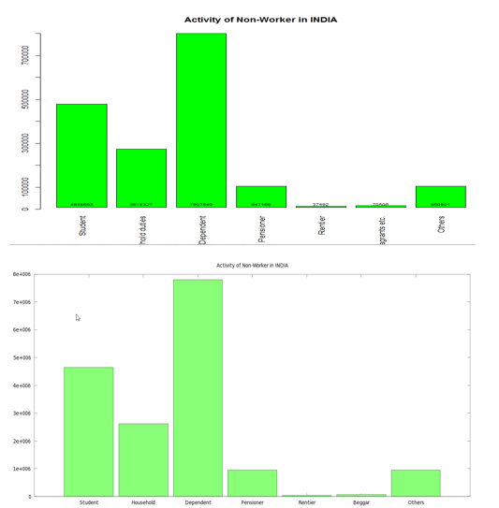
Plot comparison
R
Octave

Slide 13
Drawbacks of R and Octave
R
Restrictions on data size (in-memory)
Single-threaded
R has a steep learning curve
Memory management issues : R can quickly consume all available memory
Octave
Graphics quality is inferior
Lacks implementation of anonymous functions
Programs execute relatively slowly
Not good for large scale parallel computations
Reference [4]

Slide 14
Conclusion
Use R if you want to extract the details from the dataset like it is done in SQL.
Use R for rendering better visualization.
R is suited for doing Big Data Analytics, Statistical analysis.
Use Octave for numerical computations – solving Linear , Non linear problems.

Slide 15
References
[1] Ramsay J.O, Hooker G, Graves S Functional Data Analysis with R and Matlab 2009, ISBN 9780387981857.
[2] David Hiebeler MATLAB / R reference June 24 2014.http://www.math.umaine.edu/hiebeler/comp/matlabR.pdf
[3] Bitao Liu, Duncan Temple Lang RMatlab Interface Jan 15 2007
[4] Ecaterina Coman, Matthew W. Brewster, Sai K. Popuri, and Andrew M. Raim, and Matthias K. Gobbert A Comparative Evaluation of Matlab, Octave, FreeMat, Scilab, R

Slide 16

Questions

Slide 17


