Slide 1
CS580
(Computer Graphics Rendering)
Rasterization
HW2
Flat-shaded z-buffer triangle teapot
Ulrich Neumann

Slide 2
Rendering HWs in steps
first build a display (HW1)
then rasterize a screen space triangle (HW2)
  Input tris (pre-transformed)
  Output pixels to display created in HW1
then add transforms (HW 3)
then add shading (HW 4)
…..

Slide 3
Rasterization
The center points (marked by x’s) are the integer coordinates of the pixels, eg., (3,2)
The colors at those points are stored in the frame buffer
The circles represent the area (patch) of color that is created around the pixel point by the display
0
1
Pixel Array
and coordinates (X,Y)
2
3
Y
0
1
2
3
4
X

Slide 4
Rasterizing Lines
Given two endpoints, P= (x₀, y₀), R = (x₁, y₁)
find the pixels that make up the line
R
P

Slide 5
Rasterizing Lines
Requirements
No gaps
Minimize error (distance to true line)

Slide 6
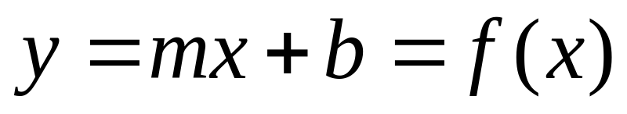
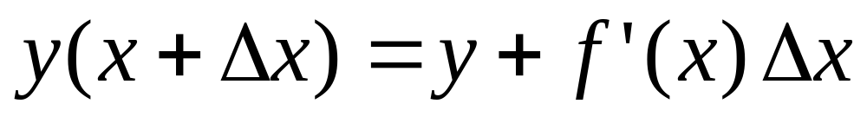
Rasterizing Lines
Equation of a Line:
Taylor Expansion:
So if we have an x,y position on the line,
we can find the next point incrementally

Slide 7
Rasterizing Lines
Assume –1 < m < 1, x0 < x1 so lines are +/- 45 degrees
Line (int x0, int y0, int x1, int y1)
float dx = x1 – x0;
float dy = y1 – y0;
float m = dy/dx;
float x = x0, y= y0;
for(x = x0; x <= x1; x++)
setPixel(x,round(y));
y = y+m;
The mid-point algorithm is a faster version of this idea,
eliminating floats and rounding http://www.mat.univie.ac.at/~kriegl/Skripten/CG/node25.html
0
1
X1
2
X0
3
0
1
2
3
4

Slide 8
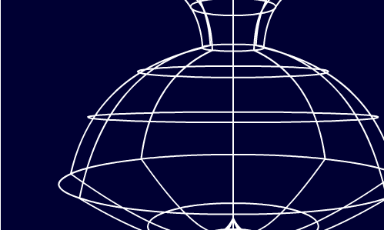
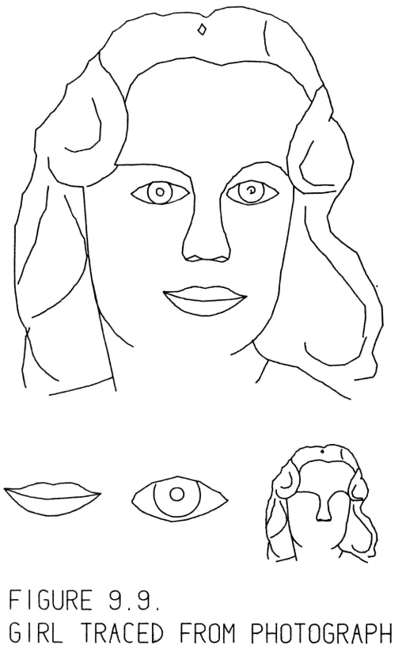
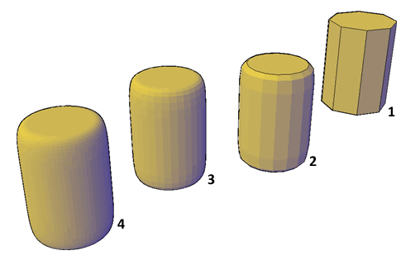
Line and Surface Renderings
3D line drawing is sufficient for conveying or manipulating objects.
More realistic 3D graphics requires an ability to draw surfaces.
Visualizations including both lines and surfaces are possible and useful.
“SketchPad” submitted January
1963 by the author for the degree of Doctor of Philosophy to the
Massachusetts Institute of Technology

Slide 9
Triangles as a 3D Surface Model
Triangles (tris) are a simple explicit 3D surface representation
Convex and concave polygons (polys) can be decomposed into triangles (usually offline)
Tris are planar and unambiguously defined by three vertex coordinates (coords)
There are several common options for structuring triangle data
We define triangles with a vertex-coordinate list per triangle - used in HWs
Tri 1 = XYZ_{A}, XYZ_{B}, XYZ_{D} and Tri 2 = XYZ_{C}, XYZ_{B}, XYZ_{D}
The order of vertices (verts) does not matter and the three edges are unambiguous
Note that verts B and D (or edge BD) are repeated since they are shared by both tris
Another common encoding is a triangle strip (or T-strip or winged-edge)
List each vertex once, taking care to sequence the verts
so that any string of three vertices is a complete triangle
XYZ_{A} Tri 1
XYZ_{B}
XYZ_{D}
XYZ_{C} Tri 2
Note that the next triangle in the strip would have to share verts C and D
A
B
Tri 1
Tri 2
C
D

Slide 10
Vertices
Verts have X,Y,Z coords and other attributes like color, normal, texture coords, etc.
Verts are where we “know something” about the model.
Verts are model "sample points".
Tris are planar approximation of “true” object geometry.
Coords are relative to some origin and axes (e.g., Model Space).
Example of tri from pot4.asc input file: {X, Y, Z, Nx, Ny, Nz, U, V}
triangle
1.400000 2.250000 0.000000 -0.902861 -0.429934 0.000000 0.000000 0.000000
1.273482 2.323828 0.541834 -0.918898 0.095044 -0.382874 0.250000 0.250000
1.380469 2.323828 0.000000 -0.995495 0.094810 -0.000000 0.000000 0.250000

Slide 11
Rasterization
Rasterizer fills pixel samples inside tri edges and interpolates parameters known at verts
3 verts are given (V1, V2, V3)
  coordinates and parameters at each vert
Verts imply 3 edges
Pixels inside edges are
affected by the triangle
  colored based on
  vert parameters
  parameter values
  are interpolated to
  pixel locations and then used to compute pixel color
0
V1
1
V2
2
3
V3
0
1
2
3
4

Slide 12
Rasterization and Hidden Surface Removal
Two algorithm “classes” have evolved over many years
Image order rasterization -- ray tracing / ray casting
  traverse pixels (image), process each in object space
  transform rays from image space to world space
  Turner Whitted's paper (sig 79), Glassner, web, etc
Object order rasterization -- scan-line / LEE
  traverse primitives (tris), process each in image space
  transform objects from world space to screen space
  Reyes (PIXAR) paper (sig87) - classic reference
  We’ll examine two object order rasterization algorithms. Pick one of them for HW2.
    LEE or scan line

Slide 13
Linear Expression Evaluation
Use E3 as an example (1st quadrant vector, positive slope dy/dx
  All edges are clockwise (CW) about tri (need to sort verts)
  Tail of vector is (X,Y)
  Head is (X + dX, Y + dY)
Edge Equation: E(x,y) = dY (x-X) - dX (y-Y) [1]
  = 0 for points (x,y) on line (use E3 for this example)
  = + for points in half-plane to right/below line
  = - for points in half-plane to left/above line
Note: these relations hold for all multiples of dY and dX: KdY, KdX (all E vectors within the same line)
The in/out tri regions have same sign relative to all 3 edges.
Use [1] definition and cast into general form of
2D line equation : Ax + By + C = 0
dYx - dYX - dXy + dXY = 0 (multiply terms in [1])
dYx + (-dXy) + (dXY - dYX) = 0 (collect terms)
  A = dY
  B = -dX
  C = dXY – dYX (Computer A,B,C from edge verts)
E3
-
-
+
E2
-
E1

Slide 14
LEE for Rasterization
Given 3 tri verts defining 3 edges,
  Compute consistent CW or CCW edge orientation by sorting verts
  (see next slide)
  Compute A, B, C for each edge
For each pixel in the bounding box of the verts
  Compute LEE result for all three edges
  Pixels with consistent sign for all three edges are inside the tri and therefore colored (green)
  Note circled pixel falls exactly on line
    Include edge pixels on left or right edges (also determined by sort) to avoid missed pixels (or pinholes) between tris
E3
-
-
+
E2
-
E1

Slide 15
Vertex Sorting
Given 3 tri verts we need to sort them
  Find CW edge cycle
  Determine L/R and Top/Bot edges for edge-pixel ownership
Start by sorting vert Y-coords
  V2, V1, V3 is low-to-high Y ordering (for case shown)
  So, CW edges are either 2-1, 1-3, 3-2 or 2-3, 3-1, 1-2
  depending on which are L/R edges
To find L/R relationship, use mid-Y vert V1 (X₁, Y₁) and find point P (circled) along non-V1 edge (V2-V3) with same y value (y = Y₁)
  Formulate line eq for V2-V3 to get
  Ax + By + C = 0
  Plug in y = Y₁ and solve for x
  Compare x to X₁ and greatest value
  establishes R-edge(s)
  In case shown, x < X₁, so edges with
  V1 (mid-Y vertex) must be R edges
If two verts have exact same Y-values, treat as
special case (horizontal top or bottom edge)
V2
P
V1
-
V3

Slide 16
Interpolate Z
In addition to X,Y coords, verts also have Z
  Need to determine the Z value at each pixel in a triangle
  Compute Z during rasterization
A general 3D plane equation has four terms:
  Ax + By + Cz + D = 0 [1]
  where vector (A,B,C) is normal to the plane
The cross-product of two tri edges produces the (A,B,C) vector
Create edge vectors (X,Y,Z)₀ and (X,Y,Z)₁ from any two pairs of verts
(X,Y,Z)₀ X (X,Y,Z)₁ = (A,B,C) = norm to plane of edges (and tri)
Use (A,B,C) and plug any vertex coord into [1] and solve for D
Given (A,B,C,D) for a given tri, evaluate [1] at any pixel (x,y) and solve for z at that pixel (interpolated Z value)
We can substitute other parameters (e.g., u,v) for Z, and compute (A,B,C,D) plane coefficients to interpolate these parameters to pixels
  need this later for interpolations of texture or color or normals

Slide 17
Z-buffer to remove hidden surfaces
For each pixel inside triangle:
  Interpolate Z value (Zpix)
  Compare computed Z-pix value against current
  Z-value in Frame Buffer (Zfb)
  If Zpix < Zfb, write new pixel color and Zpix into FB (overwrite old values)
  Otherwise, do nothing, skip pixel – it’s an occluded surface point
This assumes a coord system such that Z increases with distance from the viewer
Pixel color is know (give by application in HW2)

Slide 18
Hardware for LEE Rasterization
Parallel evaluation is possible for all pixels in NxM footprint given 3 edge coef-sets (A,B,C)
  this is the basis of Pixel-Planes and Pixel-Flow systems from UNC (1980s and 1990s) and many graphics accelerators today
First rasterize - find the pixel coverage and do hidden surface removal for a triangle
Then interpolate other vertex parameters needed for color, and store them at visible pixels in a deep frame buffer
After all tris are rasterized, compute (deferred) shading of all FB pixels using the values stored at each FB pixel
  Shading is parrallel (SIMD) and only for visible surfaces

Slide 19
Rasterization Papers to Read
Siggraph 1985 - "Fast Spheres, Shadows, Textures, Transparencies, and Image Enhancements in Pixel-Planes," Henry Fuchs,et. al.
2000 Sig/Euro Workshop on Graphics Hardware - "Tiled Polygon Traversal Using Half-Plane Edge Functions," Joel McCormack, Robert McNamara
Siggraph 1988 - "A Parallel Algorithm for Polygon Rasterization," Juan Pineda
Siggraph 2005 - “Resolution-Independent Curve Rendering Using Programmable Graphics Hardware,” Charles Loop, Jim Blinn

Slide 20
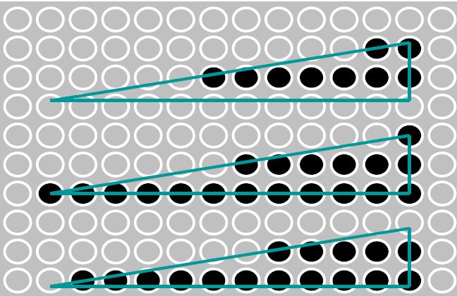
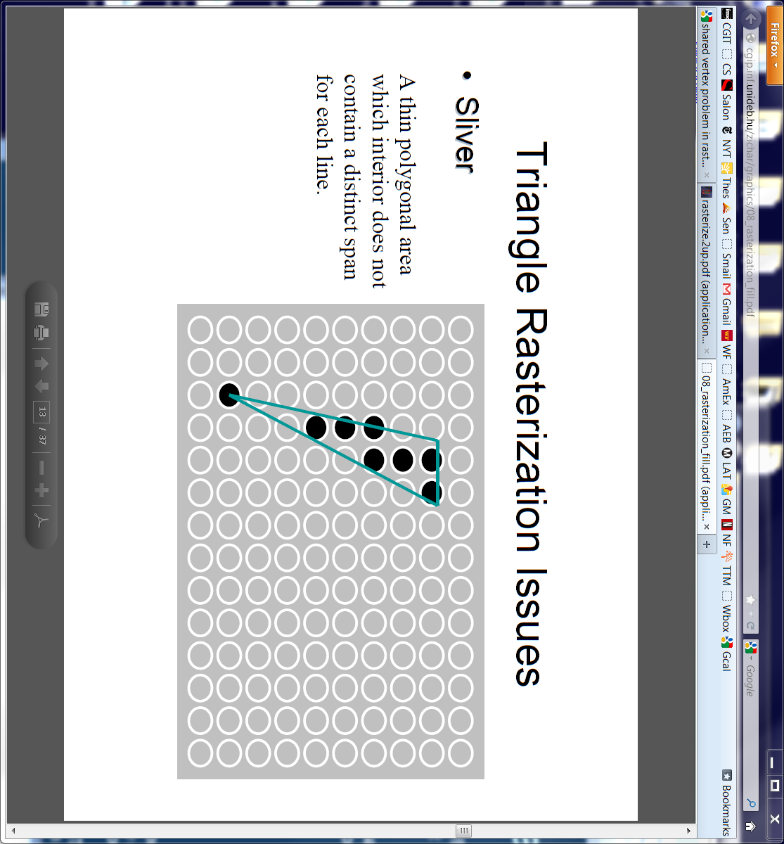
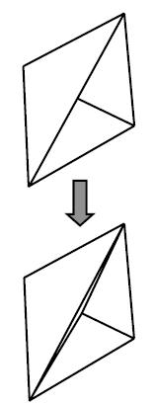
Rasterization Special Cases
*** Watch/detect for special cases for
  Define a convention for pixels on exact L/R T/B edges
    one edge covers pixel, the other does not
  Horizontal edges – watch sort and traversals
    Use slope or y-intercept methods to sort left/right edges
  Thin tris can have zero pixels covered in a row/column
    Ensure loop controls manage zero-iteration cases
Test yourself (these need not be addressed in your HW)
  What if a vertex falls exactly on a pixel? How can you ensure that one and only one triangle will color that pixel?
  Why is it a bad idea to create a model with a T-junction?
  A T-junction is created when a vertex lies on another triangle’s edge (see example to right)

Slide 21
Scan Line Rasterizer
DDA uses slope dx/dy to compute tri edges at each scan line
Generic DDA has position start, end, current, and slope data
  Add additional parameter value (Z) start, end, current, and slope data for interpolation
Assume conventions:
  Screen origin is UL corner of screen
  Screen coords (RH) -> X = right, Y = down, and Z into screen
X
1
1
2
2
3
3
Y

Slide 22
Scan Line Algorithm
1
1
2
2
3
3
Sort verts by Y into (1-2, 2-3), and (1-3) (sort for sequence of use)
Setup edge DDAs for (1-2), (2-3), (1-3)
Sort edges by L or R (2 possible configurations - above figure)
Ex: Assign edge DDA s as L (1-2-3), and R (1-3) (for right-most tri in figure)
Recall: Comparing X-coords of vert 2 and 3 is not valid L/R test
    Use dx/dy slopes (1-2) < or > (1-3) as test OR use y-intercept method of slide 15
Advance (1-2) and (1-3) DDA current positions to top y-scan line (ceiling)
Setup span DDA on successive lines based on edge DDA position values
Set span DDA current and end positions to right and left edge values
Advance span current position to left-most covered pixel (ceiling)
Interpolate span position and parameters (Z) until current position > end
Test interpolated-Z against FB-Z for each pixel - low Z wins
Write color value into FB pixel (default or computed color)
Switch from 1-2 edge to 2-3 edge when current 1-2 edge position > Y(2)
Continue spans until vert 3 is passed: current 1-3 edge position > Y(3)

Slide 23
interpolators – init edges
Setup edge DDAs for E(1-2), E(2-3), E(1-3)
E(1-2) {
  start = V1 (X,Y,Z)
  end = V2 (X,Y,Z)
  current = V1 (X,Y,Z)
  slope_{x} = dx/dy (X2-X1)/(Y2-Y1)
  slope_{z} = dz/dy (Z2-Z1)/(Y2-Y1)
  }
V1
V2
V3

Slide 24
interpolators – advance edges
Advance (1-2) and (1-3) DDA current positions to top y-scan line (orange points)
Move down edges to first line
ΔY = ceil(V1(Y)) – V1(Y)
E(1-2) {
  start = V1 (X,Y,Z)
  end = V2 (X,Y,Z)
  current =
  V1 (X + slope_{x} ΔY),
  V1 (Y + ΔY),
  V1 (Z + slope_{z} ΔY)
  slope_{x} = dx/dy (X2-X1)/(Y2-Y1)
  slope_{z} = dz/dy (Z2-Z1)/(Y2-Y1)
  }
V1
V2
V3

Slide 25
interpolators - span setup and advance
Setup span DDA on successive lines based on edge DDA values
Set span DDA current and end positions to right and left edge values
SPAN {
  start = L (X, Z)
  end = R (X, Z)
  current = L (X, Z)
  slope_{z} = dz/dx (RZ-LZ)/(RX-LX)
  }
Advance span current position to left-most covered pixel (red point) ΔX = ceil(LX) - LX
SPAN {
  start = L (X, Z)
  end = R (X, Z)
  current = LX + ΔX, LZ + ΔX slope_{z}
  slope_{z} = dz/dx (RZ-LZ)/(RX-LX)
  }
V1
L
R
V2
V3

Slide 26

HW2
Tris are pre-transformed into screen coordinates for HW2
Input file has tris with X,Y,Z ready for rasterization
Color is assigned for each tri
The renderer must do z-buffering
so you need to initialize z in
the frame buffer, in addition
to setting the background color
Initial z-value is MAXINT,
the maximum positive integer
value

Slide 27
HW2.txt
Your assignment is to produce a working scan converter based on the files you're given below.
The API calls in rend.cpp *must* be provided just as they are outlined.
Remember to interpolate Z and do Z-buffer testing on each pixel write to the Display.
*** Changes in the API are not allowed ***
The standard application you are given must work without modification.
Your renderer will link in your display code from HW1.
If your display code is not yet correct, you'll have to complete it since you need it now.
There are several other files there that will be useful.
- Gz.h : Global definitions
- Application2.cpp : new application that calls for your rend.cpp functions
- rend.cpp : new skeleton file with API definition and comments
- pot4.screen.asc : the Utah teapot triangle data transformed for scan conversion
- pot4.ppm : the result of running with input file pot4.screen.asc to create pot4.ppm"
The result images are made into a 256x256 window.
Do not change the resolution/size of your display image since the transformation
is precomputed for that image size.
NOTE – You mush initialize Z in your frame buffer in addition to the background color

Slide 28
Application API
View Application2.cpp
New API calls to GzNewRender() and GzBeginRender()
Note: nameListTriangle[] is an array of “type” tokens
and valueListTriangle[] is an array of parameters of that type
Color is sent to renderer via the generic GzPutAttribute() call that also uses pointers to a token list and value list
Note: a simple shading function is within the application and it computes a color for each triangle
GzBeginRender() is called to initialize everything for a new frame – now the renderer has to manage the display

Slide 29
Tokens and Values
int GzPutAttribute (GzRender *render, int numAttributes,
GzToken *nameList, GzPointer *valueList)
List of Tokens (ints) List of values
  GZ_RGB_COLOR Float Color [3]
  ….. …..
Increment through tokens (ints) and use (sizeof) token type to increment the pointer through the value list
Only use GZ_RGB_COLOR for HW2, but other data will be passed in later HWs
int GzPutTriangle (GzRender *render, int numParts,
GzToken *nameList, GzPointer *valueList)
Same with PutTriangle function – only use GZ_POSITION token for HW2 – that token means valueList is a pointer to 3 vertex positions XYZ, XYZ, XYZ

Slide 30
Renderer API
Look at Rend.cpp
Note separate GzPutAttribute() and GzPutTriangle() calls
Tokens for “types” in PutTriangle call only use GZ_POSITION right now – no other triangle data for HW2
Color is passed to Renderer as RGB array of floats defined over the range [0.0, 1.0]
Ctoi( ) function converts float color range of [0.0, 1.0] to GzIntensity 12-bit range for PutPixel calls to the display
  Bound the float range to ensure conversion doesn’t overflow 12-bit range (0-4095)

Slide 31
The “Original” Scan Line Algorithm
The “classic” scan line algorithm was a variation of what is described in the prior slides.
Walk the screen scan lines (top to bottom) and deal with all triangles that intersect the current line. This requires only one scan-line of Z-buffer for hidden surface calculations.
Y-sort all triangles based on their lowest-Y vertex. Put all of them into the unrenderred list
For all scan lines {
Test the pool of unrendered tri’s to see if any start on the current line. If so, move them to the current tri list.
Render the current list tris for by incrementing their DDAs to the current line – do the same edge stepping and span stepping we discussed. Keep all the DDA parameters for a triangle in each tri data structure since we’ll need them on subsequent lines. Use Z-buffering for all pixel writes.
Increment the scan line and test all current list tris for completion. Remove all completed tris from the current list.
}

