Slide 1
Adam Optimizer
Durga TMC, Zach Tsakounis, Joseph Brailovsky, Selena Smith

Slide 2
Agenda
Explanation, definitions & why they’re needed
Math equations
Code demo

Slide 3
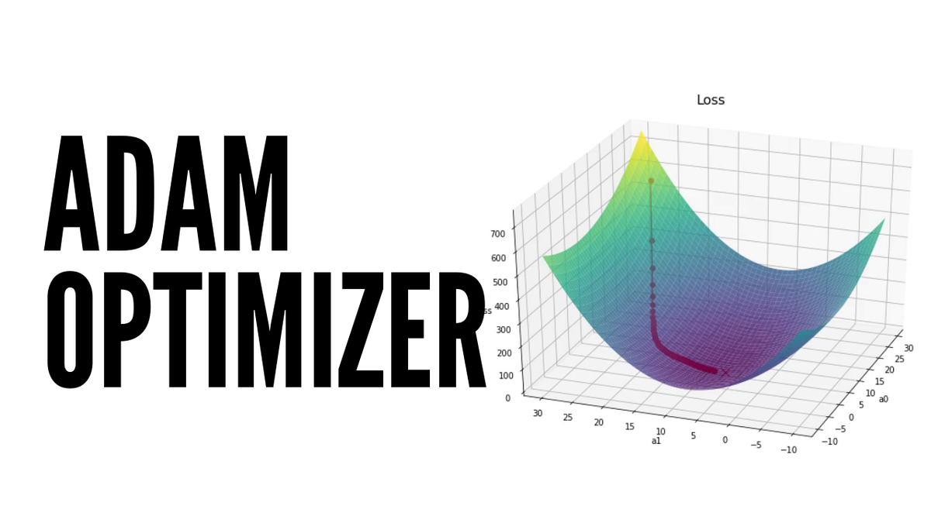
Adaptive Moment Estimation (Adam)
Adam optimization is a stochastic gradient descent method that is based on adaptive estimation of first-order and second-order moments.
Used for training deep learning models.
Notes:
Combines the advantages of other algorithms for sparse gradients and non-stationary settings. Good example is the demo Dr. Chung conducted in class with machine learning between the banana and the coin. Adam allows for faster learning at a lower cost.
In simpler terms, Adam is a smart optimization algorithm that tries to find the best set of parameters for a machine learning model by carefully considering the past gradients and adapting the learning rate accordingly.

Slide 4
Purpose
Adam Optimizer updates the model with parameters (weights, biases) by which the learning rate is adapted. This will reduce an error in the model.
Adam Optimizer assist in minimizing the loss function.
Notes:
Adam optimizer updates with parameters (weights, biases) by which, learning rate is adapted. This reduces an error in the model, basically finds global minimum.
Adam has combining advantages of AdaGrad & RMSProp.

Slide 5
Advantages:
Computationally efficient.
Little memory requirements.
Well suited for problems that are large in terms of data and/or parameters.
Appropriate for non-stationary objectives.
Hyper-parameters values do well on most problems and typically require little tuning.
Disadvantages:
Adam does not converge to an optimal solution in some areas.
Adam can suffer a weight decay problem (which is addressed in AdamW).
Applications- Natural Language processing & Image Recognition applications.
Notes:
Advantages: Computationally efficient, little memory, Suited for problems that have large data, Appropriate for non-stationary objectives & Hyper-parameters values do well on most problems and require less tuning.
Disadvantages- Does not converge to optimal solution, can suffer a weight decay problem.

Slide 6
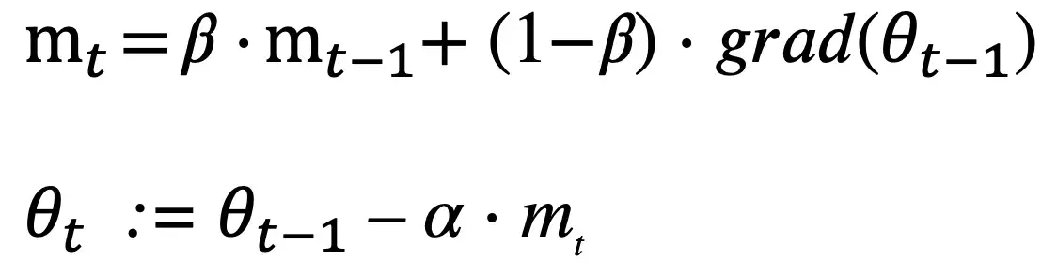
Math Equations
Notes:
These equations describe the main steps in the Adam optimization algorithm, which combines gradient descent (which finds local minimums) with an adaptive learning rate that takes into account the past gradients and squared gradients. By using these moving averages to adjust the learning rate for each parameter, Adam is able to achieve faster convergence and better accuracy compared to other optimization algorithms

Slide 7
Code Example
# Import packages
import tensorflow as tf
import pandas as pd
# Read data
df = pd.read_csv(“data.csv”)
# Split the data into features (X) and labels (y)
X = df.drop("target", axis=1)
Y = df["target"]
# Train data
X_train, X_test, y_train, y_test = train_test_split(X, Y, test_size=0.2)
Notes:
This code uses a simple two-layer neural network to solve a binary classification problem. The data is loaded from a CSV file using Pandas and split into features (X) and labels (y). As a quick refresher, our features act as independent variables and the labels as dependent variables or what we are trying to predict. The data is then split into training and testing sets and loaded into TensorFlow datasets. The model is first defined using the sequential model in tensorflow. The sequential model is linear and uses one layer after another to optimize our prediction and minimize the loss function. The Adam optimizer is used to compile the model and utilize the previous equations to slightly train the data as it passes through each epoch or quote on quote layer. Finally, the model is evaluated on the test set and the loss and accuracy are printed.

Slide 8
Code Example (cont.)
# Define a model
model = tf.keras.Sequential([
tf.keras.layers.Dense(32, activation='relu', input_shape=(X.shape[1],)),
tf.keras.layers.Dense(1, activation='sigmoid'),])
# Compile the model with Adam optimizer
model.compile(optimizer=tf.optimizers.Adam(),
loss='binary_crossentropy',
metrics=['accuracy'])
# Train the model
history = model.fit(train_dataset.batch(32), epochs=10)
# Evaluate the model on the test set
test_loss, test_accuracy = model.evaluate(test_dataset.batch(32))
print("Test Loss: {:.4f}, Test Accuracy: {:.2f}%".format(test_loss, test_accuracy * 100))

Slide 9

Poll

Slide 10
References
https://www.tensorflow.org/api_docs/python/tf/keras/optimizers/Adam
https://machinelearningmastery.com/adam-optimization-algorithm-for-deep-learning/#:~:text=What%20is%20the%20Adam%20optimization,iterative%20based%20in%20training%20data.

