Slide 1
Synthetic Time-Series Data
Generative Adversarial Networks (GANs)
Shahram Sabzevari

Slide 2
Agenda
Why synthetic data?
Generative Adversarial Networks (GANs)
TimeGAN
Runtime/Results
Conclusion

Slide 3
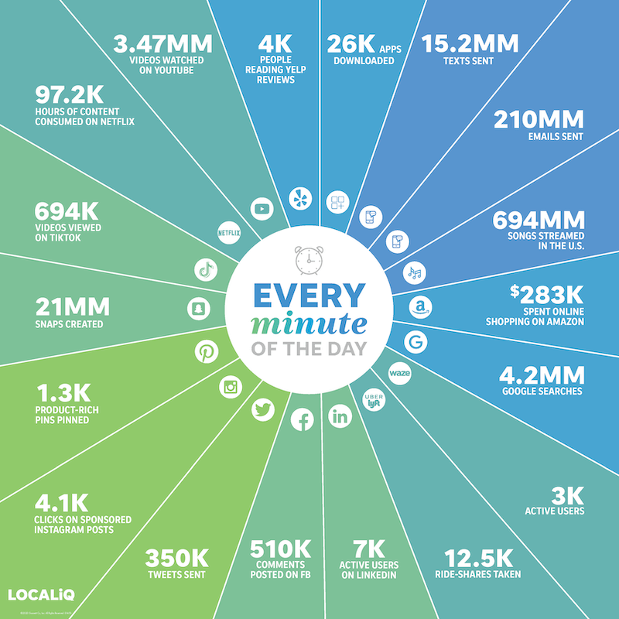
Why synthetic data?
In 2020, the amount of data on the internet hit 40 zetabytes. A zetabyte is about a trillion gigabytes. So why we need synthetic data?
There are many good reasons behind it. Here are some important ones:
Cost of preparing and labeling data
Prototype Development
Edge-case Simulation
Data Privacy

Slide 4
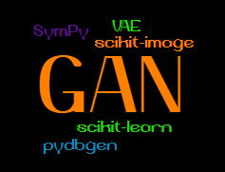
How can we generate synthetic data?
Deep Generative Models
Implicit Density
Explicit Density
Drawing numbers from a distribution
Agent-based modeling
Deep learning models
Direct
Markov Chains
Markov Chains
Variational
Generative Matching Moment Nets (GMM)
Generative Adversarial Networks (GAN)
Boltzmann-machines (BM)
Variational Autoencoder (VAE)
Deep generative models' taxonomy

Slide 5
TimeGAN
TimeGAN is proposed in 2019.
It is different from other GAN architecture. It has 4 components:
Generator
Discriminator
Recovery
Embedder
It introduced the concept of supervised loss and embedding network. Supervised loss: The model is capturing the time conditional distribution by using the original data as a supervision. Embedding network: It is reducing the adversarial learning space dimensionality.
It can generate both static (dimensions) and sequential data (TS) at the same time.
Less sensitive to hyperparameters.
The training process is more stable.

Slide 6
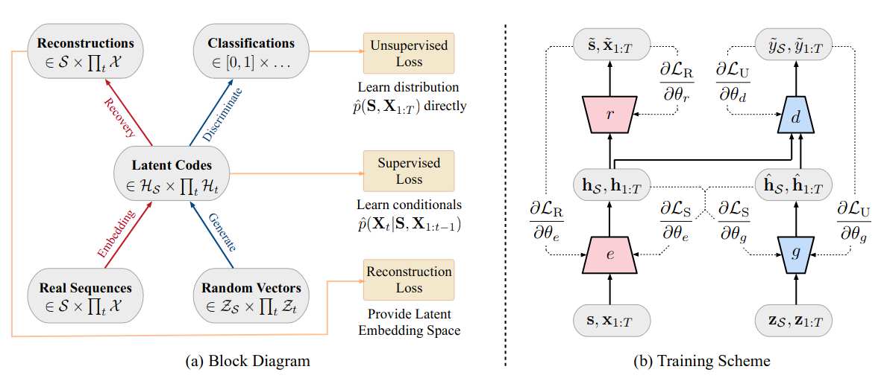
TimeGAN

Slide 7
TimeGAN
Reconstruction loss: Compares the reconstruction of the encoded data compared to the original data.
Supervised loss: Measures the quality of generator approximation of the next time step in the latent space.
Unsupervised loss: This is the familiar min-max game. It shows the relation of the generator and discriminator networks.

Slide 8
TimeGAN
There are three training phases:
Phase I: Training the Autoencoder
Phase II: Training the supervisor to capture the temporal behavior.
Phase III: The combined training of all components. We try to minimize all three loss functions in this phase.

Slide 9
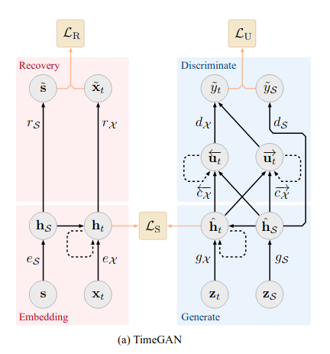
TimeGAN
For simplicity I am using a 3 layers GRU network for all 4 components.
It is possible to change this and add/reduce the layers or use LSTMs instead of the GRU.

Slide 10
References
https://www.smartinsights.com/internet-marketing-statistics/happens-online-60-seconds/
https://papers.nips.cc/paper/2014/file/5ca3e9b122f61f8f06494c97b1afccf3-Paper.pdf
https://papers.nips.cc/paper/2019/file/c9efe5f26cd17ba6216bbe2a7d26d490-Paper.pdf

