Slide 1
Synthetic Time-Series Data
Generative Adversarial Networks (GANs)
Shahram Sabzevari

Slide 2
Agenda
Why synthetic data?
Generative Adversarial Networks (GANs)
TimeGAN
Runtime/Results
Conclusion

Slide 3
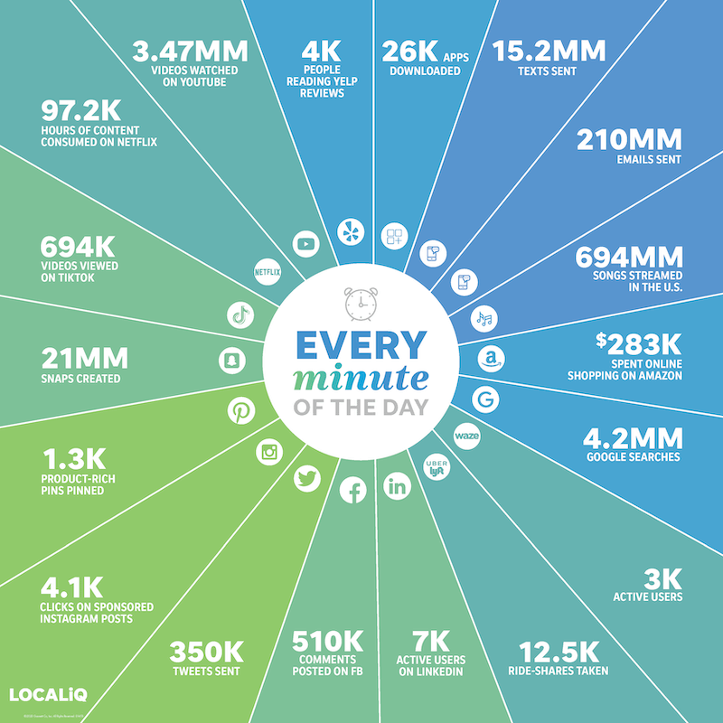
Why synthetic data?
In 2020, the amount of data on the internet hit 40 zetabytes. A zetabyte is about a trillion gigabytes. So why we need synthetic data?
There are many good reasons behind it. Here are some important ones:
Cost of preparing and labeling data
Prototype Development
Edge-case Simulation
Data Privacy

Slide 4
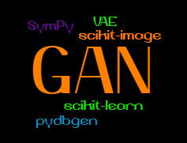
How can we generate synthetic data?
Deep Generative Models
Implicit Density
Explicit Density
Drawing numbers from a distribution
Agent-based modeling
Deep learning models
Direct
Markov Chains
Markov Chains
Variational
Generative Matching Moment Nets (GMM)
Generative Adversarial Networks (GAN)
Boltzmann-machines (BM)
Variational Autoencoder (VAE)
Deep generative models' taxonomy

Slide 5
TimeGAN
TimeGAN is proposed in 2019.
It is different from other GAN architecture. It has 4 components:
Generator
Discriminator
Recovery
Embedder
It introduced the concept of supervised loss and embedding network. Supervised loss: The model is capturing the time conditional distribution by using the original data as a supervision. Embedding network: It is reducing the adversarial learning space dimensionality.
It can generate both static (dimensions) and sequential data (TS) at the same time.
Less sensitive to hyperparameters.
The training process is more stable.

Slide 6
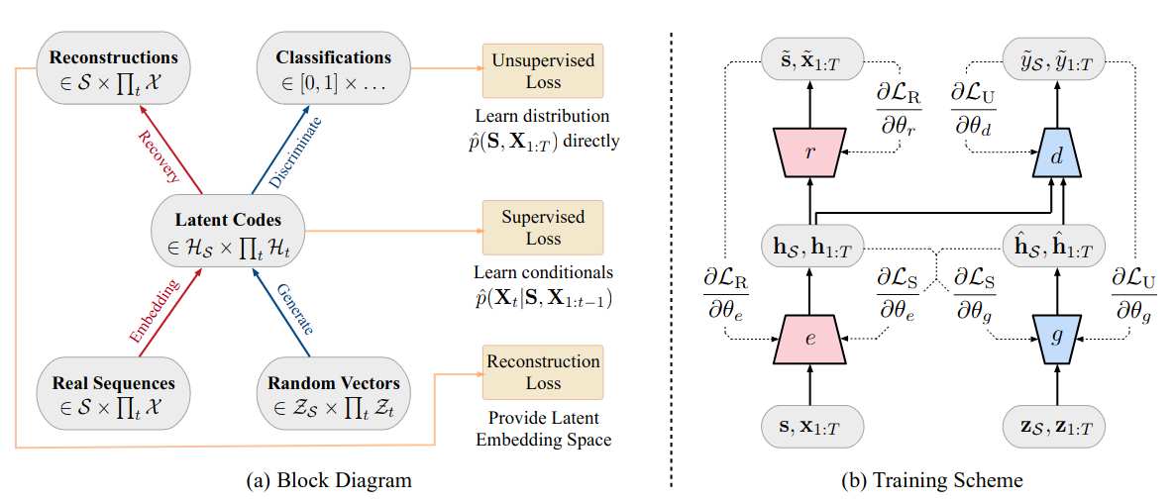
TimeGAN

Slide 7
TimeGAN
Reconstruction loss: Compares the reconstruction of the encoded data compared to the original data.
Supervised loss: Measures the quality of generator approximation of the next time step in the latent space.
Unsupervised loss: This is the familiar min-max game. It shows the relation of the generator and discriminator networks.

Slide 8
TimeGAN
There are three training phases:
Phase I: Training the Autoencoder
Phase II: Training the supervisor to capture the temporal behavior.
Phase III: The combined training of all components. We try to minimize all three loss functions in this phase.

Slide 9
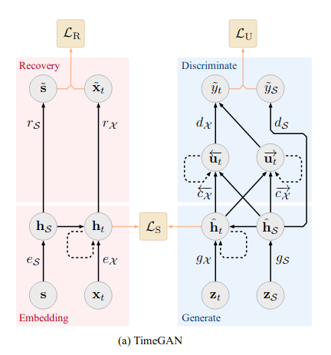
TimeGAN
For simplicity I am using a 3 layers GRU network for all 4 components.
It is possible to change this and add/reduce the layers or use LSTMs instead of the GRU.

Slide 10
Data
I have used the data downloaded from Yahoo finance for Google, Apple, and Amazon stock for last 3 to 5 years.
I deliberately used the data in COVID area and before to observe how the behavior is reflected in the synthetic data.

Slide 11
Results - Experiments
I have experimented with 10K, 20K, and 50K then plotted the Synthetic vs real data in two ways:
for each variable I have plotted sample of the data
Then Reduce the dimension using PCA and TSNE and plot the PCA and TSNE in 2 dimension to compare the data.
Finally, two regressor were trained:
one on real data, predicting the real data
Another one on synthesized data , predicting the real data

Slide 12
Results - Runtime
The training is computationally intensive. Especially in the phase III where the generator and embedder are trained twice the discriminator. I am running it on a ThinkPad with 10th Gen i7 CPU and 16GB memory. I do not have NVIDIA GPU. Here are runtime stats:
For 10K:
Phase I (Embedding network): ~15m
Phase II (Supervisor network): ~15m
Phase III (Joint network training): ~2H:30m
For 20K:
Phase I (Embedding network): ~30m
Phase II (Supervisor network): ~30m
Phase III (Joint network training): ~3H:30m
For 50K:
Phase I (Embedding network): ~7H
Phase II (Supervisor network): ~7H
Phase III (Joint network training): ~21H
As you can see the runtime increases significantly, but you will see that we are not benefited much from the extra time.

Slide 13
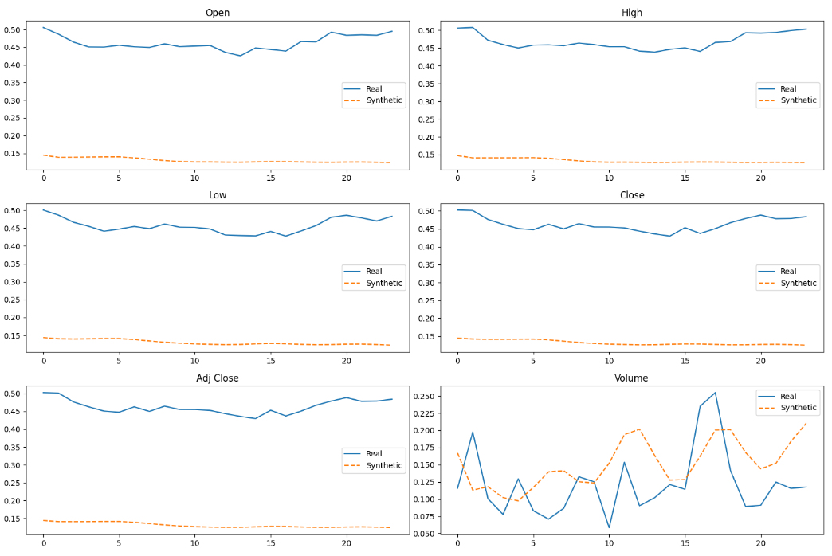
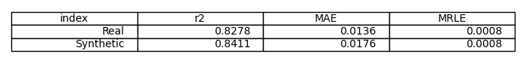
Results – 10k
All columns except the volume are in higher level compared to the real data however, the shape is close.
Also looking at the PCA and TSNE you will see a bit of noise.
However, the regression model’s performance is promising.

Slide 14
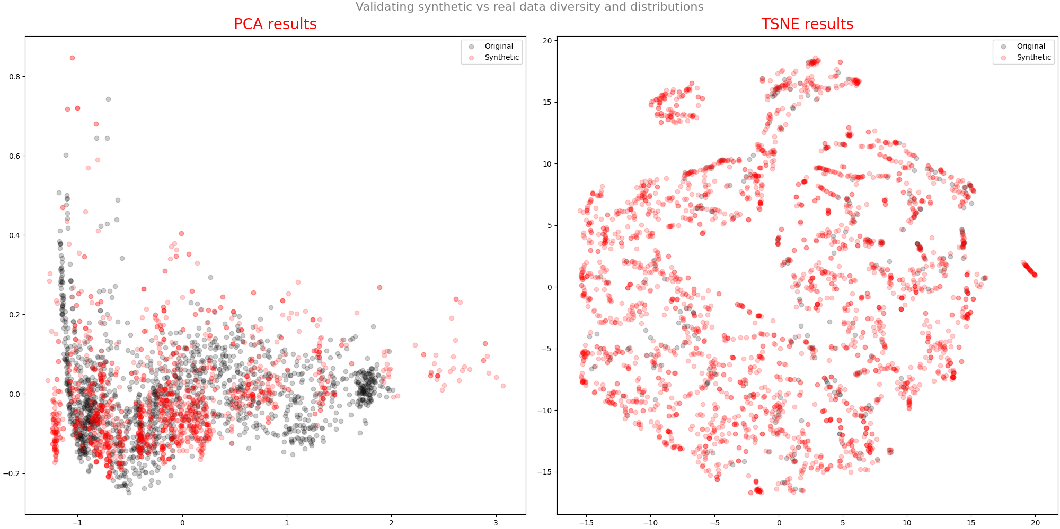

Slide 15
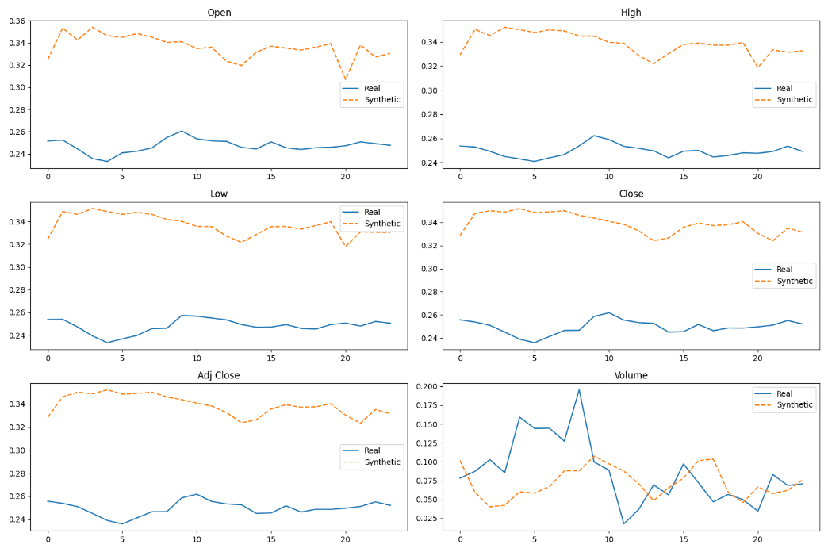
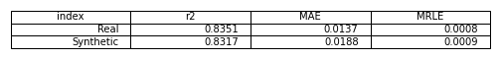
Results – 20k
By training another 10K the gap starts to closes and PCA and TSNE are start to mimic the real data better.
We also loss a non-significant amount on predicting power.
Given the runtimes are still reasonable one may choose this but, in my opinion, it doesn’t make much of a difference.

Slide 16
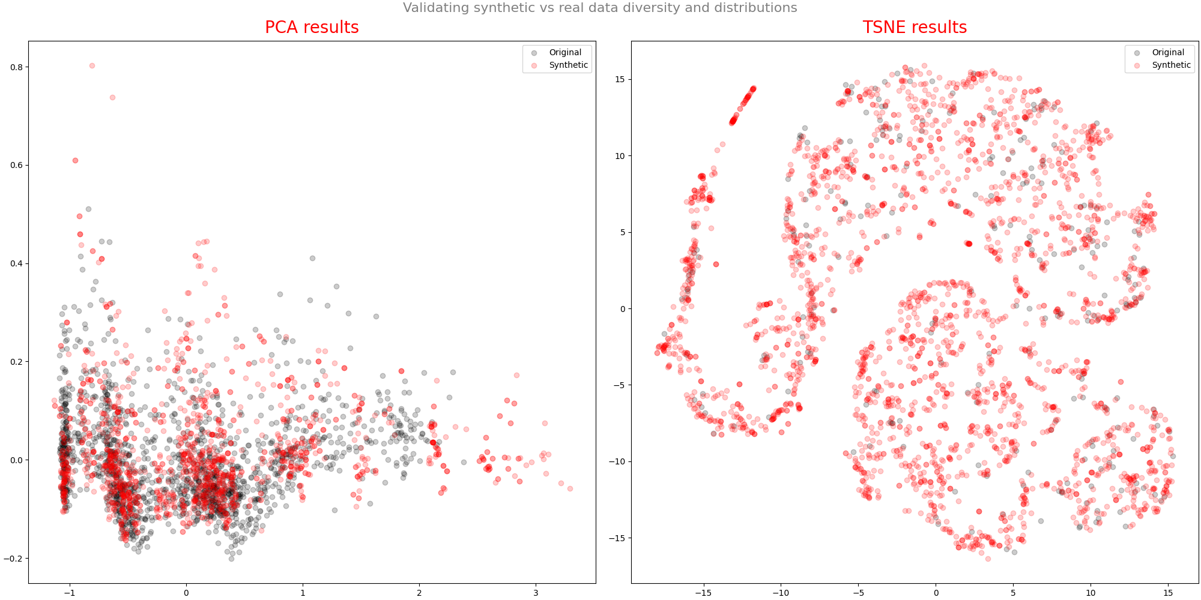

Slide 17
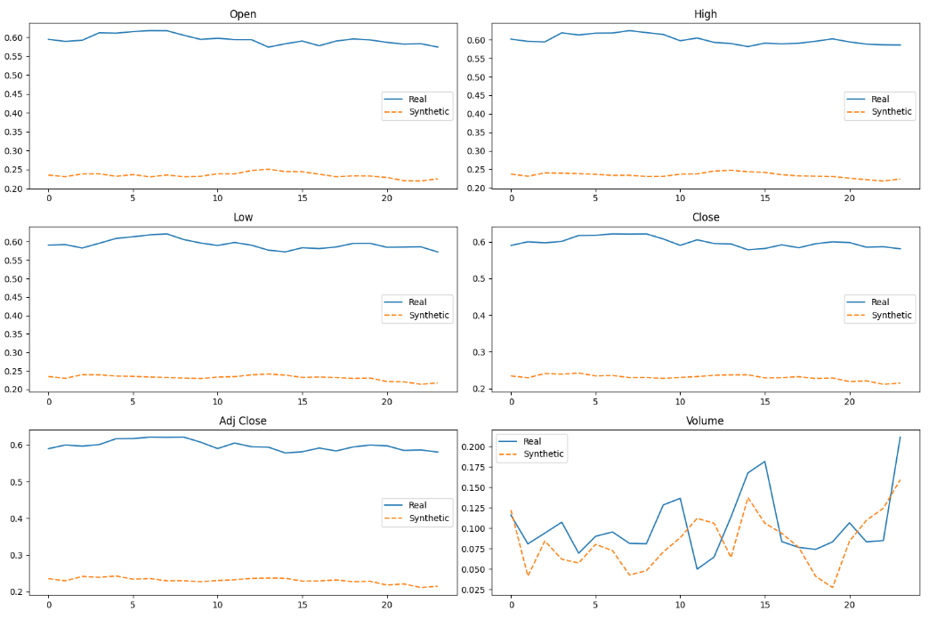
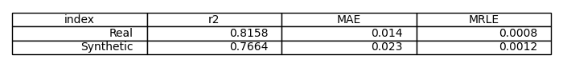
Results – 50k
For this dataset, the 50K steps suggestion doesn’t worth the effort.
Although it provides better shapes in all the graphs but it losses 6% on prediction power while taking significant training time.

Slide 18
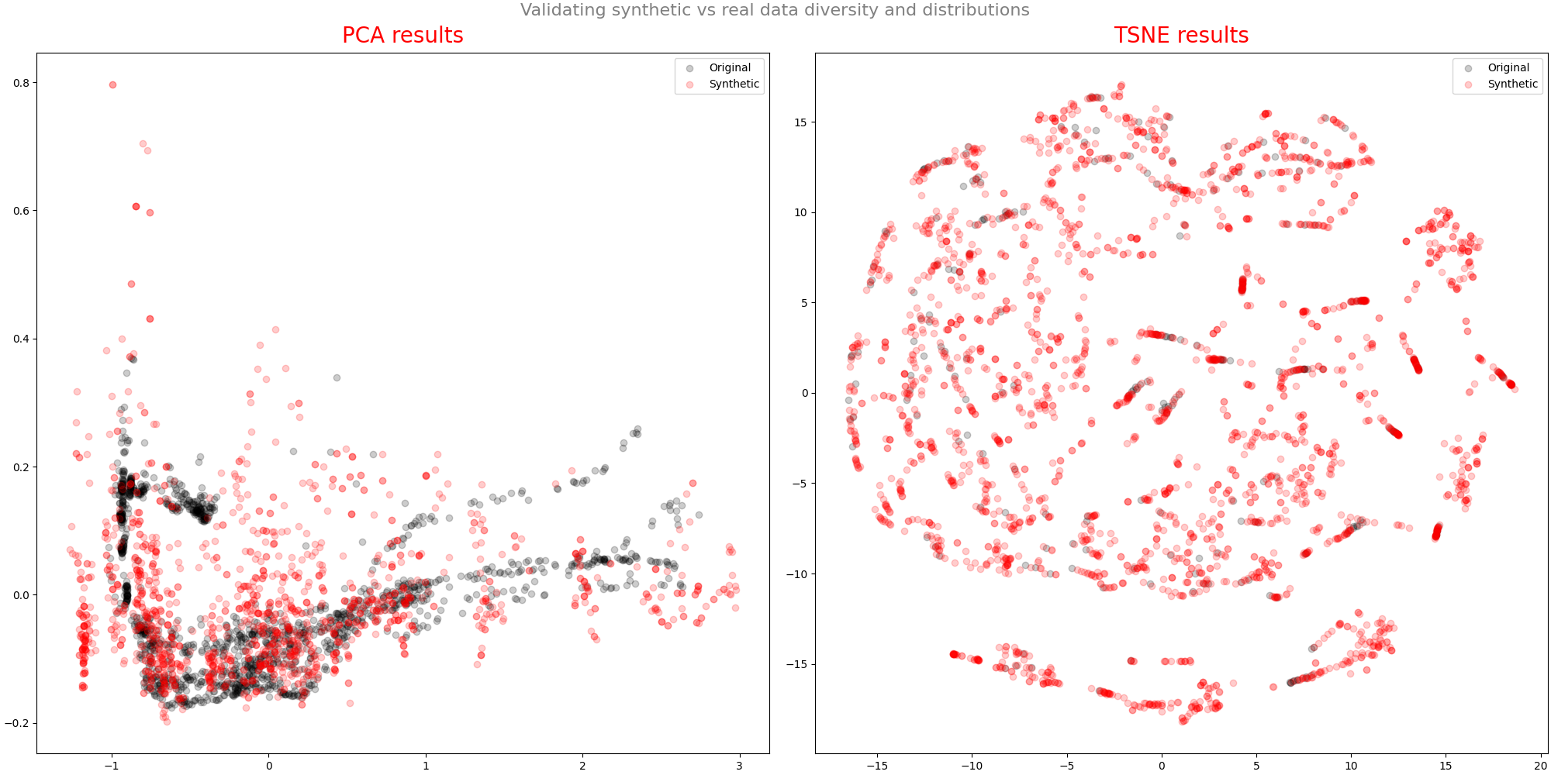

Slide 19
Future experiments
Use LSTM
Use more complex network structure
Hyperparameter tuning
Sensitivity analysis

Slide 20
References
https://www.smartinsights.com/internet-marketing-statistics/happens-online-60-seconds/
https://papers.nips.cc/paper/2014/file/5ca3e9b122f61f8f06494c97b1afccf3-Paper.pdf
https://papers.nips.cc/paper/2019/file/c9efe5f26cd17ba6216bbe2a7d26d490-Paper.pdf

