Slide 1
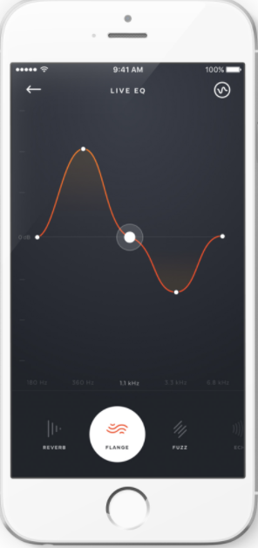
Motivation:
Microphones are one of the most versatile sensors available in consumer electronics today.
Currently the main usage of microphones is in detection of sound in the vicinity, that needs to be transmitted to receiver.
We propose using microphone for detecting motion using doppler effect.

Slide 2
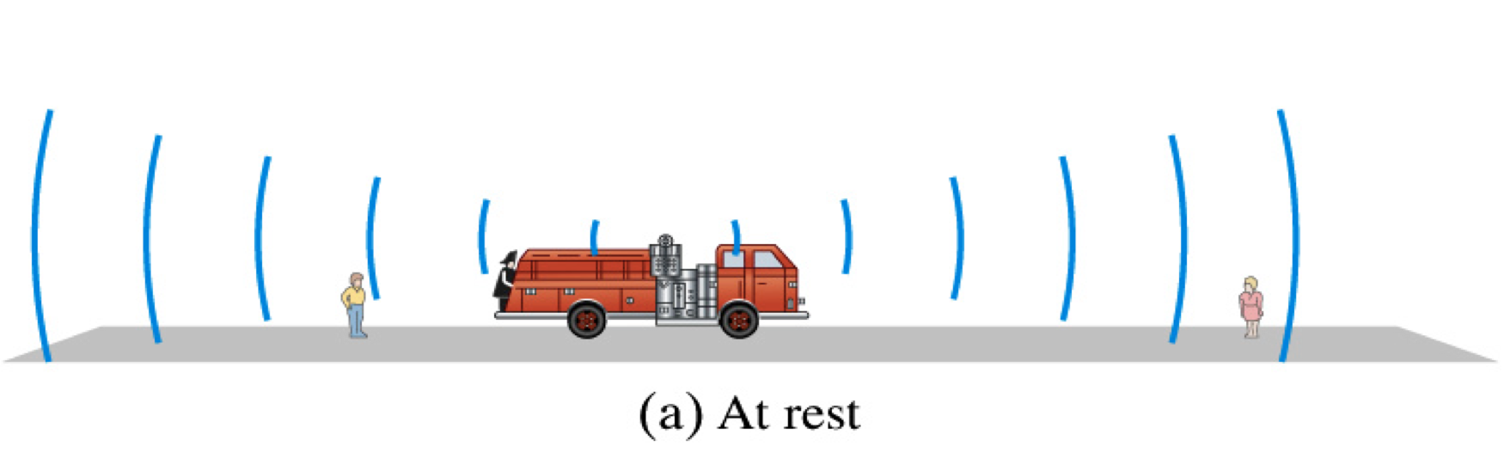
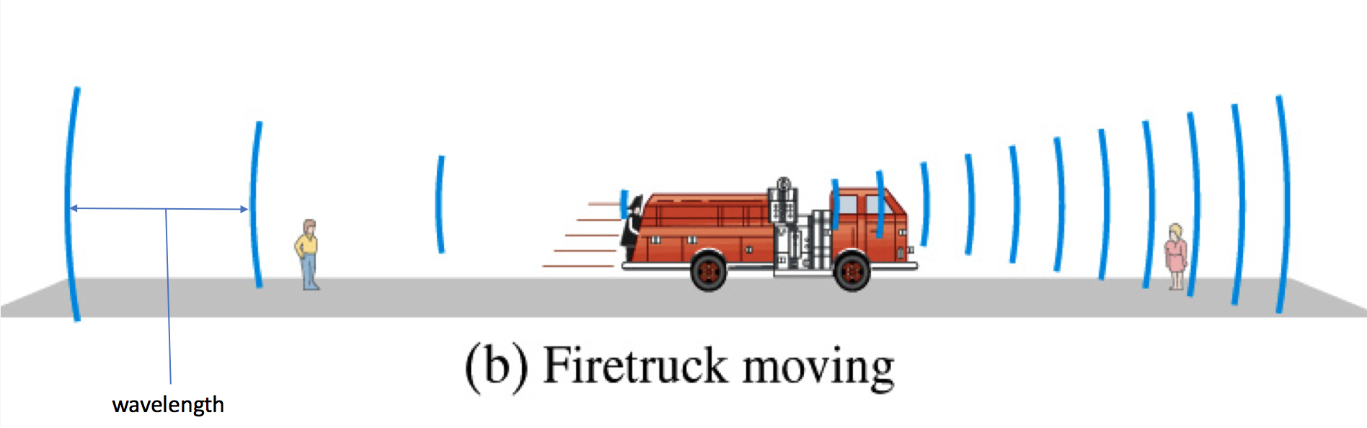
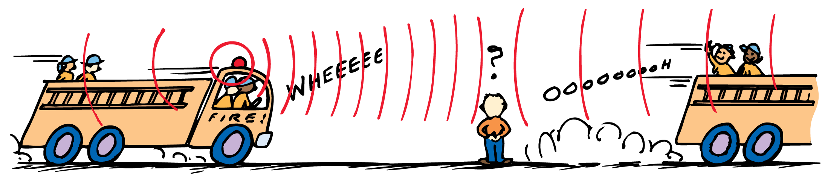
Doppler Effect
When a Source approaches, the pitch sounds higher than normal because the sound wave crests arrive more frequently.
When the Source passes and moves away, a drop in pitch in observed because the wave crests are arriving less frequently
Long wavelength
Low Frequency
Small wavelength
High Frequency
The Doppler effect characterizes the frequency change of a a sound wave as the source or observer moves.
The change in loudness is not the Doppler Effect! It is the shift in frequency
Notes:
As a wave source approaches, an observer encounters waves with a higher frequency. As the wave source moves away, an observer encounters waves with a lower frequency.
This apparent change in frequency due to the motion of the source (or receiver) is called the Doppler effect.
The greater the speed of the source, the greater will be the Doppler effect.

Slide 3
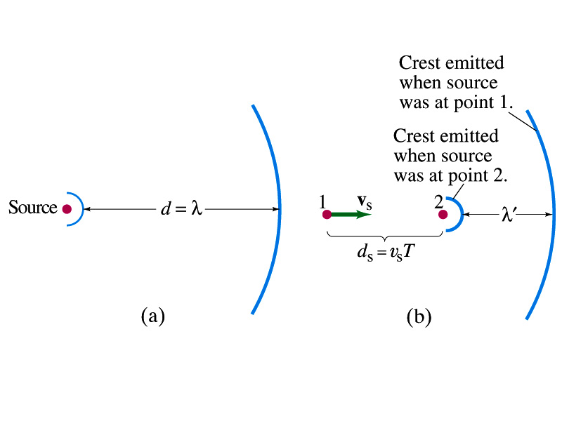
Towards the Observer:
Away from Observer:

Slide 4
Using Doppler Effect to Detect Motion

Slide 5
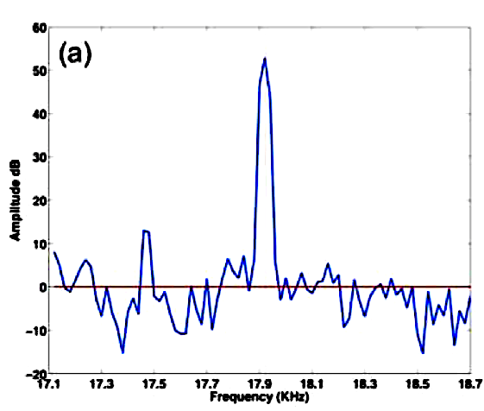
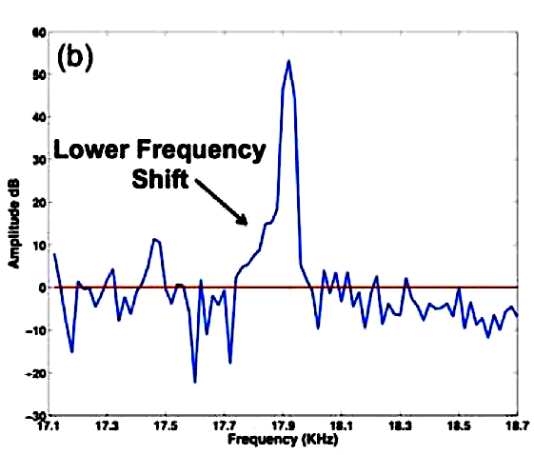
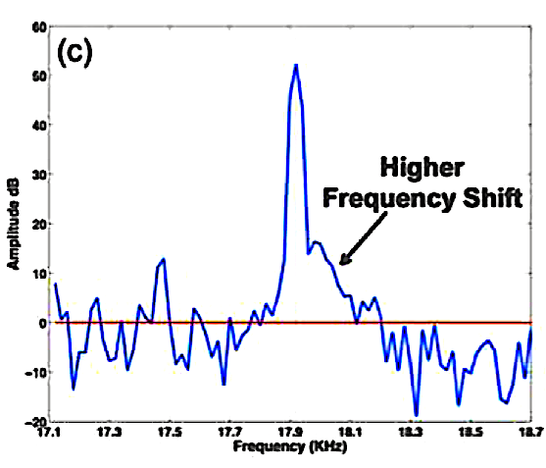
Increase in bandwidth on left, due to motion away from device
Increase in bandwidth on right, due to motion towards the device
Pilot Tone with no motion

Slide 6
A motion is registered if frequency shift bandwidth is of 4 or more bins. The left or right frequency shift determines the specific motion
Compute the FFT
Signal conditioning
Bandwidth Extraction
Signals from microphone
Motion detection
Buffer incoming time domain signal
Any motion in proximity of device, will cause shifts, that
will be picked up by the microphone
Scan the frequency
bins on both sides independently until the amplitude drops below 10% of the pilot tone peak
FFT is computed
with 2048 point vectors spread equally over the spectral width of 22.05 kHz

Slide 7
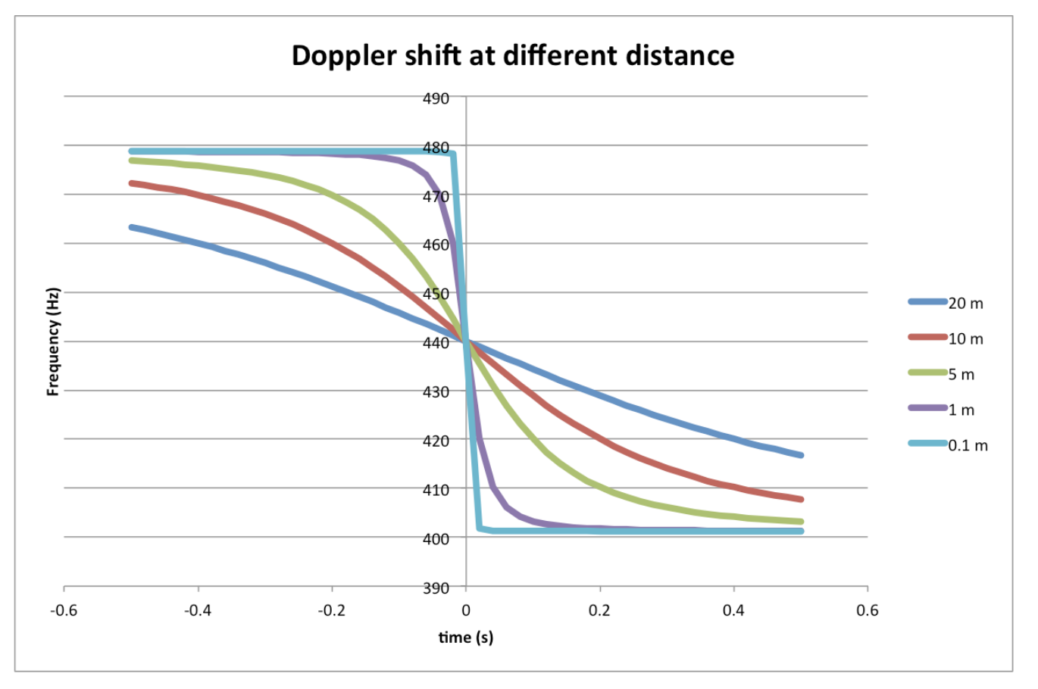
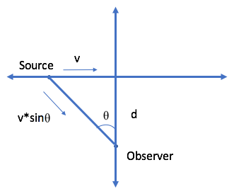
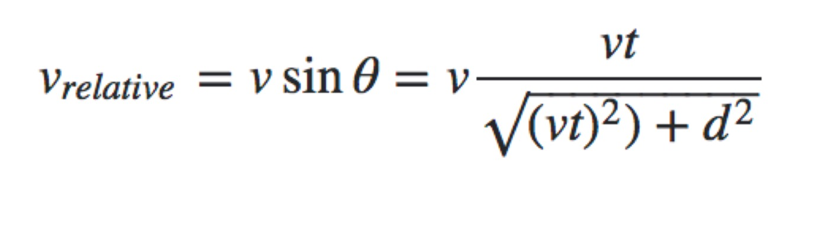

Slide 8
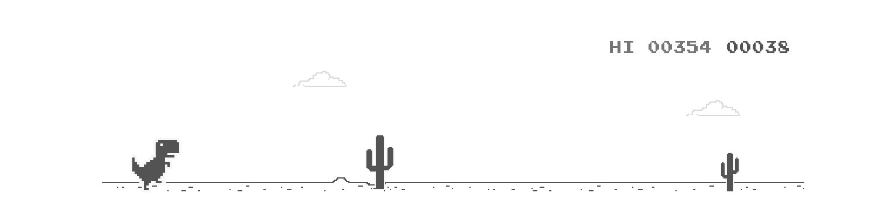
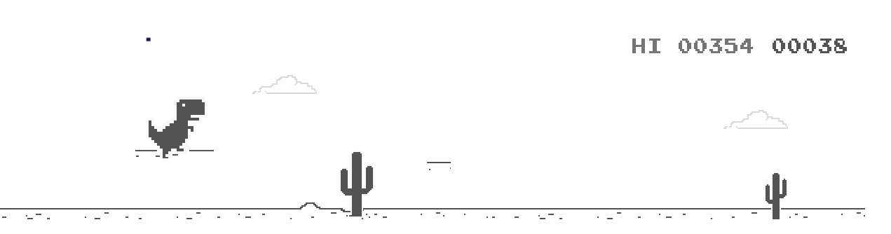
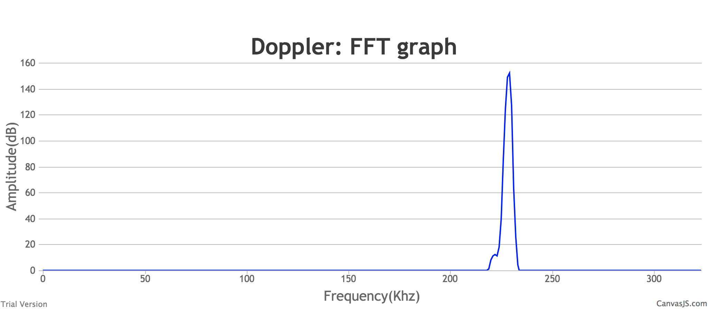
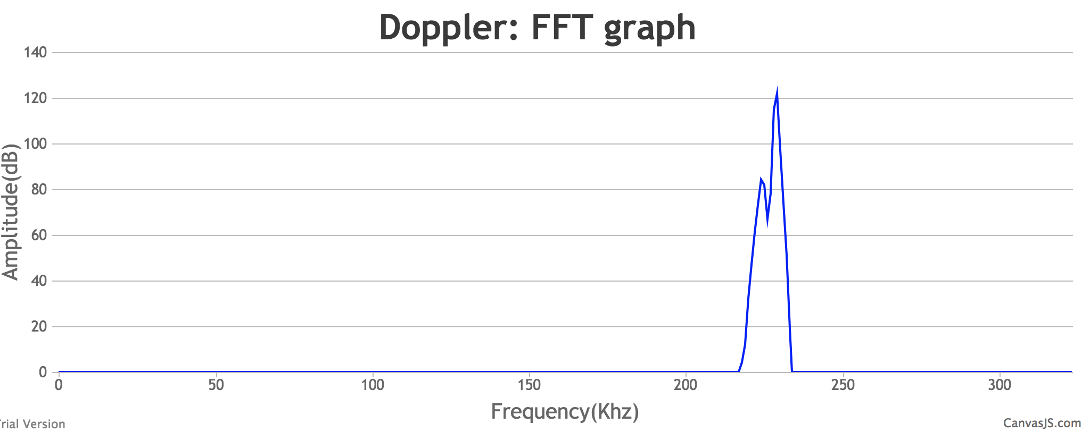
Playing Google Trex game using Gestures
Shift in Frequency -> Jump Action

Slide 9
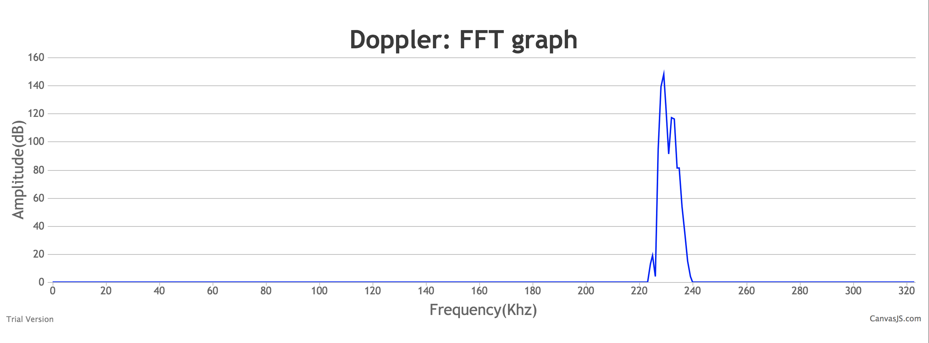
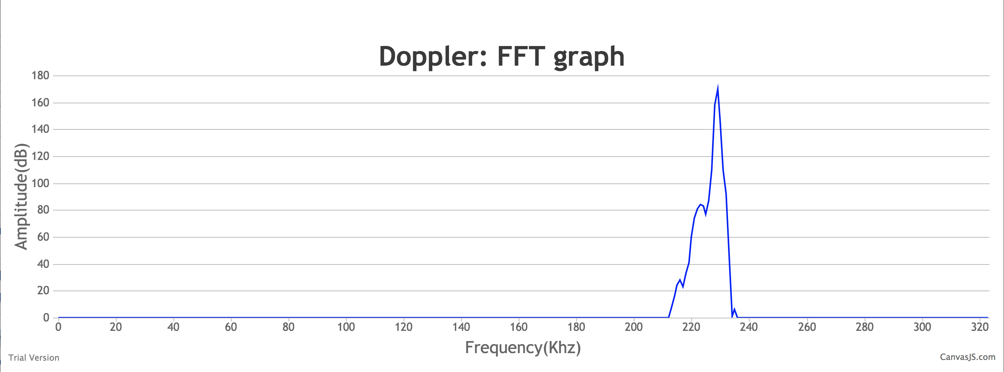
Web Page Scrolling using Gestures
Hand motion towards the computer
Hand motion away from the computer
Web Page Scroll UP
Web Page Scroll DOWN

Slide 10
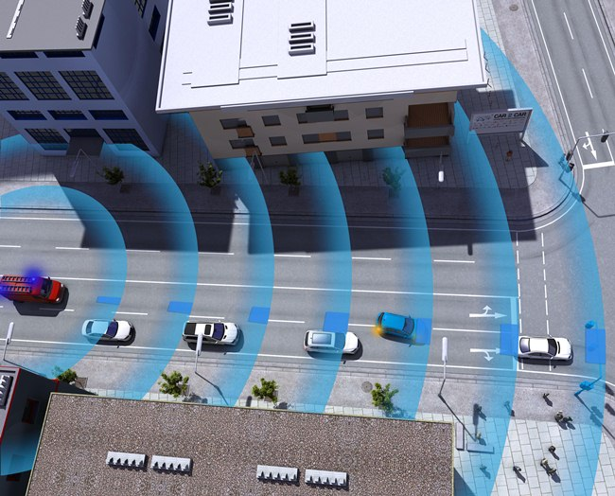
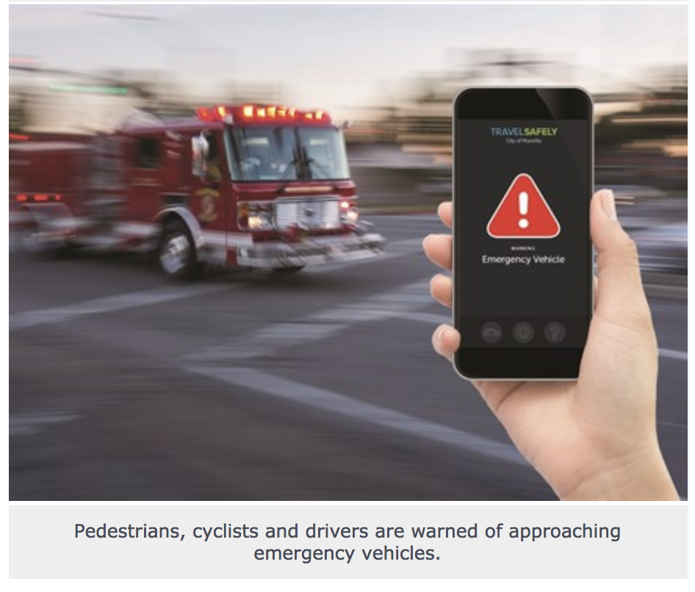
Emergency vehicle approaching notifier app
Using Doppler effect to identify if a vehicle that makes loud alarm noise is approaching.
Useful for people with hearing disabilities, who may rely on acoustic signals for navigation in the world.

