Slide 1
GROUP – 15
Classification of Arrhythmia using ECG Data.

Slide 2
Group members:
Name | Section | Roll No
Shivani Chauhan | A | 181500678
Sachi Tripathi | A | 181500598
Sarvesh Kumar Sharma | A | 181500625
Satyam Kumar Jha | A | 181500627

Slide 3
OBJECTIVE:
Distinguish between the presence and absence of cardiac arrhythmia using ECG data.
Classify a patient into one of the Arrhythmia classes.

Slide 4
Introduction
Cardiac Arrhythmia is a of a group of conditions in which the electrical activity of the heart is irregular or is faster or slower than normal.
it is the leading cause of death for both men and women in the world.

Slide 5
Dataset:
https://archive.ics.uci.edu/ml/datasets/Arrhythmia
Consists of 452 different training examples and spans 16 different classes.
The 279 columns include the age, the sex, the height and the weight of the person as well as some ’workable’ information.
Out of the 452 training examples, 245 is for normal people.
We have examples of 12 different types of arrhythmia.
Among these 12 types of arrhythmia, the most represented ones are classes 2 (coronary artery disease) and 10 (Right bundle branch block).

Slide 6
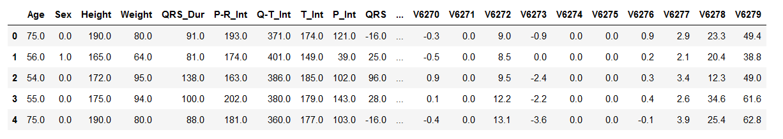
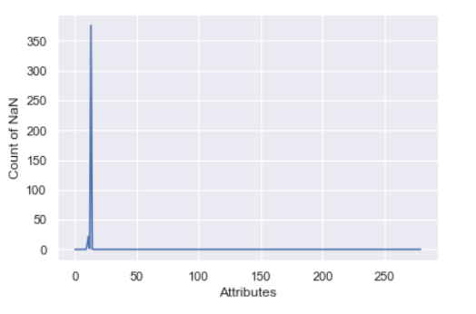
DATASET LOOK

Slide 7
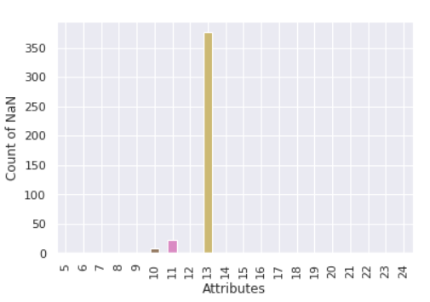
Missing Values
The Dataset Contains 408 missing values

Slide 8
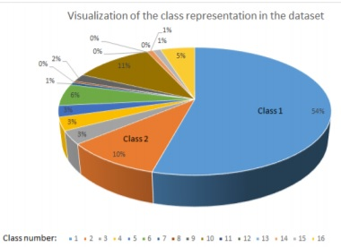
Visualization of class representation in dataset

Slide 9
Expected Algorithms:
Logistic Regression
Tree classifiers
Support Vector Machines (SVM)
Naive Bayes
Random Forest
• KNN

Slide 10
Expected Outcome:
Prediction and classification of Cardiac Arrhythmia with maximum accuracy.

Slide 11
Applications:
Theses Machine Learning Techniques can be deployed in hospitals where a large dataset is available and can help the doctors in Diagnosis of cardiac Arrhythmia and to cut down the number of causalities due to heart diseases in future.

