Slide 1
Brain Tumor Detection and Categorization Using Deep Learning Techniques
Supervised By
Dr. S.M. Hasan Mahmud
Assistant Professor
Department of Computer Science
American International University-Bangladesh
Rameen Farhan (20-41981-1)
Raqibul Alam (20-42692-1)
MD Minhajul Hoque Chowdhury (20-43086-1)
MD Shahadat Hossen (20-43083-1)

Slide 2
CONTENT
Introduction
Literature Review
Methods-Flowchart
Methods-Diagram
Data Preprocessing
Feature Extraction
Analysis of CNN Models for Original Dataset
Analysis of CNN Models for Unsharp Mask Filter
Analysis of CNN Models for Gaussian Filter
Analysis of CNN Models for Laplacian Filter
Results or Findings
Discussion & Conclusion
Representation of predictions
Limitations
Future work

Slide 3
introduction
Brain tumors
Common and dangerous diseases with various types.
gliomas(cancerous)- Gliomas are tumors that arise from glial cells in the brain or spinal cord, meningiomas(non-cancerous)-re usually benign tumors that arise from the meninges, the protective layers surrounding the brain and spinal cord. They are often slow-growing, pituitary(non-cancerous)
Tumor classification
Diagnostic tools
CT scans, MRI, and X-rays which are used by doctors.
MRI advantages
Versatile imaging technique for evaluating soft tissues like brain tumors.

Slide 4
introduction
Crucial for effective treatment and patient survival.
Early detection
Brain tumor statistics
The American Brain Tumor Association (ABTA) estimates that about 80% of malignant brain tumors are gliomas which is cancerous
X-rays detect fractures,
CT scans provide detailed body images;
MRI captures organs and soft tissues;
ultrasound generates real-time images;
PET scans visualize metabolic activity;
Medical Images
Medical Images Analysis
diagnosis,
treatment planning
progress monitoring

Slide 5
introduction
Advancements
Machine learning, computer vision and image processing enable automated analysis, improving accuracy and efficiency in diagnosis and treatment.
Motivation
The aim is to detect brain tumors early using image processing and machine learning algorithms to support the medical industry in improving diagnostic capabilities and providing timely interventions.
Benefits of early detection
Early detection enhances treatment success rates, reduces the overall burden on affected individuals, and improves their chances of recovery.
Objective
Create a model to identify brain tumors and improve the model’s accuracy.

Slide 6
Literature review
H. Khan et al., propose a novel approach for categorizing brain MRI scan images as cancerous or noncancerous using a convolutional neural network (CNN) combined with Data Augmentation and Image Processing. They compare their CNN model with pre-trained VGG-16, ResNet-50, and Inception-v3 models using transfer learning. Despite the small dataset used, their model achieves exceptional accuracy of 100%, outperforming VGG-16 (96%), ResNet-50 (89%), and Inception-v3 (75%). Furthermore, their model exhibits low complexity and computational requirements, making it highly efficient and accurate compared to existing pre-trained models.
Ahmet Çinar developed a brain tumor diagnosis system using CNN models and MRI images. They utilized the ResNet50 architecture as the base model, modifying it by removing the last 5 layers and adding 8 new ones. The developed model achieved an impressive accuracy of 97.2%. Additionally, they compared the performance of other models such as AlexNet, ResNet50, DenseNet201, InceptionV3, and GoogLeNet, with the highest performing model accurately classifying brain tumor images. The method showcased effectiveness and potential for utilization in computer-aided systems for brain tumor detection, as supported by previous literature studies.

Slide 7
Literature review
Zahid Rasheed and his team proposed an algorithm that was evaluated using benchmarked data and compared with the performance of pre-trained VGG16, VGG19, ResNet50, MobileNetV2, and InceptionV3 algorithms. The experimental findings revealed a significant classification accuracy of 98.04%.
Tonmoy Hossain et al., for instance, employed six traditional classifiers, namely Support Vector Machine (SVM), K-Nearest Neighbor (KNN), Multilayer Perceptron (MLP), Logistic Regression, Naive Bayes, and Random Forest, using the Sci-kit-learn implementation. Subsequently, they experimented with Convolutional Neural Network (CNN) and achieved an impressive accuracy of 97.87%, highlighting its compelling performance.

Slide 8
Literature review
Aryan Sagar Methil proposed an approach that involved conducting experimental research on a dataset consisting of tumors with diverse sizes, shapes, textures, and locations. The classification task was performed using Convolutional Neural Network (CNN). The CNN model achieved a recall rate of 98.55% on the training set and an impressive 99.73% on the validation set, demonstrating its highly convincing performance.
A. Deshpande et al., introduced a brain tumor classification framework utilizing artificial intelligence and Convolutional Neural Network (CNN) algorithms. The effectiveness of the framework was evaluated both with and without super-resolution techniques. The combination of super-resolution and the ResNet50 architecture achieved an impressive accuracy of 98.14%. Experimental results using MRI images demonstrated that the proposed super-resolution framework, which incorporates discrete cosine transform (DCT), CNN, and ResNet50, effectively enhances the accuracy of tumor classification.

Slide 9
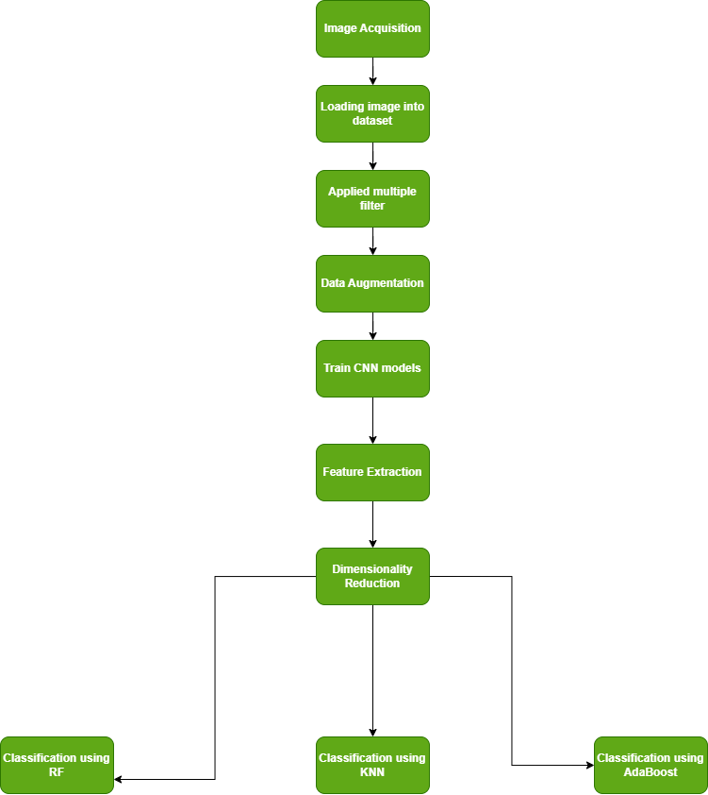
Flowchart
Methods

Slide 10
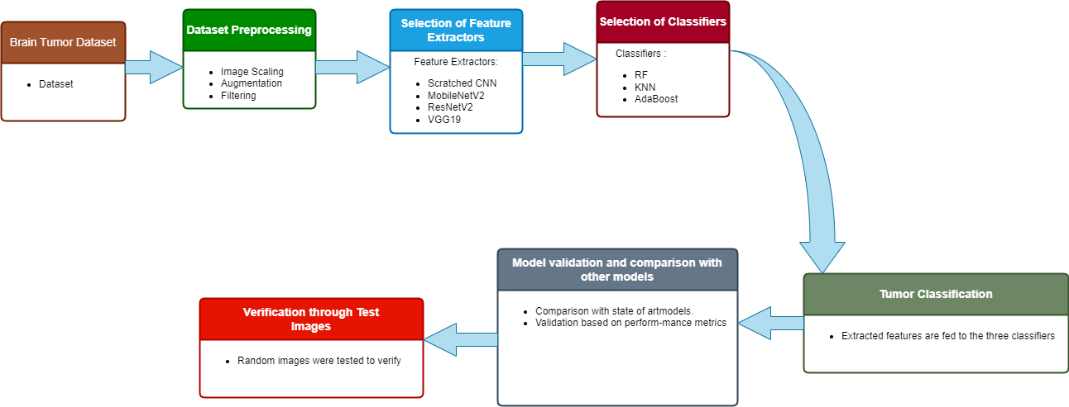
Diagram
Methods

Slide 11
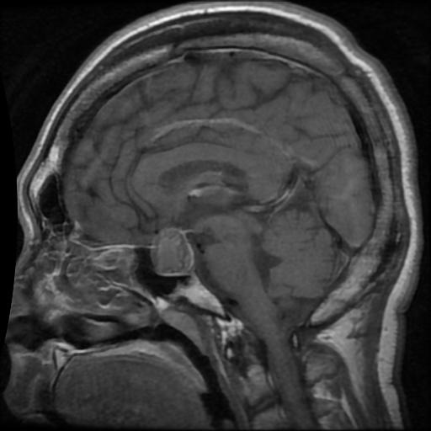
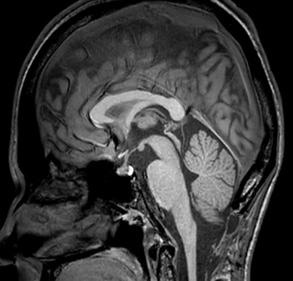
Dataset
multi-class classification dataset with four classes
gliomas, meningiomas, pituitary, and no tumor
The Glioma, Meningioma, and Pituitary datasets each have 1,168 MRI pictures,
whereas the No tumor dataset has 1,175 images

Slide 12

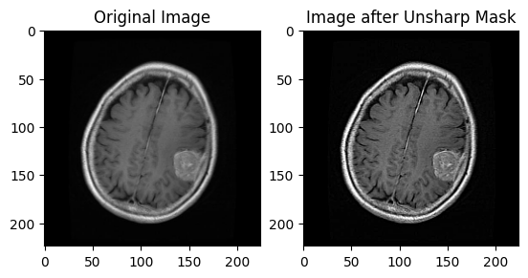
Filter
Unsharp mask : enhance image sharpness by accentuating edges and fine details

Slide 13
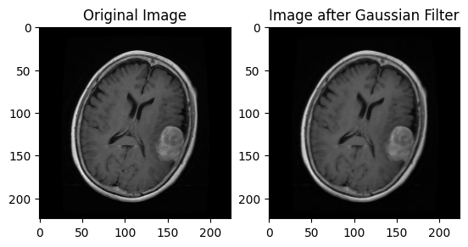
Filter
Gaussian : image processing technique that uses a Gaussian function to blur or smooth a picture.

Slide 14
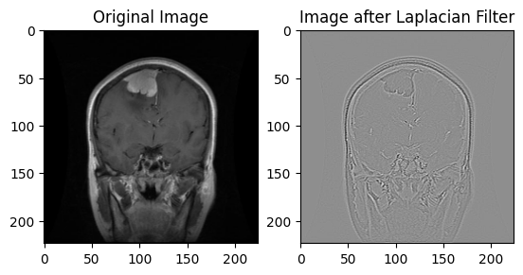
Filter
Laplacian: is a technique for image processing that uses the image's second derivative to enhance edges and detect features.

Slide 15
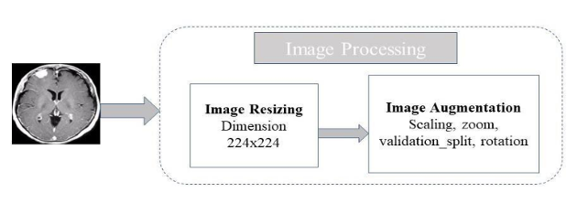
Data Preprocessing
Image Scaling
Data augmentation
All photos are scaled to 224*224 pixels.
normalize the images' pixel values by dividing them by 255.
0 to 1
Horizontal flip
Rotation
Zoom
Height shift
Width shift
Shear
Fill mode

Slide 16
Data Preprocessing
Train Test split
Label Encoder
used to evaluate the performance of a model.
divided into two subsets
one for training the model, and the other for testing or validating its performance.
working with categorical data
Categorical data consuming much memories
Label encoding is applied to convert these categorical labels into numerical values

Slide 17
Feature extraction
Scratched CNN Model
VGG19
Layer(type) | Output Shape | Param #
conv2d (Conv2D) | (None, 222, 222, 32) | 896
max_pooling2d (MaxPooling2D) | (None, 111, 111, 32) | 0
conv2d_1 (Conv2D) | (None, 109, 109, 64) | 18496
max_pooling2d_1 (MaxPooling2D) | (None, 54, 54, 64) | 0
conv2d_2 (Conv2D) | (None, 52, 52, 128) | 73856
max_pooling2d_2 (MaxPooling2D) | (None, 26, 26, 128) | 0
flatten (Flatten) | (None, 86528) | 0
dense (Dense) | (None, 128) | 11075712
dense_1 (Dense) | (None, 4) | 516
Layer(type) | Output Shape | Param #
vgg19 (Functional) | (None, 7, 7, 512) | 20024384
Flatten(Flatten) | (None, 25088) | 0
Dense(Dense) | (None, 128) | 3211392
dense_1(Dense) | (None, 4) | 516

Slide 18
Feature extraction
MobileNetV2
ResNet50
Layer(type) | Output Shape | Param #
mobilenetv2_1.00_224 (Functional) | (None, 7, 7, 1280) | 2257984
global_average_pooling2d(GlobalAveragePooling2D) | (None, 1280) | 0
dense (Dense) | (None, 128) | 163968
dense_1 (Dense) | (None, 4) | 516
Layer(type) | Output Shape | Param #
resnet50 (Functional) | (None, 7, 7, 2048) | 23587712
global_average_pooling2d_1(GlobalAveragePooling2D) | (None, 2048) | 0
Dense_2 (Dense) | (None, 128) | 262272
dense_3(Dense) | (None, 4) | 516

Slide 19
Classifier
Random Forest
K-Nearest Neighbors (KNN)
AdaBoost

Slide 20
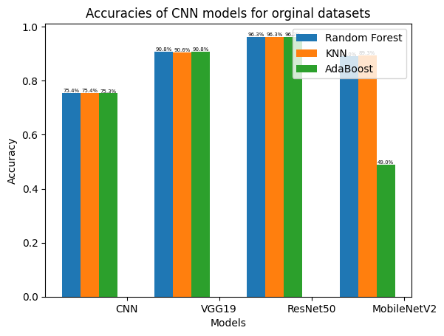
Histogram of CNN Models for Original Dataset

Slide 21
Analysis of CNN Models for Original Dataset
Models | RF | KNN | Ada.B
CNN | 73.4% | 73.4% | 73.3%
VGG19 | 90.8% | 90.6% | 90.8%
ResNet50 | 96.3% | 96.0% | 96.0%
MobileNetV2 | 89% | 89.3% | 49%

Slide 22
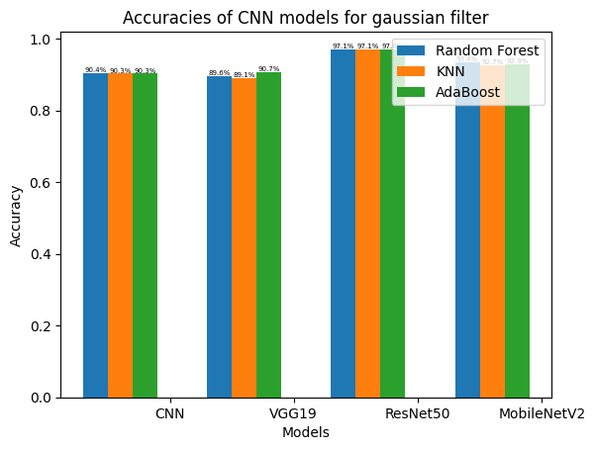
Histogram of CNN Models for gaussian filter

Slide 23
Analysis of CNN Models for gaussian filter Dataset
Models | RF | KNN | Ada.B
CNN | 90.4% | 90.3% | 90.3%
VGG19 | 89.6% | 89.1% | 90.7%
ResNet50 | 97.1% | 97.1% | 97.0%
MobileNetV2 | 93.4% | 92.7% | 92.9%

Slide 24
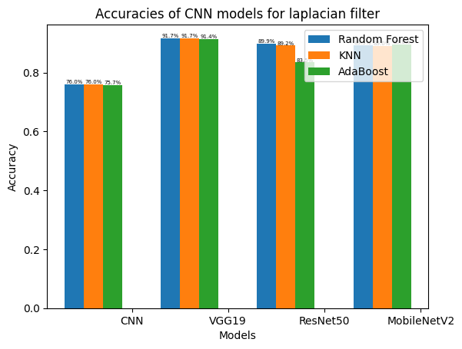
Histogram of CNN Models for Laplacian filter

Slide 25
Analysis of CNN Models for laplacian filter Dataset
Models | RF | KNN | Ada.B
CNN | 76% | 76% | 75.7%
VGG19 | 91.7% | 91% | 91.4%
ResNet50 | 89.9% | 89.2% | 83.5%
MobileNetV2 | 89.3% | 89% | 89.6%

Slide 26
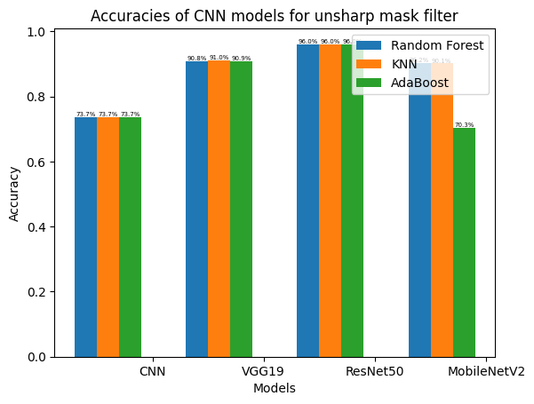
histogram of CNN Models for unsharp mask filter

Slide 27
Analysis of CNN Models for unsharp mask filter Dataset
Models | RF | KNN | Ada.B
CNN | 73.7% | 73.7% | 73.7%
VGG19 | 90.8% | 91% | 90.9%
ResNet50 | 96% | 96% | 95.3%
MobileNetV2 | 90.2% | 90.1% | 70.3%

Slide 28
Results or findings
Dataset | Best Model | Best Classifier | Best Accuracy
Original Dataset | ResNet50 | Random Forest | 96.3%
Gaussian Filter Dataset | ResNet50 | Random Forest/KNN | 97.1%
Laplacian Filter Dataset | vgg19 | Random Forest | 91.7%
Unsharp mask Filter Dataset | ResNet50 | Random Forest/KNN | 96%

Slide 29
Discussion & Conclusion
Based on the highest overall accuracy, the Gaussian Filter Dataset with the ResNet50 model and the Random Forest classifier stands out as the most favorable choice.

Slide 30
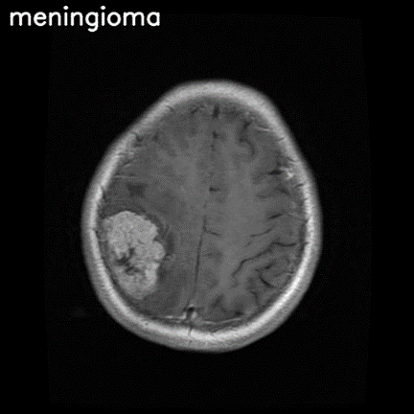
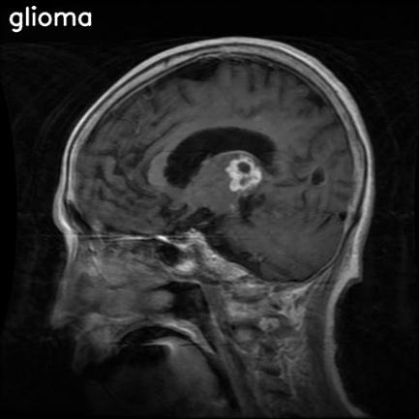
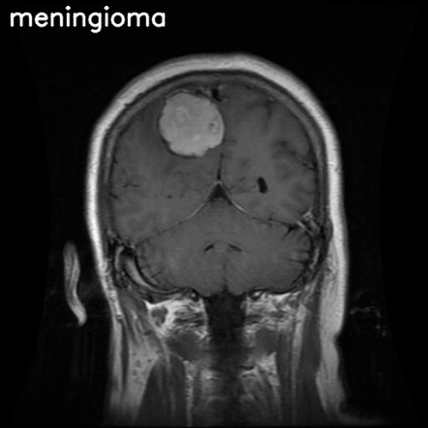
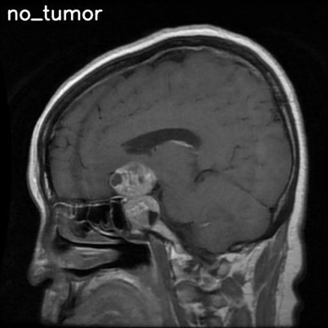
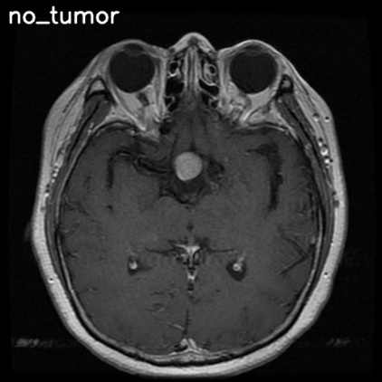
Representation of predictions

Slide 31
Limitations
Limited dataset
Limited types of tumors
Limited clinical validation
Limited comparisons between models
Hardware and computational Requirements

Slide 32
Future Work
improve brain tumor classification accuracy
will focus on specific tumor datasets such as meningioma, pituitary adenoma, and craniopharyngioma
intend to work on other medical imaging, such as CT scans and X-rays
aims to help clinicians make informed judgements about their patients' ultimate treatment

Slide 33
THANK YOU

