Slide 1
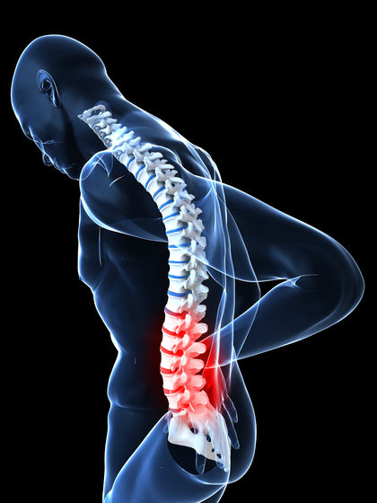
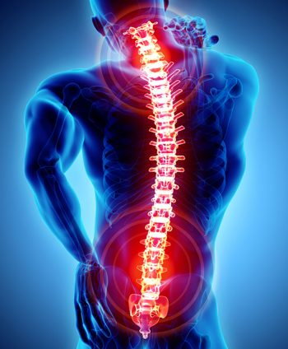
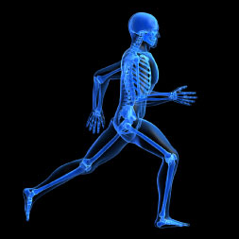
SOME DISORDERS AND ABNORMALITES ASSOCIATED WITH HUMAN SKELETAL SYSTEM…
Osteoporosis
Osteoarthritis
Slipped dis
THE FUNCTIONS OF THE SKELETAL SYSTEM…
Contributes to maintaining body composition and maintaining a straight body posture.
Contributes to movement.
Protects the internal organs of the body.
Absorbs shocks and vibration on the body

