Slide 1
02. User authentication & access control

Slide 2
Identification & authentication : -
Identification means Finding out who someone is and Authentication is a mechanism of verifying that identification.
Put another way, identification is claiming an identity; authentication is proving it.
Identification : “Who are you?” n individual used to recognized an individual user.
Authentication : “Who are you and how can you prove it?” The process of determining identity of a user or entity.

Slide 3
User names & passwards : -
A Username is a name that uniquely identifies someone on a computer system.
A computer may be setup with multiple accounts, with different usernames for each account.
A username is almost always paired with a password. A Password is a string of characters used to verify the identify of a user during the authentication process.
This username/password combination is referred to as a login, and is often required for users to log in to computer system.
Passwords are typically used in conjuncture with a username; they are designed to be known only to the user.
The use of strong password is thus essential in order to protect the security and identity.

Slide 4
Guessing a passward : -
Password guessing is the process of attempting to gain access to a system through the systematic guessing of passwords in an attempt to gain a login to a target system.
Password cracking is the process of recovering passwords. from data that have been stored in or transmitted by a computer system.
Cracking a password may seem like a next to impossible task, but we should surprised how easy it can be. There are dozens of password cracking programs in the market.
A directory attack is the guessing of a password by repeated trial and error.
In a brute-force attack, the attacker simply attempts to guess. the password by logically trying every possible combination.
The hybrid attack combines the directory & brute-force attack.
It is able to crack passwords much faster.

Slide 5
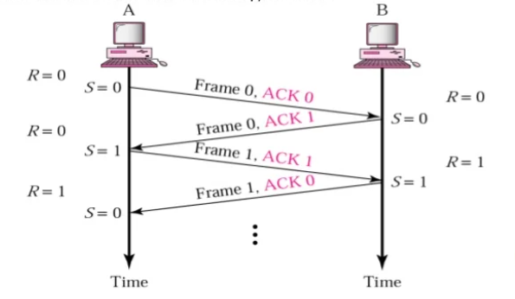
Passward attack : -
PIGGY BACKING : -
i) Piggybacking is actually when someone tags along with another person who is authorized to gain entry into a restricted area, or pass something.
ii) An attacker may back a communication channel to a computer. It gains access to a system via intervals of inactivity in another user's legitimate connection.
ii) This can happen in several ways, including piggybacking on public wireless networks and piggybacking into a password- protected system.
iv) The attack is also reffered as a between the line attack, the attacker will exploit network connection weaknesses and force entry into a system using a registered users connection.

Slide 6
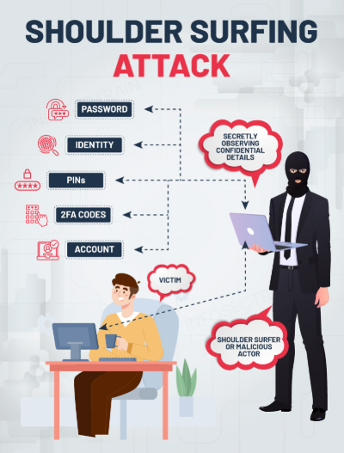
Shoulder surfing : -
Shoulder surfing is a type of social engineering technique to obtain information such as Personal Identification Numbers (PINs), passwords and other confidential data by looking over the victim's shoulder.
One way of stealing the password is standing behind an individual and notes the password while he she is typing if it (shoulder surfing).
Shoulder surfing is easily done in crowded places.
There are two types of shoulder-surfing attack :
1. Direct observation Attacks : - Information is obtained by a person who is directly monitoring the authentication sequence.
2. Recording Attacks : - Information is obtained by recording Woman the authentication sequence for later analysis to open device.

Slide 7
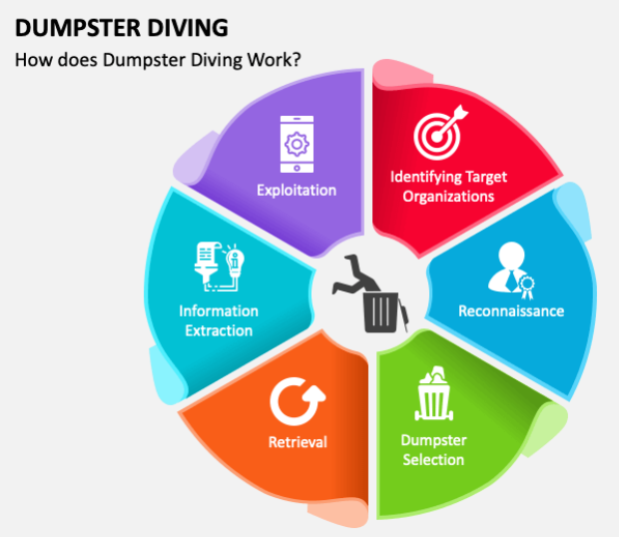
Dumpster diving : -
Dumpster diving refers to the act of literally climbing inside a trash dumpster and searching for information that could be a benefit to the hacker when he or she attacks the network.
The trash may be in a public dumpster or in a restricted area requiring unauthorized entry. There is a famous saying," one man's treasure." That means what one person might be of high value to the other.
It is used more often in the context of any method (especially physical method) by which a hacker might look for information about a computer network.

Slide 8
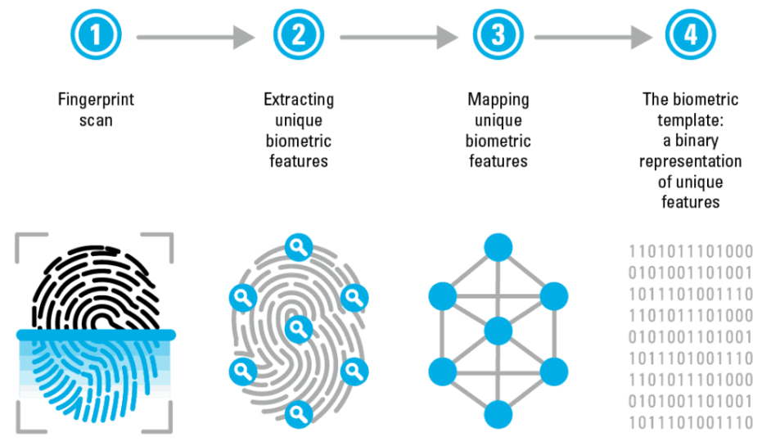
2.2 biometrics : -
Fingerprint identification number : -
i) Fingerprint recognition system is the most known and used biometrics solution to authenticate on biometric system because of the ten available sources and ease of acquistion.
ii) Every person has a unique fingerprint which is composed of ridges, grooves, and direction of the lines. The uniqueness of Siling fingerprint is determined by these features as well as minutiae features such as bifurcation and spots.
iii) Fingerprint matching techniques are of three types : -
1. Minutiae Based Techniques : - In these minutiae points are Found and then mapped to their relative position on finger.
2. Correlation Based Method : - It uses richer gray scale information. It overcomes problems of minutiae-based method, by being able to work with bad quality data.
3. Pattern Based (Image Based) Matching : - It compare the basic Fingerprint patterns (arch, whorl, and loop) between a stored template and a candidate fingerprint. Hob jobrod

Slide 9
Merits of fingerprint Recognition system : -
1. It is the most contemporary & economical method.
2. It is highly reliable and secure.
3. It works on a small template size, which speeds up the verifying process.
4. It consumes less memory space.
De-Merits of FingerPrint Recognition System : -
1. Scars, cuts or absence of Finger can hinder the recognition process.
2. The system can be fooled by using artificial finger of wax.
3. It involves physical contact with the system.
4. They leave the pattern of finger behind at the time of me entering sample.
Applications of Finger Paint Recognition system : -
1. Verification of driver-license authenticity.
2. Checking validity of driving license.
3. Borden Control/ Visa issuance.
4. Access control in organizations.

Slide 10
Handprint/hand geometry recognization : -
i) It includes measuring length and width of palm, surface area, length and position of fingers, and overall bone structure of the hand.
ii) A person's hand is unique and can be used to identify person from others.
iii) There are hoo Hand Geometry systems :
1. Contact Based : - a hand is placed on a scanner's surface. This placement is positioned by five pins.
2. Contact Less : - In this approach neither pins nor platform are required for hand image acquisition.

Slide 11
Merits of Hand Geometry Recognition system : -
1. It is sturdy and user friendly.
2. The changes in skin moisture or texture do not affect the result.
De-Merits of Hand Geometry Recognition system : -
1. Since the hand geometry is not unique, it is not.
2. It is effective in case of adults & not for growing children.
3. If candidates hand is with jewelry, plaster, or arthritis, it is likely to introduce a problem.
Applications of Hand Geometry Recognition System :
1. Nuclear power plants and Military.
2. Access Control.

Slide 12
Retinal scanning system : -
i) Retina is the lining layer at the back of the eyeball that covers 65% of the eyeball's inner surface. It contains photosensitive cells.
ii) Each person's retina is unique due to the complex network of blood vessels that supply blood.
iii) It is a reliable biometric as the retina pattern remains unchanged throughout the person's life, barring the patterns of persons having diabetes, glaucoma or some degenerative disorders.
iv) A low-intensity infrared light beam is casted into a person's eye for 10 to 15 seconds; this light is absorbed by the blood. Vessels forming a pattern of blood vessels during the scan. This pattern is then digitized & stored in the database.

Slide 13
Merits of Retinal Scanning System : -
1. It cannot be forged.
2. It is highly reliable as the error rate is 1 out of crore samples (which is almost 01).
De-Merits of Retinal scanning system : -
1. It is not very user friendly as the user needs to maintain. steadiness that can cause discomfort.
2. It tends to reveal some poor health conditions such hypertension or diabetes, which causes privacy issues.
3. Accuracy of the results is prone to diseases such as cataracts, glaucoma, diabetes, etc..
Applications of Retinal Scanning system : -
1. It is practiced by some government bodies such as CID, FBI.
2. Apart from security applications, it is also used for various do diagnostics.

Slide 14
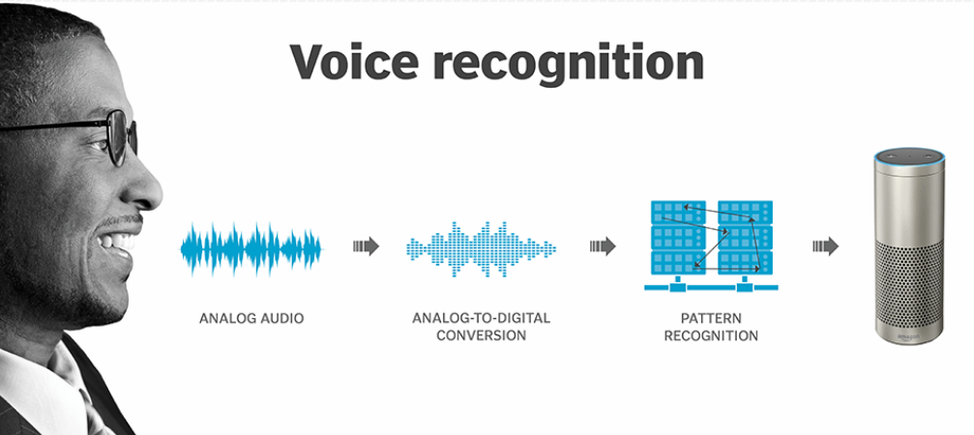
Voice pattern : -
Voice pattern analysis of the pitch, tone, cadence and Frequency of a person's voice.
Biometric technology reduces each spoken word to segments. Each segment several tones that can be captured in a digital format.
The tones collectively identify the speaker’s unique voice. print. voice prints are stored in databases in a manner similar to the storing of fingerprints or other biometric data.
A person's speech is subject to change depending on health and emotional state.

Slide 15
Merits of Voice Recognition system : -
1. It is non-invasive and user friendly.
2. Difficult to replicate or forge.
3. Enhances accessibility for individuals with physical disabilities
Demerits of voice Recognition system : -
1. Sensitive to background noise and voice changes.
2. vulnerable to recording-based attacks.
3. Accuracy may degrade with illness like cold, sore throat.
Applications of Voice Recognition system : -
1. For unlocking smartphones and tablets.
2. Call center authentication to verify customer's identities without PINS or passwords.
3. Banking and Financial services.
4. Access control systems in secure facilities or workplaces.

Slide 16
Signature & writing pttern : -
Signature and writing patterns biometrics are forms of behavioral biometrics that analyze an individual's unique handwriting and signature characteristics to verify their identity.
It focus on how a person writes, rather than what they write, making them distinct from traditional text analysis.
It takes into account factors such as: Speed, Pressure, stroke order, Pen tilt, Timing.
Dynamic Signature verification (DSV) is often integrated with. other biometric methods.

Slide 17
Merits of signature & writing Pattern + Applications : -
1. Used in banking and legal documents with user familiarity.
2. Electronic signature systems.
3. Writting pattern can be used in forensic document examination fraud detection, etc.
Demerits of Signature & writing Pattern : -
1. Handwriting and signature can vary depending on mood, health or even writing surface which decrease reliability.
2. Though difficult to replicate, Skilled Forgers could still pose a threat.

Slide 18
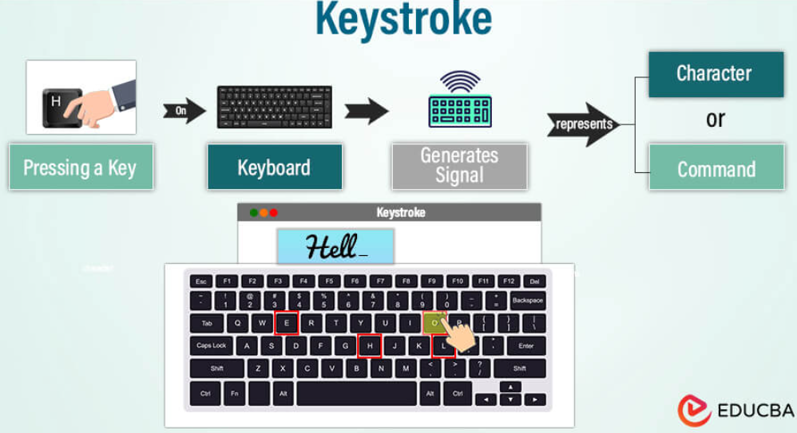
Keystrokes : -
A keystroke biometric system identifies individuals based on their unique typing patterns.
Every person has distint ways of typing, such as how long they press keys (dwell time) and the intervals between key presses (Flight time).
These characteristics can be recorded, analyzed, and used as a biometric identifier.
It is often used in multi-factor authentication systems to provide an additional layer of security.

Slide 19
Merits of keystroke : -
1. Ongoing verification without interrupting the user.
2. It works passively.
3. Low-cost as it requires no specialized hardware.
De-Merits of Keystroke : -
1. Factors like fatigue, stress, or injury can affect a user's typing style.
2. Not Accuracy as other biomeltic methods like fingerprint or facial recognition.
Applications of Keystroke : -
1. Enhancing the security of password-based authentication.
2. Identifying potential fraud.
3. Monitoring for ongoing verification throughout a session.

Slide 20
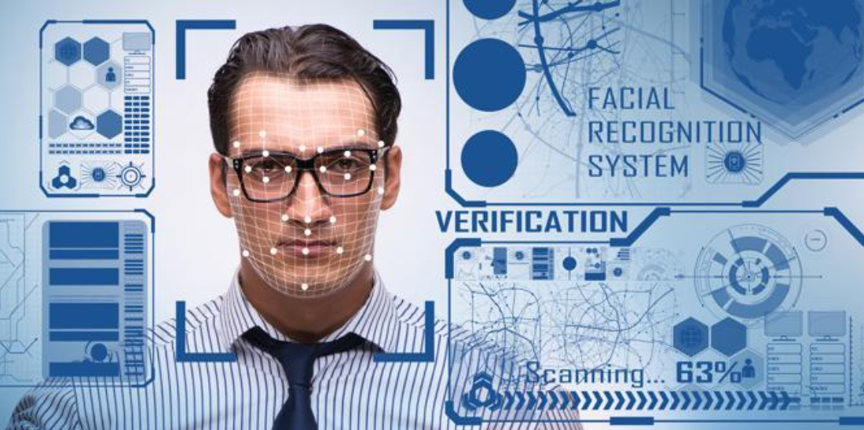
Facial recognition : -
Facial recognition is based on determining shape and size of jaw, chin, shape and location of eyes, eyebrows, nose, lips, and cheekbones.
2D facial scanners start reading face geometry & recording on the grid.
The facial geometry is transferred to the database in terms of points.
The comparison algorithms perform face matching and come up with the results.

Slide 21
Merits of facial Recognition system : -
1. It offers easy storage of templates in database.
2. It reduces the statistic complexities to recognize face image.
3. It involves no physical contact with the system.
Demerits of Facial Recognition system : -
1. facial traits change over time.
2. Uniqueness is not guaranteed (in case of twins).
3. Requires adequate lighting to get correct input.
Applications of facial Recognition system : -
1. Verification for access control.
2. Criminal Identification.
3. Surveillance.

Slide 22
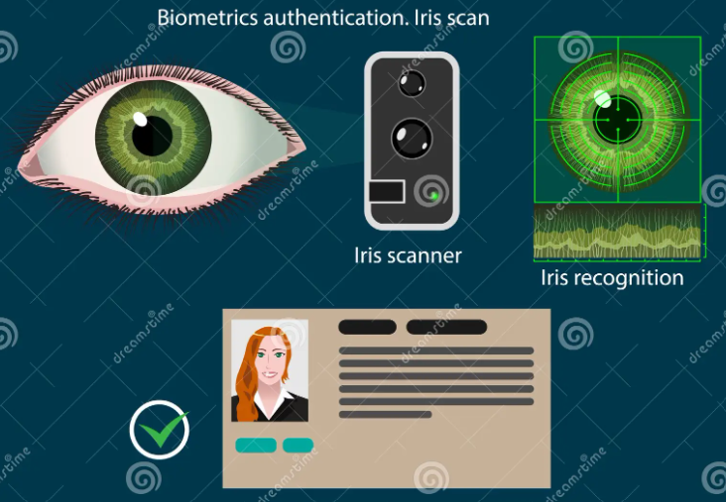
Iris recognition : -
This recognition works on the basis of iris pattern in human eye. The iris is the pigmented elastic tissue which controls the diameter of pupil.
In adult humans, the texture of iris is stable throughout their lives.
The iris patterns of left and right eyes are different. The iris patterns and colors change from person to person.
iv) It involves taking the picture of iris with a capable camera, storing it, and comparing the same with the candidate eyes using mathematical algorithms.

Slide 23
Merits of Iris Recognition : -
1. It is highly accurate as the chance of matching two iries.
2. It is highly scalable.
3. The candidate need not remove glasses or contact lenses.
4. No physical contact with the system.
5. Instant verification (2 to 5 seconds) because of small template size.
De-Merits of Iris Recognition : -
1. Iris scanners are expensive.
2. High quality images can fool the scanner.
3. A person is required to keep head very still for accurate scanning.
Applications of Iris Recognition : -
1. National Security and Identity card such as Adhaar card.
2. Google uses iris recognition for accessing their data centers.

Slide 24
2.3 Access control : -
i) Access control is an important tool of security to protect data and other resources.
ii) The access control mechanism refers to prevention of unauthorized use of a resource.
iii) Access Control List (ACL) is a set of rules that define security policy. These ACLS contain one or more Access Control Entries CACEs), which are the actual rule definition themselves.
iv) These rules can restrict access by specific user, time of day, IP address, function, or specific system from which a for access attempt is being made.

Slide 25
Authentication mechanism : -
In Authentication -
1. A Brute force attack is an automated process of trial and error used to guess a person's username, password, credit- card number of cryptographic key.
2. Insufficient Authentication occurs when a website permits an attacker to access sensitive content or functionality without shaving to properly authenticate.
3. Weak password recovery validation is when an attacker to illegaly obtain, change user's password.

Slide 26
Principle of access control : -
1. Authentication : - The act of proving an assertion, such as the Identity of a person or computer user. It might involve. validating personal identity documents, verifying the authencity of a website with a digital certificate, or slow checking login credentials against stored details.
2. Authorization : - The function of Specifying access rights or privileges to resources. for example, human resources staff are normally authorized to access employee record and this policy is usually Formalized as access control rules in a computer system.
3. Audit : - Frequently used as part of access control to enforce the principle of least privelege. Over time, users can end up with access they no longer need, eg. when they change roles. Regular audits minimize this risk.

Slide 27
Policies : -
There are three types of access control system are : -
1. Discretionary Access Control (DAC).
2. Mandatory Access Control (MAC).
3. Role-Based Access Control (RAC).

Slide 28
1. Discreationary access control (DAC) : -
When user set an access control mechanism to allow or deny access to an object (system resource), such a mechanism is a Discretionary Access Control (DAC).
The Discretionary Access Control is also called as an Identity- Based Access Control (IBAC).
The DAC policies include the file permissions model implemented by nearly all operating systems.
Discretionary Access Control List (DCL) determines which Users and groups can access the object (system resource) for operations. It consists of a list of Access Control Entries (ACEs).

Slide 29
2. Mandatory access control (Mac) : -
When a system mechanism controls access to an object and an individual user cannot alter that access, then such control is called as Mandatory Access Control (MAC).
Mandatory Access Control (MAC) is also called as Rule-based access b control.
MAC is a more restrictive scheme that does not allow users to define permissions on files, regardless of ownership. Instead, security decisions are made by a central policy administrator.
Each security rule consists of a subject, which represents the party attempting to gain access, an object, referring to the resource being accessed, and a series of permissions that define the extent to which that resource can be accessed.

Slide 30
3. role-based access control (RBAC) : -
Role-Based Access Control (RBAC) is a method of regulating access to computer resources based on the roles of individual users within an enterprise.
In RBAC, the rights and permissions are assigned to roles instead of individual users.
RBAC is also called as Non-Discretionary Access control (NDAC).
The RBAC framework provides administrators with the capability to regulate who can perform what actions, when, from where, in what order, and in some cases under what relational circumstances.

