Slide 1
03. Cryptography

Slide 2
3.1] introduction of cryptography : -
Cryptography is the science of securing information by converting it into an unreadable format, so that only authorized users can understand it.
It ensures confidentiality, integrity, authentication, and non-repudiation of data.
Types of Cryptography : -
1. Symmetric Key Cryptography.
Example : DES, AES.
2. Asymmetric Key Cryptography.
Example : RSA.
3. Hash Functions.
Example : SHA, MD5.

Slide 3
Plain Text : -
i) Plain Text refers to the original, unencrypted message or data that is readable and understandable.
ii) It is the data to be protected during transmission.
Cipher Text : -
i) Cipher text is the result of applying a encryption algorithm to the plain text, transforming it into an unreadable and secure format.
ii) The Cipher text is not guarded, it flows on public channel.
iii) It can be intercepted by anyone who has access to the communication channel.

Slide 4
Cryptography : - PT CT
Cryptography is the science and art of securing communication by converting Plain text into cipher text through the use of algorithms and keys.
Characteristics of cryptography : -
1. The type of operations used for transforming plaintext to cipher text.
2. The number of keys used.
3. The way in which the plaintext is processed.

Slide 5
Cryptanalysis : - CT PT
Cryptanalysis is also known as Codebreaking.
It is a process of trying to break any cipher text message to obtain the original plain text message.
The person attempting a cryptanalysis is called as a cryptanalyst.
The goal of a cryptanalyst is to find some weakness or insecurity in the cryptographic scheme to prevent obtaining plaintext without keys.
Types of attacks within cryptanalysis : -
1. Ciphertext-only attack.
2. Known-plaintext attack.
3. Chosen-plaintext attack.
4. Chosen-ciphertext attack.
5. Chosen-text attack.

Slide 6
Cryptology : -
Cryptology is the art and science that deals with both cryptography and cryptanalysis.
It involves the study of secure communication techniques.
Today we need cryptology because of the everyday use of computers and the Internet.
It is important for businesses to be able to protect the information in their computers.

Slide 7
Encryption : -
Encryption is the process of converting plain text into cipher text using a specific algorithm and an encryption key.
It is a mathematical process that produces a cipher-text for any given plaintext.
The goal is to protect the confedentiality and integrity of information.
Encryption key : It is a value that is known to the sender. The sender inputs the encryption key into the encryption algorithm along with the plaintext in order to compute the cipher-text

Slide 8
Decryption : -
Decryption is the reverse process of Encryption.
It involves converting cipher text back into plain text using a decryption algorithm and the corresponding decryption key.
It is a mathematical process that produces a plaintext for any given cipher-text.
Decryption Key : It is a value that is known to the receiver. The decryption key is related to the encryption. key, but is not always identical to it.

Slide 9
3.2] substitution & transposition techniques : -
1. Substitution Techniques : -
A Substitution cipher changes characters in the plaintext to produce to ciphertext.
A substitution technique is one in which the letters of plaintext are replaced by other letters or by numbers or symbols.

Slide 10
1] Caesar cipher : -
Caesar Cipher is a simple substitution cipher where each alphabet in a message is replaced by an alphabet THREE places down the line.
It is named after Julius Caesar, who is historically known to have used this encurruption algorithm.
Caesar cipher is suspectable to a statistical "ciphertext only" attack.
Demerits of Caesar cipher : -
1. The encryption and decryption algorithms are known.
2. There are only 25 keys to try.
3. The language of the plaintext is known and easily recognizable.

Slide 11
2] monoalphabetic cipher : -
Monoalphabetic Cipher is the modified version of caesar cipher.
Rather than substituting according to regular pattern, any letter can be substituted for any other letter, as long as each letter has a unique substitute left and vice versa.
The shift value changes for each letter based on a pre- defined Key. The key might specify different shift values for different letters.

Slide 12
2. Transposition techniques : -
A transposition cipher rearranges the characters in the plaintext to form the cipher text.
The letters are not changed.
Simple Columnar : -
In this transposition technique, the plain text is written horizontally, and then read vertically to create the cipher text.
The order of reading is determined by a key, which specifies the columns to be read in a certain order.
The key is typically a word or a sequence of numbers.
The number of letters in the key determines the no. of columns in the transposition quid.

Slide 13
Steganography : -
Steganography is derived from the Greek that originally means: steganos = secret-graphy = writing i.e. "to hide in plain sight”.
It is defined as the art and science of communicating in such a way that the presence of a message cannot be detected.
The other major use of steganography is for copyright marketing, which can be further divided into watermarking and fingerprinting.
Steganography provides a means of secret communication which cannot be removed without significantly altering the data in which it is embedded.

Slide 14
Procedure : -
1. Choose the Cover Medium : -
- Select the medium (image, audio, video, text) in which the secret message will be hidden.
- The most common medium is an image (eg. PNG, JPEG)
2. Prepare the Secret Data : -
- The data that needs to be hidden. could be plain text, an image, or any other kind of data.
- IF desired, the data can also be encrypted beforehand to enhance security.
3. Encoding Process (Hiding the Data) : - Choose a method for embedding the secret data into the cover medium. Some common techniques include :
Least significant Bit (LSB) Substitution.
Frequency Domain Techniques.
Spread Spectrum.
Masking and Filtering.

Slide 15
4. Generate the stego–Medium : -
- After embedding, the modified file is called the stego-medium (stego-image, stego-audio).
- This file should appear visually the same as the original, concealing the fact that any data is hidden within it.
5. Transmission or Storage : -
- The stego-medium can now be transmitted over a communication channel (email, social media ete) or stored for later retrieval.
- It should appear as a regular file.
6. Decoding (Extraction of Hidden Data) : -
- The recipient needs to know the steganographic technique used to hide the data.
- Using the reverse process of the embedding technique, extract the secret data from the stego-medium.

Slide 16
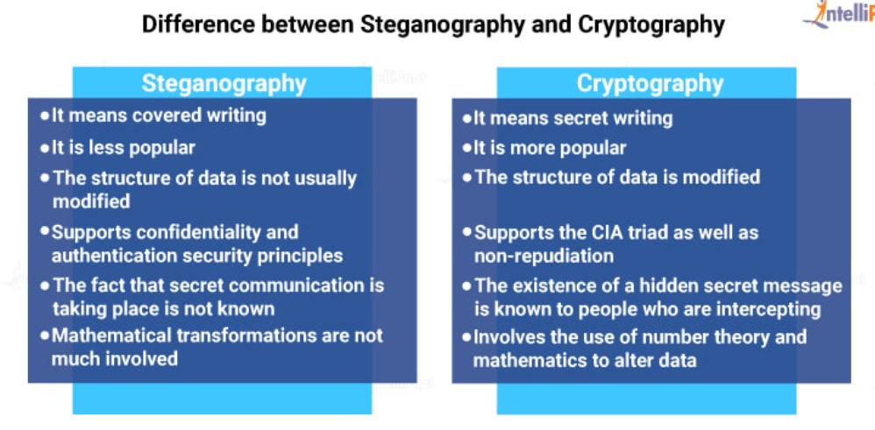
Difference between steganography & cryptography : -

Slide 17
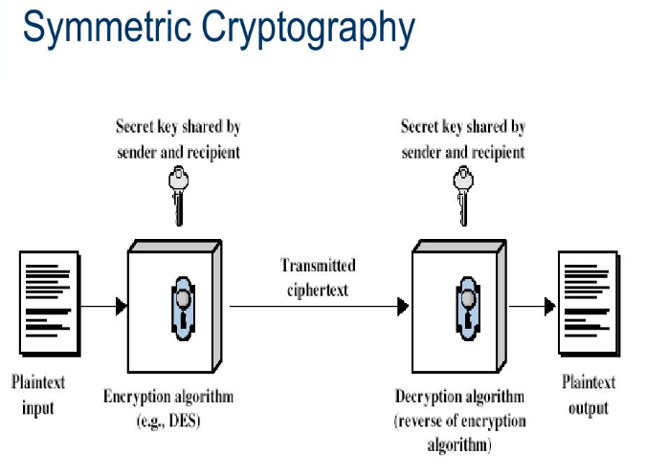
3.4] symmetric & asymmetric cryptographt : -
Symmetric Cryptography : -
The encryption process where same keys are used for encrypting and decrypting the information is known as symmetric-key Encryption.
The study of symmetric crypto-systems is refferred to as symmetric cryptography.
Some well-known examples of symmetric key encryption. methods are - Digital Encryption standard (DES), Triple-DES, IDEA, and BLOWFISH.
The key is shared.

Slide 18
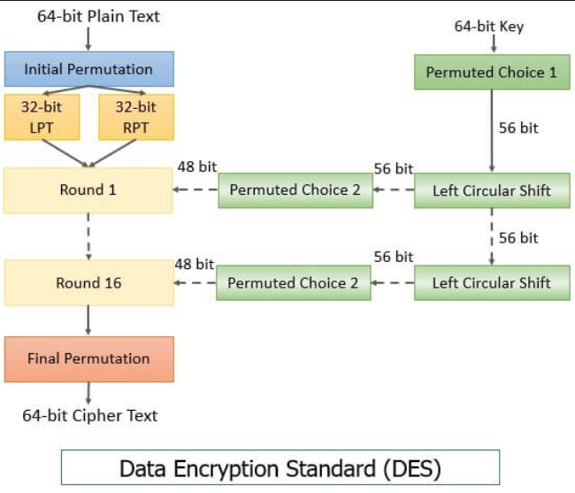
2. Des (data encryption standard) algorithm : -
DES is a symmetric key block cipher which encrypts data in 64-bit block.
The key size is 56-bit.
The encryption process is made of two permutations i.e. P-boxes, which is called initial and final permutation.
DES uses both transposition and substitution. It's input, output and key are each 64-bits long.
The cipher consists of 16 rounds or iterations Each rounds uses a seperate key of 48-bits.
Mainly used in Electronic code Block (ECB), Cipher Block Chaining mode (CBC), CFB (Cipher Feed Back).

Slide 19
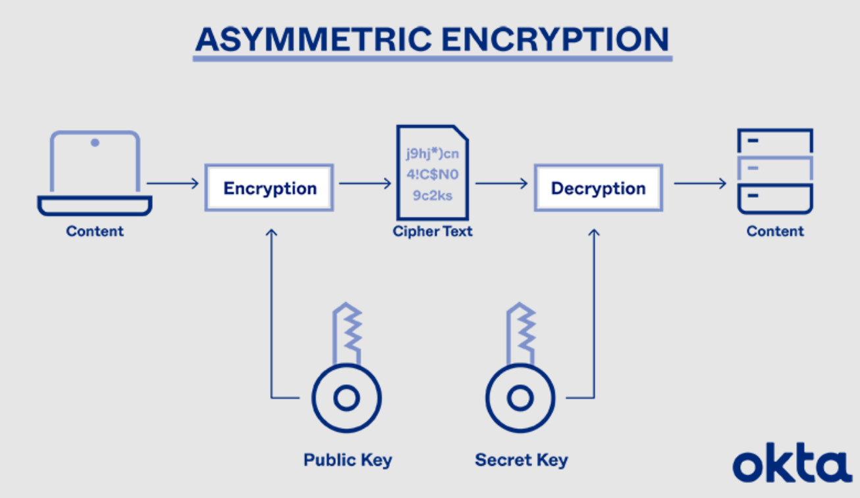
Asymmetric cryptography : -
An asymmetric-key cipher uses two keys : one private (to encrypt data) and one public (to decrypt data).
It is also known as Public key cryptography.
Users get the key from an certificate Authority.
Both sender and Receiver has to share their public keys for encryption and has to use their Private Key for Decryption.
Private key is not shared and kept hidden.
These keys are generated together.

Slide 20
Digital signature : -
A digital signature is an authentication mechanism that enables the creator of a message to attach a code that acts as a signature.
The sender uses their private key to generate a digital signature.
Typically, a hash function is applied to the message create a message digest, which is then encrypted with the sender's private key to produce the digital signature.
The receiver uses the sender's public key to verify the a signature.
Private key - Used for making digital signature.
Public key - used to verify the digital signature.

Slide 21
Example : -
I agree.
efcc61clc03db8d8ea85695445co73c8140ed755.
- This is a digital signature.
- Digital signature are numbers.
- They are document content dependent.
Advantages : -
- Easy for the signed to sign a message
- Easy for anyone to verify a message
- Hard for anyone to forge a digital signature.
- Provides Authenticity, Integrity and Non-repudiation

Slide 22
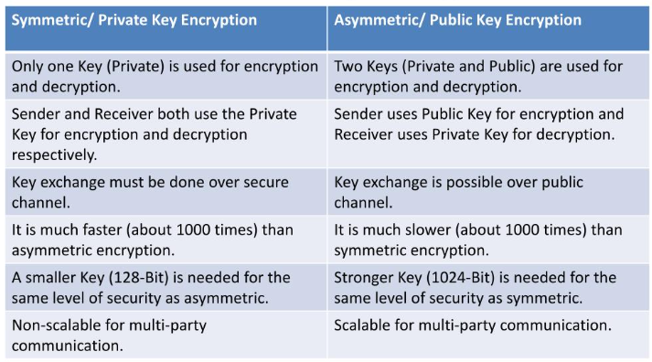
Difference between : -

