Slide 1
Bhumika sunil shedhe
01. BASICS OF SOFTWARE TESTING

Slide 2
Software Testing : -
Software Testing Definition : Software testing is a method used to verify if the actual software product meets the expected requirements and to ensure it is defect - free.
2. Goal of Software Testing : The primary goal is to identify errors, gaps, or missing requirements when compared to the actual requirements.
Role of a Software Tester : A software tester is responsible for finding bugs as early as possible and ensuring they are fixed.
Methods of Testing : -
Manual Testing :
Automated Testing :

Slide 3
What is quality ?
1. Quality can be understood in several ways, all revolving around meeting needs and expectations.
2. Meeting Customer Needs : Quality is fundamentally about satisfying the needs and expectations of customers, considering aspects like functionality, design, reliability, durability, and price of a product or service.
3. Client Satisfaction : It is the ability of a product or service to fulfill the needs and expectations of the client.
4. Degree of Excellence : Quality can be concisely defined as "a degree of excellence.“
5. Conformance to Requirements : In the context of software, high-quality software typically conforms to the user's requirements.

Slide 4
Software quality :-
1. Software quality measures how well software is designed and how well it conforms to that design.
2. It also encompasses various non-functional aspects crucial for a reliable and efficient system.
Definition : Software quality is assessed by two main factors :
Quality of Design : This refers to how well the software is initially conceptualized and structured to meet its intended purpose.
Quality of Conformance : This measures how accurately the developed software adheres to the established design specifications.

Slide 5
role of testing : -
COST EFFECTIVE : Testing ant IT project on-time helps you to save your money for long term. In case, if the bug cought in the earlier stage of testing, it cost less to fix.
SECURITY : It is the most vuherable and sensitive benefit of software testing. It helps in removing risks and problems earlier.
PRODUCT QUALITY : Testing ensures a quality product is delivered to customers.
CUSTOMER SATISFACTION : The main aim of any product is to give satisfaction to their customers. UI/UX testing ensures the best user experience.

Slide 6
terminologies in software testing : -
DEFECT : A defect is the difference between the expected and actual results, representing a deviation from customer requirements. Defects are typically found after the application is in production and are identified by testers and resolved during the development phase of the SDLC (Software Development Life Cycle).
FAILURE : Failure is the accumulation of multiple defects that ultimately lead to a software failure and a loss of information. Failures are detected by end-users when they encounter a specific issue in the software.
ERROR : An error is a mistake made in the code that prevents the code from executing or compiling. Errors can be syntactic, UI-related, calculation-related, or even hardware-related.
FAULT : A fault is a state that causes the software to fail in accomplishing its essential function. It is an anomaly in the software that may lead to incorrect behavior. Faults can be functional, logical, or security-related.
BUG : A bug is an informal name for a defect. While a defect is an imperfection in the software, a bug is a manifestation of that defect when the code is written incorrectly (e.g., missing code, wrong code, or extra code). The most common type of bug is a mistake.

Slide 7
OBJECTIVES OF TESTING : -
1. Executing a program with the intent of finding an error.
2. To prevent the founded error.
3. To check if the system meets the requirements of the users.
4. To check if the system does what it is expected to do.
5. Ensures quality of the product.
6. To evaluate software perfoemance, usability & reliability.
7. Finding an yet undiscovered error.
8. Ensuring that it satisfies business and system requirement specifications.
9. Gaining customers confidence in software correctness.
10. To Check if system is “Fit for purpose.”

Slide 8
Test cases : -
A Test Case is a fundamental concept in software testing, defined by the following characteristics :
Definition : A Test Case is a structured set of actions designed to verify a specific feature or functionality of a software application.
Components : It typically includes essential elements such as test steps, test data, preconditions, expected results, and actual results, all developed for a specific test scenario to ensure requirement verification.
Documentation : A Test Case serves as a detailed document outlining all possible inputs and the navigation steps required to execute the test.
Defect Reporting : It plays a crucial role in defect reporting by enabling testers to link identified defects directly to their corresponding Test Case IDs, facilitating efficient tracking and resolution.

Slide 9
entry and exit criteria : -
When to start testing ? ( Entry criteria )
An early start to testing reduces the cost & time to rework & produce error-free software that is delivered to the client.
Testing can be started from the requirement gathering phase & continued till the deployment of the software.
During the requirement gathering phase, the analysis & verification of requirements are also considered as testing.
Reviewing the design in the design phase with the intent to improve design is also testing.
Testing performed by a developer on completion of the code is also categorized as testing.

Slide 10
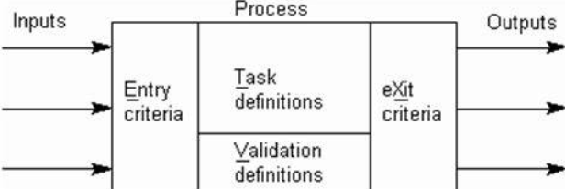
when to stop testing ? ( exit criteria )
Testing Deadline.
Completion of test case execution.
Completion of functional & code coverage to certain point.
Bug rate falls below a certain level & no high-priority bugs are identified.
Management Decision.

Slide 11
Skills for software tester : -
Programming & Scripting Knowledge.
2. Understanding of database & SQL.
3. Communication Skills.
4. Problem Solving Skills.
5. Understanding of business & Domain Knowledge.
6. Collaboration & Team Work.
7. Attention to Details.
8. Analytical Thinking.
9. Knowledge of testing tools.
10. Explores & Creative.

Slide 12
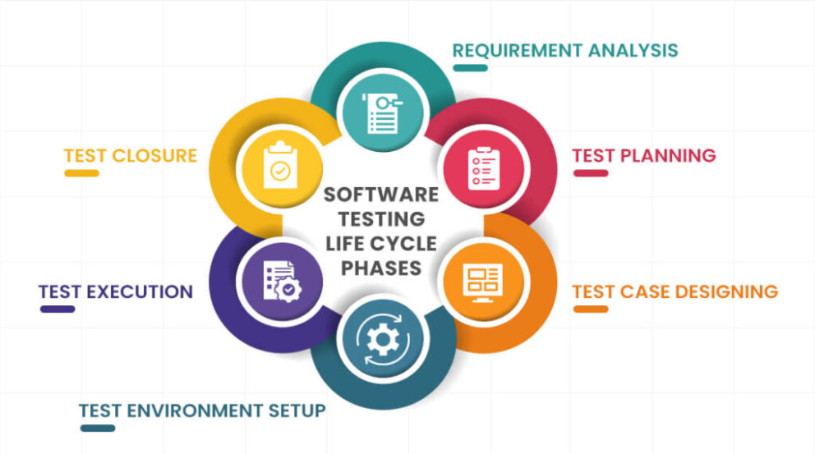
software testing life cycle : -

Slide 13
1. Requirement analysis : - When the system requirement document is ready & shared with the stake holders, the testing team starts hight level analysis concerning the AUT (Application Under Test. )
2. Test planning : - Test team plans the strategy & approach.
3. Test case designing : - Develop the test cases based on scope & criteria.
4. Test environment setup : - When integrated environment is ready to validate the product.
5. test execution : - Real-time validation of product & finding bugs.
6. test closure : - Once testing is completed, matrix, reports, results are documented.

Slide 14
Quality assurance : -
ⅰ) Quality Assurance is also known as QA Testing. It is defined as an activity to ensure that an organization is providing the best product to the customers.
ii) Quality Assurance focuses on process standard, project audit, and procedures for development.
iii) QA is also known as a set of activities designed to evaluate the process to produce a product.
iv) It yields high quality product offerings that build trust and loyalty with customers.

Slide 15
Quality control :-
Quality control also known as a QC is a sequence of tasks to ensure the quality of software by identifying defects & correction of defects in the developed software.
The main purpose of this process is to correct all types of defects before releasing the software .
It is done by eliminating sources of problems through the corrective tools.
The responsibility of quality control is of specific team which is known as the testing team.

Slide 16
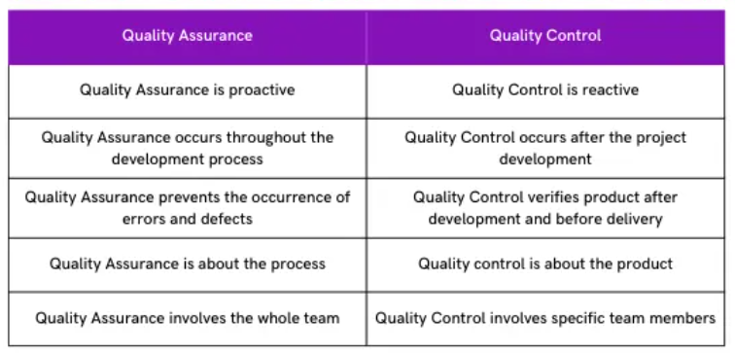
Difference Between Quality assurance & quality control

Slide 17
verification : -
Verification is the process of confirming something. Here, confirming that the software meets its specifications.
The verification process involves activities like reviews, walk-throughs & inspection.
It ensures that the product is built according to the requirements & design specifications.
It is also known as static testing, where we are ensuring that “ we are developing the right product or not. ”

Slide 18
validation : -
Validation is the process of confirming that the software meets the user’s requirements.
Validation testing ensures that the product actually meets the client’s needs.
It is a testing where tester perform functional & non - functional testing.
Validation testing is also known as dynamic testing, where we are ensuring that “ we have developed the product right.”

