Slide 1
04. Test management

Slide 2
Test planning : -
A test plan is a detailed document that describes the test strategy, objectives, schedule, estimation, deliverables and resources required to perform testing for a software product.
The test plan serves as a blueprint to conduct software testing activities as a defined process, which is minutely monitored and controlled by the test manager.
Types of Test Plans : -
Master Test Plan : - High-level dowments covering the overall testing approach for a project.
2. Testing Level Specific Test Plan : - Approach for testing at specific level, such as unit, integration, system or acceptance testing.
3. Testing Type specific Test Plan : - for major testing like performance and security.

Slide 3
stlc preparing & test plan : -
Preparing the test plans refers to the process of organizing and outlining the steps, objectives and scope necessary to execute testing effectively.
It is a critical phase in testing that lays and ground work for the actual testing process.

Slide 4
-
Test Plan ID: Unique Identifier for Test Plan.
Test Plan Name: Title or name of the Test Plan.
Version: Version number of the Test Plan.
Date: Date when the test plan was created or updated
Author: Name of the person who created the test plan.
Objective: Goals and objectivies of the testing process.
Scope: Description of the features, functionalities or areas to be tested.
Test strategy: Overall approach to testing, induding types of tests and technique used.
Test criteria: Criteria for passing or failing the tests.
Test Deliverables: Documents and artifads that will be produced, such as test cases, test scripts and test reports.
Testing Schedule: Timeline for testing activities, include start and end elates.
Resource Requirements: Resource needed for testing, induding hardware, software and personnel.
Risk Analysis: Potential risks and their mitigation strategies related to the testing process.
Assumptions: Assumptions made during the creation of test plan.
Dependencies: Dependensies that could impact the testing process, such as external systems or components.
Approval: sign-off or approval section for stakeholders to validate the test plan.
Figure : test plan template

Slide 5
Scope management : -
The boundaries of what will and will not be tested comer under scope Management.
Scope Management in test planning ensures that the testing effort is focused, well defined, and aligned with project objectives.
Scope Includes : -
1. Objectives & Requirement : - clearly defined goals and specific stakeholder requirements for the project.
2. Constraints & Limitations : - Boundaries like time, budget & available resources that restrict: the scope.
3. Assumptions : - Expectations used for planning purposes (eg. resource availability, technology reliability.
4. Risk Involved : - Identification of risks, their potential impact and the action plan to mitigate them.

Slide 6
deciding test approach : -
The test approach defines the overall strategy for planning, desigining and executing tests.
1. Analytical Approach : -
a) Risk-Based strategy : - Tests are planned, prioritized, and executed based on identified risks.
b) Analytical-Based Strategy : - Requirements analysis is used to plan, estimate, and design tests.
2. Model-Based Approach : - Model (formal or Informal) are created during the design phase. The system under test is compared against these models to validate functionality.
3. Methodical Approach : - A pre-planned structured strategy is followed, such as adhering to standards like 150 9126.
4. Process or standard compliant Approach : - Utilizes external standards or frame works to guide testing efforts Ce.g. compliance testing).
5. Regression-Averse Approach : - Focuses on Reusing existing automated tests to ensure no new defects are introduced in previously working function.

Slide 7
setting–up criteria for testing : -
Test Criteria is a standard or rule on which a test procedure or test judgement con be based.
Types of Test Criterias-
1. Pass and Fail Criteria : -
- Specifies conditions under which a test is considered passed or failed.
- These criteria are essential for evaluating the correctness and functionality of the system under test.
2. Suspend Criteria : -
- Identifies conditions under which testing should be temporarily halted.
- For example, severe defects, unavailability of critical resources, or instability of the test environment.
3. Resume criteria : -
- Defines conditions for resuming testing after it was suspended.
- This may include resolving blocking issues, stabilizing the test environment, or completing prerequisite tasks.

Slide 8
identifying responsibilities : -
The testing environment requires a collaborative effort where roles and responsibilities are clearly defined to ensure the process is efficient and comprehensive.
1. Specify the number of testing staff and their roles : – Define how many individuals are needed and what specific roles they will play, such as test leads, testers, or test coordinators.
2. Identify people responsible for acceptance testing : - Determine who will oversee and execute the acceptance testing phase to ensure product meet requirements.
3. Identify the test team for the test environment : – Indude roles such as developers, testers, operational staff, and testing service providers who will be involved in setting-up, maintaining and using the test environment.

Slide 9
staffing needs : -
1. Test Manager/Lead : -
- Skills : strong project management, communication, leader- ship, and problem-solving skills.
2. Test Analysts/Engineers : -
- Skills : knowledge of testing methodologies (Functional, regression, performance), testing tools (JIRA, Test Rail), and software under test..
3. Performance Test Engineers : -
- Skills : familiarity with Performance Testing tools (JMeter, LoadRunner), system architecture & performance metrics.
4. Security Testers : -
- Skills : knowledge of security testing tools (ZAP, Burp Suite), security protocols and potential threats.
5. Environment/ Infrastructure Support : -
- Skills : Knowledge of system configuration, cloud environments, and environment setup tools.
6. Subject Matter Experts (SMEs) : -
- Skills : In-depth knowledge of the application or domain being tested.

Slide 10
training needs : -
1. Testing Tools and Technologies : -
- Training : Provide hands-on workshops or courses on specific tools like JIRA, Test Rail, Selenium, JMeter, etc.
2. Test Methodologies and Best Practices : -
- Training : Conduct Training sessions on testing methods.
(Agile, Waterfall, v-Model) and best practices for test case design, defect management and risk-based testing.
3. Automation Training : -
- Training : Provide training in programming languages, automation tools and integration of automated tests into the CI/CD pipeline.
4. Performance and security Testing : -
- Training : offer specialized courses on load testing, stress testing, and vulnerability scanning tools and techniques.
5. Domain-specific Knowledge : -
- Training : Arrange for sessions with SMEs to provide insights into the application's functionality and business requirements.
6. Defect Management and Reporting : -
- Training : Hold workshops on defect management tools and ensure consistency in reporting defect sevirity and impact.

Slide 11
Resource requiremeents : -
Test Manager has the responsibility to estimate the resources.
All the team should come and decide along with the Test Manager.
If resources are underestimated it will directly affect the product.
Some of Resources Required : -
1. Machine requirements like RAM, Processor, Hard disk.
2. Supporting S/W, OS.
3. No. of licence Copies.
4. Supporting tools like configuration management tools, test generators, compilers, etc…

Slide 12
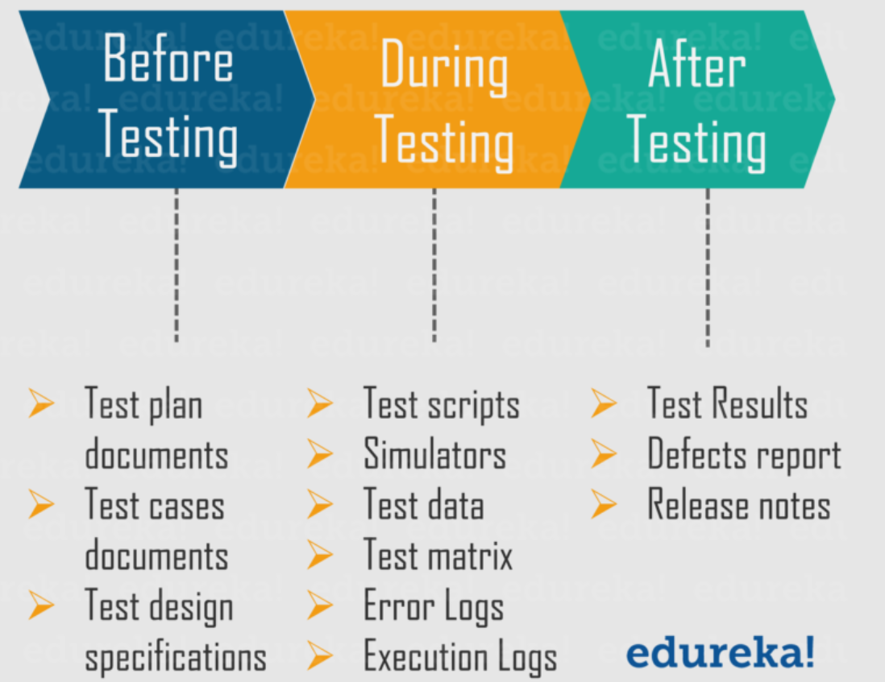
Test deliverable : -
Test deliverable is the test of all the documents, tools and other components that has to be developed & maintained in support of the testing efforts.
There are different test deliverable at every phase of the software development lifecycle.

Slide 13
Testing task : -
Testing Tasks uses 'Work Break Down' structure i.e. First various tasks are identified and identify the dependency then among them.
Following things should be done : -
- Identify skills for testing.
- Determine size estimation for testing - Loc (Line of code) or FP (function Points).
- Determine effort estimation for people - Days/months/years.

Slide 14
Test management : -
Test Management involves managing all aspects of the testing process, including tools, standards, an'd: people..
It allows different teams to plan, develop, execute and access all testing activities :
1) Standards : -
a) Internal standards.
b) External standards ( customer, National, International ).
2) Test Infrastructure Management.
3) Test People/Team Management.

Slide 15
choice of standards : -
a) Internal standards : -
- Developed by software development organization.
- Used for internal purposes.
- It may derived from national or international standard.
b) External standards : -
- Made by other entity than the organization.
- These are Heated as legal requirements for product.
- Types of external standards :
(1) Customer Standards : -
- Defined by Customers to suppliers.
(2) National standards : -
- Defined by regulatory authorities.
- Applicable to a producer & consumers.
- Violating standards leads to legal actions.
(3) International standards : -
- Defined Globally.
- Applicable to all producer & consumers TOM.
- Eg. ISO 29119, IEEE 829 Standards.

Slide 16
test infrastructure management : -
Test Infrastructure Management refers to the processes, tools and resources involved in setting up, maintaining, and managing the environments required for testing.
More stability, continuity and reliability is provided to automation testing by providing stronger infrastructure.
It is used for supporting automated & manual testing.
Testing In Frastructure indudes : -
1. Test plan document.
2. Test Cases ( Planned and Designed ).
3. Test Environment ( Backend & Frontend ).
4. Defect Tracking Database.
5. Version control system.
6. Requirement tracing tools.
7. Test Labs.

Slide 17
Test process management : -
Test team is formed with people with various skill and experience level.
Thus, to maximize quality their skills need to manage along with the people which can be done by test leader.
It means managing the team of people involved in the software testing process.
Test managers or leads must plan, organize, and control testing staff to ensure the testing activities are completed efficiently.
Test People Management is the process of organizing, leading, and coordinating testing team members by assigning roles, responsibilities, and tasks, while motivating them and resolving conflicts to achieve effective and efficient testing outcomes.
It covers : -
- Resource allocation ( who will test what ).
- Skill management ( training testers in required tools/techniques ).
- Motivation & communication ( keeping testers engaged and informed ).
- Conflict management ( resolving misunderstandings between developers / testers or within the test team ).
- Performance evaluation ( checking tester effectiveness ).

Slide 18
integration with product release : -
Integration with Product Release ensures the testing activities are synchronized with the development and release cydes to ensure product quality.
Key elements include : -
1. Alignment Testing with Release cycles.
2. CI/CD Integration.
3. Test Case Versioning.
4. Defect Management.
5. User Acceptance Testing ( UAT ).
6. Post-Release Testing.

Slide 19
test process : -
A test process is the structured set of activities carried out to ensure the quality of a software product by finding defects, verifying functionality, and validating that the system meets requirements.
The test process is a systematic approach that ensures software quality by planning, designing, executing, and closing testing activities in an organized way.
The Test Process outlines the step-by-step execution of testing activities.
It includes Following activities : -
1) Base Lining a Test Plan.
2) Test case specification.
3) Update of Traceability Matrix.

Slide 20
1. base lining a test plan : -
It is one type of Non-Functional testing.
It referes to the validation of documents and specifications on which test cases would be designed.
Generally, a baseline is defined as a line that forms the base for any measurement, comparison or calculations.
It is developed by competent people and given to higher authorities for approval.
If accepted, then followed for further all activities; If any changes are needed, then it is made to test plan and again approval.
Majority of the issues are solved through baseline testing.

Slide 21
2. Test case specification : -
Test Case specification is a detailed document that defines how a specific fundionality of a system should be tested.
Test Case specification has to be done separately for each unit.
Based on the approach specified in the test plan, first determine the feature to be tested for each unit.
Success of product is depending quality of test cases through which it was passed.

Slide 22
3. Update of traceability matrix : -
Traceability Matrix act as a tool that validate whether every requirement is tested or not.
Every test case should be associated with requirement and every requirement has one or more associated test cases.
RTM (Requirement Traceability Mattix) is created in requirement gathering phase by putting unique id to each one.
When a test case is Finised, corressponding requirement which is being tested is updated with test specification identifier.

Slide 23
test reporting : -
Test Reporting documents the results of testing, providing insights for decision-making.
What does a test report contain?
1. Project Information : -
- Project Name.
- Description ( versions, etc ).
2. Test objedive : -
- Test Type ( unit, Performance, etc ).
- Purpose.
3. Test Summary : -
- Test Passed ( Pass Percentage ).
- Test Failed ( Fail Percentage ).
- Test Blocked.
4. Defect : -
- Description.
- Priority status ( open, closed, responding ).

Slide 24
recommending product release : -
Based on the test summary report, an organization can take a decision on whether to release a product or not.
Ideally, an organization would like to release a product with zero defeds.
However, market pressures may cause the product to be released with the senior management is convinced that there is no major risk of customer dissatisfaction.
Such decisions should be taken after consultation with the customer support team.

Slide 25
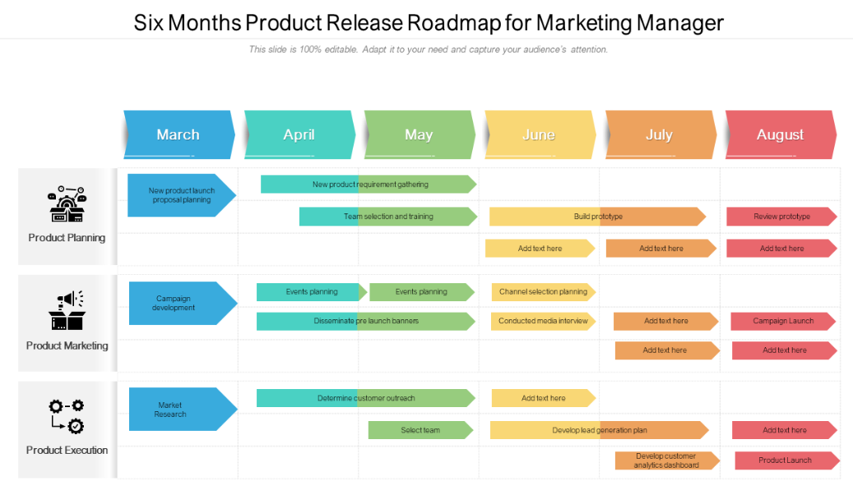
Example of Product Release Matrix : -

Slide 26
collecting & analyzing metrics : -
The basic measurements from running the test are then converted to meaningful mettics by the use of appropriate transformation formulae : -
Test cases Executed Ratio = ( No. of test cases executed / Total no. of test cases written ) * 100
Passed Test cases Ratio = ( No. of Passed Tests / Total No. of tests executed ) * 100
Failed Test cases Ratio = ( No. of Failed Tests / Total No. of Tests executed ) * 100
Productivity = ( No. of test cases executed / Time spent in test execution )
Defect Rejection Ratio = ( No. of defects rejeced / Total no. of defects raised ) * 100
Defect Fix Rejection Ratio = ( No. of defect fixes rejected / No. of defects Fixed ) * 100
Test design efficiency = No. of test designed / Total Time
Test review efficiency = No. of test reviewed / Total Time

Slide 27
preparing test summary report : -
Test Summary report is a document which contains summary of test activities and final test results.
After the testing ayde is complete, it is important to communicate the test results to the stakeholders.
Test summary report will be different for different kind of testing.
In addition to test coverage and unresolved defects test summary reports should also contain test strategy, test objectives and overall result of test effort.

Slide 28
contents of a test summary report : -
1. Purpose of the Document.
2. Application overview.
3. Testing scope.
4. Metrics.
5. Types of Testing Performed.
6. Test Environment & Tools.
7. Lessons Learned.
8. Recommendations.
9. Best Practices.
10. Exit Criteria.
11. Conclusion/sign OFF.
12. Definitions, Acronyms and Abbreviations.

