Slide 1
5. Memory Management

Slide 2
5.1 MEMORY MANAGEMENT :-
1.Background- Basic Memory Hardware, Address Binding. logical and Physical Address space, swapping
2. Memory management is the functionality of an operating system which handles or manages primary memory and moves processes back and forth between main memory and disk during execution.
3. memory Memory location, management regardless keeps of either it is allocated track of each and every to some process or it is free
Basic Memory Hardware:-
1.In operating system, hardware memory hardware typically includes RAM Random Access Memory) and secondary storage devices like hard drives er 15 SSDS
2. RAM is volatile memory used for actively running programs and storing data temporarily , while secondary storage holds data persistently even when the system is powered off
3. The operating system manages memory allocation ensuring efficient we of resources and facilitate Ing communication between hardware and software

Slide 3
2. Adders Binding :-
Address an operating binding in memory management within system refers to the association physical of logical addresses I generated by the CPU) with addresses are). It ensures (locations in the memory hardware - and that a program's instructions data are correctly mapped to physical memory
Address binding techniques:-
1) compile time binding
2) Load time binding
3) Execution time binding
3. Logical and Physical Address space:-
In memory management within an operating system, the concepts of logical and physical address spaces play a crucial role
1. Logical Address space : This is the set of all possible addresses generated by a CPU during program execution. It represents the addresses that a program can represented reference. These address are relative to the starting address of the program and on do not directly correspond to physical locations in memory

Slide 4
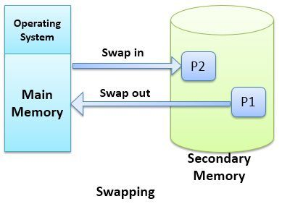
2. Physical Address space :-
This is the actual set of memory addresses available in the physical memory hardware. Each address is the physical address space corresponds to a Anique location in the physical memory chips
The operating system's memory management unit (MMU) is responsible for mapping 1ogical address to physical addresses.
5.2 Swapping:-
swapping is a mechanism in which a process can be swapped temporary out of main memory (or move) to second any storage (disk) and make the memory available to other processes.

Slide 5
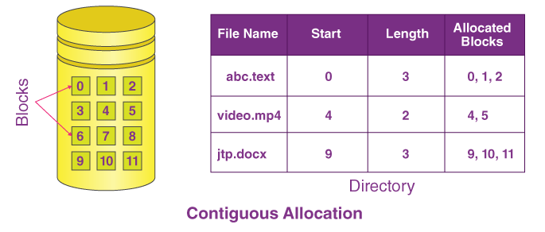
5.3 contiguous Memory Allocation, Fragmentation
1. contiguous Memory allocation :-
contiguous Memory allocation refers to a memory management techniques in which whenever there occurs request by a user process for the memory, one of the sections of the contiguous memory block would be given to that process, in accordance with its requirement
contiguous memory allocation is a memory management technique where each process is allocated a contiguous block of memory

Slide 6
Disadvantages of contiguous Memory allo cation:
1 Fragmentation issues can arise, leading to in
2) It's hard to change memory sizes easily
operating allocation system mech anis' uses the following memory
Single partition allocation | single partition allocation refers to a method of memory management where the entire available memory is divided into one large partition
multiple partition allocation | Multiple partition allocation refers to dividing the available memory into several partitions of varying sizes'
      Advantages of contiguous Memory allocation
1) Efficient memory access
2) Faster traversal and indexing operations.
3) Easier memory management
Disadvantages of contiguous Memory allocation:
1) Fragmentation issues can arise, leading to in
2) It's hard to change memory sizes easily
3) Memory can get jumbled upvoer time.

Slide 7
Fragmentation :-
Fragmentation in memory management occurs when memory becomes divided into small, non - contiguous block, making it challenging to allocution large contiguous blocks of memory even if the total free memory is sufficient.
As processes are loaded and removed from memory It happens after sometime that process es cannot be allocated to memory blocks considering their small size and memory blocks remains unused. This problem is known as fragmentation
      Fragmentation is of two types:-
 | Total memory space is enough to Saits. fy a request or to reside a process in it, but it is not contiguous, so it cannot be used.
Internal fragmentation | Memory block assigned to process is bigger some portion of memory is left unused, as it cannot be use by another process.
Extternal framentation

Slide 8
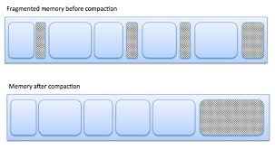
The fowling. diagram shows how fragmentation can cause waste of memory and a compaction technique can be used to Create more free memory out of fragmented memory
fragmented memory before compaction:-

Slide 9
5.3 Paging, Page Table, Page Falt, segmentation:-
Paging:-
Paging is a memory management scheme Used by operating systems to handle memory allocation and virtual memory.
Tt divides memory into fixed size blocks called pages and allocates memory to processes in these page-sized units. In
Paging allows for more efficient use of physical memory and simplifies the memory management
a process requires more memory than is available in physical RAN, paging allows the operating system to swap pages in and out of secondary storage, such as a hard disk, to create the illusion of larger amount of physical memory than actually exists
Main memory is divided into small fixed sized block of memory called frames and the size of a frame is kept the same as that of a page.

Slide 10
Paging diagram

Slide 11
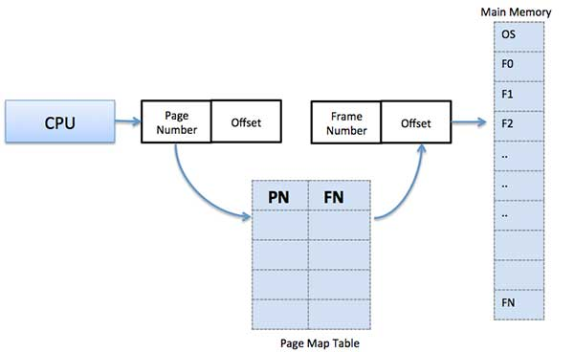
Address Translation:
Page address is called: logical address and represented by page number and the offset Logical address Page address number+ page offset
Frame address is called physical address and represent d by a frame number and the offset Logica Physical address = Frame number + page offset
A data structure called page map table is used to process keep track of the relation between a page of a to a

Slide 12
when the system allocates a frame to any page it translates this logical address into a physical address and create entry into the page table to be used throughout execution of the program.
when a process is to be executed, its corresponding pages are loaded into any available memory frames.
Advantages and disadvantages of Paging:
1) Paging reduces external fragmentation, but still suffer from: internal fragmentation..
2) paging is simple to implement and assumed as an efficient memory management technique
3) Due to equal size of pages and frames, swapping becomes very easy
Page Fault :-
A page fault occurs when a program attempts to access data or code that is in its address space but it not warranty located in the system RAM. so when page fault occurs then following sequence of events happens:

Slide 13
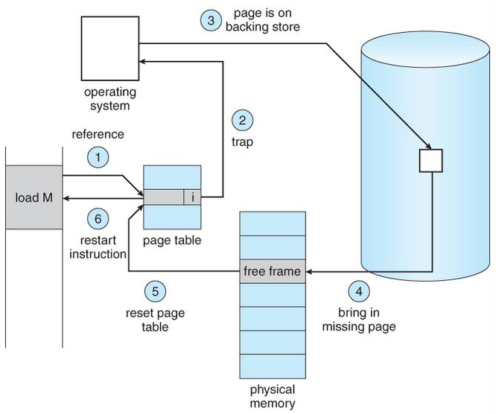
Page Fault occurs :
1) CPU tries to access a page not in physical memory..
2) Interrupt: CPU alerts the OS about the page fault
3) check Page Table: cheeks if the page is valid but not in memory.
4) Fetch Page: If needed, OS fetches the page from dist. into memory
5) update Tables: OS updates pages tables to reflect the new page location.
6) Resume process : Process is allowed to continue from where it left off.

Slide 14
7) optional: It no free memory, OS decides which page If replace
Error handling :if any errors ,appropriate actions
Continuation: Process continues execution with the requested page now in memory.
segmentation :-
1) segmentation in a memory management technique in which each job divided into several segments of different sizes, one for each module that contains pieces that, perform related functions
2) when a proves is to be executed its corresponding segmentations are loaded into non-contiguous memory three though every segment is loaded into a contiguous block of available memory.

Slide 15
Operating System
100
200
300
400
500
600
700
800
NM
Segment 1
SN | Size | Memory Address
1 | 400 | 1100
2 | 200 | 500
3 | 100 | 800
N | X | NM
Segment 2
Segment 3
Segment N

Slide 16
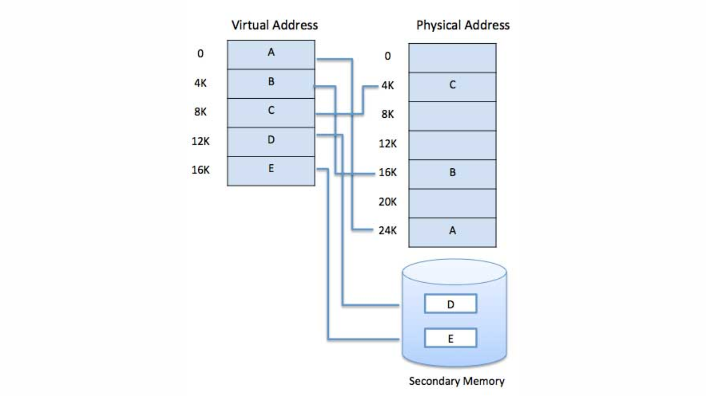
5.5 virtual Memory- concept., Demand Paging
virtual memory is a memory management technique used by operating systems to provide the illusion of a larger memory space than is actually avail. able physically
2) It allows program to use more memory than is physically available by temporarily transfixing data between RAM and disk storage.
This helps in multitasking, allowing multiple process es to nun on currently without running out of memory:
virtual memory is commonly implemented by demand paging.

Slide 17
Demand Paging :-
Demand paging is a memory management scheme sed in operating systems where pages are only loaded into memory when they are demanded by the program being executed
This means that not all pages of a program need to be loaded into memory at once, which helps conserve memory, resource.
when a page that is not currently in memory is accessed, a page fault occurs, and the operating system loads the required page from disk into memory
This technique allows for more efficient memory usage and bettered overall system performance

Slide 18
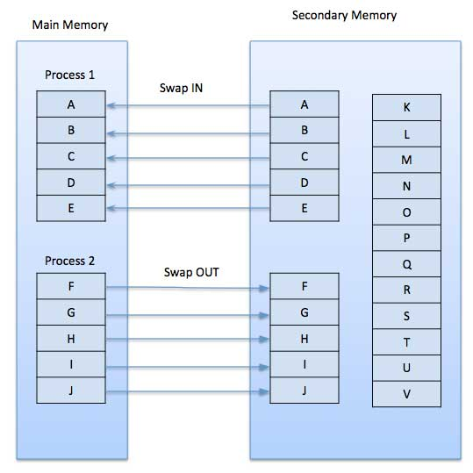

Slide 19
Advantages:-
Large virtual memory
More efficient use of memory
Disadvantages:-
Number of tables and the amount of processor overhead for handling page interrupts are greater than in the case of the simple paged management techniques
5.6] page Replacement Algorithms :- First In First out (FIFO) Least Recently used (LRU) ,Optimal page Replacement No recently used (NRU)
In operating system, a page replacement algorithm manages memory when a page fault occur
1] First In First out (fifo) :-
This is the simplest page replacement algorithm
In this algorithm , the operating system keeps track of all pages in the memory in a queue , the oldest page is in the from of the queue
When a page needs to be replaced page In the front of the queue is selected for removal
E.g.,

Slide 20
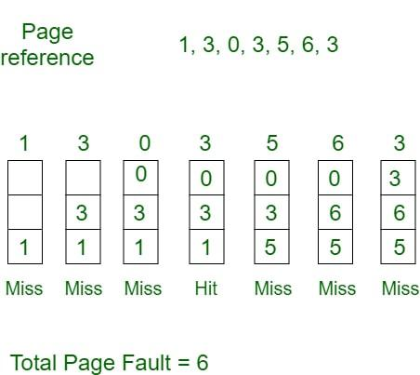

Slide 21
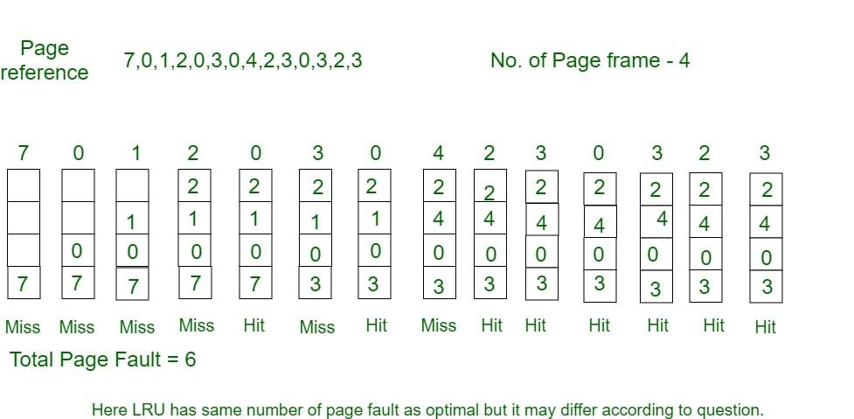
2) Least Recently Used (LRU) :-
In this algorithm, page will be replaced which is least recently used
Page which has not been used for the longest time in main memory is the one which will be selected for replacement.
Easy to implement , keep a list, replace pages by looking back into time.

Slide 22
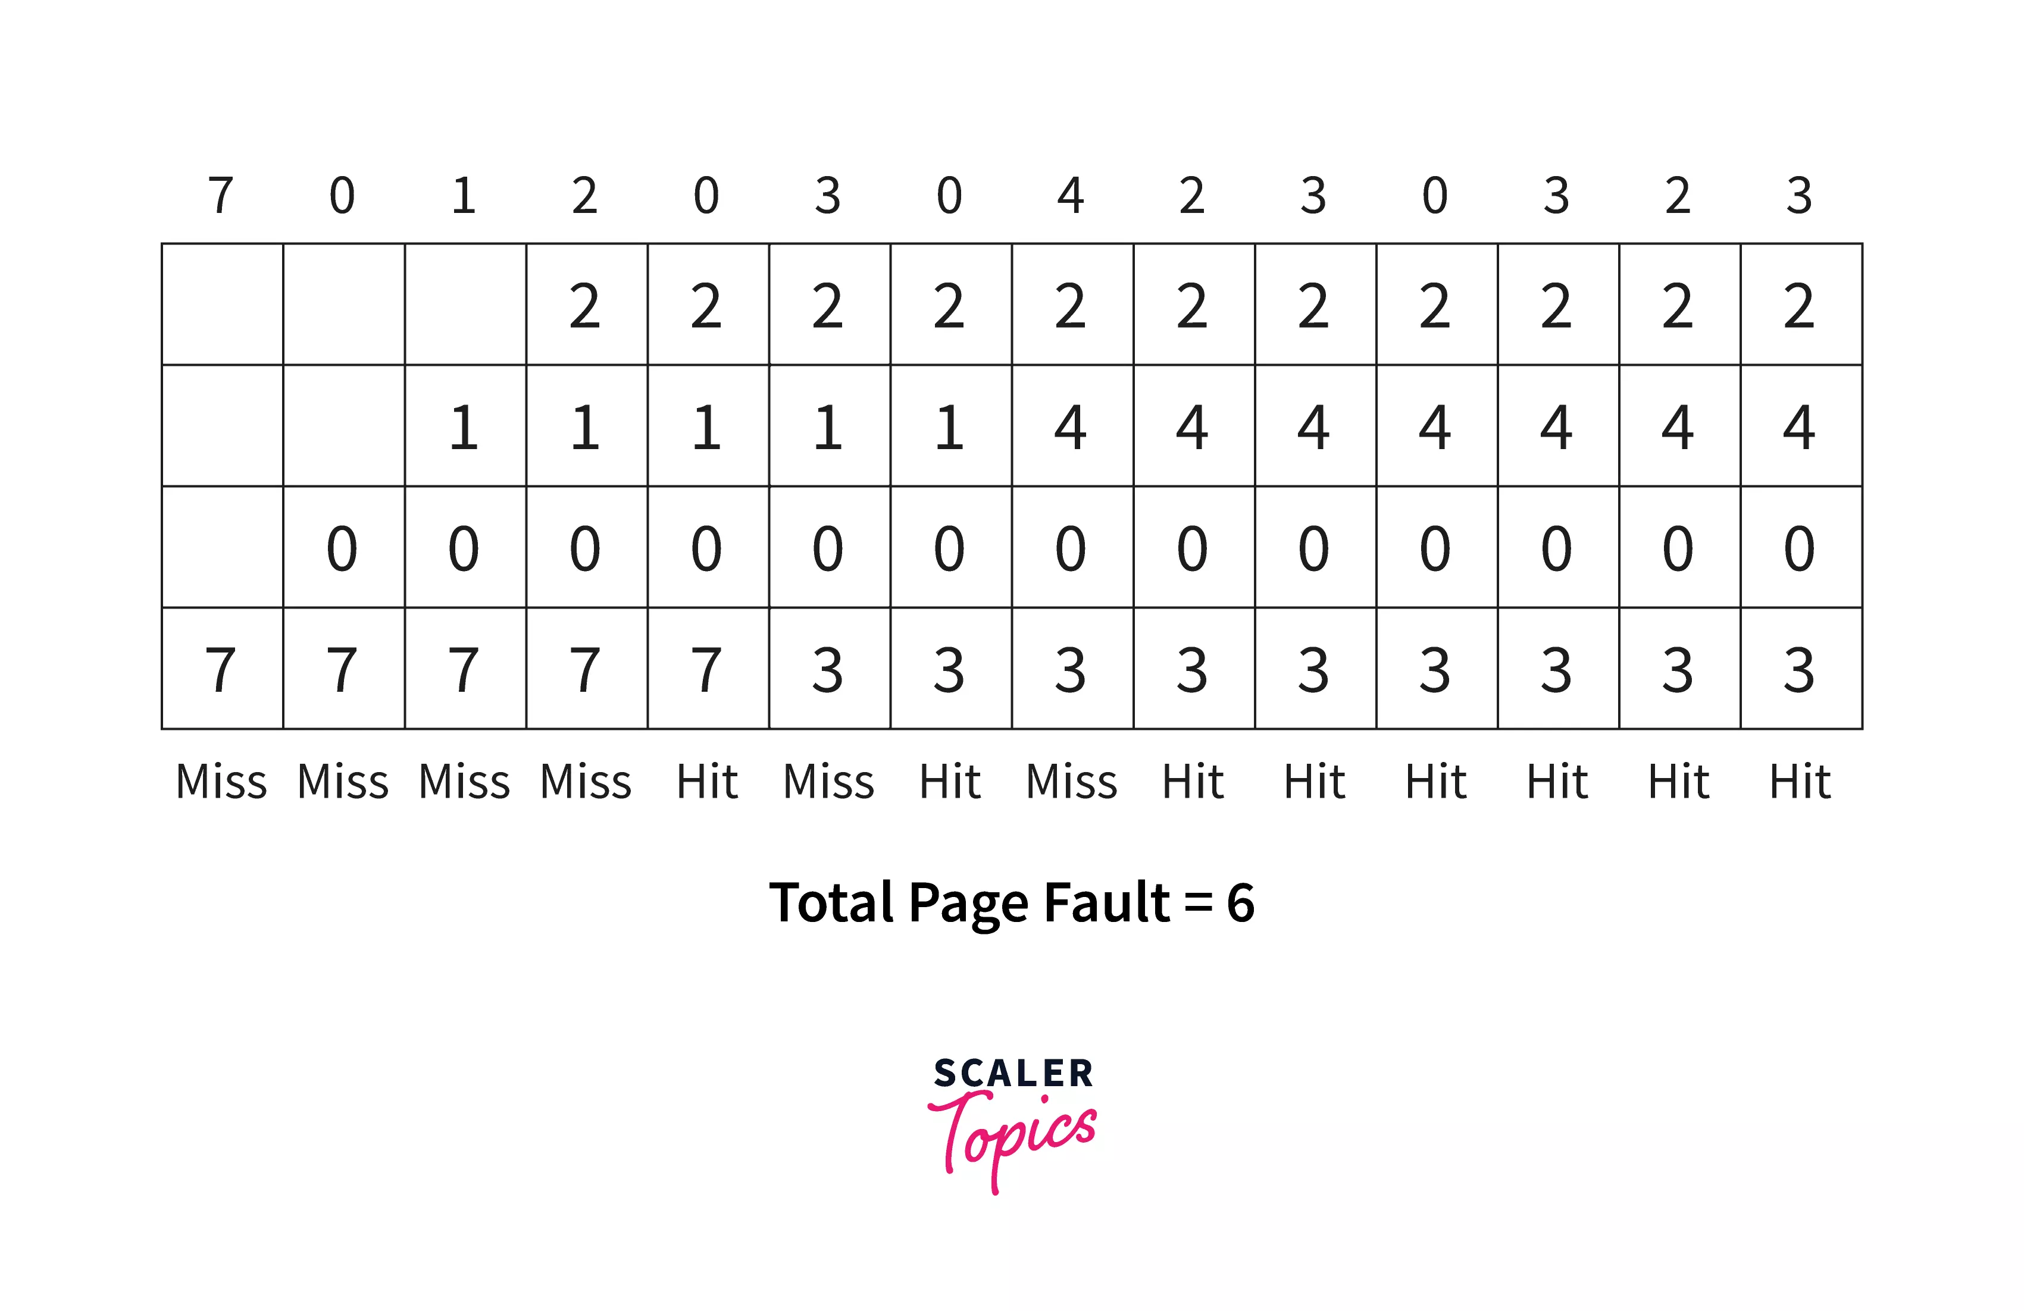
3) optimal Page Replacement:-
An optimal page replacement algorithm has the lowest page- fault rate of all algorithms.
An optimal page- replacement algorithm exists, and has been called OPT or MIN.
Replace the page that will not be used for longest period of time. use the time when a page is to be used

