Slide 1
02. Motions

Slide 2
Introduction : -
Definition of Motion : -
Motion is the change in the position of an object with respect to its surroundings or a reference point with the passage of time.
An object is said to be in motion if it changes its position continuously over time.
If the position does not change, the object is said to be at rest.
Motion means “movement” — when something moves from one place to another.
Example : -
A moving car changes its position with time → In motion
A parked car does not change its position → At rest

Slide 3
Types of motion : -
Translatory Motion : - Movement of a body from one place to another (e.g., car moving on a road).
Rotatory Motion : – Movement of a body about a fixed axis (e.g., rotation of a fan blade).
Oscillatory Motion : – Back and forth movement about a mean position (e.g., pendulum).
Vibratory Motion : – Very fast to-and-fro motion (e.g., vibration of a tuning fork).

Slide 4
2.1] linear motion : -
Definition : -
Linear motion (or rectilinear motion) is the motion of a body in a straight line or along one dimension.
In this type of motion, an object moves from one point to another along a straight path.
Example : -
A car moving on a straight road, a ball dropped from a building, etc.

Slide 5
Basic teams of linear motion : -
1. DISTANCE : -
It is the total length of the path covered by a body during motion.
It is a scalar quantity (has magnitude only).
SI Unit : meter (m)
Example : -
If a car moves 60 m east and then 40 m west,
Total distance = 60 + 40 = 100 m

Slide 6
2. Displacement : -
It is the shortest distance between the initial and final positions of a body.
It is a vector quantity (has both magnitude and direction).
SI Unit : meter (m)
Example : -
For the same case above,
Displacement = 60 – 40 = 20 m east

Slide 7
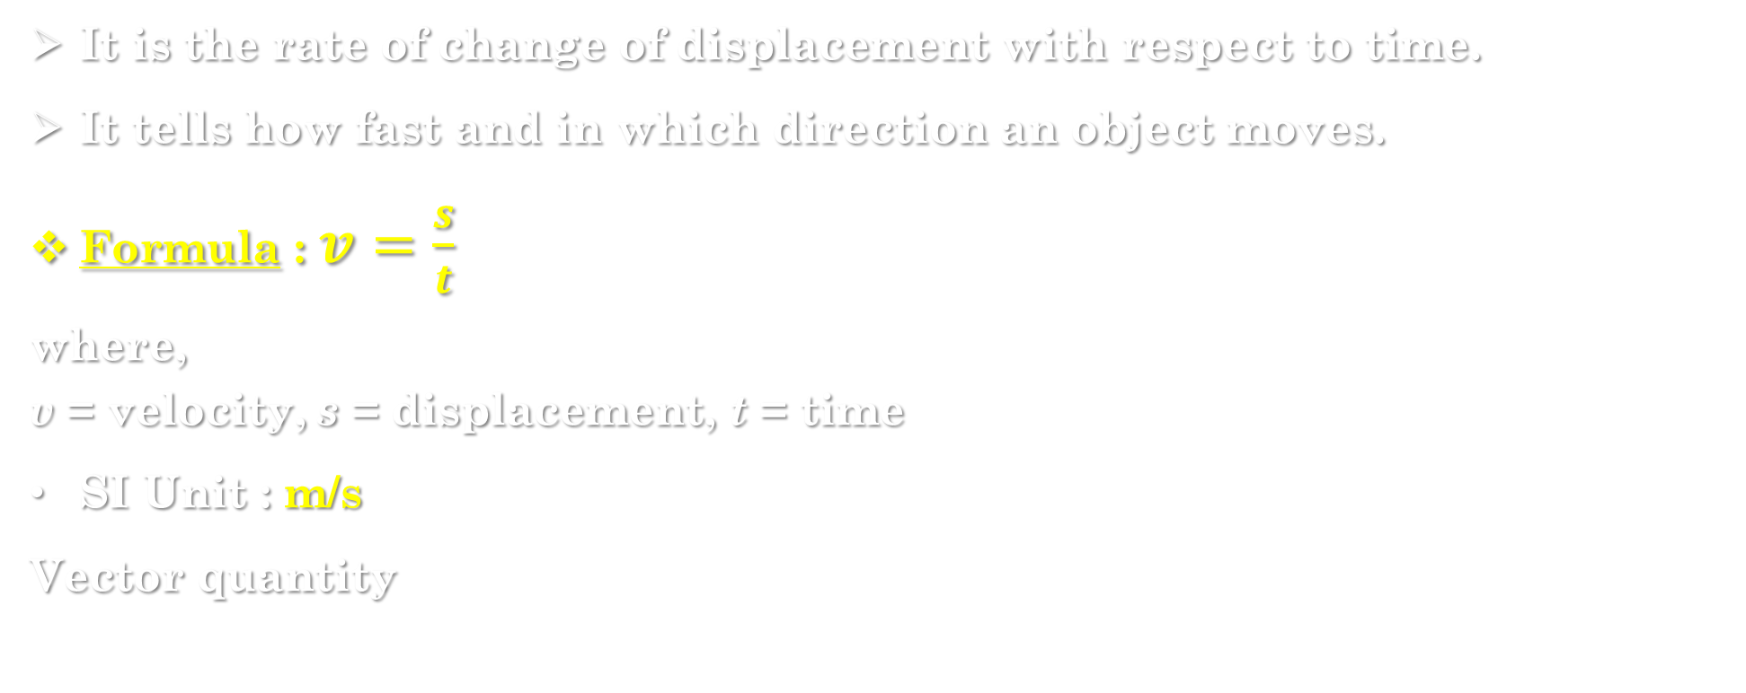
3. Velocity : -
It is the rate of change of displacement with respect to time.
It tells how fast and in which direction an object moves.
Formula : $v=\frac{s}{t}$
where,
v = velocity, s = displacement, t = time
SI Unit : m/s
Vector quantity

Slide 8
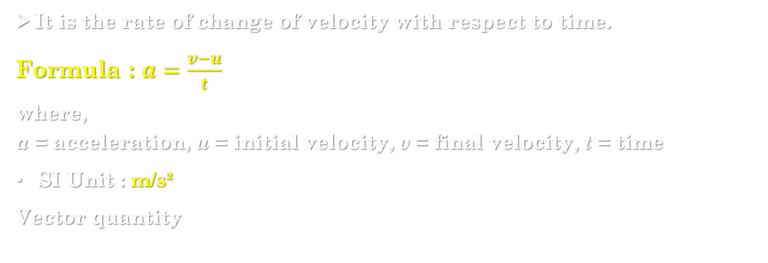
4. Acceleration : -
It is the rate of change of velocity with respect to time.
Formula : $a=\frac{v−u}{t}$
where,
a = acceleration, u = initial velocity, v = final velocity, t = time
SI Unit : m/s²
Vector quantity

Slide 9
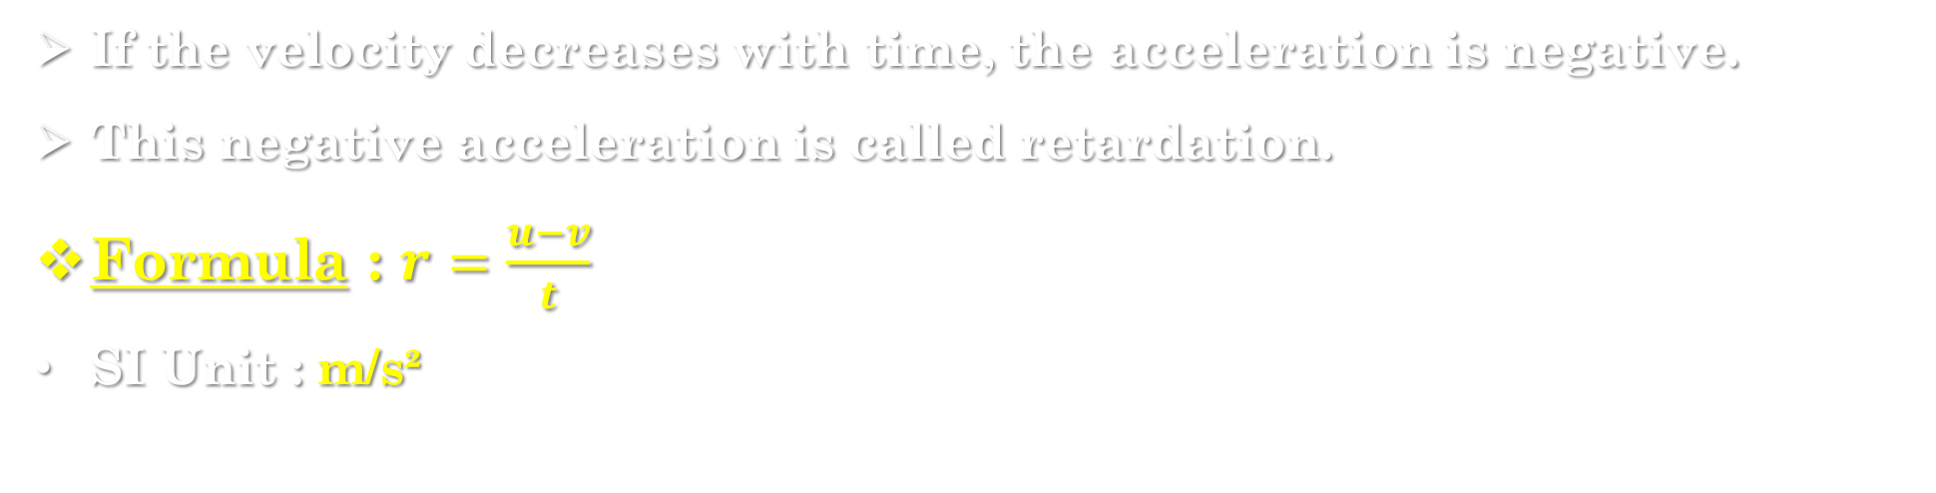
5. Retardation : -
If the velocity decreases with time, the acceleration is negative.
This negative acceleration is called retardation.
Formula : $r=\frac{u−v}{t}$
SI Unit : m/s²

Slide 10
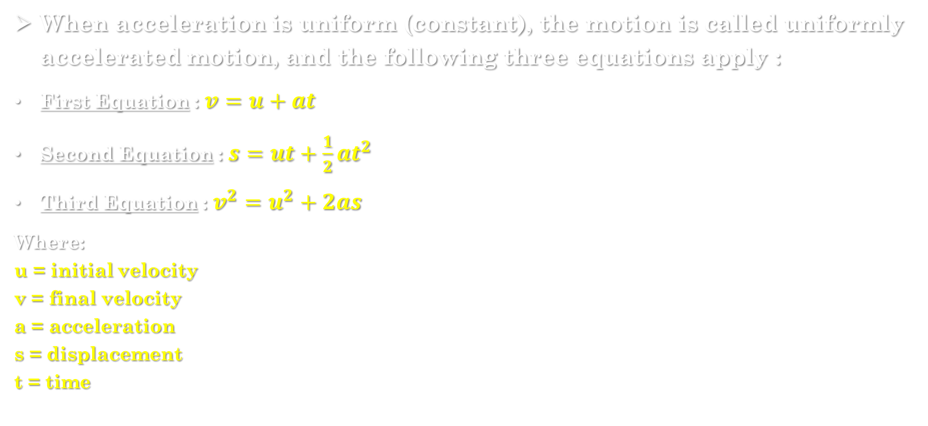
Equations of uniformly acceleration motion : -
When acceleration is uniform (constant), the motion is called uniformly accelerated motion, and the following three equations apply :
First Equation : $v=u+at$
Second Equation : $s=ut+\frac{1}{2}at^{2}$
Third Equation : $v^{2}=u^{2}+2as$
Where:
u = initial velocity
v = final velocity
a = acceleration
s = displacement
t = time

Slide 11
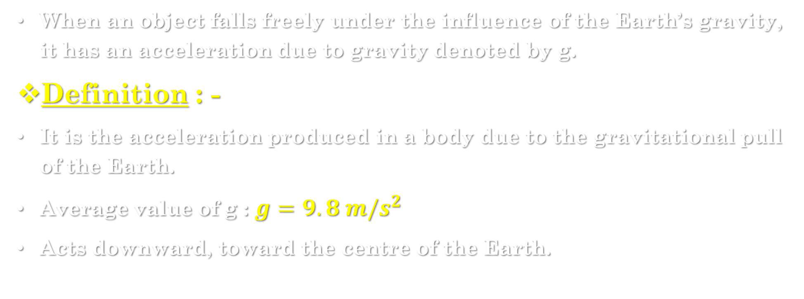
Acceleration due to gravity : -
When an object falls freely under the influence of the Earth’s gravity, it has an acceleration due to gravity denoted by g.
Definition : -
It is the acceleration produced in a body due to the gravitational pull of the Earth.
Average value of g : $g=9.8 m/s^{2}$
Acts downward, toward the centre of the Earth.

Slide 12
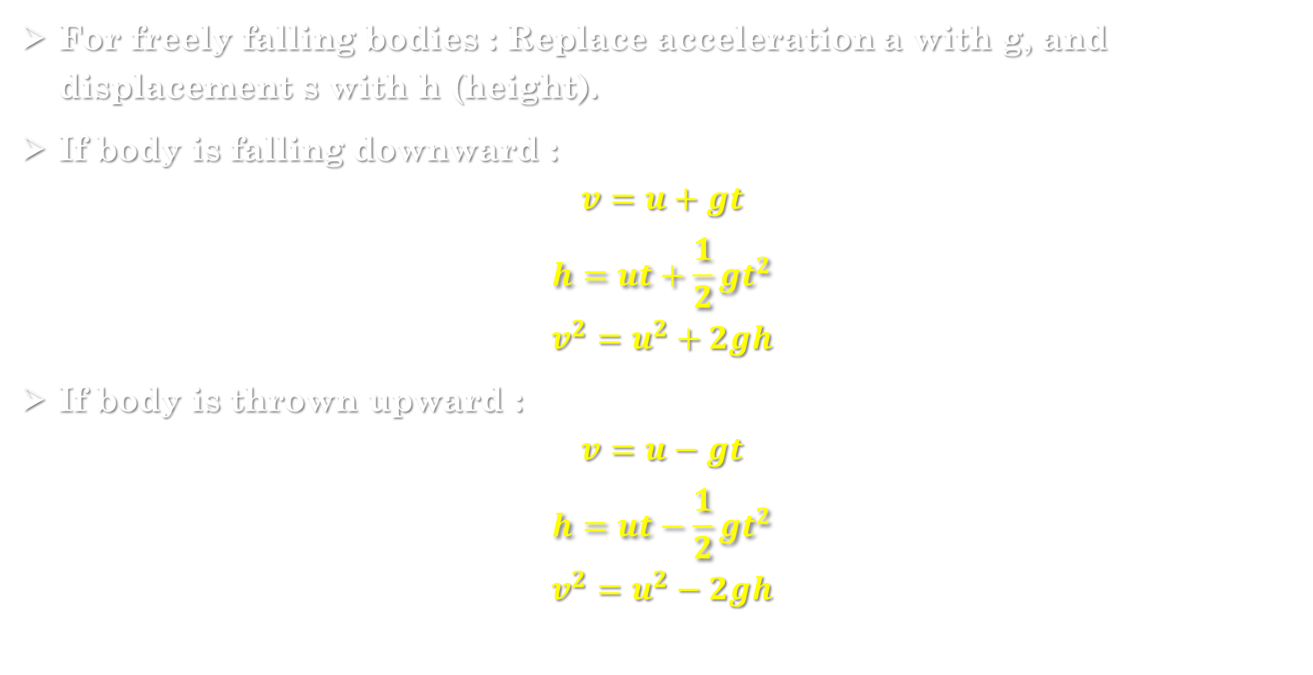
Equations of motions under gravity : -
For freely falling bodies : Replace acceleration a with g, and displacement s with h (height).
If body is falling downward :
$$v=u+gt$$
$$h=ut+\frac{1}{2}gt^{2}$$
$$v^{2}=u^{2}+2gh$$
If body is thrown upward :
$$v=u−gt$$
$$h=ut−\frac{1}{2}gt^{2}$$
$$v^{2}=u^{2}−2gh$$

Slide 13
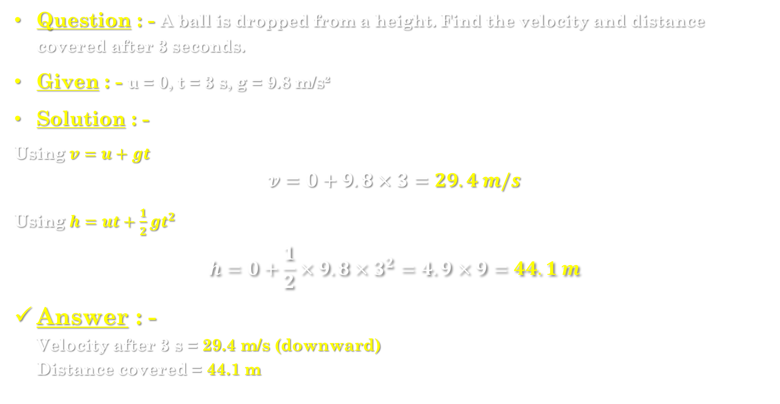
Numerical example : -
Question : - A ball is dropped from a height. Find the velocity and distance covered after 3 seconds.
Given : - u = 0, t = 3 s, g = 9.8 m/s²
Solution : -
Using $v=u+gt$
$$v=0+9.8×3=29.4 m/s$$
Using $h=ut+\frac{1}{2}gt^{2}$
$$h=0+\frac{1}{2}×9.8×3^{2}=4.9×9=44.1 m$$
Answer : -
Velocity after 3 s = 29.4 m/s (downward)
Distance covered = 44.1 m

Slide 14
2.2] Periodic motions : -
Definition of Periodic Motion : -
A periodic motion is the motion that repeats itself at regular intervals of time.
Example : -
The motion of a pendulum, the revolution of Earth around the Sun, the motion of a clock’s hands, etc.

Slide 15
1. Oscillatory motion : -
Oscillatory motion is the to-and-fro motion of a body about a mean (equilibrium) position.
Examples : -
Motion of a simple pendulum.
Motion of a swing.
Motion of a spring when stretched and released.

Slide 16
2. Vibratory motion : -
Vibratory motion is a very fast to-and-fro motion of a body about its mean position within a small distance.
Examples : -
Vibration of a tuning fork.
String of a guitar when plucked.
Atoms in a solid vibrating about their fixed positions.

Slide 17
3. Simple harmonic motion (s.h.m.) : -
A body is said to perform Simple Harmonic Motion if its acceleration is directly proportional to its displacement from the mean position and is always directed toward that mean position.
Examples : -
Motion of a simple pendulum.
Vibration of a mass attached to a spring.
Small oscillations of a tuning fork.

Slide 18
4. Circular motion : -
Circular motion is the motion of a body moving along a circular path with a fixed radius.
Examples : -
Revolution of Earth around the Sun.
Rotation of a fan blade.
Motion of a satellite around Earth.

Slide 19
Terms Related to Simple Harmonic Motion (S.H.M.) : -
Term | Definition | Symbol / Unit | Example / Meaning
Time Period (T) | Time taken by the body to complete one full oscillation. | Seconds (s) | If a pendulum takes 2 s for one swing, T = 2 s
Frequency (f) | Number of oscillations per second. | Hertz (Hz) | ( f = \frac{1}{T} )
Amplitude (A) | Maximum displacement of the body from its mean position. | Meter (m) | Greater amplitude → greater swing
Wavelength (λ) | The distance between two consecutive points in the same phase (e.g., crest to crest) in a wave. | Meter (m) | Used in waves and sound motion
Phase (ϕ) | Describes the state or position of the particle performing S.H.M. at any instant. | Radian | Two particles with same phase move together

Slide 20
2.3] angular motion : -
Definition : -
When a body moves around a fixed point or fixed axis, it is said to be in angular motion (or rotational motion).
Example : -
Rotation of a ceiling fan.
Spinning of a wheel.
Rotation of Earth about its axis.

Slide 21
Uniform circular motion : -
If a body moves with constant speed in a circular path, the motion is called uniform circular motion.
Even though speed is constant, the direction of velocity keeps changing, hence the motion is accelerated.
Examples : -
A satellite moving around Earth.
A stone tied to a string and whirled in a circle.
Blades of a fan rotating.

Slide 22
Radius vector : -
A radius vector is a line joining the center of the circle to the position of the moving body on the circular path.
Example : -
If a stone is tied to a string and rotated, the string itself is the radius vector.

Slide 23
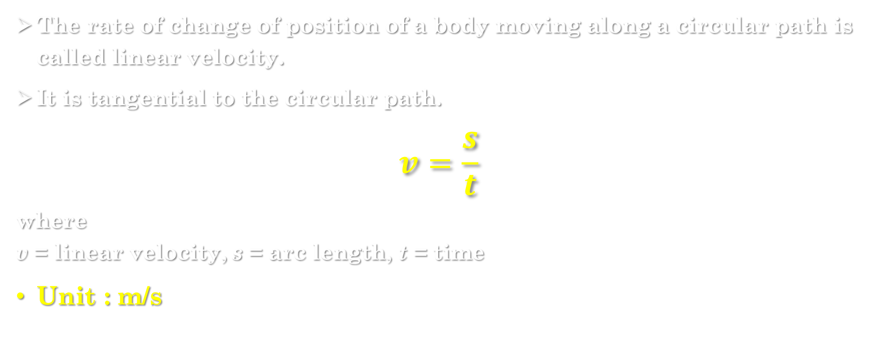
Linear velocity : -
The rate of change of position of a body moving along a circular path is called linear velocity.
It is tangential to the circular path.
$$v=\frac{s}{t}$$
where
v = linear velocity, s = arc length, t = time
Unit : m/s

Slide 24
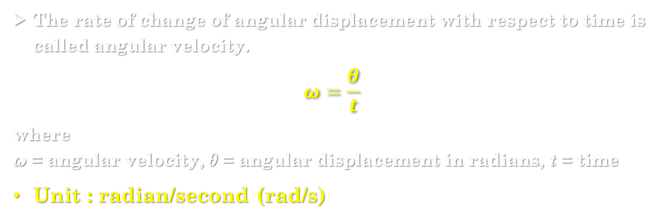
Angular velocity : -
The rate of change of angular displacement with respect to time is called angular velocity.
$$ω=\frac{θ}{t}$$
where
ω = angular velocity, θ = angular displacement in radians, t = time
Unit : radian/second (rad/s)

Slide 25
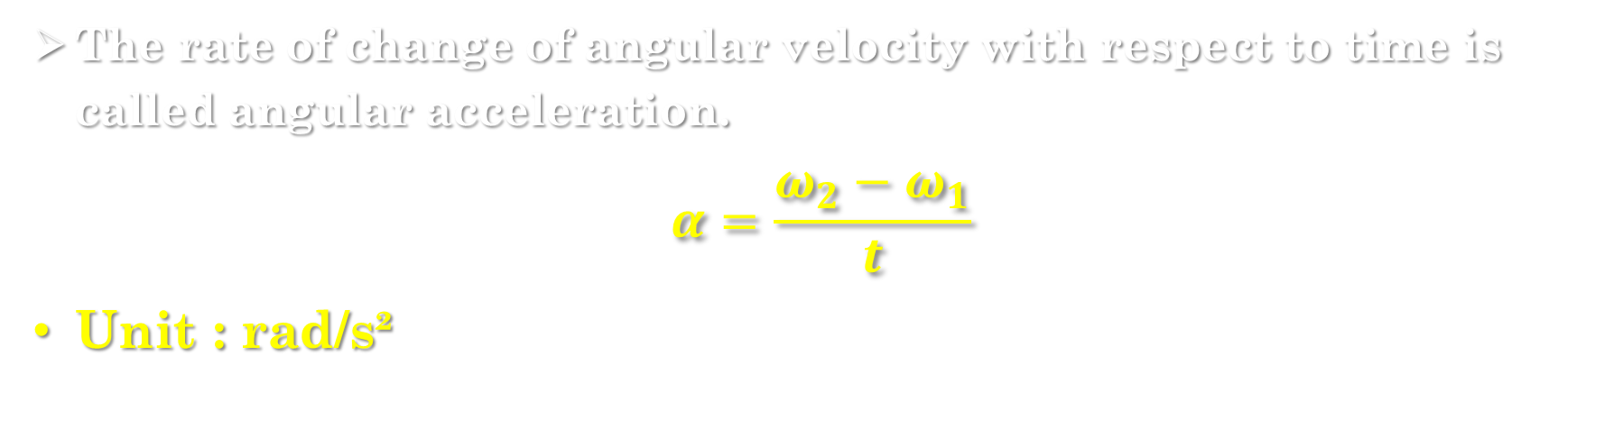
Angular acceleration : -
The rate of change of angular velocity with respect to time is called angular acceleration.
$$α=\frac{ω_{2}−ω_{1}}{t}$$
Unit : rad/s²

Slide 26
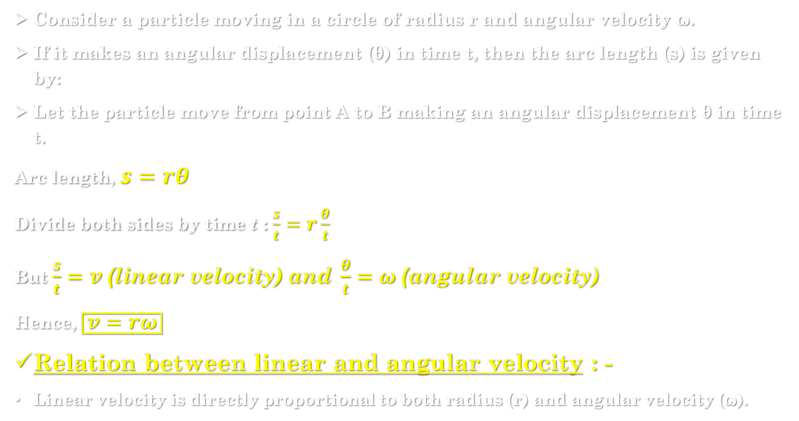
Relation between linear & angular velocity : -
Consider a particle moving in a circle of radius r and angular velocity ω.
If it makes an angular displacement (θ) in time t, then the arc length (s) is given by:
Let the particle move from point A to B making an angular displacement θ in time t.
Arc length, $s=rθ$
Divide both sides by time t : $\frac{s}{t}=r\frac{θ}{t}$
But $\frac{s}{t}=v \text{(}\text{linear} \text{velocity}\text{)} \text{and} \frac{θ}{t}=ω \text{(}\text{angular} \text{velocity}\text{)}$
Hence, $\boxed{v=rω}$
Relation between linear and angular velocity : -
Linear velocity is directly proportional to both radius (r) and angular velocity (ω).

Slide 27
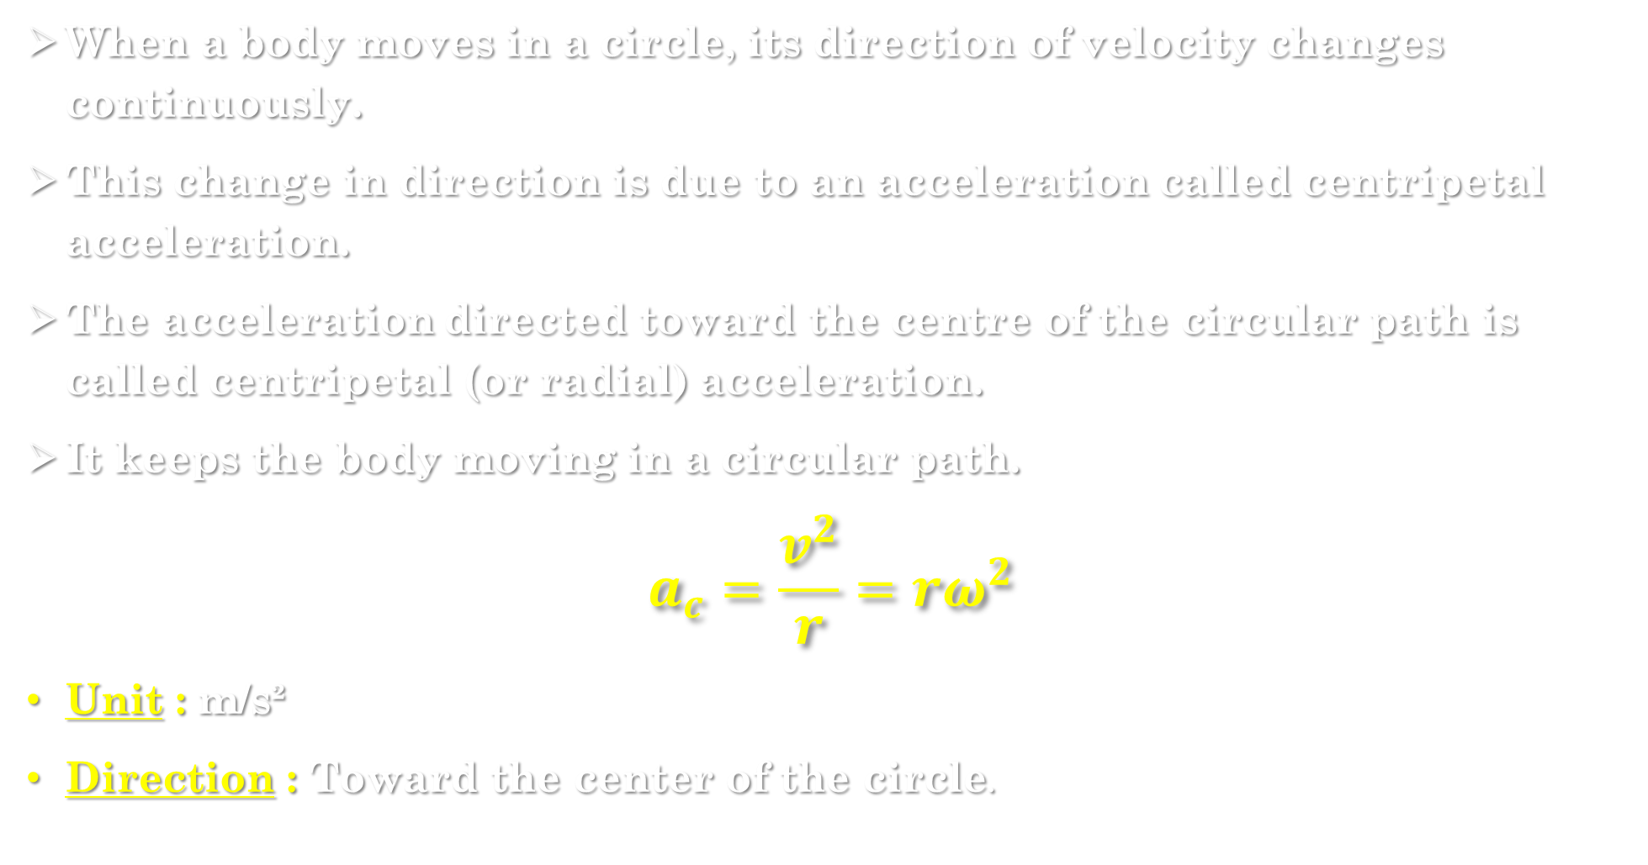
Radical or centripetal acceleration : -
When a body moves in a circle, its direction of velocity changes continuously.
This change in direction is due to an acceleration called centripetal acceleration.
The acceleration directed toward the centre of the circular path is called centripetal (or radial) acceleration.
It keeps the body moving in a circular path.
$$a_{c}=\frac{v^{2}}{r}=rω^{2}$$
Unit : m/s²
Direction : Toward the center of the circle.

Slide 28
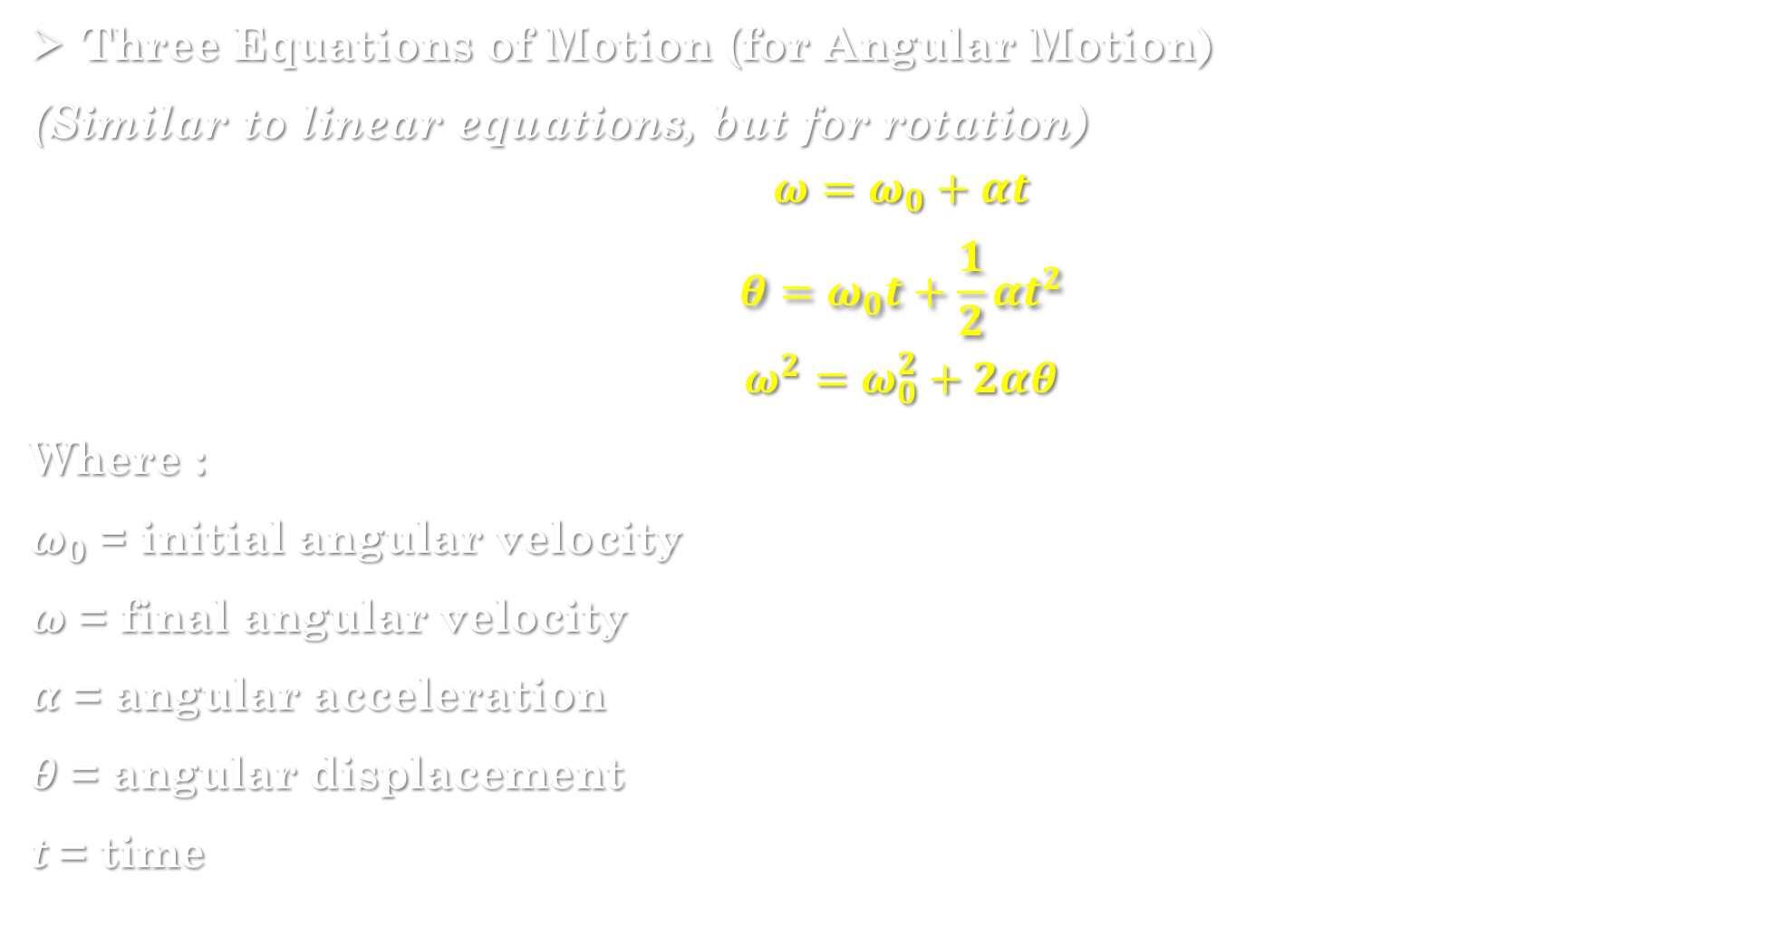
Three equations of motion : -
Three Equations of Motion (for Angular Motion)
(Similar to linear equations, but for rotation)
$$ω=ω_{0}+αt$$
$$θ=ω_{0}t+\frac{1}{2}αt^{2}$$
$$ω^{2}=ω_{0}^{2}+2αθ$$
Where :
$ω_{0}$= initial angular velocity
$ω$ = final angular velocity
$α$ = angular acceleration
$θ$ = angular displacement
$t$= time

Slide 29
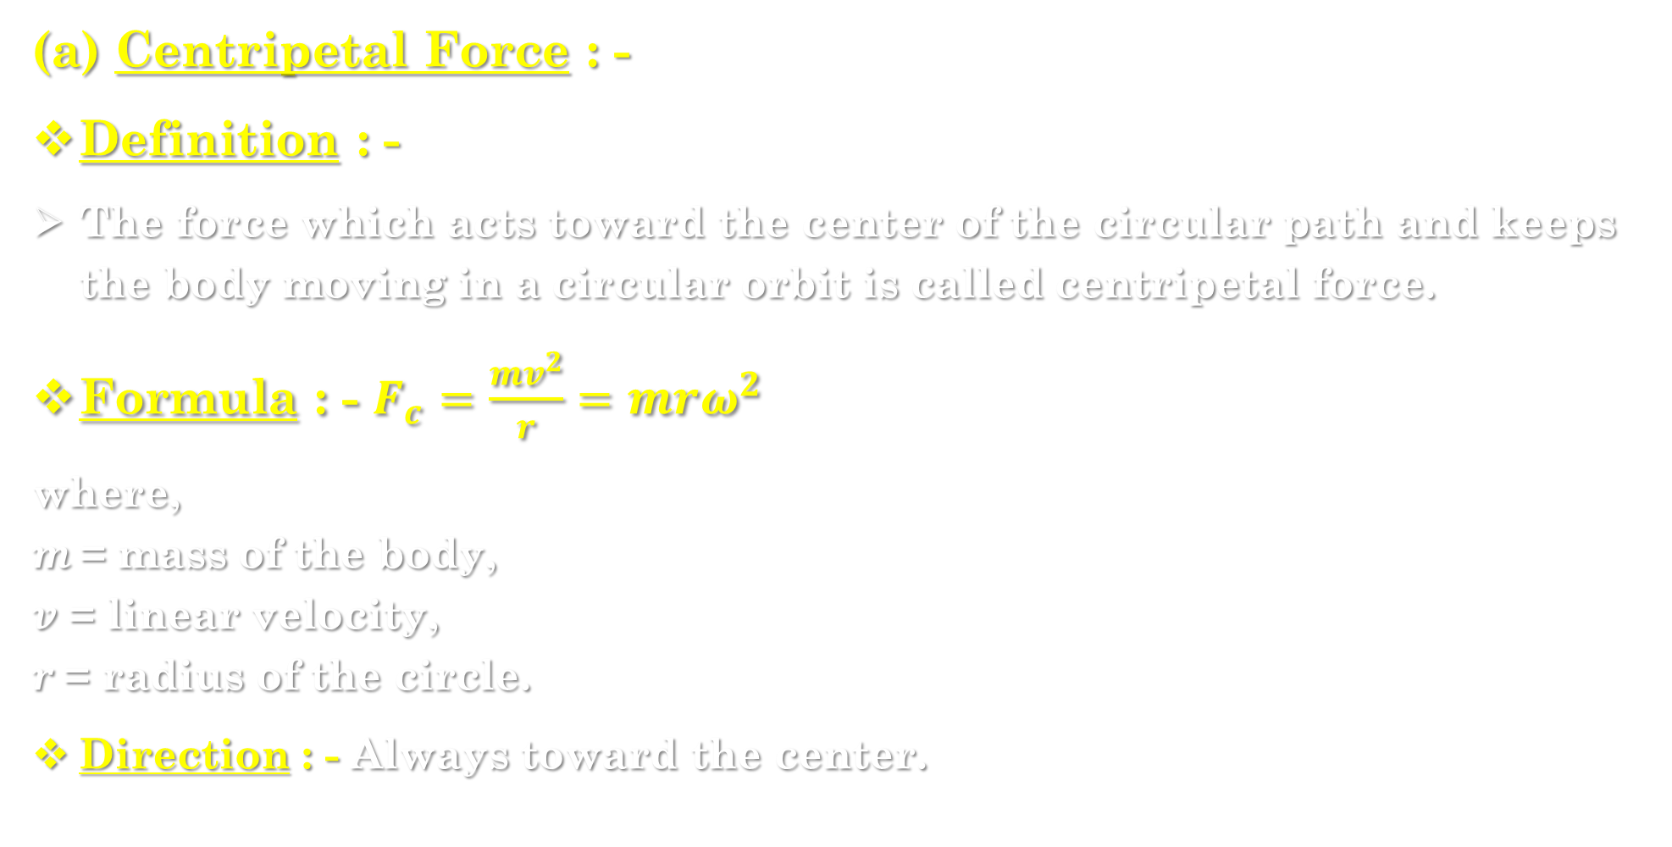
Centripetal & centrifugal forces : -
(a) Centripetal Force : -
Definition : -
The force which acts toward the center of the circular path and keeps the body moving in a circular orbit is called centripetal force.
Formula : - $F_{c}=\frac{mv^{2}}{r}=mrω^{2}$
where,
$m$= mass of the body,
$v$ = linear velocity,
$r$= radius of the circle.
Direction : - Always toward the center.

Slide 30
Examples : -
The tension in a string of a whirling stone.
Gravitational force between Earth and Moon.
Frictional force between car tyres and road in turning.
Applications : -
Used in designing banked roads and race tracks.
Used in centrifuges to separate liquids of different densities.
Important in satellite motion and planetary orbits.

Slide 31
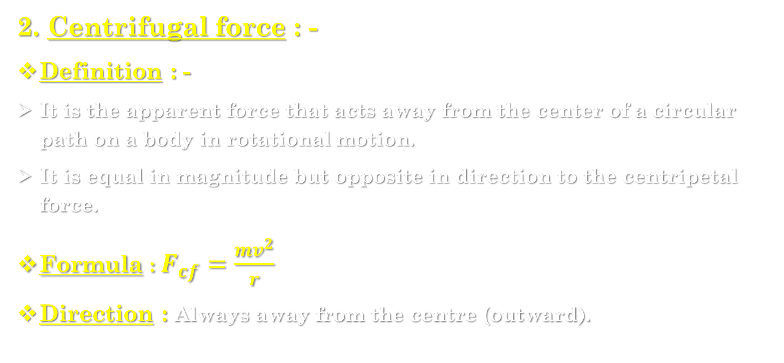
2. Centrifugal force : -
Definition : -
It is the apparent force that acts away from the center of a circular path on a body in rotational motion.
It is equal in magnitude but opposite in direction to the centripetal force.
Formula : $F_{cf}=\frac{mv^{2}}{r}$
Direction : Always away from the centre (outward).

Slide 32
Examples : -
Water moving outward in a washing machine.
Mud flying off the wheel of a moving vehicle.
Passenger pushed outward when a car takes a sharp turn.
Applications : -
Used in centrifugal dryers and cream separators.
Helps in artificial gravity creation in space stations.
Used in centrifuges to separate mixtures based on density.

Slide 33
2.4] laws of motion : -
1. Newton’s First Law of Motion (Law of Inertia) : -
Statement : -
A body continues to be in its state of rest or of uniform motion in a straight line unless an external unbalanced force acts on it.
Explanation : -
This means that if no external force is applied, an object at rest will stay at rest, and a moving object will continue to move with constant velocity in a straight line.

Slide 34
Example : -
A book on a table remains at rest until pushed.
When a moving car suddenly stops, passengers move forward due to inertia of motion.
Application : -
Seat belts in vehicles protect passengers from inertia.
Dust is removed from clothes by shaking (dust tends to remain at rest).

Slide 35
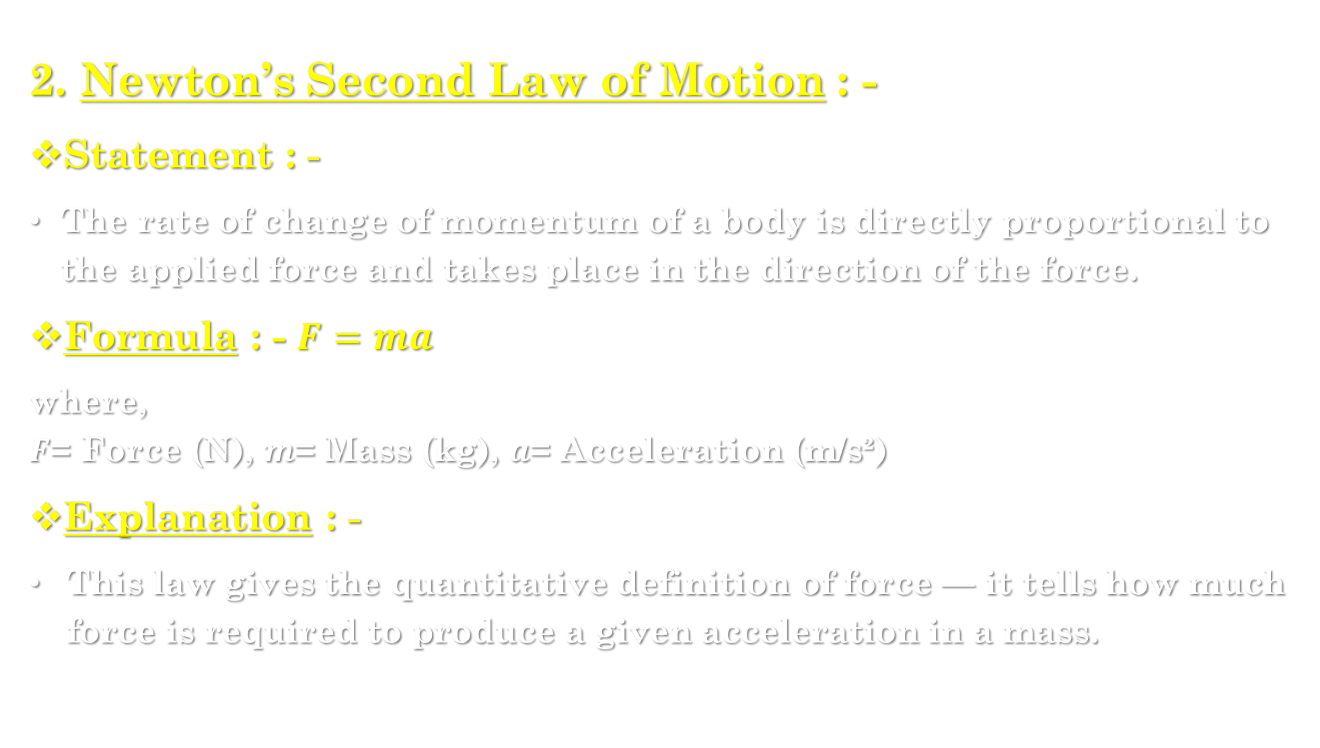
2. Newton’s Second Law of Motion : -
Statement : -
The rate of change of momentum of a body is directly proportional to the applied force and takes place in the direction of the force.
Formula : - $F=ma$
where,
$F$= Force (N), $m$= Mass (kg), $a$= Acceleration (m/s²)
Explanation : -
This law gives the quantitative definition of force — it tells how much force is required to produce a given acceleration in a mass.

Slide 36
Example : -
Pushing a car requires more force than pushing a bicycle because the car has more mass.
Applications : -
Used in rockets and jet propulsion (force = rate of change of momentum).
In sports, applying more force increases acceleration of a ball.
Explains impact of collisions and vehicle safety designs.

Slide 37
3. Newton’s Third Law of Motion : -
Statement : -
For every action, there is an equal and opposite reaction.
Explanation : -
When one body exerts a force on another, the second body exerts an equal but opposite force on the first body.

Slide 38
Examples : -
A gun recoils backward when it fires a bullet.
A swimmer pushes water backward and moves forward.
While walking, we push the ground backward and the ground pushes us forward.
Applications : -
Rocket propulsion: gases expelled backward push the rocket forward.
Flight of birds: wings push air downward and air pushes the bird upward.
Recoil of guns and jet engines

Slide 39
2.5] ancient theory of gravitation : -
1. Ancient Indian Theory : -
a) Aryabhata (476–550 AD) : -
Aryabhata, in his book Aryabhatiya, explained that the Earth attracts all objects toward itself.
He stated that the apparent falling of objects to the ground is due to this attraction of Earth.
He also said that the Earth rotates on its axis, which gives the appearance of the rising and setting of the Sun.
b) Brahmagupta (598–668 AD) : -
Brahmagupta extended Aryabhata’s ideas in his text Brahmasphutasiddhanta.
He mentioned that all things fall toward the Earth because it attracts them.
This was one of the earliest references to the force of gravity in scientific literature.

Slide 40
2. Ancient Greek Theory (Aristotle’s View) : -
Aristotle (384–322 BC) believed that heavier objects fall faster than lighter ones.
He also thought that objects have a “natural place,” and their motion is directed toward that place (for example, stones fall to Earth because it is their natural place).
However, this was later proved incorrect by Galileo.
3. Galileo Galilei (1564–1642) : -
Galileo showed experimentally that all bodies fall at the same rate in the absence of air resistance, regardless of their mass.
This laid the foundation for Newton’s Laws of Motion and Universal Gravitation.

Slide 41
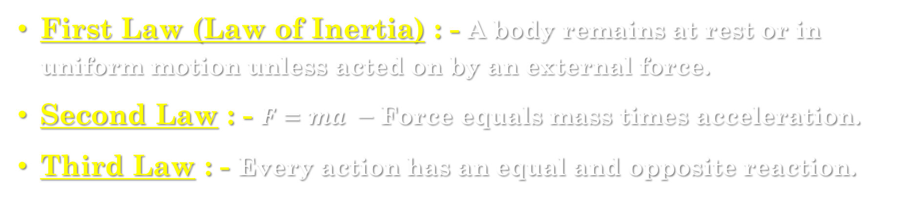
Newton’s laws of motion : -
First Law (Law of Inertia) : - A body remains at rest or in uniform motion unless acted on by an external force.
Second Law : - $F=ma −$Force equals mass times acceleration.
Third Law : - Every action has an equal and opposite reaction.

Slide 42
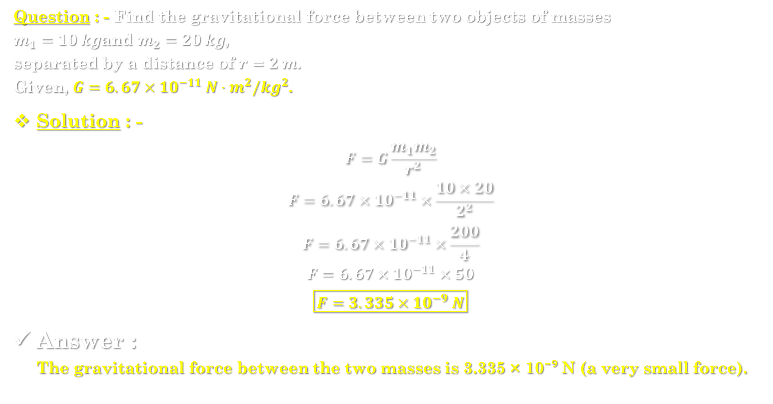
Numerical example : -
Question : - Find the gravitational force between two objects of masses
$m_{1}=10 kg$and $m_{2}=20 kg$,
separated by a distance of $r=2 m$.
Given, $G=6.67×{10}^{−11} N⋅m^{2}/kg^{2}$.
Solution : -
$$F=G\frac{m_{1}m_{2}}{r^{2}}$$
$$F=6.67×{10}^{−11}×\frac{10×20}{2^{2}}$$
$$F=6.67×{10}^{−11}×\frac{200}{4}$$
$$F=6.67×{10}^{−11}×50$$
$$\boxed{F=3.335×{10}^{−9} N}$$
Answer :
The gravitational force between the two masses is 3.335 × 10⁻⁹ N (a very small force).

