Slide 1
06. Pl / sql programming

Slide 2
Introduction of pl/sql : -
PL/SQL (Procedural Language/Structured Query Language) is an extension of SQL developed by Oracle Corporation.
It adds procedural programming features such as loops, conditions, and variables to SQL.
PL/SQL allows users to write block-structured programs that can include SQL statements to interact with the database efficiently.
It is mainly used to create stored procedures, functions, triggers, and packages for automating tasks in databases.

Slide 3
Advantages of pl/sql : -
Combines SQL and Procedural Features :
PL/SQL allows the use of SQL statements along with procedural constructs like loops, conditions, and functions.
Improved Performance : -
Multiple SQL statements can be sent to the database at once, reducing network traffic and execution time.
High Security : -
Access to data can be controlled through stored procedures instead of direct access to tables.
Portability : -
PL/SQL code can run on any Oracle Database without modification.
Error Handling : -
It provides powerful error handling using the EXCEPTION section.
Modular Programming : -
Code can be divided into blocks, procedures, and functions for better organization and reusability.

Slide 4
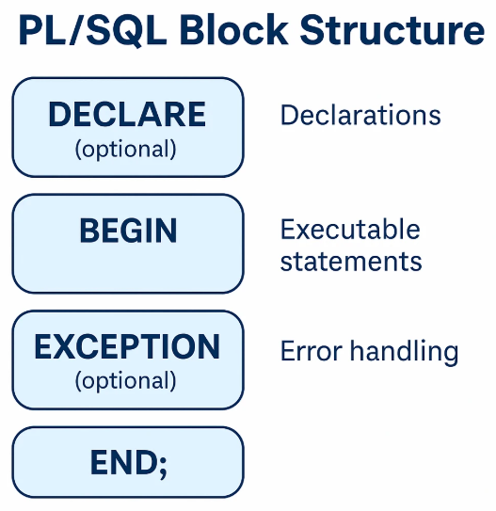
Pl/sql block structure : -
In PL/SQL (Procedural Language/SQL), every program is divided into blocks — the basic units of code.
Each PL/SQL block groups together logically related declarations and statements.
It provides modularity, readability, and reusability to database programs.
Explanation of Sections : -
DECLARE : Used to declare variables, constants, and cursors. (Optional)
BEGIN : Contains SQL and PL/SQL statements to be executed.
EXCEPTION : Handles runtime errors or exceptions. (Optional)
END : Marks the end of the block.

Slide 5
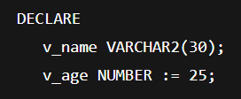
1. Declare section : -
This section is used to declare variables, constants, cursors, and user-defined data types that will be used in the program.
If no declaration is required, this part can be skipped.
Example : -

Slide 6
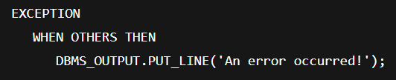
2. Begin section : -
This is the main executable part of the block.
All SQL statements (like SELECT, INSERT, UPDATE, DELETE) and PL/SQL statements (like IF, LOOP, etc.) are written here.
Every block must contain this section.
Example : -

Slide 7
3. Exception section : -
This section is used to handle errors (exceptions) that occur during program execution.
If an error occurs, control passes to this section.
Example : -

Slide 8
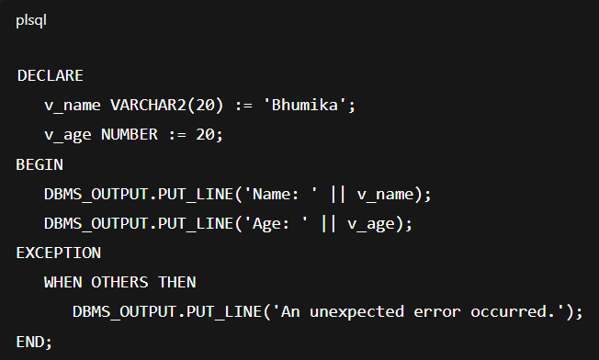
End statement : -
This marks the end of the PL/SQL block.
It must always be followed by a semicolon (;).
Complete Example : -

Slide 9
Types of pl/sql blocks : -
Anonymous Block : -
  Not stored in the database.
  Executed once and then discarded.
  Example: The above block.
Named Block : -
  Stored permanently in the database.
  Includes procedures, functions, triggers, and packages.

Slide 10
Pl/sql execution environment : -
The PL/SQL execution environment is a part of the Oracle Database Server.
It consists of two main components:
PL/SQL Engine :
  Processes PL/SQL code.
  Executes procedural statements like loops and conditions.
SQL Engine :
  Executes SQL statements such as SELECT, INSERT, UPDATE, and DELETE.
The PL/SQL Engine separates procedural statements (executed locally) from SQL statements (sent to the SQL Engine).
This improves performance and reduces network traffic.

Slide 11
Pl/sql data types : -
PL/SQL supports various data types for storing different kinds of data:
Category | Data Type | Description
Numeric | NUMBER(p,s) | Stores integer or decimal values
Character | CHAR(size), VARCHAR2(size) | Stores string or text data
Date/Time | DATE, TIMESTAMP | Stores date and time values
Boolean | BOOLEAN | Stores TRUE, FALSE, or NULL
Large Objects | CLOB, BLOB | Stores large character or binary data

Slide 12
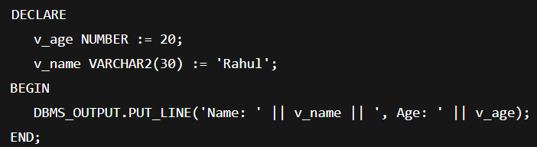
Variables in pl/sql : -
Variables in PL/SQL
A variable is a named memory location used to store a value.
Variables must be declared before use in the DECLARE section.
Syntax : -
Example : -

Slide 13
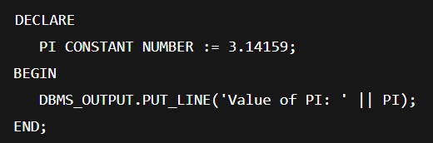
Constants in pl/sql : -
A constant is similar to a variable but its value cannot be changed after declaration.
Declared using the keyword CONSTANT.
Syntax : -
Example : -

Slide 14
Control structure in pl/sql : -
Control Structures in PL/SQL are used to control the flow of execution of a program.
They allow a programmer to make decisions, repeat statements, and execute statements in sequence based on certain conditions.
There are three main types of control structures in PL/SQL : -
1. Conditional Control.
2. Iterative (Loop) Control.
3. Sequential Control.

Slide 15
1. Conditional control : -
Conditional control is used to make decisions in the program based on true or false conditions.
It helps in executing specific statements depending on a given condition.
PL/SQL Conditional Statements : -
  IF...THEN Statement.
  IF...THEN...ELSE Statement.
  IF...THEN...ELSIF...ELSE Statement.
  CASE Statement.

Slide 16
A] if…then statement : -
Executes a set of statements only if the condition is true.
Example : -
IF salary > 50000 THEN
DBMS_OUTPUT.PUT_LINE('High Salary');
END IF;

Slide 17
b] if…then...else statements : -
Executes one set of statements if the condition is true and another if it is false.
Example : -
IF marks >= 40 THEN
DBMS_OUTPUT.PUT_LINE('Pass');
ELSE
DBMS_OUTPUT.PUT_LINE('Fail');
END IF;

Slide 18
C] if…then…elseif…else statement : -
Used when multiple conditions need to be checked.
Example : -
IF marks >= 75 THEN
DBMS_OUTPUT.PUT_LINE('Distinction');
ELSIF marks >= 60 THEN
DBMS_OUTPUT.PUT_LINE('First Class');
ELSIF marks >= 40 THEN
DBMS_OUTPUT.PUT_LINE('Pass');
ELSE
DBMS_OUTPUT.PUT_LINE('Fail');
END IF;

Slide 19
D] case statement : -
The CASE statement is used to select one of several possible actions.
Example : -
CASE grade
WHEN 'A' THEN DBMS_OUTPUT.PUT_LINE('Excellent');
WHEN 'B' THEN DBMS_OUTPUT.PUT_LINE('Good');
WHEN 'C' THEN DBMS_OUTPUT.PUT_LINE('Average');
ELSE DBMS_OUTPUT.PUT_LINE('Fail');
END CASE;

Slide 20
3. Sequential control : -
Sequential control means that statements are executed one after another in the order in which they are written in the PL/SQL block.
The control automatically moves from one statement to the next.
This is the default execution flow in PL/SQL.
Example : -
BEGIN
DBMS_OUTPUT.PUT_LINE('Step 1: Start program');
DBMS_OUTPUT.PUT_LINE('Step 2: Execute task');
DBMS_OUTPUT.PUT_LINE('Step 3: End program');
END;
Here, each statement is executed sequentially.

Slide 21
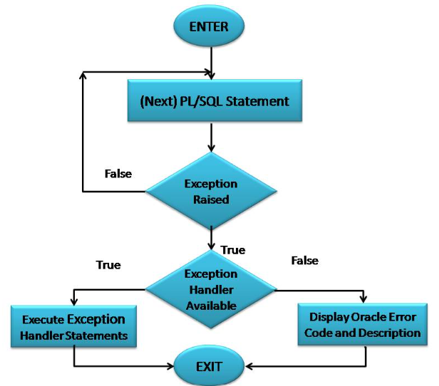
6.3] exception handling in pl/sql : -
In PL/SQL, an exception is an error condition that occurs during the execution of a program.
Exception Handling is a mechanism that allows a programmer to detect and handle errors gracefully, instead of abruptly terminating the program.
By using exception handling, the programmer can control what happens when an error occurs, ensuring the program continues to run or terminates safely.
Types of Exceptions in PL/SQL : -
Predefined Exceptions.
User-Defined Exceptions.

Slide 22
Need for exception handling : -
To maintain normal program flow during runtime errors.
To display meaningful error messages instead of system errors.
To debug and handle specific error conditions efficiently.
To ensure database consistency even after an error occurs.
Advantages of Exception Handling : -
Prevents program termination on runtime errors.
Makes debugging easier by showing user-friendly error messages.
Increases program reliability and robustness.
Ensures data consistency and integrity.

Slide 23
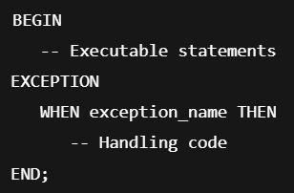
Structure of exception handling : -
The EXCEPTION section is written after the BEGIN block in a PL/SQL program.
Syntax : -

Slide 24
1. Predefined exceptions : -
Predefined exceptions are automatically defined by Oracle for common runtime errors.
These exceptions are internally raised by the PL/SQL engine when certain errors occur (like division by zero, invalid cursor, etc.).
Example of Predefined Exception : -
DECLARE
num1 NUMBER := 10;
num2 NUMBER := 0;
result NUMBER;
BEGIN
result := num1 / num2;
DBMS_OUTPUT.PUT_LINE('Result: ' || result);
EXCEPTION
WHEN ZERO_DIVIDE THEN
DBMS_OUTPUT.PUT_LINE('Error: Division by zero not allowed.');
END;
Output : -
Error: Division by zero not allowed.

Slide 25
2. user-defined function : -
User-defined exceptions are custom exceptions created by the programmer to handle specific business logic errors that are not covered by predefined exceptions.
Steps to Create a User-Defined Exception : -
Declare the exception in the DECLARE section.
Raise the exception using the RAISE statement.
Handle it in the EXCEPTION section.

Slide 26
Example of pre-defined function : -
insufficient_balance EXCEPTION; -- Step 1: Declare exception
balance NUMBER := 1000;
withdraw_amount NUMBER := 1500;
BEGIN
IF withdraw_amount > balance THEN
RAISE insufficient_balance; -- Step 2: Raise exception
END IF;
DBMS_OUTPUT.PUT_LINE('Withdrawal successful!');
EXCEPTION
WHEN insufficient_balance THEN -- Step 3: Handle exception
DBMS_OUTPUT.PUT_LINE('Error: Insufficient balance in account.');
END;
Output :
Error: Insufficient balance in account.

Slide 27
6.4] cursor : -
A Cursor in PL/SQL is a pointer or a temporary work area created in the memory when an SQL statement is executed.
It is used to store and process the result set (rows) returned by a query one row at a time.
Since SQL operations in PL/SQL can return multiple rows, cursors help to access each row individually, making data manipulation easier.
Types of Cursors : -
PL/SQL supports two types of cursors:
Implicit Cursor
Explicit Cursor

Slide 28
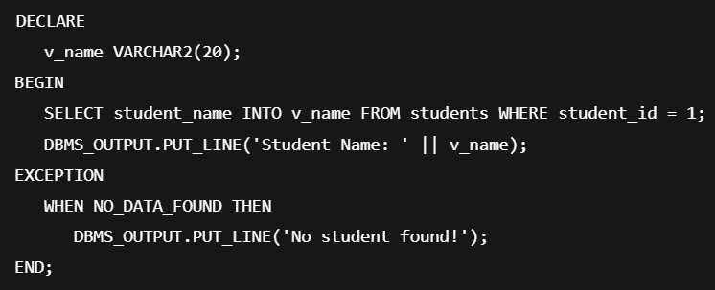
1. Implicit cursor : -
Implicit cursors are automatically created by Oracle whenever a DML statement (SELECT INTO, INSERT, UPDATE, DELETE) is executed.
Created by : Oracle automatically.
Used when : The SQL statement returns only one row.
Example of Implicit Cursor : -

Slide 29
2. Explicit cursor : -
Explicit cursors are manually defined and controlled by the programmer to process multiple rows returned by a SELECT query.
Used when : The query returns more than one row.
Steps in Using an Explicit Cursor : -
Declare the cursor.
Open the cursor.
Fetch rows from the cursor.
Close the cursor.

Slide 30
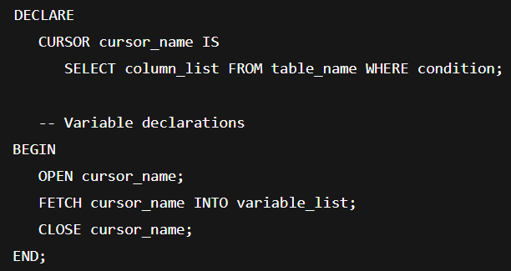
Syntax : -

Slide 31
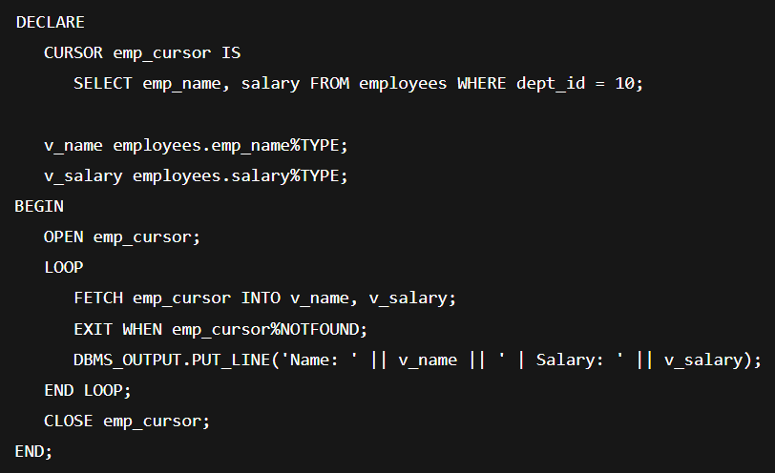
Example of explicit cursor : -

Slide 32

Parameterized cursor : -
A parameterized cursor allows passing parameters or values dynamically to a cursor at runtime.
It helps in reusing the same cursor for different input values.
Syntax : -

Slide 33
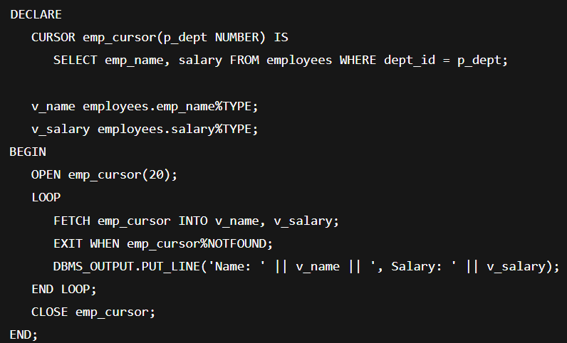
Example : -

Slide 34

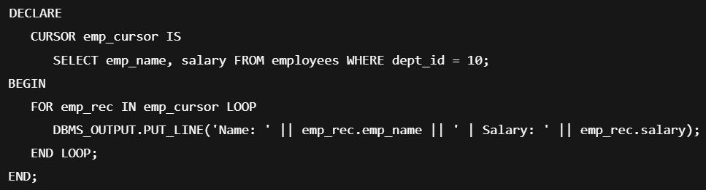
Cursor for loop : -
A Cursor FOR loop simplifies cursor handling by automatically opening, fetching, and closing the cursor.
Syntax : -
Example : -

Slide 35
Opening & closing cursor in pl/sql : -
In PL/SQL, when working with explicit cursors, you must manually open and close them to manage the flow of data retrieval.
Opening and closing a cursor are essential steps in controlling how and when data is fetched from a query result set.

Slide 36

1. Opening a cursor : -
Opening a cursor means executing the SQL query defined in the cursor and allocating memory to store the result set (rows returned by the query).
When a cursor is opened : -
The SELECT statement inside the cursor is executed.
All the rows that satisfy the query are identified and stored in the cursor’s memory area.
The cursor pointer is positioned before the first row in the result set.
Syntax : -

Slide 37
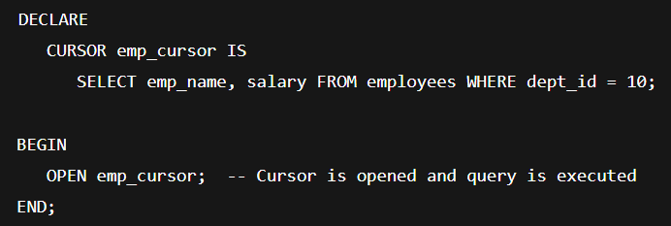
Example : -
Here, the emp_cursor is opened, and Oracle executes the SELECT query to fetch employee data for department 10.

Slide 38

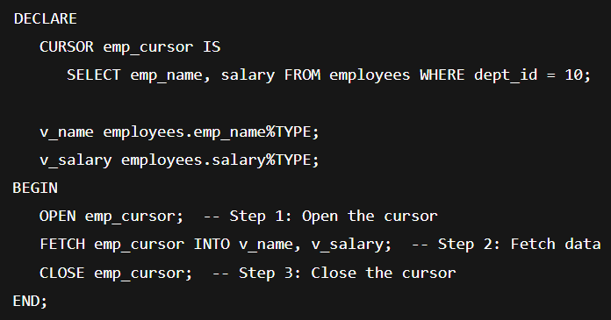
2. Closing a cursor : -
Closing a cursor means releasing the memory allocated to it and ending the cursor’s processing.
Once closed, the cursor cannot be used to fetch rows unless it is opened again.
Syntax : -
Example : -

Slide 39
Fetching a record from a cursor in pl/sql : -
Fetching a record from a cursor means transferring the current row of the cursor’s result set into specified variables.
Each FETCH statement moves the cursor to the next row automatically.
After opening a cursor, the next step is to fetch records from the result set (the rows returned by the cursor’s query).
Fetching means retrieving one row (or multiple rows) from the cursor into PL/SQL variables so that you can use the data in your program.
Syntax : -
cursor_name → The name of the cursor you opened.
variable1, variable2, ... → Variables that will store the data from each column of the current row.

Slide 40
6.5] Function in pl/sql : -
A Function in PL/SQL is a named block that performs a specific task and returns a single value to the calling program.
It is similar to a procedure, but the main difference is that a function must return a value, whereas a procedure may or may not.
Functions are used to perform calculations, manipulate data, and return results that can be used in SQL queries or PL/SQL programs.

Slide 41
Advantages of functions : -
Code Reusability : -
Functions can be called multiple times in different programs, reducing code repetition.
Modularity : -
Complex programs can be divided into smaller, manageable units (functions).
Maintainability : -
Easier to maintain and debug as each function performs a single task.
Improved Performance : -
Functions can be compiled and stored in the database for faster execution.
Return Values : -
Functions can return a single value that can be used directly in expressions, SELECT statements, or PL/SQL blocks.

Slide 42
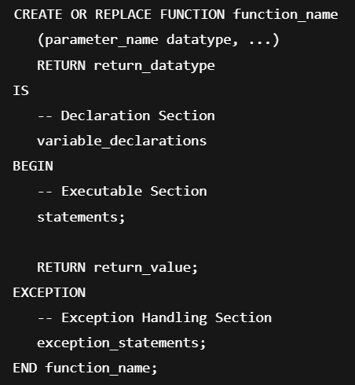
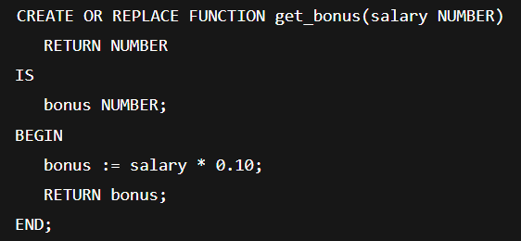
Structure of a Function : -
Example : -

Slide 43
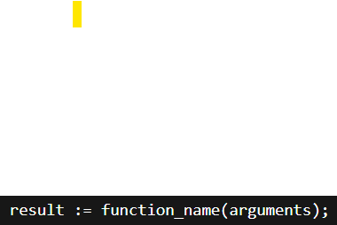
Executing a function : -
A function can be executed in multiple ways:
In PL/SQL block : -
result := function_name(arguments);
In SQL statement : -
SELECT function_name(column_name) FROM table_name;
Using DUAL table : -
SELECT function_name(value) FROM dual;

Slide 44

Deleting (dropping) a function : -
To delete a stored function from the database, use the DROP FUNCTION command:

Slide 45
6.6] stored procedures in pl/sql : -
A Stored Procedure in PL/SQL is a named block of code that performs one or more specific tasks and is stored permanently in the database.
Unlike a function, a stored procedure may or may not return a value but can return multiple values through OUT parameters.
Stored procedures help in modular programming and efficient database management.

Slide 46
Advantages of stored procedures : -
Improved Performance : -
Procedures are compiled once and stored in the database, so they execute faster than individual SQL statements.
Code Reusability : -
Once created, a procedure can be called multiple times by different applications.
Reduced Network Traffic : -
Multiple SQL statements can be executed within a single procedure call, reducing communication between client and server.
Better Security : -
Access can be restricted by granting execution rights instead of direct table access.
Easier Maintenance : -
Any changes to business logic can be made in the procedure without affecting the calling applications.
Modular Programming : -
Large programs can be divided into smaller, manageable subprograms.

Slide 47
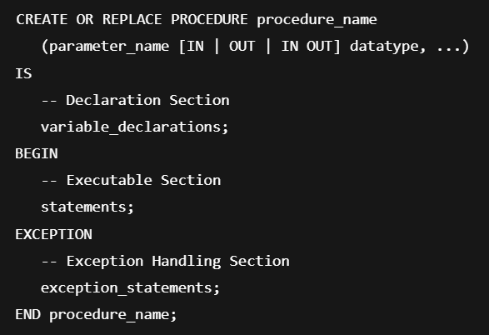
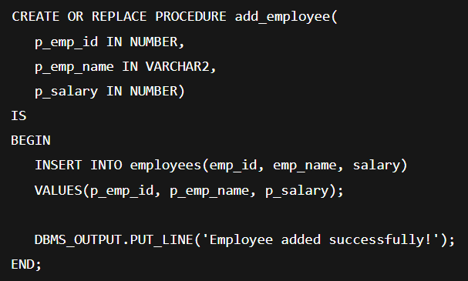
Structure of a Stored Procedure : -
Example : -

Slide 48
Creating a stored procedure : -
Syntax (SQL) : -
CREATE PROCEDURE procedure_name
AS
BEGIN
-- SQL statements
END;
Example : -
Create a stored procedure to display all students with marks above 60.
CREATE PROCEDURE GetHighScorers
AS
BEGIN
SELECT Name, Marks
FROM STUDENT
WHERE Marks > 60;
END;

Slide 49
Executing a stored procedure : -
Syntax : -
EXEC procedure_name;
OR
EXECUTE procedure_name;
Example : -
EXEC GetHighScorers;
→ Executes the stored procedure and displays all students with marks greater than 60.

Slide 50
Deleting a stored procedure : -
If a stored procedure is no longer needed, it can be deleted using the DROP PROCEDURE command.
Syntax : -
DROP PROCEDURE procedure_name;
Example : -
DROP PROCEDURE GetHighScorers;
→ Deletes the stored procedure GetHighScorers from the database.

Slide 51
6.7] database triggers : -
A Trigger is a special stored procedure in a database that is automatically executed (fired) when a specified event occurs on a table.
Triggers are used to monitor and respond to events like INSERT, UPDATE, or DELETE operations.
Example in Simple Words : -
If you want the database to automatically record every time a student's record is deleted.
You can create a trigger that inserts the deleted record into a “backup” or “log” table.

Slide 52
Use of database triggers : -
To maintain data integrity automatically.
To enforce business rules.
To log changes made to data (auditing).
To perform automatic actions when data changes.
To enhance security by restricting or monitoring data modifications.

Slide 53
How to apply database triggers : -
Identify the table on which the trigger will act.
Decide the event — when to trigger (INSERT, UPDATE, DELETE).
Define the timing — before or after the event.
Write the trigger body — what action should be performed.
Create and store the trigger in the database.

Slide 54
Types of database triggers : -
BEFORE Trigger : - Executes before the event occurs (used for validation or modification).
AFTER Trigger : - Executes after the event occurs (used for logging or updating other tables).
INSTEAD OF Trigger : - Used in place of the triggering operation (mainly for views).
Row-Level Trigger : - Executes once for each row affected.
Statement-Level Trigger : - Executes once for the entire SQL statement, regardless of the number of rows affected.

Slide 55
Syntax for creating a trigger : -
General Syntax : -
CREATE TRIGGER trigger_name
BEFORE | AFTER | INSTEAD OF
INSERT | UPDATE | DELETE
ON table_name
FOR EACH ROW
BEGIN
-- Trigger body (SQL statements)
END;

Slide 56
Deleting a trigger : -
If you no longer need a trigger, you can remove it using the DROP TRIGGER command.
Syntax : -
DROP TRIGGER trigger_name;

