Slide 1
Timer, Interrupts, Serial and Parallel communication

Slide 2
3.1 8051 Timer/Counter: Logic and Modes, Programming of 8051 timer
The 8051 has two independent 16 bit up counter timers name 0 and timer 1
8051 has two timer / counter which can be used as: Timer to generate a time generate a time delay ; and a counter to count events happening outside the microcontroller
Tomer 0 (T0) and timer 1 (T1) which act as counter and timer also
Both timers are 16 bit wide and each can act as separate 8 bit register and divided as high and low byte
16 bit
TH 8 byte TL 8 byte
(Higher byte) (Low byte )
8051 counter always count up i.e. it count in the incremental order
Each counter has 16 bit count register in the special function register area

Slide 3
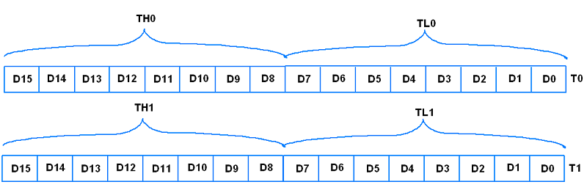
The Timer special function registers (SFRS) associated with /counter in 8051 include
1] Timer o Registers:
1] TMOD (Timer Mode): Used to set the operating mode of Timer 0. It specifies whether timer o operates as a 16-bit timer or as two separate 8 -bit timers.
2] Timer 1 Registers:
1] TMOD (Timer Mode): similar to Timer O, also configures the operating mode of Timer 1.

Slide 4
D7
D6
D5
D4
D3
D2
D1
D0
Gate
C1/T1
M1
M0
Gate
C0/T0
M1
M2
Timer 1 / Counter 1
Timer 0 / Counter 0
Gate :- This bit is used to start or stop the counter
To Start - counter set 1
To Stop - counter set 0
C1 / T1 :- This bit is used to decide whether timer is used as a delay generation or an event counter
Counter - 1
Counter - 0
M1 and M0 :- bit decide the mode of the timer.

Slide 5
M0 | M1 | Mode
0 | 0 | Mode 0 | 13 bit timer mode
0 | 1 | Mode 1 | 16 bit timer mode
1 | 0 | Mode 2 | 8 bit timer mode
1 | 1 | Mode 3 | 5 bit timer mode
Modes:
Mode-1: (16-bit timer mode) –
It is a 16-bit timer therefore it allows valve From 0000 FFFF H to be loaded into the time's register TL and TH.
FFFF …… 0001 0000
2. Mode-0:
(13-bit timer mode) Mode o is exactly same as mode1 except that it is a 13-bit timer instead of 16-bit.
3. Mode-2: (Auto related mode)
-It is an 8-bit timer mode only value 00 to FFH can be loaded into the timers register TH
FF
.
.
.

Slide 6
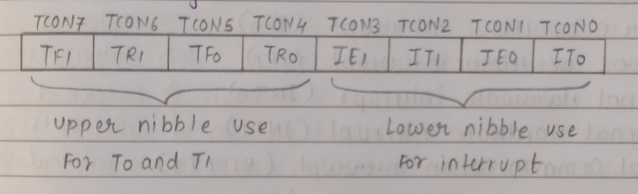
02
01
00
In mode 2 if Overflow condition is raised then TF is set of 1, TL is relocked automatically with original value kept by the TH register
4. Mode -3 : (Split timer mode)
Timer 0 and 1 may be programmed to be in mode 0,1,2 independently of similar mode for other timer
But timers do not operate independently if mode 3 is chosen for timer 0.
Placing timer 1 in mode 3 cause it to counting bit TR 1, and timer 1 flag TF 1 are then used by timer 0.
2) TCON (Timer Control) : It indicates the status of the timers thar whether the overflow condition id achieved or not
Or the control bit is set or not the will be give by the register.
It is 8 – bit register

Slide 7
TF 1 and TF0 : Timer 1 and Timer 0 Overflow flag set
TR 1 and TR 0 : Timer run control bit for start timer or timer 0
TE 1 and IE 0 : Interrupt edge used for enable external interrupts
IT 1 and IT 0 : external interrupt control bit
Instructions for start counter :
1] SETB TR 0 for timer 0
2] SETB TR 1 for timer 1
Instructions for stop counter :
1] CLR TR0 for timer 0
2] CLR TR1 for timer 1
3.2] 8051 interrupts:
Interrupts:
- Interrupt are the even that temporarily suspend the main program and pass the control to external source and execute their work
- It then passes the control to the main program where it had left off .

Slide 8
There are total five types of internal and external interrupts in 8051
Timer 0 overflow interrupt (TF0) Internal
Timer 1 overflow interrupt (TF1) Interrupts
External hardware interrupt (INT0) External
External hardware interrupt (INT1) Interrupts
Serial communication interrupt (RT/TI) Internal interrupt
All the interrupt are maskable and vector interrupts :
Interrupt source and their vector address :-
Interrupt source | Vector address | Interrupt priority
External interrupt – INT0 | 0 0 0 3 H | 1
Timer 0 overflow interrupt TF0 | 0 0 0 B H | 2
External interrupt – INT 1 | 0 0 13 H | 3
Timer 1 overflow interrupt TF 1 | 0 0 1B H | 4
Serial communication interrupt (RT/TI) | 0 0 23 H | 5

Slide 9
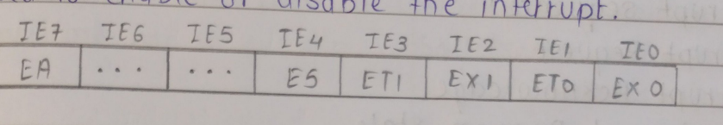
Special function register (SFRS) of interrupts
1] IE Register
2] TP Register
IE (Interrupt Enable) Register :- It is a 8 – bit register used to enable or disable the interrupt
EA : if EA = 0 ; no interrupt will be acknowledged if EA = 1 ; interrupt source is individually enabled or disabled by setting or clearing its enable bits.
IE 6 and IE 5 : Not implemented , Reserved for future use
ET 1 : Enable or disable timer 1 overflow interrupt
EX 1 : Enable or disable external interrupt 1
ET 0 : Enable or disable timer 0 overflow interrupt
EX 0 Enable or disable external interrupt 0.
2. IP (Interrupt priority) Register : It is a 8 – bit register used for setting the priority of all five interrupts

Slide 10
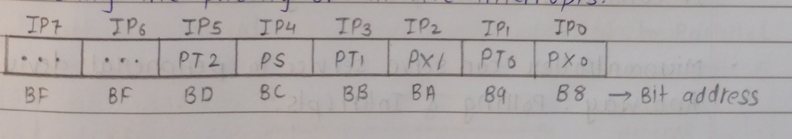
-JP7 (IP.6): Not implemented; reserved for future use.
-PT2: Not defined in the 8051 microcontroller; used in the 8052 microcontroller.
-PS: Used to set or clear the priority of the serial interrupt.
-PT1: Used to set or clear the priority of the Timer 1 overflow interrupt.
-PX1: Used to set or clear the priority of the external hardware interrupt 1 (INT1).
-PT0: used to set or clear the priority of timer 0 overflow interrupt
-PX0: used to set or clear the priority of external hardware interrupt 0(INT0)
Interrupt Sequence
1.Interrupt Request
2. Interrupt Acknowledge
3. Save current program state
4. Fetch interrupt vector
5. Jump to interrupt service Routine(ISR)
6. Execute ISR
7. Return Drom Interrupt

Slide 11
Polling:
The state of continuous monitoring is known as polling
The Microcontroller keeps checking the status of other devices and while doing so it does not perform any apparition
It consumes all its processing time for monitoring
Microcontroller can serve service to peripheral devices by two ways : Polling and Interrupt
Interrupt | Polling
Interrupt the device notice the CPU that is require its attention | In polling CPU steadily checks whether the devices needs attention
Interrupt is not a protocol it’s a hardware mechanism | Polling is not a hardware mechanism it’s a protocol
In interrupts the devices is serviced by the interrupt handles | While in polling the device is services by the CPU
Interrupt can taker place at any time | Where as in polling , CPU steactily ballots the device at regular or at proper interval

Slide 12
3.3 Serial communication
Communication
Serial Parallel
IT takes one bit at a time Simultaneously Transmitted
Parallel to Serial Serial to Parallel
Communication Communication
Serial Communication Parallel Communication
Microcontroller 8051
Peripheral devices
transmitter
Receiver
transmitter
Receiver

Slide 13
Types of Communication Link
Simplex
Half Duplex
Full Duplex
Simplex :- In simple communication , transmitter only transmit the data and receiver always receive the data
e.g. Print , Monitor
2. Half Duplex :- In half Duplex , transmitted transmits the data and receives the data but not at the same time. Only one direction at a time
e.g. Walkietalkie
3. Full Duplex :- In full Duplex Communication , Transmitter transmits the data and receives the data at a same time
e.g. Telephone network
TX
RX
TX
TX
TX
TX

Slide 14

Serial Communication :
- 805 1 Microcontroller supports full duplex serial port
Special function Register
SBVF Register (Serial Buffer)
SCON Register (Serial Control)
PCON Register (Power Control)
TCON Register (Timer Control)
a) SBUF Register
It is a 8 - bit register
805 transmit 8 – bit data and receive 8 – bit data at the time of transmission
IT is going to stop the 8 – bit data into buffer
Buffer is called serial buffer used for storage of data
b) SCON Register
IT is a 8 bit register
The contain made selection bit Serial port interrupt bit (TI / RI) the ninth data bit for transmission and receiving

Slide 15
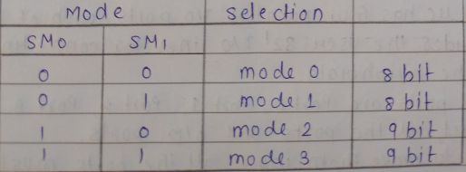

SM0 and SM1 are the mode selection
SM2 : Microcontroller communication in mode 2 and mode 3
REN : Enable serial communication
TBB : 9th nit transmitted in mode 2
RBB : 9th bit received in mode 2 and mode 3
TI : Transmit interrupt flag
RI :Receive interrupt Flag
C) Pcon Register:
-It is a 8 bit register
SMOD : Serial rate modify bit
Set 1= Double baud rate using timer1
Set 0= User timer 1 baud rate

Slide 16
- D6 , D5 , D4 : reserved for Future
- GF1 and GF0 : General purpose registers
PD : Power down , Reduces the power flag
TDL : IDLe mode , set the idle mode of 8051 microcontroller
3.4 Parallel Communication:
Parallel Communication of 8051 microcontroller
The 8051 microcontroller has four parallel I/O ports , each of 8 – bits so it provides the user 32 I/O lines for connection the microcontroller to the peripherals.
The four ports are ports 0 , port 1 , port 2 , port 3
Upon reset , all the ports are O/P ports
In order to make them input , all the ports must be set i.e. a high bit must by the instruction ‘SET B”
e.g. Mov A , # offH ; A = ff
Mov po , A ; make po an input port
Port 0 :
Port 0 is an 8 bit I/O with dual purpose . These port pins are used for the lower ordered
Multiplexed address/ data bus (AD0 – AD7) , Otherwise this port can be either input or output
Port 0 is not provided with push –up resistors of nearly 10 k are to be connected externally

Slide 17
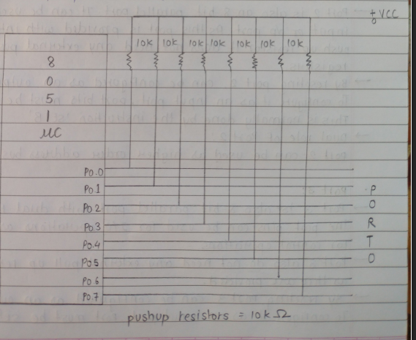
Dual role of port 0
ALE = 0 , it provides data D0-D1 and when
ALE = 1 , it provides address A0-A7

Slide 18
Port 1 :
Port 1 (8 pins ) has no dual application and acts only as input or output port; In contrast to port 0 , This port dos not need any push up resistor since pull up resistors are connected internally
By reseting port 1 can be configured as an output port To configure it as an input port , port bits must be set high. This is normally done by the instruction “SETB”
e.g. MOV A , # ffH ; A = ff Hex
MOV p1 , A ; make p1 an input port by writing 1 all of its pins
Port 2 :
Port 2 is also an 8 bit parallel port . It cab be used as input or O/P port . As this port is provided with internal push up resistor it does not need any external push up register
By reseting port 2 , can be Configure as an output port, To configure it as an input port bits must be set high This is normally done by the instruction “SET B”
Dual role of port 2 :
Port 2 can be used as higher order address bus A8-A15
Port 3:
-Port 3 is also 8 bit parallel port with dual function the port pins can be used for I/O operations as well as for control operations
Port 3 also do not need any extension pull up resistors as they are provided
By resetting port 3 can be configured as an output port to configure it as an input port , port must be set high

Slide 19
This is normally dome by the interaction “SET B”
Alternate function of port 3
This port is also used for timers , serial communication interrupts and ready and write operations

