Slide 1
5. Introduction to
Embeded system

Slide 2
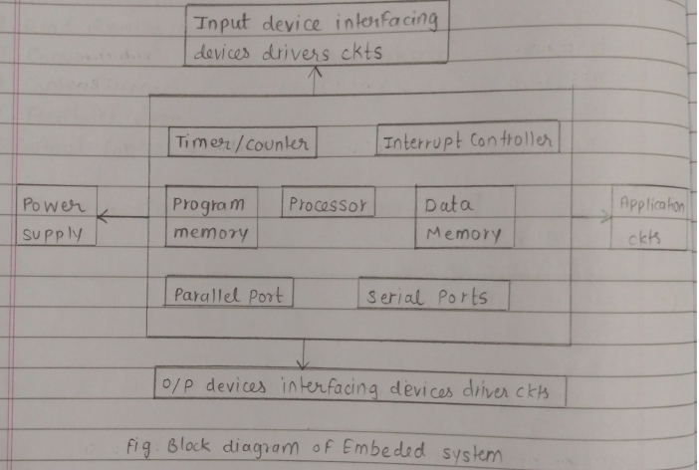
5.1 Block diagram of embeded system :-
Embeded system are integrated system made up of computer hardware and sofware that perform a specific task.

Slide 3
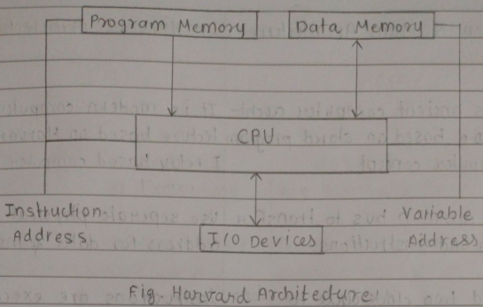
5.2 Harvare and non neuman architecture, RISC & CISC processors :-
Harvard architecture :-
The architecture which have seperate program memory and data memory that is called as hardware architecture.
Architecture is computer and the data complexity is less.

Slide 4
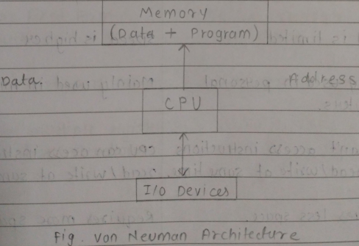
Non - Neuman architecture :-
The architecture which have no seperate program memory and data memory that is called as non neuman architecture.
Data complexity is more in non neuman architecture.

Slide 5
Difference Between von Neumann Architecture and Harvard Architecture :-
Von Neumann Architecture
Single memory for both instructions and data
One common bus for data and instructions
Slower (bottleneck issue, called Von Neumann Bottleneck)
Cheaper and simpler design
Used in general-purpose computers (PCs, laptops)
More flexible memory usage
Harvard Architecture
Separate memory for instructions and data
Separate buses for data and more instructions
Faster due to parallel data & instruction access
More expensive and complex
Used in microcontrollers, DSPs, embedded systems
Less flexible (fixed instruction & data memory sizes)

Slide 6
Difference Between RISC & CISC :-
RISC(Reduced Instruction Set Computer)
Small and simple instruction set
Faster (one instruction per cycle)
Simple hardware
Larger (more instructions needed)
Low
ARM, MIPS, SPARC
Mobile phones, embedded systems
CISC (Complex Instruction Set Computer)
Large and complex instruction set
Slower (multiple cycles per instruction)
Complex hardware
Smaller (fewer instructions needed)
High
Intel x86, AMD processors
Laptops, desktops, servers

Slide 7
Characteristics of Embedded Systems :-
1. Specific Function :- Designed to perform one dedicated task or a limited set of tasks.
2. Real-Time Operation :- Many embedded systems must respond quickly to inputs (e.g., airbags, pacemakers).
3. Low Power Consumption :- Works on limited power, often battery-powered.
4. Small Size :- Compact hardware and software design.
5. High Reliability :- Must work continuously without failure (e.g., ATM, medical devices)
6. Limited Resources :- Uses limited memory, processing power, and storage compared to general computers.
7. Low Cost :- Designed to be economical for mass production.
8. Minimal or No User Interface :- Often works automatically with little human interaction.
9. Real-Time Constraints :- Must give output within a fixed time (critical systems).
10. Hardware + Software Integrated :- Combination of microcontroller/microprocessor with software (firmware).

Slide 8
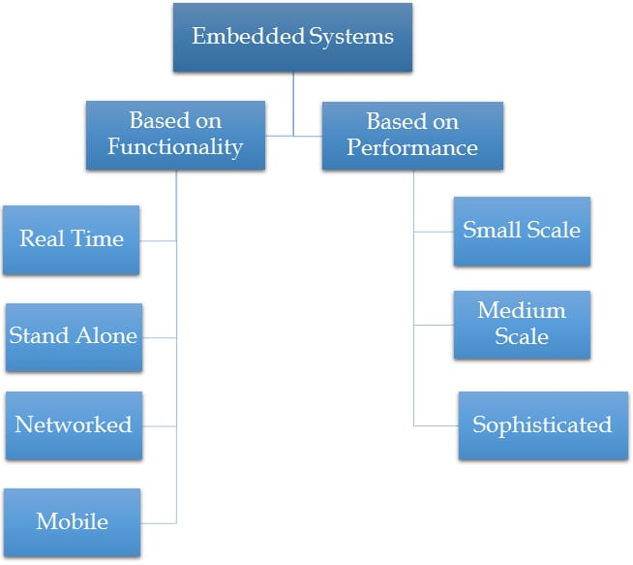
Classification of Embeded system :-

Slide 9
Based on performancs & function requirement :-
Real-Time Systems -
Hard real-time – must meet deadline (airbag system, pacemaker)
Firm real-time – deadline important but occasional miss allowed
Soft real-time – delay tolerable (multimedia, gaming system)
Standalone – works independently (calculator, digital watch)
Networked – connected to network (router, smart TV)
Mobile – portable embedded devices (smartphone)
Based on performancs & Microcontroller :-
Small-scale – simple controllers (e.g., washing machine, microwave)
Medium-scale – microprocessors, RTOS (e.g., smart security systems)
Large-scale – complex hardware + OS (e.g., avionics, industrial robots)

