Slide 1
Open source embedded development board (Arduino)

Slide 2
6.1] Arduino Birth: -
Arduino is an open source microcontroller board based on the microchip ATMega328p microcontroller.
It was developed by Arduino cc and initially released in 2005.
The microcontroller board is equipped with sets of digital and analogy Ilo pins that may be interfaced to various expansion boards and other ckt.
The board basically has 4 digit Ilo pins and is programmed with Arduino IDE via a type B USB cable, ora barrel connector accepts voltage between 7V and 20V.
It consists 2k bytes SRAM, 1kb EPROM.

Slide 3
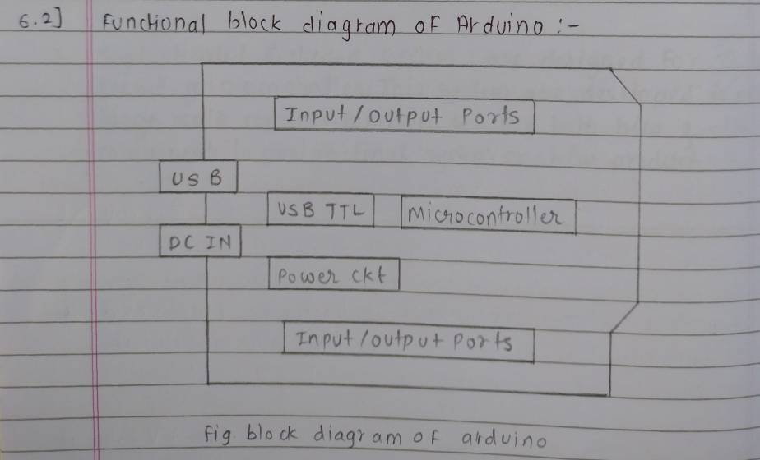

Slide 4
USB Socket : The USB socket on the Arduino UNO has two Functions: one is the communication to connect with computer through a USB port and also to load the firmware into the Arduino with the help of the boot loader
DC Barrel Jack. The DC barrel is used to supply Power to the UNO. We can supply 7-12 v through it and hence, we can use 12v DC adapter, 9V DL adapter on the jack to the power the Arduino board.
USB TTL chip: The communication with the computer the Arduino relies on a uSB TIL interface in UNO AT Mega 328D with custom Firmware act as USB TTL interface chip.
Digital & Analog I/0: The Arduino UNO has 14 digital 210 pins and 6 analog input pins. The digital I10 pins are 5v logic level and we can also use the analog pins as digital 110 foo. The Arduino Uno supports & channel to bit ADC inputs through no-A5 which can be sampled and analyze using UNO
ATMega328P: The ATMega328P microcontroller UNO: use 28 pin Dlp version of ATMega328P. It is pre-programmed with a bootloader that allow to directly upload the program to Arduino through uSB without the need For an external programmer.

Slide 5
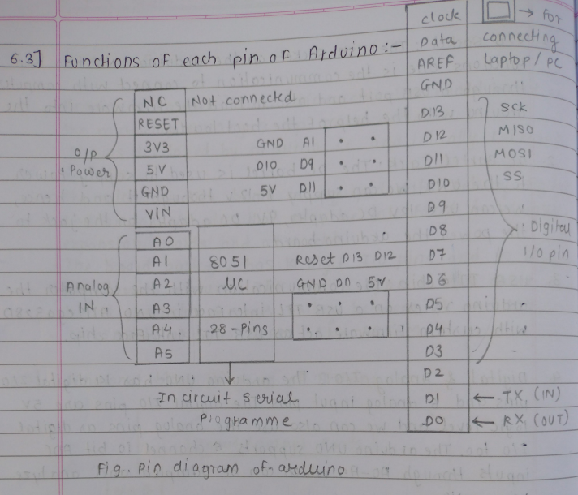

Slide 6
Vin: This is the input voltage pin of the Arduino board used to provide input supply From an external power source.
5V: This pin is used as a regulated power supply voltage and it is wed to give supply to the board as well as onboard components
3.3V: This pin is used to provide a supply of 3.3V which is generated from a volta voltage regulator on the board.
GND: This pin of the Boord is used to ground the Arduino board.
Reset: This pin is used to reset the microcontroller.
Analog Pins: The pins Ao to A5 are used as an analog input and it is in the range of 0-5V
Digital Pins : The pins o to 13 are used as a digital input or output for the Arduino board
Serial Pins (DI &DO) : This pins are also known as UART pin. The Transmiter pin no. 1 and receiver pin no.0 is used to fransmit ond receive the data respectively.

Slide 7
9. SPl Pins :
1) SS: Pin no is used as a slave select.
2) MOSI: pin no. 1l is used as a Master out slave in
3) MISO: Pin no. 12 is used as a Master in slave out
4) SCK : Pin no. 13 is used as a serial clock.
10. AREF pin : This is an analog reference pin of the Arduino board. It is used to provide a reference voltage from an external power supply
6.4] I/O Functions, Looping Techniques, Decision Making Techniques:-
I/O functions: These include functions to read From & write to digital and analog pins for digital pins, we have Functions like digital Read() and digital Write(), while for analog pins, we use analog Read() and analog Write().
Looping Techniques :- The loop Function is the main loop where your Arduino code runs repeatedly. Common looping- techniques include using for loops, 'while loops‘ to- while loops' to iterate through tasks.
Decision Making Techniques :- Arduino supports decision making structure such as if, else if, and else statements for conditional branching. You can also use switch statements For multi-way branching based on the value of a variable

Slide 8
6.5] Programming of an Arduino :-
1] LED Blink Program on Arduino:
int LED pi * 0 = 12 ;
int delay T = 20000
void setup()
{
//put your setup code here to run once
pin Mode (LED pin, OUTPUT);
void loop()
{
// put your main code here to run repeatedly
digital Write (LED Pin, HIGH);
delay (delay T);
digital Write (LED pin, LOW);
delay (delay T);
digital Write (LED pin, Low);
delay (delay T);
}

Slide 9
2] DAC Program on Arduino (using PWM):
void setup() {
// Initialize digital pin 5 as an output pin
pin Mode(5, OUTPUT);
}
void loop() {
// Set PWM at roughly 50% duty cycle on pin 5 (value 130 out of 255)
analog Write(5, 130);
}
3] DC Motor Control Program on Arduino:
int pinOfMotor = 11; // Pin 11 initialized to control motor, must be a PWM pin
void setup() {
pinMode(pinOfMotor, OUTPUT);
}
void loop() {
digitalWrite(pinOfMotor, HIGH); // Turn motor ON
delay(2000); // Run motor for 2 seconds
digitalWrite(pinOfMotor, LOW); // Turn motor OFF
delay(2000); // Wait for 2 seconds
}

Slide 10
4) stepper Motor Piogram an Arduino:
#include <Stepper.h>
const int stepsPerRevolution = 2048; // 32 steps per revolution * 64 gear ratio
// Initialize the stepper library on pins 8, 9, 10, 11 (example pins)
Stepper myStepper(stepsPerRevolution, 8, 10, 9, 11);
void setup() {
Serial.begin(9600); // Initialize serial communication
}
void loop() {
if (Serial.available() > 0) {
int val = Serial.parseInt(); // Read number of steps from serial input
Serial.println(val); // Print the value for debugging
myStepper.step(val); // Move the stepper motor by 'val' steps
}
}

Slide 11
5) LCD display program on Arduino:
#include <LiquidCrystal.h>
// Initialize the library with the numbers of the interface pins
// Pins: RS=13, Enable=12, D4=6, D5=4, D6=3, D7=2
LiquidCrystal lcd(13, 12, 6, 4, 3, 2);
void setup() {
// Set up the LCD's number of columns and rows
lcd.begin(16, 2);
}
void loop() {
// Set the cursor to column 0, line 0 (first row)
lcd.setCursor(0, 0);
lcd.print("Time in seconds:");
// Set the cursor to column 0, line 1 (second row)
lcd.setCursor(0, 1);
lcd.print(millis() / 1000); // Display number of seconds since program started
delay(1000); // Update every 1 second
}

Slide 12
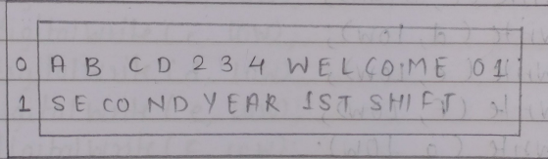
6] 7- segment display program an Arduino
const int a = 2;
const int b = 3;
const int c = 4;
const int d = 5;
const int e = 6;
const int f = 7;
const int g = 8;
void setup() {
pinMode(a, OUTPUT);
pinMode(b, OUTPUT);
pinMode(c, OUTPUT);
pinMode(d, OUTPUT);
pinMode(e, OUTPUT);
pinMode(f, OUTPUT);
pinMode(g, OUTPUT);
}

Slide 13
void zero() {
digitalWrite(a, HIGH);
digitalWrite(b, HIGH);
digitalWrite(c, HIGH);
digitalWrite(d, HIGH);
digitalWrite(e, HIGH);
digitalWrite(f, HIGH);
digitalWrite(g, LOW);
}
void one() {
digitalWrite(a, LOW);
digitalWrite(b, HIGH);
digitalWrite(c, HIGH);
digitalWrite(d, LOW);
digitalWrite(e, LOW);
digitalWrite(f, LOW);
digitalWrite(g, LOW);
}

Slide 14
void two() {
digitalWrite(a, HIGH);
digitalWrite(b, HIGH);
digitalWrite(c, LOW);
digitalWrite(d, HIGH);
digitalWrite(e, HIGH);
digitalWrite(f, LOW);
digitalWrite(g, HIGH);
}
void three() {
digitalWrite(a, HIGH);
digitalWrite(b, HIGH);
digitalWrite(c, HIGH);
digitalWrite(d, HIGH);
digitalWrite(e, LOW);
digitalWrite(f, LOW);
digitalWrite(g, HIGH);
}

Slide 15
void loop() {
zero();
delay(2000);
one();
delay(2000);
two();
delay(2000);
three();
delay(2000);
}

