Slide 1
Software Project Management

Slide 2
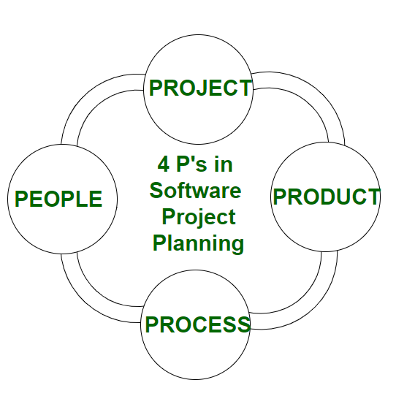
6.1 The management spectrum-4P’s
The Management Spectrum - 4 P’s in Software Project Management
The 4 P's represent four critical and interrelated components essential for managing software projects effectively. These are:
People
Product
Process
Project
People
The most important asset in software projects.
Includes all stakeholders such as developers, project managers, customers, users, analysts, testers, and sponsors.
Success depends on well-managed teams, clear roles, communication, and motivation.
Skills like leadership, collaboration, and problem-solving are crucia

Slide 3
2. Product
Represents the end deliverable of the project—either a software application or system.
Planning around the product involves defining scope, features, quality attributes, and constraints.
Understanding the product helps guide design, development, testing, and deployment.
Clear definition avoids scope creep, improves quality, and ensures alignment with customer needs.
3. Process
The structured set of activities and methodologies used to develop the product.
Provides a framework for planning, implementation, quality assurance, configuration management, and delivery.
A well-defined process gives predictability, minimizes risks, and enhances team efficiency.
Examples include Waterfall, Agile, Spiral, and DevOps processes.
4. Project
Refers to the organized effort to achieve objectives within cost, time, and resource constraints.
Project management includes scheduling, budgeting, resource allocation, risk management, and progress monitoring.
Acts as an integration point where people, product, and process converge to deliver value.
Milestones, tasks, and quality assurance checks form part of project tracking.

Slide 4
Summary
The 4 P's are pillars of software project management:
P | Focus Area | Importance
People | Talent and Stakeholders | Well-managed and motivated teams drive success
Product | Software Deliverables | Clear scope and quality definition guide efforts
Process | Methodology & Workflow | Structured development ensures consistency
Project | Planning and Control | Effective management aligns all factors

Slide 5
6.2 Metrics for Size Estimation: Line of Code (LoC), Function Points (FP).
Line of Code (LoC)
Definition:
LoC measures the size of a software project by counting the number of source code lines written (excluding comments and blank lines).
Details:
Often reported as KLoC (thousands of lines of code).
Easy to measure after coding is complete, but difficult to estimate early.
Highly dependent on programming language—some languages require fewer lines for the same functionality.
Reflects the developer's perspective and coding effort.
Advantages:
Simple and widely known metric.
Useful for tracking productivity and effort post-development.
Forms the basis for several cost estimation models (e.g., COCOMO).
Disadvantages:
Varies with coding style and language.
Not good for early project estimation.
Two programs with the same LoC may differ vastly in complexity.
Does not account for requirements or functionality directly.

Slide 6
2. Function Points (FP)
Definition:
Function Points estimate software size by quantifying the functionality delivered, based on user-visible features such as inputs, outputs, inquiries, files, and interfaces.
Calculation Process:
Identify and count function types (input, output, inquiries, internal files, external interfaces).
Assign complexity weights to each function.
Sum weighted counts to get Unadjusted Function Points.
Adjust total by complexity factors (e.g., performance, usability) to get the final Function Point count.
Advantages:
Language and technology independent.
Can be estimated early in the project using requirements.
Measures the user's perspective of software size.
Facilitates comparison across projects and organizations.
Disadvantages:
Subjective and relies on accurate function identification.
More complex to calculate than LoC.
Less effective for compute-intensive systems.

Slide 7
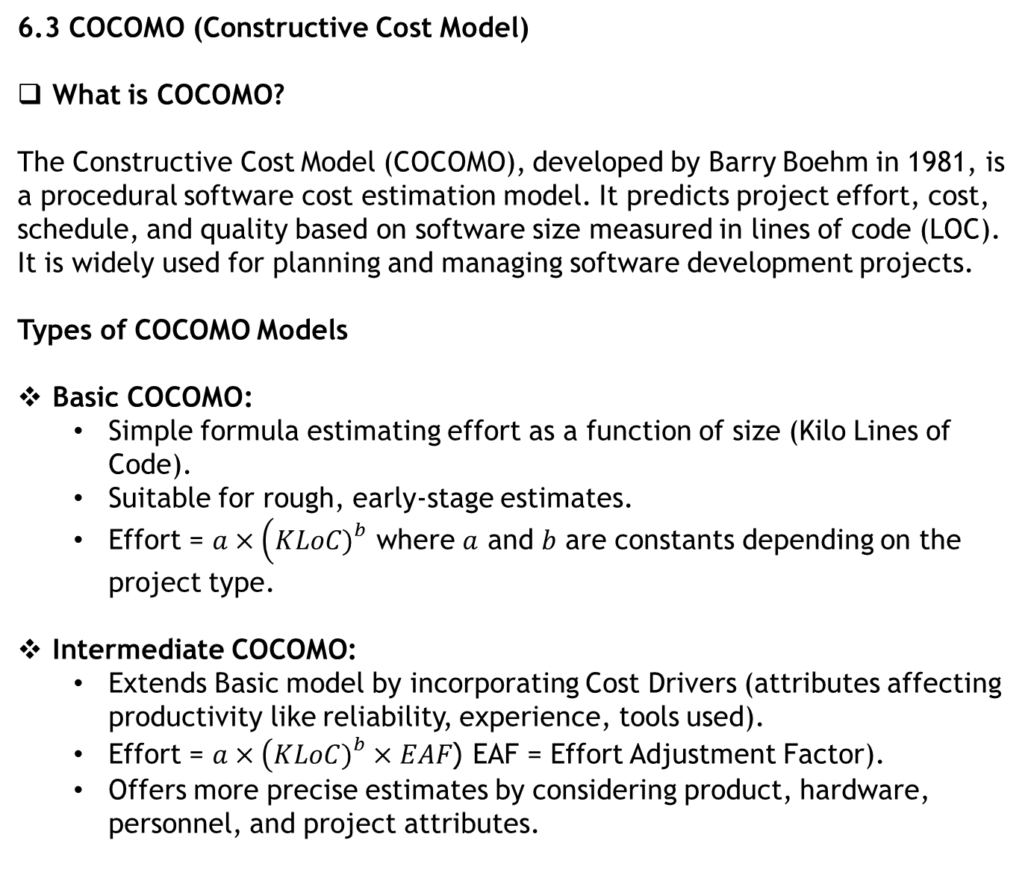
6.3 COCOMO (Constructive Cost Model)
What is COCOMO?
The Constructive Cost Model (COCOMO), developed by Barry Boehm in 1981, is a procedural software cost estimation model. It predicts project effort, cost, schedule, and quality based on software size measured in lines of code (LOC). It is widely used for planning and managing software development projects.
Types of COCOMO Models
Basic COCOMO:
  Simple formula estimating effort as a function of size (Kilo Lines of Code).
  Suitable for rough, early-stage estimates.
  Effort = $a×\left(KLoC{\left.)\right.}^{b}\right.$ where $a$ and $b$ are constants depending on the project type.
Intermediate COCOMO:
  Extends Basic model by incorporating Cost Drivers (attributes affecting productivity like reliability, experience, tools used).
  Effort = $a×\left(KLoC{\left.)\right.}^{b}×EAF\right.$ (EAF = Effort Adjustment Factor).
  Offers more precise estimates by considering product, hardware, personnel, and project attributes.

Slide 8
Detailed COCOMO:
  Further elaboration that applies cost drivers to individual phases/modules.
  Provides the most detailed and accurate estimation.
Project Classifications
Organic Projects: Small teams, well-understood problems, familiar environments.
Semidetached Projects: Medium-sized teams, some complexity, mix of inexperienced and experienced staff.
Embedded Projects: Complex systems with tight hardware/software integration, large teams, and stringent requirements
Important Parameters in COCOMO
Effort (person-months): Amount of labor needed.
Development Time (months): Time to complete project.
People Required: Team size estimates.
Cost Drivers: Factors like reliability, database size, complexity, programmer experience, used to adjust effort.

Slide 9
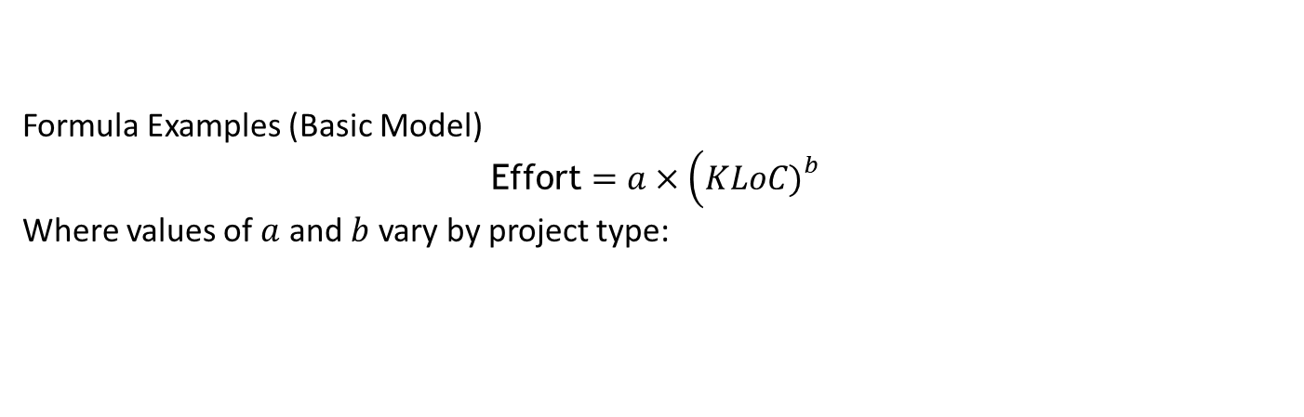
Formula Examples (Basic Model)
$$\text{Effort}=a×\left(KLoC{\left.)\right.}^{b}\right.$$
Where values of $a$ and $b$ vary by project type:
Project Type | aaa | bbb
Organic | 2.4 | 1.05
Semidetached | 3.0 | 1.12
Embedded | 3.6 | 1.20
Benefits of COCOMO
Provides quantitative estimation for planning.
Supports early project scoping and budgeting.
Adaptable for different project types and sizes.
Incorporates a range of project and personnel factors.
Limitations
Relies on accurate size estimation (LoC).
Cost drivers require subjective assessment.
May not fit well with modern rapid development methodologies without extensions.

Slide 10
COCOMO remains a foundational cost estimation approach useful in software project management for predicting effort, cost, and schedule with reasonable accuracy, especially in traditional development environments.
6.4 Risk Management: Risk Identification, Risk Assessment, RMMM Strategy.
1. Risk Identification
Definition: The process of detecting and documenting potential risks that could negatively impact the software project.
Activities: Brainstorming sessions, analysis of historical project data, stakeholder interviews, and checklists.
Purpose: Create a comprehensive risk list for further analysis.
Example: Identifying the risk of delayed requirements, technology changes, or resource unavailability.
2. Risk Assessment
Definition: Analyzing identified risks to determine their probability of occurrence and impact on the project.
Process:
  Assign values (e.g., 1 to 10) for likelihood and severity.
  Calculate Risk Exposure Factor = Probability × Impact.
  Prioritize risks based on exposure for focused management.
Tools: Risk matrices, qualitative and quantitative analysis.
Outcome: A prioritized risk register guiding mitigation strategies.

Slide 11
3. Risk Mitigation, Monitoring, and Management (RMMM) Strategy
Mitigation: Implement strategies to avoid, reduce, transfer, or accept risks.
  Avoidance: Alter project plan to eliminate risk.
  Reduction: Take proactive steps to minimize risk impact or likelihood.
  Transfer: Shift risk to a third party (e.g., insurance, outsourcing).
  Acceptance: Acknowledge risk when costs of mitigation outweigh benefits.
Monitoring: Continuously track risks to detect changes in status or new risks.
Management: Adjust mitigation plans and communicate updates to stakeholders.
Purpose: Reduce risk impact and ensure readiness for issues that arise.
Summary
Step | Description | Key Activities
Risk Identification | Detect and list potential risks | Brainstorming, historical analysis, checklists
Risk Assessment | Evaluate likelihood and impact, prioritize risks | Assign values, calculate risk exposure
RMMM Strategy | Develop and implement mitigation, monitor, manage | Avoid, reduce, transfer, accept, continuous monitoring

Slide 12
6.5 DevOps testing methods.
DevOps Testing Methods
DevOps testing integrates testing throughout the entire software development lifecycle with an emphasis on automation, continuous testing, and collaboration to ensure rapid delivery of high-quality software
Key DevOps Testing Methods
1.Unit Testing
  Tests small, isolated code parts (functions, methods).
  Fast feedback on code correctness.
  Typically automated using frameworks like JUnit, NUnit.
2.Component Testing
  Tests combined components or modules.
  Verifies interactions within boundaries of a component
3.Integration Testing
  Tests interactions between integrated components/services.
  Detects interface and data flow errors.

Slide 13
4.API Testing
  Validates individual or chained microservices or APIs.
  Tests data types, contracts, and error handling.
5.Functional Testing
  Tests user workflows or business features end-to-end.
  Ensures application performs expected tasks.
6.End-to-End (E2E) Testing
  Simulates real user scenarios covering entire system flow, including external dependencies.
  Provides high confidence in system behavior.
7.Performance/Stress Testing
  Measures system behavior under load, stress, and varying conditions.
  Tools: JMeter, Blazemeter, K6.
8.Acceptance Testing
  Evaluates if the software meets business requirements.
  Verified by stakeholders or customers.
9.Regression Testing
  Ensures new code changes do not break existing functionality.
  Automated suites are crucial for frequent changes.

Slide 14
10.Security Testing
  Incorporates security checks throughout development.
  Static code analysis (SAST), dynamic testing (DAST), software composition analysis (SCA).
11.Fuzz Testing
  Inputs random or malformed data to uncover vulnerabilities and crashes.
DevOps Testing Characteristics
Continuous Testing: Automated tests run continuously during the pipeline, enabling rapid feedback.
Shift-Left Testing: Testing is moved earlier in the development, often integrated into code commits.
Automation: Reduces manual effort, improves consistency, and accelerates release cycles.
Collaboration: Developers, testers, and ops teams work closely, sharing responsibility for quality.
Comprehensive Coverage: Combines many test types (unit, integration, E2E, security) for robust quality assurance.
Tool Integration: Uses tools like Jenkins, Selenium, JUnit, and others integrated into CI/CD pipelines.

Slide 15
Benefits
Early bug detection and faster fixes.
Higher code quality and reliability.
Reduced time to market.
Improved team productivity and morale.
Better alignment with business needs through continuous feedback.

