Slide 1
04. Stack

Slide 2
4.1] STACK : -
🔹 4.1 Definition & Examples of Stack : -
Definition:
A Stack is a linear data structure that follows the LIFO (Last In, First Out) principle.
➡️ The last element inserted into the stack is the first one to be removed.
Real-Life Examples:
A stack of plates — you remove the top plate first.
Undo/Redo feature in text editors.
Browser history (Back button)

Slide 3
Stack as an abstract data types (ADT) : -
A stack can be defined by the following operations:
push(x) – Insert element x into the stack
pop() – Remove and return the top element
peek() / top() – Return the top element without removing it
isEmpty() – Check if stack is empty
isFull() – Check if stack is full (for array implementation)

Slide 4
4.2] Operations on stack : -
Operations on Stack
A stack is a linear data structure that works on the LIFO (Last In, First Out) principle.
The main operations that can be performed on a stack are:
👉 PUSH, POP, and TOP/PEEK
🔹 1. PUSH Operation
Definition:
The PUSH operation is used to insert (add) a new element into the top of the stack.
2. POP Operation
Definition:
The POP operation is used to remove the topmost element from the stack.

Slide 5
1. PUSH Operation : -
Definition:
The PUSH operation is used to insert (add) a new element into the top of the stack.
Algorithm:
1. Check if the stack is full (top == size - 1)
2. If full → Stack Overflow
3. Else → Increment top
4. Insert the new element at stack[top]
C Example:
void push(int x) {
if (top == SIZE - 1)
printf("Stack Overflow\n");
else {
top++;
stack[top] = x;
printf("%d pushed to stack\n", x);
}
}

Slide 6
2. POP Operation : -
Definition:
The POP operation is used to remove the topmost element from the stack.
Algorithm:
1. Check if the stack is empty (top == -1)
2. If empty → Stack Underflow
3. Else → Print the top element
4. Decrement top by 1
C Example:
void pop() {
if (top == -1)
printf("Stack Underflow\n");
else {
printf("%d popped from stack\n", stack[top]);
top--;
}
}

Slide 7
3. TOP/PEED Operation : -
Definition:
The TOP (or PEEK) operation is used to view the top element of the stack without removing it.
Algorithm:
1. If stack is empty → Underflow
2. Else → Return stack[top]
C Example:
void peek() {
if (top == -1)
printf("Stack is empty\n");
else
printf("Top element = %d\n", stack[top]);
}

Slide 8
4.3] Stack Overflow : -
1. Stack Overflow
Definition:
A Stack Overflow occurs when we try to push (insert) an element into a full stack.
In other words, the program tries to store data beyond the stack’s maximum capacity.
Condition:
if (top == SIZE - 1)
printf("Stack Overflow");
Here:
SIZE → maximum stack capacity
top → index of the last element in the stack

Slide 9
Example : -
#include <stdio.h>
#define SIZE 3
int stack[SIZE];
int top = -1;
void push(int x) {
if (top == SIZE - 1)
printf("Stack Overflow\n");
else {
top++;
stack[top] = x;
printf("%d pushed\n", x);
}
}
int main() {
push(10);
push(20);
push(30);
push(40); // overflow occurs
return 0;
}
✅ Output:
10 pushed
20 pushed
30 pushed
Stack Overflow

Slide 10
2. Stack Underflow : -
2. Stack Underflow
Definition:
A Stack Underflow occurs when we try to pop (remove) an element from an empty stack.
It means there are no elements to remove.
Condition:
if (top == -1)
printf("Stack Underflow");

Slide 11
Example : -
#include <stdio.h>
#define SIZE 3
int stack[SIZE];
int top = -1;
void pop() {
if (top == -1)
printf("Stack Underflow\n");
else {
printf("%d popped\n", stack[top]);
top--;
}
}
int main() {
pop(); // underflow occurs
return 0;
}
✅ Output:
Stack Underflow

Slide 12
4.4] Applications of Stack : -
1. Reversing Data (Strings, Lists, Numbers)
2. Checking Balanced Parentheses
3. Expression Evaluation (Postfix / Prefix)
4. Function Calls and Recursion
5. Undo/Redo Feature
6. Browser History / Navigation
7. Memory Management
8. Depth First Search (DFS) Algorithm

Slide 13
4.5] Polish Notation : -
Polish Notation (Prefix and Postfix)
🔹 What is Polish Notation?
Polish Notation is a way of writing arithmetic expressions without using parentheses, by changing the position of the operator relative to its operands.
It is based on the stack concept and is used in expression evaluation and compiler design.
🔸 Types of Polish Notation : -
1. Infix Notation.
2. Prefic Notation.

Slide 14
1. Infix Notation (Normal Form)
This is the regular form we use in arithmetic expressions.
📘 Example:
(A + B) * (C - D)
Here, the operator is between operands.
2. Prefix (Polish) Notation
Definition:
In Prefix, the operator comes before operands.
Example:
Infix: (A + B) * (C - D)
Prefix: * + A B - C D
How to Read:
→ * means multiply
→ First multiply the result of (+ A B) and (- C D)
So expression = (A + B) * (C - D)

Slide 15
4.6] Reversing a list : -
🔹 Definition:
Reversing a list means changing the order of elements in a list so that the first element becomes the last, and the last becomes the first.
📘 Example:
Original List | Reversed List
[10, 20, 30, 40, 50] | [50, 40, 30, 20, 10]

Slide 16
Why use Stack to Reverse a List?
A stack works on the LIFO (Last In, First Out) principle —
which means the last element pushed into the stack is the first one to come out.
So, if we push all elements of a list into a stack and then pop them one by one,
we get them in reverse order.
🔹 Algorithm (Steps)
Step 1: Create an empty stack.
Step 2: Push all elements of the list into the stack (from first to last).
Step 3: Pop each element from the stack and store it back into the list.
Step 4: The list is now reversed.

Slide 17
Example
Let’s take a list:
[1, 2, 3, 4, 5]
Step 1: Push all into stack
Stack (Top → Bottom): [5, 4, 3, 2, 1]
Step 2: Pop all elements
Pop → 5, 4, 3, 2, 1
Now the reversed list = [5, 4, 3, 2, 1]

Slide 18
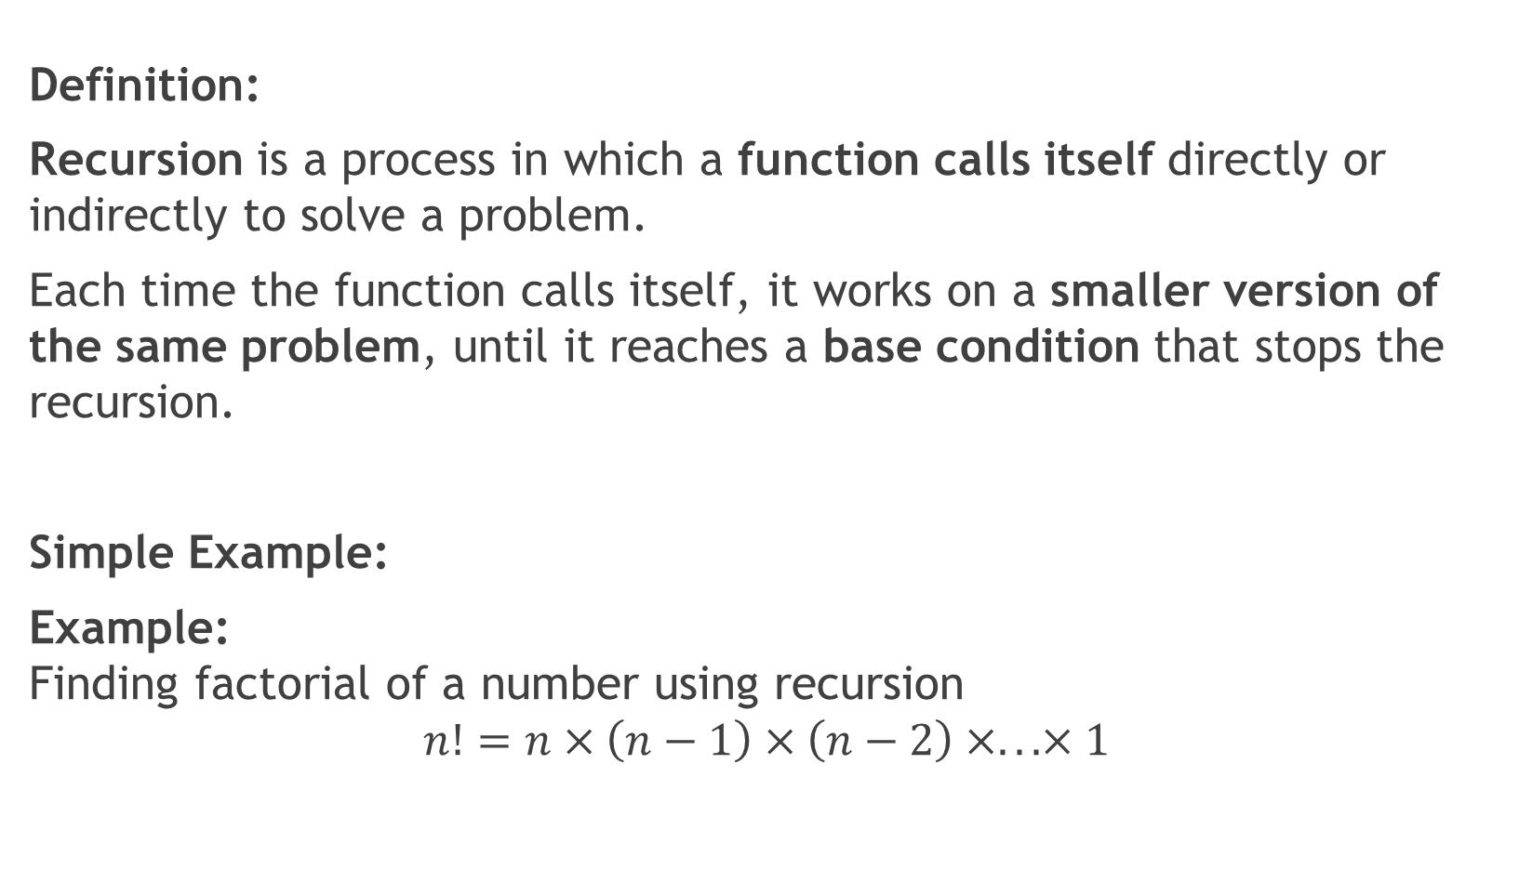
4.7] Recursion : -
Definition:
Recursion is a process in which a function calls itself directly or indirectly to solve a problem.
Each time the function calls itself, it works on a smaller version of the same problem, until it reaches a base condition that stops the recursion.
Simple Example:
Example:
Finding factorial of a number using recursion
$$n!=n×\left(n−1\right)×\left(n−2\right)×...×1$$

