Slide 1
06. Trees & graphs

Slide 2
Trees & Graphs : -
Both Trees and Graphs are non-linear data structures used to represent relationships among data elements.
Introduction to Tree
🔹 Definition:
A Tree is a non-linear hierarchical data structure that consists of nodes connected by edges.
It represents data in a parent-child relationship form.
🔹 Example:
A
/ \
B C
/ \
D E
Here:
A → Root node
B, C → Children of A
D, E → Leaf nodes (no children)

Slide 3
Types : -
Type | Description
Binary Tree | Each node has at most two children (left and right).
Binary Search Tree (BST) | Left child < Parent < Right child.
Full Binary Tree | Every node has 0 or 2 children.
Complete Binary Tree | All levels filled except possibly the last.
AVL Tree | Height-balanced binary tree.
General Tree | A node can have any number of children.
Types of Trees

Slide 4
5.1] Tree Terminologies : -
Term | Definition
Node | Each element of a tree is called a node.
Root | The topmost node in the tree. (e.g., A)
Parent Node | A node that has child nodes. (e.g., A is parent of B and C)
Child Node | Nodes that have a parent. (e.g., B and C are children of A)
Leaf Node / Terminal Node | Nodes that have no children. (e.g., D, E)
Edge | Connection between two nodes. (e.g., A–B, B–D)
Siblings | Nodes having the same parent. (e.g., B and C)
Level | The root node is at level 0 (or 1), its children at next level, and so on.
Height / Depth | The length of the longest path from the root to a leaf node.
Subtree | Any node and its descendants form a subtree.
Degree of Node | Number of children a node has.
Degree of Tree | Maximum degree among all nodes in the tree.

Slide 5
6.2] Types of TREE : -
A Tree is a non-linear data structure used to represent data in a hierarchical form (like a family tree or folder structure).
There are several types of trees based on their structure and rules.
General Tree.
Binary Tree.
Binary Search Tree.

Slide 6
1. General Tree : -
🔹 Definition:
A General Tree is a tree in which any node can have any number of children.
There is no restriction on the number of child nodes.
🔹 Structure Example:
A
/ | \
B C D
/ \
E F
🔹 Applications:
File directory structures
Organization hierarchy
XML/HTML document structures

Slide 7
2. Binary Tree : -
🔹 Definition:
A Binary Tree is a tree in which each node can have at most two children —
called left child and right child.
🔹 Structure Example:
A
/ \
B C
/ \
D E
🔹 Applications:
Expression evaluation (Arithmetic expressions)
Parsing and searching operations
Implementing priority queues and heaps

Slide 8
3. Binary Search Tree (BST) : -
🔹 Definition:
A Binary Search Tree is a special type of binary tree in which:
The left child contains nodes with values less than the parent node.
The right child contains nodes with values greater than the parent node.
🔹 Structure Example:
50
/ \
30 70
/ \ / \
20 40 60 80
🔹 Properties:
Left < Root < Right
No duplicate nodes allowed.
Traversing the BST in in-order gives elements in ascending order.

Slide 9
Introduction to graph : -
🔹 Definition:
A Graph is a non-linear data structure consisting of a set of vertices (nodes) and edges (connections) between them.
Formally,
Graph G = (V, E)
where
V → set of vertices
E → set of edges connecting vertices
🔹 Example:
A —— B
| / |
| / |
C —— D
Here:
V = {A, B, C, D}
E = {(A,B), (A,C), (B,C), (B,D), (C,D)}

Slide 10
Graph Terminologies : -
Term | Definition
Vertex (Node) | Fundamental unit of a graph. (e.g., A, B, C, D)
Edge | Connection between two vertices. (e.g., (A,B))
Adjacent Vertices | Two vertices connected by an edge.
Path | A sequence of edges connecting vertices.
Degree of Vertex | Number of edges connected to a vertex.
Loop | An edge that connects a vertex to itself.
Parallel Edges | Two or more edges connecting the same pair of vertices.
Connected Graph | A graph where every vertex is reachable from every other vertex.
Disconnected Graph | Some vertices are not connected to others.
Weighted Graph | Each edge has a weight (cost, distance, etc.).
Directed Graph (Digraph) | Edges have directions (→).
Undirected Graph | Edges have no direction.
Cycle | A path where the start and end vertices are the same.
Acyclic Graph | A graph with no cycles. (All trees are acyclic graphs.)

Slide 11
🔹 Operations in BST:
Insertion: Add a node at correct position based on value.
Deletion: Remove a node and rearrange links.
Search: Search for a value efficiently (O(log n) average time).
🔹 Applications:
Efficient searching and sorting
Database indexing
Symbol tables in compilers

Slide 12
6.3] Representation of Tree : -
A Tree is a non-linear data structure that connects nodes using links (edges).
To store and process a tree in a computer, we need to represent it properly in memory.
There are two main methods to represent a tree:
Using Arrays
Using Linked Lists

Slide 13
1. Array Representation : -
🔹 Idea:
Each node of the tree is stored in an array, and the position (index) represents the relationship between parent and child.
This method is usually used for Complete Binary Trees.
🔹 Rules (for Binary Tree):
If a node is stored at index i, then:
Left child → index 2i
Right child → index 2i + 1
Parent → index i/2 (integer division)
Advantages:
Easy to locate parent and child using formulas
Memory efficient for complete trees
🔹 Disadvantages:
Wastes memory if the tree is sparse
Difficult to add or delete nodes dynamically

Slide 14
2. Linked List Representation : -
🔹 Idea:
Each node contains:
Data (value)
Pointer to its left child
Pointer to its right child
🔹 Structure (in C):
struct node {
int data;
struct node *left;
struct node *right;
};
🔹 Example:
For the tree:
A
/ \
B C
/ \
D E

Slide 15
🔹 Advantages : -
Dynamic — can grow or shrink easily
No wasted space
Works well for any type of tree (not only binary)
🔹 Disadvantages : -
Requires extra memory for pointers
Accessing parent nodes is not straightforward

Slide 16
6.4] Operations on trees : -
OPERATIONS ON TREES
A Tree is a non-linear data structure used to store hierarchical relationships between elements.
Common operations performed on trees include :
Insertion
Deletion
Searching
  Depth-First Search (DFS)
  Breadth-First Search (BFS

Slide 17
1. Insertion : -
🔹 Definition:
Insertion means adding a new node to the tree while maintaining its structure or specific properties (like in a Binary Search Tree).
🔹 Steps (in Binary Tree):
Start from the root node.
If the tree is empty, the new node becomes the root.
Otherwise, find the correct position where the new node should be inserted (usually the first available place in level order).
Insert the new node as left or right child.
🔹 Steps (in Binary Search Tree – BST):
If the tree is empty → the new node becomes the root.
If new value < current node → go to left subtree.
If new value > current node → go to right subtree.
Repeat until a null position is found, then insert the node.

Slide 18
Example (BST Insertion) : -
Insert 45 into this BST:
50
/ \
30 70
/ \ / \
20 40 60 80
👉 45 < 50 → go left
👉 45 > 30 → go right
👉 45 > 40 → insert as right child of 40

Slide 19
2. Deletion : -
🔹 Definition:
Deletion means removing a node from the tree and rearranging remaining nodes to maintain structure or property.
🔹Example:
Delete 30 from the BST:
50
/ \
30 70
/ \ / \
20 40 60 80
30 has two children → replace it with inorder successor (40).
New tree:
50
/ \
40 70
/ / \
20 60 80

Slide 20
Example : -
Delete 30 from the BST:
50
/ \
30 70
/ \ / \
20 40 60 80
30 has two children → replace it with inorder successor (40).
New tree:
50
/ \
40 70
/ / \
20 60 80

Slide 21
A. Depth-First search (DFS) : -
DFS explores as deep as possible along each branch before backtracking.
It uses stack (explicit or recursion).
Types of DFS Traversals:
Traversal Type | Order of Visit
Pre-order | Root → Left → Right
In-order | Left → Root → Right
Post-order | Left → Right → Root

Slide 22
Example : -
For tree
A / \ B C / \ D E
Traversal Type | Sequence
Pre-order | A, B, D, E, C
In-order | D, B, E, A, C
Post-order | D, E, B, C, A

Slide 23
B. Breadth-First Search (BFS) : -
Also called Level-Order Traversal.
🔹 Definition:
BFS visits all nodes level by level, from top to bottom and left to right.
It uses a Queue data structure.
🔹 Example:
For the same tree:
A
/ \
B C
/ \
D E
BFS Traversal (Level Order):
👉 A → B → C → D → E

Slide 24
5.5] Tree Traversing : -
🔹 Definition:
Tree Traversal means visiting all the nodes of a tree exactly once in a specific order.
Traversal helps us access, print, or process the data stored in each node.
There are two main types of tree traversals:
Depth-First Traversal (DFS)
  Pre-order
  In-order
  Post-order
Breadth-First Traversal (BFS)
  Level-order (covered earlier)

Slide 25
1. Pre-order Traversal : -
🔹 Definition:
In pre-order traversal,
we visit the root node first, then traverse the left subtree, and finally the right subtree.
🔹 Steps:
Visit the root.
Traverse the left subtree.
Traverse the right subtree.
🔹 For the above tree:
Order of visiting →
A → B → D → E → C

Slide 26
2. In-order Traversal : -
🔹 Definition:
In in-order traversal,
we traverse the left subtree first, then visit the root, and finally the right subtree.
🔹 Steps:
Traverse the left subtree.
Visit the root.
Traverse the right subtree.
🔹 For the above tree:
Order of visiting →
D → B → E → A → C

Slide 27
3. Post-order Traversal : -
🔹 Definition:
In post-order traversal,
we first traverse the left subtree, then the right subtree, and finally visit the root node.
🔹 Steps:
Traverse the left subtree.
Traverse the right subtree.
Visit the root.
🔹 For the above tree:
Order of visiting →
D → E → B → C → A

Slide 28
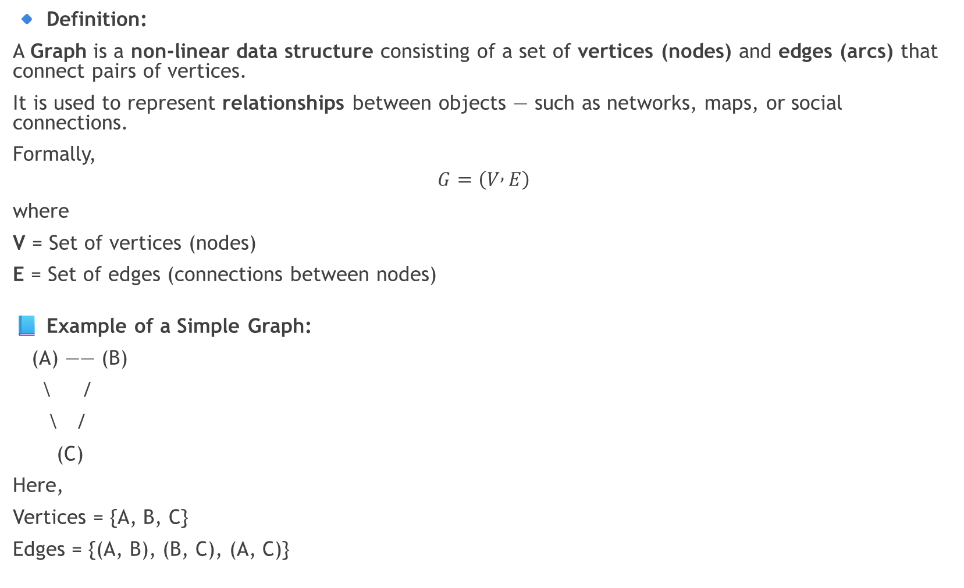
5.6] Introduction to Graph : -
🔹 Definition:
A Graph is a non-linear data structure consisting of a set of vertices (nodes) and edges (arcs) that connect pairs of vertices.
It is used to represent relationships between objects — such as networks, maps, or social connections.
Formally,
$$G=\left(V , E\right)$$
where
V = Set of vertices (nodes)
E = Set of edges (connections between nodes)
📘 Example of a Simple Graph:
(A) —— (B)
\ /
\ /
(C)
Here,
Vertices = {A, B, C}
Edges = {(A, B), (B, C), (A, C)}

Slide 29
GRAPH TERMINOLOGIES : -
Term | Definition | Example / Explanation
Graph | A collection of nodes (vertices) connected by edges (arcs). | Social network, road map
Node / Vertex | A point in the graph representing an entity. | A, B, C are vertices
Edge / Arc | A connection (or line) between two vertices. | (A, B) connects A and B
Directed Graph (Digraph) | A graph where each edge has a direction. | (A → B) means one-way connection
Undirected Graph | A graph where edges have no direction. | (A — B) means two-way connection
In-degree | Number of incoming edges to a vertex (in directed graph). | If 3 arrows point to A, In-degree = 3
Out-degree | Number of outgoing edges from a vertex. | If 2 arrows go from A, Out-degree = 2
Adjacent Vertices | Two vertices are adjacent if they are connected by an edge. | A and B are adjacent if (A, B) exists
Successor | In a directed graph, a vertex pointed to by another vertex. | If A → B, then B is successor of A
Predecessor | In a directed graph, a vertex that points to another vertex. | If A → B, then A is predecessor of B
Relation | The connection or association between two vertices. | A road, link, or reference between two nodes
Weight / Cost | A value (number) assigned to an edge, representing cost, distance, or time. | (A — B) weight = 5 km
Path | A sequence of edges connecting two vertices. | Path A → B → C
Length of Path | The number of edges (or sum of weights) in a path. | A → B → C → D has length = 3 edges
Loop | An edge that connects a vertex to itself. | (A → A)
Parallel Edges (Multiple Edges) | Two or more edges connecting the same pair of vertices. | Two routes between cities A and B

Slide 30
Types of Graphs (Basic Overview) : -
Type | Description
Undirected Graph | Edges have no direction.
Directed Graph (Digraph) | Edges have direction (arrows).
Weighted Graph | Each edge has a numerical weight.
Unweighted Graph | All edges are considered equal.
Simple Graph | No loops or multiple edges.
Multigraph | Can have multiple edges between same vertices.

Slide 31
Example : -
Example (Directed Weighted Graph) :
(A)
/ \
5/ \3
/ \
(B) →2→ (C)
Vertices = {A, B, C}
Edges = {(A → B, 5), (A → C, 3), (B → C, 2)}
In-degree of A = 0
Out-degree of A = 2
In-degree of C = 2
Path A → B → C has length 2 (total weight = 7)

