Slide 1
3.1 Introduction and Terminologies: Node, Next Address and Pointer, Null pointer, Empty list

Slide 2
3.1 Introduction and Terminologies: Node, Next Address and Pointer, Null pointer, Empty list
Introduction and Terminologies in Linked List:
Node: A node is the basic unit of a linked list. It typically contains two parts — the data (which stores the actual value) and the next address (or pointer) that holds the memory address of the next node in the list. This linking between nodes enables the list to be traversed from one node to another.
Next Address and Pointer: The next address is stored in a pointer within each node. This pointer connects the current node to the next node in the sequence. The pointer essentially "points" to the location of the next node in memory, enabling the linked structure.
Null Pointer: The last node in a linked list has a pointer that does not point to any other node; this is called a null pointer. It signifies the end of the list, indicating there are no further nodes.
Empty List: An empty list is a linked list that contains no nodes at all. Its head pointer is set to null, meaning there is no data or nodes to traverse.

Slide 3
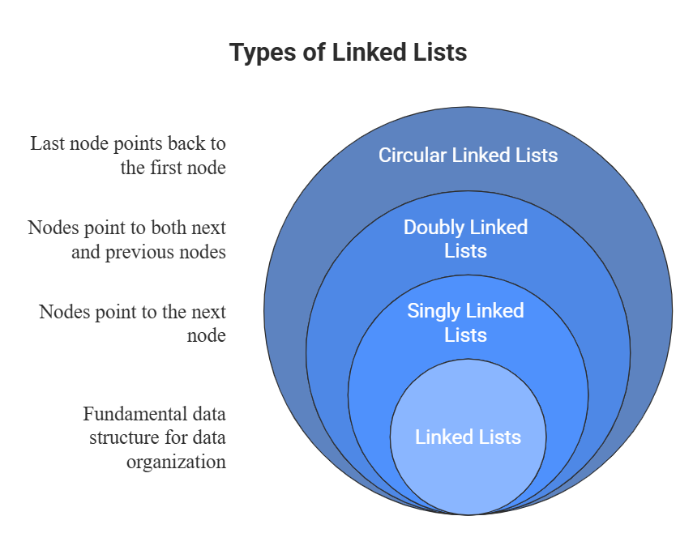
3.2 Types of Linked List: Single Linked List, Doubly Linked List, Circular Linked List Doubly Circular Linked List

Slide 4
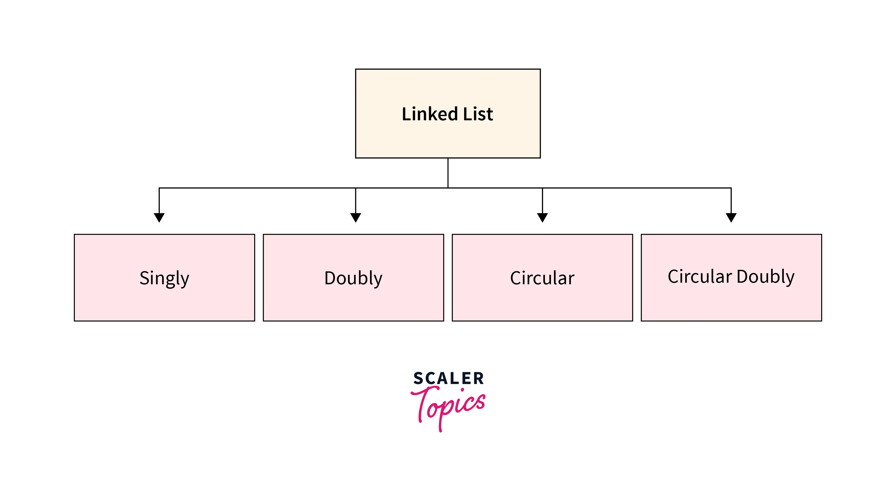
Types of Linked Lists:
Single Linked List:
Each node contains data and a pointer to the next node.
Allows traversal only in one direction (forward).
The last node’s pointer points to null, indicating the end of the list.
Simple and uses less memory since each node has one pointer.
Doubly Linked List:
Each node contains data and two pointers: one to the next node and one to the previous node.
Enables traversal in both forward and backward directions.
Requires more memory due to extra pointer but provides flexible navigation.

Slide 5
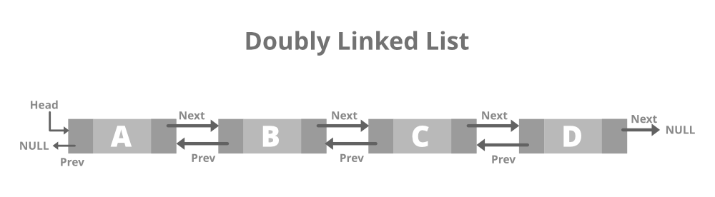
Circular Linked List:
Similar to a singly linked list but the last node points back to the first node, making the list circular.
Allows continuous traversal without a null pointer.
Useful in applications needing circular navigation or loops.
Doubly Circular Linked List:
Combines doubly linked and circular linked list features.
Each node has two pointers (previous and next).
The last node’s next pointer points to the first node and the first node’s previous pointer points to the last node.

Slide 6
3.3 Operations on Single Linked List: Searching, Insertion - (At Front ,In between and At End ), Deletion - (From Front ,In between, From End)
Searching
Traverses the linked list from the head node.
Compares each node’s value to the search key.
Continues until a match is found or end of list is reached (next pointer is null).
Time complexity: O(n).
​
2. Insertion
At Front:
  Create a new node.
  Set its next pointer to current head.
  Update head to point to new node.
  Time complexity: O(1)
In Between (at specific position):
  Traverse to desired location.
  Set new node’s next pointer to the next node.
  Link previous node’s next pointer to new node.
  Time complexity: O(n).

Slide 7
At End:
Traverse to last node (next pointer is null).
Set last node’s next pointer to new node.
Time complexity: O(n).
3. Deletion
From Front:
  Set head to head’s next pointer.
  Free memory of removed node.
  Time complexity: O(1).
In Between (at specific position):
  Traverse to previous node of target.
  Update previous node’s next pointer to skip target node.
  Free memory of removed node.
  Time complexity: O(n).
From End:
  Traverse to second last node.
  Set its next pointer to null.
  Free memory of last node.
  Time complexity: O(n).

Slide 8
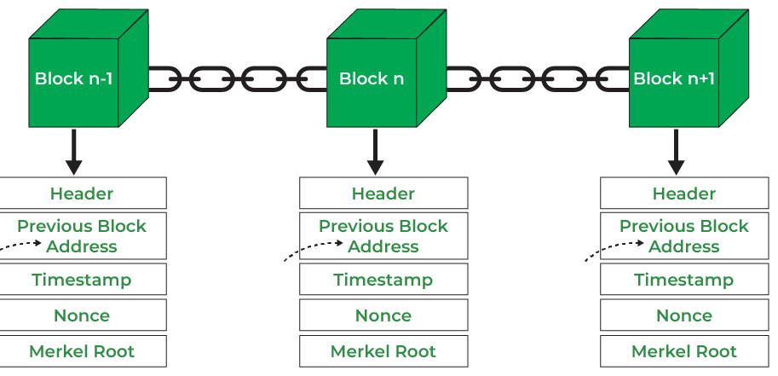
3.4 Blockchain data structure: Introduction to Blockchain, Applications of Blockchain

Slide 9
Introduction to Blockchain Data Structure
A blockchain is a decentralized digital ledger that records data in blocks that are cryptographically linked to form a chain. Each block contains a set of transactions, a hash of the previous block, a timestamp, and other metadata. The use of cryptographic hashes ensures data integrity and makes it nearly impossible to tamper with the information recorded in earlier blocks, guaranteeing security and immutability. Multiple copies of the blockchain are distributed across a peer-to-peer network, so every participant has access to the complete record, ensuring transparency and trust among users
Components of Blockchain
Block: The primary unit, containing transaction data, a timestamp, and a reference to the hash of the previous block.
Chain: The sequential, cryptographically connected series of blocks.
Distributed Ledger: Each node maintains a copy of the complete blockchain.
Node: A networked computer that stores, verifies, and helps propagate new blocks.
Consensus Mechanism: Collective process for agreement on the validity of transactions and blocks across all nodes (e.g., Proof of Work or Proof of Stake).

Slide 10
Applications of Blockchain
Cryptocurrencies: Used as the data structure for digital currencies like Bitcoin and Ethereum, recording transactions securely and transparently.
Supply Chain Management: Tracks and authenticates each stage in the movement of goods for transparency and accountability.
Healthcare: Secures patient records, enabling authorized access across institutions while preserving privacy.
Voting Systems: Ensures tamper-proof recording of votes and transparency in election processes.
Smart Contracts: Self-executing programs stored on blockchain, automating contract verification and execution without intermediaries

