Slide 1
3.Process management

Slide 2
3.1 Process
A process is basically a program in execution.
A process is defined as an entity which represents the basic unit of work to be implemented in the system.
Program becomes process when it loaded in memory
To put it in simple terms, we write our computer programs in a text file and when we execute this program, it becomes a process which performs all the tasks mentioned in the program.
When a program is loaded into the memory and it becomes a process, it can be divided into four sections ─ stack, heap, text and data. The following image shows a simplified layout of a process inside main memory
Stack
Head
Data
Text

Slide 3
Sr.no | Component & Description
1 | Stack The process Stack contains the temporary data such as method/function parameters, return address and local variables.
2 | Heap This is dynamically allocated memory to a process during its run time.
3 | Text This includes the current activity represented by the value of Program Counter and the contents of the processor's registers.
4 | Data This section contains the global and static variables.

Slide 4
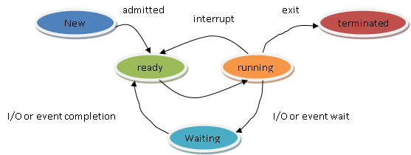
Process State
New: The process is being created
Running: Instructions are being executed
Waiting: The process is waiting for some event to occur.(I/O)
Ready: The process is waiting to be assigned to a processor
Terminated: The process has finished execution

Slide 5
Structure of the Process Control Block
The process control stores many data items that are needed for efficient process management. Some of these data items are explained with the help of the given diagram −
Process State
Process Number
Program counter
Register
Memory Limits
List of Open File

Slide 6
The following are the data items −
Process State
This specifies the process state i.e. new, ready, running, waiting or terminated.
Process Number
This shows the number of the particular process.
Program Counter
This contains the address of the next instruction that needs to be executed in the process.
Registers
This specifies the registers that are used by the process. They may include accumulators, index registers, stack pointers, general purpose registers etc.
List of Open Files
These are the different files that are associated with the process
CPU Scheduling Information
The process priority, pointers to scheduling queues etc. is the CPU scheduling information that is contained in the PCB. This may also include any other scheduling parameters
Memory Management Information
The memory management information includes the page tables or the segment tables depending on the memory system used. It also contains the value of the base registers, limit registers etc.

Slide 7
I/O Status Information
This information includes the list of I/O devices used by the process, the list of files etc.
Accounting information
The time limits, account numbers, amount of CPU used, process numbers etc. are all a part of the PCB accounting information.
Location of the Process Control Block
The process control block is kept in a memory area that is protected from the normal user access. This is done because it contains important process information. Some of the operating systems place the PCB at the beginning of the kernel stack for the process as it is a safe location.

Slide 8
3.2 Process Scheduling
Definition
The process scheduling is the activity of the process manager that handles the removal of the running process from the CPU and the selection of another process on the basis of a particular strategy.
3.2.1 Process Scheduling Queues
The OS maintains all PCBs in Process Scheduling Queues. The OS maintains a separate queue for each of the process states and PCBs of all processes in the same execution state are placed in the same queue. When the state of a process is changed, its PCB is unlinked from its current queue and moved to its new state queue.
The Operating System maintains the following important process scheduling queues
● Job queue − This queue keeps all the processes in the system.
● Ready queue − This queue keeps a set of all processes residing in main memory, ready and waiting to execute. A new process is always put in this queue.
● Device queues − The processes which are blocked due to unavailability of an I/O device constitute this queue.

Slide 9
Ready queue
CPU
I/O
I/O queue
I/O request
Time slice expired
Child executes
Fork a child
Interrupt occur
Wait for an interrupt
Queuing diagram representation of process scheduling

Slide 10
3.2.2 Schedulers
Schedulers are special system software which handle process scheduling in various ways. Their main task is to select the jobs to be submitted into the system and to decide which process to run. Schedulers are of three types −
● Long-Term Scheduler
● Short-Term Scheduler
● Medium-Term Scheduler
Long Term Scheduler
It is also called a job scheduler. A long-term scheduler determines which programs are admitted to the system for processing. It selects processes from the queue and loads them into memory for execution. Process loads into the memory for CPU scheduling.
Short Term Scheduler
It is also called as CPU scheduler. Its main objective is to increase system performance in accordance with the chosen set of criteria. It is the change of ready state to running state of the process. CPU scheduler selects a process among the processes that are ready to execute and allocates CPU to one of them.
Short-term schedulers, also known as dispatchers, make the decision of which process to execute next. Short-term schedulers are faster than long-term schedulers.

Slide 11
Medium Term Scheduler
Medium-term scheduling is a part of swapping. It removes the processes from the memory. It reduces the degree of multiprogramming. The medium-term scheduler is in-charge of handling the swapped out-processes.
3.2.3 Context Switch
A context switch is the mechanism to store and restore the state or context of a CPU in Process Control block so that a process execution can be resumed from the same point at a later time. Using this technique, a context switcher enables multiple processes to share a single CPU. Context switching is an essential part of a multitasking operating system features.

Slide 12
P1 -
i1
i2
i3
i4
a
3
b
5
c
6
i1
i2
i3
i4

Slide 13
P2 -
i1
i2
i3
i4
a
12
b
9
c
15
i3
12
9
15

Slide 14
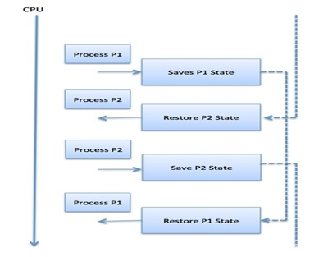

Slide 15
Context switches are computationally intensive since register and memory state must be saved and restored. To avoid the amount of context switching time, some hardware systems employ two or more sets of processor registers. When the process is switched, the following information is stored for later use.
● Program Counter
● Scheduling information
● Base and limit register value
● Currently used register
● Changed State
● I/O State information
● Accounting information

Slide 16
3.3 Inter Process Communication:-
Process can be of two types-
Independent Process
Independent process is the process that can not affect or be affected by the other processes. Independent processes do not share any data like temporary or persistent with any other process.
2. Co-operating process
Cooperating processes are affect or be affected by the other processes executing in the system. Cooperating process shares data with other processes.
Shared Memory
Process 1
Process 2
Shared Memory

Slide 17
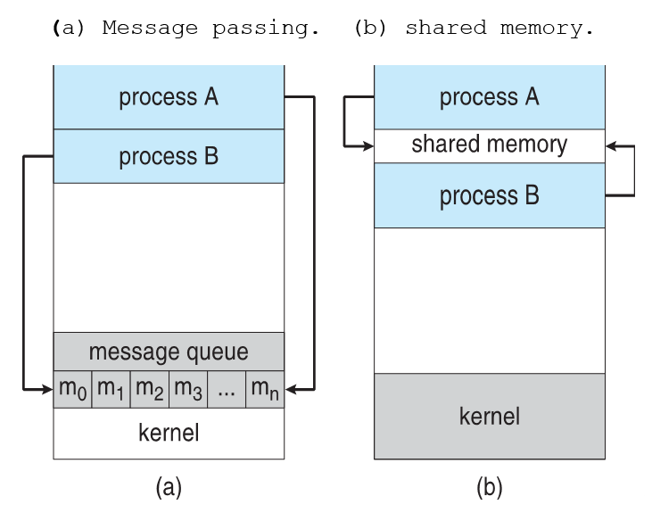
Observe :- in a distributed system, message – passing is the only possible communication model

Slide 18
Stack
Stack
Registers
Registers
Code
Code
File / data
File / data
P1
P2

Slide 19
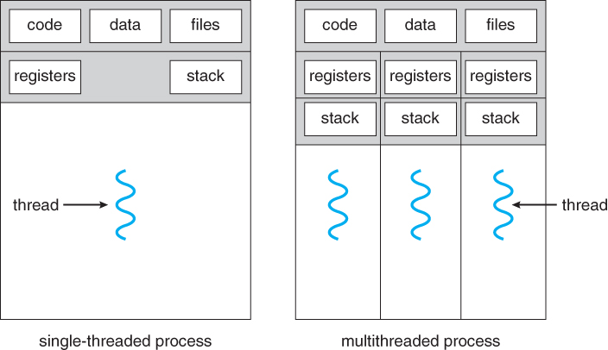

Slide 20
Process | Thread
System calls are involved | No System calls are involved
All the different processes are treated separately by the operating system. | All user level peer threads are treated as a single task by the operating system.
Processes require more time for context switching . | Threads require less time for context switching.
Processes are totally independent and don’t share memory. | A thread may share some memory with its peer threads.
Communication between processes requires more time than between threads. | Communication between threads requires less time than between processes .
If a process gets blocked, remaining processes can continue execution. | If a user level thread gets blocked, all of its peer threads also get blocked
Individual processes are independent of each other | Threads are parts of a process and so are dependent.
Processes have independent data and code segments. | A thread shares the data segment, code segment, files etc. with its peer threads.

Slide 21
Types of Thread
Threads are implemented in following two ways −
● User Level Threads − User managed threads.
● Kernel Level Threads − Operating System managed threads acting on kernel, an operating system core.
User Level Threads
In this case, the thread management kernel is not aware of the existence of threads. The thread library contains code for creating and destroying threads, for passing message and data between threads, for scheduling thread execution and for saving and restoring thread contexts. The application starts with a single thread.
Advantages
● Thread switching does not require Kernel mode privileges.
● User level thread can run on any operating system.
● Scheduling can be application specific in the user level thread.
● User level threads are fast to create and manage. Disadvantages

Slide 22
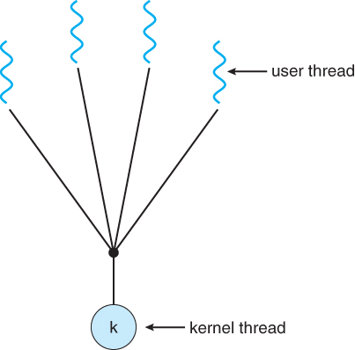
Disadvantages
● In a typical operating system, most system calls are blocking.
● Multithreaded application cannot take advantage of multiprocessing.

Slide 23
Kernel Level Threads
In this case, thread management is done by the Kernel. There is no thread management code in the application area. Kernel threads are supported directly by the operating system. Any application can be programmed to be multithreaded. All of the threads within an application are supported within a single process.
The Kernel maintains context information for the process as a whole and for individuals threads within the process. Scheduling by the Kernel is done on a thread basis. The Kernel performs thread creation, scheduling and management in Kernel space. Kernel threads are generally slower to create and manage than the user threads.
Advantages
● Kernel can simultaneously schedule multiple threads from the same process on multiple processes.
● If one thread in a process is blocked, the Kernel can schedule another thread of the same process.
● Kernel routines themselves can be multithreaded.
Disadvantages
● Kernel threads are generally slower to create and manage than the user threads.
● Transfer of control from one thread to another within the same process requires a mode switch to the Kernel.

Slide 24
User-level threads | Kernel-level threads
Managed by Users | Managed by operating System
No System calls are involved | System calls are involved
Context switching is faster | Context switching slower
User level threads are fast to create and manage. | Kernel threads are generally slower to create and manage than the user threads.
3.5 Multi-Threading Models
One to One Model:-
The one to one model maps each of the user threads to a kernel thread. This means that many threads can run in parallel on multiprocessors and other threads can run when one thread makes a blocking system call.

Slide 25
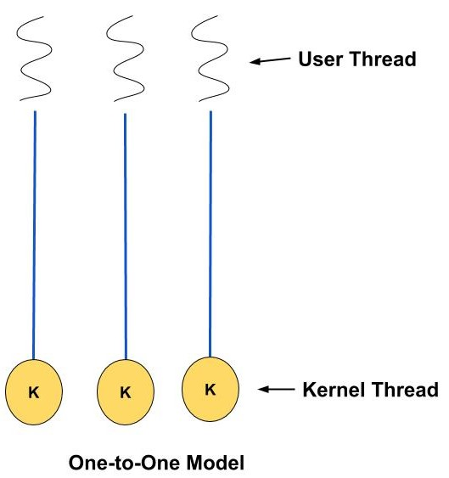
Many to One Model
The many to one model maps many of the user threads to a single kernel thread. This model is quite efficient as the user space manages the thread management.

Slide 26
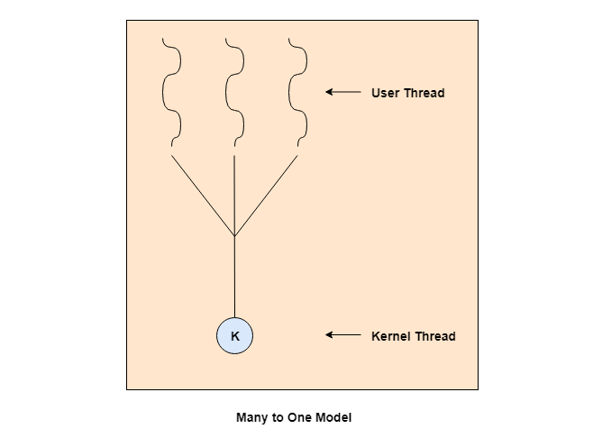
Many to Many Model
The many to many model maps many of the user threads to an equal number or lesser kernel threads. The number of kernel threads depends on the application or machine.

Slide 27
