Slide 1
6. File System

Slide 2
6.1] File - concepts, Attributes, operations, Type, file system structure:-
A file can be defined as a data structure which stores the sequence of rewards.
file are stored in a file system, which may exist on a disk or in the main memory.
files can be simple or complex.
The collection of files is known as Directory. The collection of directories at the different level й known as Filesystem.
Data
Files
Directory
File system

Slide 3
Attributes of file :-
1] Name :- Every file carries a name by which the file is recognized In the file system . One directory cannot have two with the same name.
2] Identifier :- Along with name , Each file has its own extension which identifies the type of the file
for example :- a text file has the extension.txt , a video file has the extension .mp4
3] Type :- In a file system, the files are classified in different types such as video files, audio files, text file etc.,
4] Location :- In the file system , there are several location on which the files can be stored . Each file carries its location as its attributes
5] Size :- The size of the file is one of its most important attributes by size of the file , we mean the number of byte acquired by the file in the memory
6] Protection :- The Admin of the Computer may want the different protection for the different files Therefore each file carriers its own set permission to the different group of users

Slide 4
7] time and Date :- Every file carries a time stamp which contains the time and date on which the file is last modified
File Operations :-
A file is a collection of logically related data that is recorded on the secondary storage in the form of sequence of operations
Create operations :- This operation is used to create a file In the file system. It is the most widely used operation performed on the file system. To create a new file of a particular type the associated application program calls the file system This file system allocated space to the file As the file system knows the format of directory structure . So entry of this new filr is made into the appropriate directory
Open Operation :- This operation is the common operation performed on the file once the file is created , it must be opened before performing the file processing operations . When the user wants to open a file , it provided a file name to open the particular file in the file system. It tells the operating system o invoke the open system call and passes the file name to the file system

Slide 5
3] Write operating :- This operation is used to write the information into a file A system call write is issued that specifies the name of the file and the length of the data has to be written to the file. Whenever the file length id increased by specified value and the file pointer is repositioned after the last by the written
4] Read-Operation :- This operation ready’s the contents from a file. A Read pointer id maintained by the os , pointing to the position up to which the data has been read
5] Re-position or seek operation :- The seek system call re-positions the fille pointers from the current position to a specific place in the file i.e. forward or backward depending upon the user’s requirement .This operation is generally performed with those file management system that support direct access files
6] Delete operations :- Deleting the file will not only delete all the data stored inside the file it is also used so that disk space occupied by it is freed . In order to delete the specified file the directory is searched
7] Truncate operation :- Truncate is simple deleting the file except deleting attributes . The file is not completely deleted although the information stored
Inside the file gets replaced

Slide 6
8] Close operation :- When the processing of the file is complete, it should be closed so that all the changes made permanent and all the resources occupied should be released on closing it deallocate all the internal descriptors that were descriptors that were created when the file was opened
9] Append Operation : - This operation adds data to the and of the file
10] rename operation :- This operation is used to rename the existing file
Types of files:-
Text file :- These contains human – readable text such as documents , scripts , configuration files, etc
Binary files :- These contains data in a binary format, such as executable programs , images , videos , audio files , etc.
Compressed files :- These are achieves containing one or more files that have been compressed to reduce their size , such as ZIP , TAR , GZIP , etc
Database files:- There contains structured data stored in a database format , used by database management system (DBMS) , such as Sqlite , MySQL, etc.

Slide 7
5. Configuration files :- These contains setting and configuration for software applications or the operation system itself , such as . In files, XML files , JSON files , etc.
6. Temporary files :- There are created by programs for temporary storage and are usually deleted once their purpose is served
7. System files :- There are essential files for the operating system’s functionality , such as system libraries kernel modules , etc.
File System Structure :-
File system provide efficient access to the disk by allowing data to be stored , location and retrieved in a convenient way.
A file system must be able to store the file , locate the file and retrieve the file
Most of the operating system use layering approach for every task including file system
Every layers of the file system is responsible for some activities

Slide 8
Application Programs
Logical file system
File organization module
Basic file system
I/O Control
Devices
Fig . Different layers of file system

Slide 9
when an application program asks for a file, the request is directed to the logical file system. The logical file system contains Meta deo data and directory structure.
If the application program doesn't have the required will throw permissions an of the file, then this layer will throw an error.
Generally files are divided into various logical blocks . Therefore, in order to stored and retrieve the Files the logical blocks needs to be mapped to physical call blocks . This mapping is done by file organization module . It is responsible for free space management
Once the organization module decided which physical block the application program needs , it passes this information to basic file system . The basic file system is responsible for issuing the commands
I/O controls contain the code by using which it can access hard disk .These
Code are known as device drivers.

Slide 10
5.2 ] Access Methods :- Sequential , Direct , Swapping There are various ways to access files stored in secondary memory
1] Sequential Access :-
Most of the operating system access the file sequentially
In sequential access , the os lead the file word by word . A pointer is maintained which initially pointed to the base address of the file . If the user wants to read first word of the file then the pointer provides that word to the user and increases its value by 1 word . This process continues till the end of the file.
1 block
512 Byte
10th
15th
11th
30th
File
Sequential access
Hard disk
1 sector
512 Byte
1 sector

Slide 11
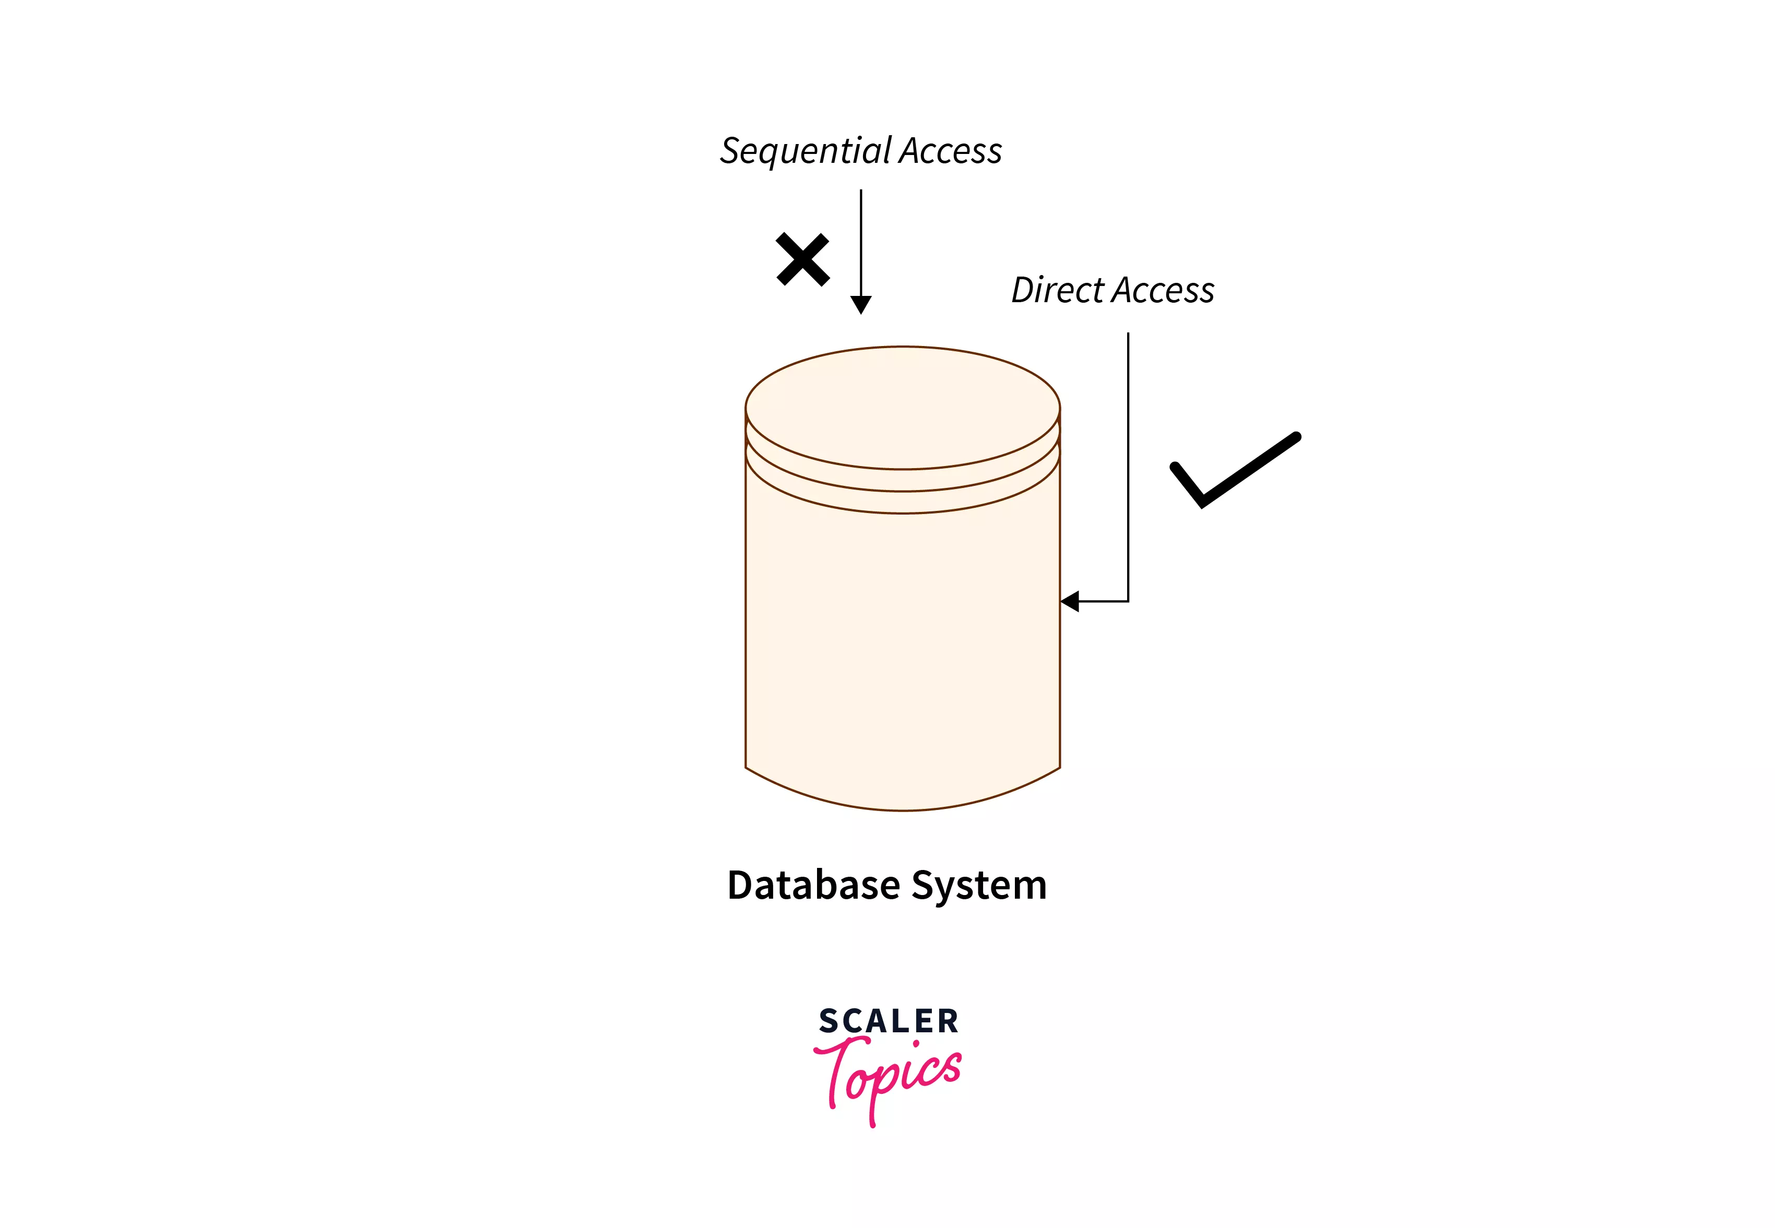
2) Direct Access:
The direct access is mostly required in the case of database systems.
In operating systems, a direct access methods refers to the ability to access data directly by specifying its location, usually through an address or index.
This contrasts with sequential access, where data is accessed in a linear fashion.

Slide 12
6.3] File allocation method: contiguous, Linked, Indexed
2) Linked List allocation:-
In linked list allocation, each file is considered as the linked list of disk blocks. However, the diskes blocks allocated to a particular file need not to be contiguous to a file contains on the dist. Each disk block allocated a pointer which points to the next disk block allocated to the same file.
File Block 1
File Block 2
File Block 3
File Block 4
7
2
10
8

Slide 13
Advantages :-
There is no external external fragmentation with linked allocation
Any Free block can be utilized in order to satisfy the file block request
file can continue to grow as long as the free blocks are available.
Directory entry will only contain the starting block address
Disadvantages :-
Random Access is not provided
Pointers require some space in the disk blocks
Any of the pointers in the linked list must not be broken otherwise the file will get corrupted
Need to traverse each block.
3) Indexed Allocation :-
Indexed allocation scheme stores all the disk pointers in one of the blocks called indexed block.
Indexed block doesn't hold the file data, but it holds the pointers to all the disk blocks allocated to that particular file. Directory entry will only contain the index block address.

Slide 14
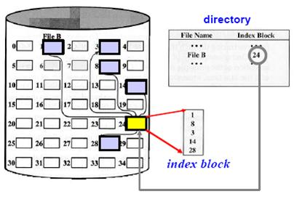
Advantages :-
support direct access
A bad data block causes the lost of only that block
Disadvantage :-
1) A bad index block could cause the lost of entre file
2) size of a file depends upon the number of pointers, a index block can hold.
3) Having an index block for a small file is totally wastage
4) More pointer overhead

Slide 15
6.4] Directory structure :- single Level, Two-level :-
What is directory?
Directory can be defined as the listing of the related files on the disk
The directory may store same or the entire file attributes.
A directory can be viewed as a file which contains the meta data of the bunch of files.
BI decretory
File 1 | Attr 1 | Attr 2 | Attr n
File 2 | Attr 2 | Attr 2 | Attr n
File 3 | Attr 3 | Attr 2 | Attr n
File 4 | Attr 4 | Attr 2 | Attr n
Directory
Files
Directory
Files
Partition 1
Metadata
Partition 2
Storage

Slide 16
Single Level Directory :-
The simplest method is to have one big list of all the files on the disk. The entire system will contain only one directory which is supposed to mention au the files present in the file system
The directory contains one entry per each file present on the file system.
Directory
1 . jpg
Method.txt
os.docx
2.mp4
ITP.txt
Files
Single level Directory

Slide 17
Advantages :-
Implementation is very simple
If the size of the files are very small then the searching becomes faster
File generation , searching , deleting is very simple since we have only directory
Disadvantage :-
We cannot have two files with same name
The directory may be very big therefore searching for a file may take so much time
Protection cannot be implemented for multiple users
There are no ways to group same kind of files
Choosing the unique name for every file is a bit complex and limits the number of files in the system because most of the operating system limited the number of characters used to construct the file name

