Slide 1
01. Database system concept

Slide 2
1.1] introduction to Database : -
1. DATA : -
Data refers to raw facts and figures that have no particular meaning until processed.
It can be in the form of numbers, text, images, audio, or video.
Example : -
  Names : “Riya”, “Amit”
  Numbers : 25, 90, 75
2. DATABASE : -
A Database is a collection of related data that is organized so that it can be easily accessed, managed, and updated.
It stores data in a structured format using tables (rows and columns).
Example:
Roll_No | Name | Marks
1 | Riya | 85
2 | Amit | 90

Slide 3
3. Database Management System (DBMS) : -
A Database Management System (DBMS) is a software used to store, manage, and manipulate databases.
It provides a systematic and efficient way to create, retrieve, update, and manage data.
Examples of DBMS software : -
Oracle, MySQL, Microsoft Access, PostgreSQL, SQL Server.
Functions of a DBMS : -
Data Storage Management – Stores data efficiently.
Data Retrieval – Fetches required information quickly.
Data Manipulation – Allows adding, deleting, and updating data.
Data Security – Protects data from unauthorized access.
Backup & Recovery – Restores data in case of failure.

Slide 4
Advantages of dbms : -
A Database Management System (DBMS) offers many benefits over traditional file-based systems.
It provides efficient data management, security, and consistency, making it essential for modern applications.
1. Data Redundancy is Reduced.
2. Data Consistency.
3. Data Sharing.
4. Data Security.
6. Backup and Recovery.
5. Data Integrity.
7. Data Independence.
8. Easy Data Access.
9. Multi-user Environment.
10. Improved Decision Making.

Slide 5
Applications of dbms : -
1. Banking and Finance : - Used for managing customer accounts, transactions, and loans.
2. Education : - Used in schools, colleges, and universities to maintain student and staff data.
3. Airline and Railway Reservation Systems : - DBMS handles seat reservations, ticket booking, and scheduling.
4. E-commerce : - Manages customer information, product catalogs, orders, and payments.
5. Healthcare : - Stores and manages patient records, appointments, and medical histories.
6. Government and Public Sector : - Used for managing citizen data, tax records, vehicle registration, and census data.
7. Telecommunications : - Maintains customer call records, billing information, and service plans.
8. Library Management : - Used in libraries to store book details, member information, and issue/return records.
9. Human Resource Management : - Used in organizations to manage employee information, payroll, attendance, and performance records.
10. Social Media Platforms : - Store and manage user profiles, posts, likes, messages, and comments.

Slide 6
1.2] data abstraction : -
Definition : -
Data Abstraction refers to hiding the complex details of how data is stored and maintained, and showing only the essential information to the user.
It helps simplify the database system by dividing it into different levels.
Data abstraction = “Show only what is necessary, hide the rest.”
Example : -
For a student database :
Physical level : Actual bytes and files storing data.
Logical level : Tables like Student (RollNo, Name, Marks).
View level : A user sees only Name and Marks.

Slide 7
Data dictionary : -
Definition : -
A Data Dictionary is a repository (or catalog) that stores metadata, i.e., data about data.
It contains information about the structure, organization, and constraints of the database.
Data dictionary = “A database about the database.”
Example : -
For a Student table :
Field Name | Data Type | Size | Description
RollNo | Integer | 4 | Unique student ID
Name | Varchar | 30 | Student name
Marks | Integer | 3 | Total marks

Slide 8
Instance & schema : -
Definition : -
Both Instance and Schema describe the structure and state of the database but in different ways.
Example : -
Schema : -
Student (Roll_No, Name, Marks)
Term | Definition | Nature | Example
Schema | Logical structure or design of the database. | Fixed | A blueprint showing tables, columns, and data types.
Instance | The actual data stored in the database at a given time. | Variable | The current rows in the Student table.

Slide 9
1.3] data independency : -
Definition : -
Data Independence is the capacity to modify the schema at one level of the database system without requiring changes at the next higher level.
It helps in achieving data abstraction — hiding details of how data is stored or managed internally.
Types of Data Independence : -
There are two types of data independence :
Logical Data Independency.
Physical Data Independency.

Slide 10
1. Logical data independency : -
Definition : -
It means the ability to change the logical structure of the database (like adding or removing fields or tables) without changing user views or application programs.
Modify what data is stored (structure) without changing how users access it.
Example : -
If a new column Address is added to the Student table —
users who only access Name and RollNo need not change their queries.
SELECT Name, Roll_No FROM Student;
Still works even after adding a new column.

Slide 11
2. Physical data independency : -
Definition : -
It means the ability to change the physical storage or organization of data without affecting the logical schema or application programs.
Modify how data is stored without changing what data is stored.
Example : -
If a database administrator changes how data is stored on disk (e.g., from a file to an indexed structure), the logical structure of the database (tables, fields) and user queries remain unchanged.
SELECT * FROM Student;
Works the same way even if storage method changes.

Slide 12
1.4] Components of a DBMS : -
1. Database Engine (Storage Manager) : - It is the core of DBMS. It stores, retrieves, and updates data in the database. It interacts with files on the disk.
2. Query Processor : - It interprets and executes SQL commands given by the user. Converts high-level queries into low-level instructions.
3. Database Manager (Transaction Manager) : - Controls transactions, maintains data consistency, and ensures ACID properties (Atomicity, Consistency, Isolation, Durability).
4. Metadata / Data Dictionary : - Stores data about data — such as table names, field types, constraints, and user permissions.
5. Concurrency Control Manager : - Manages simultaneous access to the database by multiple users to prevent conflicts.
6. Recovery Manager : - Ensures data recovery in case of failure or system crash.
7. Authorization and Security Manager : - Controls user access and ensures data security by providing authentication (usernames and passwords).
8. User Interface : - Allows interaction between the user and the database through commands or GUI (Graphical User Interface).

Slide 13
2. Overall Structure of a DBMS : -
The structure of DBMS can be divided into three levels (as per data abstraction):
Level | Description
1. External Level (View Level) | Describes how users view the data. Each user may have a different view.
2. Conceptual Level (Logical Level) | Describes what data is stored and the relationships among data.
3. Internal Level (Physical Level) | Describes how data is physically stored in storage devices.

Slide 14
3. Database Users : -
There are different types of users who interact with the DBMS :
Type of User | Description | Example
1. Database Administrator (DBA) | Responsible for managing the entire DBMS. Controls access, security, and performance. | Admin of a college database.
2. Database Designers | Design the structure of the database, tables, and relationships. | System analysts.
3. Application Programmers | Write programs that interact with the database. | Developers using C, Java, Python, etc.
4. End Users | Access the database through applications. | Students checking results online.

Slide 15
4. Functions of Database Administrator (DBA) : -
1. Database Design : – Defines the structure, tables, and relationships in the database.
2. Security Management : - Controls user access rights and ensures data security.
3. Backup and Recovery : - Creates backup copies and restores data in case of loss or failure.
4. Performance Monitoring : - Monitors system performance and optimizes query execution.
5. Data Integrity Management : - Ensures accuracy and consistency of data using constraints.
6. Database Maintenance : - Updates, upgrades, and maintains the DBMS software and data files.
7. User Management : - Adds, removes, or modifies user accounts and their privileges.
8. Storage Management : - Allocates and manages storage space efficiently.

Slide 16
1.5] data modeling in dbms : -
Define : -
Data Modeling is the process of organizing and structuring data to represent how it will be stored, accessed, and related in a database.
It defines the relationships between data elements and provides a blueprint for designing a database.
There are three main data models used in DBMS : -
Hierarchical Model
Network Model
Relational Model

Slide 17
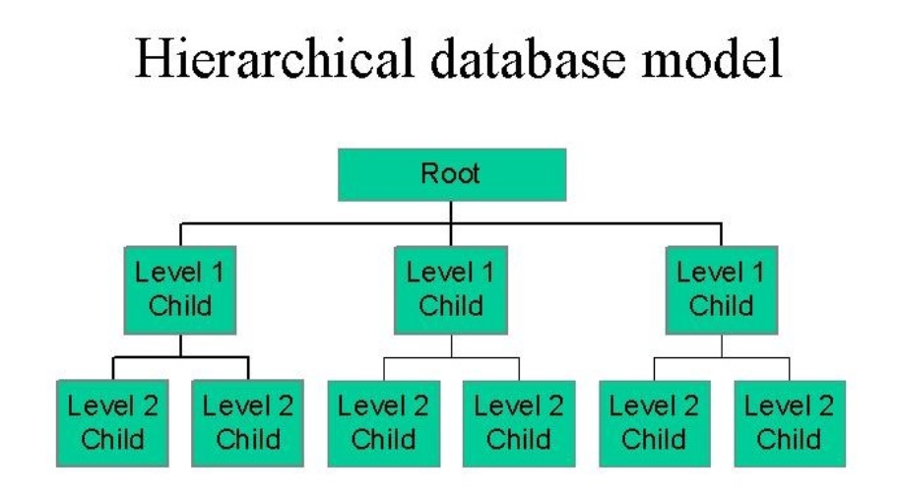
1. Hierarchical data model : -
In the hierarchical model, data is organized in a tree-like structure.
Each record (called a node) has one parent and many children — forming a parent - child relationship.
Data is represented using a one - to - many (1:N) relationship.

Slide 18
Advantages : -
Simple and easy to understand.
Fast data access due to a clear hierarchy.
Data integrity is maintained through parent-child links.
Disadvantages : -
Difficult to modify structure.
Complex when relationships are many-to-many (M:N).
Searching for child records from different branches is hard.

Slide 19
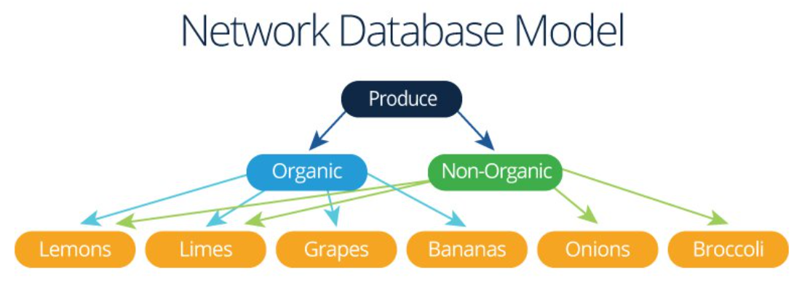
2. Network data model : -
The Network Model represents data as records (nodes) connected by links (pointers).
Unlike the hierarchical model, a record can have multiple parent and child records, allowing many-to-many (M:N) relationships.
Data is represented using a graph structure with interconnected nodes.

Slide 20
Advantages : -
Handles complex relationships easily (many-to-many).
Faster data access through direct links.
More flexible than hierarchical model.
Disadvantages : -
Structure is complex to design and maintain.
Requires knowledge of pointers and paths.
Not suitable for ad-hoc queries.

Slide 21
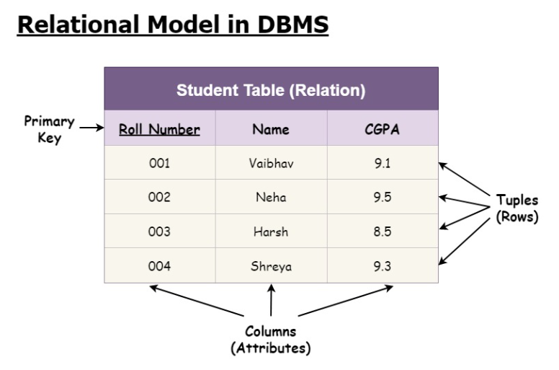
3. Relational data model : -
In the Relational Model, data is organized into tables (relations) consisting of rows (tuples) and columns (attributes).
Each table represents an entity, and relationships are defined using keys (primary, foreign).
It is based on E.F. Codd’s relational theory.

Slide 22
Advantages : -
Easy to understand and use (uses SQL).
High flexibility and scalability.
Strong data integrity through keys and constraints.
Supports data independence and ad-hoc queries.
Disadvantages : -
Slower for very large and complex databases.
Requires more storage and processing time.

