Slide 1
04. normalization

Slide 2
4.1] introduction normalization : -
Normalization is a systematic process used in database design to organize data in a way that reduces redundancy (repetition of data) and improves data integrity.
It ensures that the database is efficient, consistent, and easy to maintain. Normalization eliminates these issues by dividing large tables into smaller, related tables and defining relationships between them.
Normalization is carried out in several steps known as Normal Forms (NF). Each normal form has specific rules that must be satisfied before proceeding to the next.
Types of Normal Forms : -
1. First Normal Form (1NF).
2. Second Normal Form (2NF).
3. Third Normal Form (3NF).
4. Boyce-Codd Normal Form (BCNF).

Slide 3
Data redundancy : -
Data redundancy occurs when the same piece of data is stored in multiple places within a database.
It leads to unnecessary duplication of data, which increases storage space and may cause inconsistency.
Problems Caused by Data Redundancy :
Increased storage space : Duplicate data takes more memory.
Data inconsistency : If one copy is updated and another is not, the data becomes inconsistent.
Difficult maintenance : More data to manage, update, or delete.
Reduced efficiency : Queries and updates take longer time.

Slide 4
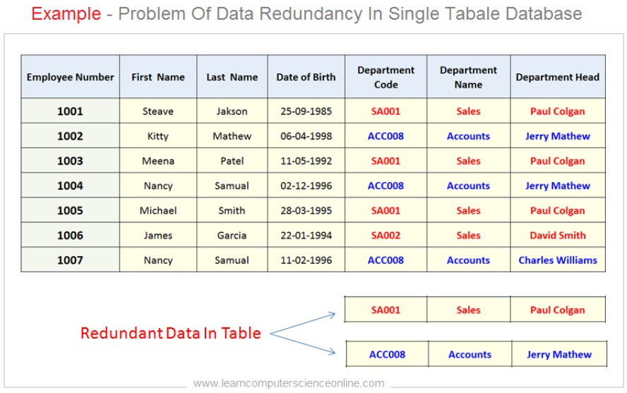
Example of data redundancy : -

Slide 5
Updating anomalies : -
When data redundancy exists, it often causes anomalies (errors or problems) during operations like updating, inserting, or deleting data.
Updating anomalies are mainly of three types :
1. Update Anomaly : - Occurs when a data item is updated in one place but not everywhere it appears.
Example : -
If “Mr. Patil” changes to “Mr. Deshmukh”, it must be updated in all rows.
If one record is missed, the database becomes inconsistent.

Slide 6
2. Insertion Anomaly : - Occurs when new data cannot be inserted into the database without the presence of other data.
Example : -
If a new course “Networking” is introduced but no student has enrolled yet, we cannot insert the course details until at least one student joins.
3. Deletion Anomaly : - Occurs when deleting data unintentionally removes additional useful information.
Example : -
If the only student enrolled in “DBMS” (Ram) leaves and his record is deleted, the course and instructor information for “DBMS” is also lost.

Slide 7
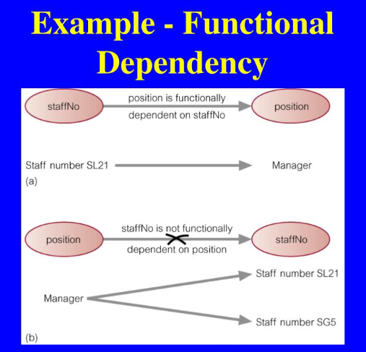
Functinal dependency : -
A Functional Dependency (FD) in DBMS is a relationship between two attributes of a relation (table), which shows that one attribute uniquely determines another.
If an attribute A uniquely determines attribute B, it is written as:
➡ A → B
(read as “A functionally determines B”)
This means that for each value of A, there is exactly one corresponding value of B.
Types of Functional Dependencies : -
Trivial Functional Dependency:
Non-Trivial Functional Dependency:
Transitive Functional Dependency:

Slide 8
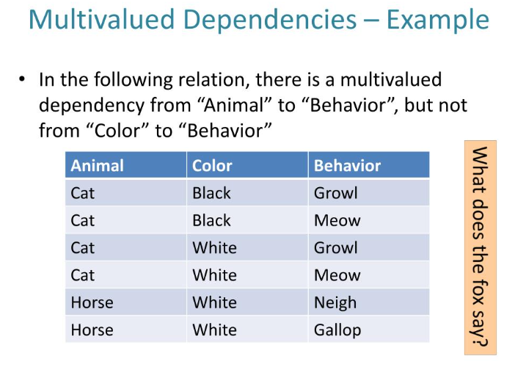
Multi-value dependency : -
A Multi-Valued Dependency (MVD) in DBMS is a type of data dependency where one attribute in a table determines multiple independent values of another attribute.
If an attribute A determines multiple values of attribute B, independently of other attributes, it is represented as:
➡ A →→ B
(read as “A multi-determines B”)
This means that for a single value of A, there can be multiple values of B, and these values of B are independent of other attributes in the relation.

Slide 9
Normalization based on functional dependencies : -
Functional dependencies form the basis for the first three normal forms (1NF, 2NF, 3NF) and Boyce-Codd Normal Form (BCNF).
1NF (First Normal Form) : - Every attribute contains atomic (indivisible) values.
2NF (Second Normal Form) : - Removes partial dependency, i.e., no non-key attribute depends on a part of a composite key.
3NF (Third Normal Form) : - Removes transitive dependency, i.e., non-key attributes should not depend on other non-key attributes.
BCNF (Boyce-Codd Normal Form) : - For every FD (A → B), A must be a candidate key.

Slide 10
Normalization based on multi-valued dependencies : -
Multi-valued dependencies are used to define Fourth Normal Form (4NF) and Fifth Normal Form (5NF).
1. 4NF (Fourth Normal Form) : -
Must be in BCNF.
There should be no multi-valued dependency except those that are functional dependencies.
2. 5NF (Fifth Normal Form) : -
Also called Project-Join Normal Form (PJNF).
Deals with join dependencies, ensuring that a relation cannot be further decomposed without losing information.

Slide 11
Normal forms : -
Normal Forms in DBMS are rules or guidelines used to organize data in a database efficiently.
They help in removing data redundancy, avoiding anomalies, and ensuring data consistency through a step-by-step process called Normalization.
Each level of Normal Form builds upon the previous one, making the database more structured and reliable.
Types of Normal Forms : -
1. First Normal Form (1NF).
2. Second Normal Form (2NF).
3. Third Normal Form (3NF).
4. Boyce–Codd Normal Form (BCNF).

Slide 12
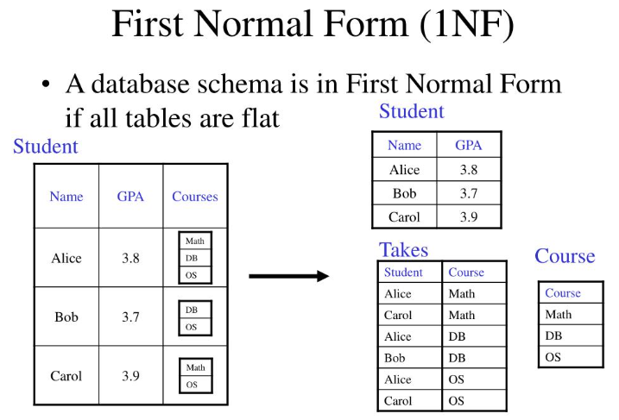
1. First normal form (1nf) : -
A relation (table) is said to be in First Normal Form (1NF) if all its attributes contain only atomic (indivisible) values, and there are no repeating groups or arrays.
Each record must be unique, identified by a primary key.
Rules for 1NF : -
Each table cell should contain only one value (atomic value).
Each record (row) must be unique.
Each column should have a unique name.
The order of rows and columns does not matter.

Slide 13
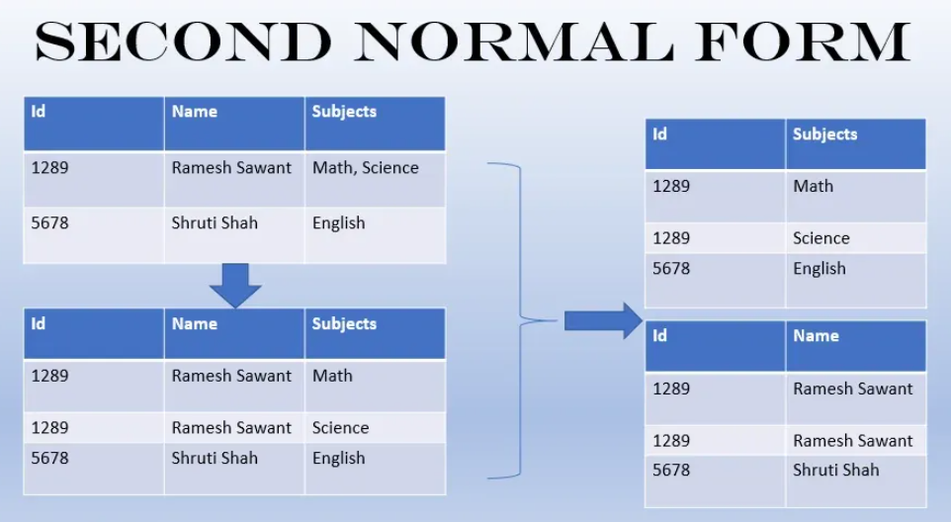
2. Second normal form (2nf) : -
A relation (table) is said to be in Second Normal Form (2NF) if :
1. It is already in First Normal Form (1NF), and
2. All non-key attributes are fully functionally dependent on the entire primary key — not just a part of it.
In other words, 2NF removes partial dependency, which occurs when a non-key attribute depends on only part of a composite (multi-attribute) primary key.

Slide 14
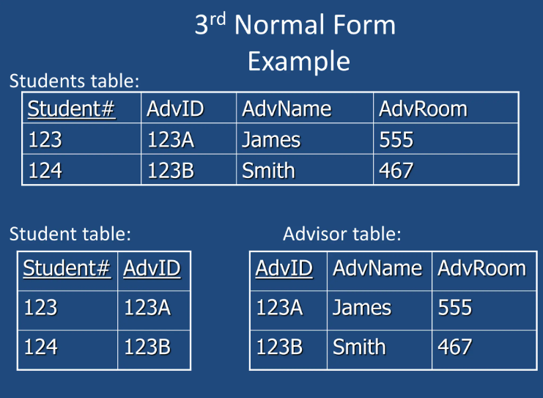
3. Third normal form (3nf) : -
A relation (table) is said to be in Third Normal Form (3NF) if :
1. It is already in Second Normal Form (2NF), and
2. There is no transitive dependency between non-key attributes.
In simple terms, every non-key attribute must depend only on the primary key, not on another non-key attribute.
Example : -
If A → B and B → C, then A → C is a transitive dependency.

Slide 15
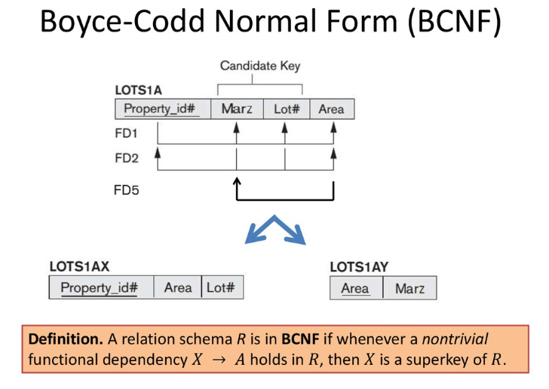
4. boyce-codd normal form (bcnf) : -
A relation (table) is said to be in Boyce–Codd Normal Form (BCNF) if:
1. It is already in Third Normal Form (3NF), and
2. For every functional dependency (A → B), the determinant (A) must be a candidate key.
In simple words, every determinant in a relation should be a candidate key.
BCNF is considered a stronger version of 3NF and removes certain types of anomalies that 3NF cannot handle.
Rules for BCNF : -
It is in 3NF, and
For every non-trivial functional dependency A → B, A is a super key (or candidate key).

