Slide 1
05. Transaction Processing

Slide 2
5.1] transaction concepts : -
In a Database Management System (DBMS), a transaction is a sequence of one or more database operations (such as INSERT, UPDATE, DELETE, or SELECT) that are treated as a single logical unit of work.
A transaction ensures that the database remains in a consistent state even in case of failures such as system crashes, power loss, or concurrent access by multiple users.
Example of a Transaction : -
Consider a bank transaction where ₹1000 is transferred from Account A to Account B.
Steps involved : -
Read balance of Account A.
Subtract ₹1000 from Account A.
Add ₹1000 to Account B.
Write new balances to both accounts.

Slide 3
Transaction Properties (ACID Properties) : -
1. Atomicity : -
Atomicity means that a transaction is treated as a single, indivisible unit.
Either all operations of a transaction are executed successfully (commit) or none are executed (rollback).
Example : -
If ₹1000 is deducted from Account A but not added to Account B due to a failure, the entire transaction is rolled back — so the money is not lost.

Slide 4
2. Consistency : -
Ensures that a transaction brings the database from one valid state to another valid state.
The integrity constraints (like foreign keys, unique keys, etc.) must always hold true before and after a transaction.
Example : -
The total amount in both accounts (A + B) before and after the transfer remains the same - database remains consistent.

Slide 5
3. Isolation : -
Each transaction should execute as if it is the only transaction in the system.
Concurrent transactions should not interfere with each other.
Isolation prevents problems like dirty reads, lost updates, and uncommitted data access.
Example : -
If two users try to transfer money from the same account at the same time, each transaction should execute independently to avoid incorrect balances.

Slide 6
4. Durability : -
Once a transaction is committed, its changes are permanent, even if the system fails immediately after.
The DBMS ensures this by storing changes in non-volatile memory (like disk).
Example : -
If money transfer is completed and confirmed, the new balances remain even after a system crash.

Slide 7
Transaction States in DBMS : -
1. Active State : -
The transaction is currently being executed.
All read/write operations are performed in this state.
2. Partially Committed State : -
The transaction has executed its final statement but changes are not yet saved permanently.
The system performs checks to ensure everything is valid before committing.
3. Committed State : -
The transaction has successfully completed and all changes are permanently stored in the database.
The system ensures durability.

Slide 8
4. Failed State : -
The transaction cannot proceed due to an error or system failure.
Any partial changes are rolled back to maintain consistency.
5. Aborted State : -
The transaction has been rolled back after failure.
The database returns to its previous consistent state.
Sometimes the transaction may be restarted automatically

Slide 9
5.2] Concurrent Execution of Transactions : -
Concurrent Execution of Transactions means that two or more transactions are executed simultaneously (at the same time) in a multi-user database system.
Instead of executing one transaction completely before starting another, the DBMS allows overlapping execution of multiple transactions to improve performance and resource utilization.
Example : -
Suppose two users perform actions on a bank database:
- T1: Transfers ₹1000 from Account A to Account B
- T2: Adds 5% interest to Account A
If both transactions run concurrently, the database system handles them together — but must ensure that the final result is correct and consistent, as if they were executed one after another.

Slide 10
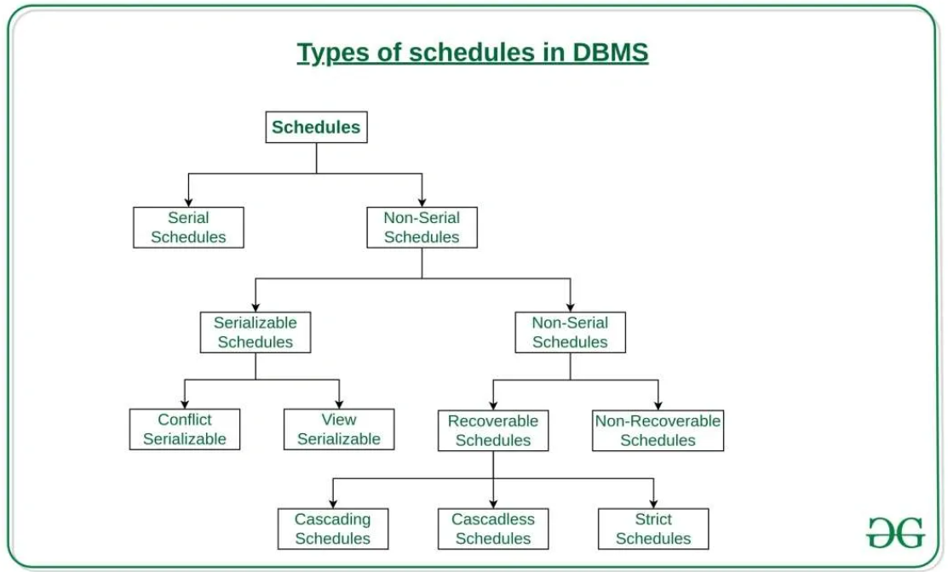
5.3] schedule : -
In a Database Management System (DBMS), a schedule defines the order in which multiple transactions’ operations (READ, WRITE) are executed.
It helps to manage concurrent transactions and ensures that the final outcome is consistent with the database rules.
A schedule is a sequence that shows the interleaving of operations from one or more transactions.
Types of Schedules : -
1. Serial Schedule.
2. Concurrent Schedule (Non-Serial Schedule).
3. Cascade less Schedule.

Slide 11
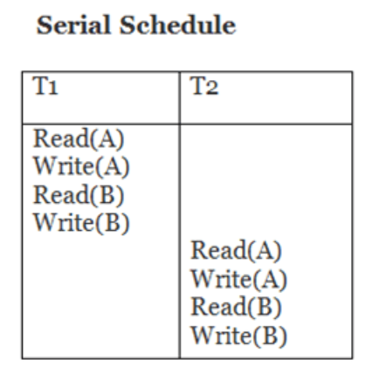
1. Serial schedule : -
A Serial Schedule in DBMS is a type of transaction schedule in which transactions are executed one after another, without any overlap between their operations.
A Serial Schedule is a schedule where transactions are executed sequentially, one after another, ensuring data consistency but offering less concurrency.
Advantages : -
Simple and easy to implement.
Guaranteed correctness (no concurrency problems).
Disadvantages : -
Slow execution due to waiting.
Poor resource utilization and low system throughput.

Slide 12
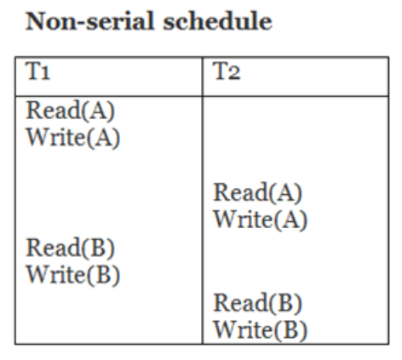
2. Concurrent Schedule : -
A Concurrent Schedule, also known as a Non-Serial Schedule, is a type of schedule in which operations of two or more transactions are interleaved - meaning they execute simultaneously or overlap in time.
In such a schedule, the DBMS ensures that the final result of concurrent execution is the same as some serial schedule, thus maintaining data consistency.
Advantages : -
Increases throughput (more transactions executed in less time).
Reduces waiting time for users.
Efficient use of CPU and I/O resources.
Disadvantages : -
May lead to data inconsistency if not properly managed.
Needs Concurrency Control (like locking or timestamp ordering).

Slide 13
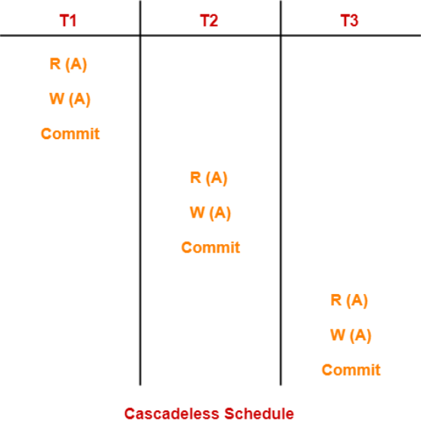
3. Cascadeless schedule : -
A Cascadeless Schedule in DBMS is a type of transaction schedule in which no transaction is allowed to read data written by another uncommitted transaction.
In other words, a transaction can read or access data only after the transaction that last modified the data has committed.
This prevents the cascading rollback problem, where the failure of one transaction causes multiple other transactions to roll back.
Advantages : -
No cascading rollback occurs.
Ensures safe and consistent execution of transactions.
Easier error recovery.
Disadvantages : -
Slightly reduces concurrency, as some transactions must wait for others to commit.

Slide 14
5.4] lock-based protocol : -
A Lock-Based Protocol defines the rules for acquiring and releasing locks to ensure that transactions execute safely and maintain a serializable schedule (a schedule equivalent to some serial execution).
Types of Lock-Based Protocols : -
1] Simple Lock Protocol : -
  A transaction must acquire a lock on a data item before reading or writing it.
  The lock must be released after the operation is completed.
  Does not always guarantee serializability.

Slide 15
2] Two-Phase Locking Protocol (2PL) : -
The most widely used lock-based protocol.
Each transaction has two phases :
a) Growing Phase : -
  The transaction may acquire locks but cannot release any.
b) Shrinking Phase : -
  The transaction may release locks but cannot acquire new ones.
3] Strict Two-Phase Locking (Strict 2PL) : -
  All locks are held until the transaction commits or aborts.
4] Rigorous Two-Phase Locking : -
  Both shared and exclusive locks are held until the transaction commits.

Slide 16
What is lock ?
A Lock is a variable associated with each data item that indicates the transactional access permission on that data.
Locks help ensure that only authorized transactions can read or write a particular data item at a given time.
Types of Locks : -
1. Shared Lock (S-Lock).
2. Exclusive Lock (X-Lock).

Slide 17
1. Shared lock (s-lock) : -
A shared lock allows a transaction to read a data item.
Multiple transactions can hold shared locks on the same item simultaneously, as long as none wants to write it.
No transaction can modify the data until all shared locks are released.
Used for reading data safely.
Example : -
If Transaction T1 has a shared lock on data item A,
→ T2 can also acquire a shared lock on A (for reading).
→ But no transaction can write A until all S-locks are released.

Slide 18
2. Exclusive lock (x-lock) : -
An exclusive lock allows a transaction to both read and write a data item.
When a transaction holds an exclusive lock, no other transaction can read or write that data item.
Used for updating or modifying data.
Example : -
If Transaction T1 has an X-lock on data item A,
→ No other transaction can acquire S-lock or X-lock on A until T1 releases it.

Slide 19
Granting of locks : -
What is Granting of Locks?
Granting of locks means allowing a transaction to acquire control over a data item by providing a lock - either Shared (S) or Exclusive (X) - depending on the operation (read or write).
The Lock Manager checks whether the requested lock is compatible with existing locks on that data item before granting it.
Example : -
Let data item X be shared by transaction T1.
T1: Requests a Shared (S) lock on X → Granted ✅
T2: Requests another Shared (S) lock on X → Granted ✅
T3: Requests an Exclusive (X) lock on X → Denied ❌ (must wait until T1 and T2 release their locks)

Slide 20
Lock granting process : -
Lock Granting Process : -
When a transaction T requests a lock on data item A, the process follows these steps :
Check the Lock Table : -
  See if any other transaction currently holds a lock on A.
Check Compatibility : -
  Use the compatibility matrix to determine if the new lock can be granted.
Grant or Delay : -
  If compatible → Grant the lock immediately.
  If not compatible → Put the transaction in the waiting queue until the lock is released.
Update the Lock Table : -
  Record that transaction T now holds a lock on data item A.

Slide 21
Advantages of Controlled Lock Granting : -
Ensures serializability of transactions.
Prevents inconsistent reads or writes.
Maintains isolation between concurrent transactions.
Disadvantages Lock Granting : -
May lead to waiting (transactions get delayed).
Possibility of deadlocks (if two transactions wait for each other’s locks).

Slide 22
Lock-based protocol : -
A Lock-Based Protocol is a concurrency control mechanism that uses locks to manage the order in which transactions access data items.
It ensures that the database remains consistent and serializable (i.e., the result of concurrent transactions is the same as some serial execution).

