Slide 1
Basics of Microcontroller 8051

Slide 2
1.1 General architecture of Microcontroller
A microcontroller is a compact integrated circuit designed to govern a specific operation in an embedded system. A typical microcontroller includes a processor, memory and input/output (I/O) peripherals on a single chip.
Sometimes referred to as an embedded controller or microcontroller unit (MCU), microcontrollers are found in vehicles, robots, office machines, medical devices, mobile radio transceivers, vending machines and home appliances, among other devices. They are essentially simple miniature personal computers (PCs) designed to control small features of a larger component, without a complex front-end operating system (OS)
The general architecture of a microcontroller typically consists of several integrated components on a single chip that work together to perform control tasks for embedded systems.
Key components in the general architecture of a microcontroller include:
Central Processing Unit (CPU): Acts as the brain of the microcontroller, executing instructions stored in memory. It contains the Arithmetic Logic Unit (ALU) for performing arithmetic and logical operations, and registers

Slide 3
Memory:
  Read-Only Memory (ROM) or Flash: Used to store the program instructions permanently or semi-permanently.
  Random Access Memory (RAM): Used for temporary data storage during program execution.
Input/Output (I/O) Ports: Interfaces that allow the microcontroller to communicate with external devices by receiving inputs or sending outputs.
Timers and Counters: Hardware modules that measure time intervals, count events, or generate precise timing pulses.
Interrupt Controller: Manages interrupts that allow the microcontroller to respond immediately to urgent events.
Oscillator and Clock Circuit: Provides the timing signal to synchronize all operations within the microcontroller.
Bus System: Connects the CPU to memory and peripherals, allowing communication within the microcontroller.

Slide 4
This integrated structure allows a microcontroller to serve as a compact embedded system controller, performing dedicated functions with high efficiency.
For example, the 8051 microcontroller architecture includes a CPU, on-chip RAM and ROM, I/O ports, timers, serial communication ports, and interrupt control.
In summary, the general architecture of a microcontroller integrates the processor core (CPU), memory units (RAM and ROM), various input/output ports, timers, interrupt system, and clock circuitry on a single chip to operate as a complete embedded control system.

Slide 5
How do microcontrollers work?
A microcontroller is embedded inside of a system to control a singular function in a device. It does this by interpreting data it receives from its I/O peripherals using its central processor. The temporary information that the microcontroller receives is stored in its data memory, where the processor accesses it and uses instructions stored in its program memory to decipher and apply the incoming data. It then uses its I/O peripherals to communicate and enact the appropriate action.
Microcontrollers are used in a wide array of systems and devices. Devices often utilize multiple microcontrollers that work together within the device to handle their respective tasks.
For example, a car might have many microcontrollers that control various individual systems within, such as the anti-lock braking system, traction control, fuel injection or suspension control. All the microcontrollers communicate with each other to inform the correct actions. Some might communicate with a more complex central computer within the car, and others might only communicate with other microcontrollers. They send and receive data using their I/O peripherals and process that data to perform their designated tasks.

Slide 6
1.2 Comparison of Microprocessor and Microcontroller
Microcontroller | Microprocessor
It is a CPU on a single chip used for general-purpose processing | It is a complete computer system on a single chip (CPU + Memory + I/O).
Its designing and hardware cost is low. | Its designing and hardware cost is high.
Easy to replace. | Not so easy to replace.
It is built with CMOS technology, which requires less power to operate. | Its power consumption is high because it has to control the entire system.
It consists of CPU, RAM, ROM, I/O ports. | It doesn’t consist of RAM, ROM, I/O ports. It uses its pins to interface to peripheral devices.
CPU is stands - alone ROM, I/O , Timer are separate | CPU, RAM , ROM , I/O and timer are all on a single chip
Designer can decide on the amount of Rom , RAM and I/O ports. | Fix amount of on – chip ROM, RAM , I/O ports
Faster in processing because it focuses only on computation. | Comparatively slower due to multiple built-in functions.
More expensive as external components are required. | Cheaper due to integrated components.

Slide 7
Usually higher clock speed. | Usually lower clock speed.
Larger circuit as external components are needed. | Compact circuit as all components are inbuilt.
Intel 8085, Intel 8086, Intel i3/i5/i7 | 8051, PIC, AVR, ARM
Used where intensive computation is required (like PCs, servers | Used in control-based applications (like home appliances, robotics).
Applications of Micro controllers
• Home Appliances: Washing Machine, Microwave Oven, Intercom, Telephone, Security Systems, VCR, Cable TV Tuner, Remote Controls, Video Games, Sewing Machines, Camera etc.
• Office : Telephones, Computers,, Laser Printer, Paging, Copiers etc.
• Auto : Engine Control, Air Bag, Instrumentation, Transmission Control, Climate Control, Cellular Phone, Keyless entry.

Slide 8
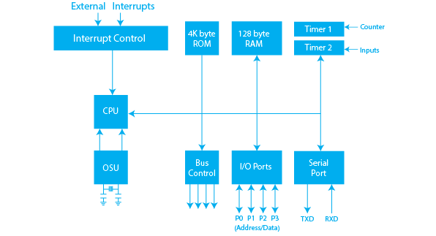
1.3 Architecture of 8051
Block Diagram of 8051 Microcontroller

Slide 9
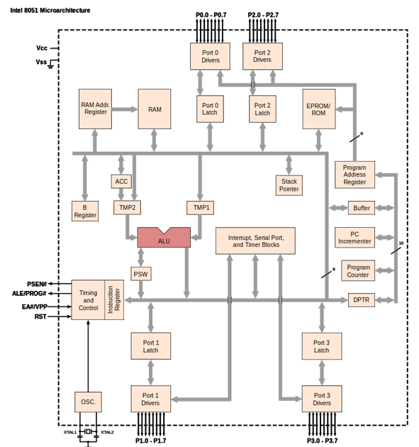

Slide 10
Explanation of 8051 Microcontroller Architecture Diagram
The 8051 microcontroller is a single-chip 8-bit microcontroller developed by Intel.
It consists of CPU, Memory (RAM & ROM), Timers, I/O Ports, Serial Port, and Interrupts, all inside one chip.
Let’s understand each block shown in the diagram
1. Central Processing Unit (CPU)
The CPU is the brain of the microcontroller.
It fetches instructions from program memory, decodes them, and executes them.
It controls all the other blocks inside the microcontroller.
2. ALU (Arithmetic and Logic Unit)
Performs arithmetic operations (addition, subtraction, multiplication, division)
and logical operations (AND, OR, XOR, compare).
Works with Accumulator (ACC) and B Register to process data.
3. Accumulator (ACC) and B Register
Accumulator (ACC): Main register used for data storage during ALU operations.
B Register: Used with the accumulator for multiplication and division instructions

Slide 11
4. Program Status Word (PSW)
Stores status flags such as Carry, Auxiliary Carry, Overflow, and Parity bits.
It tells about the result of the last ALU operation (e.g., if result was zero, negative, etc.).
5. Memory Units
a) ROM / EPROM (Program Memory)
Stores the program instructions permanently.
Standard 8051 has 4 KB of on-chip ROM.
b) RAM (Data Memory)
Used for temporary data storage while the program runs.
Standard 8051 has 128 bytes of RAM.
Divided into:
  Working registers (R0–R7)
  Stack area
  Bit-addressable area
6. Program Counter (PC)
A 16-bit register that holds the address of the next instruction to be executed.
It is automatically incremented after each instruction fetch.

Slide 12
7. Data Pointer (DPTR)
A 16-bit register used to access external memory or large data tables.
8. Stack Pointer (SP)
Points to the top of the stack in internal RAM.
Stack is used during function calls, interrupts, and temporary storage.
9. Input/Output Ports (P0, P1, P2, P3)
8051 has four 8-bit I/O ports (P0–P3) → total 32 pins.
They can be used for input or output operations.
Port 0 and Port 2 are also used for address/data multiplexing when external memory is used.
10. Timers/Counters
Two 16-bit timers (Timer 0 and Timer 1) are available.
Used for:
  Measuring time intervals.
  Counting external events.
  Generating delays.

Slide 13
14. Control Signals
Signal | Full Form | Function
PSEN | Program Store Enable | Enables external program memory.
ALE | Address Latch Enable | Used to separate address and data signals.
EA | External Access | Selects internal or external ROM.
RST | Reset | Resets the microcontroller to the starting address.
15. Timing and Control Block
Coordinates the flow of data and control signals inside the 8051.
Works closely with the oscillator and other control signals.
16. Interrupt, Serial Port, and Timer Blocks
These blocks handle interrupt management, serial communication, and timing operations as shown in the middle of the diagram.

Slide 14
11. Serial Communication Port
Allows serial data transfer (bit-by-bit communication).
Used to connect 8051 with devices like PCs, GSM modules, etc.
12. Interrupt Control
Provides five interrupt sources:
  Two external interrupts
  Two timer interrupts
  One serial interrupt
Interrupts allow the microcontroller to respond quickly to urgent events.
13. Oscillator and Clock Circuit
The Oscillator (OSC) provides the clock signal for all operations.
Usually connected to a crystal oscillator (e.g., 12 MHz) between XTAL1 and XTAL2 pins.
The clock synchronizes all internal processes.

Slide 15
The architecture of the 8051 microcontroller is based on an 8-bit Harvard architecture, comprising various essential components that enable it to perform a wide range of control and processing functions in embedded systems.
Key Components of 8051 Architecture
1.CPU (Central Processing Unit)
The CPU is the core of the microcontroller, responsible for executing instructions stored in its memory.
It contains an Arithmetic Logic Unit (ALU), registers, and control logic to perform operations such as arithmetic, logic, and data transfer.
Interrupts are handled by the CPU, with five primary sources: the timers (Timer 0 and Timer 1), external hardware interrupts (INT0 and INT1), and serial communication interrupts.
2.Memory
The 8051 includes 4 KB of on-chip ROM for program storage and 128 bytes of RAM for data and register storage.
Memory organization divides RAM into areas for register banks, bit-addressable memory, and general-purpose scratch pad memory

Slide 16
3.Ports
The microcontroller has four 8-bit ports (P0, P1, P2, P3) for interfacing with external devices, which can be configured as input or output.
Port 0 and Port 2 are also used for external memory access via multiplexed address/data lines
4.Bus System
The system bus includes an 8-bit data bus, a 16-bit address bus, and control signals, facilitating communication between the CPU and peripherals
5.Oscillator
An external crystal oscillator (commonly 12 MHz) provides the clock signal for the microcontroller, controlling timers and the system clock.
6.Other Components
Serial communication ports support full-duplex UART communication.
Special Function Registers (SFRs) control various operations.
7.Construction
The entire architecture is fabricated using CMOS technology, integrating all components into a single silicon chip for reliability and compactness

Slide 17
Types of Interrupts
The interrupts of the 8051 microcontrollers have the following sources
• TF0 (Timer 0 Overflow Interrupt)
• TF1 (Timer 1 Overflow Interrupt)
• INT0 (External Hardware Interrupt)
• INT1 (External Hardware Interrupt) • RI/TI (Serial Communication Interrupt)
Memory
The memories of the 8051 microcontroller architecture include a program memory and data memory.
• The instructions of the CPU are stored in the Program Memory. It is usually implemented as Read-Only Memory or ROM, where the Program written into it will be retained even when the power is down or the system is reset.
• Data Memory in a Microcontroller is responsible for storing values of variables, temporary data, intermediate results, and other data for the proper operation of the program.

Slide 18
Timer and Control Unit
The main function of a timer is to make a delay otherwise time gap among two events. This microcontroller includes two timers where each timer is 16-bit where the system can generate two delays concurrently to produce the suitable delay. Generally, every microcontroller uses hardware delays where a physical device can be used through the processor to generate the particular delay which is called a timer.
The delay can be generated through the timer based on the requirement of the processor & transmits the signal to the processor whenever the particular delay gets generated.
By using this processor, we can also produce a delay based on the requirement of the system. However, this will guide to remain the processor active all the time because it will not perform any other task in that specific period. As a result, the existence of a timer within the microcontroller permits the processor to be free for performing other operations.
The microcontroller also includes a program counter, data pointer, stack & stack pointer, instruction registers including latches, temporary registers & buffers for the I/O ports

Slide 19
Registers
Registers in microcontrollers are mainly used to store data and short-term instructions which are mainly used to process addresses to fetch data. This microcontroller includes 8-bit registers which have 8-bit start from D0 to D7. Here, D0 to D7 is LSB (least significant bit) and D7 is the most significant bit (MSB).
To make the data process better than 8-bit, then it must be separated into eight different bit parts. It includes several registers however general-purpose type registers are frequently available to programmers. There are classified into two types like General purpose & Special purpose. So, most of the general-purpose registers are listed below.
• An accumulator is mainly used to execute arithmetic & logic instructions.
• Registers like B, R0 toR7 are used for storing instruction addresses & data.
• Data Pointers or DPTR is used to allow & process data in dissimilar addressing modes. This register includes DPH (high byte) & a DPL (low byte) which is mainly used to hold a 16-bit address. So, it can be used as a base register within not direct jumps, lookup table instructions & external data transfer.
• Program counter or PC is a 16-bit register used to store the next instruction’s address to be performed
• These registers are 8-bits other than program counter & data pointer registers.

Slide 20
PSW Register
The term PSW stands for Program status word and it is one kind of register in the microcontroller. It is also called a flag register, used to demonstrate the position of arithmetic logic instructions such as zero carry bit, carry bit, etc. PSW or flag register is an 8-bit register where 6-bits are used. This register includes 8-flags where these flags are known as conditional flags. These flags will perform instruction simply if the condition is satisfied.
These conditional flags are overflow, parity, auxiliary carry & carry. The Program status word registers bit numbers like 3 & 4 are used to alter the bank registers whereas 1 & 5 are not used but they can be used by the programmer for executing a specific task.
Register Banks
For stacks & register banks, Ram with 32 Bytes is used and these are separated in four types of banks. So, every back includes 8-registers which range from R0 to R7. Here, R0 & R7 denotes the locations of RAM like zero location and seventh location. The second bank register begins from location 8 & ends 05H. The third bank register begins from 10H & completed at the 17H location. The final bank can be placed among the 18H-1FH.

Slide 21
Stack
The part of RAM like Stack is mainly used through the processor for data storage otherwise address momentarily. In a microprocessor, it is a very significant part because there are extremely restricted numbers of registers for storing addresses and data.
In the 8051 microcontrollers, the stack is 8-bit wide and it can hold data from 00 – FFH. The stack pointer can be used through the CPU to allow the stack. This microcontroller includes an 8-bit stack pointer that means it can allow values from 00H to FFH. Once it is activated, then the stack pointer includes the 07 value.
Organization of Memory
The microcontroller has complex memory organization and it includes a separate address bus that is used for program memory, external RAM & data memory. It depends on Harvard architecture that is developed through Harvard in the year 1944.

Slide 22
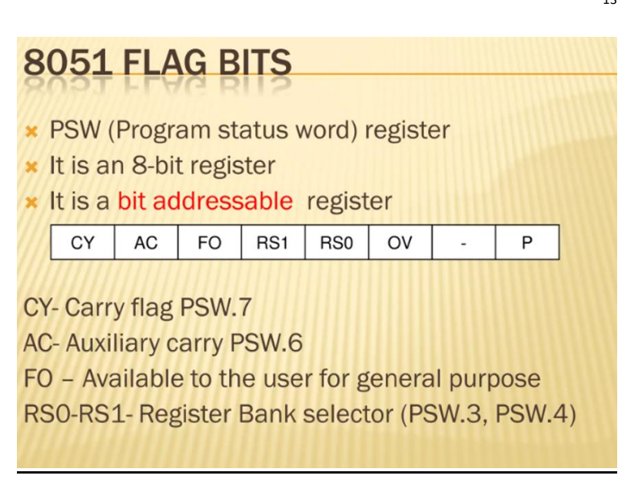
Internal Ram Organization

Slide 23
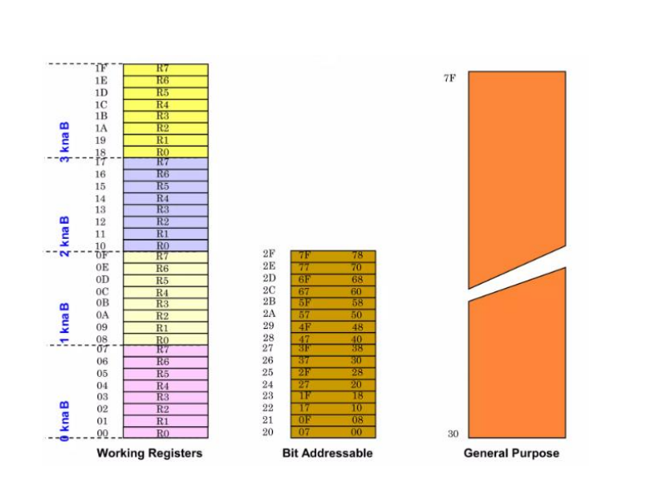

Slide 24
Features
The main features of the 8051 microcontroller architecture include the following.
• 8-bit CPU through two Registers A & B.
• 8K Bytes – Internal ROM and it is a flash memory that supports while programming the system.
• 256 Bytes – Internal RAM where the first RAM with 128 Bytes from 00H to 7FH is once more separated into four banks through 8 registers in every bank, addressable registers -16 bit & general-purpose registers – 80.
• The remaining 128 bytes of the RAM from 80H to FFH include Special Function Registers (SFRs). These registers control various peripherals such as Serial Port, Timers, all I/O Ports, etc.
• Interrupts like External-2 & Internal-3 • Oscillator & CLK Circuit.
• Control Registers like PCON, SCON, TMOD, TCON, IE, and IP
• 16-bit Timers or Counters -2 like T0 & T1.
• Program Counter – 16 bit & DPRT (Data Pointer).
• I/O Pins – 32 which are arranged like four ports such as P0, P1, P2 & P3. • Stack Pointer (SP) – 8bit & PSW (Processor Status Word).
• Serial Data Tx & Rx for Full-Duplex Operation

Slide 25
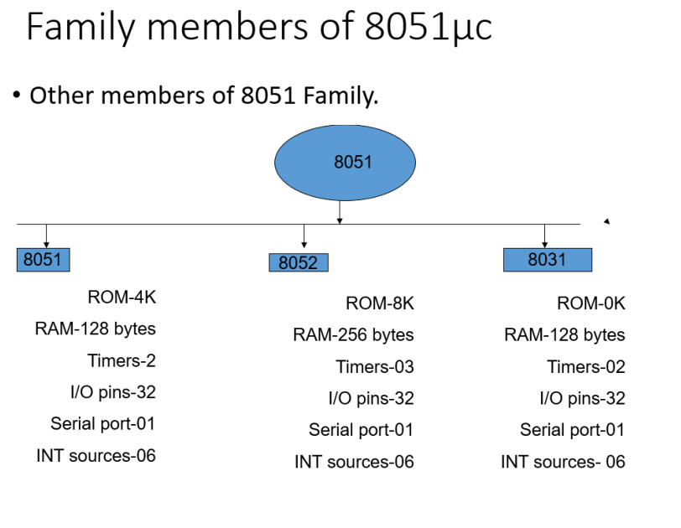

Slide 26
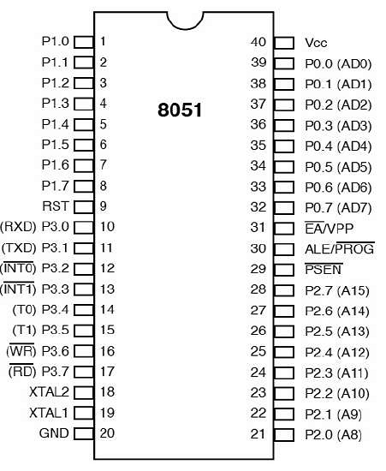
1.4 Pin configuration and signal description of 8051

Slide 27
Pins 1 to 8 − These pins are known as Port 1. This port doesn’t serve any other functions. It is internally pulled up, bi-directional I/O port.
Pin 9 − It is a RESET pin, which is used to reset the microcontroller to its initial values.
Pins 10 to 17 − These pins are known as Port 3. This port serves some functions like interrupts, timer input, control signals, serial communication signals RxD and TxD, etc.
Pins 18 and 19 − These pins are used for interfacing an external crystal to get the system clock.
Pin 20 − This pin provides the power supply to the circuit.
Pins 21 to 28 − These pins are known as Port 2. It serves as I/O port. Higher order address bus signals are also multiplexed using this port.
Pin 29 − This is PSEN pin which stands for Program Store Enable. It is used to read a signal from the external program memory
Pin 30 − This is EA pin which stands for External Access input. It is used to enable/disable the external memory interfacing.

Slide 28
Pin 31 − This is ALE pin which stands for Address Latch Enable. It is used to demultiplex the address-data signal of port.
Pins 32 to 39 − These pins are known as Port 0. It serves as I/O port. Lower order address and data bus signals are multiplexed using this port.
Pin 40 − This pin is used to provide power supply to the circuit.

Slide 29
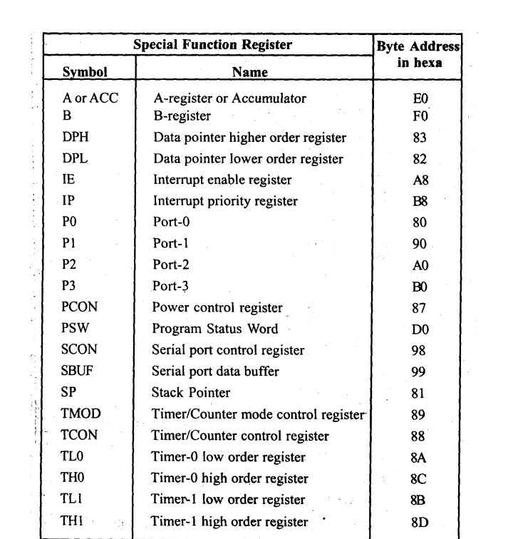
Special Function Registers
Special Function Registers are critical for programming the 8051 as they allow direct manipulation of hardware and system functions

Slide 30
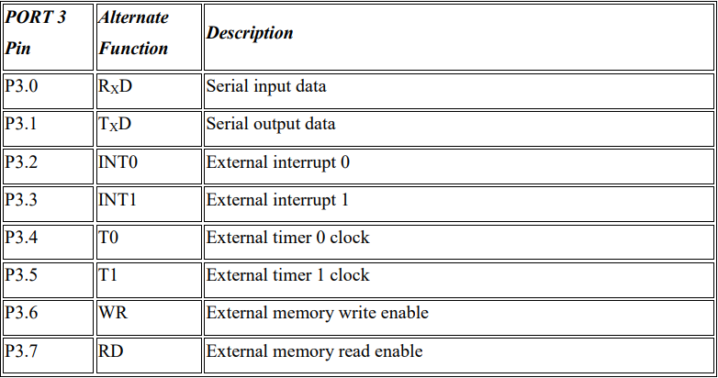
Port 3 Alternate Function
• All port pins can be used as general I/O, but they also have an alternative function. In order to use these alternative functions, a logic one (1) must be applied to appropriate bit of the P3 register.
• In terms of hardware, this port is similar to P0, with the difference that its pins have a pull-up resistor built-in.
• The alternate function of each pin of port 3 is as follows.

Slide 31
Types of 8051 Microcontroller Interrupts
8051 Microcontroller suffers five different types of interrupts that hampers the main program execution. These five types of interrupts are:
• Timer 0 overflow interrupt- TF0
• Timer 1 overflow interrupt-TF1
• External hardware interrupt- INT0
• External hardware interrupt- INT1
• Serial communication interrupt- RI/TI
External Hardware Interrupt- (INT0 & INT1)
The 8051 microcontrollers are able to respond to external events through its external interrupts, INT0 and INT1.

Slide 32
External Interrupt 0 (INT0)
• It is connected to the 8051’s pin PORT3.2.
• An interrupt request is issued when this pin transitions from low to high in response to an external signal.
• It is possible to program the microcontroller to carry out a particular Interrupt Service Routine (ISR) in response to this interrupt.
• Set the IE (Interrupt Enable) bit for INT0 in the TCON register and configure the IT0 (Interrupt Type 0) bit in the TCON register corresponding to the desired triggering condition (edge or level-triggered) in order to enable and configure INT0.

Slide 33
External Interrupt 1 (INT1)
• It is connected to the 8051’s pin PORT3.
• When that particular pin encounters a low-to-high transitions, INT1, like INT0, creates an interrupt request.
• By configuring the IT1 (Interrupt Type 1) bit in the TCON register and setting the IE bit for INT1 in the TCON register, one can enable and configure INT1.
• A specific ISR can be executed by the microcontroller in response to INT1
Timer Interrupts (Timer0 and Timer1)
Timer 0 and Timer 1 are hardware timers with internal timer interrupts featured in the 8051 microcontrollers. In microcontroller applications, these timers are used to measure time intervals and generate precise delays. The interrupt system of the microcontroller enables it to react quickly to outside events. Interrupts for Timer 0 and Timer 1 are produced when their respective timers exceed their limit. The microcontroller will run the interrupt service routine (ISR) for that timer if the related interrupt is enabled, and the associated interrupt flag is set upon overflow.

Slide 34
Timer0 Interrupt
• Since Timer 0 is an 8-bit timer, its count range is 0 to 255.
• There are two modes of operation for it, 13-bit and 16-bit. It employs the TH0 (Timer 0 High) and TL0 (Timer 0 Low) registers in 13-bit mode and only the TH0 register in 16-bit mode.
• It is possible to set timer 0 to interrupt when it approaches zero instead of staying at its maximum value. The microcontroller can perform a particular interrupt service routine (ISR) in response to the interrupt request that this overflow generates.
Timer1 Interrupt
• Timer 1 is a 16-bit timer with a counting range of 0 to 65,535.
• It can operate in 16- or 8-bit mode. It employs the TL1 (Timer 1 Low) and TH1 (Timer 1 High) registers in 8-bit mode and only the TH1 register in 16-bit mode.
• Timer 1 can be set up to produce an interrupt when it overflows, just like Timer 0. This interruption may cause a certain ISR to be executed.

Slide 35
Serial Communication Interrupts (UART)
UART (Universal Asynchronous Receiver/Transmitter) is a serial communication protocol used with 8051 microcontrollers. Data is sent over a single cable, bit by bit, in serial transmission. In this sense, “interrupts” refers to the processes that enable the microcontroller to react quickly to external events.
Two SFRs controls the function of interrupts in 8051 microcontrollers. IE is Responsible for disable/enable the function and IP is Responsible for priority assignment: The priority list offers 3 levels of interrupt priority: Reset: When a reset request arrives, everything is stopped and the microcontroller restarts. Reset can be used to disable the interrupt priority 1. Interrupt priority 0 can be disabled by both Reset and interrupt.
Some of the registers used in this microcontroller are :
• IE (Interrupt Enable) Register
• IP (Interrupt Priority) Register
• TCON (Timer Control) Register

Slide 36
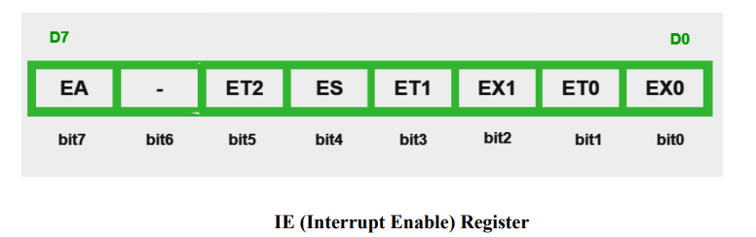
IE (Interrupt Enable) Register
Interrupts can be enabled and disabled using IE Register. It is a register in the 8051 microcontroller that controls interrupt prioritization and triggering. It includes many bits, such as:
EA-Global Interrupt Enable/Disable – When it is set it enables all interrupt, if cleared disables all interrupts
• 0- Disables all interrupt requests
• 1- Enables all interrupt requests

Slide 37
ES (Serial Communication Interrupt Enable)- This bit enables or disables the interrupt for serial communication.
• 1- Interrupt is enabled by UART system
• 0-Interrupt cannot be generated by UART system
ET0- Bit enables or disables timer 0 interrupt.
• 1-Timer 0 is enables an interrupt
• 0-Interrupt cannot be generated by the timer 0
ET1– Bit enables or disables timer 1 interrupt.
• 1- Interrupt is enabled by timer 1
• 0-Interrupt is disabled by timer 1

Slide 38
EX0 and EX1 (External Interrupt 0 and External Interrupt 1 Enable
• These bits control the interrupts from external devices.
• EX0 – bit enables or disables external 0 interrupt: 0 – change of the INT1 pin logic state cannot generate an interrupt and 1 – enables an external interrupt on the pin INT1 state change
• EX1 – bit enables or disables external 1 interrupt: 0 – change of the pin INT0 logic state cannot generate an interrupt and 1 – enables an external interrupt on the pin INT0 state change.
IT0 and IT1 (External Interrupt 0 and External Interrupt 1 Type)– These bits determine the type of trigger for external interrupts (level or edge-triggered).

Slide 39
IP (Interrupt Priority) Register
One cannot predict when one may receive an interrupt request. If multiple interrupts are enabled, it can happen that a request for another interrupt is made while the first one is ongoing. There is a priority list that tells the microcontroller what to do in order to determine whether to respond to a new interrupt request or to carry on with existing operations. The microcontroller restarts once everything stops in response to a reset request. Only Reset has the ability to disable Interrupt priority 1. Both Reset and interrupt priority 1 have the ability to disable interrupt priority 0. The interrupt priority register, or IP Register, indicates which of the current interrupt sources is more significant than other. The program’s start typically defines the interrupt priority. An interrupt will be immediately paused and given preference over any other interrupt if the one with greater priority comes while the other is still in progress. Whenever two interrupt requests that have different priorities occurs simultaneously, the higher priority interrupt is handled first. If two interrupt requests with the same priority level arise one after the other, the subsequent request needs to wait until the entire process is accomplished.

Slide 40
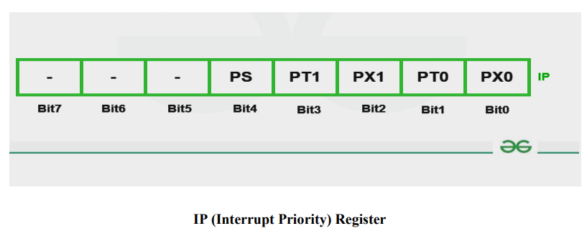
Bit0 (PX0)- External0 interrupt priority bit
• 0- Sets low priority to external 0 interrupt
• 1- Sets high priority to external 0 interrupt
Bit1 (PT0)- Timer 0 interrupt priority bit
• 0- Assigns low priority to Timer0 interrupt
• 1- Assigns high priority to Timer0 interrupt

Slide 41
Bit2 (PX1)- External1 interrupt priority bit
• 0- Sets low priority to external1 interrupt
• 1- Sets high priority to external1 interrupt
Bit3 (PT1)- Timer1 interrupt priority bit
• 0- Sets low priority to timer1 interrupt
• 1- Sets high priority to timer1 interrupt
Bit4 (PS)- Serial Input priority bit
• 0- Assigns low priority to serial interrupt
• 1- Assigns high priority to serial interrupt
Bit 5,6 & 7- These bits are called as the Reserved bits.

Slide 42
1.5 Memory Organization of 8051
The 8051 microcontroller's memory is divided into Program Memory and Data Memory. Program Memory (ROM) is used for permanent saving program being executed, while Data Memory (RAM) is used for temporarily storing and keeping intermediate results and variables.
Program Memory (ROM)
Program Memory (ROM) is used for permanent saving program (CODE) being executed. The memory is read only. Depending on the settings made in compiler, program memory may also used to store a constant variables. The 8051 executes programs stored in program memory only. code memory type specifier is used to refer to program memory.
8051 memory organization allows external program memory to be added.
How does the microcontroller handle external memory depends on the pin EA logical state

Slide 43
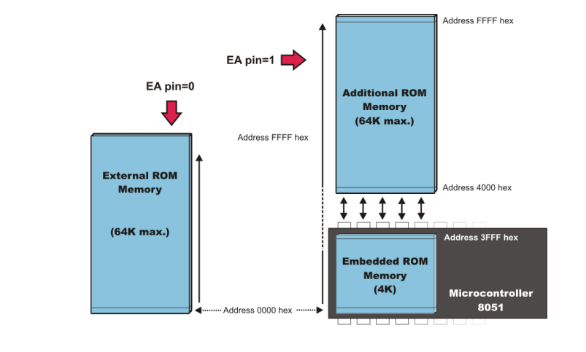
Internal Data Memory
Up to 256 bytes of internal data memory are available depending on the 8051 derivative. Locations available to the user occupy addressing space from 0 to 7Fh, i.e. first 128 registers and this part of RAM is divided in several blocks. The first 128 bytes of internal data memory are both directly and indirectly addressable. The upper 128 bytes of data memory (from 0x80 to 0xFF) can be addressed only indirectly.

Slide 44
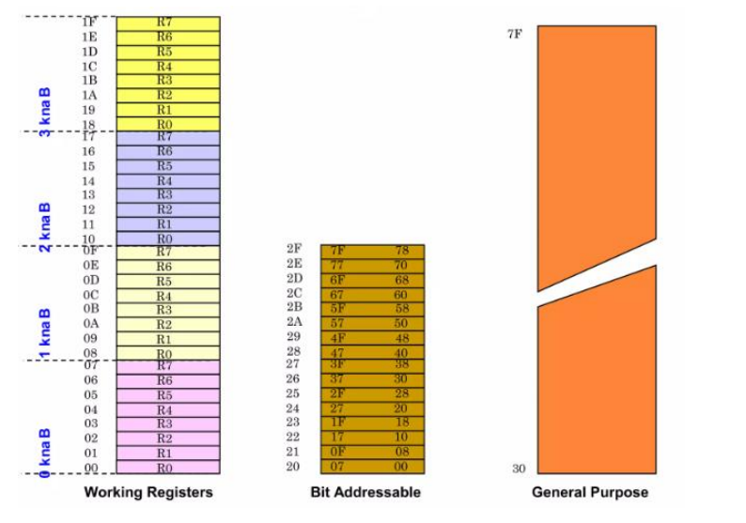
Since internal data memory is used for CALL stack also and there is only 256 bytes splited over few different memory areas fine utilizing of this memory is crucial for fast and compact code. See types efficiency also.
Memory block in the range of 20h to 2Fh is bit-addressable, which means that each bit being there has its own address from 0 to 7Fh. Since there are 16 such registers, this block contains in total of 128 bits with separate addresses ( Bit 0 of byte 20h has the bit address 0, and bit 7 of byte 2Fh has the bit address 7Fh). Three memory type specifiers can be used to refer to the internal data memory: data, idata, and bdata

Slide 45
External Data Memory
Access to external memory is slower than access to internal data memory. There may be up to 64K Bytes of external data memory. Several 8051 devices provide on-chip XRAM space that is accessed with the same instructions as the traditional external data space. This XRAM space is typically enabled via proper setting of SFR register and overlaps the external memory space. Setting of that register must be manually done in code, before any access to external memory or XRAM space is made.

Slide 46
1.6 Special features of 8051- Boolean Processor, Power saving options- idle and power down mode, Derivatives of 8051(8951, 8952, 8031, 8751).
Boolean Processor in 8051 Microcontroller
The 8051 microcontroller is widely used in various embedded systems applications due to its simplicity, ease of use, and versatility. One of the essential components of the 8051 microcontroller is its Boolean Processor, which plays a crucial role in performing logical and bitwise operations.
• The 8051 microcontroller supports bit addressable memory and bit manipulation instructions for Boolean operation that’s why 8051 is also called as Boolean processor.
• The ALU is the core component of the Boolean Processor in 8051 microcontroller. It performs arithmetic and logical operations on binary data..
• The internal RAM contains 128 addressable bits, and the SFR space supports up to 128 other addressable bits

Slide 47
• All port lines are bit-addressable, and each can be treated as a separate single-bit port.
• The Boolean Processor supports various logical and bitwise operations, which can be performed using instructions such as AND, OR, XOR, and NOT.
• These operations allow manipulation of individual bits or groups of bits within registers or memory locations.
• For example, ANL C,P1.4 ; AND the bit on P1.4 with carry flag
ORL P0.1, #1 ; OR the bit P0.1 with 1 (SET bit P0.1)
• The Boolean Processor also supports conditional branching instructions based on the status of the flags in the PSW. These instructions allow the microcontroller to change the program flow based on the result of previous operations.
• For example,
JC rel ; Jump on relative 8-bit address if carry flag is set
2. JNC rel ; Jump on relative 8-bit address if carry flag is not set
3. JB bit,rel ; Jump on relative 8-bit address if direct bit is set

Slide 48
• The Boolean Processor provides instructions to perform left and right shift operations as well as rotate operations on the accumulator or other registers. These operations are useful for shifting or rotating the bits within a binary number.
The Boolean Processor in the 8051 microcontroller enables efficient execution of logical and bitwise operations required in many embedded systems applications
It provides a versatile set of instructions and registers to perform arithmetic, logical, shift, and rotate operations. The use of flags in the PSW allows for conditional branching, enabling decision-making based on the outcome of previous operations.
Overall, the Boolean Processor greatly enhances the computational capabilities of the 8051 microcontroller

Slide 49
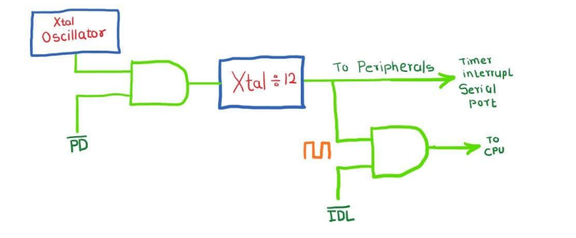
8051 Power Down and Idle Mode
• Power Saving mode in 8051 microcontroller is used to save energy during idle time of processor and during power down time of processor. So, is important to make microcontroller as a power saving device.
• The 8051 uses current of approximately 25 mA during the normal operation.
• In power saving mode, the 8051 microcontroller reduces its total consumption to approximately 40μ
• The 8051 supports two power-saving modes of operation: Idle and Power Down as shown in Figure

Slide 50
Idle Mode
• After setting the bit IDL in the PCON register, the microcontroller turns into idle power saving mode.
• Where serial port, timers and interrupt system continue operating normally consuming 6.5 mA. 29
• In Idle mode, the content of all registers and I/O ports is remains unchanged i.e. the CPU status is preserved entirely.
• SP, PC, PSW, Accumulator and other registers remains as it is their data during IDLE mode.
• In order to operate the microcontroller normally, interrupt or reset signal can be used.
• Then the IDL bit is automatically cleared and the continues execution from program instruction following that instruction which has set the IDL bit.

Slide 51
Power Down Mode
• After setting the bit PD in the PCON register, the microcontroller turns into idle power saving mode.
• In this mode, 8051 turns off its internal oscillator which reduces power consumption.
• In power-down mode, the 8051 microcontroller operates using only 2V power supply where the total power consumption is less than 40 μA.
• The microcontroller can be brought to normal mode by using hardware reset signal only.
• In Power Down mode, the contents of all SFR registers and I/O ports remains as it is.
• But after the microcontroller brought into the normal mode, the content of the SFR register is lost, but the content of internal RAM is saved.
• Reset signal must of approximately 10 ms so that 8051 microcontroller can stabilize quartz Oscillator operating.

Slide 52
• In the Power Down mode, the oscillator is completely stopped, and the instruction that invokes Power Down is the last instruction executed by 8051 microcontroller.
• The internal RAM and Special Function Registers save their values till the Power Down mode is removed.
Difference Between Power Down Mode and Idle Mode in 8051
Aspect | Power Down Mode | Idle Mode
Clock status | Oscillator clock stopped, CPU and peripherals clocks OFF | CPU clock stopped, peripheral clocks active
CPU operation | CPU halted | CPU halted
Peripheral operation | Peripherals inactive | Peripherals active (timers, serial port, interrupts)
Power consumption | Very low (< 40 μA) | Reduced but higher than Power Down (e.g., 6.5 mA)
Exit from mode | Usually hardware reset or external interrupt in some cases | Interrupt or hardware reset
Power supply voltage | Can operate at lower voltage (around 2V) | Normal voltage operation

Slide 53

PCON register
The purpose of the Register PCON bits is:
• SMOD Baud rate is twice as much higher by setting this bit.
• GF1 General-purpose bit (available for use).
• GF1 General-purpose bit (available for use).
• GF0 General-purpose bit (available for use).
• PD By setting this bit the microcontroller enters the Power Down
• IDL By setting this bit the microcontroller enters the Idle

Slide 54
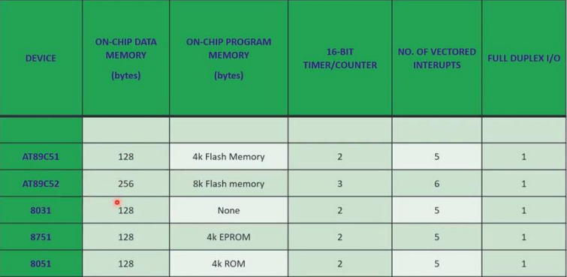
Derivatives of 8051 (8951, 8952, 8031, 8751)

