Slide 1
Process Models

Slide 2
2.1 Personal and Team Process Models (PSP and TSP)
Personal Software Process (PSP)
The Personal Software Process (PSP) is a structured methodology designed to help individual software engineers improve their personal work processes through disciplined practices and measurement of their performance.
Objectives and Benefits of PSP:
Improve estimating and planning skills.
Enable engineers to make realistic commitments.
Manage personal project quality.
Reduce defects and improve reliability of work.
Track and analyze time spent on activities, defects, and size of work to understand performance and guide improvements.
Promote self-assessment and continuous personal process improvement.
PSP involves activities such as planning, high-level design, design review,
development (coding and testing), and postmortem analysis to evaluate and refine personal work practices

Slide 3
Team Software Process (TSP)
The Team Software Process (TSP) extends PSP concepts to the team level, focusing on team productivity, collaboration, and disciplined process management to deliver high-quality software effectively. TSP provides a framework for managing team roles, tasks, metrics, and quality.
Key Features and Benefits of TSP:
Emphasizes team collaboration and communication.
Uses structured process management similar to PSP but scaled to team dynamics.
Metrics-driven approach to measure progress, quality, and productivity.
Supports iterative and incremental development steps.
Encourages continuous improvement with feedback from peers and stakeholders.
Helps teams achieve predictable, high-quality software delivery.

Slide 4
Comparison Summary
Aspect | PSP | TSP
Focus | Individual software engineer | Team of software engineers
Goal | Improve individual skills and quality | Improve team productivity and product quality
Process Approach | Bottom-up, disciplined, metrics-based | Top-down, process-driven, team management
Scope | Personal planning, coding, defect tracking | Team roles, project tracking, quality control
Benefits | Enhanced estimation, reduced defects | Better collaboration, higher team productivity
Complexity | Intellectually challenging for individuals | Requires discipline at team level
Both PSP and TSP aim to improve software quality and productivity but operate at different levels—the individual and the team—to ensure better-managed, predictable software development processes

Slide 5
2.2 Waterfall Model
Waterfall Model in Software Development
The Waterfall Model is a traditional, linear, and sequential software development methodology introduced by Winston W. Royce in 1970. It emphasizes a structured flow where each phase must be completed before the next one begins, resembling a waterfall cascading downwards.
Phases of the Waterfall Model
1] Requirements Analysis and Specification
  All software requirements are gathered from the customer and analyzed for completeness and consistency.
  2. Documented in a Software Requirement Specification (SRS) which serves as a contract between developers and clients

Slide 6
2] System Design
  The system architecture and overall design is created based on the requirements.
  This phase includes High-Level Design (HLD), outlining components and their interactions, and Low-Level Design (LLD), detailing modules and algorithms.
3] Implementation (Coding)
  Developers write source code according to the design specifications.
  The system is developed as smaller units or modules which are individually tested (unit testing).
4] Integration and Testing
  All individual units are integrated and tested collectively as a complete system (system testing).
  Defects found during testing are fixed, often requiring revisiting the implementation phase.
5] Deployment
  The completed software product is delivered to the customer and deployed in the production environment.
6] Maintenance
  Post-deployment, issues arising in the operational environment are fixed, and updates or enhancements are released as needed.

Slide 7
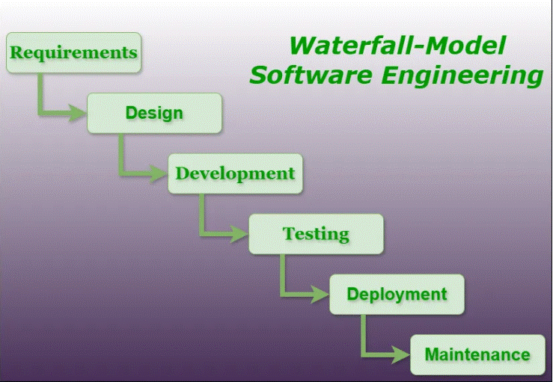
Characteristics of the Waterfall Model
Sequential Flow: Progression is downward through distinct phases without overlap.
Phase Completion: Each phase has specific deliverables and must be signed off before the next phase begins.
Documentation-Centric: Heavy emphasis on documentation such as SRS, design documents, and test plans.
Limited Customer Interaction: Requirements are gathered upfront, with minimal changes allowed during development.
Suitable for: Projects with well-understood requirements and low expected changes.

Slide 8
The Waterfall Model remains fundamental in software engineering, especially for projects requiring strict documentation and structured progress, though its inflexibility often leads to newer iterative models like Agile being preferred for dynamic requirements.
2.3 V Model
V Model in Software Development
The V Model, also called the Verification and Validation Model, is an extension of the Waterfall model that emphasizes a corresponding testing phase for each development stage
Structure of the V Model
The V model visualizes the development process as a "V" shape with two main sides:
Left Side (Verification Phases): These phases correspond to requirements gathering, design, and coding, focusing on definition and planning.
Right Side (Validation Phases): Corresponding to the left side phases, these involve different levels of testing designed to validate the work done in the verification phases.

Slide 9
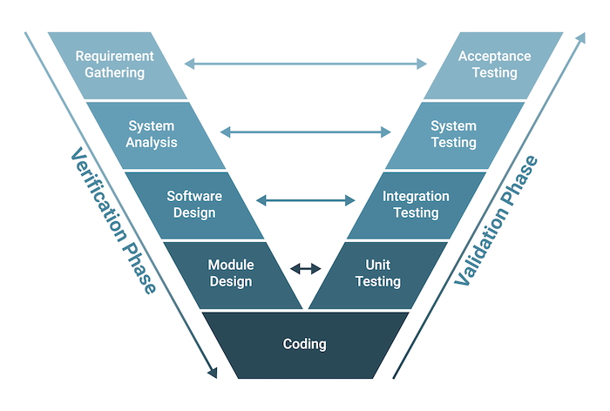
Phases of the V Model
Business Requirement Analysis (Verification)
  Understand customer/business requirements.
  Plan acceptance tests based on these requirements.
System Design (Verification)
  Define the overall system architecture.
  Develop system test plans.
Architectural Design (Verification)
  Design the system's component structure or modules (High-Level Design).
  Plan integration testing based on module interactions.

Slide 10
4.Module Design (Verification)
  Create detailed module-level design (Low-Level Design).
  Plan unit testing for individual components.
5.Implementation (Coding)
  Write code modules based on the detailed design.
6.Unit Testing (Validation)
  Test individual modules for correctness, corresponding to module design.
7.Integration Testing (Validation)
  Test module interactions and data flow, corresponding to architectural design.
8.System Testing (Validation)
  Test the entire system against the system design specifications.
9.Acceptance Testing (Validation)
  Verify the software against the business requirements to ensure it meets customer expectations.

Slide 11
Features and Benefits
Early Test Planning: Testing activities are planned alongside development, improving defect detection early.
Clear Traceability: Each development phase has a corresponding testing phase, ensuring requirements are verified and validated methodically.
Structured and Disciplined: Best suited for projects with well-defined and stable requirements.
Reduces Errors: Defects are caught early, reducing expensive fixes later in development.
2.4 Incremental Process Model
Incremental Process Model in Software Development
The Incremental Process Model is a software development approach where the project is divided into smaller, manageable parts called increments. Each increment represents a functional portion of the overall system, developed through individual cycles of requirement analysis, design, implementation, and testing

Slide 12
Key Characteristics
Partial System Delivery: The software is developed and delivered in increments, with each providing additional features.
Early Availability: Core functionality becomes available early, allowing users to begin using and testing it.
Customer Feedback: Feedback from users after each increment is incorporated into future increments to improve the system.
Flexibility: The model easily accommodates changes and evolving requirements over development.
Combination of Linear and Iterative: Each increment follows a structured phase but the overall development is iterative and adaptive.
Phases of the Incremental Model
1.Requirement Gathering and Analysis: High-level requirements are collected initially and refined for each increment.
2.Design: The architecture and detailed design are developed incrementally.
Implementation: Code for the increment's features is developed.
3.Testing: Each increment is thoroughly tested before integration.
4.Integration: Increments are integrated progressively to build the complete system.
5.Evaluation and Feedback: Stakeholders review each increment, providing feedback for subsequent increments

Slide 13
When to Use the Incremental Model
Projects where requirements are partially known or expected to evolve.
Large and complex systems that benefit from staged delivery.
Environments where early software deployment transforms into competitive advantage.
Situations where budget constraints demand releasing a working product in phases.
Projects needing close customer collaboration to refine the product continuously.
The Incremental Model balances predictability with flexibility by delivering working software early and iteratively, enabling risk reduction and easier management of evolving requirements.Software is a collection of instructions, data, or programs that operate computers and perform specific tasks. It enables hardware to function according to user requirements through programs and associated documentation. Software is intangible, consisting of executable code and related resources that allow computers and devices to perform various functions, such as operating systems, applications, and utilities.
Key Points About Software
Software directs hardware operations without being a physical component.
It includes executable programs, libraries, and user manuals.
Examples encompass operating systems, word processors, browsers, and games.

Slide 14
Types of Software
System Software: Manages hardware and provides a platform for running application software.
Application Software: Designed for end-user tasks like word processing or gaming.
Programming Software: Tools aiding software development like compilers and debuggers.
2.5 Evolutionary Process Model: Prototyping
Evolutionary Process Model: Prototyping
The Prototyping Model is an evolutionary software development approach in which an early, incomplete version of the software—called a prototype—is created to help understand requirements and refine functionality through user feedback.
What is Prototyping Model?
A prototype is a preliminary working version of the software with limited functionality.
The prototype is developed quickly based on initial requirements and shown to users for evaluation.

Slide 15
User feedback is gathered and used to refine and enhance the prototype iteratively.
This cycle continues until the prototype meets user expectations and can form the basis for the final system development.
Phases of the Prototyping Model
1.Requirements Gathering and Analysis: Initial requirements are collected through discussions with users to understand high-level system objectives.
2.Quick Design: A rapid design focusing on the user interface and functional aspects visible to users is created to build the prototype.
3.Building the Prototype: The actual prototype is developed that implements basic features.
4.User Evaluation: The prototype is demonstrated to users to gather feedback about strengths, weaknesses, and missing features.
5.Refining the Prototype: The prototype is refined based on feedback with changes made to improve or extend functionality.
6.Final System Development and Maintenance: Once the prototype is approved, the final version of the system is built using the refined prototype as a reference. Maintenance follows thereafter.
.

Slide 16
Advantages of Prototyping Model
Early detection and correction of errors.
Better understanding of user requirements through active involvement.
Quick user feedback leads to better design decisions.
Identification of missing or misunderstood functionality early.
Disadvantages
Can take more time due to iterative refinements.
May require more resources.
High user involvement may distract developers or shift focus.

Slide 17
2.6 Selection criteria for software process model.
Selection Criteria for Software Process Model
Choosing the right software process model is crucial for the success of a development project. The selection depends on various factors related to project characteristics, team, customer involvement, and risk. Below are key criteria typically used to select the most suitable software process model:
Requirements Characteristics
Stability of Requirements: If requirements are stable and well-understood at the beginning, linear models (like Waterfall) are preferred. For evolving or unclear requirements, iterative or evolutionary models suit better.
Complexity and Size of Requirements: Complex systems with numerous requirements may demand incremental or agile approaches for better manageability.
Visibility of Requirements: If user needs can be defined early with clarity, traditional models work well. Otherwise, prototyping or incremental models help discover requirements gradually.

Slide 18
2. Development Team Factors
Team Size and Experience: Large teams may need structured, formal models like Waterfall or V-Model, while smaller, experienced teams can adopt agile or iterative models.
Domain and Technical Knowledge: Familiarity with technology and domain impacts model choice, favoring flexible models for less experienced teams.
3. User Involvement and Expertise
Level of User Involvement: High involvement recommends iterative, incremental, or agile models to incorporate continuous feedback.
User Experience: Novice users may require prototypes to clarify needs; experienced users can partake more in formal approaches.
4. Project Type and Risk
Project Size and Complexity: Large, complex projects may benefit from incremental or spiral models to mitigate risks throughout development.
Schedule Constraints: Tight schedules might prefer incremental or agile deployment to deliver features early.
Budget Constraints: Limited budget can influence models that optimize effort and rework, such as incremental or prototyping

Slide 19
5. Other Considerations
Technology Availability: New or emerging technology projects may require evolutionary or iterative processes.
Criticality and Quality Requirements: High-criticality projects (e.g., medical, aerospace) need rigorous models like V-Model or Spiral for systematic verification and validation.
Flexibility Needs: When flexibility in design and evolution is essential, iterative models are favored over rigid sequential models
Summary Table of Selection Parameters
Criterion | Suitable Models
Stable, clear requirements | Waterfall, V-Model
Evolving/unclear requirements | Incremental, Prototyping, Agile
Large & Complex projects | Spiral, Incremental, Agile
High user involvement | Agile, Incremental, Prototyping
Small, skilled teams | Agile, Iterative
High criticality & quality | V-Model, Spiral
Tight schedule | Incremental, Agile

