Slide 1
05. Optics and Optical Fiber

Slide 2
Introduction of optics & optical fiber :
Definition of OPTICS : -
Optics is the branch of physics that deals with the study of light — its nature, properties, and behavior when it interacts with different materials.
It explains how light travels, reflects, refracts, and forms images through lenses and mirrors.
Types of Optics : -
Geometrical Optics : -
Includes reflection, refraction, mirrors, and lenses.
Example : Image formation by a convex lens or mirror.
Physical Optics : -
Includes interference, diffraction, and polarization.
Example : Rainbow colors, soap bubble colors, etc.

Slide 3
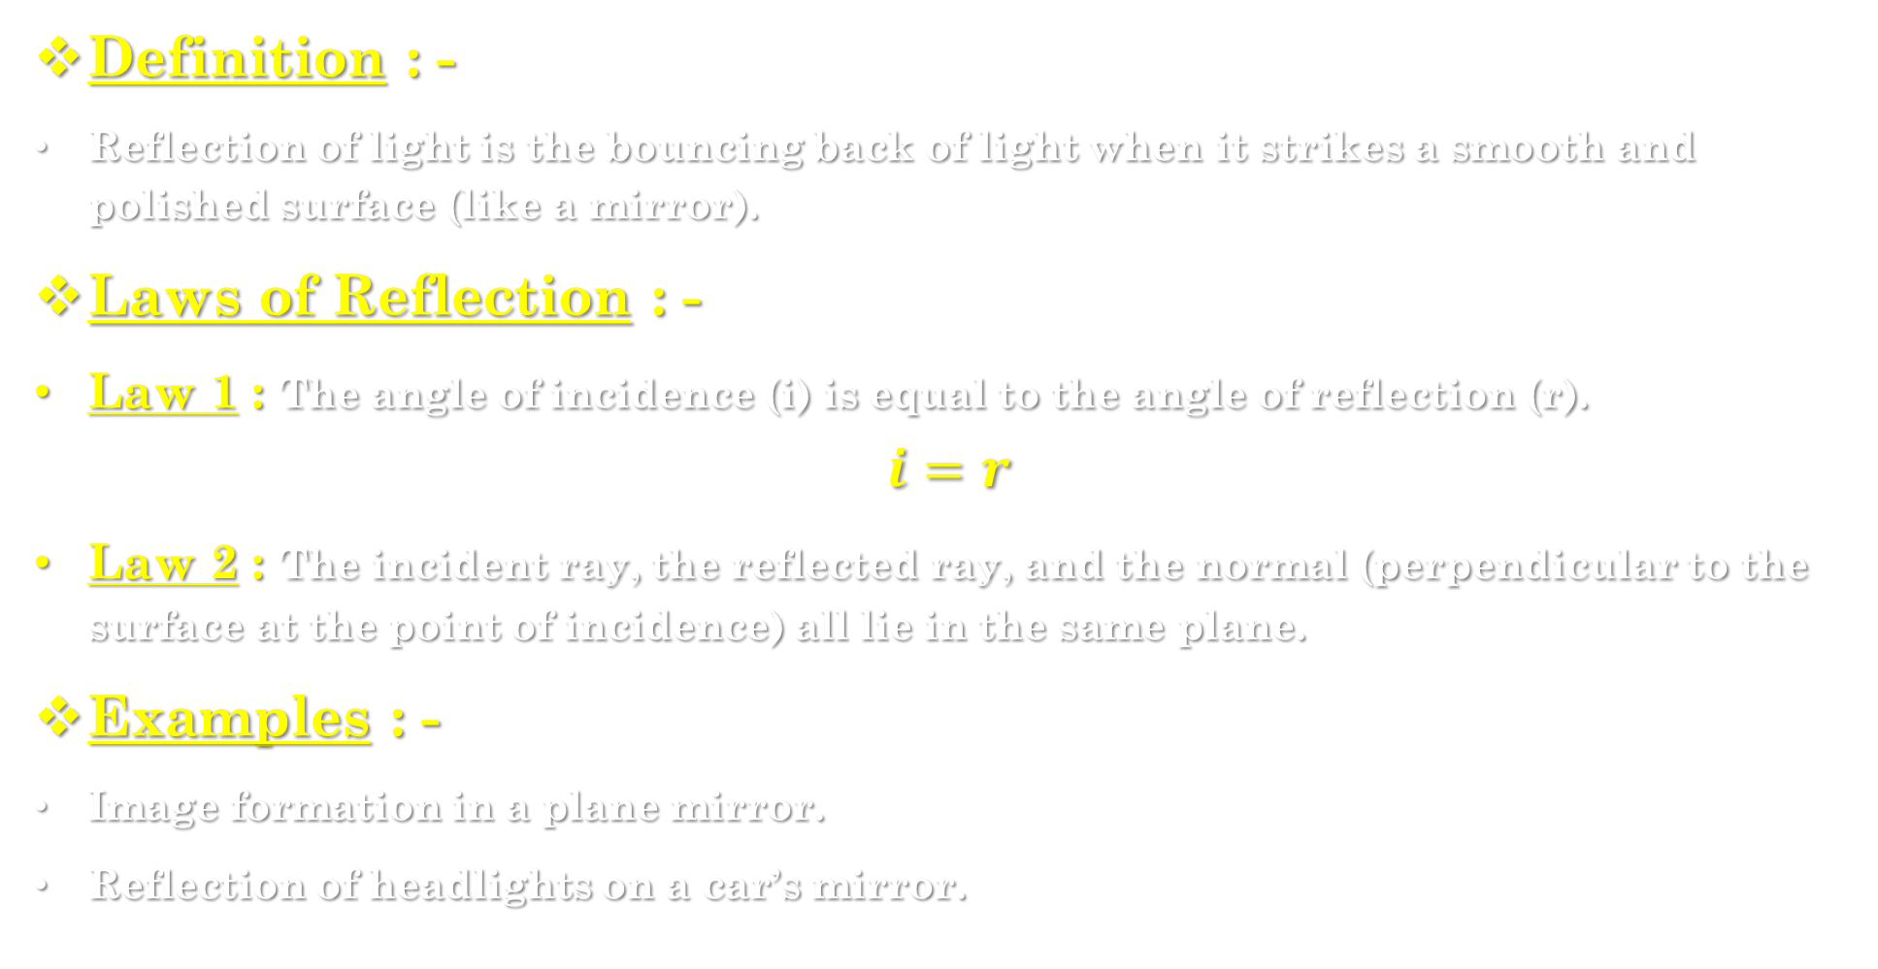
5.1] reflection of light : -
Definition : -
Reflection of light is the bouncing back of light when it strikes a smooth and polished surface (like a mirror).
Laws of Reflection : -
Law 1 : The angle of incidence (i) is equal to the angle of reflection (r).
$$i=r$$
Law 2 : The incident ray, the reflected ray, and the normal (perpendicular to the surface at the point of incidence) all lie in the same plane.
Examples : -
Image formation in a plane mirror.
Reflection of headlights on a car’s mirror.

Slide 4
Types of Reflection : -
Regular Reflection (Specular) : -
  Occurs on smooth surfaces like mirrors.
  Produces clear images.
Irregular Reflection (Diffuse) : -
  Occurs on rough surfaces.
  Light is scattered in different directions, no clear image is formed.

Slide 5
Refraction of light : -
Definition : -
Refraction of light is the bending of light rays when they pass from one medium to another (like air to water) due to a change in speed.
Explanation : -
When light passes from a rarer medium (air) to a denser medium (glass or water), it bends towards the normal.
When light passes from a denser medium to a rarer medium, it bends away from the normal.
Examples : -
A stick in water appears bent due to refraction.
Lenses (concave or convex) work on the principle of refraction.
Rainbow formation is due to refraction and dispersion of light.

Slide 6
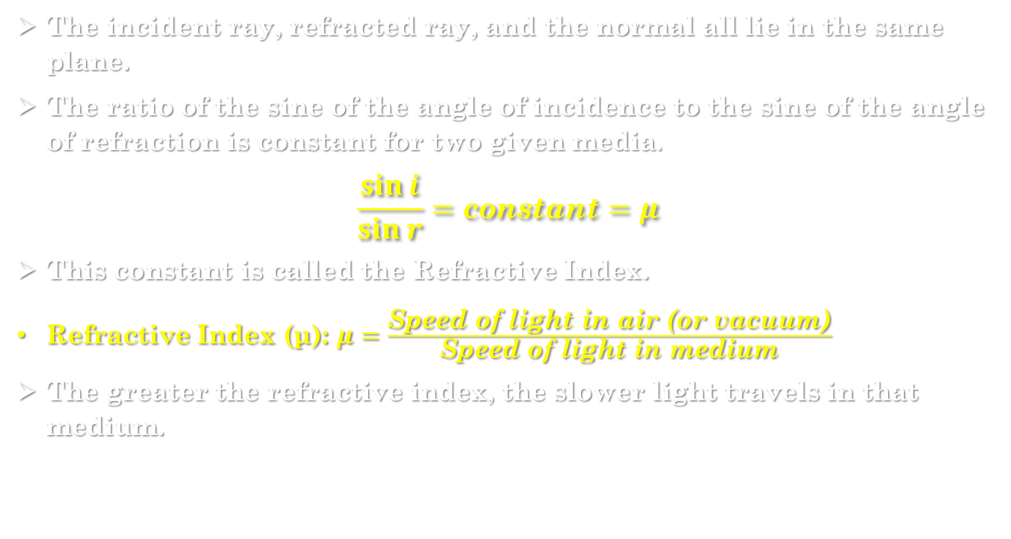
5.3] laws of refraction : -
The incident ray, refracted ray, and the normal all lie in the same plane.
The ratio of the sine of the angle of incidence to the sine of the angle of refraction is constant for two given media.
$$\frac{\sin{i}}{\sin{r}}=\text{constant}=μ$$
This constant is called the Refractive Index.
Refractive Index (μ): $μ=\frac{\text{Speed} \text{of} \text{light} \text{in} \text{air}\text{ (}\text{or} \text{vacuum}\text{)}}{\text{Speed} \text{of} \text{light} \text{in} \text{medium}}$
The greater the refractive index, the slower light travels in that medium.

Slide 7
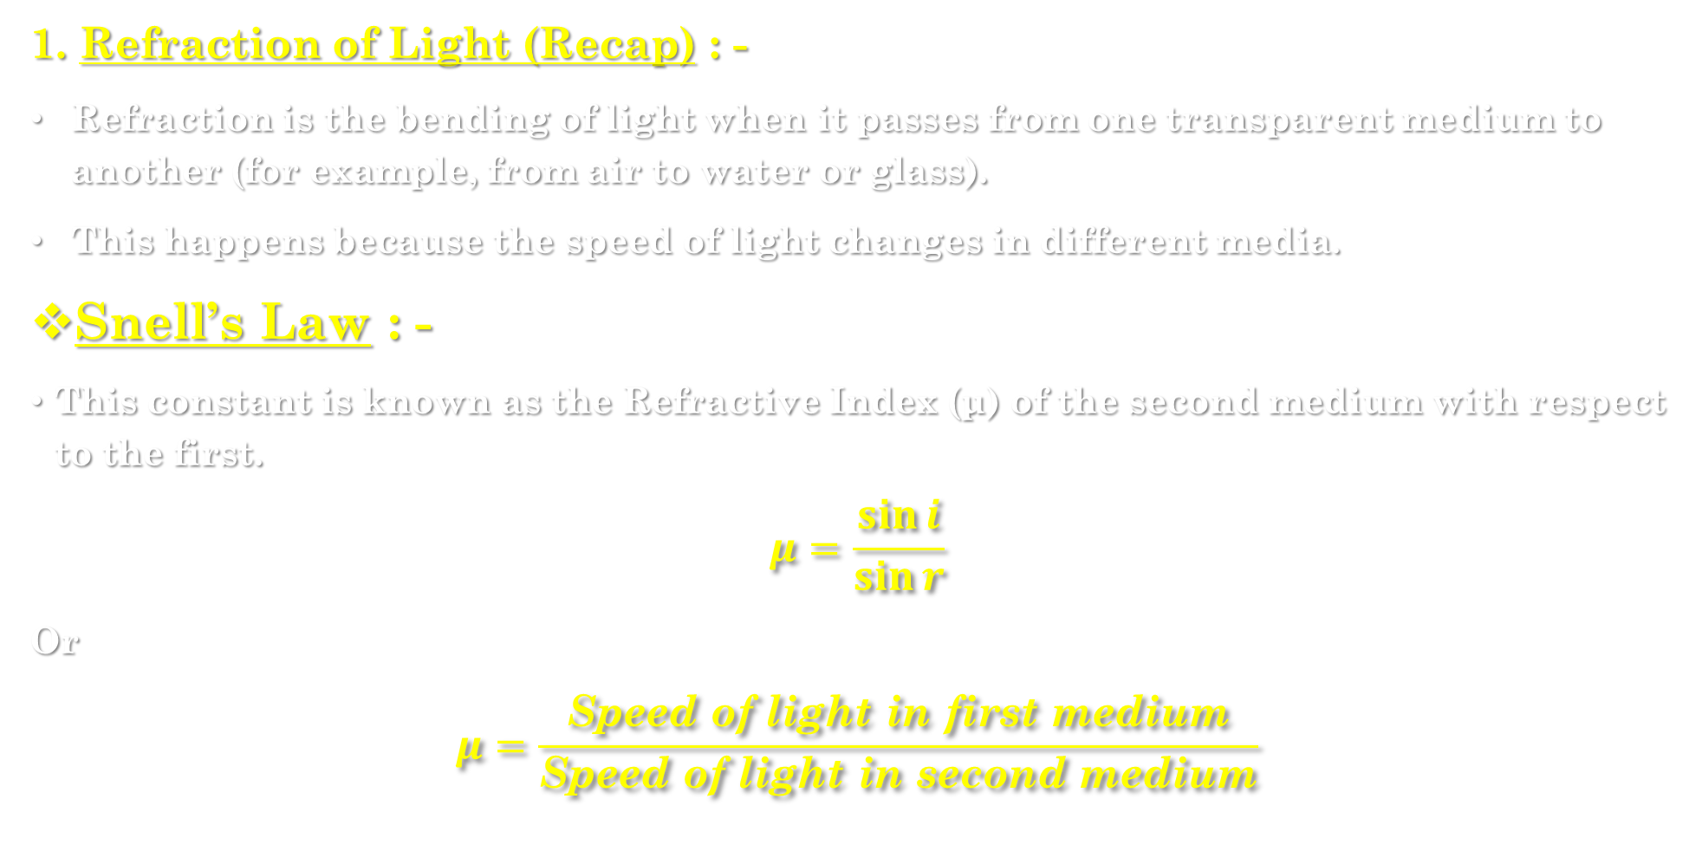
Laws of refraction & snell’s law : -
1. Refraction of Light (Recap) : -
Refraction is the bending of light when it passes from one transparent medium to another (for example, from air to water or glass).
This happens because the speed of light changes in different media.
Snell’s Law : -
This constant is known as the Refractive Index (μ) of the second medium with respect to the first.
$$μ=\frac{\sin{i}}{\sin{r}}$$
Or
$$μ=\frac{\text{Speed} \text{of} \text{light} \text{in} \text{first} \text{medium}}{\text{Speed} \text{of} \text{light} \text{in} \text{second} \text{medium}}$$

Slide 8
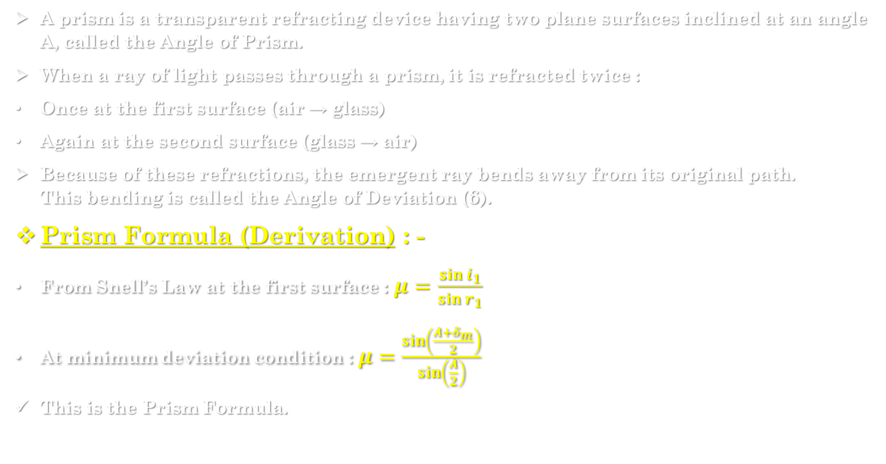
Prism formula : -
A prism is a transparent refracting device having two plane surfaces inclined at an angle A, called the Angle of Prism.
When a ray of light passes through a prism, it is refracted twice :
Once at the first surface (air → glass)
Again at the second surface (glass → air)
Because of these refractions, the emergent ray bends away from its original path.
This bending is called the Angle of Deviation (δ).
Prism Formula (Derivation) : -
From Snell’s Law at the first surface : $μ=\frac{\sin{i_{1}}}{\sin{r_{1}}}$
At minimum deviation condition : $μ=\frac{\sin\left(\frac{A+δ_{m}}{2}\right)}{\sin\left(\frac{A}{2}\right)}$
This is the Prism Formula.

Slide 9
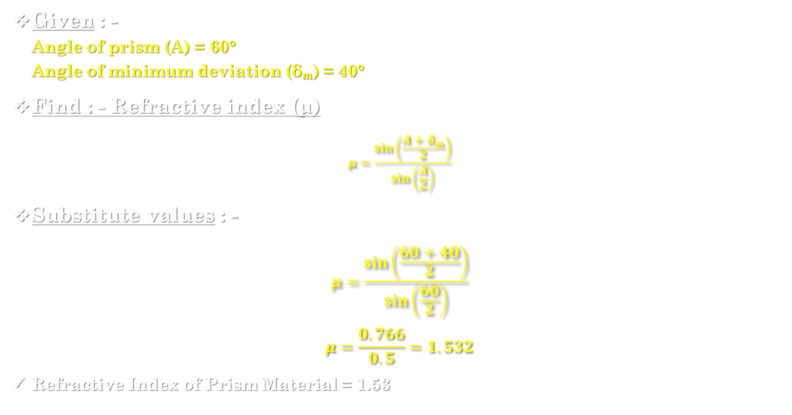
Numerical example : -
Given : -
Angle of prism (A) = 60°
Angle of minimum deviation (δₘ) = 40°
Find : - Refractive index (μ)
$$μ=\frac{\sin\left(\frac{A+δ_{m}}{2}\right)}{\sin\left(\frac{A}{2}\right)}$$
Substitute values : -
$$μ=\frac{\sin\left(\frac{60+40}{2}\right)}{\sin\left(\frac{60}{2}\right)}$$
$$μ=\frac{0.766}{0.5}=1.532$$
Refractive Index of Prism Material = 1.53

Slide 10
5.4] optical fiber : -
Definition : -
An optical fiber is a thin, flexible, transparent fiber made of glass or plastic that transmits light signals from one end to another by total internal reflection (TIR).
Construction of Optical Fiber : -
Core : -
  The inner part of the fiber through which light travels.
  Made of high refractive index glass.
Cladding : -
  The outer optical layer that surrounds the core.
  Has a lower refractive index to cause total internal reflection.
Protective Coating : -
  Outer plastic layer to protect the fiber from damage.

Slide 11
5.5] principle of propagation of light through optical fiber : -
Introduction : -
An optical fiber is a thin, flexible, transparent fiber made of glass or plastic that can transmit light signals from one place to another over long distances.
The working principle of optical fiber is based on the phenomenon of Total Internal Reflection (TIR).

Slide 12
5.6] structure of optical fiber : -
An optical fiber mainly has three parts :
Core : -
  The inner transparent part through which light travels.
  Made of glass or plastic with a high refractive index.
Cladding : -
  A surrounding layer around the core.
  Has a slightly lower refractive index than the core.
  Helps in keeping the light confined inside the core by Total Internal Reflection.
Protective Coating (Jacket) : -
  Outer layer that protects the fiber from damage, moisture, or scratches.

Slide 13
Basic structure : -
An optical fiber consists of three main parts : -
(a) Core : -
The innermost part of the optical fiber.
It is a thin cylinder of glass or plastic through which light travels.
It has a high refractive index (denser medium).
Typical diameter: 5 µm to 100 µm (depending on fiber type).
Function : -
To carry light signals through multiple total internal reflections.

Slide 14
(b) Cladding : -
The outer layer surrounding the core.
Made of glass or plastic with a slightly lower refractive index than the core.
This difference in refractive indices allows Total Internal Reflection to occur.
Function : -
To reflect light back into the core and prevent signal loss.
(c) Protective Coating (Jacket or Buffer Coating) : -
The outermost layer of the fiber.
Made of plastic, rubber, or polymer material.
Protects the fiber from moisture, mechanical damage, and bending losses.
Function : -
To protect the delicate inner core and cladding from environmental damage.

Slide 15
5.7] Application in electronic medical : -
Telecommunication : -
  Used for telephone lines, internet connections, and cable TV networks.
  Provides high-speed data transmission over long distances.
Computer Networking : -
  Used in LAN (Local Area Network) and WAN (Wide Area Network) connections.
  Ensures fast and interference-free communication.
Data Transmission : -
  Used in satellite links, submarine cables, and mobile communication systems.
  Enables high bandwidth and low signal loss.
Defense and Aerospace : -
  Used for secure communication in military and aircraft systems, as optical signals cannot be easily tapped.
Industrial Automation : -
  Used in sensors and control systems for monitoring temperature, pressure, or vibrations.

Slide 16
Applications in medical field : -
Endoscopy : -
  Used in endoscopic instruments to view internal organs without surgery.
  Transmits light to and from inside the body for diagnosis.
Laser Surgeries : -
  Optical fibers deliver laser light to precise parts of the body for surgical treatments.
Light Transmission : -
  Used in dental instruments and microscopes for illumination.
Blood Flow and Temperature Measurement : -
  Used in fiber optic sensors to monitor blood flow, pressure, and temperature inside the body.

Slide 17
2. Comparison between Optical Fiber and Electrical Cable : -
Feature | Optical Fiber | Electrical Cable (Copper Wire)
Signal Type | Light signal | Electrical signal
Transmission Speed | Very high (speed of light) | Moderate
Bandwidth (Data capacity) | Very high | Limited
Signal Loss | Very low | High over long distance
Interference | Immune to electromagnetic interference | Affected by EMI and noise
Weight and Size | Light and thin | Heavy and bulky
Material Used | Glass or plastic | Copper or aluminum
Cost | High initial cost, low maintenance | Low initial cost, high maintenance
Security | High – difficult to tap | Low – easy to tap signals
Durability | More durable and flexible | Less durable

