Slide 1
03. Electrostatics

Slide 2
Introduction of electrostatic : -
Electrostatics is the branch of physics that deals with the study of electric charges at rest (i.e., stationary charges).
It explains the forces, fields, and potentials produced by these static electric charges.
When certain materials are rubbed together (for example, glass rod with silk or ebonite rod with fur), they acquire the property of attracting or repelling other materials.
This happens because electric charges are transferred from one body to another, creating positive and negative charges.

Slide 3
3.1] definition of electric charge : -
Definition of Electric Charge : -
Electric charge is a fundamental property of matter that causes it to experience a force when placed in an electric or magnetic field.
Electric charge is the property due to which matter attracts or repels other matter electrostatically.
Types of Charges : -
Positive Charge (+) : -
  Produced when an object loses electrons.
  Example : A glass rod rubbed with silk becomes positively charged.
Negative Charge (−) : -
  Produced when an object gains electrons.
  Example : An ebonite rod rubbed with fur becomes negatively charged.

Slide 4
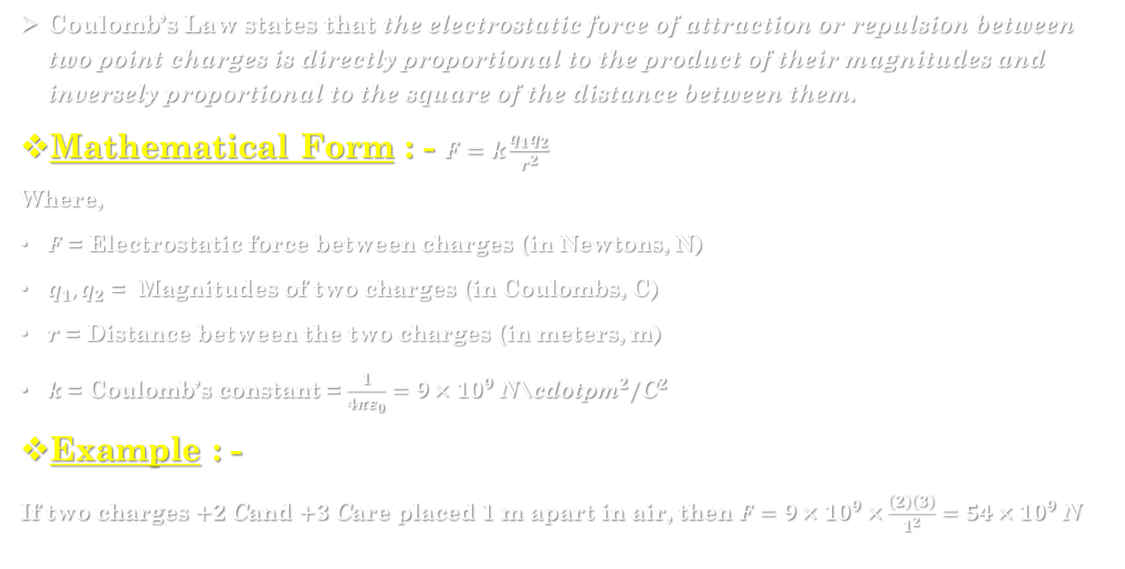
3.2] Coulomb’s law : -
Coulomb’s Law states that the electrostatic force of attraction or repulsion between two point charges is directly proportional to the product of their magnitudes and inversely proportional to the square of the distance between them.
Mathematical Form : - $F=k\frac{q_{1}q_{2}}{r^{2}}$
Where,
$F$ = Electrostatic force between charges (in Newtons, N)
$q_{1},q_{2}$ = Magnitudes of two charges (in Coulombs, C)
$r$ = Distance between the two charges (in meters, m)
$k$ = Coulomb’s constant = $\frac{1}{4πε_{0}}=9×{10}^{9} {\text{N}\text{\backslash }\text{cdotpm}}^{2}/{\text{C}}^{2}$
Example : -
If two charges $+2 \text{C}$and $+3 \text{C}$are placed 1 m apart in air, then $F=9×{10}^{9}×\frac{\left(2\right)\left(3\right)}{1^{2}}=54×{10}^{9} \text{N}$

Slide 5
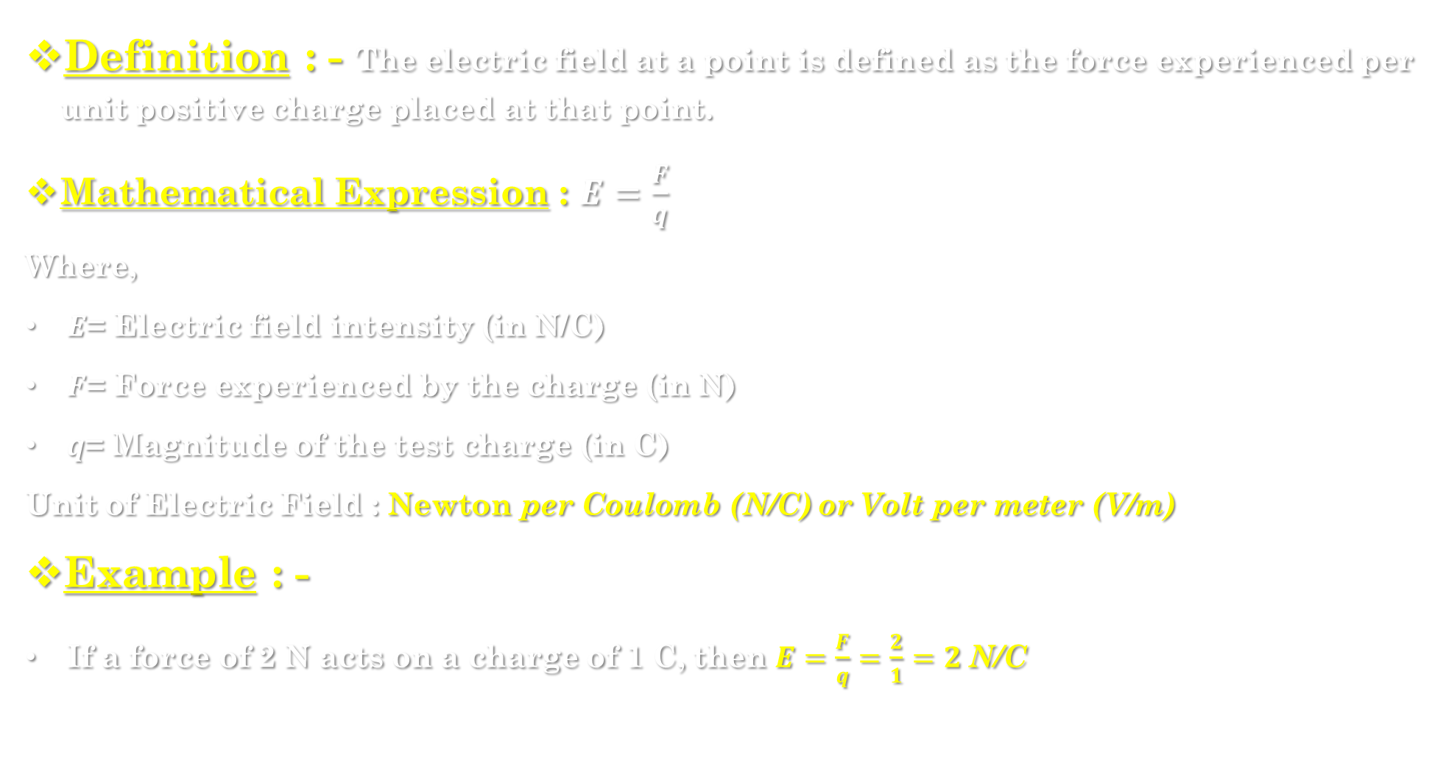
3.3] Definition of electric field : -
Definition : - The electric field at a point is defined as the force experienced per unit positive charge placed at that point.
Mathematical Expression : $E=\frac{F}{q}$
Where,
$E$= Electric field intensity (in N/C)
$F$= Force experienced by the charge (in N)
$q$= Magnitude of the test charge (in C)
Unit of Electric Field : $\text{Newton} \text{per} \text{Coulomb}\text{ (}\text{N}\text{/}\text{C}\text{)} \text{or} \text{Volt} \text{per} \text{meter}\text{ (}\text{V}\text{/}\text{m}\text{)}$
Example : -
If a force of 2 N acts on a charge of 1 C, then $E=\frac{F}{q}=\frac{2}{1}=2 \text{N}\text{/}\text{C}$

Slide 6
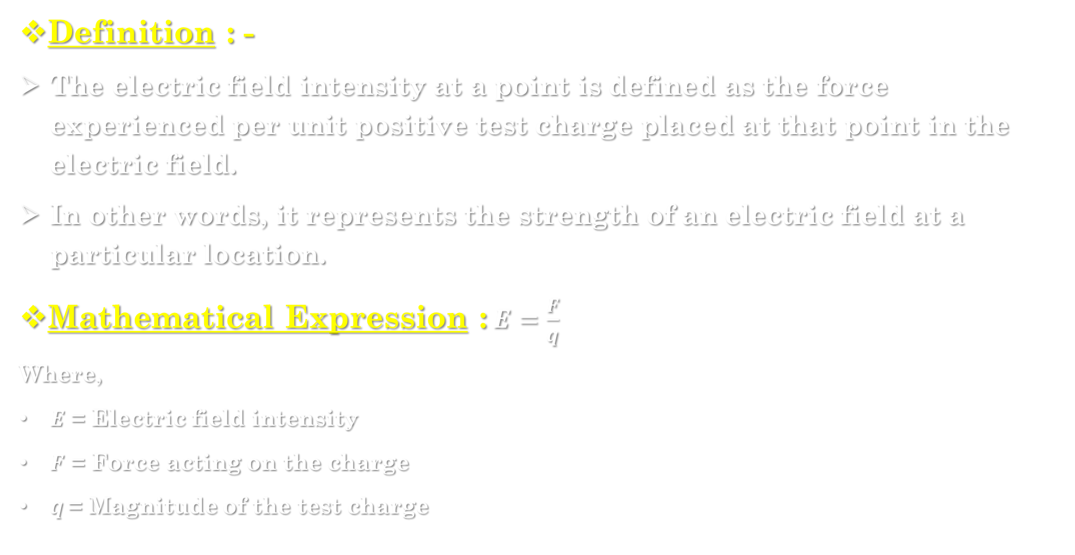
Electric field intensity (e) : -
Definition : -
The electric field intensity at a point is defined as the force experienced per unit positive test charge placed at that point in the electric field.
In other words, it represents the strength of an electric field at a particular location.
Mathematical Expression : $E=\frac{F}{q}$
Where,
$E$ = Electric field intensity
$F$ = Force acting on the charge
$q$= Magnitude of the test charge

Slide 7
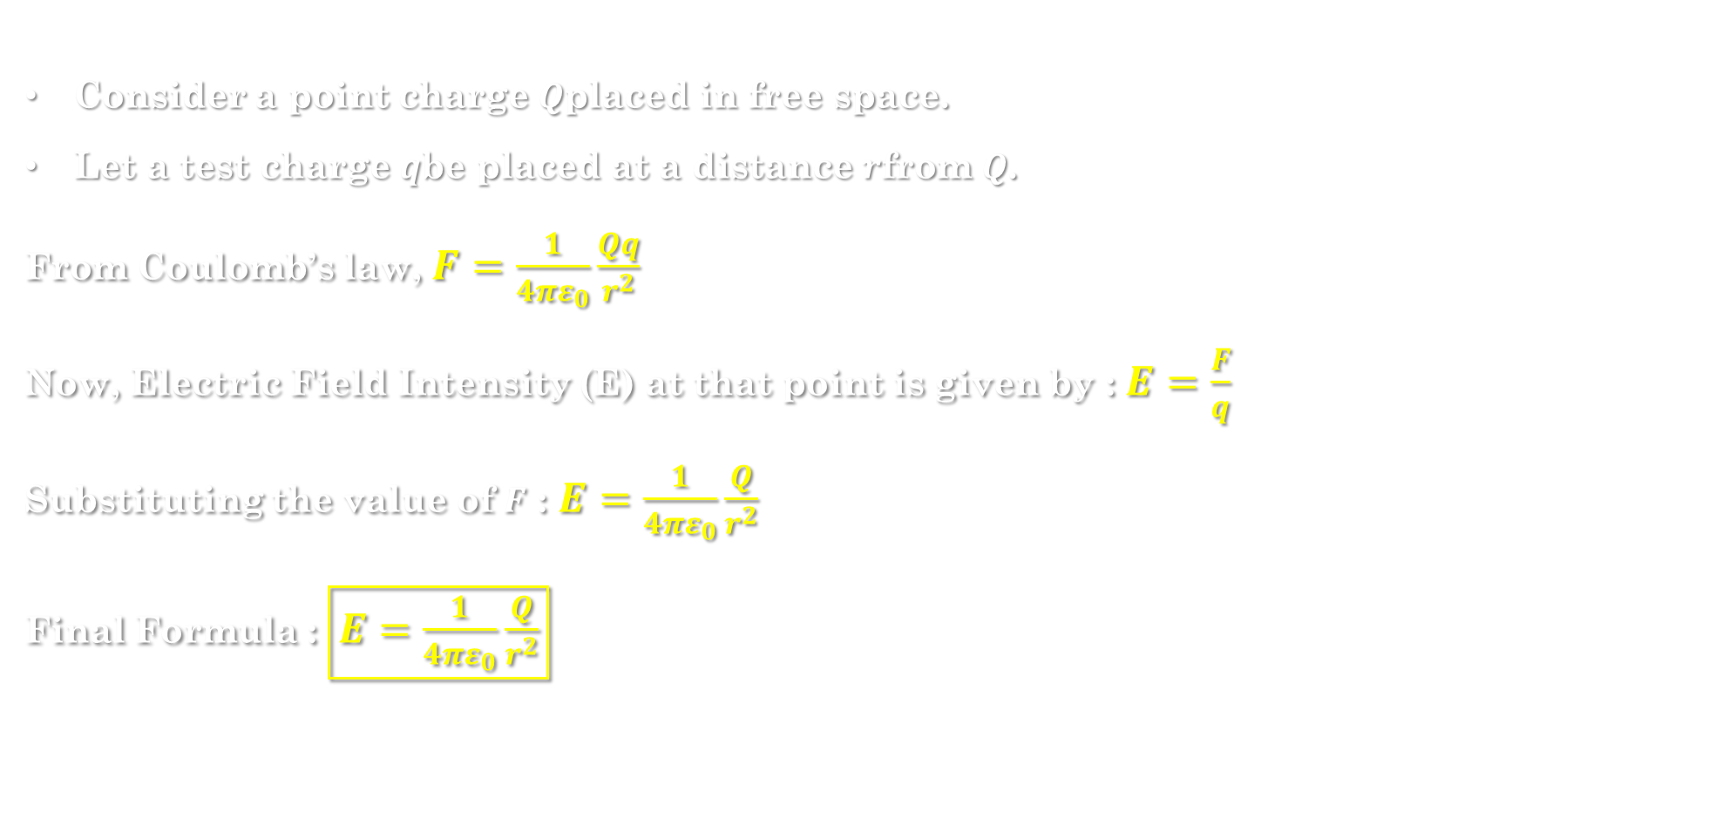
Derivation of electric field intensity due to a point charge : -
Consider a point charge $Q$placed in free space.
Let a test charge $q$be placed at a distance $r$from $Q$.
From Coulomb’s law, $F=\frac{1}{4πε_{0}}\frac{Qq}{r^{2}}$
Now, Electric Field Intensity (E) at that point is given by : $E=\frac{F}{q}$
Substituting the value of $F$ : $E=\frac{1}{4πε_{0}}\frac{Q}{r^{2}}$
Final Formula : $\boxed{E=\frac{1}{4πε_{0}}\frac{Q}{r^{2}}}$

Slide 8
3.4] Electric lines of force : -
Definition : -
Electric lines of force are imaginary lines drawn in an electric field such that the tangent at any point on the line gives the direction of the electric field at that point.
In simple words - they represent the path along which a positive test charge would move if placed in the field.
Representation : -
They are drawn from Example :
For a single positive charge, lines radiate outward.
For a single negative charge, lines converge inward.
Between opposite charges, lines go from positive to negative.

Slide 9
Properties of electric lines of force : -
Originate and terminate : Start from positive charge and end on negative charge.
Never intersect : Two lines of force never cross each other, because the electric field at a point can have only one direction.
Direction : The direction of lines gives the direction of electric field (tangent at a point shows E’s direction).
Field strength : The closer the lines, the stronger the electric field; the farther apart, the weaker the field.
Perpendicular to surface : Lines of force are always perpendicular to the surface of a charged conductor.
Do not form closed loops : They start from positive and end on negative, hence never form closed curves (unlike magnetic lines).
No lines inside conductor : Inside a charged conductor, the electric field is zero, so no lines of force are drawn inside.
Curved in non-uniform field : In a non-uniform electric field, lines of force are curved.

Slide 10
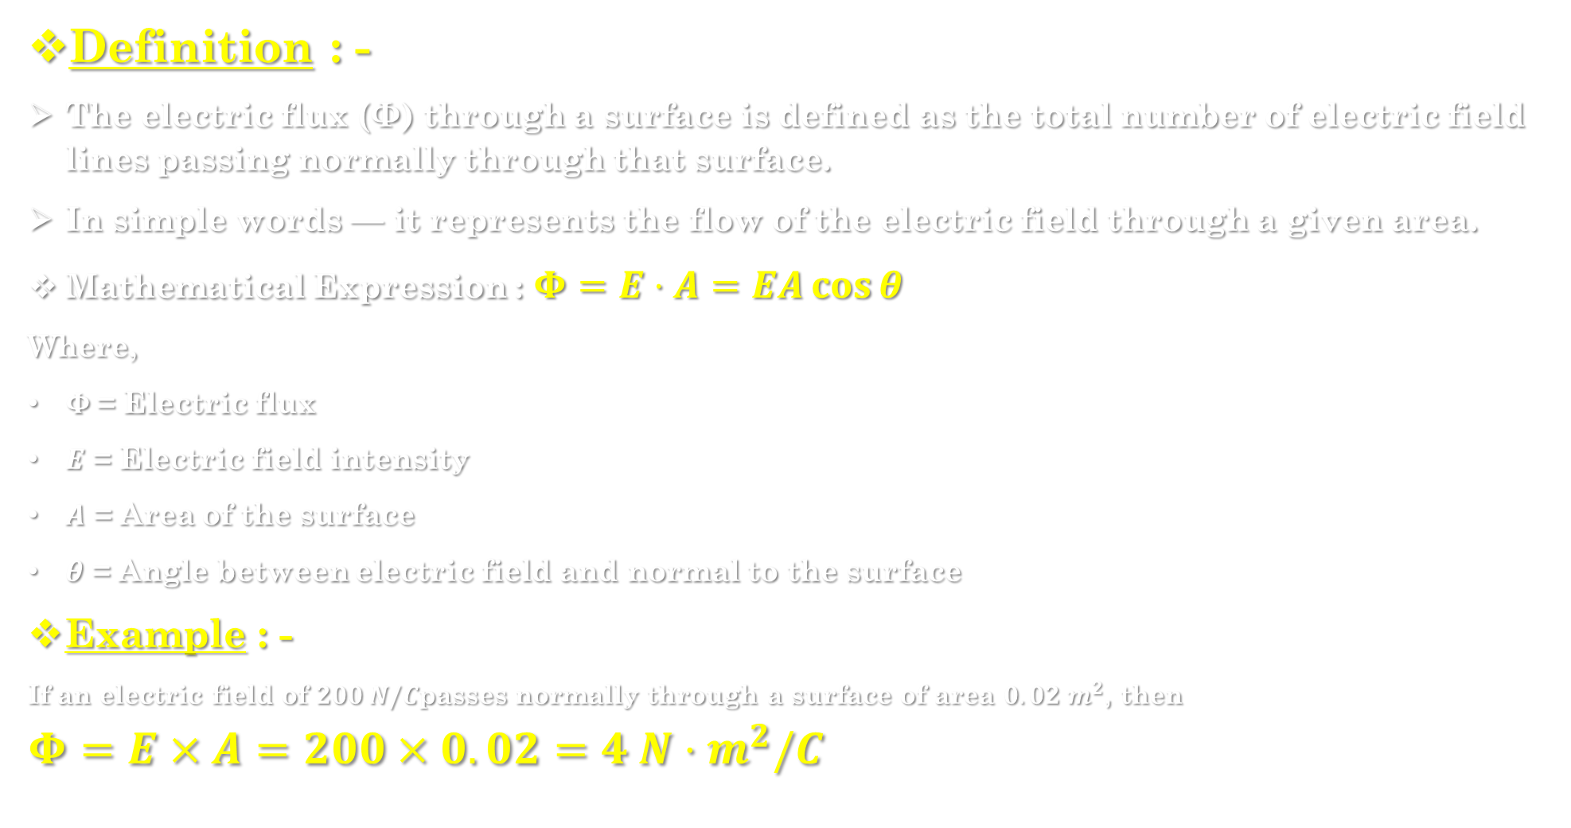
3.5] Electric flux : -
Definition : -
The electric flux (Φ) through a surface is defined as the total number of electric field lines passing normally through that surface.
In simple words — it represents the flow of the electric field through a given area.
Mathematical Expression : $Φ=E⋅A=EA\cos{θ}$
Where,
$Φ$= Electric flux
$E$ = Electric field intensity
$A$ = Area of the surface
$θ$ = Angle between electric field and normal to the surface
Example : -
If an electric field of $200 N/C$passes normally through a surface of area $0.02 m^{2}$, then
$$Φ=E×A=200×0.02=4 N⋅m^{2}/C$$

Slide 11
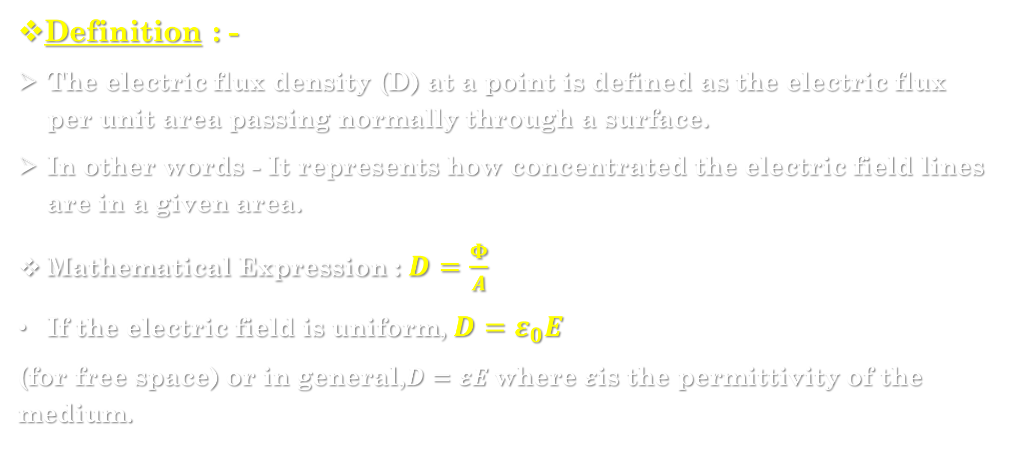
Electric flux density (d) : -
Definition : -
The electric flux density (D) at a point is defined as the electric flux per unit area passing normally through a surface.
In other words - It represents how concentrated the electric field lines are in a given area.
Mathematical Expression : $D=\frac{Φ}{A}$
If the electric field is uniform,$D=ε_{0}E$
(for free space) or in general,$D=εE$where $ε$is the permittivity of the medium.

Slide 12
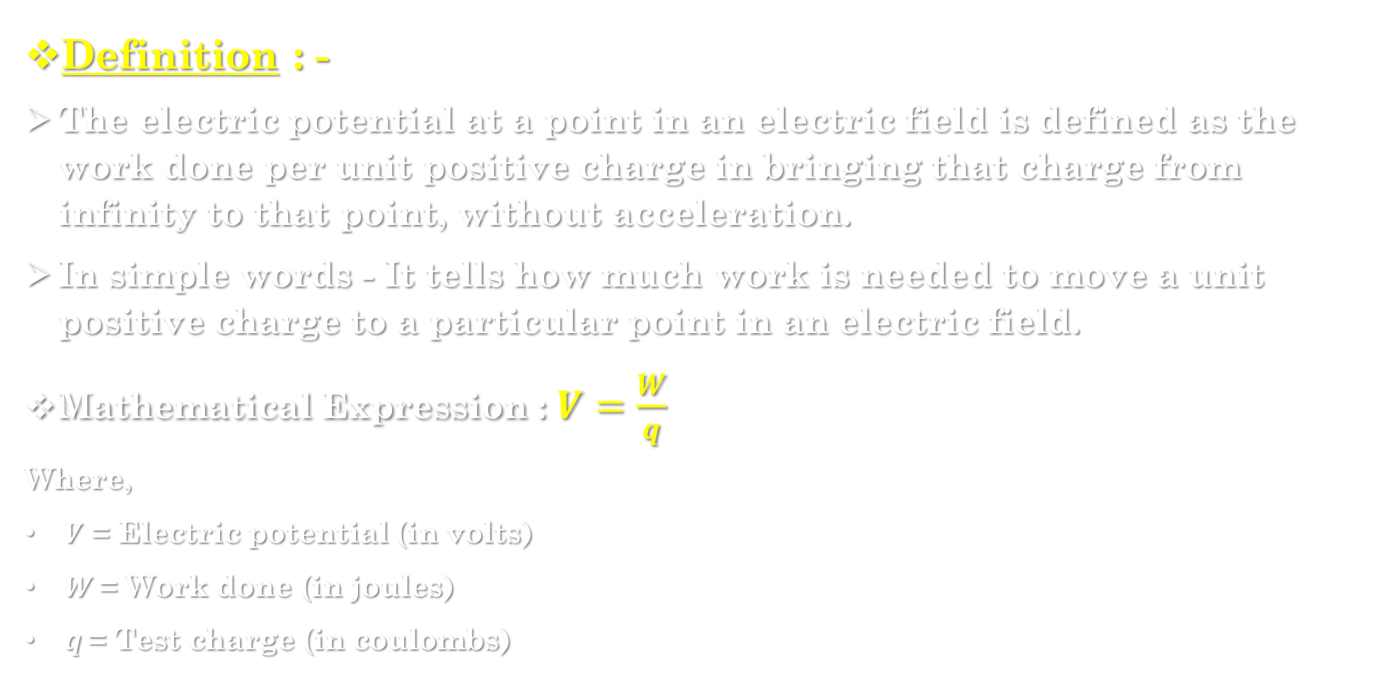
3.6] electric potential (v) : -
Definition : -
The electric potential at a point in an electric field is defined as the work done per unit positive charge in bringing that charge from infinity to that point, without acceleration.
In simple words - It tells how much work is needed to move a unit positive charge to a particular point in an electric field.
Mathematical Expression : $V=\frac{W}{q}$
Where,
$V$ = Electric potential (in volts)
$W$= Work done (in joules)
$q$= Test charge (in coulombs)

Slide 13
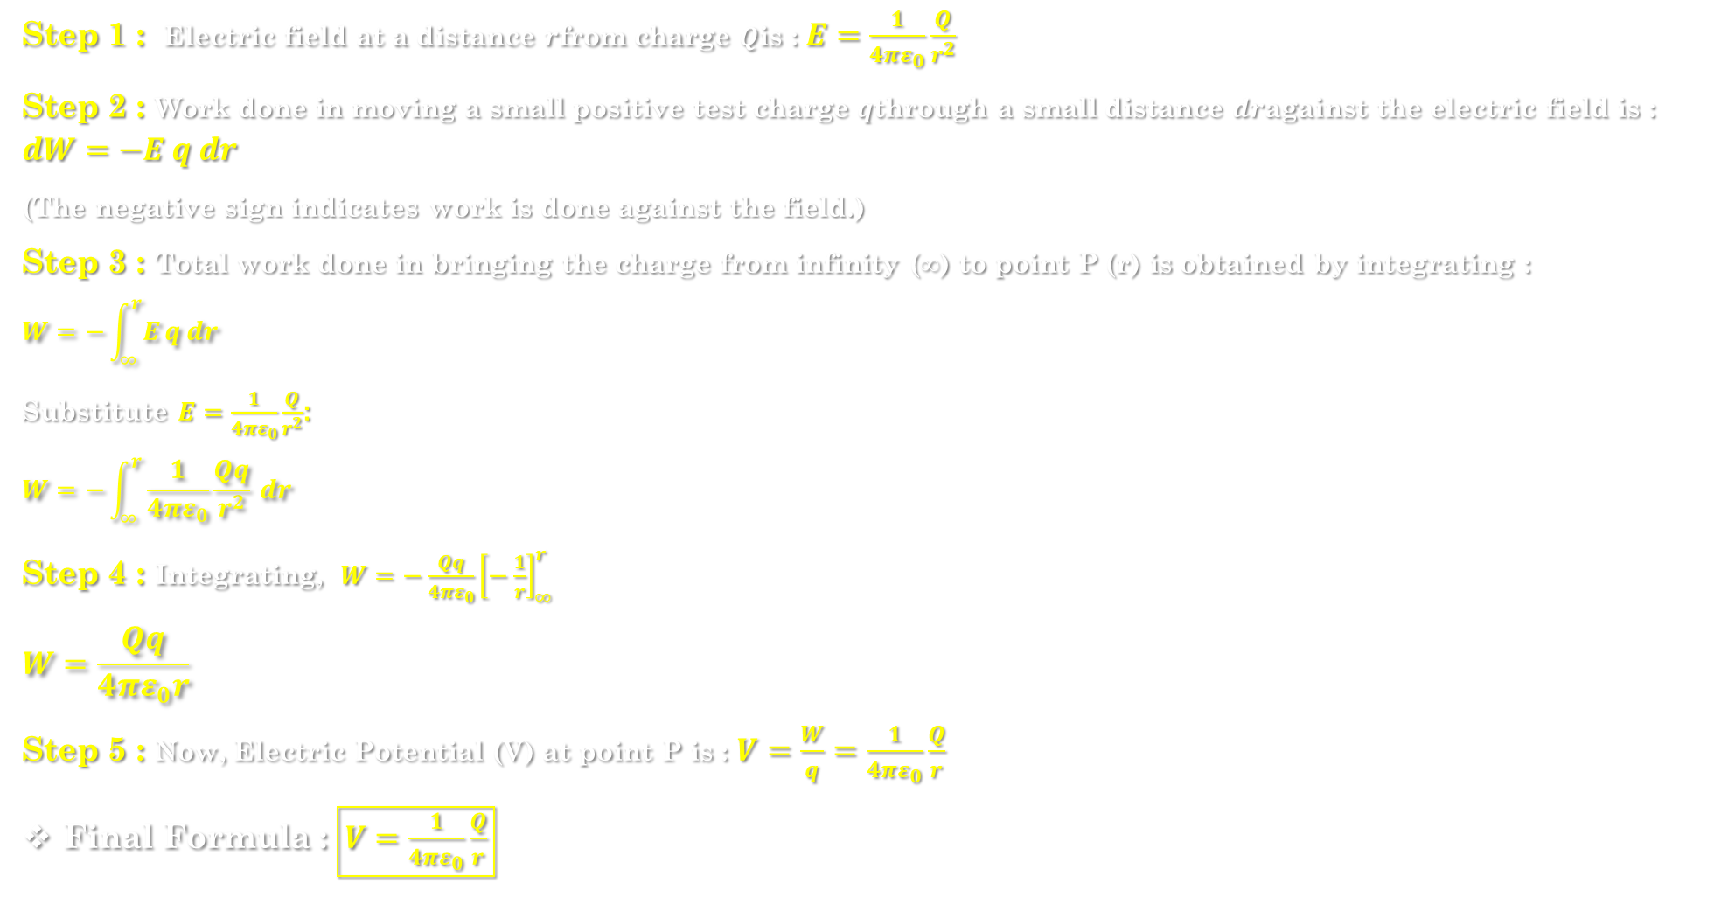
Derivation of electric potential due to a point charge : -
Step 1 : Electric field at a distance $r$from charge $Q$is : $E=\frac{1}{4πε_{0}}\frac{Q}{r^{2}}$
Step 2 : Work done in moving a small positive test charge $q$through a small distance $dr$against the electric field is :
$$dW=−E q dr$$
(The negative sign indicates work is done against the field.)
Step 3 : Total work done in bringing the charge from infinity (∞) to point P (r) is obtained by integrating :
$$W=−\int_{∞}^{r}{E}q dr$$
Substitute $E=\frac{1}{4πε_{0}}\frac{Q}{r^{2}}$:
$$W=−\int_{∞}^{r}{\frac{1}{4πε_{0}}}\frac{Qq}{r^{2}} dr$$
Step 4 : Integrating, $W=−\frac{Qq}{4πε_{0}}{\left[−\frac{1}{r}\right]}_{∞}^{r}$
$$W=\frac{Qq}{4πε_{0}r}$$
Step 5 : Now, Electric Potential (V) at point P is : $V=\frac{W}{q}=\frac{1}{4πε_{0}}\frac{Q}{r}$
Final Formula : $\boxed{V=\frac{1}{4πε_{0}}\frac{Q}{r}}$

Slide 14
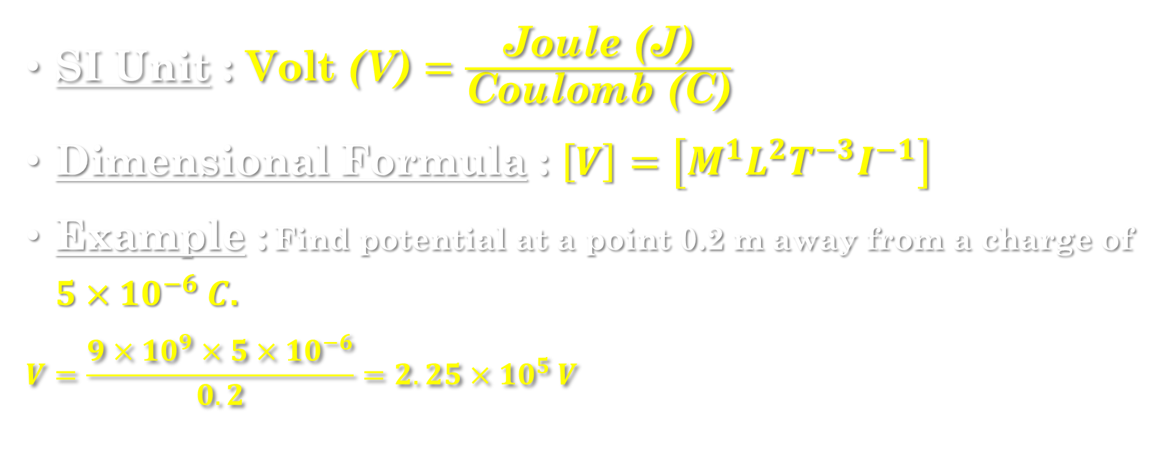
SI Unit : $\text{Volt}\text{ (}\text{V}\text{)}=\frac{\text{Joule}\text{ (}\text{J}\text{)}}{\text{Coulomb}\text{ (}\text{C}\text{)}}$
Dimensional Formula : $\left[V\right]=\left[M^{1}L^{2}T^{−3}I^{−1}\right]$
Example : Find potential at a point 0.2 m away from a charge of $5×{10}^{−6} C$.
$$V=\frac{9×{10}^{9}×5×{10}^{−6}}{0.2}=2.25×{10}^{5} V$$

Slide 15
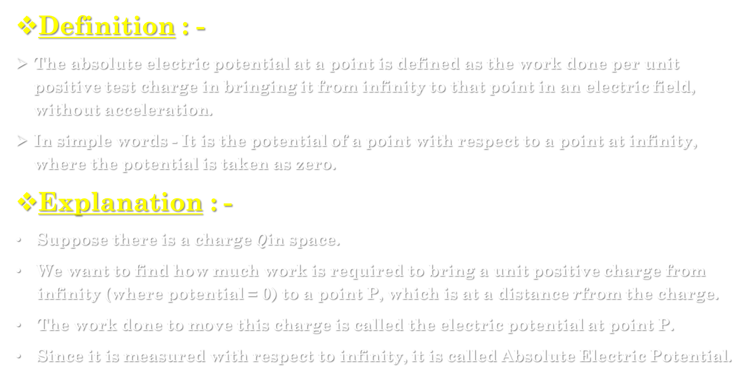
3.8] Absolute electric potential : -
Definition : -
The absolute electric potential at a point is defined as the work done per unit positive test charge in bringing it from infinity to that point in an electric field, without acceleration.
In simple words - It is the potential of a point with respect to a point at infinity, where the potential is taken as zero.
Explanation : -
Suppose there is a charge $Q$in space.
We want to find how much work is required to bring a unit positive charge from infinity (where potential = 0) to a point P, which is at a distance $r$from the charge.
The work done to move this charge is called the electric potential at point P.
Since it is measured with respect to infinity, it is called Absolute Electric Potential.

Slide 16
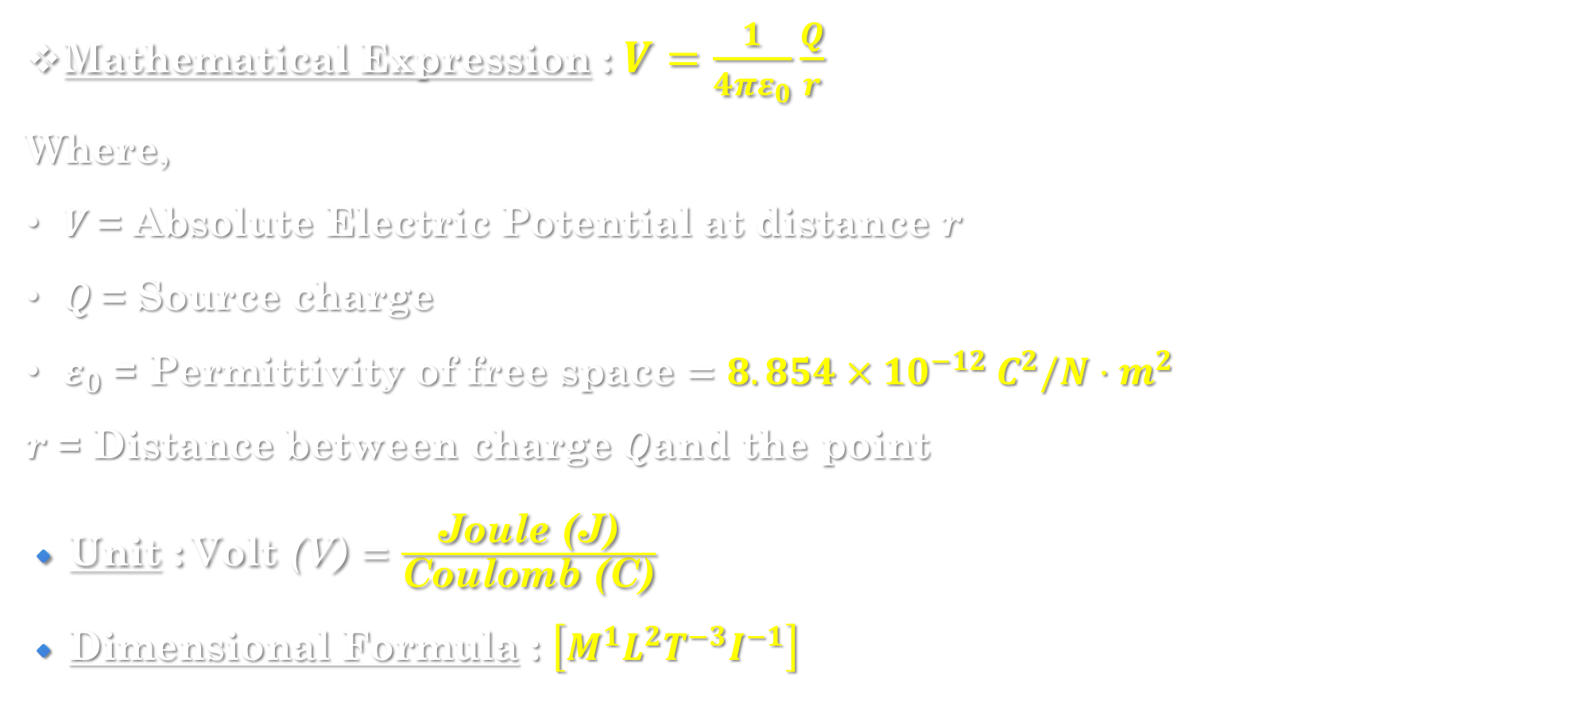
Mathematical Expression : $V=\frac{1}{4πε_{0}}\frac{Q}{r}$
Where,
$V$= Absolute Electric Potential at distance $r$
$Q$= Source charge
$ε_{0}$= Permittivity of free space $=8.854×{10}^{−12} C^{2}/N⋅m^{2}$
$r$= Distance between charge $Q$and the point
🔹 Unit : $\text{Volt}\text{ (}\text{V}\text{)}=\frac{\text{Joule}\text{ (}\text{J}\text{)}}{\text{Coulomb}\text{ (}\text{C}\text{)}}$
🔹 Dimensional Formula : $\left[M^{1}L^{2}T^{−3}I^{−1}\right]$

Slide 17
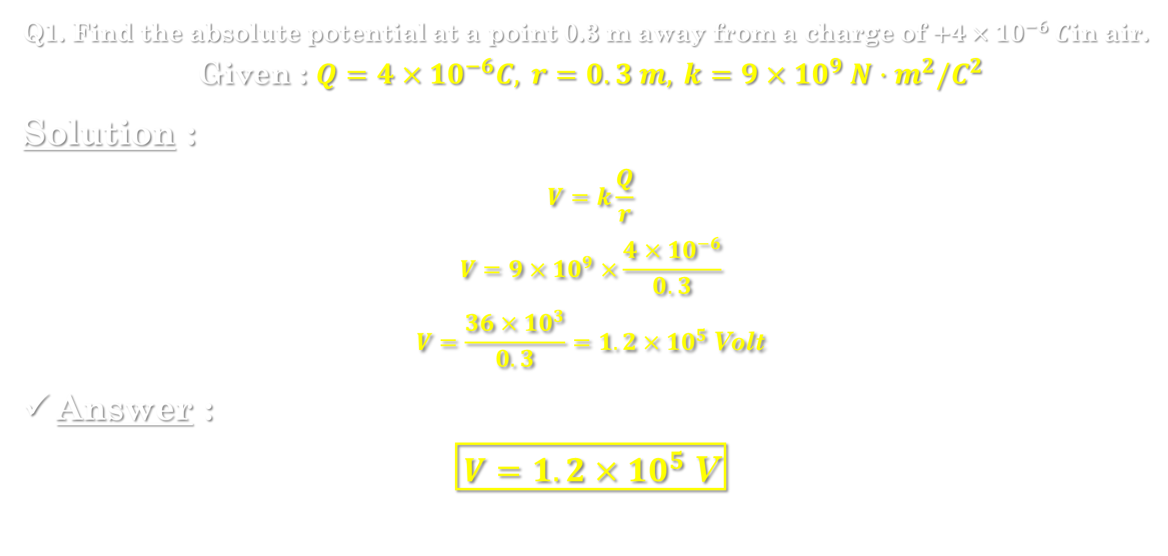
Numerical example : -
Q1. Find the absolute potential at a point 0.3 m away from a charge of $+4×{10}^{−6} C$in air.
$$\text{Given} \text{:} Q=4×{10}^{−6}C, r=0.3 m, k=9×{10}^{9} N⋅m^{2}/C^{2}$$
Solution :
$$V=k\frac{Q}{r}$$
$$V=9×{10}^{9}×\frac{4×{10}^{−6}}{0.3}$$
$$V=\frac{36×{10}^{3}}{0.3}=1.2×{10}^{5} \text{Volt}$$
Answer :
$$\boxed{V=1.2×{10}^{5} \text{V}}$$

