Slide 1
04. Electricity and Electromagnetism

Slide 2
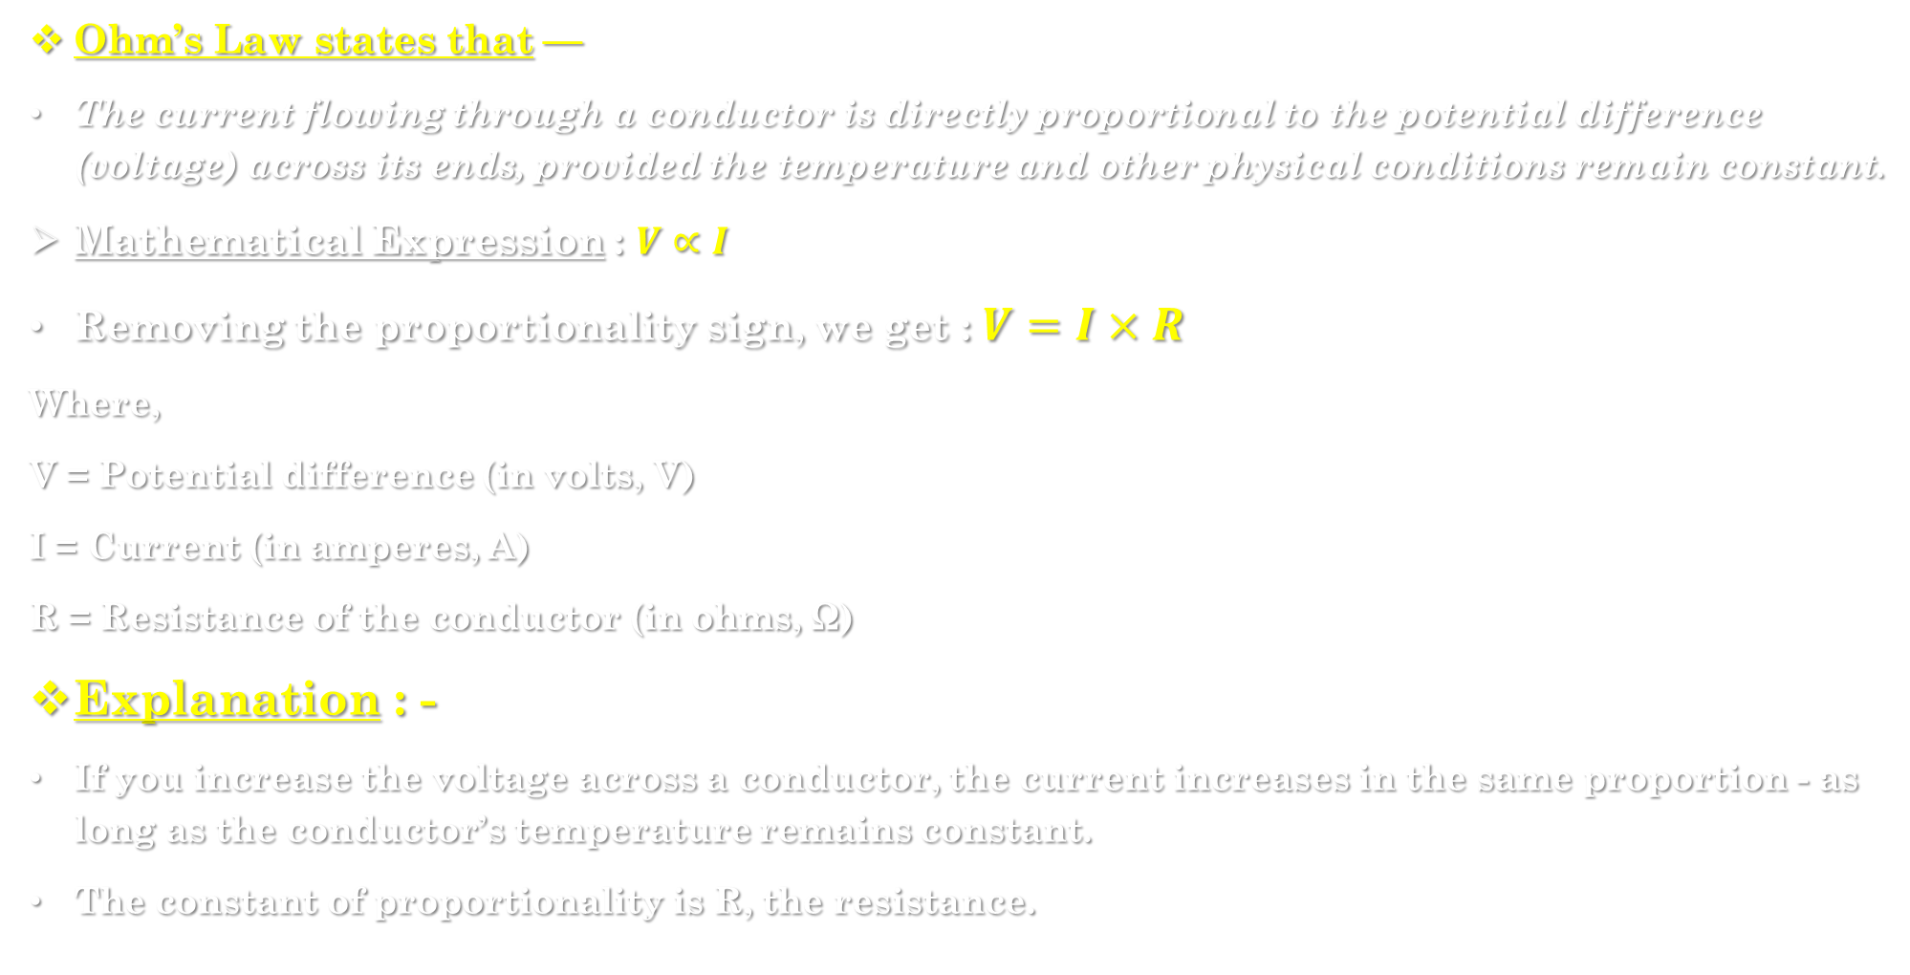
4.1] ohm’s law : -
Ohm’s Law states that —
The current flowing through a conductor is directly proportional to the potential difference (voltage) across its ends, provided the temperature and other physical conditions remain constant.
Mathematical Expression : $V∝I$
Removing the proportionality sign, we get : $V=I×R$
Where,
V = Potential difference (in volts, V)
I = Current (in amperes, A)
R = Resistance of the conductor (in ohms, Ω)
Explanation : -
If you increase the voltage across a conductor, the current increases in the same proportion - as long as the conductor’s temperature remains constant.
The constant of proportionality is R, the resistance.

Slide 3
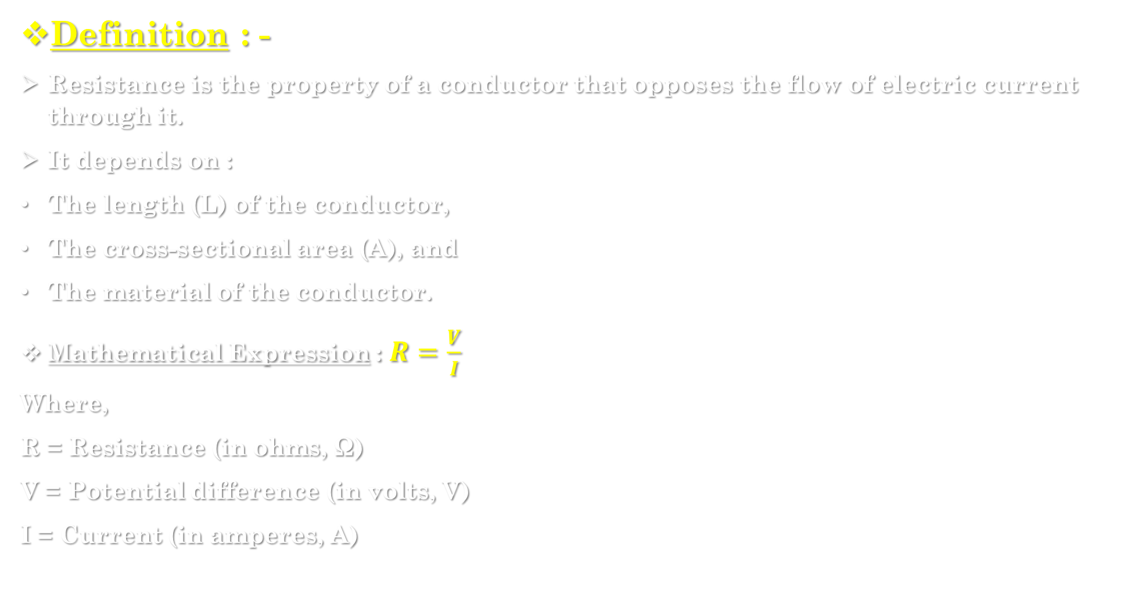
4.2] Resistance : -
Definition : -
Resistance is the property of a conductor that opposes the flow of electric current through it.
It depends on :
The length (L) of the conductor,
The cross-sectional area (A), and
The material of the conductor.
Mathematical Expression : $R=\frac{V}{I}$
Where,
R = Resistance (in ohms, Ω)
V = Potential difference (in volts, V)
I = Current (in amperes, A)

Slide 4
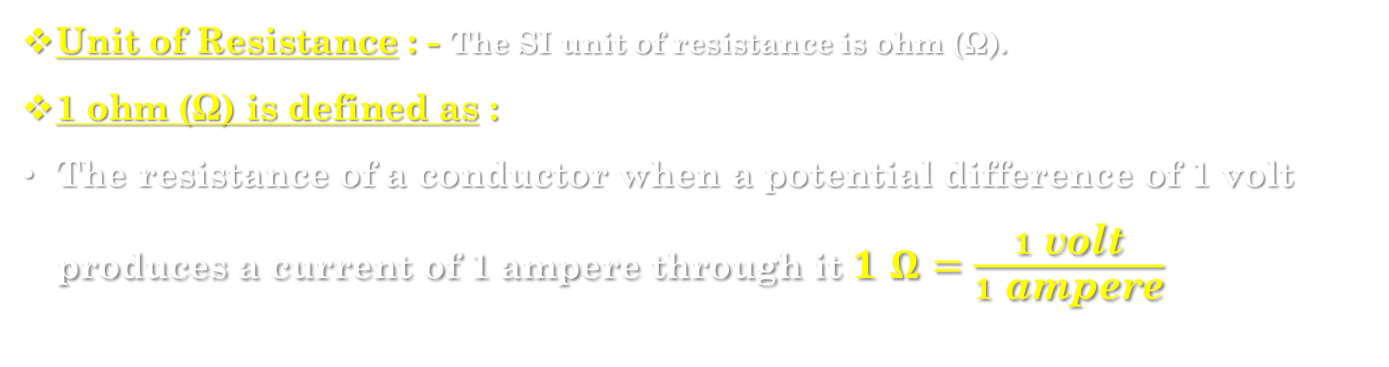
Unit of Resistance : - The SI unit of resistance is ohm (Ω).
1 ohm (Ω) is defined as :
The resistance of a conductor when a potential difference of 1 volt produces a current of 1 ampere through it $1 Ω=\frac{1 \text{volt}}{1 \text{ampere}}$

Slide 5
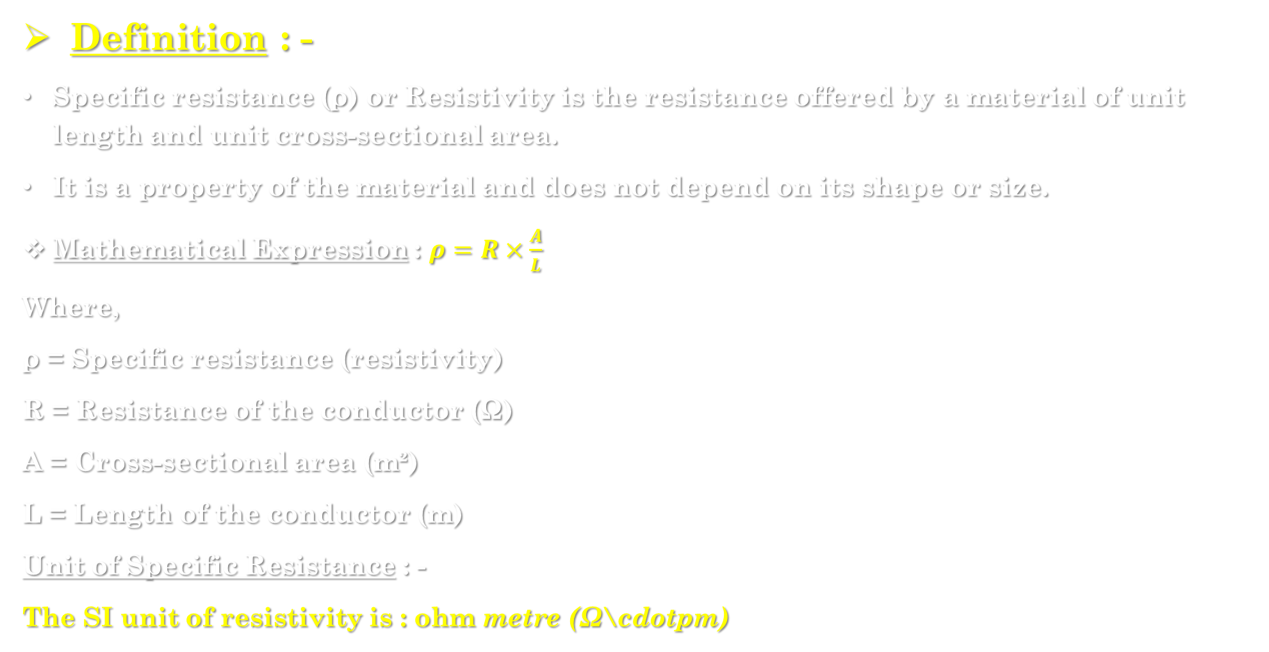
Specific resistance : -
Definition : -
Specific resistance (ρ) or Resistivity is the resistance offered by a material of unit length and unit cross-sectional area.
It is a property of the material and does not depend on its shape or size.
Mathematical Expression : $ρ=R×\frac{A}{L}$
Where,
ρ = Specific resistance (resistivity)
R = Resistance of the conductor (Ω)
A = Cross-sectional area (m²)
L = Length of the conductor (m)
Unit of Specific Resistance : -
The SI unit of resistivity is : $\text{ohm} \text{metre} \text{(}\text{Ω}\text{\backslash }\text{cdotpm}\text{)}$

Slide 6
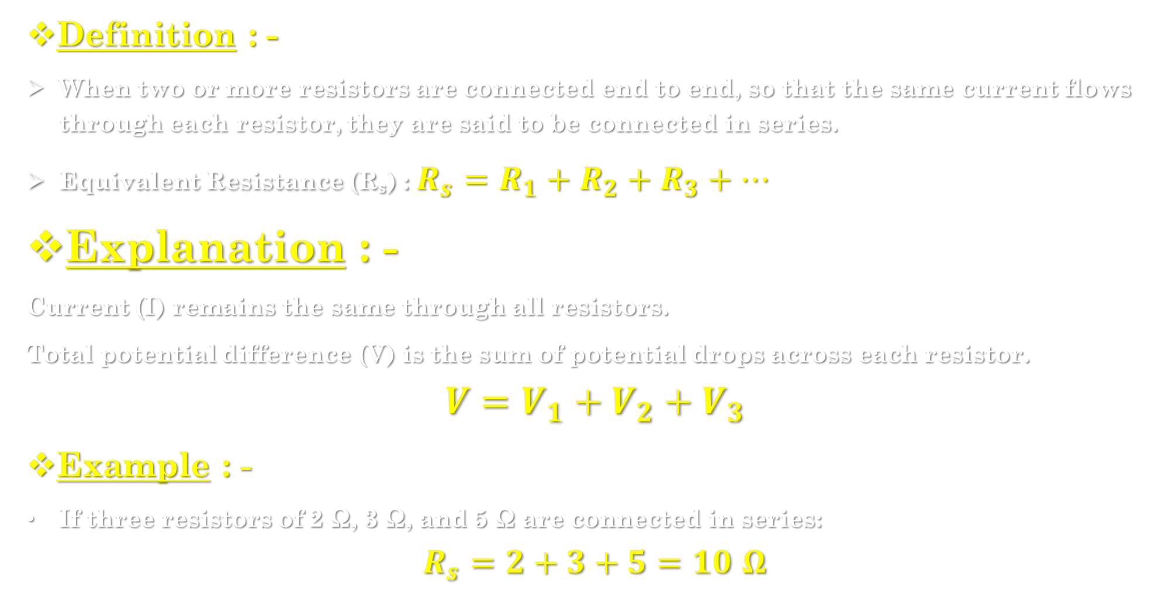
4.3] resistance in series combination : -
Definition : -
When two or more resistors are connected end to end, so that the same current flows through each resistor, they are said to be connected in series.
Equivalent Resistance (Rₛ) : $R_{s}=R_{1}+R_{2}+R_{3}+…$
Explanation : -
Current (I) remains the same through all resistors.
Total potential difference (V) is the sum of potential drops across each resistor.
$$V=V_{1}+V_{2}+V_{3}$$
Example : -
If three resistors of 2 Ω, 3 Ω, and 5 Ω are connected in series:
$$R_{s}=2+3+5=10 Ω$$

Slide 7
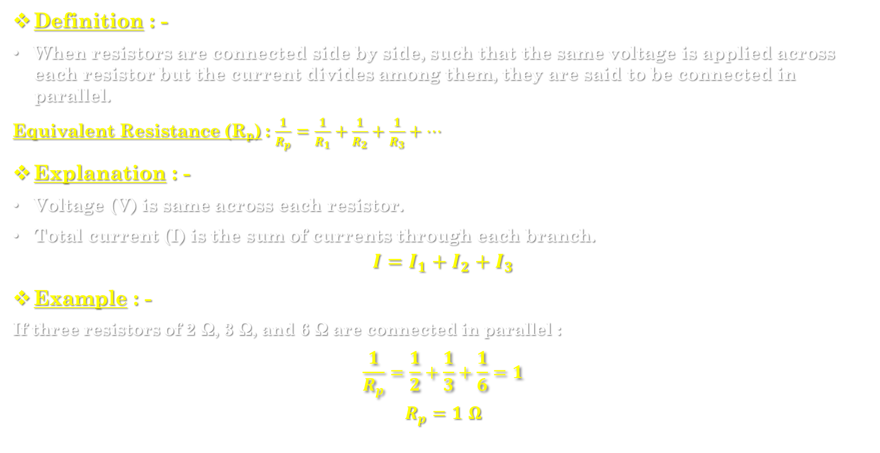
Resistance in parallel combination : -
Definition : -
When resistors are connected side by side, such that the same voltage is applied across each resistor but the current divides among them, they are said to be connected in parallel.
Equivalent Resistance (Rₚ) : $\frac{1}{R_{p}}=\frac{1}{R_{1}}+\frac{1}{R_{2}}+\frac{1}{R_{3}}+…$
Explanation : -
Voltage (V) is same across each resistor.
Total current (I) is the sum of currents through each branch.
$$I=I_{1}+I_{2}+I_{3}$$
Example : -
If three resistors of 2 Ω, 3 Ω, and 6 Ω are connected in parallel :
$$\frac{1}{R_{p}}=\frac{1}{2}+\frac{1}{3}+\frac{1}{6}=1$$
$$R_{p}=1 Ω$$

Slide 8
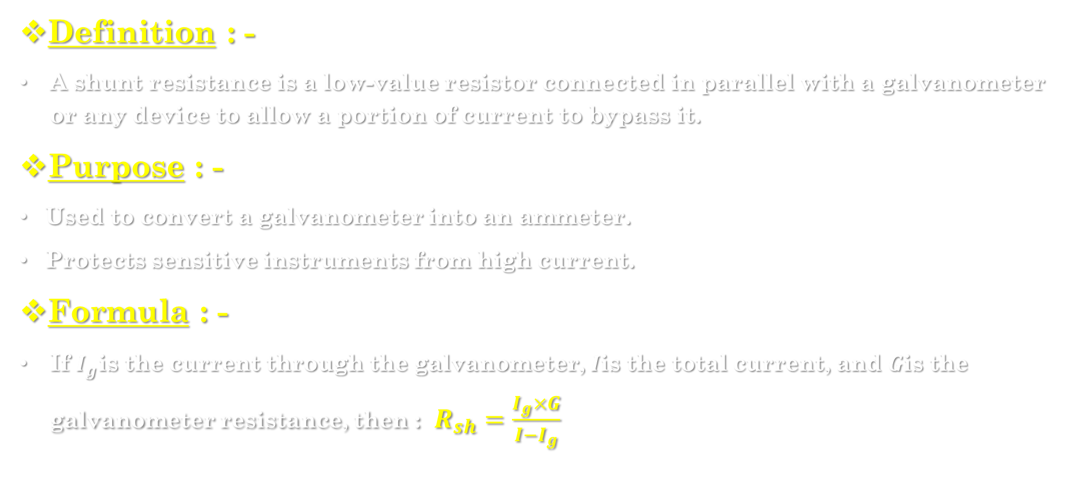
Shunt resistance : -
Definition : -
A shunt resistance is a low-value resistor connected in parallel with a galvanometer or any device to allow a portion of current to bypass it.
Purpose : -
Used to convert a galvanometer into an ammeter.
Protects sensitive instruments from high current.
Formula : -
If $I_{g}$is the current through the galvanometer, $I$is the total current, and $G$is the galvanometer resistance, then : $R_{sh}=\frac{I_{g}×G}{I−I_{g}}$

Slide 9
4.4] electromagnetism : -
Definition : -
Electromagnetism is the branch of physics that studies the relationship between electricity and magnetism.
It explains how electric currents produce magnetic fields, and how changing magnetic fields can produce electric currents.
Examples in Daily Life : -
Electric Bell – works using an electromagnet.
Electric Motor – converts electrical energy into mechanical motion using magnetic fields.
Electric Generator – converts mechanical energy into electrical energy.
Transformers – use electromagnetic induction to transfer energy between circuits.

Slide 10
4.5] magnetic effect of current : -
Definition : -
The Magnetic Effect of Current means that when an electric current flows through a conductor, it produces a magnetic field around it..
When current flows through a straight conductor, magnetic field lines are formed in concentric circles around it.
The direction of the magnetic field depends on the direction of current flow..
Examples : -
Magnetic field around a straight conductor.
Magnetic field inside a coil or solenoid.
Electromagnets and electric motors work on this principle.
Applications : -
Electric bell, relay, electric motor, loudspeaker, and magnetic cranes.

Slide 11
Magnetic induction : -
Definition : -
Magnetic Induction is the process by which a material (usually iron or steel) becomes magnetized when placed near a magnet or in a magnetic field, without direct contact.
Explanation : -
When a magnetic material is placed in a magnetic field, the magnetic domains inside the material align in one direction.
This alignment makes the material behave like a magnet.
The magnetism disappears when the magnetic field is removed (in case of soft iron).

Slide 12
Example : -
If a soft iron nail is placed near a magnet, it becomes temporarily magnetized and can attract small pins — this happens due to magnetic induction.
Applications : -
Used in making temporary magnets (electromagnets).
Principle used in transformers and generators.
Basis of electromagnetic induction (producing current from changing magnetic field).

Slide 13
4.6] Properties of magnetic lines of force : -
Definition : -
Magnetic lines of force (also called magnetic field lines) are imaginary lines used to represent the direction and strength of a magnetic field around a magnet or a current-carrying conductor.
Properties : -
They always form closed continuous curves.
They never intersect each other.
The direction of magnetic lines of force
The closeness (density) of the lines indicates field strength.
They exert a force on a magnetic pole.
They do not pass through non-magnetic materials.
The tangent at any point to a magnetic line of force gives the direction of the magnetic field at that point.
They are crowded near the poles of a magnet.

Slide 14
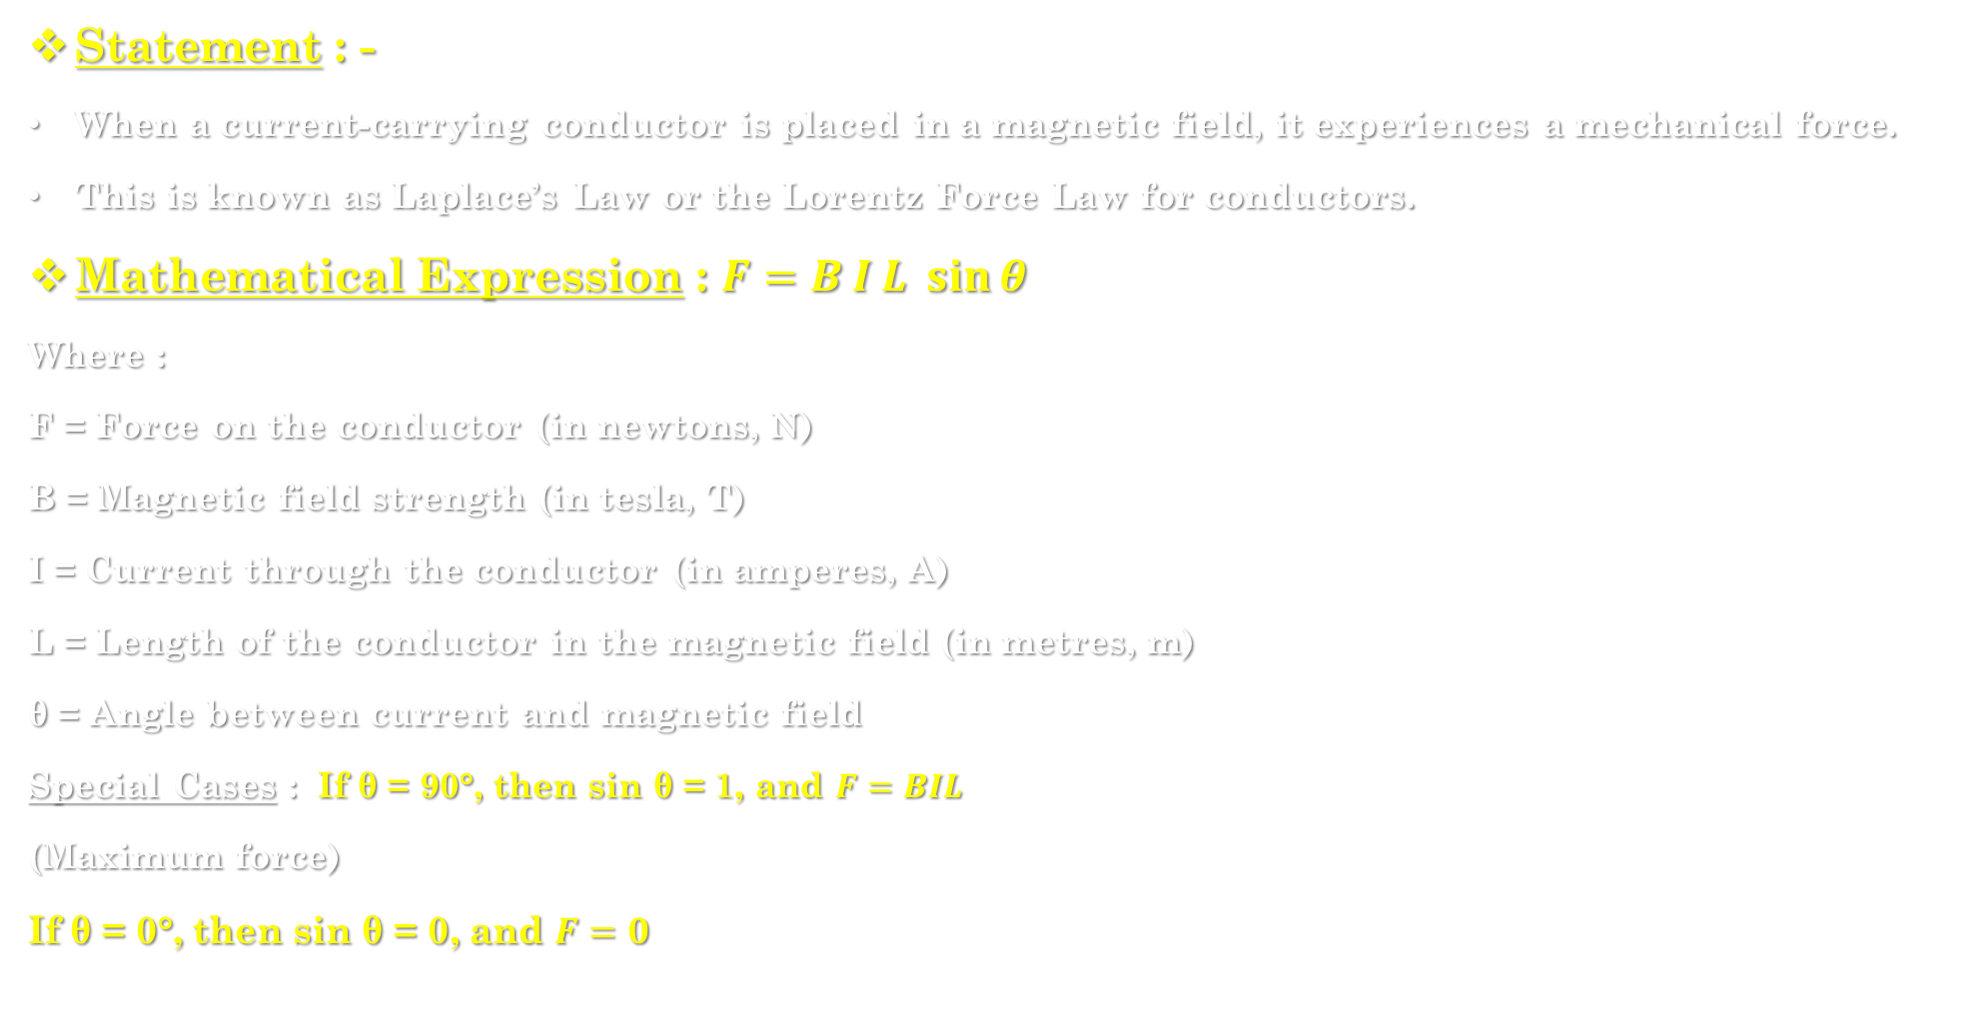
4.7] laplace’s law : -
Statement : -
When a current-carrying conductor is placed in a magnetic field, it experiences a mechanical force.
This is known as Laplace’s Law or the Lorentz Force Law for conductors.
Mathematical Expression : $F=B I L \sin{θ}$
Where :
F = Force on the conductor (in newtons, N)
B = Magnetic field strength (in tesla, T)
I = Current through the conductor (in amperes, A)
L = Length of the conductor in the magnetic field (in metres, m)
θ = Angle between current and magnetic field
Special Cases : If θ = 90°, then sin θ = 1, and $F=BIL$
(Maximum force)
If θ = 0°, then sin θ = 0, and $F=0$

Slide 15
Fleming’s left hand rule : -
Statement : -
This rule gives the direction of force on a current-carrying conductor placed in a magnetic field.
Rule : -
Stretch your left hand such that :
Forefinger (Index finger) → points in the direction of magnetic field (B),
Middle finger → points in the direction of current (I),
Thumb → gives the direction of force (motion) on the conductor.
Used in :
Electric motors, where electrical energy is converted into mechanical energy.

Slide 16
Fleming’s right hand rule : -
Statement : -
This rule gives the direction of induced current when a conductor moves in a magnetic field.
Rule : -
Stretch your right hand such that:
Forefinger → points in the direction of magnetic field (B),
Thumb → points in the direction of motion of the conductor,
Middle finger → gives the direction of induced current (I).
Used in : -
Electric generators, where mechanical energy is converted into electrical energy.

Slide 17
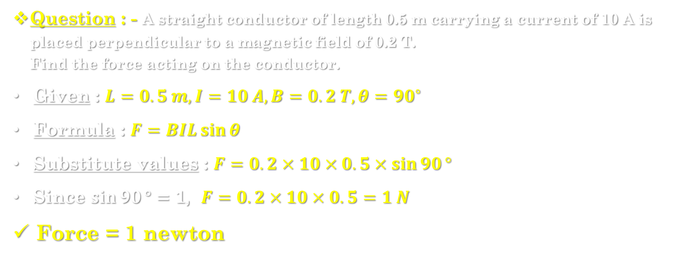
Numerical example : -
Question : - A straight conductor of length 0.5 m carrying a current of 10 A is placed perpendicular to a magnetic field of 0.2 T.
Find the force acting on the conductor.
Given : $L=0.5 m, I=10 A, B=0.2 T, θ={90}^{∘}$
Formula : $F=BIL\sin{θ}$
Substitute values : $F=0.2×10×0.5×\sin{90}°$
Since $\sin{90}°=1$, $F=0.2×10×0.5=1 N$
Force = 1 newton

