Slide 1
01. Units and Measurements

Slide 2
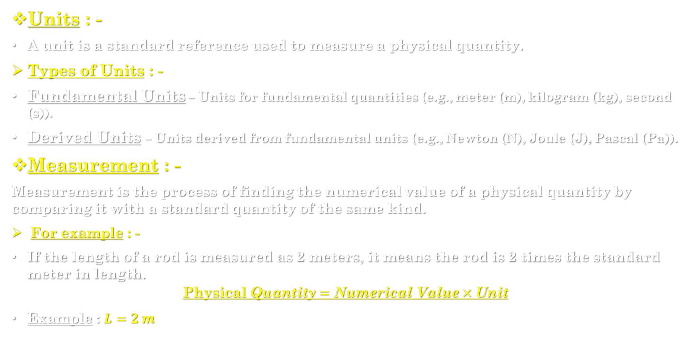
Introduction : -
Units : -
A unit is a standard reference used to measure a physical quantity.
Types of Units : -
Fundamental Units – Units for fundamental quantities (e.g., meter (m), kilogram (kg), second (s)).
Derived Units – Units derived from fundamental units (e.g., Newton (N), Joule (J), Pascal (Pa)).
Measurement : -
Measurement is the process of finding the numerical value of a physical quantity by comparing it with a standard quantity of the same kind.
For example : -
If the length of a rod is measured as 2 meters, it means the rod is 2 times the standard meter in length.
$$\text{Physical} \text{Quantity}=\text{Numerical} \text{Value}×\text{Unit}$$
Example : $L=2 m$

Slide 3
1.1] fundamental physics quantities : -
Fundamental (or Base) Physical Quantities are those physical quantities that do not depend on other quantities for their definition.
They are independent and cannot be derived from any other physical quantity.
These quantities form the foundation for all other (derived) quantities in physics.
List of Fundamental Physical Quantities with Examples : -
Sr. No. | Physical Quantity | Symbol | SI Unit | Symbol of Unit | Example
1. | Length | l | metre | m | Measuring distance between two points
2. | Mass | m | kilogram | kg | Mass of an object, e.g., 5 kg bag
3. | Time | t | second | s | Duration of an event, e.g., 10 s
4. | Electric Current | I | ampere | A | Current flowing in a wire
5. | Thermodynamic Temperature | T | kelvin | K | Temperature of an object
6. | Amount of Substance | n | mole | mol | Amount of gas in moles
7. | Luminous Intensity | Iv | candela | cd | Brightness of a light source

Slide 4
1.2] derived physical quantities : -
Derived Physical Quantities are those quantities that are obtained (or derived) from the fundamental physical quantities by using mathematical relationships.
In simple words, they depend on two or more fundamental quantities.
Derived physical quantities are the quantities which can be expressed in terms of fundamental quantities by means of a mathematical relation.
Examples : -
Velocity, Force, Energy, Power, Pressure, Density, Volume, Area, etc.

Slide 5
Examples of Derived Physical Quantities : -
Sr. No. | Derived Quantity | Formula | Depends on | SI Unit | Symbol of Unit | Example
1. | Area | length × breadth | Length | square metre | m² | Area of a floor = 4 m × 5 m = 20 m²
2. | Volume | length × breadth × height | Length | cubic metre | m³ | Volume of a box
3. | Speed / Velocity | distance ÷ time | Length, Time | metre per second | m/s | Speed of car = 60 m/s
4. | Acceleration | change in velocity ÷ time | Length, Time | metre per second² | m/s² | Acceleration of a falling body
5. | Force | mass × acceleration | Mass, Length, Time | newton | N = kg·m/s² | Force applied on an object
6. | Work / Energy | force × distance | Mass, Length, Time | joule | J = N·m = kg·m²/s² | Work done by lifting an object
7. | Power | work ÷ time | Mass, Length, Time | watt | W = J/s | Power of an electric motor
8. | Density | mass ÷ volume | Mass, Length | kilogram per cubic metre | kg/m³ | Density of water = 1000 kg/m³
9. | Pressure | force ÷ area | Mass, Length, Time | pascal | Pa = N/m² | Air pressure in a tyre

Slide 6
1.3] scalar quantities : -
Scalar quantities are those physical quantities which have only magnitude (size or numerical value) but no direction.
In simple words, they can be completely described by a single number and unit.
Examples : -
Mass, Length, Time, Speed, Distance, Temperature, Energy, Work, Volume, Density, Power.
Example statement : -
The temperature of water is 30°C (only magnitude, no direction).
The speed of a car is 60 km/h.

Slide 7
Vector quantities : -
Vector quantities are those physical quantities which have both magnitude and direction.
They require direction for their complete description and follow the laws of vector addition.
Examples : -
Displacement, Velocity, Acceleration, Force, Momentum, Weight, Electric field, Magnetic field.
Example statement : -
A force of 10 N acts towards the east.
The velocity of a car is 60 km/h north.

Slide 8
Comparison between Scalar and Vector Quantities : -
Feature | Scalar Quantity | Vector Quantity
Definition | Has only magnitude | Has both magnitude and direction
Representation | Represented by a number and unit | Represented by an arrow (→)
Direction | Not required | Direction is essential
Example | Mass, Time, Speed, Energy | Force, Velocity, Acceleration, Displacement
Mathematical Operation | Added algebraically | Added using vector laws (triangle/parallelogram law)

Slide 9
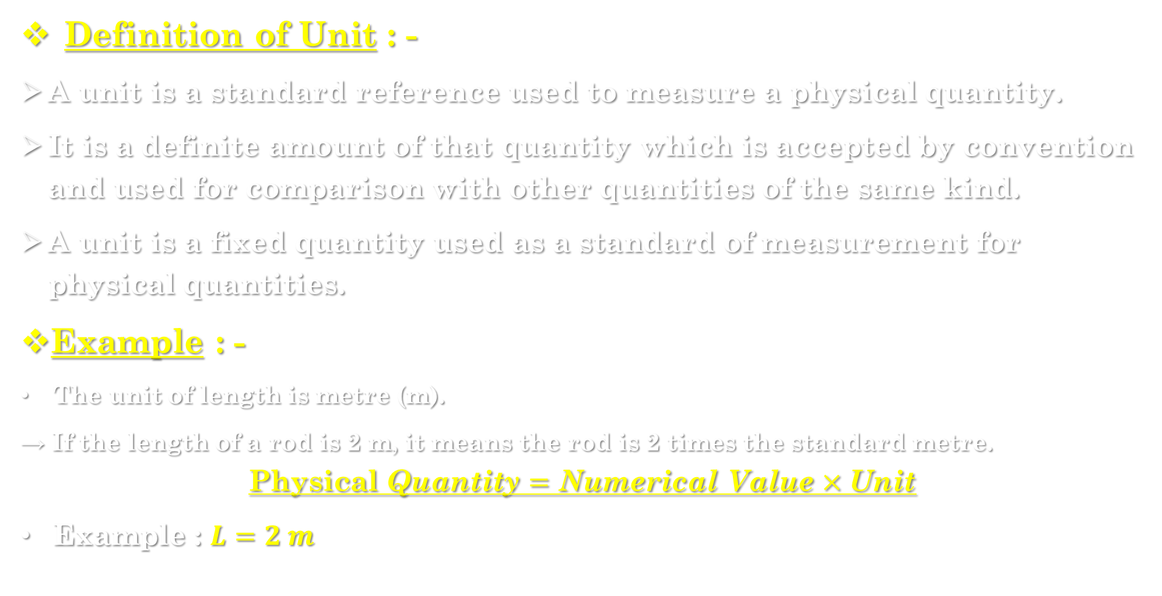
1.4] definition & requirements of unit : -
Definition of Unit : -
A unit is a standard reference used to measure a physical quantity.
It is a definite amount of that quantity which is accepted by convention and used for comparison with other quantities of the same kind.
A unit is a fixed quantity used as a standard of measurement for physical quantities.
Example : -
The unit of length is metre (m).
→ If the length of a rod is 2 m, it means the rod is 2 times the standard metre.
$$\text{Physical} \text{Quantity}=\text{Numerical} \text{Value}×\text{Unit}$$
Example : $L=2 m$

Slide 10
Requirements (Characteristics) of a Good Unit :
Sr. No. | Requirement | Description
1. | Well Defined | The unit should be clearly defined and easily reproducible at any time and place.
2. | Stable | The value of the unit should not change with time, temperature, or place.
3. | Easily Reproducible | Anyone should be able to reproduce the same unit accurately anywhere.
4. | Convenient in Size | The unit should neither be too large nor too small for practical use.
5. | Universally Accepted | The unit should be accepted and used internationally (like SI units).
6. | Independence | The unit should be independent of other quantities.

Slide 11
1.5] system of units : - c.g.s., m.k.s. & S.i. units
Definition : -
A system of units is a complete set of units used to measure fundamental physical quantities such as length, mass, and time.
Different countries or scientists in the past used different systems of units, leading to confusion.
To bring uniformity, several systems were developed — the main ones being C.G.S., M.K.S., and S.I. systems.

Slide 12
Types of Systems of Units : -
Sr. No. | System of Units | Fundamental Units | Commonly Used In
1. | C.G.S. System | Length – centimetre (cm) Mass – gram (g) Time – second (s) | Used in small-scale laboratory measurements
2. | M.K.S. System | Length – metre (m) Mass – kilogram (kg) Time – second (s) | Used in engineering and scientific work
3. | S.I. System (International System of Units) | Length – metre (m) Mass – kilogram (kg) Time – second (s) + 4 more base quantities | Used worldwide in science and technology

Slide 13
1. c.g.s. system : -
Full form : Centimetre–Gram–Second
Basic units : -
  Length → centimetre (cm)
  Mass → gram (g)
  Time → second (s)
Used for : Small-scale laboratory work.
Example : Velocity = cm/s, Force = dyne, Work = erg.

Slide 14
2. m.k.s. system : -
Full form : Metre–Kilogram–Second
Basic units : -
  Length → metre (m)
  Mass → kilogram (kg)
  Time → second (s)
Used for : Engineering and everyday applications.
Example : Velocity = m/s, Force = newton, Work = joule.

Slide 15
3. s.i. system : -
Full form : Système International d’Unités (International System of Units)
Adopted : In 1960 by the General Conference on Weights and Measures (CGPM).
Base Units : Seven base quantities:
Physical Quantity | Symbol | SI Unit | Symbol of Unit
Length | l | metre | m
Mass | m | kilogram | kg
Time | t | second | s
Electric Current | I | ampere | A
Temperature | T | kelvin | K
Amount of Substance | n | mole | mol
Luminous Intensity | Iv | candela | cd

Slide 16
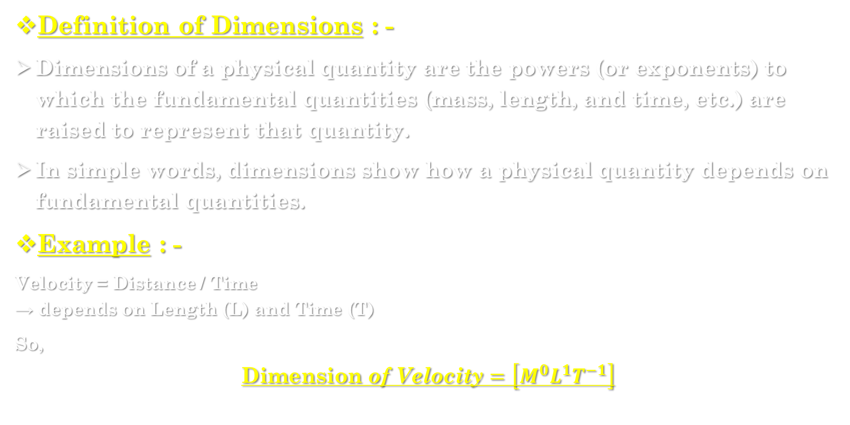
1.6] dimensions & dimensional formula : -
Definition of Dimensions : -
Dimensions of a physical quantity are the powers (or exponents) to which the fundamental quantities (mass, length, and time, etc.) are raised to represent that quantity.
In simple words, dimensions show how a physical quantity depends on fundamental quantities.
Example : -
Velocity = Distance / Time
→ depends on Length (L) and Time (T)
So,
$$\text{Dimension} \text{of} \text{Velocity}=\left[M^{0}L^{1}T^{−1}\right]$$

Slide 17
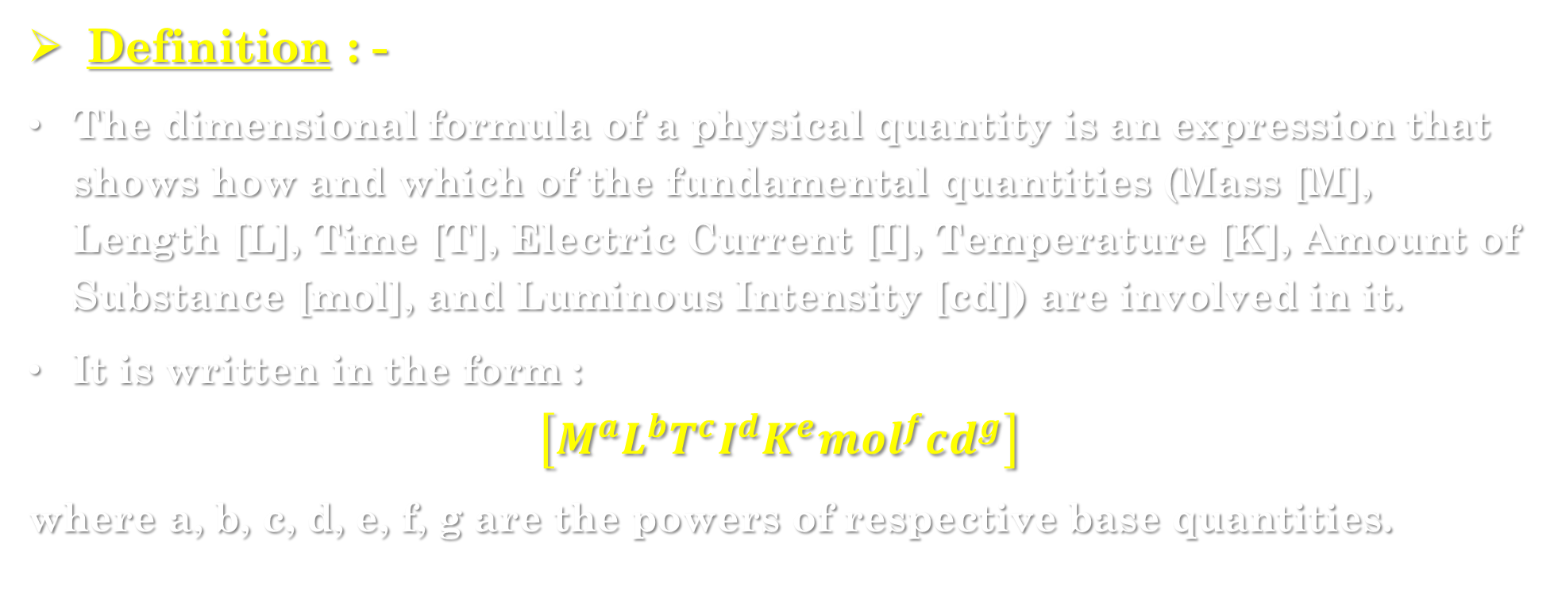
Dimensional formula : -
Definition : -
The dimensional formula of a physical quantity is an expression that shows how and which of the fundamental quantities (Mass [M], Length [L], Time [T], Electric Current [I], Temperature [K], Amount of Substance [mol], and Luminous Intensity [cd]) are involved in it.
It is written in the form :
$$\left[M^{a}L^{b}T^{c}I^{d}K^{e}mol^{f}cd^{g}\right]$$
where a, b, c, d, e, f, g are the powers of respective base quantities.

Slide 18
1.7] Rules & conventions for writing units : -
Units must be written according to international conventions (as per the SI system).
These rules ensure clarity, uniformity, and accuracy in scientific writing.
Rules to Write Units : -
No. | Rules | Example
1. | Units should be written in singular form, not plural. | ✅ 10 metre ❌ 10 metres
2. | Leave a space between the numerical value and the unit. | ✅ 25 m ❌ 25m
3. | Unit symbols do not take a full stop (.) unless at the end of a sentence. | ✅ 10 kg ❌ 10 kg.
4. | Symbols of units are not in plural form. | ✅ 5 kg ❌ 5 kgs
5. | Use correct capitalization : Unit symbols named after a person start with a capital letter; others are lowercase. | Force = N (Newton), metre = m
6. | Derived units formed by division use a slash or negative power. | m/s or m·s⁻¹
7. | Multiplication of units is shown by a dot (·) or space. | N·m or N m
8. | Use SI prefixes for large or small quantities (kilo-, milli-, etc.). | 1 km = 1000 m
9. | Only one unit per quantity should be used. | Use m/s, not m/min

Slide 19
Significant figures : -
Definition : -
Significant figures are the digits in a measurement that carry meaning or accuracy, including all certain digits and one uncertain (estimated) digit.
They represent the precision of a measured quantity.
Example : -
If a length is measured as 12.34 cm,
→ all digits (1, 2, 3, and 4) are significant figures, so it has 4 significant figures.

Slide 20
Rules for Writing Significant Figures : -
No. | Rule | Example
1. | All non-zero digits are significant. | 123 → 3 significant figures
2. | Zeros between non-zero digits are significant. | 1023 → 4 significant figures
3. | Leading zeros (before first non-zero digit) are not significant. | 0.00456 → 3 significant figures
4. | Trailing zeros (after a decimal point) are significant. | 2.300 → 4 significant figures
5. | Trailing zeros in a whole number without a decimal point are not significant. | 1500 → 2 significant figures (unless written as 1.500 × 10³)
6. | Exact or counting numbers have infinite significant figures. | 10 apples → infinite significant figures
7. | In scientific notation, all digits in the coefficient are significant. | 3.210 × 10⁵ → 4 significant figures

Slide 21
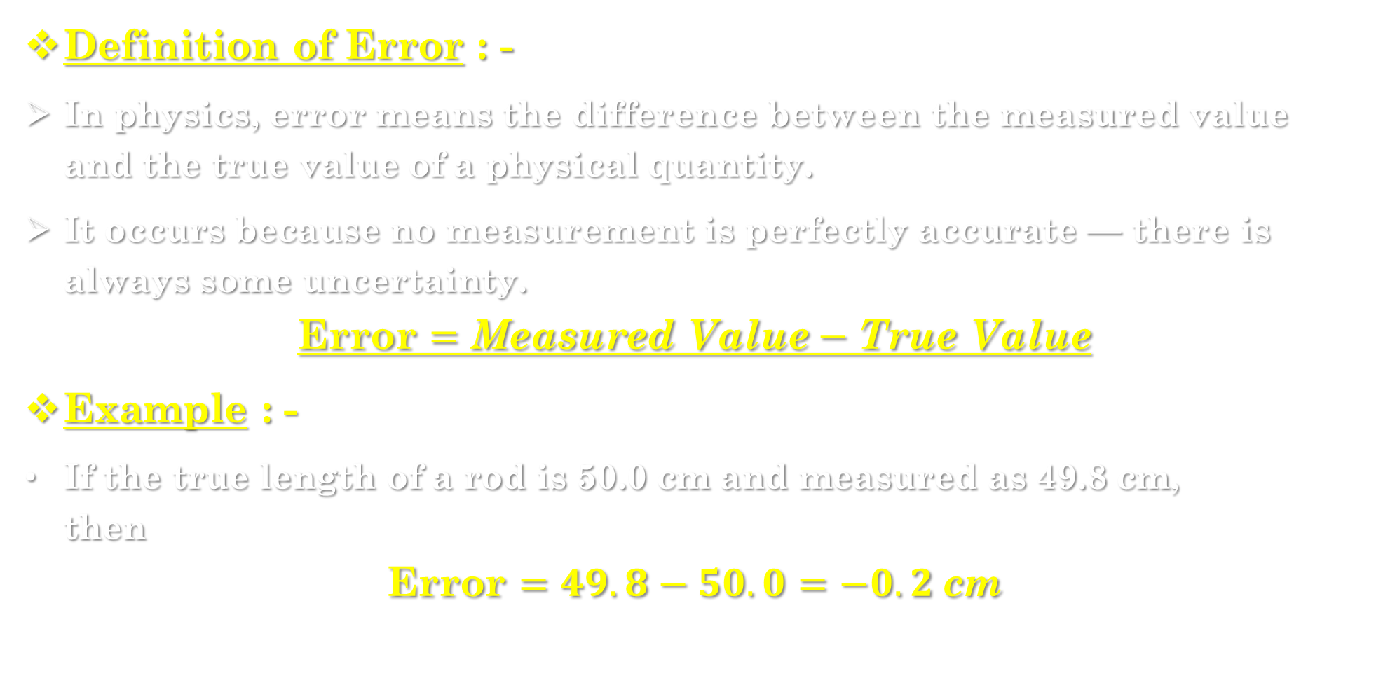
1.8] error : -
Definition of Error : -
In physics, error means the difference between the measured value and the true value of a physical quantity.
It occurs because no measurement is perfectly accurate — there is always some uncertainty.
$$\text{Error}=\text{Measured} \text{Value}−\text{True} \text{Value}$$
Example : -
If the true length of a rod is 50.0 cm and measured as 49.8 cm,
then
$$\text{Error}=49.8−50.0=−0.2 \text{cm}$$

Slide 22
types of errors : -
Errors are mainly classified into three types :
1. SYSTEMATIC ERROR : -
Errors that occur regularly and in the same direction (either always positive or always negative).
They arise due to faults in the measuring instrument, method, or observer.
Causes of Systematic Errors : -
Instrumental Errors : – due to imperfect calibration or zero error.
- Example : A faulty scale that starts from 0.2 cm instead of 0.
Observational Errors : – due to human mistakes (like parallax error while reading a scale).
- Example : Reading the needle from the wrong angle.
Environmental Errors : – caused by changes in temperature, pressure, humidity, etc.
- Example : Metal ruler expanding with heat.
Theoretical Errors : – when simplifications or wrong assumptions are made in formulae.

Slide 23
2. Random errors : -
Definition : -
Errors that occur irregularly and unpredictably in repeated measurements.
They may be positive or negative and vary from one observation to another.
Causes : -
Personal limitations of the observer
Fluctuations in experimental conditions
Lack of precision of instruments
Example : -
If a stopwatch is started or stopped a little late each time, the recorded times differ slightly.

Slide 24
3. Gross errors : -
Definition : -
These are blunders or mistakes made due to carelessness of the observer.
Examples : -
Misreading a scale
Using a wrong instrument
Recording wrong data

Slide 25
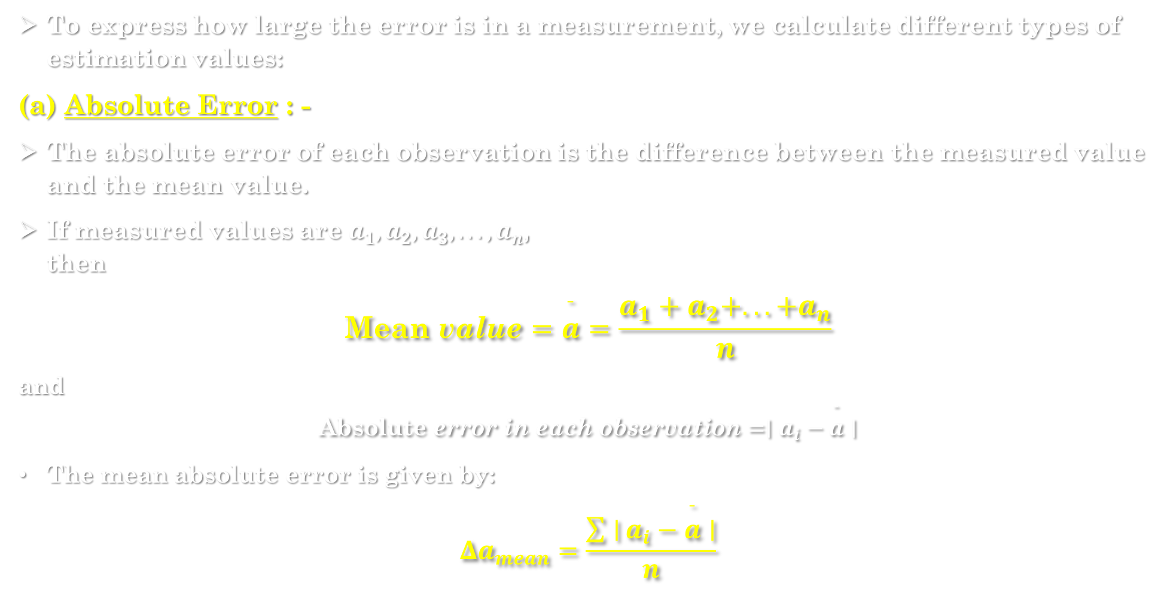
Estimation of errors : -
To express how large the error is in a measurement, we calculate different types of estimation values:
(a) Absolute Error : -
The absolute error of each observation is the difference between the measured value and the mean value.
If measured values are $a_{1},a_{2},a_{3},...,a_{n}$,
then
$$\text{Mean} \text{value}=\overset{ˉ}{a}=\frac{a_{1}+a_{2}+...+a_{n}}{n}$$
and
$$\text{Absolute} \text{error} \text{in} \text{each} \text{observation}=∣a_{i}−\overset{ˉ}{a}∣$$
The mean absolute error is given by:
$$Δa_{mean}=\frac{\sum{∣}a_{i}−\overset{ˉ}{a}∣}{n}$$

Slide 26
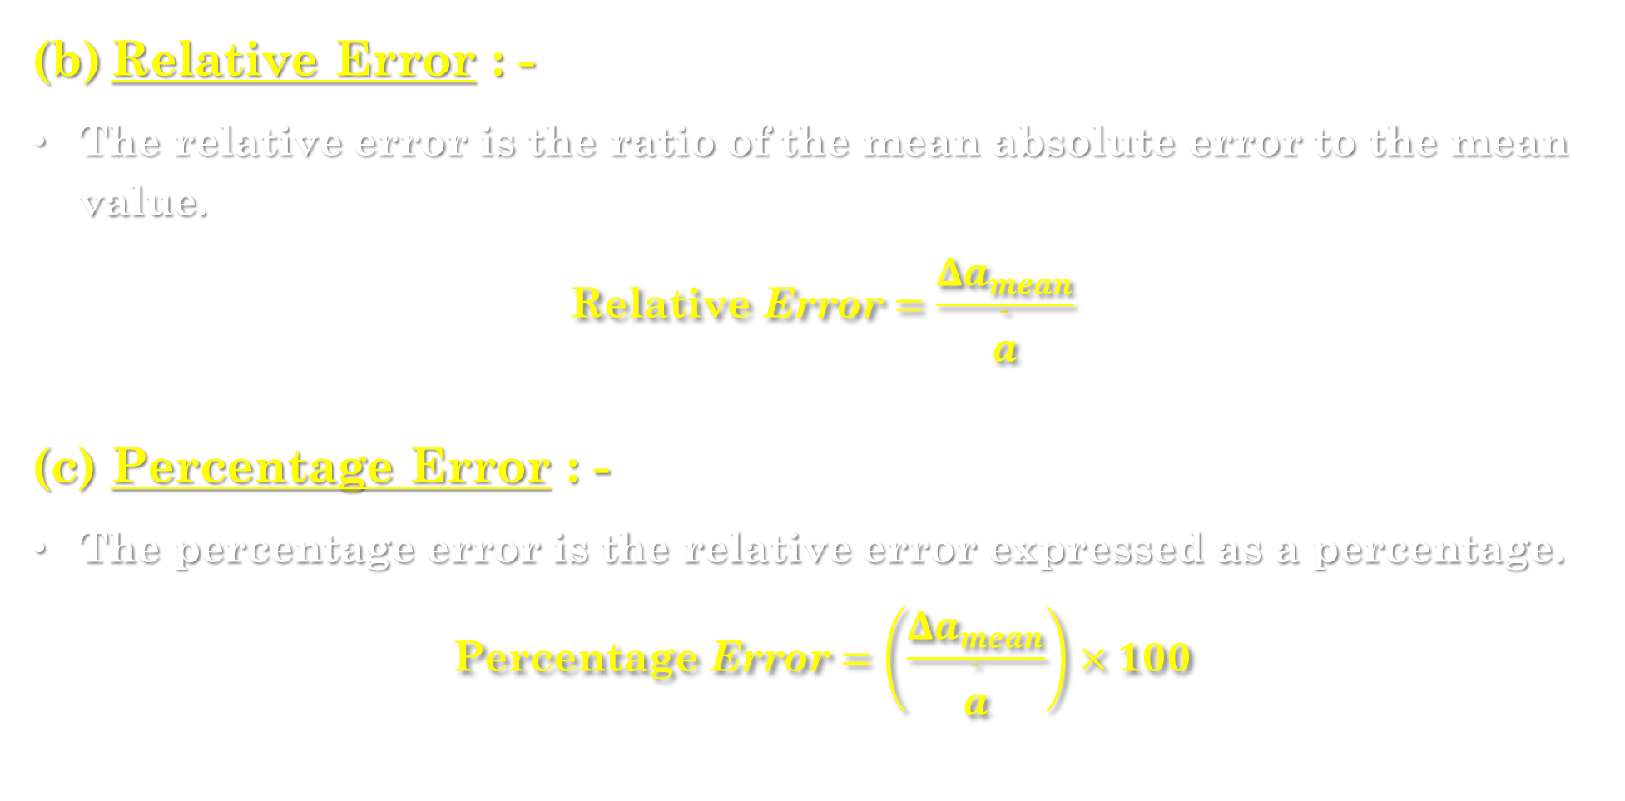
(b) Relative Error : -
The relative error is the ratio of the mean absolute error to the mean value.
$$\text{Relative} \text{Error}=\frac{Δa_{mean}}{\overset{ˉ}{a}}$$
(c) Percentage Error : -
The percentage error is the relative error expressed as a percentage.
$$\text{Percentage} \text{Error}=\left(\frac{Δa_{mean}}{\overset{ˉ}{a}}\right)×100$$

Slide 27
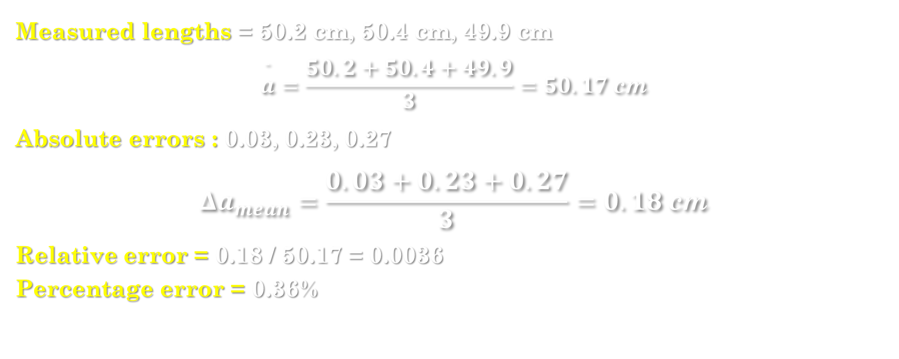
Example : -
Measured lengths = 50.2 cm, 50.4 cm, 49.9 cm
$$\overset{ˉ}{a}=\frac{50.2+50.4+49.9}{3}=50.17 \text{cm}$$
Absolute errors : 0.03, 0.23, 0.27
$$Δa_{mean}=\frac{0.03+0.23+0.27}{3}=0.18 \text{cm}$$
Relative error = 0.18 / 50.17 = 0.0036
Percentage error = 0.36%

Slide 28
Ancient astronomical instruments : -
Before modern telescopes and clocks were invented, ancient Indian astronomers developed many instruments to observe celestial bodies (Sun, Moon, stars, planets) and measure time, altitude, and position.
Some of the most important among them were Chakra, Dhanyata, Yasti, and Phalak Yantra.

Slide 29
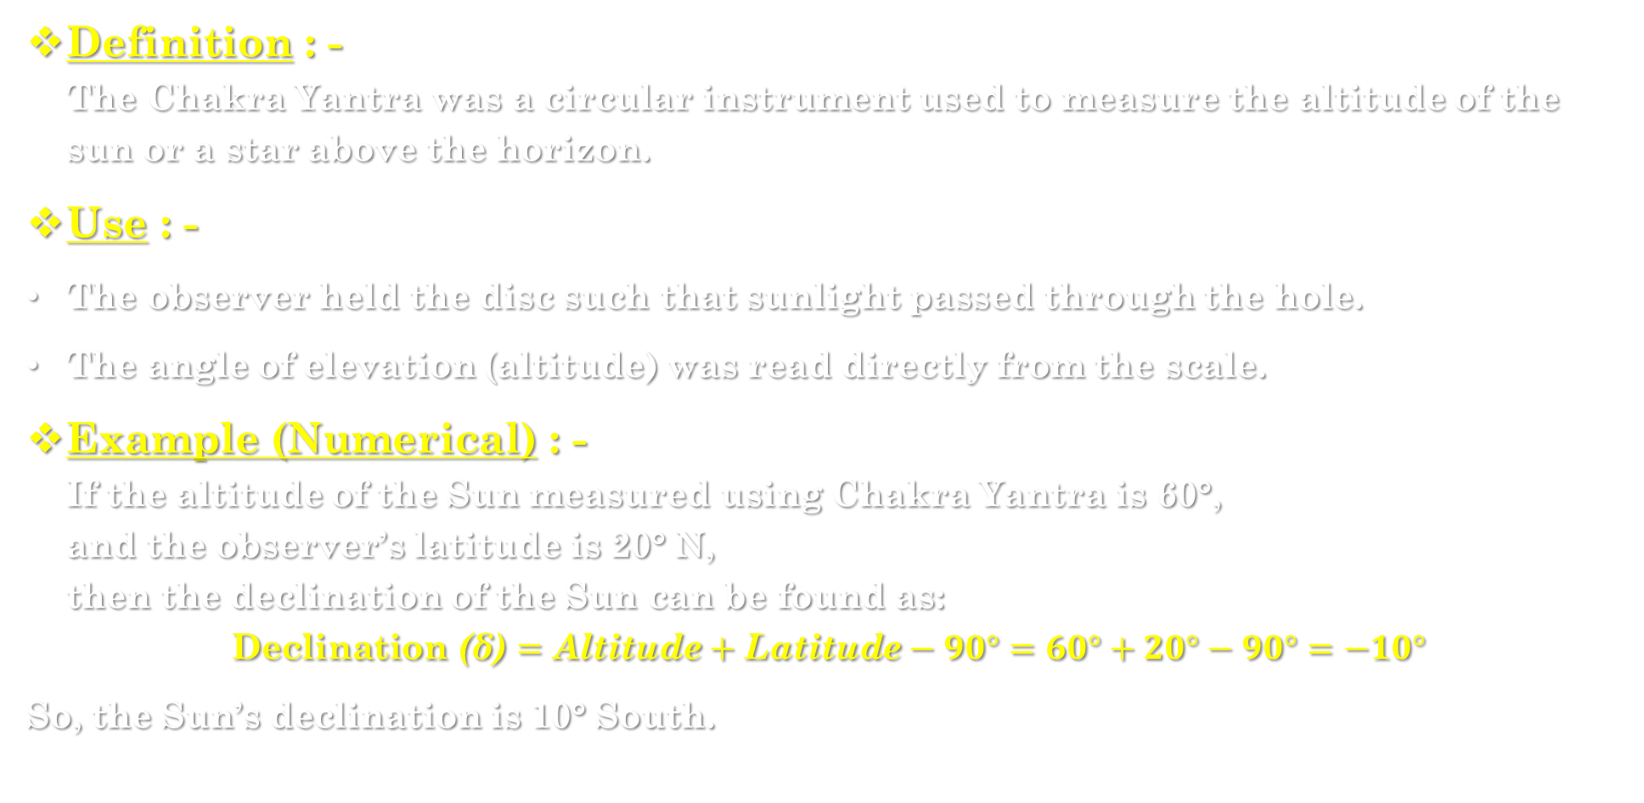
1. Chakra yantra (The circle instrument) : -
Definition : -
The Chakra Yantra was a circular instrument used to measure the altitude of the sun or a star above the horizon.
Use : -
The observer held the disc such that sunlight passed through the hole.
The angle of elevation (altitude) was read directly from the scale.
Example (Numerical) : -
If the altitude of the Sun measured using Chakra Yantra is 60°,
and the observer’s latitude is 20° N,
then the declination of the Sun can be found as:
$$\text{Declination}\text{ (}\text{δ}\text{)}=\text{Altitude}+\text{Latitude}−90°=60°+20°−90°=−10°$$
So, the Sun’s declination is 10° South.

Slide 30
2. Dhanyata yantra : -
Definition : -
The Dhanyata Yantra was a triangular or semicircular device used to measure angular distances between two celestial bodies or stars.
Structure & Use : -
Made of wood or metal, shaped like an arc or protractor.
Used along with a plumb line to ensure horizontal alignment.
Helped measure angles of elevation or angular separation.
Example : -
If the angular distance between two stars is found to be 45°, it means one star is located 45° east or west of the other.

Slide 31
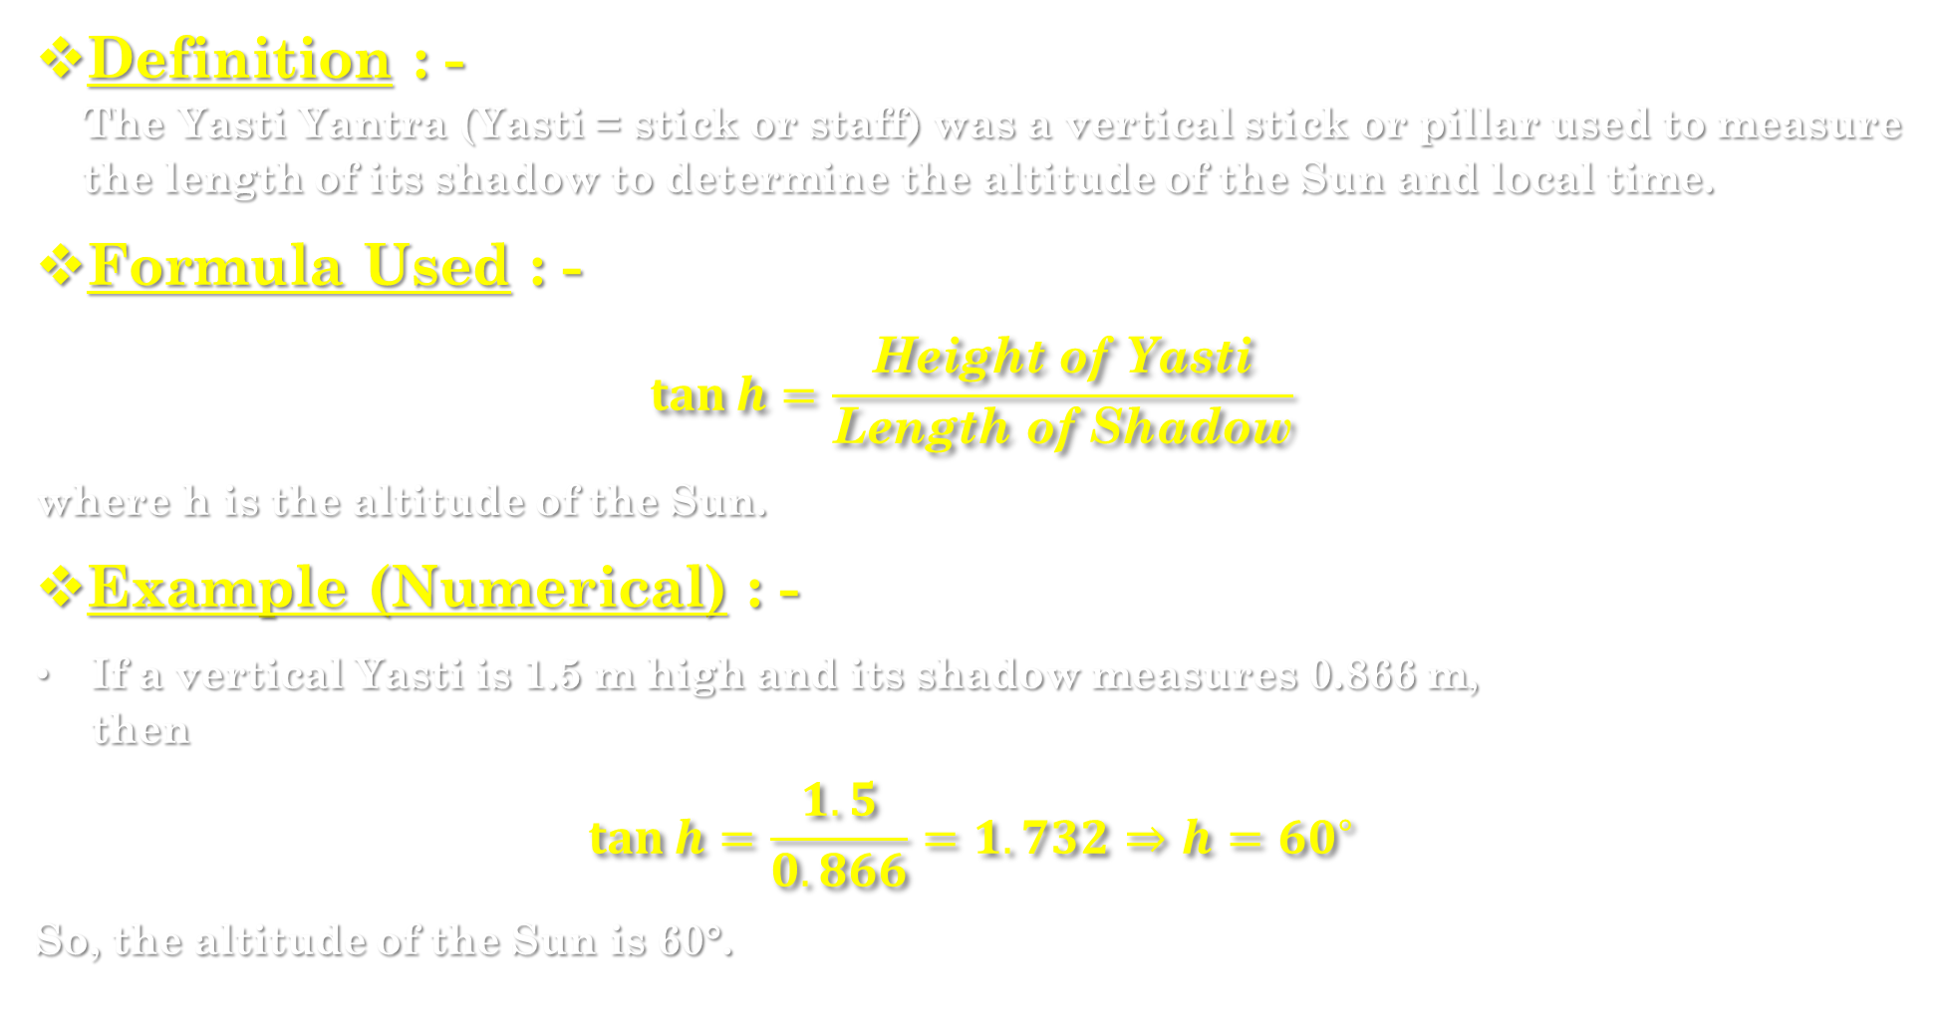
3. Yasti yantra (The staff instrument) : -
Definition : -
The Yasti Yantra (Yasti = stick or staff) was a vertical stick or pillar used to measure the length of its shadow to determine the altitude of the Sun and local time.
Formula Used : -
$$\tan{h}=\frac{\text{Height} \text{of} \text{Yasti}}{\text{Length} \text{of} \text{Shadow}}$$
where h is the altitude of the Sun.
Example (Numerical) : -
If a vertical Yasti is 1.5 m high and its shadow measures 0.866 m,
then
$$\tan{h}=\frac{1.5}{0.866}=1.732⇒h={60}^{∘}$$
So, the altitude of the Sun is 60°.

Slide 32
4. Phalak yantra (The disk instrument) : -
Definition : -
The Phalak Yantra was a flat circular plate instrument used to find the altitude and azimuth of celestial bodies.
Use : - By rotating the alidade towards the star or Sun, the altitude and direction (azimuth) could be measured.
Purpose : -
Measuring the position of the Sun, Moon, and stars.
Used in early observatories like Jantar Mantar.
Example (Numerical) : -
If the alidade shows an altitude of 45° and azimuth of 120°, it means the star is 45° above the horizon in the southeast direction.

