Slide 1
01. Program Logic development

Slide 2
1.1] fundamentals of algorithm : -
1. Notion of an Algorithm : -
An algorithm is a finite sequence of well-defined steps used to solve a specific problem.
It is a step-by-step procedure that takes some input, processes it, and produces an output.
Definition : -
An algorithm is a finite set of instructions that, when followed, accomplishes a particular task or solves a problem in a finite amount of time.
Example : -
Algorithm to find the sum of two numbers :
Step 1 : Start
Step 2 : Read two numbers a and b
Step 3 : Compute sum = a + b
Step 4 : Display sum
Step 5 : Stop

Slide 3
2. Pseudo-code conventions : -
Pseudo-code is a way of writing algorithms in a structured but human-readable form, which looks similar to a programming language but is not bound by syntax rules.
It helps in planning before writing actual code in languages like C, Java, or Python.

Slide 4
a) Assignment Statements : -
An assignment statement is used to assign a value to a variable.
Syntax : -
variable ← expression
or sometimes written as
variable = expression
Example : -
sum ← a + b
This means that the value of a + b is stored in the variable sum.

Slide 5
b) Basic Control Structure : -
Control structures determine the flow of execution in an algorithm.
They are of three main types :
1. Sequential Structure : -
Instructions are executed one after another.
Example : -
Read a, b
sum ← a + b
Print sum

Slide 6
2. Selection (Decision) Structure : -
Used for making decisions (like if-else conditions).
Syntax : -
IF condition THEN
statements
ELSE
statements
END IF
Example : -
IF marks ≥ 40 THEN
Print "Pass"
ELSE
Print "Fail"
END IF

Slide 7
3. Iteration (looping) Structure : -
Used for repeating a set of instructions until a condition is met.
Types : -
While Loop
WHILE condition DO
statements
END WHILE
For Loop
FOR i ← 1 TO 10 DO
Print i
END FOR

Slide 8
1.2] algorithmic problems : -
1. Exchange the values of two variables : -
A. Using a Temporary Variable
Algorithm : -
Step 1 : Start
Step 2 : Read two variables A and B
Step 3 : Set TEMP ← A
Step 4 : Set A ← B
Step 5 : Set B ← TEMP
Step 6 : Print A and B
Step 7 : Stop
Pseudo-code : -
READ A, B
TEMP ← A
A ← B
B ← TEMP
PRINT A, B

Slide 9
B. Without using a temporary variable : -
Algorithm : -
Step 1 : Start
Step 2 : Read A and B
Step 3 : Set A ← A + B
Step 4 : Set B ← A - B
Step 5 : Set A ← A - B
Step 6 : Print A and B
Step 7 : Stop
Pseudo-code : -
READ A, B
A ← A + B
B ← A - B
A ← A - B
PRINT A, B

Slide 10
2. Counting positive numbers from a set of integers : -
Algorithm : -
Step 1 : Start
Step 2 : Read the total number of integers N
Step 3 : Initialize COUNT ← 0
Step 4 : Repeat for each number in the set
a. Read number X
b. If X > 0, then COUNT ← COUNT + 1
Step 5 : Print COUNT
Step 6 : Stop
Pseudo-code : -
READ N
COUNT ← 0
FOR i ← 1 TO N DO
READ X
IF X > 0 THEN
COUNT ← COUNT + 1
END IF
END FOR
PRINT COUNT

Slide 11
3. Summation of a set of numbers : -
Algorithm : -
Step 1 : Start
Step 2 : Read total number of elements N
Step 3 : Initialize SUM ← 0
Step 4 : Repeat for each number in the set
a. Read number X
b. SUM ← SUM + X
Step 5 : Print SUM
Step 6 : Stop
Pseudo-code : -
READ N
SUM ← 0
FOR i ← 1 TO N DO
READ X
SUM ← SUM + X
END FOR
PRINT SUM

Slide 12
4. Reversing the digits of an integer : -
Algorithm : -
Step 1 : Start
Step 2 : Read integer N
Step 3 : Initialize REV ← 0
Step 4 : Repeat while N > 0
a. D ← N % 10 (get last digit)
b. REV ← REV * 10 + D
c. N ← N / 10 (integer division)
Step 5 : Print REV
Step 6 : Stop
Pseudo-code : -
READ N
REV ← 0
WHILE N > 0 DO
D ← N % 10
REV ← REV * 10 + D
N ← N / 10
END WHILE
PRINT REV

Slide 13
5. Find smallest positive divisor of an integer (other than 1) : -
Algorithm : -
Step 1 : Start
Step 2 : Read integer N
Step 3 : For i ← 2 to N
If N % i = 0, then
Print i
Stop (since smallest divisor found)
Step 4 : Stop
Pseudo-code : -
READ N
FOR i ← 2 TO N DO
IF N % i = 0 THEN
PRINT i
EXIT
END IF
END FOR

Slide 14
6. Find G.C.D. & L.C.M. of Two Numbers : -
a) Algorithm for G.C.D. (Euclid’s Method) : -
Step 1 : Start
Step 2 : Read two numbers A and B
Step 3 : Repeat while B ≠ 0
a. TEMP ← B
b. B ← A % B
c. A ← TEMP
Step 4 : GCD ← A
Step 5 : Print GCD
Step 6 : Stop
Pseudo-code : -
READ A, B
WHILE B ≠ 0 DO
TEMP ← B
B ← A % B
A ← TEMP
END WHILE
PRINT A

Slide 15
b) To find L.C.M. : -
LCM = (A × B) / GCD
Pseudo-code : -
LCM ← (A * B) / GCD
PRINT LCM
For Three Numbers (A, B, C):
GCD1 ← GCD(A, B)
GCD2 ← GCD(GCD1, C)
LCM ← (A * B * C) / (GCD1 * GCD2)

Slide 16
7. Generating Prime Numbers up to N : -
Algorithm : -
Step 1 : Start
Step 2 : Read N
Step 3 : -For each number i from 2 to N
a. Set FLAG ← 0
b. For j ← 2 to i/2
If i % j = 0, then set FLAG ← 1 and break
c. If FLAG = 0, print i (prime number)
Step 4 : Stop
Pseudo-code : -
READ N
FOR i ← 2 TO N DO
FLAG ← 0
FOR j ← 2 TO i/2 DO
IF i % j = 0 THEN
FLAG ← 1
BREAK
END IF
END FOR
IF FLAG = 0 THEN
PRINT i
END IF
END FOR

Slide 17
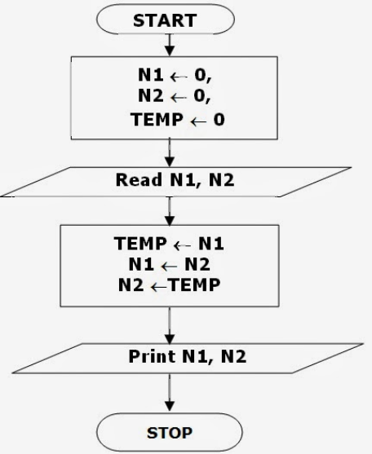
1. Exchange the value of two variables : -
(A) Using Temporary Variable : -
(B) Without Temporary Variable : -
Start → Read A, B → A ← A + B → B ← A - B → A ← A - B → Print A, B → Stop

Slide 18
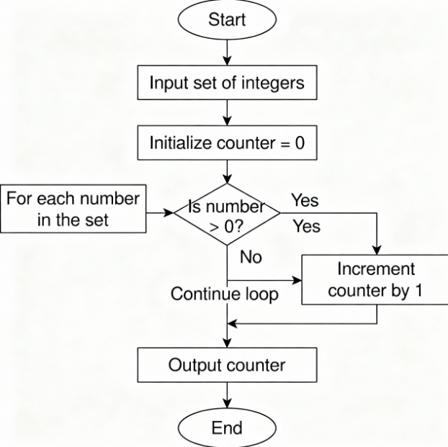
2. Counting Positive Numbers from a Set of Integers : -

Slide 19
03. Summation of Set of Numbers : -
Start → Read N → SUM ← 0 → i = 1
↓
Check i ≤ N ?
Yes → Read X → SUM ← SUM + X → i ← i + 1 → repeat
No → Print SUM → Stop

Slide 20
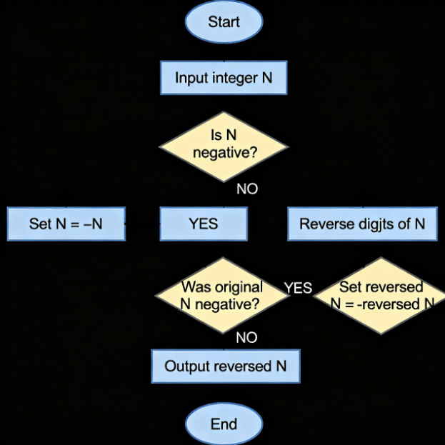
04. Reversing the Digits of an Integer : -

Slide 21
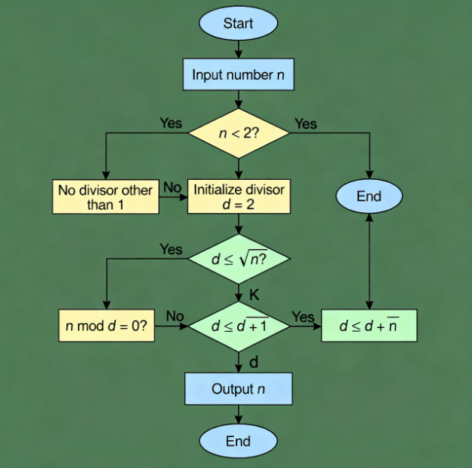
05. Smallest Positive Divisor (other than 1) : -

Slide 22
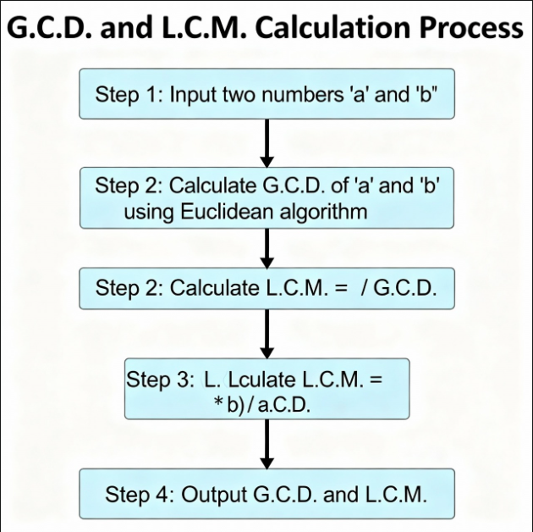
06. G.C.D. and L.C.M. of Two Numbers : -

Slide 23
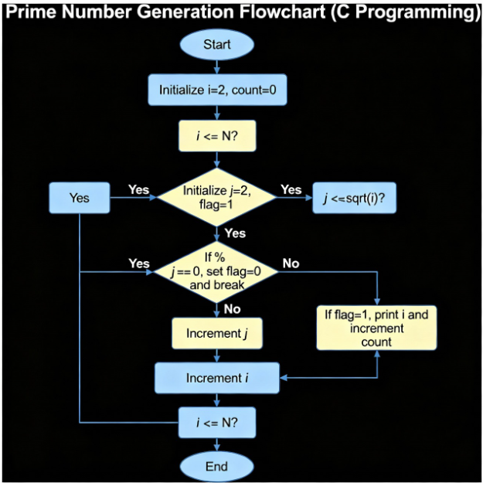
07. Generating Prime Numbers up to N : -

