Slide 1
01. Introduction of computer & information security

Slide 2
1.1 foundations of computer security : -
Definition of computer system : -
- Computer Security is the protection of computing systems and the data that they store or access.
- It deals with prevention and detention of unauthorized actions of user at computer system.
- Computer security is important for protecting the confidentiality, integrity and availability of computer system and their resources.
- It involves security majors such as Data Encryption, passwords antivirus, firewalls, etc.
- Computer security awareness helps minimize the chances of computer attacks and prevent the loss of information stored tud on the systems.

Slide 3
Need of computer security : -
1. Protect against unauthorized Access : - Unauthorized access. can lead to theft of sensitive data, modifications, or disruption of services. computer security helps prevent these unautho rized access attempts.
2. Prevention from Data Breaches : - Data Breaches can have severe consequences, including financial losses and damage to an organization's reputation. Computer security measures protect against data breaches by safeguarding sensitive information.
3. Prevention from Malware Cyber Attacks : - Malicious software (malware) and cyber attacks pose significant threats to computer system. Security measures like antivirus programs, firewalls, and instrusion detection system help prevent and mitigate the impact of these threats.
4. Business Continuity : - Computer security measures contribute to business continuity by ensuring that systems and data 2ms are available and Functional, even in the face of unexpected events or disasters.

Slide 4
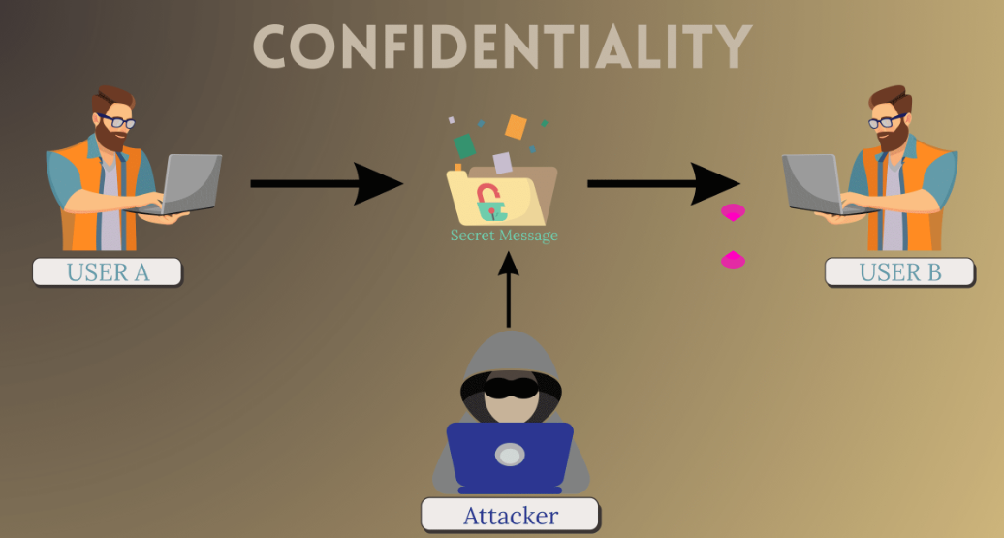
Security basics : -
1. confidenciality : -
i) Confidentiality refers to limiting information access and wear disclosure to authorized users along with preventing access by unauthorized ones.
ii) Sensitive information should be kept secret from individuals who are not authorized to see the information.
iii) Confidentiality is not only applied to storage of data but also applies to the transmission of information.
iv) Real life example : - Personal data of upto 87 million facebook users were harvested without consent & used for political advertising, compromising user confidentiality.

Slide 5
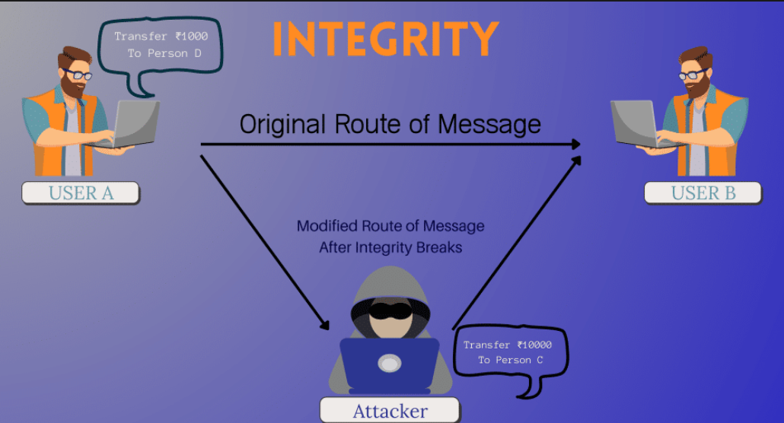
2. Integrity : -
i) Integrity refers to the trustworthiness of information resources. It should not be altered without detection.
ii) when the contents of message are changed after the sender mit sends it but before it reaches it's intended recipient, we Say that the integrity of the message is lost.
iii) Integrity ensures that information is not changed in the transit. It incluses only preservation without corruption of whatever was transmitted into the system.
iv) Real life Example : - Hackers compromised the integrity of industrial control systems at multiple power distribution companies in Ukraine, leading to power outages for over 225,000 people.

Slide 6
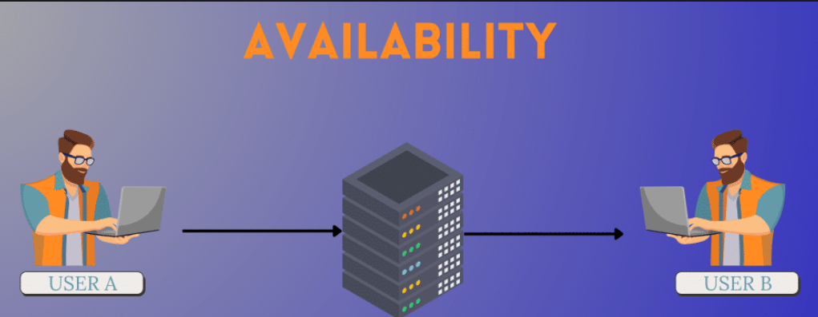
Availibility : -
i) Availability refers to the availability of information resources. An information system that is not available when need is as bad as none at all.
ii) Availability means that people who are authorized to use information are not prevented to do so.
iii) Availability may be affected by purely technical issues, natural phenomena, or human causes.
iv) For Example, an object or service is thought to be available. if –
1. It is present in a useable form.
2. It has capacity enough to meet the services needs.
3. The service is completed an acceptable period of time.

Slide 7
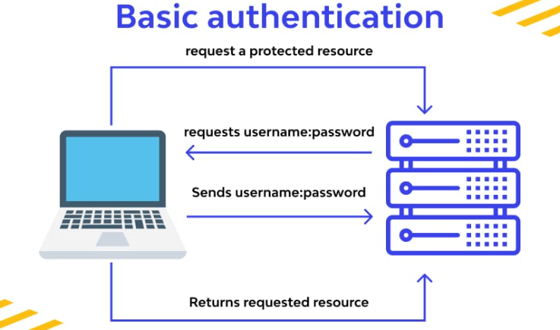
4. authentication : -
i) Authentication helps to establish proof of identities. The authentication process ensures that the origin of a message is correctly identified.
ii) It includes verifying the identity of users, systems, or processes to control access to resources.
iii) For Example : - Attackers used social engineering to trick Twitter employees into providing credentials that allowed access to internal systems.

Slide 8
5. non-repudiation : - i) Non-repudiation refers to preventing individuals from denying their actions or transactions, providing a way to trace actions back to their source. ii) It is a way to guarantee that the sender of a message can't 2005 later deny having sent the message and that the receiver can't deny having received the message. iii) Non-repudiation is the assuarance that someone can't deny the validity of something. iv) Non-repudiation also provides proof to third parties.
6. Reliability : -
i) Reliability in the computer world relates to component's ability to perform as close as possible to its original desired specifications.
ii) The definition of relability can also be expanded to incorporate a computer's ability to be reliable' at protecting one’s personal information from attackers.

Slide 9
7. Accountability : - i) Accountability refers to the principal that ensures users or entities can be held responsible for their adion's within a system. ii) It is the traceability of actions performed by a user, process jor or device. for example, the use of unique user identification and authentication supports accountability. iii) whereas, the use of shared user ID's and passwords destroys accountability.
8. Access Control : -
i) Access control refers to the mechanisms used to regulate who mall can access or use resources within a system and what they can do with those resources.
ii) It’s main goal is to ensure that only authorized users or Move entities are allowed to perform specific actions or access particular data, while unauthorized users are denied access.

Slide 10
1.2 Risk & threat analysis : -
Assets : -
- Assets are nothing but all Hardware and software components like CPU, cables, RAM, etc.
- They can include barizab tangible and intangible items assets often include : -
> Data - Information stored on systems, databases, or in transit.
> Infrastructure - Network architecture, server.
> People - Employees, user, and other personnel.
> Reputation - The perception and trustworthiness of organization.

Slide 11
Vulnerability : -
- Vulnerabilities are weaknesses or flaws in the security of a system or process that could be exploited by a threat.
- These can rise from : -
> Software Bugs - Programming errors in software code.
> Configuration Errors - Incorrectly configured settings.
> Human Error - Mistakes made by individual, such as accidental data deletion or misconfiguration.
> Outdated Software - failure to apply patches and updates to address known vulnerabilities.

Slide 12
Threat : -
i) Threats are potential dangers that can exploit vulnerabilities and negatively impact assets.
ii) It is a set of circumstances that has potential to cause loss or harm.
iii) Threat is a possible danger to the system.
iv) Types of threats include:
> Malware - software designed to harm or exploit system, such as viruses, ransomware or spyware.
> Hackers - Individual or groups attempting unauthorized access. to systems or data.
> Insiders - Employees or other trusted individual who misuse olis their access.
> Natural Disasters - Events like flood, earth quakes, or fires can hidamage physical assets.

Slide 13
Risks : - ( Assets + Vulnerability + Threat )
i) The potential for loss, damage or destruction of an asset as a result of a threat exploiting vulnerability. Risk is the intersection of assets, vulnerabilities and Threats.
ii) Threals may exist, but if there are no vulnerabilities then there is little/no risk; similarly, you can have vulnerability but if there is no threat then you have litte /no risk.
iii) A threat is blocked by control of vunerability.
iv) Interception, interruption, modification and fabrication. are the system security threats.

Slide 14
Counter measure : -
- These are actions, device, procedure or techniques for protecting your system.
- These can include :
> Access Controls - Implementing authentication and authorization mechanisms to control access.
> Firewalls and Intrusion Detection/ Prevention systems - Monitorin and filtering network traffic.
> Encryption - Protecting data by encoding it so that only authorize parties can access it.

Slide 15
1.3 Threat to security : -
VIRUS : -
i) A virus is a block of code that inserts copies of itself into other programs that causes damage to data and software.
ii) Computer virus can cause system corruption as it provides unauthorized access to sensitive information & decreases system functionality.
iii) Virus attacks are active type Trojan Horse attacks. Most viruses include a string of characters that acts as a market showing that program has been infected.
iv) Virus does not infect an already infected file in order to prevent increasing disk space usage and allowing to infect many programs.

Slide 16
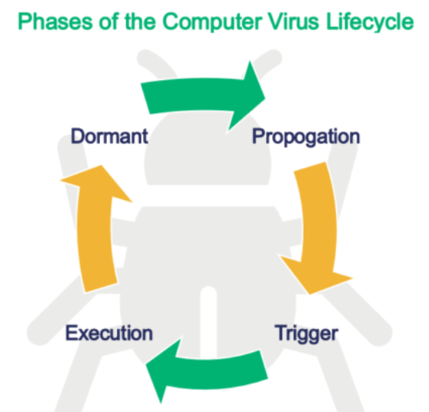
Phase of viruses : -
During its lifecycle, viruses goes though these phases : -
Dormant Phase.
Propagation Phase.
Triggering Phase.
Execution Phase.

Slide 17
1] Dormant Phase : - The virus will eventually be activated by some event, such as a date, the presence of another program or file, or the capacity of the disk exceeding some limit.
2] Propagation Phase : - The virus places an identical copy of itself into other programs Each infected program ali will now contain a clone of the virus, which will itself enter a propagation phase.
3] Triggering Phase : - The virus is activated to perform the function for which it was intended.
4] Execution Phase : - The function is performed. The function. may be harmless, such as message on the screen, or damaging, such as the destruction of programs and data Files.

Slide 18
1.4 Types of viruses : -
1] Parasitic Virus : - A parasitic virus attaches itself to or executable files and replicates, when the infected program is executed, by finding other executable files to infect.
2] Memory-resident virus : - Lodges in main memory as part of a resident system program. From that point on, the virus infects every program that executes.
3] Boot sector virus Infects : - a master boot record or boot record and spreads when a system is booted from the disk containing the virus.
4] Stealth virus : - A form of virus explicitly designed to hide itself from detection by antivirus software.
5] Polymorphic virus : - A virus that mutates with every infection, making detection by the signature of the virus is impossible.
6] Metamorphic virus : - A metamorphic virus rewrites its elf completely at each iteration, increasing the difficulty of detection. Metamorphic viruses may change their behaviour ma as well as their appearance.
7] Macro Viruses : - Macro viruses are particularly threatening for a number of reasons.
8] E-mail viruses : - The e-mail virus sends itself to everyone on the mailing list in the user's email package. The virus does local damage. The first rapidly spreading e-mail viruses, such as Melissa, made use of a Microsoft Word Macro embedded in an attachment.

Slide 19
During viruses : -
Buying software only from respectable store.
Avoid uploading of free software from public domain.
Avoid borrowing program for someone whose security standards are less.

Slide 20
Worms : -
i) Worm is a program that replicates itself by installing copies of itself on other machines accross a network.
ii) An e-mail virus has some of the characteristics of a worm because it propagates itself from system to system, it does not need user intervention to propagate. To replicate itself, a network worm uses some sort of network vehicle.
iii) It infects via buffer overflow, file sharing, configuration errors and other vulnerabilities.
iv) A network worm exibits the same phases & characteristics. as a computer virus.

Slide 21
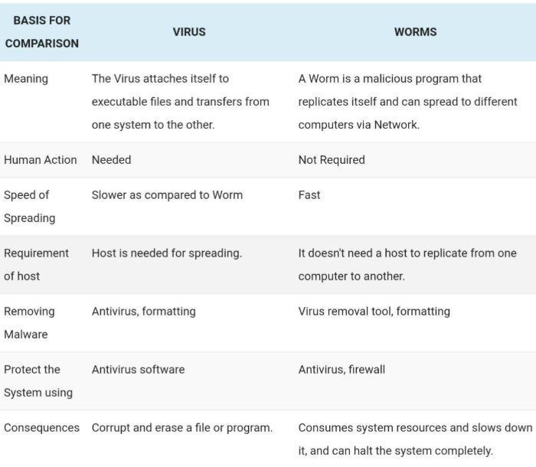
Difference between virus & worms : -

Slide 22
Trojan horse : -
i) Trojan horse is a virus that's disguised as a harmless that sometimes carries within itself the mean to allow the programs creator to secretly access the users system.
ii) Trojan horse attack may either be passive or active depending on the activities performed by the clandestine code.
iii) For Example : if the clandestine code simply steals information then it is of the passive type. But if it does something more harmful like corrupting files, then it is of the active type.
iv) Many systems have mechanisms for allowing programs. written by users to be used by other users. These program can improperly use the access rights of an executing user and leak information.

Slide 23
Intruders : -
i) An Intruder is a person who attempts to gain unauthorized access to a system, to damage that system, or to disturb data on that system.
ii) Three classes of intruders are masquerader, misfeasor, and clandestine user :
1. Masquerader : - An unauthorized user who penetrates computer system's access control and gain access to user accounts.
2. Misfeasor : - A legitimate user who accesses resources he is not authorized to access who is authorized such access butmisuses his privileges.
3. Clandestine user : - A user who seizes the supervisory control of the system and uses it to evade auditing and access control.

Slide 24
Insiders : -
i) An Insider threat is a malicious threat to an organization that comes from people within the organization, who have inside information concuring the organization's security. practices, data and computer systems.
ii) Insiders are more dangerous than outside Intruders.
iii) They have the access and knowledge necessary to cause immediate damage to an organization.
iv) Insider attacks can be motivated by revenge or simply feeling of entitlement.
- Some of the measures taken :
1. Enforce least privilege, only allowing access to the resources. employees need to do their job.
2. Set logs to see what users access and what commands they are entering.

Slide 25
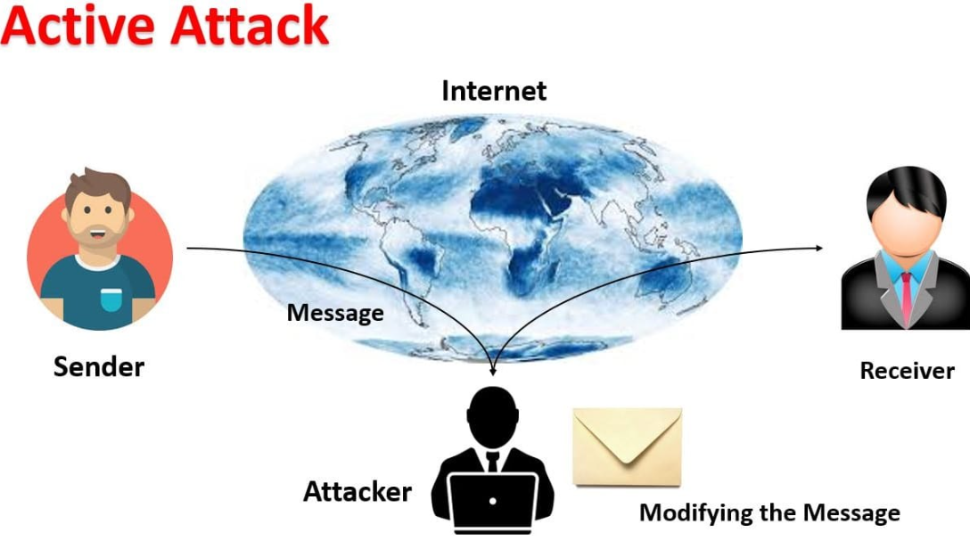
Types of attacks : -
1. Active attack : -
i) Active attacks involve some modification of the data stream or the creation of a false stream .
ii) These attacks can not be prevented easily.
iii) Active attacks can be divided into four types : -
1. Masquerade.
2. Replay.
3. Modification of message.
4. Denial of services.

Slide 26
2. Passive attack : -
i) A passive attack attempts to learn or make use of information From the system but does not affect system resources.
ii) The attacker aims to obtain information that is in transit.
iii) The term passive indicates that the attacker does not attempt to perform any modifications to the data.
iv) Passive attacks are of two types : -
1. Release of message contents.
2. Traffic analysis.

Slide 27
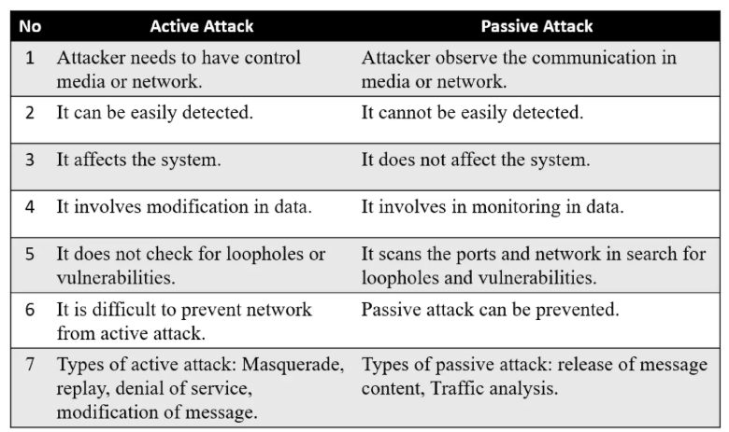
Difference between active attack & passive attack : -

Slide 28
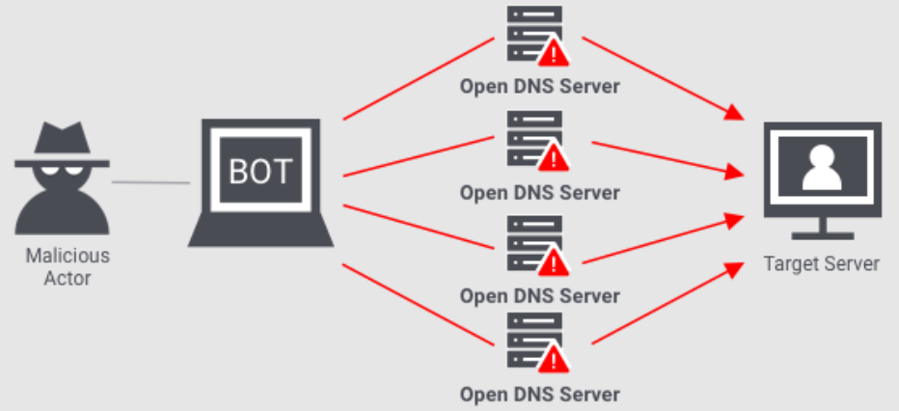
Ddos attack : -
i) A Distributed Denial of Service (DDOS) attack is a malicious attempt to disrupt normal traffic of a targeted system, service or network.
ii) This is done by overwhelming the target or its surrounding infrastructure with a flood of Internet traffic.
iii) These type of attacks are difficult to prevent because the behaviour of whole network needs to be analyzed, the behavior of small piece of code.
iv) The goal of DDoS attack is same as DoS attack; A DOS attack employing multiple attacking systems is known as DDoS attack.
v) A network of attack agents (zombies) are created by the attacker.
vi) Upon receiving the attack command from attacker, the agents commence sending a specific type of traffic against the target.

Slide 29
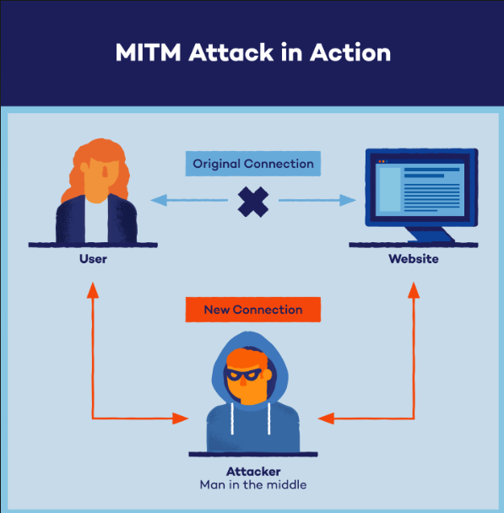
Man-in-the-middle attack : -
i) A Man-In-The-Middle (MITM) attack is an attack in which an attacker is able to read, insert and modify messages between two parties without either party knowing that the link between them has been compromised.
ii) To prevent this attack, both sender and Receiver must authenticate each other.
iii) MITM is typically used to refer to active manipulation of the messages, rather than passively eves dropping.
iv) The MITM Attack may include one or more of :
1. Eavesdropping including traffic analysis.
2. chosen ciphertext attack, depending on what receiver does with a message that it decrypts.
3. Substitution attack.
4. Replay attacks.
5. DOS attacks.

Slide 30
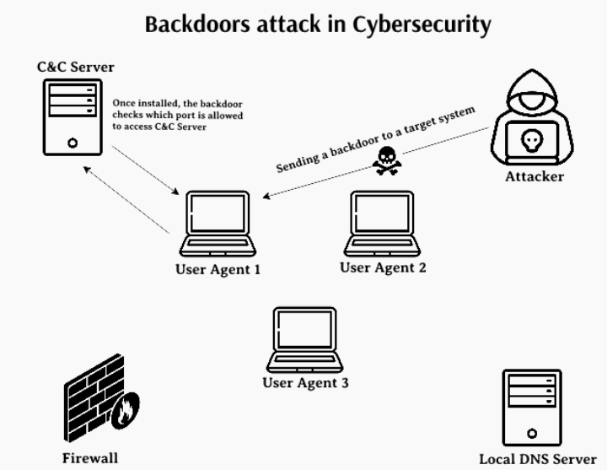
Backdoor/trapdoor attack : -
→i) Trapdoor is a secret undocumented entry point into a program used to grant access without normal methods of access authentication.
ii) This attack is initiated by gaining access to network and inserting a trapdoor program that creates a backdoor for an attacker.
iii) Trapdoor in duding backdoor passwords are unspecified and non dowmented entry points to the system.
iv) A clever trap door could be included a compiler. It is difficult to implement OS controls for trap door.
v) Security measures must focus on the program development and software update activities.

Slide 31
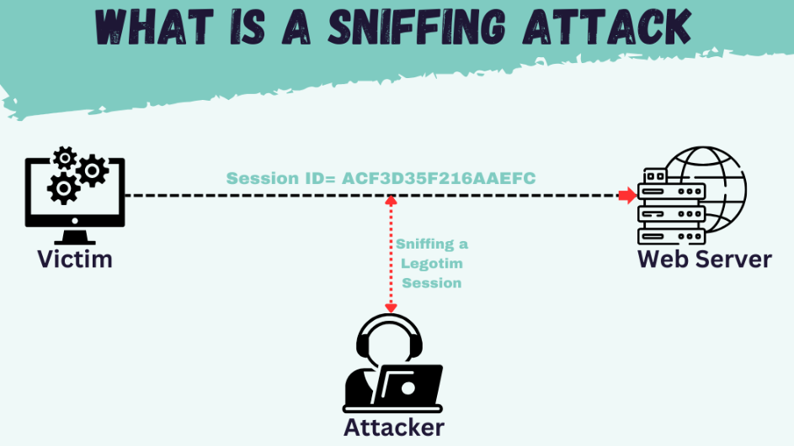
Sniffing : -
i) Sniffers are programs that allow a host to capture any network packet illicitly. Active sniffer can alter of block network traffice; while passive sniffer can only monitor network traffic.
ii) Packet Sniffing involves capturing, decoding, inspecting interpreting the information inside a network packet on a TCP/IP network.
ii) Most of the Internet runs in plain text, which means that most of the information you look at is viewable by someone with a packet sniffer.
iv) Network Sniffing is a network layer attack consisting of capturing packets from the network transmitted by other computers and reading the data content in search of sensitive information.
v) There are two ways to detect a sniffer : -
1. Host-based sniffer detection : - Small utilities can used to delect if the NIC is running in a promiscuous mode on host in a network.
2. Network-based detection : - Anti-sniffer software can be run to delect the presence of specific signature packets.

Slide 32
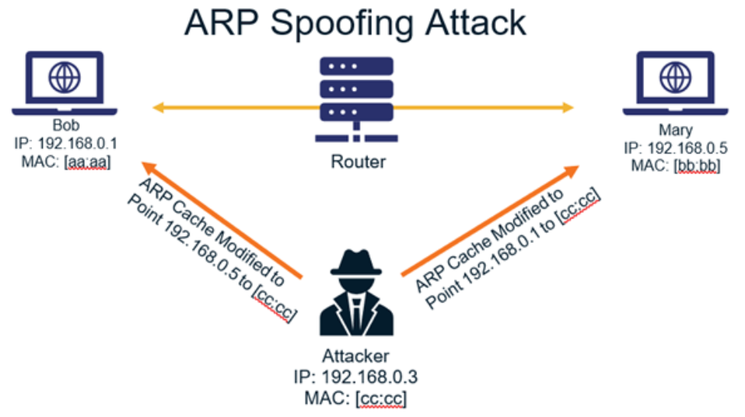
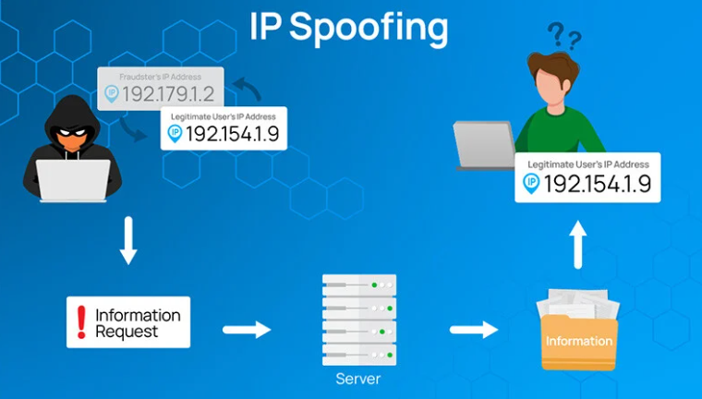
Spoofing : -
Spoofing is a situation in which one person/program successfully masquerade as another by falsify dada & thereby gaining an elligimate advantage.
Spoofing is mainly of two types : -
1. ARP Spoofing : - ARP spoofing is a one type of attack in which malicious actor sends falsify ARP messages over a local area network.
2. IP Spoofing : - IP spoofing is a hijacking technique in which the attacker masquerades as a trusted host to conceal his identify, hijacker browser or gain access to a network.

Slide 33
Tcp/ip hacking : -
i) Hacking is a term used to refer to activities aimed at exploiting security flaws to obtain critical information For gaining access to secured networks.
ii) TCP/IP Hacking is called as Active sniffing.
iii) It is a process of taking control of an already existing session between client and server.
iv) It involves attacker gaining access to a host in the network and logically disconnecting it from the network.
1] White Hat Hackers : - It is also known as Ethical Hackers. They never intent to harm a system, rather than they try to find out weaknesses in a computer or a network system as a part of vulnerability assessments.
2] Black Hat Hackers : - It is also known as crackers, are those who hack in order to gain unauthorized access to a system and harm its operations or steal sensitive information.
3] Grey Hat Hackers : - are a blend of both black and white. hat hackers. They act without malicious intent but for their fun, they exploit a security weakness in a system. network without the owner's permission or knowledge.

Slide 34
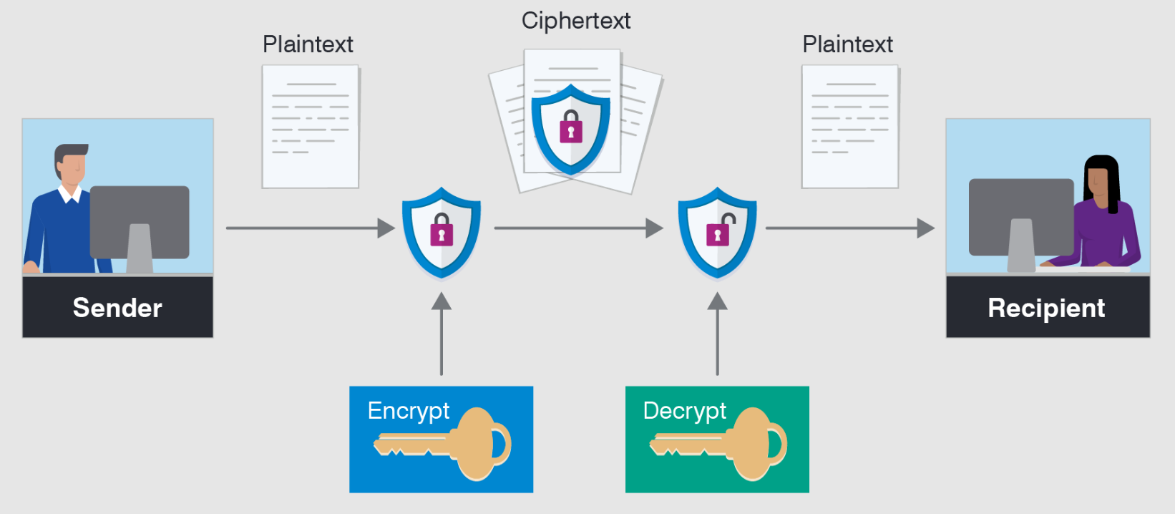
Encryption attacks : -
Types of attacks on Encrypted msg –
i) Encryption attacks target encrypted data to gain unauthorized access to plaintext information.
ii) These attacks aim to access the encrypted information without the decryption key, compromising confidentiality, integrity and authenticity of the data.
iii) Using strong Keys, ensuring proper key management and requirely updating cryptographic protocols are essential to defend against these attacks.
iv) Types-Ciphertext only, known Plaintext, chosen plaintext, Chosen Ciphertext, chosen text.

Slide 35
1.5 Operating system security : -
Operating System (OS) Security refers to the process of protecting the operating system from threats, vulnerabilities, and unauthorized access that may harm the system or compromise data integrity.
It ensures the confidentiality, integrity, and availability of system resources and user information.
An operating system acts as the interface between the user and the hardware.
Therefore, it is responsible for enforcing security policies that control how programs and users access resources such as memory, files, and devices.

Slide 36
Operating system updates : -
1] Hotfix : -
A Hotfix is a single, cumulative package that includes one or more files that are used to address a problem in a software product (i.e. a software bug).
Hotfixes are Microsoft's version of patches.
Microsoft bundles hotfixes into service packs for easier installation.

Slide 37
2. Patch : -
A patch is a program that changes to software installed on a computer software companies is patches to fix bugs in their programs.
It is a software update comprised code inserted (or patched) into the code of an executable patches may do-
1. fix a Software bug.
2. Install new drivers.
3. Address new security vulnerabilities.
4. Address software stability issues.
5. Upgrade the software.

Slide 38
3. Service pack : -
Large update that fixes issues, normally includes all Patches, Hotfixes, maintain many outstanding releases that predate the service Pack.
A service pack is a window update, often combining previously released updates, that helps to make windows. more reliable.
Service packs which are provided free of charge include security and performance improvements.

Slide 39
1.6 Information : -
Need and Importance of Information : -
i) Information is a service that supports decision making within organizations.
ii) Managing in formation through the process becomes an exercise in knowing when to formalize, and eventually discard information.
iii) Information is essential to any business.
iv) Information Lifecycle Management ( ILM ) is a process for managing information through its life cycle.
Information classification : -
i) The main reason for classifying is that not all information have the same level of importance to an organization.
ii) Classification of information is used to prevent the unauthorized disclosure, and the resultant failure of Confidentiality.

Slide 40
Criteria for information classification : -
1. Value : - It is the most commonly used criteria for classifying data in private sector. If information is valueable, it needs to be classified.
2. Age : - The classifica Hon may be lowered if the information valve decreases over the time.
3. Useful life : - If the information has been made available to new information, important changes to the information can be often considered.
4. Personal Association : - If the info is addressed by privacy law then it may need to be classified.

Slide 41
Need of Security : - i) The information security is important in organization because it can protect the confidential information. ii) Enables the organization function, also enables the safe operation of application implemented on the organization IT system, and information is an asset for an organization.
Basic Principles of security : -
i) Principle which is a core requirement of information security for the safe utilization, flow and storage of information is the CIA triad.
ii) CIA stands for confidentiality, interity and availability and these are the three main objectives. core of information security.

