Slide 1
04. Firewall & intrusion detection system

Slide 2
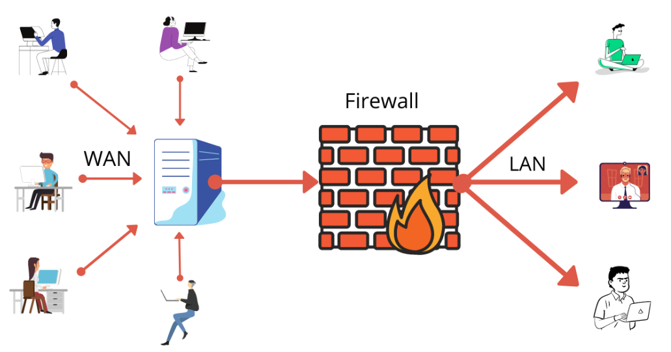
4.1 firewall : -
A firewall is an integrated collection of security measures designed to prevent unauthorized access to computer system.
A network firewall is similar to firewalls in building construction, because in both cases they are intended to isolate one 'network’ or 'compartment' from another.
The firewall is inserted between the premises network and the internet.
Aims : -
- Establish a controlled link.
- Protect the premises network from Internet-based attacks.
- Provide a single choke point.

Slide 3
Need of firewall : -
1. Access Control : - Fire wall filters incoming and outgoing packets.
2. Address/Port translation : - National Address translation (NAT) can establish a connection with external machines on Internet. This is often done by firewalls.
3. Logging : - The firewall can log all anomalous packets which are useful for analyzing intrusion, worms, DDoS attacks.
4. Authentication : - Firewalls perform authentication of external machiens attempting to establish connection with machine.
Types of firewall : -
1) Packet filters.
2) Stateful Packet Filters.
3) Application Gateways.
4) Circuit Gateways.

Slide 4
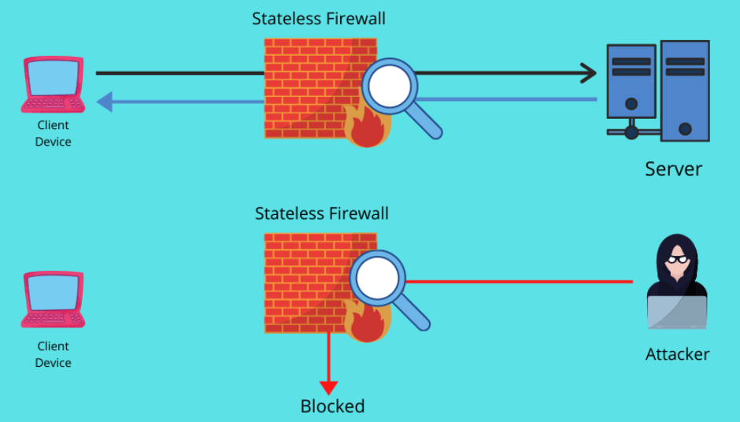
1. Packet filters (stateless) : -
A Packet-filtering firewall operates at Network Layer & sometimes at Transport Layer of the OS Model.
It's function is to control data flow into & out of a network by inspecting individual data packets.
Packet filtering firewalls are typically stateless i.e. they treat each packet individually & independently to others.
They do not keep track of the state of a connection, or considering packets that are previously processed.
This is one of the main limitations of Packet filters.
stateless firewalls may have to be fairly restrictive in order to prevent most attacks.

Slide 5
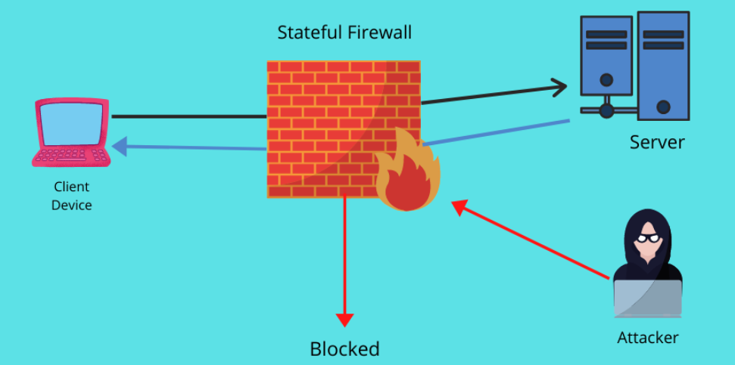
2. Stateful Packet filters : -
A stateful Firewall is an advanced type of firewall that provides better security as compared to stateless packet filters.
It operates by not only inspecting individual packets but also tracking the state of network connections.
This tracking enables the fire wall to make more informed decisions about whether to allow or block traffic based on both context of communication and contents of packet.
The firewall monitors & builds a state table which maintains information about :
- Source and Destination addresses /ports Protocols (TCP, UDP).
- Connection states (active, closing, established).

Slide 6
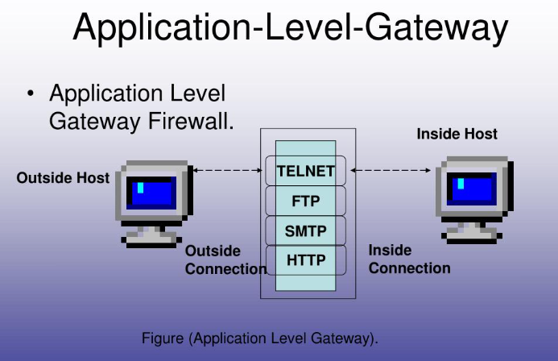
3. Application-level gateways : -
Application Proxy firewall operates at the application layer of the OSI model.
Unlike lower-layer firewalls which inspects only the headers of data packets, an application level gateway inspects the entire data content of the traffic.
Application-Level Gateways act as intermediaries or proxies between the internal network and external networks.
They filter traffic based on application - specific protocols like HTTP, FTP, DNS, and more.
Ex. Block user access to know worm websites.

Slide 7
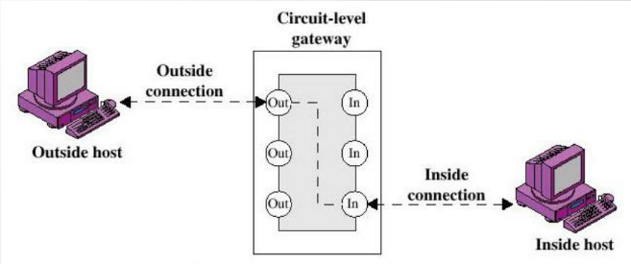
4. circuit-level gateways : -
Circuit - Level Gateways is a type of firewall that operates at the session layer of the OSI Model.
It’s primary function is to monitor & control the TCD and UDP connections (or circuits) between internal & external host.
A circuit - level gateway focuses on establishing secure connections & ensuring that only legitimate session are allowed through the firewall.
This firewall does not care about the actual data content or application protocols being used only about the integrity and validity of the session.
Ex. SOCKS package.

Slide 8
4.2 firewall policies : -
To protect private networks and individual machines from the dangers of the greater Internet, a firewall can be employed to filter incoming or outgoing traffic based on a predefined set of rules called Firewall policies.
Packets Flowing through a firewall can have one of three outcomes :
- Accepted : - Permitted through the firewall.
- Dropped : - not allowed through, with no indication of failure
- Rejected : - not allowed through, accompanied by an attempt to inform the source that the packet was rejected.
Policies used by the Firewall to handle packets are based on several properties of the packets being inspected, including the protocols used.
Two fundamental approaches to creating Firewall policies: Blacklist approach (default-allow) and whitelist approach (default-deny).

Slide 9
Firewall configuration : -
Firewall configuration are of three types : -
1) Screened host, single homed bastion host.
2) screened host, dual homed bastion host.
3) screened subnet.

Slide 10
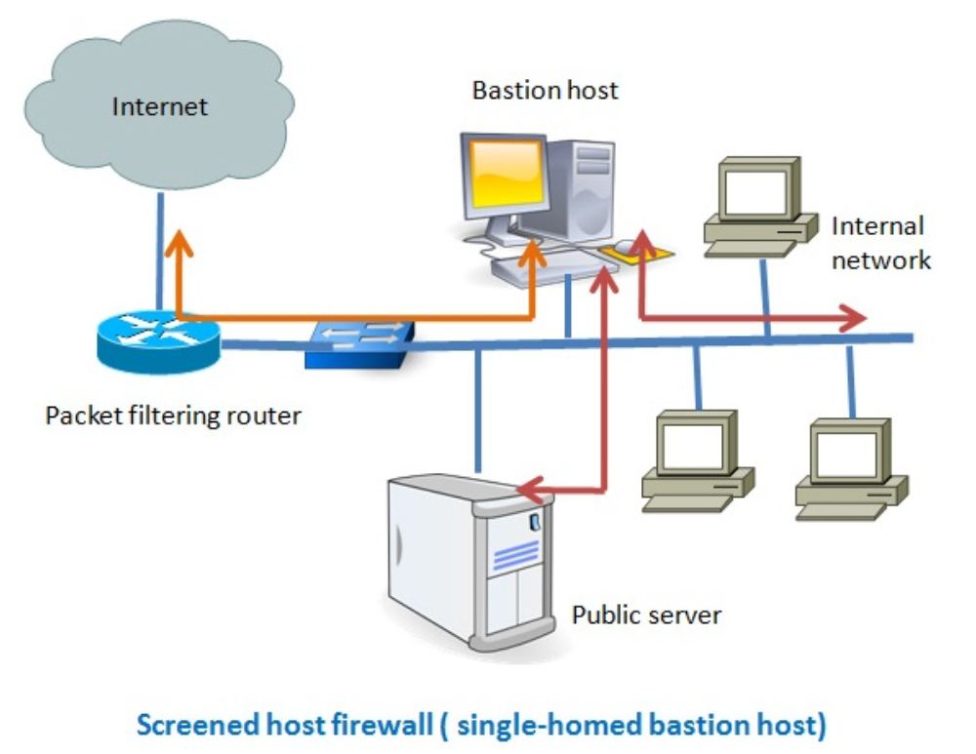
1. Screened host, single homed bastion host : -
In this system, firewall consists of two system –
1. A packet filtering router and a bastion host.
2. The bastion host performs authentication and proxy functions. This configuration affords flexibility in providing direct internet access.

Slide 11
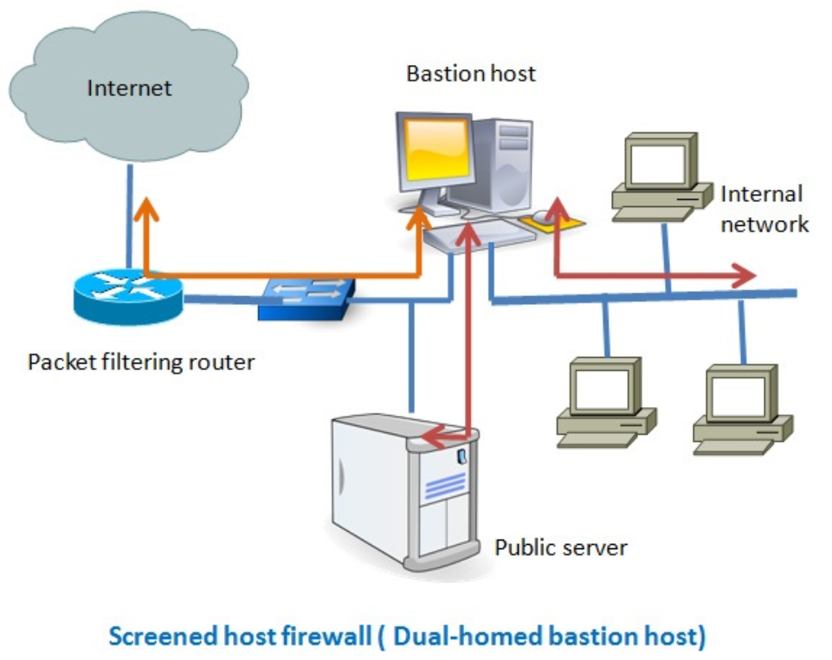
2. Screened host, dual homed bastion host : -
This configuration prevents a security breach.
The advantage of dual layers of security that were present in the previous configuration are present as well.
An information server or other hosts can be allowed direct communication with the router if this is in accord with the security policy.

Slide 12
3. Screened subnet : -
This configuration creates an isolated subnetwork which may consists of simply the bastion host but include one or more information servers and modems.

Slide 13
Firewall limitations : -
1. Firewall do not protect against inside threats.
2. Packet filter firewall does not provide any content based filtering.
3. Protocol tunneling i.e. sending data from one protocol to another protocol which negates the purpose of firewall.
4. Encrypted traffic cannot be examine and filter.
5. Heavy traffic or complex rules can lead to reduce the network performance.
6. Firewalls rely on predefined rules, which may not adapt to evolving threats in real-time.

Slide 14
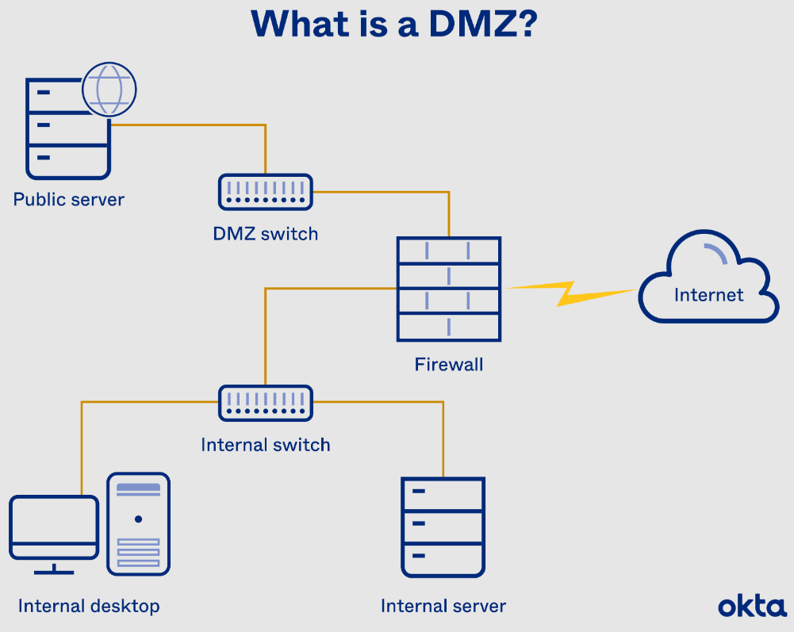
Dmz (demilitarized zone) : -
DMZ is a type of firewall Location which acts as a buffer zone between an organization's internal network and untrusted external network (internet).
The DMZ typically has at least two Firewalls : -
1. External firewall : - This seperates the DMZ from external network, controlling incoming traffic and preventing unauthorized access to the internal network.
2. Internal firewall : - This seperates the DMZ from internal network, restricting access to internal resources.
The DMZ Usually hosts services that need to be accessible from the internet: Web servers, Mail servers, FTP Servers, Proxy servers.
By placing servers in a DMZ, an organization adds an extra layer of security.

Slide 15
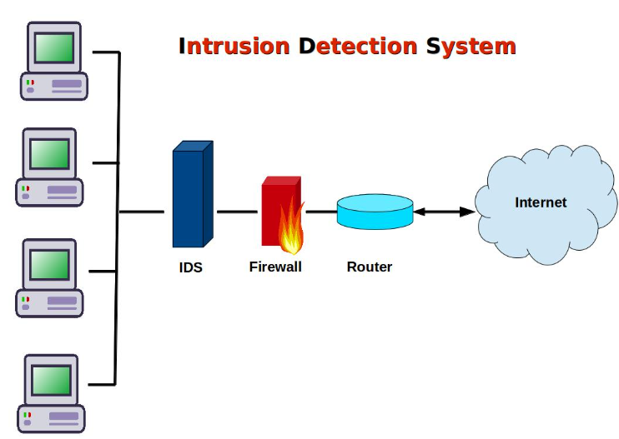
Intrusion detection system : -
Intrusion is the act of gaining unauthorized access to a o system so as to cause loss.
Intrusion Detection is the act of detecting unwanted traffic on a network or a device.
Intrusion Detection systems (IDS) attempt to identify attacks by comparing collected data to predefined signatures known to be malicious or to be a model of legal behaviour.
IDs are software or hardware systems that automate the process of monitoring the events occurring in a computer system or network.

Slide 16
Functions of ids : -
1. Monitoring and analysis of user and system activity.
2. Auditing of system configurations and vulnerabilities.
3. Assessing the integrity of critical system and data Files.
4. Recognition of activity patterns reflecting known attacks.
5. Statistical analysis for abnormal activity patterns.

Slide 17
4.3 vulnerability assessment : -
Vulnerability Assessment is a systematic review of security weaknesses in an information system.
It involves identifying security holes in software, hardware and networks or processes that could be exploited by attackers.
Tools like vulnerability scanners (eg. Nessus, OpenVAS) are used to scan systems for known vulnerabilities.

Slide 18
Misuse detection : -
Misuse Detection refers to identifying attacks by comparing observed behaviours against a predefined set of known patterns.
It rely on a database of signatures or patterns that describe known malicious activities.
The system monitors network traffic, system logs or user activities and compares them to these known signatures.
It is highly effective at identifying previously documented threats because it directly looks for pattern that have been identified and documented as malicious.

Slide 19
Anomaly detection : -
Anomaly Detection refers to identifying unusual patterns or behaviours that deviate from the norm.
It is widely used in cybersecurity, fraud detection and system monitoring.
It models normal behaviour in a system and identifies deviations from this behavious as potential anomalies.
Unlike misuse detection, anomaly detection can identify. previously unknown threats (zero-day attacks) as it does not rely on predefined signatures.

Slide 20
Honey pots : -
A Honeypot is a cybersecurity mechanism designed to Ture attackers and detect, study or divert malicious activities.
It is a "decoy" system that mimics real system, network or application, intended to appear vulnerable or valuable to attackers.
By observing the actions of attackers, honeypots help security proffessionals collect information about attack methods, tools and tactics used by cybercriminals.
Since legitimate users have no reason to interact with a honeypot, any traffic is likely to be malicious or suspicious, helping filter out potential threats.

Slide 21
Network-based nids : -
A Network-Based Intrusion Detection System (NIDS) is a security mechanism that monitors and analyzes network traffic to detect malicious activities, policy violations, or unauthorized access attempts.
Functions of NIDS : -
1. Monitoring network traffic in real-time.
2. Detecting and reporting suspicious or malicious activities.
3. Logging events for further analysis.
4. Providing alerts for network security incidents.
5. Assisting in forensic investigations after an attack.
Advantages : -
1. Monitors large amounts of network traffic efficiently.
2. Detects attacks targeting multiple hosts.
Disadvantages : -
1. Can produce false positives or false negatives.
2. Difficult to monitor switched or segmented networks.

