Slide 1
05. Network security cyber laws & compliance standard

Slide 2
5.1] Kerberos : -
Kerberos is an authentication protocol. It provides a authenticate clients to services to each other through a trusted third party.
Kerberos makes the assumption that the connection between a client and service is insecure.
Passwords are encrypted to prevent others from reading them.
Clients only have to authenticate once during a pre-defined lifetime.

Slide 3
Working of Kerberos : -
1. The AS receives the request by the client & verifies that the client is inded the computer it claims to be .
2. Upon verification, a timestamp is created. This puts the current time in a user session, along with an expiration date. The default expiration date is 8 hours.
3. The encryption key is then created. The timestamp ensures that when 8 hours are up, the key is useless.
4. The key is sent back to the client in the form of TGT. It is used for authentication of the client for future reference.
5. The client submits the TGT to the TGS to get authenticated.
6. The TGS creates an encrypted key with a timestamp and grants the client a service ticket.
7. The client decrypts the ticket, tells the TGS it has done so, and then its own encrypted keys to the service.
8. The service decrypts the keys and makes sure the timestamp is still valid. If it is the service contacts the key distribution center to receive a session that is returned to the client.
9. The client decrypts the ticket. If the keys are still valid, communication is initiated between client & server.

Slide 4
Kerberos terminology : -
Authentication Server (AS) : - A server that issues tickets for a desired service which are in turn given to users for access to the service.
TGS (Ticket-Granting Service) : - Issuess service tickets based on the TGT (Ticket-Granting - Ticket). TGs runs on the same host as the KDC (Key Destribution Center).
SS (Security Service) : - It covers the key concepts & components related to securing authentication within kerberos.

Slide 5
5.2] ip security : -
IP Security (IPSec) is the capability that can be added to present versions of Internet Protocol (IPv4 and IPV6) by means of additional headers for secure communication across LAN, WAN and Internet.
IPSec is a set of protocols that provide confidentiality, authentication, integrity and replay detection at IP layer.
The device (fire wall or gateway) on which the IP Sec mechanism resides is called as security gateway.

Slide 6
Ipsec uses two protocols for message security : -
1. Authentication Header (AH) Protocol.
2. Encapsulating Security Payload (ESP) Protocol.
1. Authentication Header (AH) Protocol : -
i) AH ensures that the data within the IP packet has not been altered during transit.
ii) It computes a cryptographic hash off the packet's content and sends this hash along with the packet.
2. ESP Protocol : -
i) ESP ensures that the payload of the IP packet is encrypted, protecting it from eavesdropping.
ii) Unlike AH Protocol, ESP can offer confidentiality through encryption, making it a more widely used protocol.

Slide 7
Ipsec has two modes of operation : -
1. Transport Mode.
2. Tunnel Mode.
1. Transport Mode : -
Transport mode mainly provide protection for upper layer protocols. The protection extends to the payload of IP packet.
The Transport mode is suitable for end-to-end communication between two work stations.
In this mode, ESP encrypts the IP payload excluding IP header.
AH authenticates the IP payload which is optional.

Slide 8
2. Tunnel mode : -
The Tunnel mode provides protection to the entire JP packets.
Security fields are added to IP packets & entire packet (AH or ESP Packet + security Packet) is a new IP packet with new header entire new packet travels through a tunnel from one point to other over IP network.
No router over the network are able to detect inner IP header.

Slide 9
5.3] email security : -
Email security describes various techniques for keeping sensitive information in email communication & accounts secure against unauthorized access, loss or compromise.
Email remains a key productivity tool for today's organizations, as well as a successful attack vector for cyber criminals.

Slide 10
1. Smtp : -
SMTP stands for simple Mail Transfer Protocol.
SMTP is a set of communication guidelines that allow Software to transmit an electronic mail over the internet.
It is a request-response based activity for sending messages to other computer users based on email addresses.
SMTP provides email exchange process along with : -
- It can send a single message to one or more receipents."
- Sending message can include text, voice, video or graphics.
- It can also send messages on network outside the internet.
SMTP attempts to provide reliable service but not guarantees- to sure recovery from failure.
SMTP server breaks into two components: User agent (UA) and Mail Transfer Agent (MTA)."!
- UA : - Prepares the message, creates the envelop and then puts the message in the envelope.
- MTA : - Transfers the mail across the internet.

Slide 11
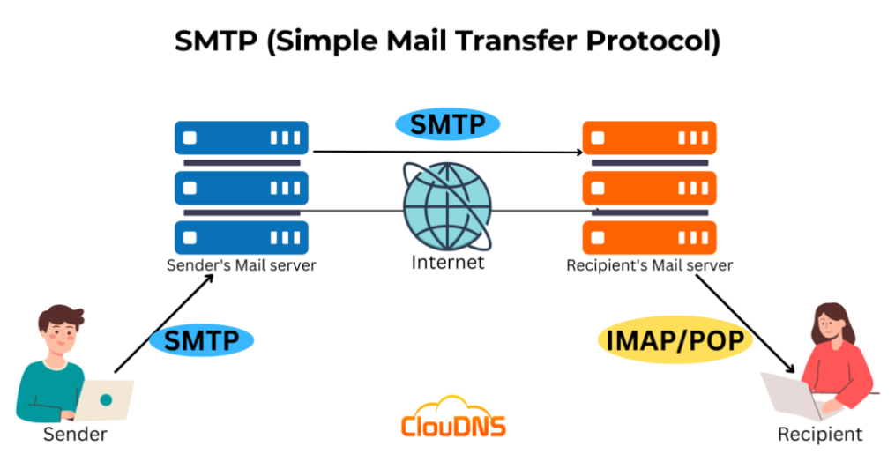
Working on SMTP : -
Composition of mail.
Submission of mail.
Delivery of mail.
Receipt & processing of mail.
Access & retrieval of mail.

Slide 12
2. Pem : -
PEM stands for Privacy Enhanced Mail.
Primary goal of PEM is to add security services for email users in the internet community.
It consists of extension to existing message processing software, plus a key management infrastructured bar to developed by IETF, to add encryption, source authentication and integrity protection to email.
Allows both public & secret long-terms keys and message key Is always symmetric.
It also specifles a detailed certification hierarchy.
Working of PEM : -
1. Canonical Conversion.
2. Digital Signature.
3. Encryption.
4. Base-64 Encoding.

Slide 13
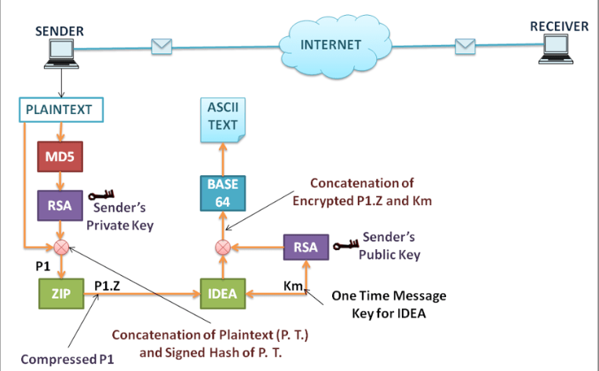
3. Pgp : -
PGP stands for Pretty Good Privacy.
PGP was designed to provide all four aspects of security i.e., Privacy, Integrity, authentication & non-repudiation in the sending of email.
PGP uses the concept of Digital signature (combination Of hasing and public key encryption) to provide integrity, authentication & non-repudiation.
PGP uses a combination of secret key encryption and public key encryption to provide privacy.
Thus, we can say, The Digital signature uses one hash function, one secret Key and two private-public key pairs.
PGP is an open source of freely available software package for email security.
It provides confidentality through the use of symmetric block encryption.

Slide 14
5.4] public key infrastructure : -
PKI is a well-known technology that can be used to establish identities, encrypt information and digitally sign documents.
PKI identifies and manages relationships of parties in an Exchange, serving a wide array of security needs.
PKI uses unique Digital certificates (DC) to secure ecommerce, email, data exchange and VPN & also to verify identity and privileges of each user.
The Certificate Authority (CA) provides a full life-cycle management of public keys and certificates.

Slide 15
Certificate : -
Certificates are digital documents that are used for secure authentication of communicating parties.
A certificate binds identity information about an entity to the entity's public key for a certain validity period.
A certificate is digitally signed by a Trusted Third Party (TTP) who verifies that the key pair actually belongs to the entity.
Certificates can be thought of as analogous to pass ports that guarantee the identity of their bearers.

Slide 16
Certification authority : -
The trusted third party who issues certificates to the identified- end entities is called a Certification Authority (CA).
A CA can be managed by an external certification service provider or it can belong to the same organization as the end entities.
CAs can also issue certificates to other (sub) CAS. This leads to a tree-like certification hierarchy
The highest trusted CA in the tree is called a root CA.

Slide 17
Registration authority : -
The Registration Authority (RA) is entity responsible split for validating and verifying the identity of individuals or organizations before they are issued a digital certificate.
The RA acts as an intermediary between the applicant and the CA.
RA ensures that the person or organization requesting in the certificate is who they claim to be.
Based on verification, the RA either approves or denies the request for a digital certificate.
Once verified, RA forwards the approved certificate request to the CA for the actual issuance of the Certificate.

Slide 18
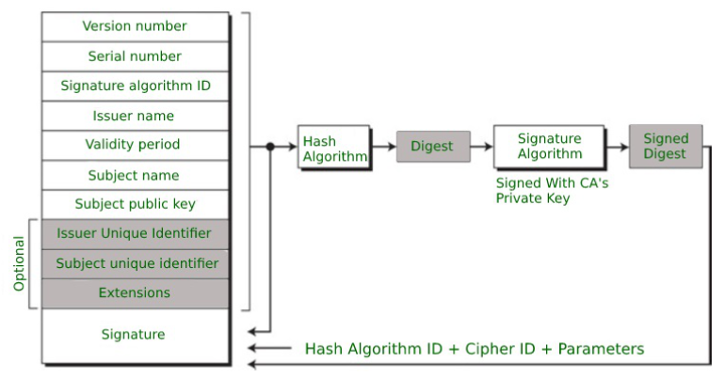
X.509/pkix certificate format : -
X.509 is a set of servers which maintains a database information about users and other attributes.
X.509 defines authentication services, certificate structure, alternative authentication protocols base on use of public key certificates.
The current version of the standard is version 3, known as X.509V3.

Slide 19
The certificate includes the elements given below : -
Version number : - It defines the X.509 version that concerns the certificate.
Serial number : - It is the unique number that the certified authority issues.
Signature Algorithm Identifier : - This is the algorithm that is used for signing the certificate.
Issuer name : - Tells about the X.509 name of the certified authority which signed and created the certificate.
Period of Validity : - It defines the period for which the certificate is valid.
Subject Name : - Tells about the name of the user to whom this certificate has been issued.
Subject’s public key information : - It defines the subject’s public key along with an identifier of the algorithm for which this key is supposed to be used.
Extension block : - This field contains additional standard information.
Signature : - This field contains the hash code of all other fields which is encrypted by the certified authority private key.

Slide 20
5.5] cyber crime : -
A crime committed using a computer and internet to access. personal information, steal a person's identity, sell illegal goods, or dishub any operations with malicious program is known as "Cyber Crime" for it.
Cyber Crime may also be refferred to as computer crime or any illegal activity done through the internet.
A cybercriminal is an individual who commits cybercrimes, where he/she makes use of computer either as a tool or target or both.
Cybercrime requires no physical contact with victims.
They can be located any where in the world, this reduces the chances of being caught.

Slide 21
Cyber crime involves such activities like : -
Child Pornography.
Credit Card fault fraud.
Cyberstalking.
Cyber Defamation.
Software Privacy.
Gaining unauthorized access to a system.
Overriding encryption to make illegal copies.
stealing another's identity to perform criminal act.
Copyright infringing software fake antivirus.
Hacking digital for gery.
Welfare fraud.
Spamming.

Slide 22
Types of cyber crimes : -
1. Hacking : - This is a type of crime where in a person's computer is broken into so that his personal or sensitive Top information can be accessed.
2. Digital Forgery : - It refers to the manipulation of digital content such as images, videos, audios, documents to deceive or mislead.
3. Theft : - This crime occures when a person violates copyrights and download music, movies, games and software.
4. Cyberstalking : - This is a kind of online harassment wherein the victim is subjected to a barrage of online messages and emails.

Slide 23
5. Identity Theft : - In this cyber crime, a criminal accesses (point of data about a person's bank account, credit cards, debit cards and other sensitive information to siphon money or to buy things online in the victim's name.
6. Malicious software : - These are internet-based software that are used to disrupt a network, to gain access to a system, to steal sensitive data or cause damage to software present in the system.
7. Child Abuse : - In this, criminals solicit minors via chat rooms for the purpose of child pornography. The people who are sexually attracted to children are called "Pedophile" who force minors to engage in sexual activities.

Slide 24
Types of cyber criminals : -
1. Hungry for Recognition : -
Hobby Hackers.
IT Professionals.
Politically motivated Hackens.
Terrorist organizations.
2. Not interested in Recognition : -
Psychological spoiled.
Financially motivated Hackers
State-sponsored hacking
Organized Criminals.
3. The Insiders : -
Disgruntled or former employees seeking revenge.
Competing companies using employees to gain economic advantage through damage/theft.

Slide 25
5.6] cyber terrorism : -
Cyberterrorism is the premeditated, politically motivated attack against information, computer systems, computer programs and data which results in violence against non-combatant targets by sub national groups.
Cyberterrorism is "any person, group or organization who with terrorist intent, utilizes, accesses or aids in accessing a computer, network, electronic system or device by any available means and thereby knowingly engages in a terrorist act.
Types of cyber terrorism : -
1. State-sponsored group.
2. Hactivist group.
3. Independent actors.
4. Small Groups.

Slide 26
Cyber laws : -
Cyber Law is a law governing cyber space.
Low encompasses the rules of conduct :
That have been approved by the government.
Which are in force over a certain territory.
Which must be obeyed by all persons on that territory.
Violatation of these rules could lead to government action such as imprisonment or fine or an order to pay compensation.
Cyber law encompasses laws relating to :
Cyber crimes.
Electronic & Digital signature.
Intellectual Property.
Data Protection and Privacy.

Slide 27
Cyber delhi jon cyber laws : -
Cyber laws in Delhi are governed by the national frame- work under the "Information Technology (IT) Act, 2000".
This law provides legal recognition to electronic documents, transactions and issues related to cybercrimes.
The IT Act is the primary law dealing with cybercrimes and e-commerce in India.
Amendments to the IT Act in 2008 expanded its scope to include more cybercrimes like cyberterrorism, identity theft and child pornography.

Slide 28
Need of cyber law : -
1. Cyberspace is an intagible dimension that is impossible to govern and regulate using conventional law.
2. cyberspace has complete disrespect for judis dictional boundaries.
3. Cyberspace is absolutely open to participation by all old minors.
4. Cyberspace offers enormous potential for anonymity to its age to members.

