Slide 1
05. Defect management

Slide 2
Introduction : -
A Defect : - Defect is the difference between expected result and actual result, due to which software starts to show abnormal behaviours during its use. So it is one of the most important responsibilities of the tester to find as much as defects possible to ensure the quality of the product is not affected.
Defect Management : - Defect Management encompasses the entire lifecycle of identifying, documenting, prioritizing, fixing and verifying defects in software. It involves a systematic approach to managing issues from discovery to resolution, ensuring that the software meets the specified requirements and quality standard.

Slide 3
Defect classification : -
1. Arithmetic Defects : - It includes the defects made by the developer in some arithmetic expression or mistake in finding solution such as arithmetic expression.
2. Logical Defects : - When the programmer doesn't understand the problem clearly and mistakes are done regarding the implementation of the code, logical defects happen.
3. Syntax Defects : - syntax defects means mistakes in the writing style of the code.
4. Multithreading Defects : - Multithreading means executing multiple tasks at the same time, hence there is possibility of complex debugging.
5. Interface Defects : - The defects in the interaction of the software and the users.
6. Performance Defects : - When the software application is unable to meet the desired & expected result, Performance defect.
7. Data Validation Defects : - It involves failing to validate user inputs leading to potential seunity vulnerabilities.
8. Deployment Defects : - It includes setup mistakes, Installation issues and problems that stops the software from functioning properly in real world.
9. Integration Defects : - When different software: modules or components do not function well together, integration errors result.
10. Documentation Defects : - These refer to errors or issue in the accompanying documentation, Including user manuals, help Files or API documentation.

Slide 4
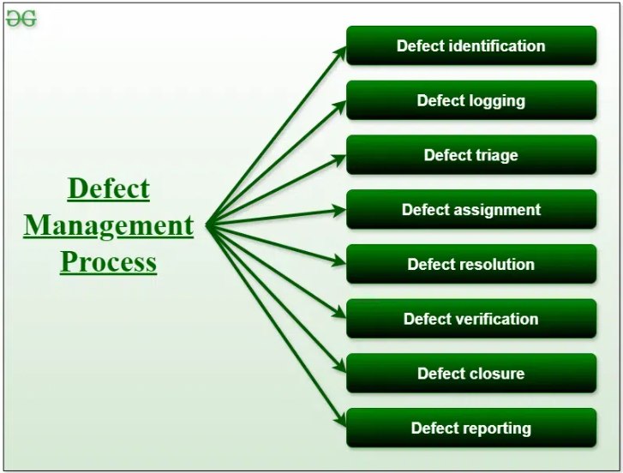
Defect management process : -
The defect management process is a systematic approach to identify, track & resolve defects in software development.

Slide 5
1. Defect Identification : - Defects are identified through various testing activities, such as unit testing, integration testing, and user acceptance testing.
2. Defect logging : - Defects are logged in a defect hacking system, along with details such as description, severity and priority.
3. Defect triage : - The triage process involves evaluating the defects to determine their priority and the resources required to resolve them...
4. Defect assignment : - Defects are assigned to developers or testers for resolution, based on their expertise & availability.
5. Defect resolution : - The assigned personal work on resolving the defects by Fixing the code, updating the documentation or perform other necessary actions...
6. Defect Verification : - Once the defect is resolved, it is verified by the tester to ensure that it has been fixed correctly and does not introduce any new defects.
7. Defect closure : - Once the defect has been verified, it is closed and the status is updated in the defect tracking system.
8. Defect Reporting : - Regulate reports on the status of defects, including the no. of open defects, the no. of defects resolved, and the average time to resolve defects, are generated to provide visibility into the Defect Management Process.

Slide 6
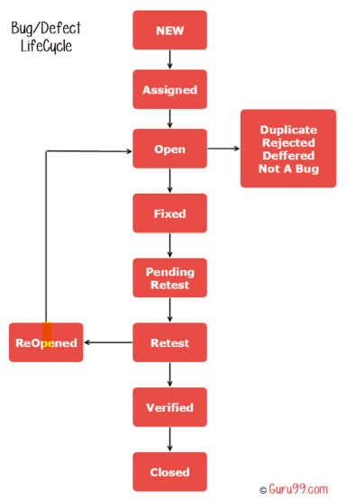
Defect life cycle : -
The Defect Life Cycle is the life cycle of a defect or it goes through covering a specific set of states in its early life.
Mainly bug life cycle refers to its entire state starting from a new defect detected to the closing off to that defect by the tester.
Alternatively, it is also called a Bug Life Cycle will booted Defect status is the current state from which the defect is currently going through. The given diagram illustrates all the possible states of the defect :

Slide 7
1. New : - when any new defect is Identified by the tester, it falls. in the 'new' state. The testere provides a proper Defect document to the development team so that they can fix the defect accordingly.
2. Assigned : - Defects in the New state are approved and is assigned to the developer team, the status of bug changes to 'Assigned“ state.
3. Open :- In this state the defect is being addressed by the developer team and the team works on the defect for fixing the bug. Based on some specific reason, if the developer team feels that the defect is not appropriate then it is transferred to either the 'Rejected' or 'Deferred' state.
4. Fixed : - After necessary changes of codes or after fixing identified bug developey team marks the state as 'fixed'.

Slide 8
5. Pending Request : - During the fixing of the defect is done, the Inteam passes the new code to the testing leam for retesting. And the code is pending for relesting on the Testing side so the status is assigned as 'Pending Request!
6. Retest : - The testen stayts work of retesting the defect to check whether the defect is fixed or not, and status is marked as 'Retesting!
7. Reopen : - After Retesting' if the team found that the bug continues even after it has fixed, then the status of the bug is again changed to 'Reopened'. Once again bug goes to the 'open' state and goes through the life cycle again. This means it goes for Re-fixing by the developer team.
8. IF Verified : - If the tester does not find any kind of defect then the status is assigned is 'verified.
9. Closed : - It is final state of the Defect life cycle, after fixing the defect, when testing found that the bug has been resolved and it does not persist then they mark the defect as a ‘closed’ state.

Slide 9
Defect template : -
A defect template is a structural format used to log, track and manage software defects during testing phase.
A typical defect template contains the information in an xls sheet as follow :

Slide 10
Defect ID: A unique serial number of defects in report :
Description: Detailed and clear description of the defect.
Action Steps: What the QA did in an application that results in the defect, step by step actions.
Expected Result: What results are expected as per the requirements when performing the action steps mentioned.
Actual Result: what results are adually showing up when performing the action steps.
Severity: The impact of the defect on the system: Critical, Major, Medium, Lower.
Priority: How urgently the defect needs to be addressed: Urgent, High, Medium, Low.
Assigned to: The name of the developer or team who is responsible for fixing the defect.
Reported by: The name of the tester who discovered the defect. status: The current state of the defect
Dale logged: The dale on which the defect was reported.
Due date: The date Hill which the defect should be fixed.
Environment-The environment in which the defect was Found ( eg. browser version, os, test environment )
Atachments-Any relevant Files like screen shots, logs or videos that provide further context for the defect.
Additional Information - Additional notes or discussions related to the defect.
Defect ID: A unique serial number of defects in report :
Description: Detailed and clear description of the defect.
Action Steps: What the QA did in an application that results in the defect, step by step actions.
Expected Result: What results are expected as per the requirements when performing the action steps mentioned.
Actual Result: what results are adually showing up when performing the action steps.
Severity: The impact of the defect on the system: Critical, Major, Medium, Lower.
Priority: How urgently the defect needs to be addressed: Urgent, High, Medium, Low.
Assigned to: The name of the developer or team who is responsible for fixing the defect.
Reported by: The name of the tester who discovered the defect.
status: The current state of the defect
Dale logged: The dale on which the defect was reported.
Due date: The date Hill which the defect should be fixed.
Environment-The environment in which the defect was Found ( eg. browser version, os, test environment )
Atachments-Any relevant Files like screen shots, logs or videos that provide further context for the defect.
Additional Information - Additional notes or discussions related to the defect.
Figure : Defect report template

Slide 11
Estimate expected impact of a defect : -
Defected Impact - The degree of severity that a defect has on the development or operation of a component or system.
How to estimate the defect impact ?
1. Once the critical risks are identified, the financial impact of each risk should be estimated.
2. This can be done by assessing the impact, in dollars, if the risk does become a problem combined with the probability that the risk will become a problem.
3. The product of thes two numbers is the expected impact of risk/defect.
4. The expected impact of a risk (E) is calculated as : E=P*I where, P = probability of risk becoming a problem and I= Impact in dollars if the risk becomes a problem.
For Example : -
- An organization with a project of 2500 Function points was about medium at defect discovery & removal would have 1650 defects remaining, after all defect 4 discovery activities.
- The calculation is 2500 x 1.2 = 3000 potential defects. Cotton cntest Inglikha The organization would be able to remove about 45% of
defects i.e. 1350 defects.
- The total potential defects (3000) less the removed defects (1350) equals the remaining defects of 1650, i.e. = 30001350 1650.

Slide 12
Techniques for finding defects : -
Defects are found either by preplanned activities specifically intended to uncover defects (e.g. quality control activities such as inspection, testing, etc) or by accident (e.g. users in production).
Techniques to find defects can be divided into three categories:
1. Static Techniques : - Testing that is done without physically executing a program or system. A code review is an example of a static testing technique.
2. Dynamic Techniques : - Testing in which system components are physically executed to identify defects Execution of test cases is an example of a dynamic testing technique.
3. Operational Techniques : - An operational system produces a deliverable containing a defect found by users, customers, or control personnel i.e. the defect is found as a result of a failure.

Slide 13
Reporting the defects : -
1. Be specific : -
Specify the exact action : Do not say something like ‘Select Button B’. Do you mean ‘Click Button B’ or ‘Press ALT+B’ or ‘Focus on Button and Enter’? Ofcourse, if the defect can be arrived at by using all three ways, its okay to use a genetic term as ‘Select’ but bear in mind that you might just get the fix for the ‘Click Button B’ scenario.
In case of multiple paths, mention the exact path you followed do not say something like “If you do ‘A and X’ or ‘B and Y’ or ‘C or Z’, you get D”. You can ofcourse, mention else where in the report that D can also be got if you do ‘B and Y’ and ‘C and Z’.
Do not use vague pronouncs : Do not say something like “ In Application A, open X,Y & Z and then close it.” What does ‘it’ stand for? ‘Z’ or ‘Y’ or ‘X’ or ‘Application A’?
2. Be detailed : - Provide more information. In other words, do not be lazy. Developers may or may not use all the information you provide, but they sure do not want to beg you for any information you.
have missed.
3. Be objective : -
i) Do not make subjective statements Like "This is a application" or " You fixed it real bad"
ii) stick to the facts and avoid the emotions.
4. Reproduce the defect : - Do not be impatient and file a defect report as soon as you. uncover a defect. Replicate it at least once more to be sure...
5. Rewiew the report : - Do not hit 'submit' as soon as you write the report. Review it at least once. Remove any typos..

Slide 14
Defect report
Defect ID: 1234
Description: Login Button not responding Action steps: 1. Open the login page....
Expected Result: Button redirects to dashboard Actual Result: Button does noting
Severity: Major
Priority: High
Assigned to: Developer 1.
Reported by: Tester 1 status: New
Dale Logged: 2024-10-21
Due Date: 2024-10-24
Environment: Windows 10, Chrome 85
Attachments: Screenshots attached
Additional Information: Awaiting more information from tester.

