Slide 1
02. Types of testing

Slide 2
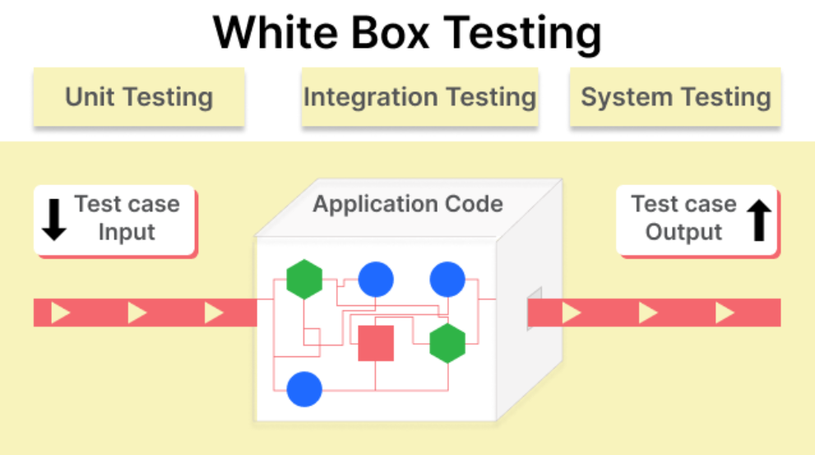
White box testing : -
White box testing is a software testing technique that involves testing the internal structure & working of a software application.
2.In white box testing the internal structure, design & coding of software are tested to verify flow of input – output.
3.It is mainly performed by the developers or white box testers who has knowledge on the programming.
4.In white box testing, code is visible to testers, so it is also called as clear box testing, open box testing, transperant box testing, code-based tesing, glass box testing or structural testing.

Slide 3
Features of white box testing : -
Find bugs early, even which are hard to find with black box techniques.
Provides good ideas to the black box testers.
Identifies the areas of the code that are not being tested.
Identifies logical errors in the code such as infinite loops or incorrect conditional statements.
Optimized code by finding performance issues, redundance code, etc…
It finds & removes any code that isn’t used when the program is running normally ( dead code ).

Slide 4
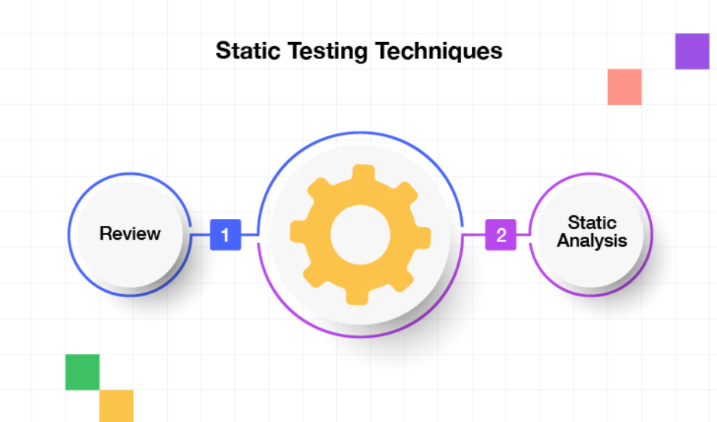
Static testing : -
Static testing is performed to check the defect in software without actually executing the code of the software application.
Static testing is done to avoid errors at an early stage of development as it is easier to identify & solve the errors.
It also helps finding errors that may not found by dynamic testing.
Static testing is also known as non-execution testing or verification testing.
In static testing includes : -
REVIEW :
STATIC ANALYSIS :

Slide 5
1. Inspection : -
Inspection is the most formal form of reviews, led by a trained moderator, who is not the auther of the meeting.
Inspection report is prepared & shared with the auther for appropriate actions.
Aim of inspection is NOT anly to identify defects, buts also to bring in for process improvement.

Slide 6
2. Technical review : -
Technical specifications are reviewed by peers in order to detect any errors.
It is led by trained maderator & not the author.
This review concentrates mainly on the technical documentation related to the software such as Test Strategy, Test Plan & Requirement specification documents..

Slide 7
3. structured walkthroughs : -
The author of whichever documents is being reviewed will explain the document to their team.
Participants will ask questions & any notes are written down.
The walkthrough can be formal & informal review.
Team member does not need to have detail knowledge of the content as the author is well prepare.
Main objective is to enable learning & giving knowledge to other team member about the content.
It is held by the authors.

Slide 8
Structural testing : -
Structure-based testing can be defined as a type of testing that tests the code’s structure & intended flows.
It includes verifying the actual code for aspects like the correct implementation of conditional statements, & whether every statements in the code is correctly executed.
This type of testing requires knowledge of code, so it is mostly done by the developers.
In Structural Testing includes :-
Code Functional Testing :
Code Coverage Testing :
Code Complexity Testing :

Slide 9
1. Code functional testing : -
In code Functional Testing the system is tested against the
Functional Requirements and specifications.
The purpose of functional testing is to test each function of the software application, by providing input, verifying the output against the functional requirements.
It focuses on simulation of actual system usage but does not develop any system structure assumptions.
It checks the User interface, APIs, Database, security, Client/server communication & other functionalities of the Application under test.
Functional test can be manual or automated.
Testers has to test only the program rather than the system.

Slide 10
Code coverage testing : -
Code coverage Testing is determining how much code is being tested. It can be calculated using formula-
Code coverage = No. of lines of code executed * 100. Total no. of lines in code
It measures the percentage of code executed by the test suit, helping developers identify untested parts of an application.
It helps in determining the performance and quality aspects of Lany software.
It also find parts of the code that are not reachable by any
test case.

Slide 11
Code complexity testing : -
Cyclomatic complexity is a testing metric used for measuring the complexity of a software program.
It defines the number of independent paths in a program, it can be calculated by using control flow graphs.
Independent Path is defined as a path that has at least one edge which has not been traversed before, in any other paths.
for example : if source code contains no control flow statement, then its cyclomatic complexity will be 1 as source code contains a single path in it. Similarly if the source code contains one if- condition they the cyclomatic complexity would be 2. Because there will be two paths one for true and other for false.

Slide 12
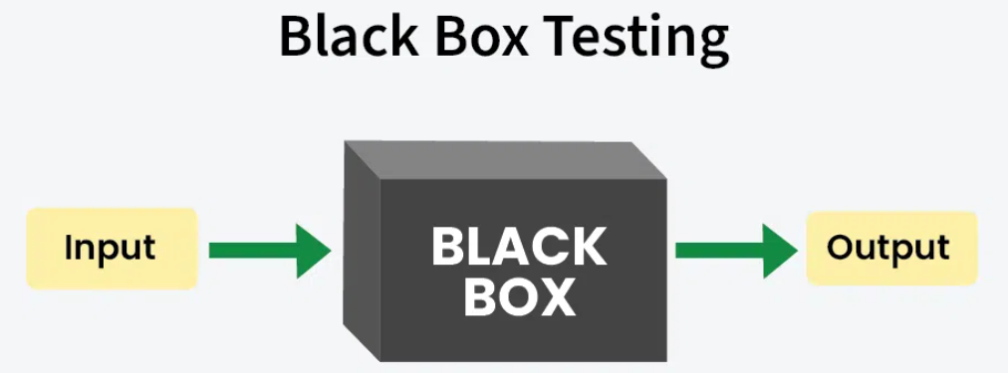
Black Box Testing : -
Black box testing is a method in which the functionalities software applications are tested without having knowledge of internal code structure.
Testers check how the software behaves from the outside, just like users would. This helps catch issues ay bugs in software.
It is also known as closed box testing, Behavioral testing it emphazies on the behaviour of the software and the code is not visible.
Black box testing check scenarios where the system can break.

Slide 13
Black box testing : -
1. Requirement Based Technique.
2. Positive and Negative Testing.
3. Boundary Value Analysis (BVA).
4. Decision Tables.
5. Equivalence Partitioning.
6. User Documentation Testing.

Slide 14
Requirement based testing : -
Requirement Based Testing is a testing approach in which test cases, conditions and data are derived from requirements.
It includes functional tests and also non-functional attributes. such as perforamance, reliability or usability.
This approach gaurantees that the software aligns with documented specifications.
RBT process is comprised of too phases: Ambiguity reviews. and cause-effect graphing.
⭑

Slide 15
Stages of requirement based testing : -
1. Defining test completion criteria : Testing is completed only when all the functional & non-functional testing is completed.
2. Design test case : Test case have five parameters namely the Initial state, data setup, inputs, expected outcomes and actual outcomes.
3. Execute Tests : Execute the test cases against the system under test and document the results.
4. Verify Test Results : Verify if the exepeded and adual results. match each other.
5. Verify Test Coverage : verify if the test cover both functional and non-functional aspects of the requirement.
6. Track and mange defects : Any defects detected during testing goes through the defect life cycle and are tracked to resolution. Defect statistics are maintained which will give us the overall status of the project.

Slide 16
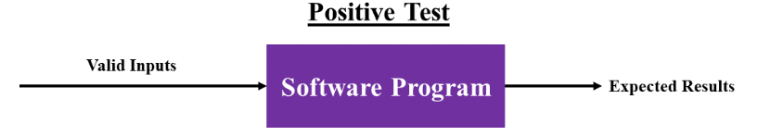
Positive testing : -
Positive Testing is a type of testing which is performed software application by providing the valid data sels ab input.
ii) It checks whether the application behaves as expected with positive inputs or not.
The main goal is to check whether the software application does what it is supposed to do.
For example : There is a text box in an application which can accept only numbers up to 99999, any other values apart from this should not be acceptable. To do positive testing, set the valid inputs from 0 to 99999 & check whether the system is accepting the values.

Slide 17
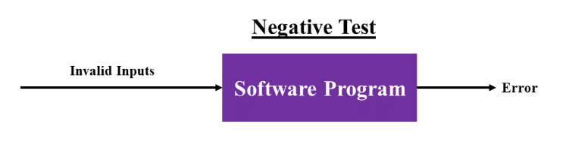
Negative testing : -
i) Negative testing is a testing method performed on the software application by providing invalid data sets as input.
ii) It checks whether the application behaves as expected with the negative user inputs or not...
iii) The purpose is to ensure that the software application does I not crash and remains stable with invalid data inputs.
iv) for example : Negative testing can be performed by entering characters A to Z or a to z Either software system should not accept the values or else it should throw an extor message for these invalid data inputs.

Slide 18
Boundary value analysis : -
BVA is a technique used to test boundary values i.e. those that contain the upper and lower limit of a variable.
It checks for the input values near the boundary that have a higher chance of error.
It is most suitable for the systems where an input is within certain ranges as it is very useful in reducing the no. of test cases.
While testing, the tester focuses on, while entering boundy value whether the software is producing correct output or not.
It is used at boundary values because the input values near the boundary have higher chances of error.
BUA is one of the widely used case design technique for Black Box testing
For Example - Assume that is a variable of a function, & its minimum value is 18 and maximum value is 56, Both 18 and 56 will be considered as boundary values. The tester pays attention to these two values, but this doesn't mean the middle values are ignored. Test cases are developed for each value • developed for each value of the range.

Slide 19
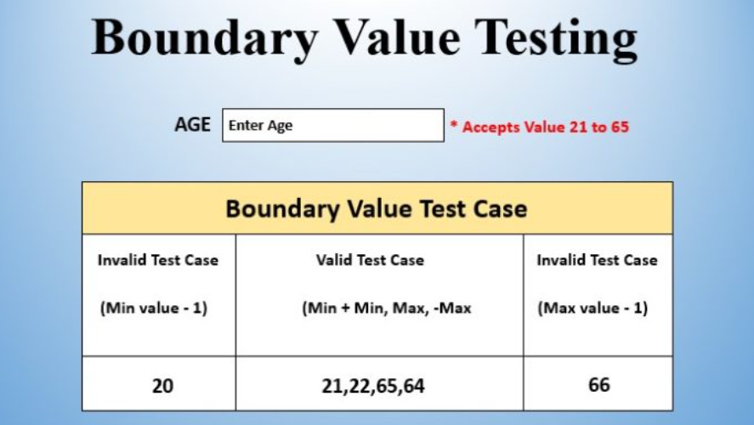
For Example - Assume that is a variable of a minimum value is 18 & maximum value is 56, Both 18 and 56 values. The tester pays attention to these two values, but this doesn't mean the middle values are developed for each value of the range.
Test Case 1 : Enter value 20 ( 21-1 ) = Invalid
Test Case 2 : Enter value 21 ( MIN ) = Valid
Test Case 3 : Enter value 22 ( 21+1 ) = Valid
Test Case 4 : Enter value 64 ( 65-1 ) = Valid
Test Case 5 : Enter value 65 ( MAX ) = Valid
Test Case 6: Enter value 66 ( 65+1 ) = Invalid

Slide 20
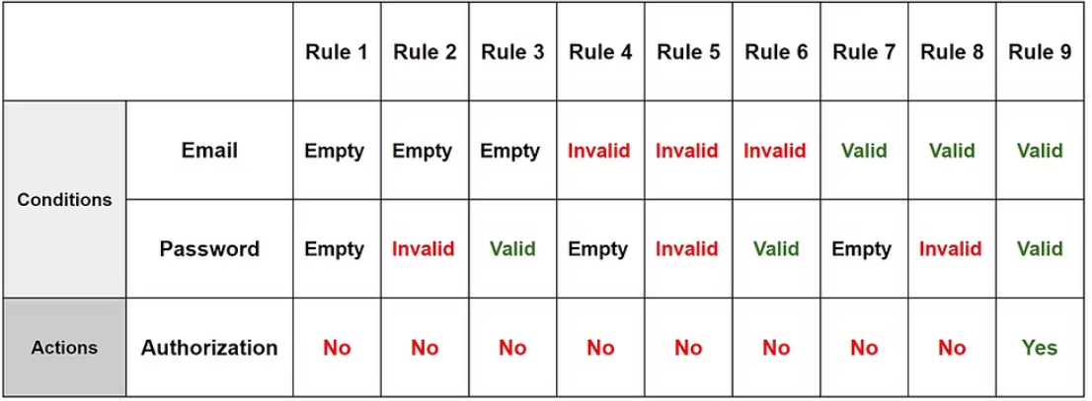
Decision table : -
Decision Tables is a systematic approach where the different. input combinations and their corresponding system behavious Coutput) are captured in a tabular form.
This test technique is appropriate for functionalities which has logical relationship between inputs (if-else logic).
In Decision Table technique, we deal with combinations of inputs. We take conditions as inputs f actions as outputs.
Complex situations rely on decision tables, as it offers the testers an organized view about the input combination and the expected output.
for Example : -
Most of us use an email account, if both email and password are correctly matched, user is directed to homepage. Totherwise it will come back to login page error message specified with Incorrect Email" or "Incorrect Password“. A decision table 'is' created for the login function.

Slide 21
Equivalence partitioning : -
Equivalence Partitioning is a software testing technique that divides the input data into partions of valid and invalid values If it is mandatory that all partitions must exibit the same behaviour.
This technique is also known as Equivalence Class Park Honing CECP).
In this technique, input values to the system are divided into different classes based on its similarity in the outcome. iv) Hence, instead of using every input value, we can now use any one value from the class to test the outcome.
In this way, we can maintain test coverage & reduce rework & time spent.

Slide 22
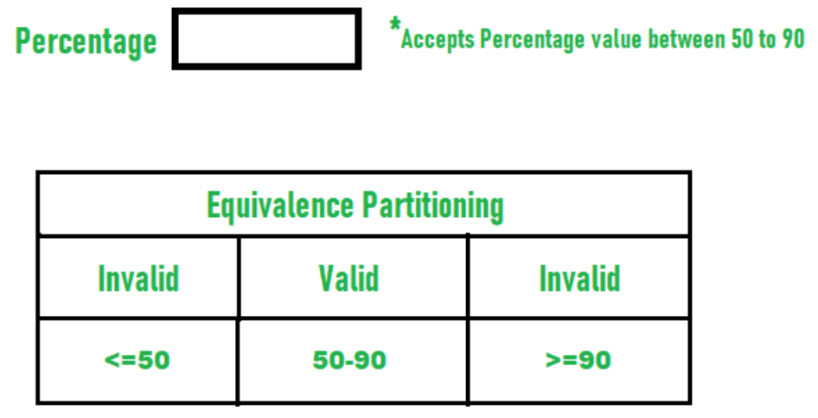
For Example : -
"AGE" only acepts numbers from 18 to 60. There will be three sets of classes.
- Two invalid classes will be: a) Less than or equal to 17. b) Greater than or equal to 61. one valid class will be between 18 to 60.
We thus have reduced the test cases to only 3 test cases. based on the formed classes.

Slide 23
User documentation testing : -
User Documentation Testing have two objectives :
1. To check if what is stated in the document is available in the Software
2. To check if what is there in the product is explained correctly
in the document.
This testing plays a vital role as the users will refer this document when they start using the software at their location.
User Documentation covers all the manuals, user guides, instalation guides, setup guides, read me files, software release notes, and online help.
Documentation for an organization saves time, cost and makes testing easy and systematic.

Slide 24
Essential software testing documents that are need to be maintained : -
1. Test Design Document.
2. Test Case Specification.
3. Test strategy.
4. Test summary reports.
5. Weekly status reports. 7. User Acceptance report.
8. Risk Management report.
9. Test log.
10. Test plan.
11. Bug reports.
12. Test dala.
13. Test analysis

Slide 25
Sample examples on white & black box testing : -
Example on while Box Testing : Imagine a function in code that calculates the factorial of a number.
Test Case :
Check if the function correctly handles the base case when n = 0
Verify the recursive calls by testing with values like n=3 or n = 5.
Test for potential infinite recursion by using negative numbers! for very large in puls.
Example on Black Box Testing : Consider a login form with Fields for a username and pass word.
Test Case :
Input valid username and password and check if the user logs in successfully.
Test invalid inputs and verify the error message is shown or not.
Check response when both fields are empty...
Test the maximum length allowed for username and password fields.

