Slide 1
03. Levels of testing
& special tests

Slide 2
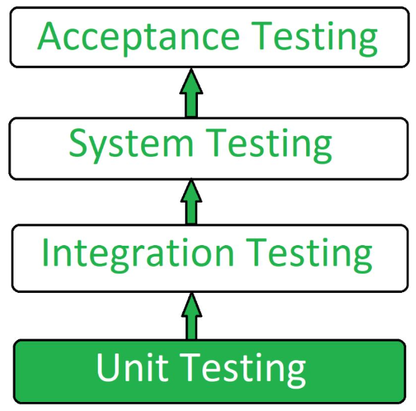
Unit testing : -
Unit testing is a type of software testing where individual units (individual function, method, procedure, module or object) of a software are tested.
The purpose is to validate that each unit of the software code performs as expected.
Unit Testing is done during the development (coding phase) of an application by the developers.
Unit testing, also known as Component Testing.
In a testing level hierarchy, unit testing is the first level of testing done before integration and other remaining levels of the testing.

Slide 3
Stubs & drivers : -
Stubs and drivers are the dummy programs in integration testing used to facilitate the software testing activity.
These programs act as a substitutes for missing modules in the testing.
They do not implement the entire programming logic of + module but they simulate data communication with the calling module while testing.
Stubs - called by the module under test.
Drivers - calls the module to be tested

Slide 4
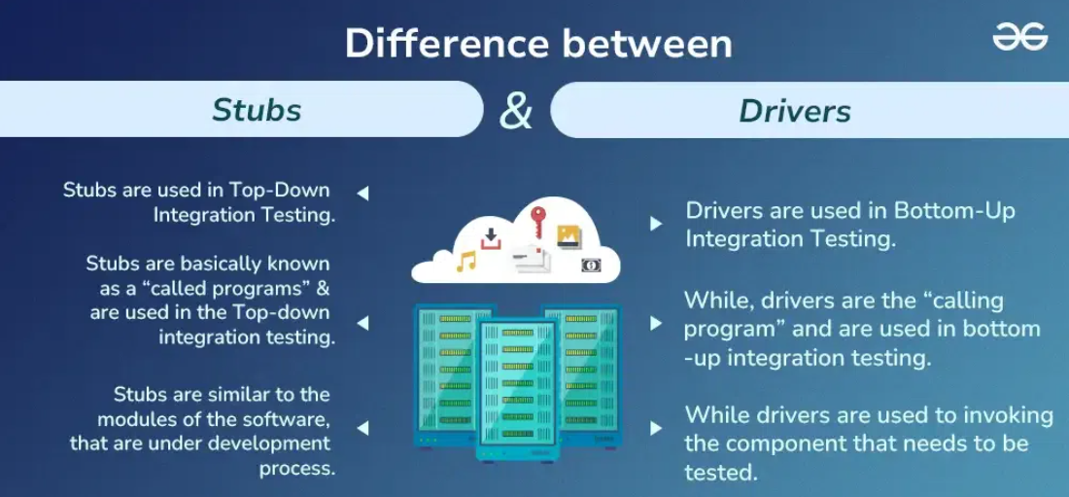
Differnce between stubs & drivers : -

Slide 5
Integration testing : -
Integration testing is defined as a type of testing where software modules are integrated logically and tested as a group.
The purpose of this level of testing is to expose defects in the interaction between these software modules when they are integrated.
Integration testing is the second level of the software testing process comes after unit testing, unit testing uses modules for testing purpose, and these modules are combined and tested in integration testing.
The goal of integration testing is to check the correctness of communication among all the modules.

Slide 6
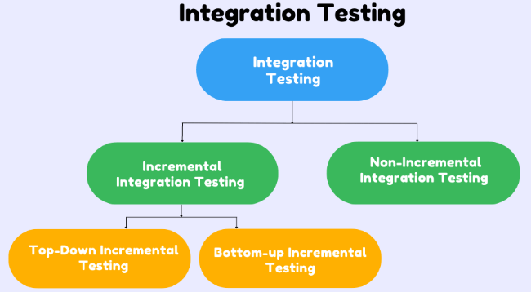
Types of integration tasting : -

Slide 7
Incremental testing : -
Incremental Testing is performed by connecting two or more modules together that are logically related and testing them before integrating with next modules.
This approach helps identify and fix errors early, isolate faults and monitor the integration process.
In this type of testing, there is a strong relationship between the dependent modules, suppose we take two or more modules and verify that the data flow between the is working fine. If it is then add more modules and test again.
It is a method of testing often used in Agile projects where a module is tested, then integrated with another module.
It's further divided into Top-Down Approach Bottom-up Approach and sandwich Approach

Slide 8
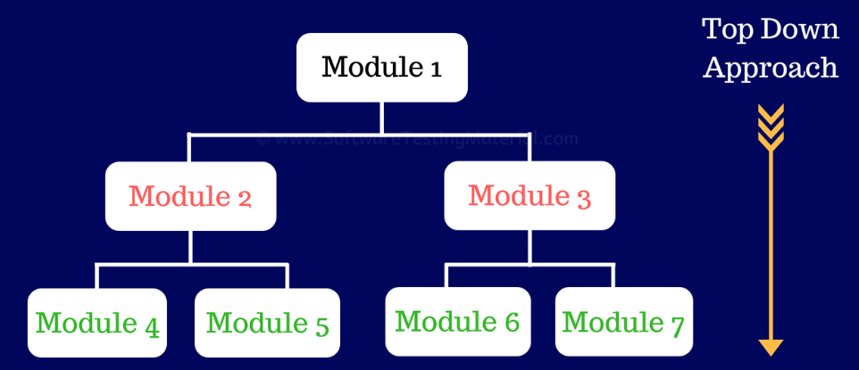
1. top – down integration testing : -
It is a type of incremental integration testing in which testing is done by integrating or joining two or more modules by moving from top to bottom through the control flow of the architecture.
High level modules are tested first, & then low-level modules are tested.
As there is a possibility that the lower level modules might not have been developed while top modules are tested, stubs are used instead of those not ready module.
Major design flaws can be detected and fixed early because vitical modules are tested first.

Slide 9
Advantages : -
Fault localization is easier.
The test product is extremely consistent.
Critical modules are tested on priority.
disAdvantages : -
Requires several stubs.
Poor supports for early release.
Basic functionality is tested at the end of the cycle.

Slide 10
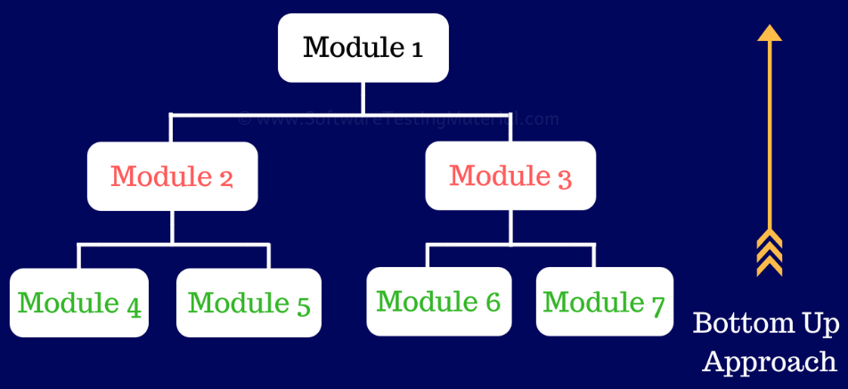
2. Bottom – up integration testing : -
The bottom-up approach starts with testing the lowest units of the application and gradually moving up one-by-one through the control flow of structure.
Low level modules are tested first and then high-level modules are tested.
There is possibility that the higher level modules might not have been developed by the time lower modules are Si tested, drivers are used to simulate the functionality of missing modules..!!!
Top level critical modules are tested at last, so it may cause a defect.

Slide 11
Advantages : -
1. Development & testing can be done together so the product will be efficient.
2. Test conditions are much easy to detect.
disAdvantages : -
1. Requires several drivers.
2. Data flow is tested very late.
3. Key interfaces defects are detected late.

Slide 12
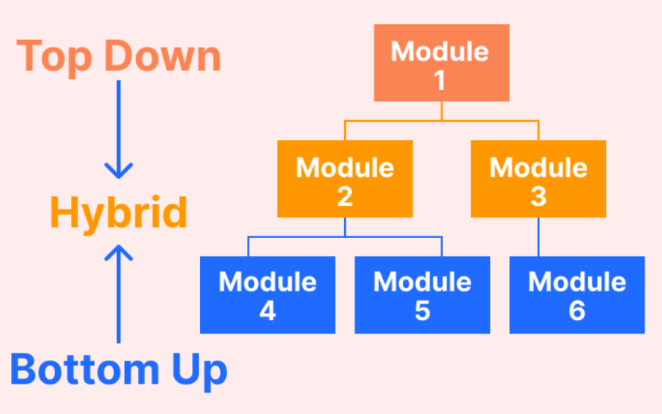
Bi-directional testing / sandwich integration testing : -
In this testing, both Top - down approach and Bottom - up approach are combined for testing, ie. top level modules are tested with lower level modules and lower level modules are tested with high-level modules simultaneously.
This approach is also known as sandwich integration testing or mixed integration testing.
It makes use of both stubs as well as drivers.
There is less possibility of occurrence of defect because each module interface is tested.

Slide 13
Advantages : -
1. Useful for large enterprise & huge projects
2. Efficiency.
3. Improved maintainability.
disAdvantages : -
1. The cost requirement is high.
2. Cannot be used in smaller system.
3. Different skills set are required.

Slide 14
Non – incremental integration/big bang integration : -
In this testing approach, All the components or modules are integrated together at once and then tested as a unit.
Non - incremental testing is only available when all the components are ready and complete.
It is convenient for small software systems, if used for large software system identification of defects is difficult.
Generally uses fewer resources since its done altogether While it offers simplicity and comprehensive coverage it can be complex and challenging, especially for large systems.

Slide 15
Advantages : -
1. Early detection of major issues.
2. Time efficient for small project.
3. Comprehensive.
Disadvantages : -
1.Complex debugging.
2.Risk of measure failure.
3. Difficult to isolate errors.

Slide 16
system testing : -
System testing is a level of testing that validates the complete and fully integrated software product.
In this testing, integration testing passed components are taken as input.
The purpose of a system test is to evaluate the end-to-end system specifications.
System testing tests the design and behaviour of the system and also the expectations of the customer.
System testing is a black box testing.
It is performed in the context of a System Requirement Specification (SRS) or Functional Requirement Specification (FRS).

Slide 17
Types of system software : -
Usability Testing.
Recoverable Testing.
Performance Testing.
Compatibility Testing.
Load Testing.
Stress Testing.
Security Testing.

Slide 18
1. Usability testing : - It is a testing method for measuring how easy & user - friendly a software application.
2. Recoverability testing : - It is an software testing that checks, how well on application can recover from craches, failure or other unexpected issues.
3. Performance testing : - It is a testing process used for testing the speed, response time, stability, reliability, scalability & resource usage of a software application under particular workload.
4. Compatibility testing : - It is a type of software testing to check whether your software is capable of running on different hardware, operating system, application, network environments or mobile devices.
5. Load testing : - It a non - functional testing process in which the performance of the software application is tested under a specific expected load.
6. Stress testing : - Stress testing is a type of software testing that verifies stability & reliability of software application.
7. Security testing : - It is a type of software testing that uncovers vulner abilities of resources of the system are protected from possible intruders or risks.

Slide 19
acceptance testing : -
It is a software testing where system is tested for acceptability FG.
The major aim of this test is to evaluate the compliance pay of the system with the business requirements and assess whether it is acceptance for delivery or not.
Acceptance Testing is the last phase of software testing performed after system testing and before making the system available for actual use.
Types of Acceptance testing : -
User Acceptance Testing (UAT).
Business Acceptance Testing (BAT).
Contract Acceptance Testing (CAT).
Regulations Acceptance Testing (RAT).
Operational Acceptance Testing (OAT).
Alpha testing.
Beta Testing.

Slide 20
types of acceptance testing : -
User acceptance testing (VAT) - It is used to determine whether the product is working for the user correctly.
Business Acceptance Testing (BAT) - It is used to determine whether the product meets the business goals or not.
Contract Acceptance testing (CAT) - CAT is a contract that specifies that once the product goes live, within a predeter mined period, the acceptance test must be performed, and mimit should pass all the acceptance use cases.
Regulations Acceptance Testing (RAT) - RAT is used to determine whether the product violates the rules and Thregulations that are defined by the government of the country where it is been released.
Operational acceptance Testing (OAT) - used to determine the operational readiness of the product.
Alpha testing - used to determine the product in the development testing environment by a testers team.
Beta Testing - used to access the product by exposing to the real end users, typically called beta testers.

Slide 21
acceptance criteria : -
The acceptance criteria consists of various predefined requirements and conditions, which are required to be met and accomplished, to make the software acceptable for end users and customers.
Acceptance criteria validates the development of the software as well as ensure that it fulfills its expected purpose, without any issue.
In short, acceptance criteria can be termed as a validation technique.
Acceptance criteria are conditions in which a software application should satisfy to be accepted by a user or customer.
Acceptance criteria are defined on the basis of the following attributes -
Functional correctness and completeness.
Data Integrity.-
Usability.
Performance.
Scalability.
Notes:
T

Slide 22
Alpha testing : -
1. Alpha testing is a type of acceptance testing : performed to identify all possible issues and bugs before releasing the final product to the end users.“
2. It is performed at developer's site.
Beta testing : -
1. It is performed by "real users" of the software application in real environment" and it can be considered as a form of external user acceptance testing.
2. It is the final test before shipping a product to the customers.
3. Testing is performed at client site.

Slide 23
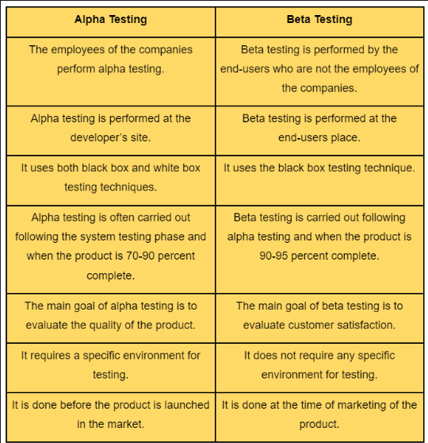
Difference between alpha testing & beta testing : -

Slide 24
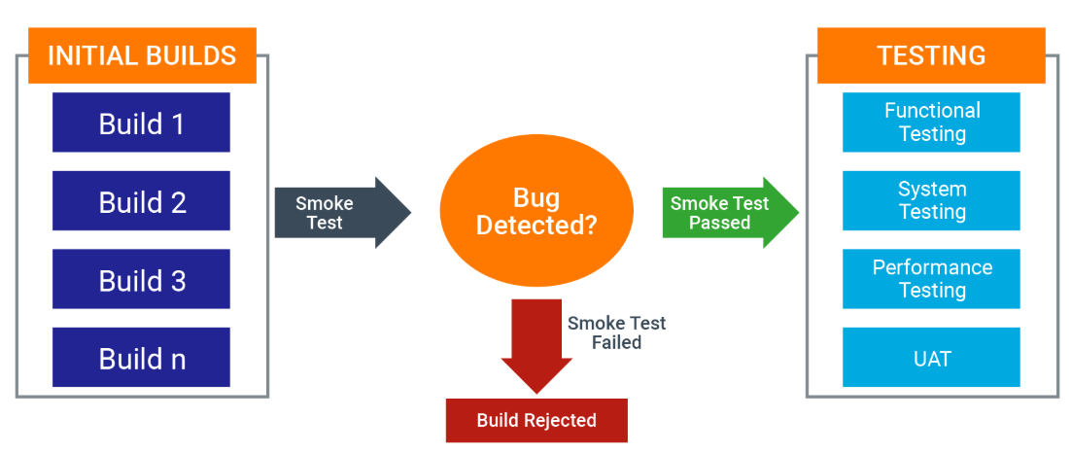
Smoke tesing : -
It is a software testing process that determines whether the deployed software build is stable or not.
Smoke testing is a confirmation for QA team to proceed with further software testing.
It is also called as “Build Verification Testing” or “Confidence Testing”.
The main aim of smoke testing is to detect early major issues.
The another aim is to refrain from wasting resources on extensive testing if the core functionality aren't by tho working properly.

Slide 25
Advantages : -
1. Easy to perform.
2. Helps in identifying defects in early stages.
3. Saves test efforts and time.
Disadvantages : -
1. It does not cover all the functionality in the application.
2. Errors may occur even after implementing all the smoke tests.
3. It will not be implemented against the negative tests or with invalid inputs.

Slide 26
Sanity testing : -
It is a kind of software testing that is performed after receiving a software build, with minor changes in code, or functionality to ascertain that the bugs have been fixed and no further issues are introduced due to these changes.
It is a quick and basic test that's performed on a stable build of the software to ensure that the code changes are working properly.
Sanity testing is a crucial checkpoint to decide whether to proceed with further testing and if the sanity test fails, the testing team rejects the build.
Sanity testing typically occurs after smoke testing.
It is a subset of regression testing and focuses on the smaller section of the application.

Slide 27
Advantages : -
1. Helps to quickly identified defects in core functionality.
2. Not expensive as compared to another type of testing.
3. Increase confidence in built stability.
Disadvantages : -
1. Dependancy on extertise.
2. Sanity testing is unscripted, hence future reference are not available.
3. Doesn’t cover design structure.

Slide 28
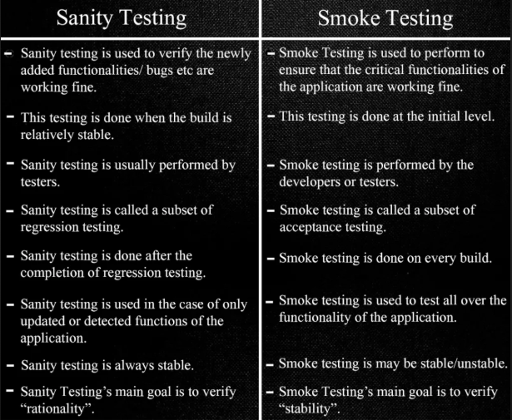
Difference between sanity testing & smoke testing : -

Slide 29
Regression testing : -
It is a type of software testing that verifies that update to a software product don't break existing functionality.
Regression testing is like a software quality checkup after any changes are made.
It involves running tests to make sure that everything! The still works as it should, even after updates or tweaks to the code.
This testing ensures that the software remains reliable and functions properly, maintaining the integrity throughout is development lifecycle.

Slide 30
Advantages : -
1. Improve product quality.
2. Reusability.
3. Time efficiency.
Disadvantages : -
1. It required even after very small changes in the code.
2. Test data management challenge.
3. Resources required.

Slide 31
Gui testing : -
It is a testing method that checks the Graphical User Interface of the software.
The purpose of Graphical User Interface (GUI) testing is to ensure that the functionalities of the software application works as per specifications by checking screens and controls like menus, buttons, icons, etc.
GUI testing processes may be either manual or automate and are often performed by third party companies, rather than developers or end users.
It provides customizable test reports.
It tests the functionality from the user’s perspective.

Slide 32
Advantages : -
1) Releases an error free application.
2) Increase the efficiency of application.
3) Improves the software quality.
Disadvantages : -
1) Time consuming.
2) Extra software required.
3) Frequent updates Needed.

Slide 33
Object oriented testing : -
5) Object oriented Testing -
i)
Whenever large scale systems are designed object oriented testing is done rather than the conventional testing strategies.
The whole object oriented testing revolves around the fundamental entity know as "class".
With the help of class concept, larger systems are divided into small well defined units which can be implemented separately.
Levels of object oriented testing : -
Class Testing : -
i) It is also known as unit testing.
ii) class testing ensuvies that the attributes of class are Implemented as per the design and specifications, it also checks the interfaces and methods are error free.
2) Inter-class Testing : -
i) It is also called as integration testing.
ii) Inter class testing involves the testing of modules or subsystems and their coordination with other modules.

Slide 34
3. System testing : -
The system is tested as whole & primary functional testing techniques are used to test the system.
Non-functional requirements like performance are also tested.
ADVANTAGES : -
1. Reusable code.
2. Managing testing.
DISADVANTAGES : -
1. Complexity.
2. Performance issue.

Slide 35
Application testing : -
It is the process of evaluating software application to ensure they meet their requirements and functions properly.
It helps identify and fixed issues early in the development process which can save time and money.
Client - server testing.
Web based Testing.

Slide 36
Client - server testing : -
A Type of testing that verify the functionality and interactions between a client and server in a distributed system.
Client server applications run on two or more systems.
In this testing, the client sends a request to the server and the server sends a response back to the client with the required information.
It is also known as Two-Tier application testing.
Advantages : -
1) GUI feature is available on both client and server side machine.
2) Data can be accessed efficiently.
Disadvantages : -
1) The cost of setting and maintenance is high.
2) If the server fails none of the client requests can be fulfilled.

Slide 37
Web – based testing : -
A testing technique to test web applications or websites for finding errors and bugs.
A web application must be tested properly before it goes to the end-users, testing a web application does not only mean finding common bugs or errors but also testing the quality related risks.
Types of web based testing : -
1) Functional testing.
2) Usability testing.
3) Compatibility testing.
4) Performance testing.
5) Static website testing.
6) Mobile based web testing.
7) E-commerce website testing.
8) Dynamic website testing.

Slide 38
Advantages : -
1) Browser compatibility.
2) Scalability & Cost Effectiveness.
Disadvantages : -
1) security concerns.
2) complexity in Responsive design testing.

