Slide 1
06. Testing tools & measurements

Slide 2
Manual testing : -
Manual testing is a software testing process in which test cases are executed manually without using any automated tool and all test cases are executed by the testers manually according to the end user's perspective.
Test case reports are also generated manually.

Slide 3
Limitations of manual testing : -
Manual testing requires more resources and time as the complete process is manual.
It's prone to human error for the cases where intensive data. calculation is involved
It is not suitable for large scale and time bounded projects.
Verifying a large amount of data is not possible.
Performance testing is impractical manually.
GUT difference, component size are difficult to verify manually.
GUI objects size difference and color combination etc is not easy to find out in manual testing.
Regression test cases are time consuming it it is manual testing.

Slide 4
Automation testing : -
Automation testing is the application of tools and technology. to testing software with the goal of reducing testing efforts. delivering capability faster and more affordably.
It helps in building better quality software with less effort.
Automation testing tools not only help us to perform regression tests but also helps us to automate data". generation, product installation, GUI interaction, defect" logging, etc.
Therefore these tools are used for both Functional and Non-functional testing.
The goal is to reduce the number of test cases to be executed manually but not to eliminate manual testing.

Slide 5
need for automation testing : -
Test automation helps you reduce the feedback cycle and bring faster validation for phases in the developm- ent of your product.
By automating your testing procedure, team has to spend very less time validating newly developed features.
When using an automated test environment, company will save money as fewer resources are spent on testing your product.
The scripts are reusable and don't need new sveipts every time.
Automation helps you find bugs in early stages of software development, reducing expenses and working hours to fix these problems as well.
Automated testing provides better insights than manual testing when some tests fail! It shows memory contents,- data tables, file contents, etc to help developers determine.
When testing a complex use case, fault occuves on the other side, automated tests can execute tests with 100 percent accuracy as they produce the same result every- time you run them.
Automation testing increases the test coverage of produc so more features are properly tested resulting in a higher quality application.
mation trating ١/٢ Manual

Slide 6
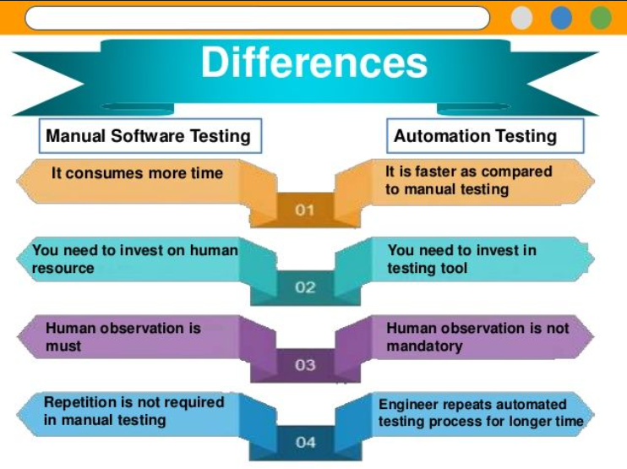
Difference between manual testing & automation testing :

Slide 7
Automation testing tools : -
Selenium : -
Selenium is an Opensowice framework for automating web browsers.
It is used to test web applications, performing auto - mation tasks and scraping data from websites.
It supports multiple programming languages including Java, Python, c-sharp, Php, Ruby.
Selenium is not a single tool but rather a suite of softw are that includes various tools :
i) selenium web Driver: It is used for automating browser, interactions.
ii) selenium IDE : It is an integrated development environment for vreating and running selenium test cases.
iii) selenium Grid : It is used for parallel testing on multiple machines or browsers.
iv) selenium Remote control : It allows programmers to code in different programming languages.
The key advantage of using selenium is its ability to simulate real world user interactions with web application which helps to identify potential issues and bugs in the applications before they become a problem for users. selenium has large and active community and open. sowice nature of selenium means that it is free to use and can be modified.

Slide 8
2. Katalon : -
It is a comprehensive test automation tool that allows you to create and execute automated tests for web, API, mobile and desktop applications.
katalon studio provides a wer friendly interface that enables you to create automated test without requiring extensive programming knowledge...
It provides a range of features such as record and pla yback, object repository, data-driven testing and custom keywords.
katalon studio is built on top of selenium and Appium frameworks and supports integration with various tools. like JIRA and Jenkins.

Slide 9
3. Bugzilla : -
An open source bug tracking system that allows developers- to keep track of outstanding problems with their product.
Bugzilla tool is written in perl language and it uses Mysal database.
It can be used as a test management tool as it can be- easily linked with other test management tools like Quality center, Testlink, etc…

Slide 10
4. QTP : -
Full form of QTP is Quick Test Professionals.
QTP tool is used to test functional regression test cases, for the web-based applications.
QTP is designed on the scripting language like VB swipt. to automate the application.
Both technical and non technical tester can use QTP.

Slide 11
5. Appium : -
An open source test automation tool used to automate mobile applications for Android, iOs and windows.
Appium support cross platform compatibility ie supporty multiple programming languages including Java, Python, Php, and Ruby.
Appium uses the web priver protocol which is commonly used for web application testing.

Slide 12
6. Lambda test : -
It is a cloud based automation testing tool for desktop and mobile application.
It provides an easy-to-use interface for testing your web apps on a large variety of configurations without the need to set up a local infrastructure.
It covers a wide range of browsers, devices and operating system.

Slide 13
Features of test tools : -
1) Static Test tools : -
These tools do not involve actual input and output. Rather they take a symbolic approach to testing ie they do not test the actual execution of the software.
These tools include the following:
i) Flow analyzers : They ensure consistency in data flow from input to output..
ii) Path tests : They find unused code and code with contradictions.
iii) Coverage analyzers : It ensures that all logic paths are tested.
iv) Interface analyzers : It examines the effects of passing variables and data between modules.

Slide 14
2. Dynamic Test Tools : -
These tools test the software system with 'live' data.
Dynamic test tools indude : -
i) Test driver : It inputs data into a module - under-test (MUT).
ii) Test beds : It simultaneously displays source code along with the program under execution.
iii) Emulators : The response facilities are used to emulate parts of the system not yet developed.
iv) Mutation analyzers : The errors are deliberately 'fed' into the code in order to test fault tolerance of the system.

Slide 15
advantages of using tools : -
1. Speed and Efficiency : Automation tools execute tests faster than manual methods reducing the time and enables frequent and continuous testing.
2. Reusability : Once you write a test scripts, you can reuse it for future tests, like regression testing.
3. More Accurate : Tools don't make mistakes like human. might during repetitive tasks. (Reducing human error)
4. Detailed Reports : Tools give clear reports, making it easier to find and fix bugs.
5. Saves money Over Time : Although costly at first, saves money in long run.

Slide 16
Disadvantages of testing tools : -
Expensive setup : Buying tools and training staff costs a lot initially.
Needs Maintenance : Test scripts need updates whenever your software changes.
Not always useful for small projects : For small projects, setting up automation might take more effort than its worth.
Skilled People Required : You need experienced testers to create and maintain automated scripts.

Slide 17
Selecting a testing tool : -
Steps 1 : Identify the requirement for tools.
Steps 2 : Evaluate the tools and vendors.
Steps 3 : Estimate cost and benefit.
Steps 4 : Make the final decision.

Slide 18
When to use automated test tools : -
Situations where automated testing is most beneficial :
1. Repetitive Testing : - Tests that need to be run repeatedly during development, such as regression tests are prime candidates for automation.
2. Large test suits : - When there are many test cases to execute, automation ensures faster & more accurate results.
3. Performance Testing : - To test how the system handles heavy traffic or many users.
4. Critical functions : - For important features like payment systems or security.
5. Tests & need speed : - Automation is faster than manual testing for large test cases.
6. Cross – test platform : - To chech if the app works on different browsers, devices or operating systems.

Slide 19
Testing using automated tools : -
Testing using automated tools is a process where specialized software tools are used to execute pre-scripted tests on a system application or product.
Automated tools help streamline the process of verifying whether a system or application works expected, reducing manual effort and increasing efficiency.
Common uses : -
1) Regression testing : Ensuring new code changes don't break existing functionality.
2) Performance testing : checking how an application performs under heavy load.
3) functional testing : Validating that individual functions of the application work correctly.

Slide 20
What are metrics & measurements : -
Measurements : -
Measurements are raw, quantifiable data points collected during the testing process.
They represent the actual values obtained from various
testing activities.
Measurements provide the input for calculating metrics.
Eg : - Number of test cases executed.
Number of defects identified.

Slide 21
Metrics : -
Testing metrics are the quantitative measures used to estimate the progress, quality, productivity and health of the software testing process.
The goal of metrics is to improve the efficiency and effectiveness in the software testing process.
Metrics are used to analyze trends, measure performance and make decisions.
Eg : - Test coverage, Defect Density.

Slide 22
Types of metrics : -
Process metrics : –
- A projects characteristics and execution are defined by process metrics.
- It can be used to improve the process efficiency of the SDLC (software development lifecycle).
2. Product Metrics : –
- A product's size, design, performance, quality and complexity are defined by product metrics.
- It deals with the quality of the software product.
3. Project Metrics : –
- Project Metrics are used to assess a project's overall quality.
- It can be wed to measure the efficiency of a project team or any testing tools being wed by the team members.

