Slide 1



Graph-Relational Domain Adaptation
Zihao Xu, Hao He, Guang-He Lee,
Yuyang Wang, Hao Wang
Notes:
Hello everyone, this is Zihao Xu. Today I am going to present our work: graph-relational domain adaptation. This is a joint work with Hao He, Guanghe li, Yuyang Wang and Hao Wang.

Slide 2
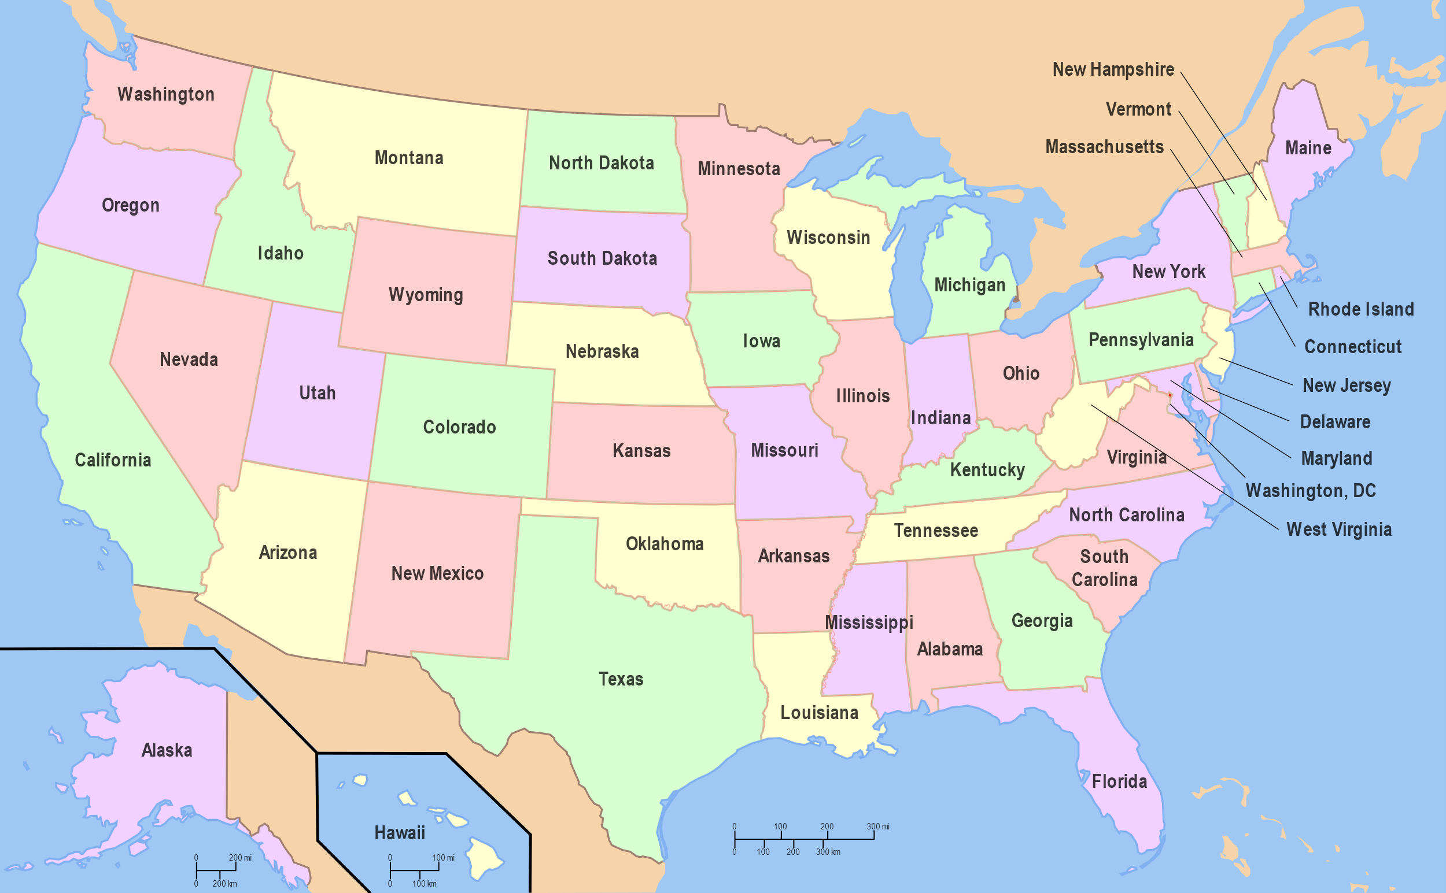
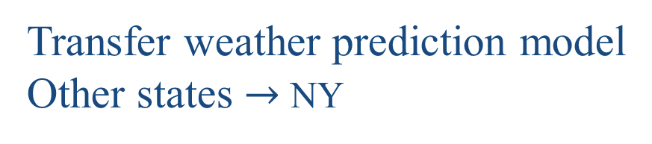
Motivation
Why we use graph in Domain Adaptation (DA)?
Domains are not equal
Transfer weather prediction model
Other states $→$ NY
1
Notes:
In our work, we incorporate a graph into adaptation tasks. Why we want to use graph in domain adaptation? The answer is, domains are actually not equal.
Let’s see an example.
Suppose now you are transferring a weather prediction model trained on other states to New York State.

Slide 3
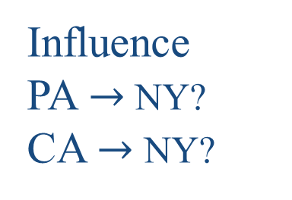
Motivation
Why we use graph in Domain Adaptation (DA)?
Domains are not equal
Influence
PA $→$ NY?
CA $→$ NY?
2
Notes:
Intuitively, NY should be influenced more from model trained in PA rather than California.

Slide 4
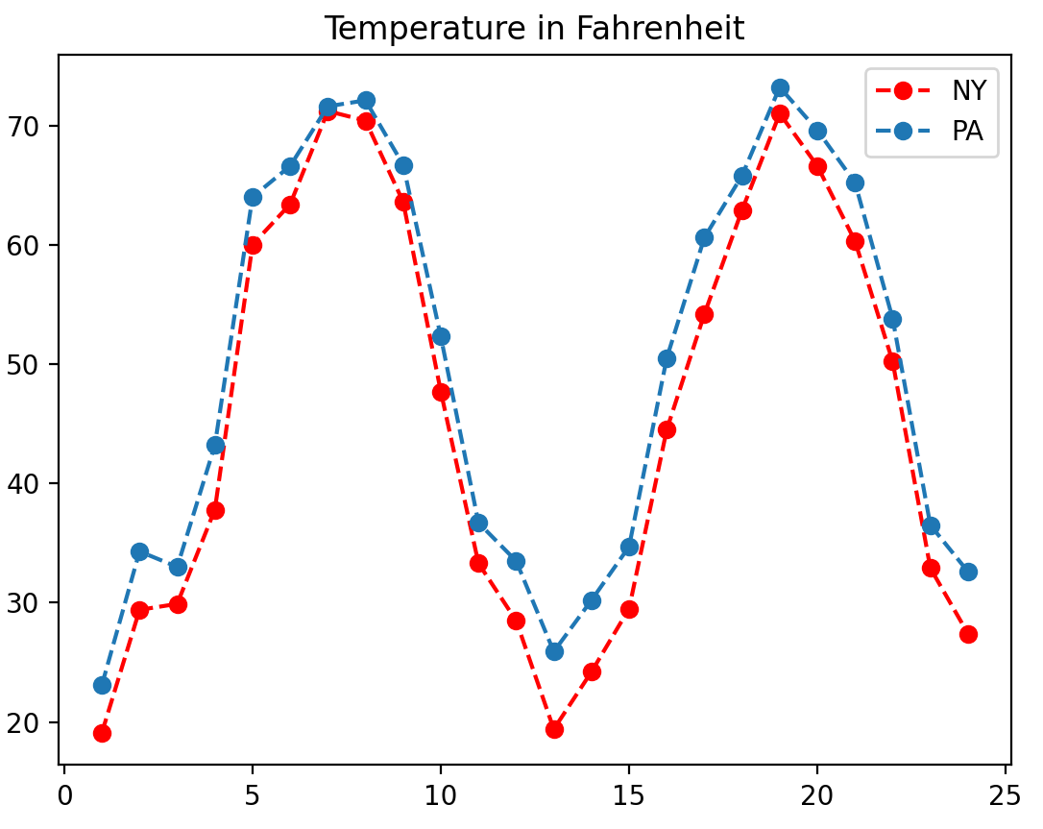
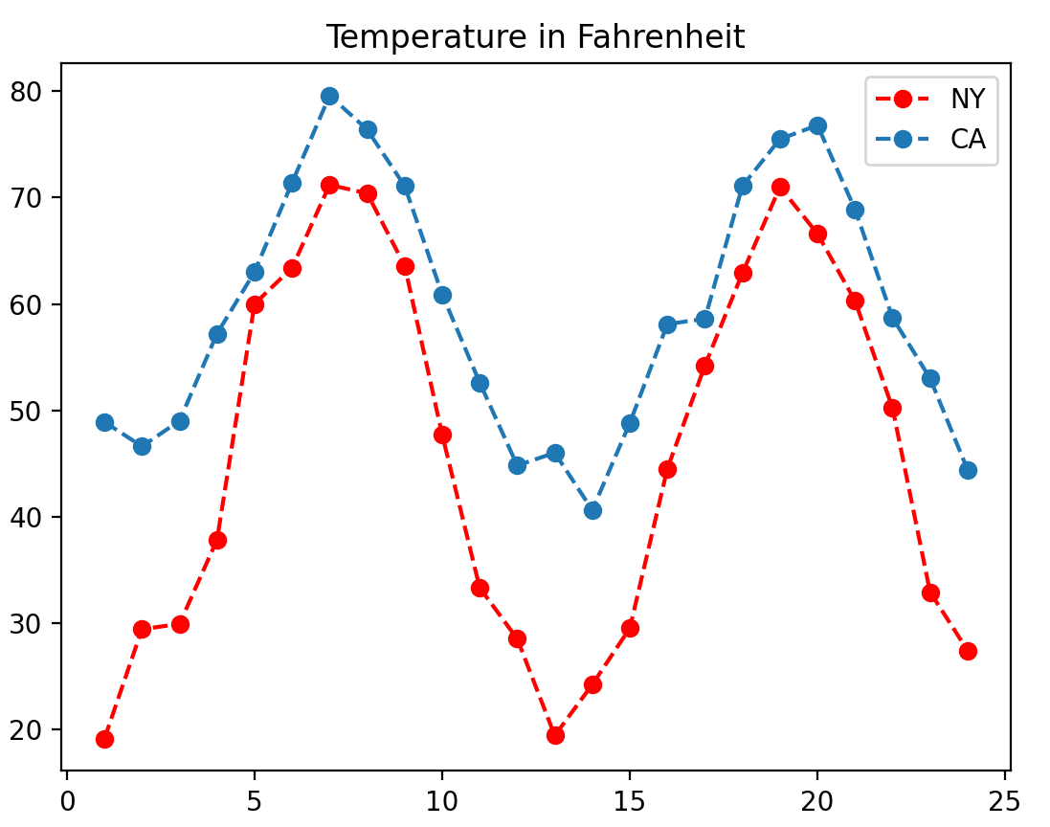
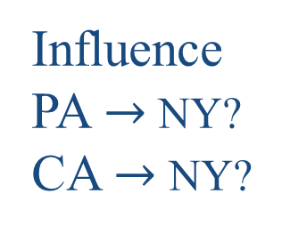
Motivation
Why we use graph in Domain Adaptation (DA)?
Domains are not equal
Influence
PA $→$ NY?
CA $→$ NY?
PA & NY
CA & NY
3
Notes:
The real data support this intuition. The first picture shows the temperature data of PA and NY, and the second shows the data of CA and NY. We can see that the data patterns in the first picture are much closer than in the second picture. This indicates that, …

Slide 5
Motivation
Why we use graph in Domain Adaptation (DA)?
Domains are not equal
Influence
PA $→$ NY?
CA $→$ NY?
Heterogeneous!
4
Notes:
This indicates that, domains are Heterogeneous. Domains are not created equally in the adaptation task.

Slide 6
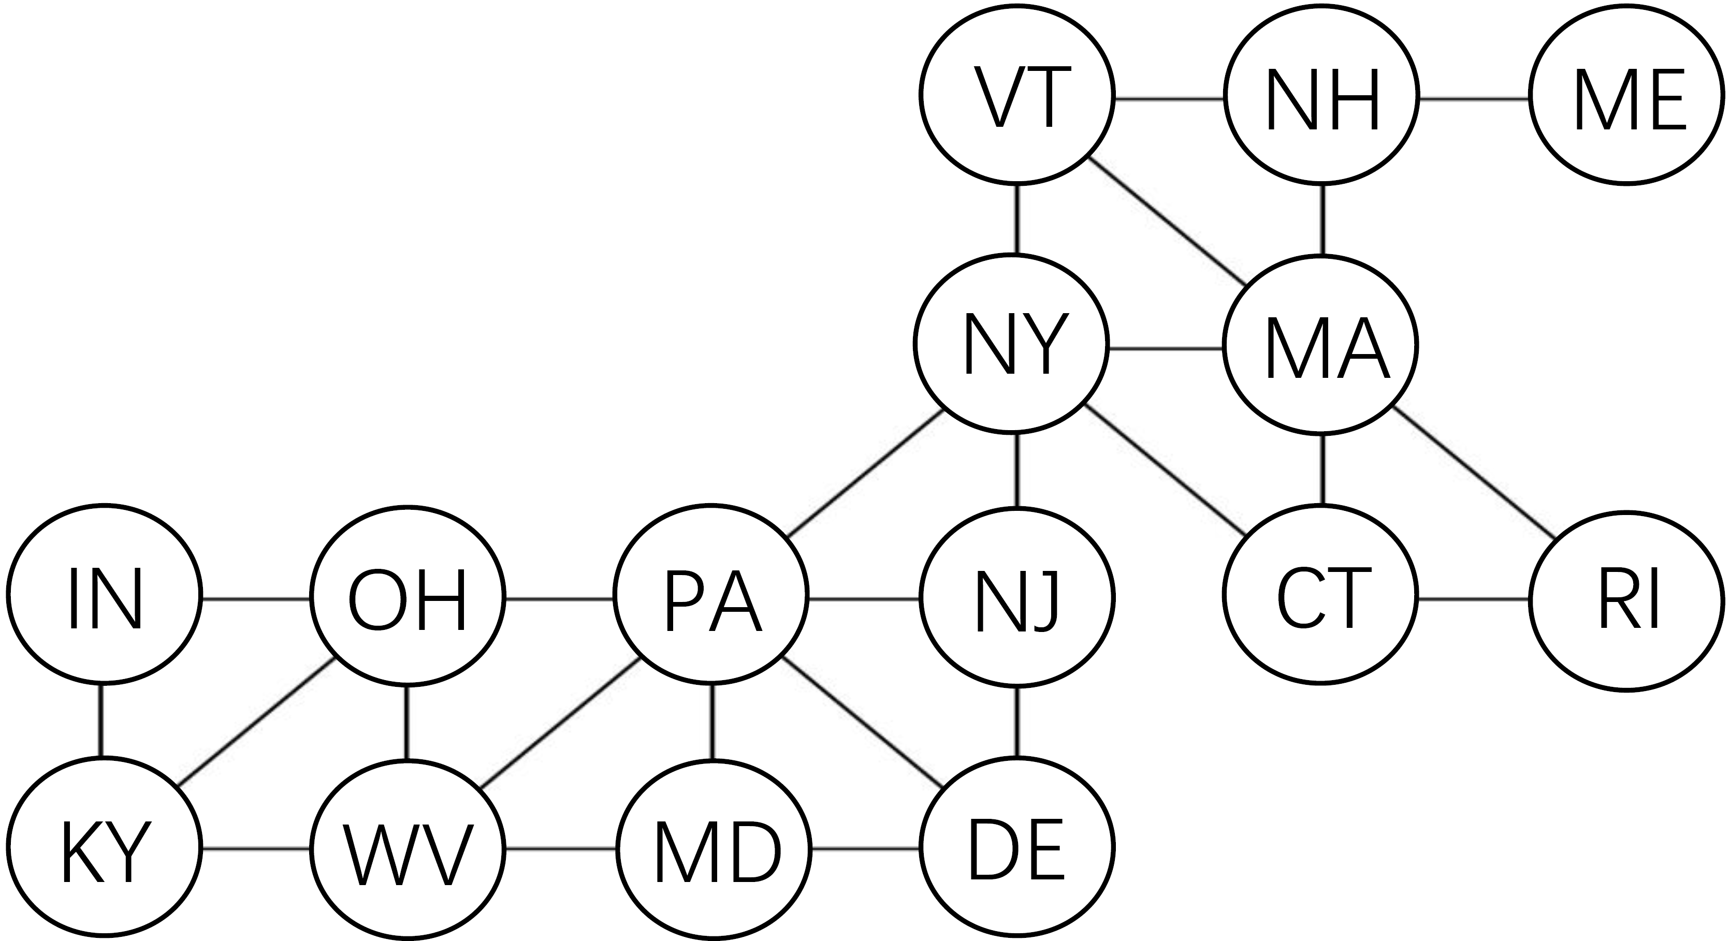
Motivation
Why we use graph in Domain Adaptation (DA)?
Use graph to model Heterogeneity
5
Notes:
Such heterogeneity can often be captured by a graph. In the example of weather prediction, we can treat each state as a node and the physical proximity between two states results in an edge, just as shown in this picture. We can generalize this to any adaptation tasks, where the domains realize the nodes, and the adjacency between two domains can be captured by an edge. That’s why we include domain graph in adaptation.
We want to emphasize that, current Domain Adaptation methods cannot support the domain graph. Our method is the first general adversarial method to adapt across domains living on a graph.
Emphasize: current da cannot support

Slide 7
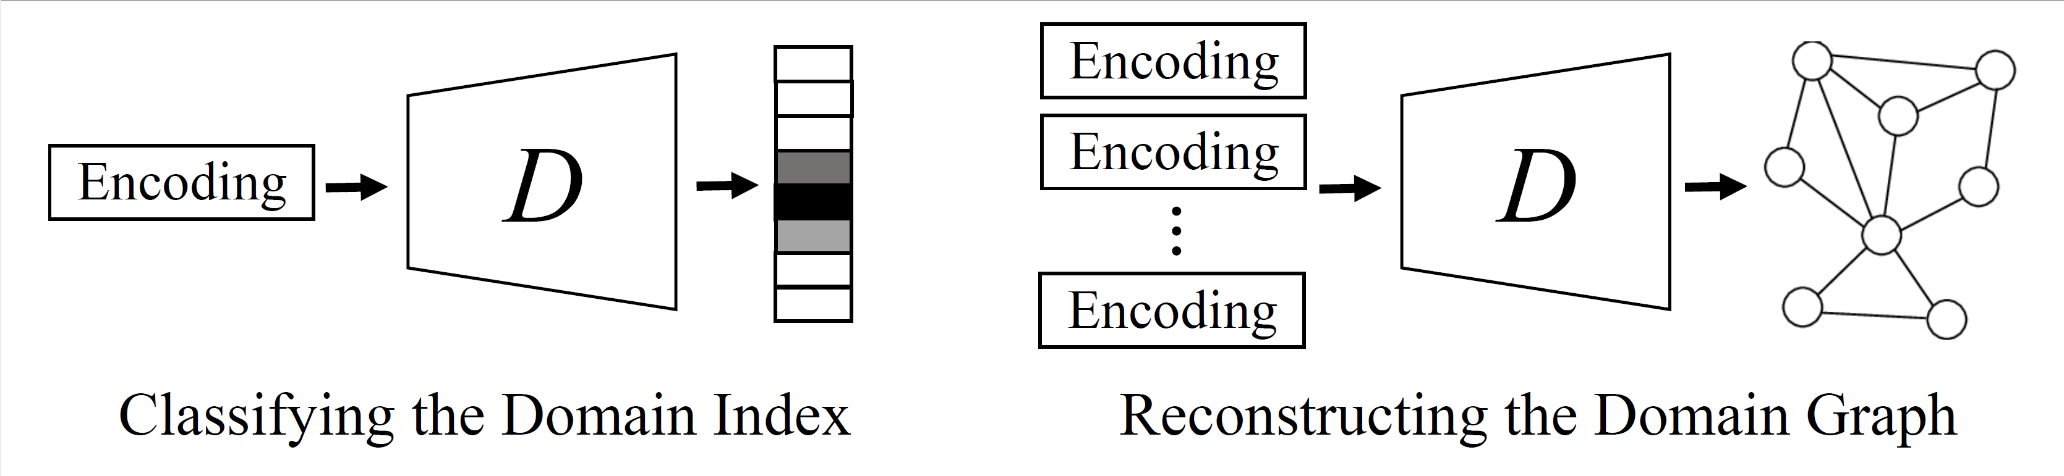
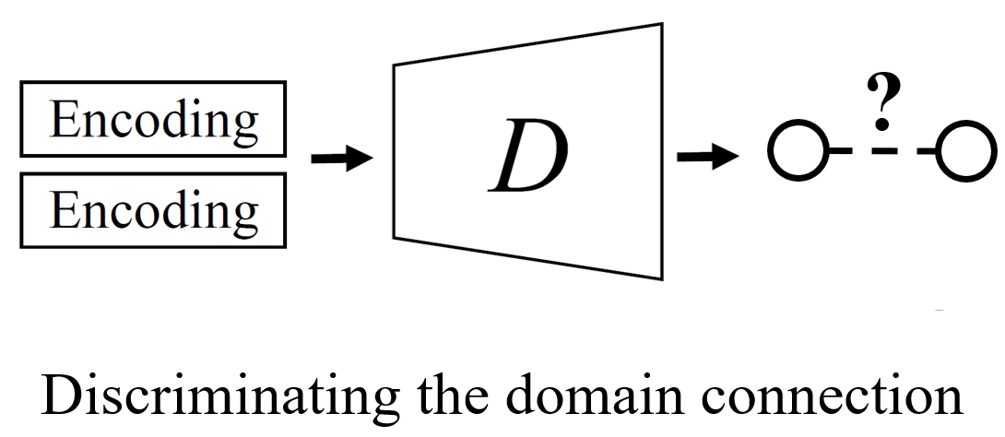
Method
How to use graph?
Novel Graph Discriminator
Traditional DA method
Ours
6
Notes:
Then comes the question: how to use the graph? The key point is to use a novel graph discriminator.
For traditional method, the discriminator will classify the domain index, while ours will try to discriminate the domain connection. This is challenging, because the graph discriminator will take encodings from multiple domains, and then conduct graph learning tasks.

Slide 8
Method
How to use graph in Domain Adaptation?
Novel Graph Discriminator
Traditional DA method
Ours
7
Notes:
By discriminating the connection, our discriminator can finally reconstruct the domain graph.

Slide 9

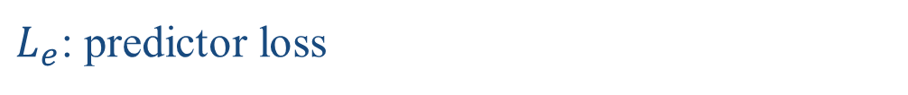
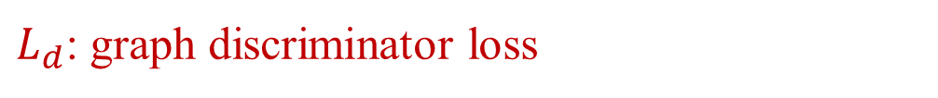
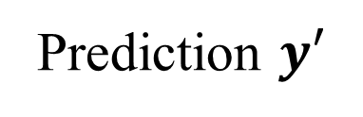
Method
How to use graph?
Model Structure
Data X
E
e
F
Prediction $y′$
Adjacency matrix A
Objective Function:
D
Domain Graph
$$\min_{E,F}{\max_{D}{L_{e}\left(E,F\right)−{λ_{d} L}_{d}(D,E)}}$$
$L_{e}$: predictor loss
$L_{d}$: graph discriminator loss
7
Notes:
Our model structure is shown here. We highlight the key difference between our model and other models in red. It follows the adversarial learning framework, where encoder E, discriminator D and predictor F play a min-max game. Here L-e denotes the predictor loss, and Ld denotes the graph discriminator loss. The Discriminator will try to reconstruct the domain graph, and The encoder tries to “fool” the discriminator by removing domain-related information. To achieve this, the encoder takes the adjacency matrix of domain graph as an extra input.

Slide 10
Method
How to use graph?
Theory (informal)
Traditional method is equivalent to using our method with a fully-connect graph (clique).
D and E converges if and only if $E_{i,j}\left[A_{i,j} | e_{i},e_{j}\right]=E_{i,j}[A_{i,j}]$.
The global optimal of the two-player game between E and D matches 3 player game E, D, F.
8
Notes:
We have also analyze our model theoretically. We find that:
First, Traditional method is equivalent to using our method with a fully –connected graph, a clique.
Second, D and E converges if and only if this equation holds. Intuitively, this means that when model converges, the encoder will remove all the information about domain connection.
And Finally, The global optimal of the two-player game between E and D matches the 3 player game E, D, F.
(This means that when the model converges, given two arbitrary data points, the connection probability of their domain is independent of the embedding provided by encoder.)

Slide 11
Method
How to use graph?
Theory (informal)
Traditional method is equivalent to using our method with a fully-connect graph (clique).
D and E converges if and only if $E_{i,j}\left[A_{i,j} | e_{i},e_{j}\right]=E_{i,j}[A_{i,j}]$.
The global optimal of the two-player game between E and D matches 3 player game E, D, F.
9
Notes:
The first property is very important, because it illustrate that our method takes the advantage of heterogeneity.

Slide 12
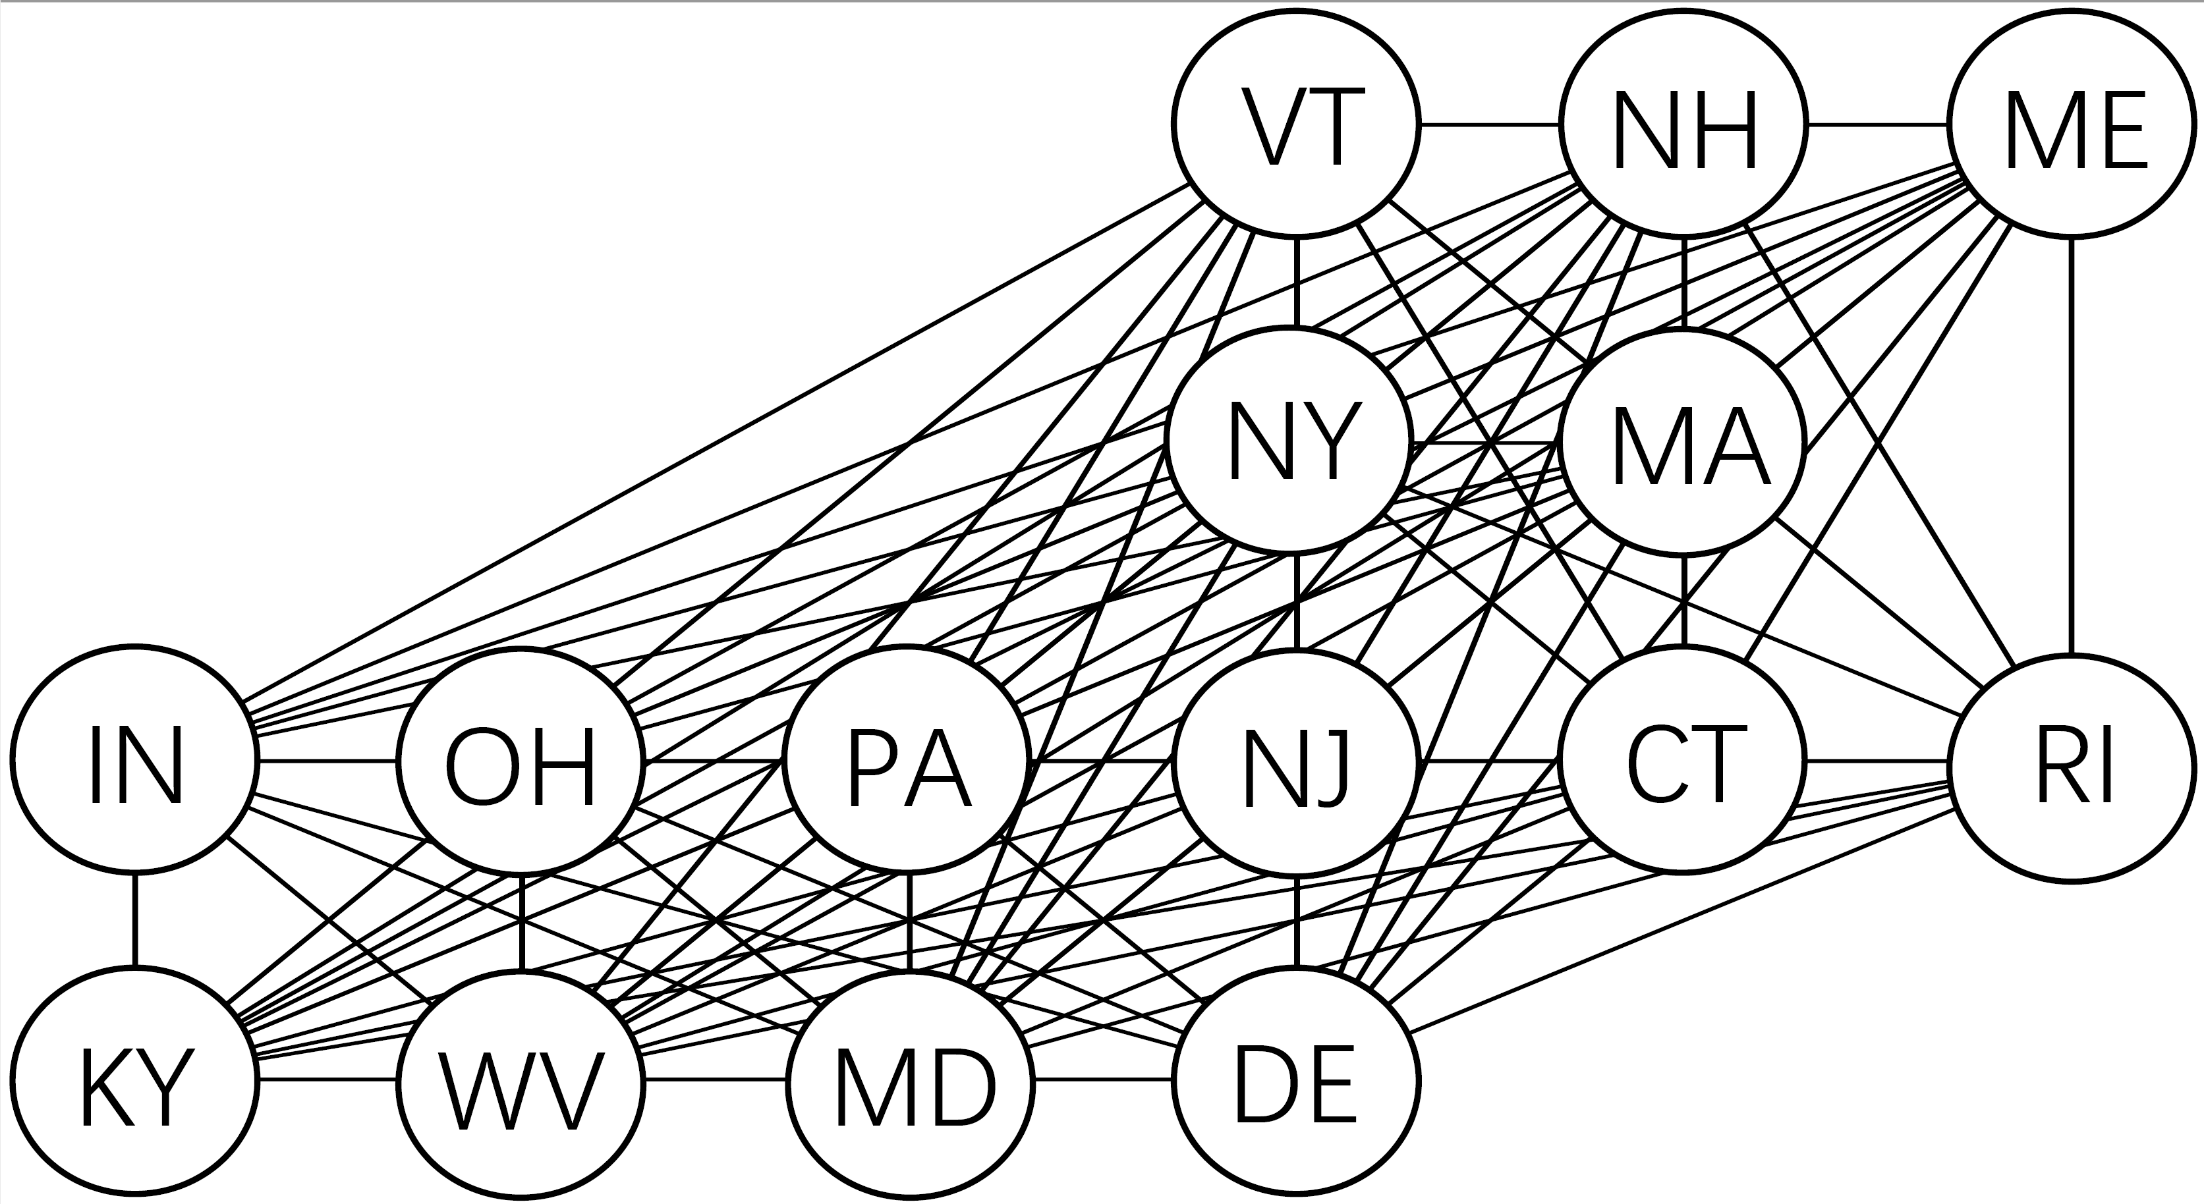
Method
How to use graph?
Take advantage of Heterogeneity
Traditional DA method
Ours
(Equivalent)
10
Notes:
We still take the weather prediction task as an example. Traditional method is equivalent to adapt across a fully-connected graph, while in our method, the domain graph is build on the geographic connection of each states. Since we takes heterogeneity into consideration, our method outperforms methods with large margin.

Slide 13
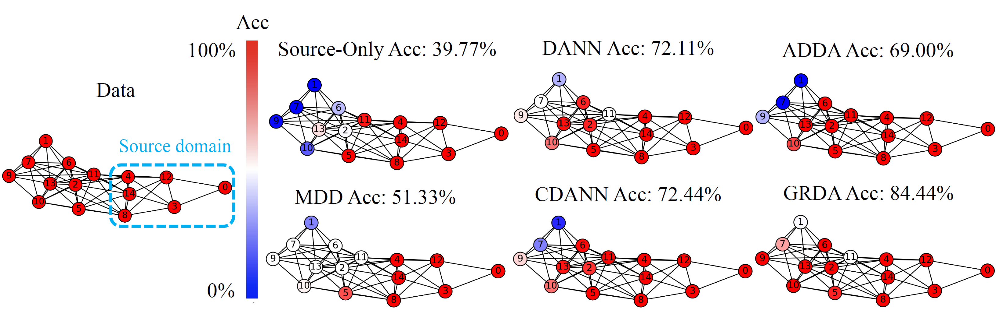
Result
Performance of our model
Experiment on DG-15
11
Notes:
Our experiments support our statements. On dataset DG-15, our model has a large gap with other models for at least 10 percent accuracy improvement.

Slide 14


Supplement
Code
Paper
https://github.com/Wang-ML-Lab/GRDA
https://arxiv.org/abs/2202.03628
12
Notes:
For more experiment results and analysis, please refer to our code and paper. Thank you!

Slide 15
Thank you!
Q & A
Notes:
Motivates
Remove the at ex
Direct to usa example.
Strong both theoretical and empirical. (informal) relax alignment.
1, Knowing the relax
2, cliqe is equivalent to previous dann.
Barplot, other visualization.
Us graph
Motivation of GRDA first. Assum that
Nodes
-> edges

