Slide 1
Deployment Pipeline Demo

Slide 2
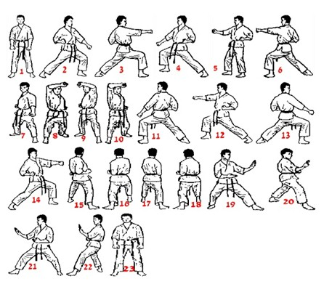
Development Kata
Karate have Kata’s that are learned
These are a series of techniques that are practiced repetitively
Repetition and practice are prerequisite to mastery
The same is with software development
We need to be able practice!

Slide 3
Deployment Pipeline
Source Control Integration
Tracks code changes
Automated Build
Provides checking for referential integrity, syntax, ect
Release Pipeline
Automated process for deploying changes

Slide 4
Why does it matter?
Isolation
Code changes can be isolated from Production Serivces
Allows for more experimental development without impacting production services
Automated
Changes can automatically be deployed to a testing environment
Automation provides consistent deployment behavior, reducing human errors
Confidence
Errors in the pipeline are sent back to developers to correct
Creates tighter feedback loops
History
Very code change is documented
Ability to deploy previous versions, reducing recovery time

