Slide 1


Influence of diversity index and population of children on Covid-19 cases in the New England region during holiday season 2020
ChE Math Project 1
Shreya Thakkar

Slide 2
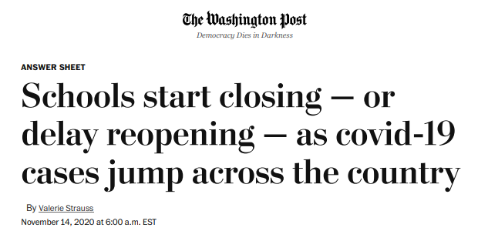

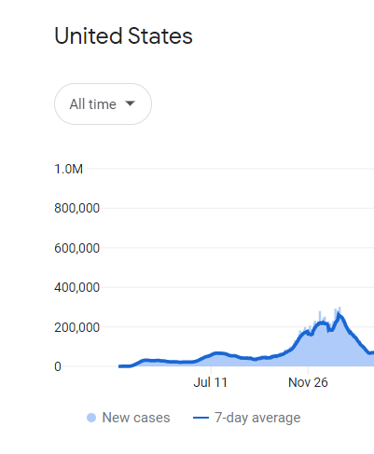
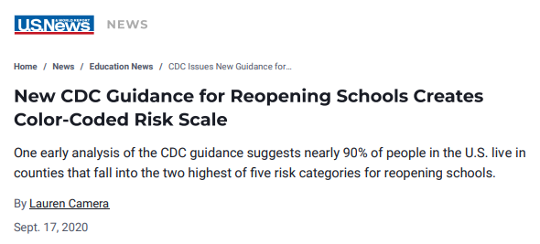
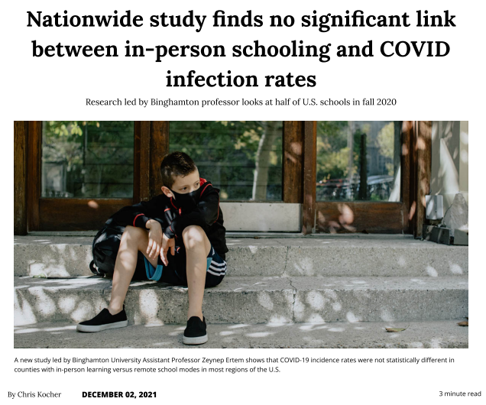
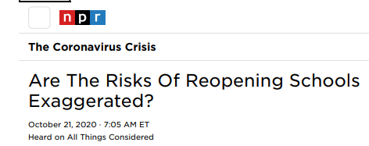
The first year of pandemic
Data comes from Wikipedia, government health ministries, The New York Times, and other authoritative sources
News article snaps accessed on Oct 24,2022

Slide 3
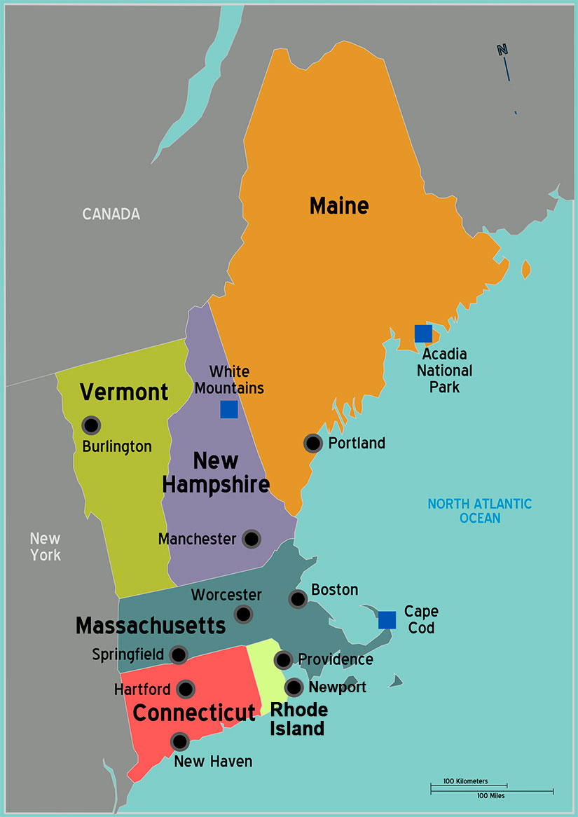


Problem Selection: Effect population of children and diversity index on Covid-19 cases in New England during holiday season 2020
AGE UNDER 18
DIVERSITY INDEX
https://i0.wp.com/indiaeducationdiary.in/wp-content/uploads/2022/08/University-of-Massachusetts-Amherst.jpeg?fit=600%2C400&ssl=1
https://newengland.com/wp-content/uploads/new-england-states-map.jpg
https://newengland.com/wp-content/uploads/new-england-states-map.jpg

Slide 4
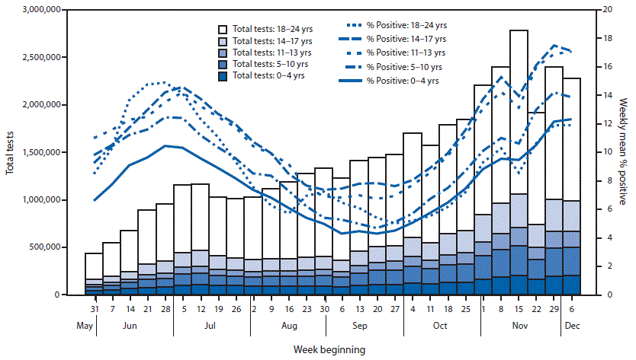
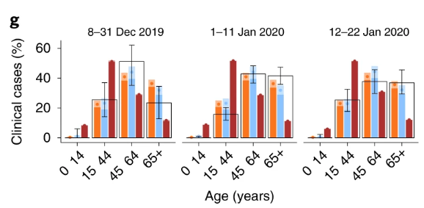
Studies of Covid-19 dependence on age of children and diversity
Davies, N.G., et al. . Nat Med 26, 1205–1211 (2020). https://doi.org/10.1038/s41591-020-0962-9
“Counties with higher percentages of racial/ethnic minority populations experienced a higher burden of COVID-19 incidence”
Karmakar M et al... JAMA Netw Open. 2021;4(1):e2036462. doi:10.1001/jamanetworkopen.2020.36462
 | % Age group (0-17) with positive test results
Hispanic/Latino | 31
White, non-Hispanic | 45.4
Black, non - Hispanic | 12.3
Asian/Pacific Islander, non-Hispanic | 3.3
American Indian/Alaska native, non-Hispanic | 2
Multiracial/ Other | 6
Leidman E, et al. MMWR Morb Mortal Wkly Rep 2021;70:88–94. DOI: http://dx.doi.org/10.15585/mmwr.mm7003e1

Slide 5
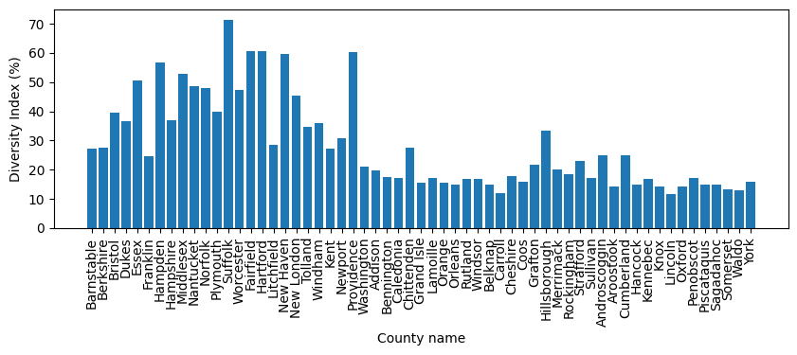
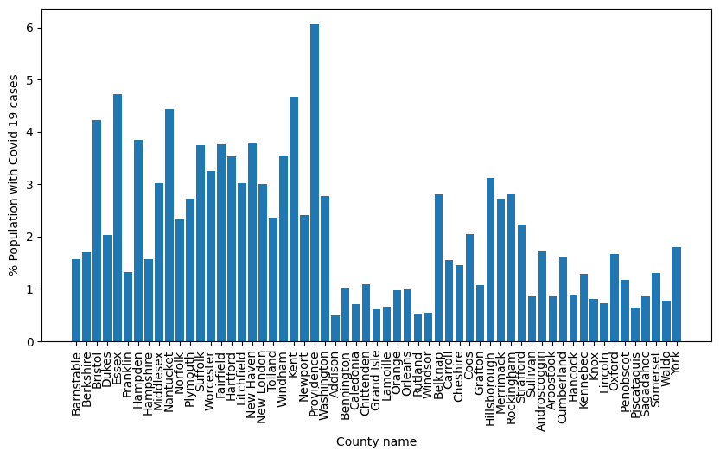
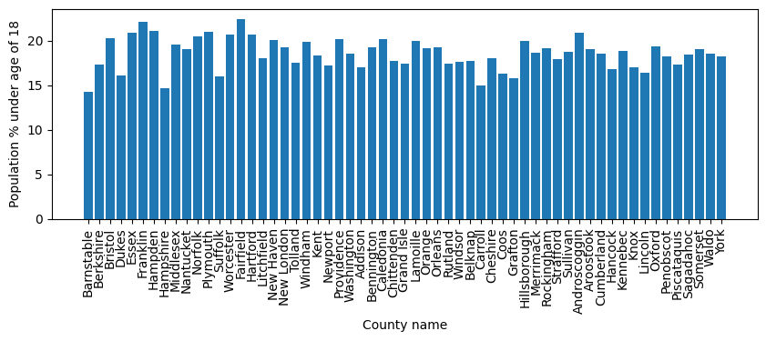
Raw data collected

Slide 6
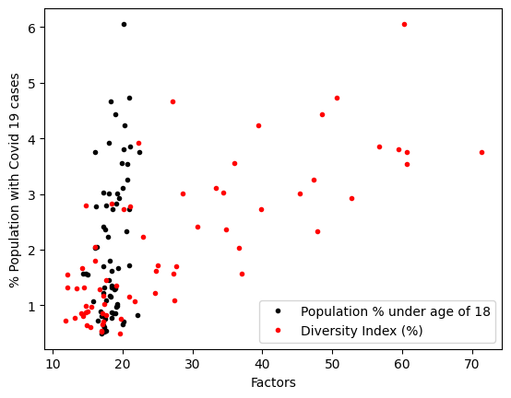
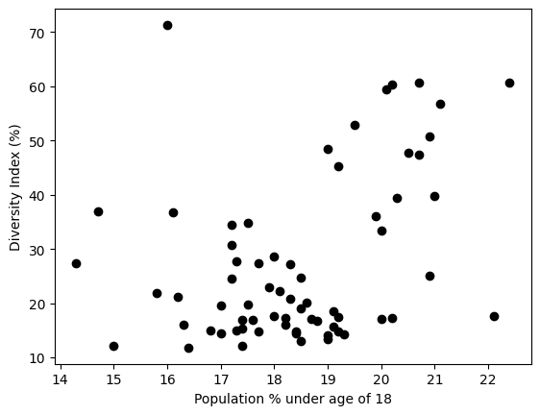
Dependence of factors

Slide 7
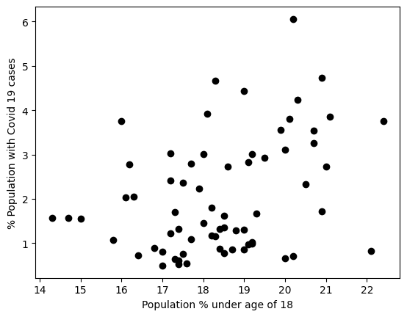
Did counties with population of children higher than 18% have lower percentage of Covid-19 cases during the holiday season of the year 2020?
Null hypothesis:
Counties with the population of children (age < 18 years) less than 18 % had lower percent of Covid-19 cases during the holiday season of 2020
2 sample Wilcoxon sum test (U-test) p value = 0.0079
Result : Null hypothesis invalid

Slide 8
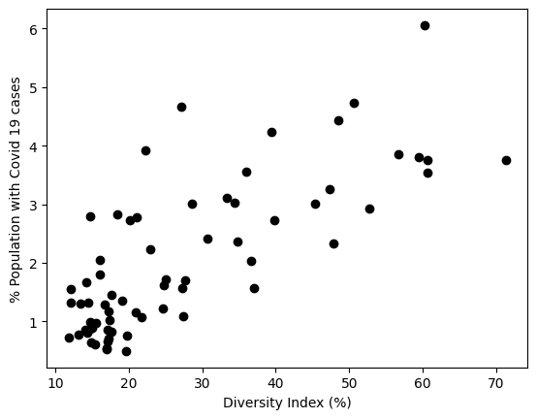
Did counties with diversity index higher than 25% have higher percentage of Covid-19 cases during the holiday season of the year 2020?
Null hypothesis:
Counties with the diversity index greater than 25 % had higher percentage of Covid-19 cases during the holiday season of 2020
2 sample Wilcoxon sum test (U-test) p value = 1
Result : Null hypothesis is valid

Slide 9
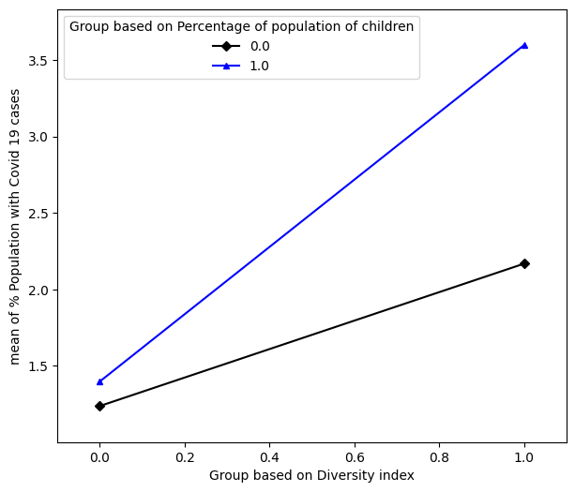
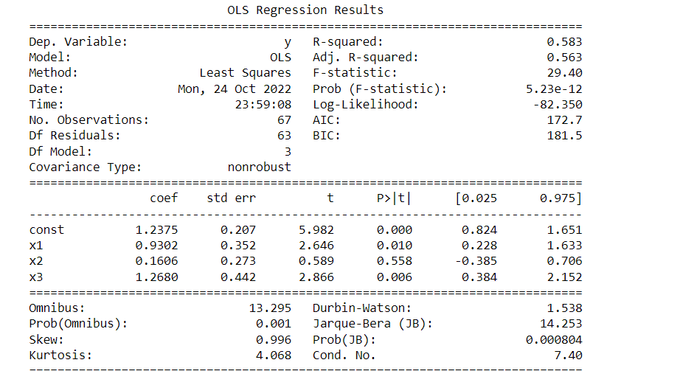
Were Covid-19 cases higher in counties with more than 18% population of children and diversity index greater than 25%?
Intercept = 1.2375
Age dependence = 0.1606
Diversity dependence = 0.9312
Interaction parameter = 1.2680
Group 0: less than 18%/25%
Group 1: greater than 18%/25%

Slide 10
Were Covid-19 cases higher in counties with more than 18% population of children and diversity index greater than 25%?
Major dependence:
Diversity dependence = 0.9312
Interaction parameter = 1.2680
Since the interaction parameter is high, it could physically signify that possibility of kids from diverse backgrounds mingling with each other in schools resulted in higher cases. Thus, schools being shut seems like a good idea.
Group 0: less than 18%/25%
Group 1: greater than 18%/25%

Slide 11
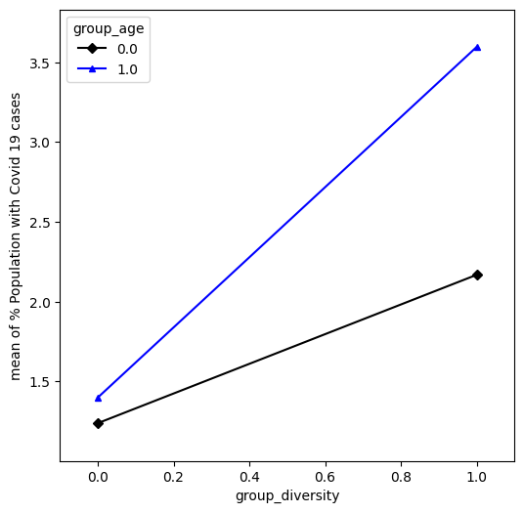
Summary
Covid-19 cases show dependence on population of children and diversity index and their interaction
Linear regression is not a great model due to data in clusters
Future work
Type of data collected
City-wise data
Overall effect over larger time period
Wider range
Non – linear model analysis

Slide 13
Diversity Index tells us the chance (%) that two people chosen at random will be from different race and ethnicity

Slide 14
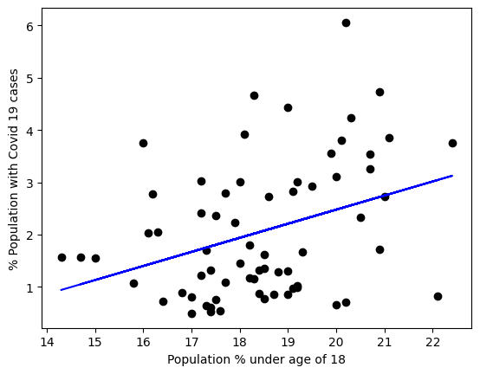
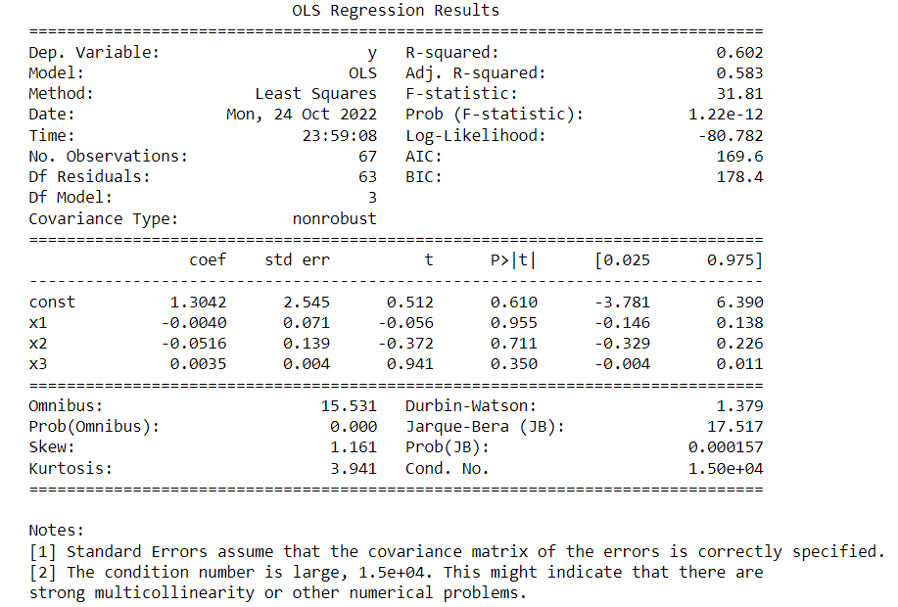
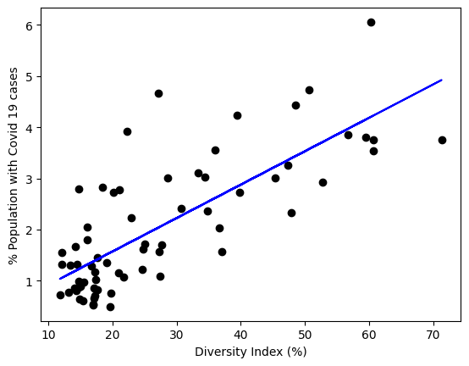
Were Covid-19 cases higher in counties with more population of children and higher diversity index?

