Slide 2
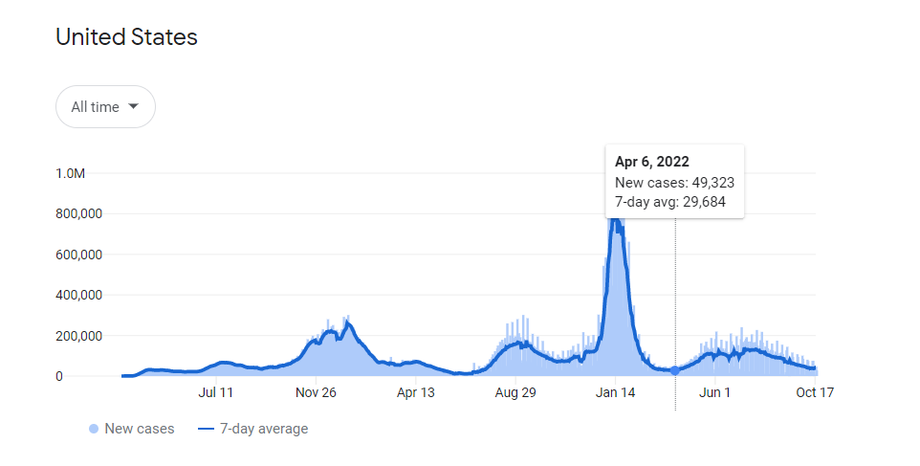
Covid-19 during holiday season of 2020 in New England
Notes:
Data comes from Wikipedia, government health ministries, The New York Times, and other authoritative sources, as attributed

Slide 3
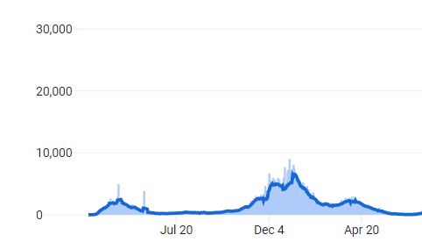
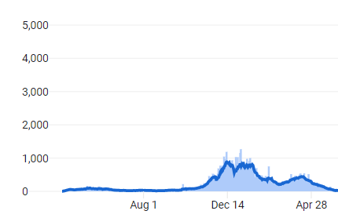
Covid-19 during holiday season of 2020 in New England
Covid-19 cases in Massachusetts during first year of pandemic
Covid-19 cases in New Hampshire during first year of pandemic
Notes:
Data comes from Wikipedia, government health ministries, The New York Times, and other authoritative sources, as attributed

Slide 4
Studies of Covid-19 in New England during Holiday season 2020
Notes:
https://www.science.org/doi/10.1126/science.abe8372

Slide 5
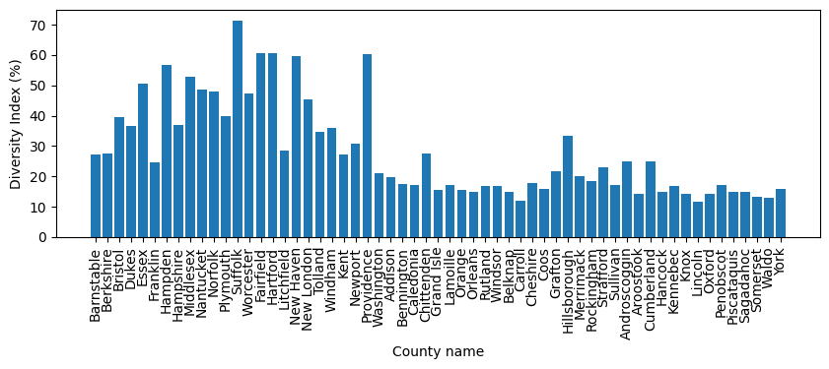
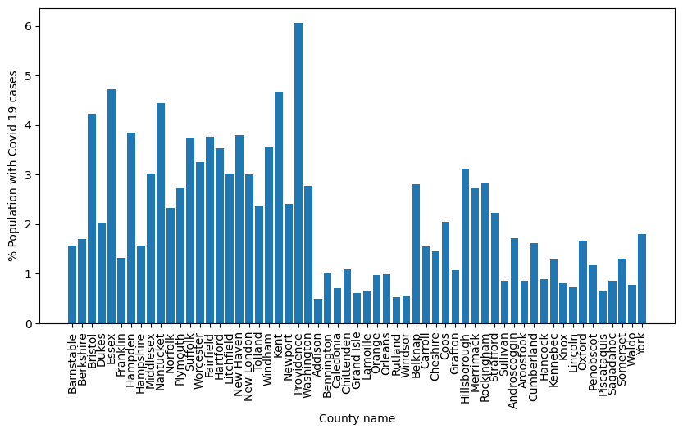
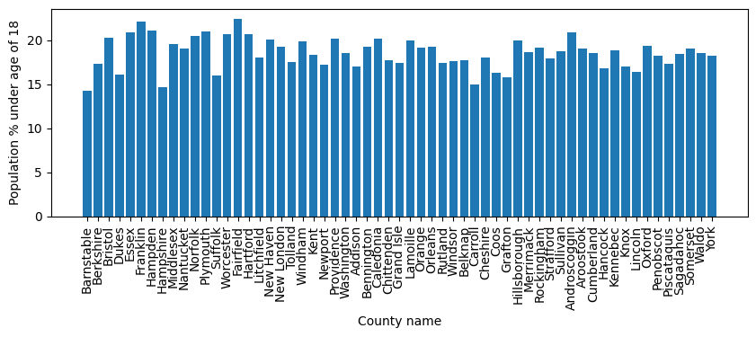
Raw data collected

Slide 6
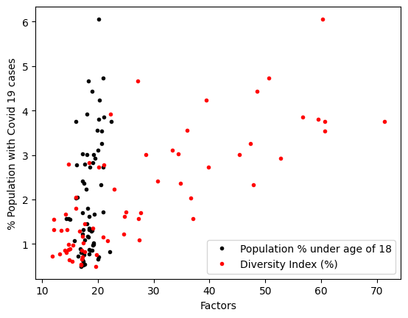
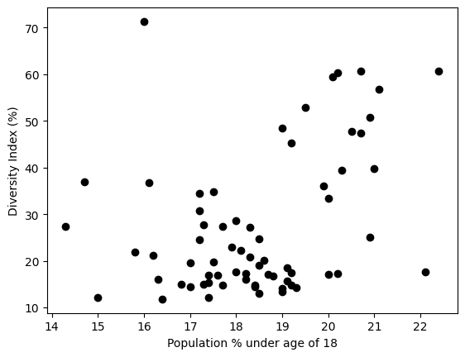
Dependence of factors

Slide 7
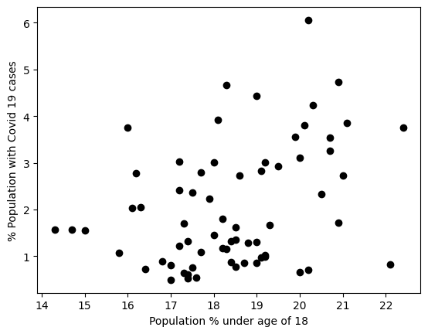
Did counties with higher population of children (age < 18 years) have lower percentage of Covid-19 cases during the holiday season (October - December) of the year 2020?
Null hypothesis:
Counties with the population of children (age < 18 years) less than 18 % had lower percent of Covid-19 cases during the holiday season of 2020
2 sample t-test p value = 0.0059
2 sample Wilcoxon sum test (U-test) p value = 0.0079
Result : Null hypothesis invalid

Slide 8
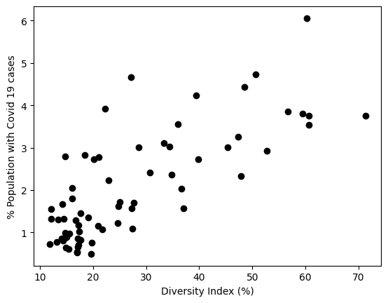
Did counties with higher diversity index have higher percentage of Covid-19 cases during the holiday season (October - December) of the year 2020?
Null hypothesis:
Counties with the diversity index greater than 25 % had higher percentage of Covid-19 cases during the holiday season of 2020
2 sample t-test p value = 1
2 sample Wilcoxon sum test (U-test) p value = 1
Result : Null hypothesis is valid

