Slide 1


Influence of diversity index and population of children on Covid-19 cases in the New England region during holiday season 2020
ChE Math Project 1
Shreya Thakkar

Slide 2
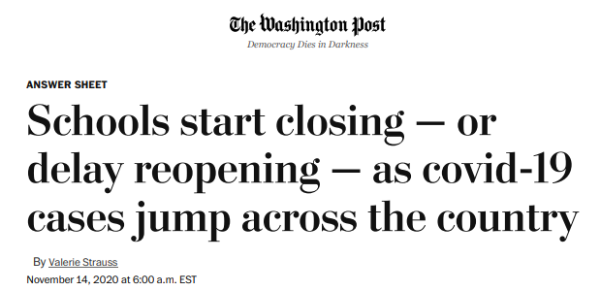
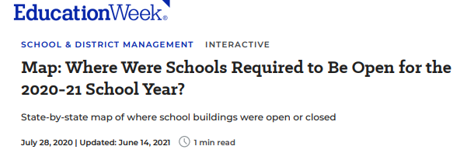
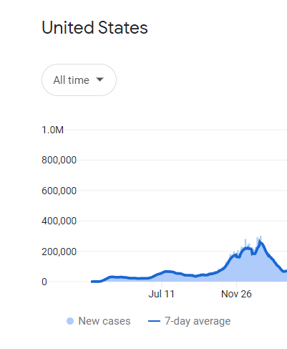
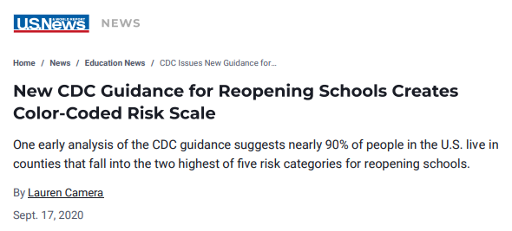
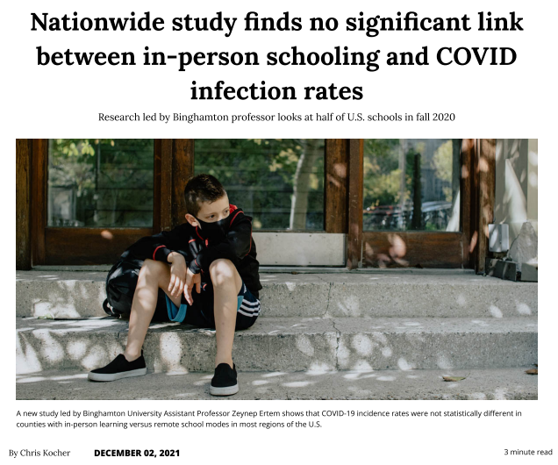
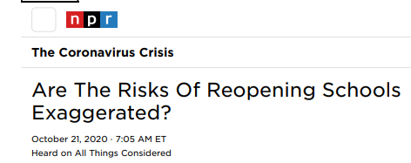
The first year of pandemic
Data comes from Wikipedia, government health ministries, The New York Times, and other authoritative sources
News article snaps accessed on Oct 24,2022

Slide 3
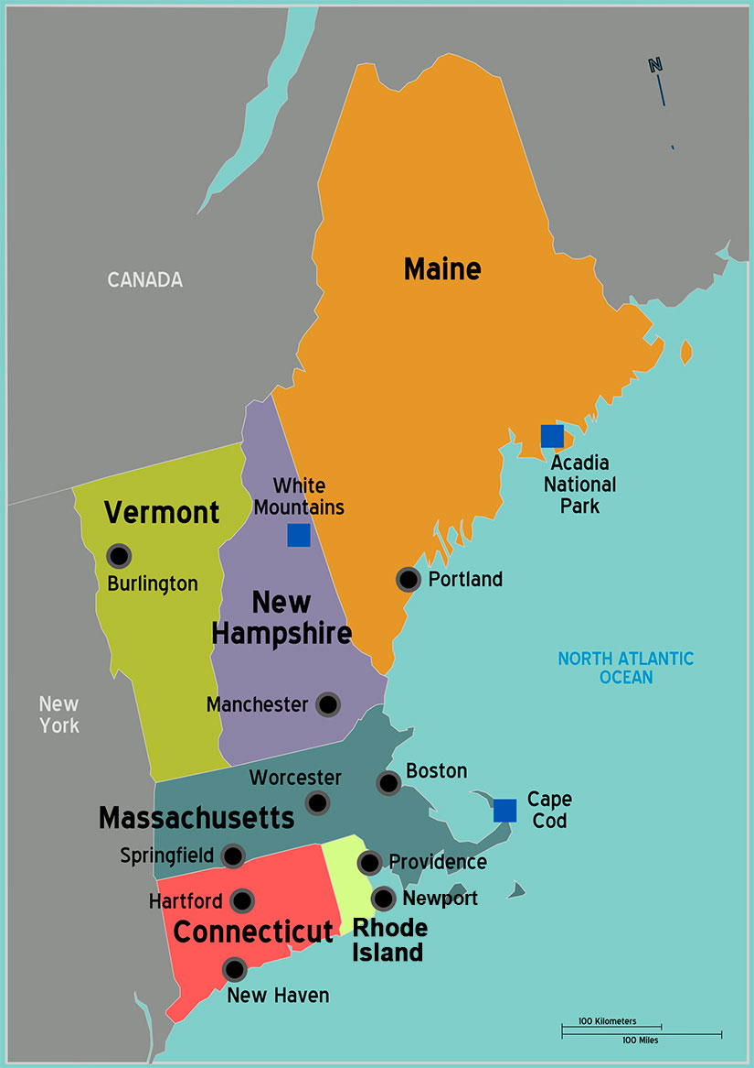


Problem Selection: Effect population of children and diversity index on Covid-19 cases in New England during holiday season 2020
AGE UNDER 18
DIVERSITY INDEX
https://i0.wp.com/indiaeducationdiary.in/wp-content/uploads/2022/08/University-of-Massachusetts-Amherst.jpeg?fit=600%2C400&ssl=1
https://newengland.com/wp-content/uploads/new-england-states-map.jpg
https://newengland.com/wp-content/uploads/new-england-states-map.jpg

Slide 4
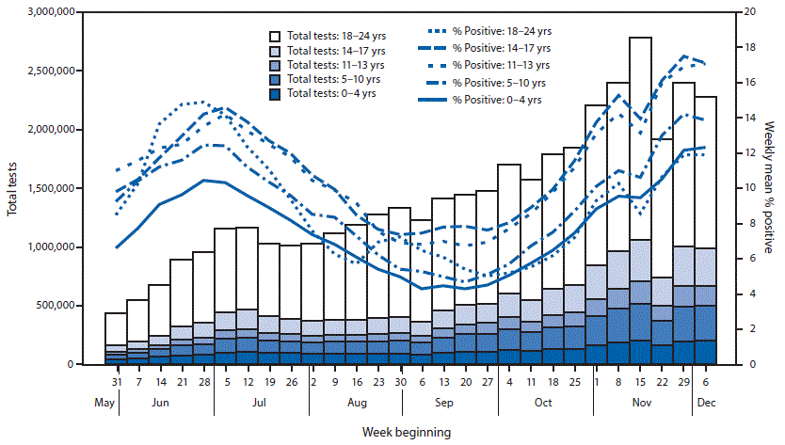
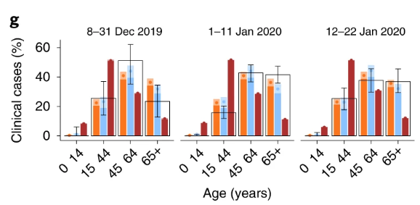
Studies of Covid-19 dependence on age of children and diversity
Davies, N.G., et al. . Nat Med 26, 1205–1211 (2020). https://doi.org/10.1038/s41591-020-0962-9
“Counties with higher percentages of racial/ethnic minority populations experienced a higher burden of COVID-19 incidence”
Karmakar M et al... JAMA Netw Open. 2021;4(1):e2036462. doi:10.1001/jamanetworkopen.2020.36462
 | % Age group (0-17) with positive test results
Hispanic/Latino | 31
White, non-Hispanic | 45.4
Black, non - Hispanic | 12.3
Asian/Pacific Islander, non-Hispanic | 3.3
American Indian/Alaska native, non-Hispanic | 2
Multiracial/ Other | 6
Leidman E, et al. MMWR Morb Mortal Wkly Rep 2021;70:88–94. DOI: http://dx.doi.org/10.15585/mmwr.mm7003e1

Slide 5
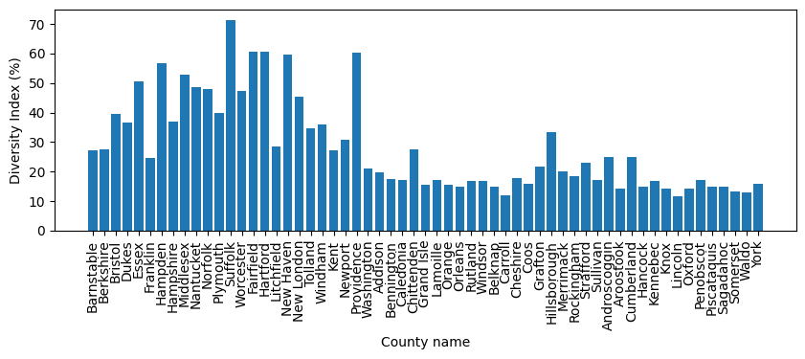
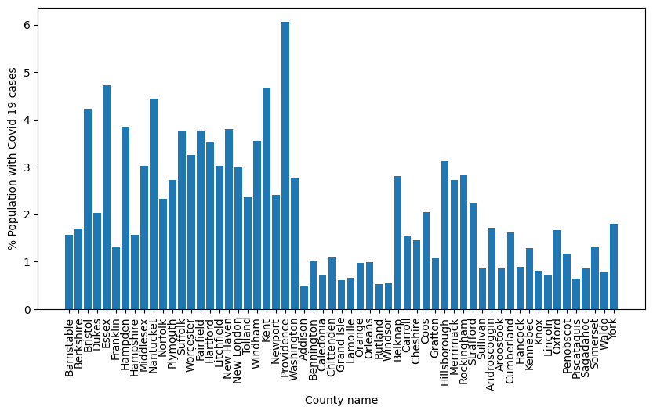
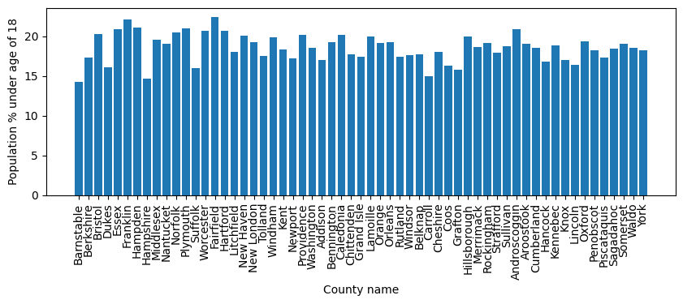
Raw data collected

Slide 6
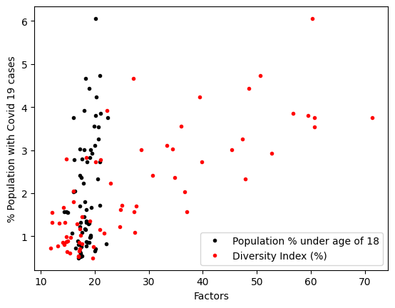
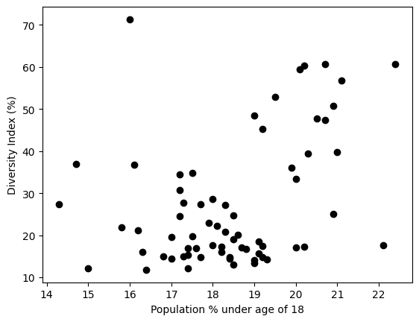
Dependence of factors

Slide 7
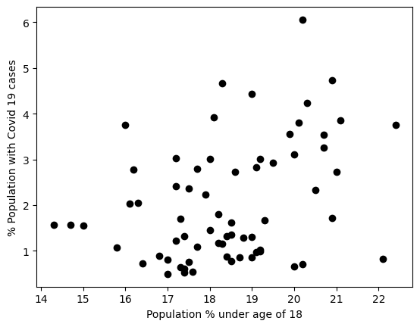
Did counties with population of children higher than 18% have lower percentage of Covid-19 cases during the holiday season of the year 2020?
Null hypothesis:
Counties with the population of children (age < 18 years) less than 18 % had lower percent of Covid-19 cases during the holiday season of 2020
2 sample Wilcoxon sum test (U-test) p value = 0.0079
Result : Null hypothesis invalid

Slide 8
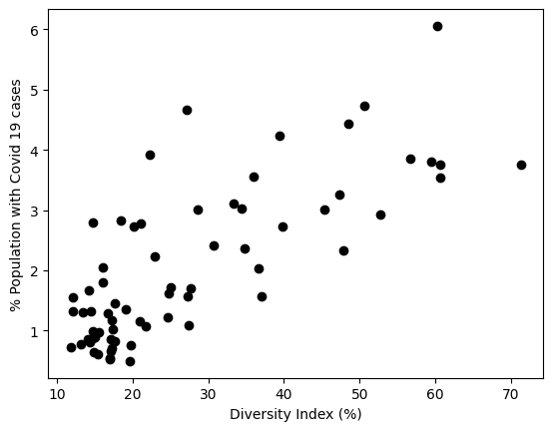
Did counties with diversity index higher than 25% have higher percentage of Covid-19 cases during the holiday season of the year 2020?
Null hypothesis:
Counties with the diversity index greater than 25 % had higher percentage of Covid-19 cases during the holiday season of 2020
2 sample Wilcoxon sum test (U-test) p value = 1
Result : Null hypothesis is valid

Slide 9
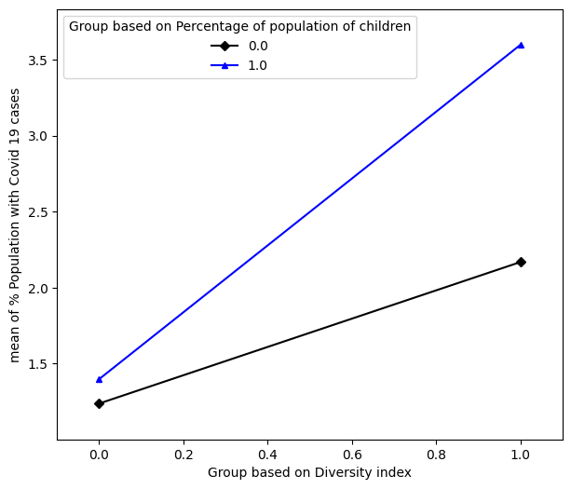
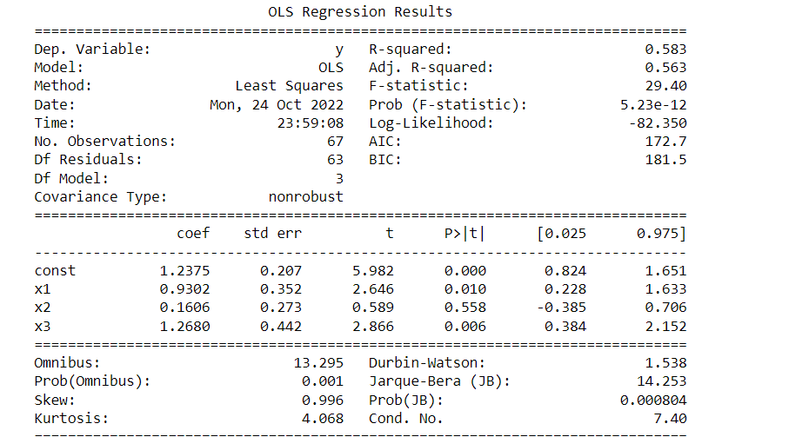
Were Covid-19 cases higher in counties with more than 18% population of children and diversity index greater than 25%?
Intercept = 1.2375
Age dependence = 0.1606
Diversity dependence = 0.9312
Interaction parameter = 1.2680
Group 0: less than 18%/25%
Group 1: greater than 18%/25%

Slide 10
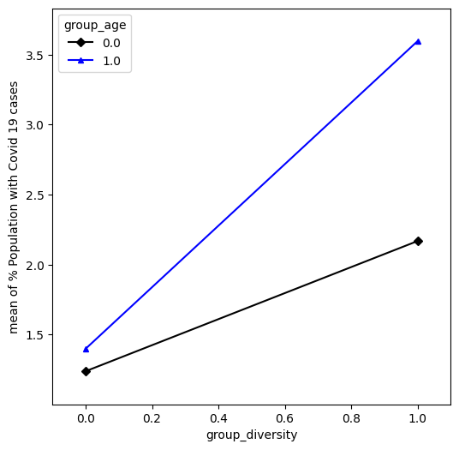
Summary
Covid-19 cases show dependence on population of children and diversity index and their interaction
Linear regression is not a great model due to data in clusters
Future work
Type of data collected
City-wise data
Overall effect over larger time period
Wider range
Non – linear model analysis

Slide 12
Diversity Index tells us the chance (%) that two people chosen at random will be from different race and ethnicity

Slide 13
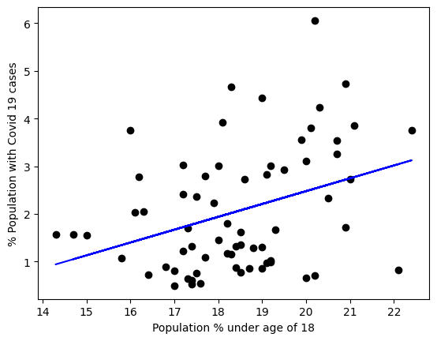
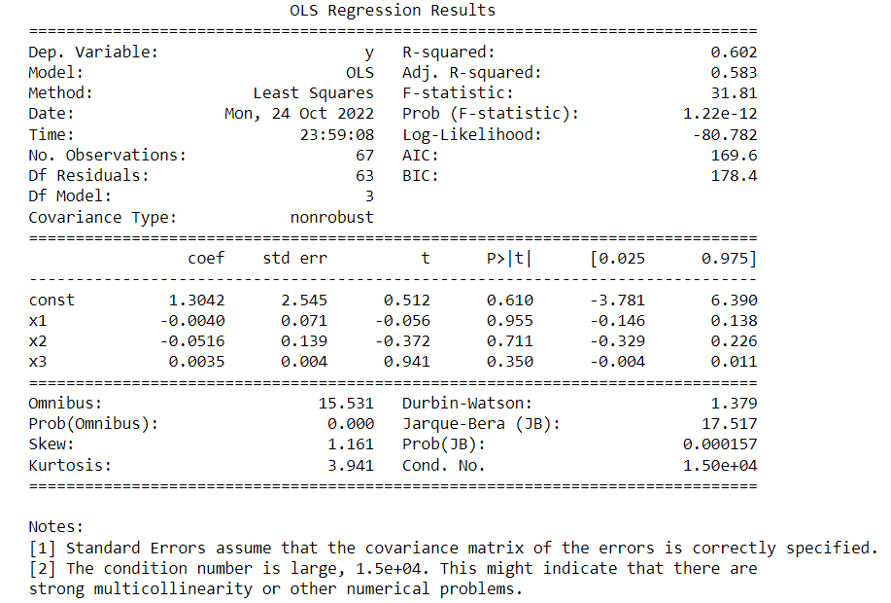
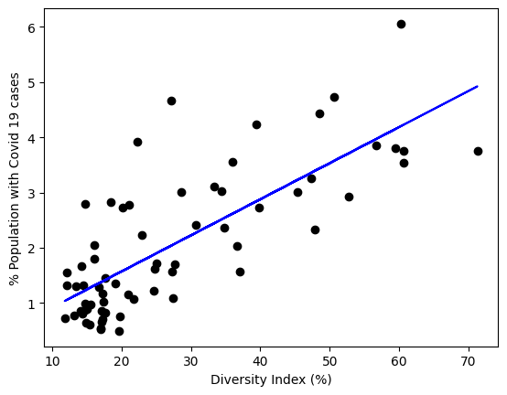
Were Covid-19 cases higher in counties with more population of children and higher diversity index?

